Slide 1
International trade
And markets

Slide 2
INTERNATIONAL TRADE AND ACCESS TO MARKETS
Learning Objectives:
Students can discuss trading relationships and patterns between:
  large, highly developed economies (HDE) such as the United States, the European Union, emerging major economies (EME) such as China and India and smaller, less developed economies (LDE) such as those in sub-Saharan Africa, southern Asia and Latin America.
Students can recognise the unequal nature of world trade and dominance of a few countries, e.g. the role of Trade Blocs and other multilateral agreements in offering unfair advantages to the few.
The role of China in world trade – research China in Africa – a growing trade relationship offering opportunities for some regions to improve their terms of trade.
LDEs are increasing their role in global trade, forming their own trade blocs (e.g. MERCOSUR in South America).
KEY WORDS:
Terms of trade
Trade Bloc
Multi-lateral agreement
Bilateral agreement
Transatlantic Trade and Investment Partnership (TTIP)
Trans Pacific Partnership (TPP)
Anti globalisation

Slide 3
Trading relationships
Trading relationships and patterns between large, highly developed countries, emerging major economies and smaller, less developed economies
Who are the main trading entities?
New players have risen to prominence in world trade - developing countries (or Less Developed Economies – LDEs), such as those in Sub-Saharan Africa, and rapidly industrialising Asian economies (Emerging Major Economies -EMEs) – e.g. BRICS and MINT.
  The USA, (which is part of NAFTA) and the EU (largely considered to be HICs).
Region / country | % share of world exports 1980 | % share of world exports 2011
Developing economies | 34 | 47
HICs | 66 | 5
China | 1 | 11

Slide 4
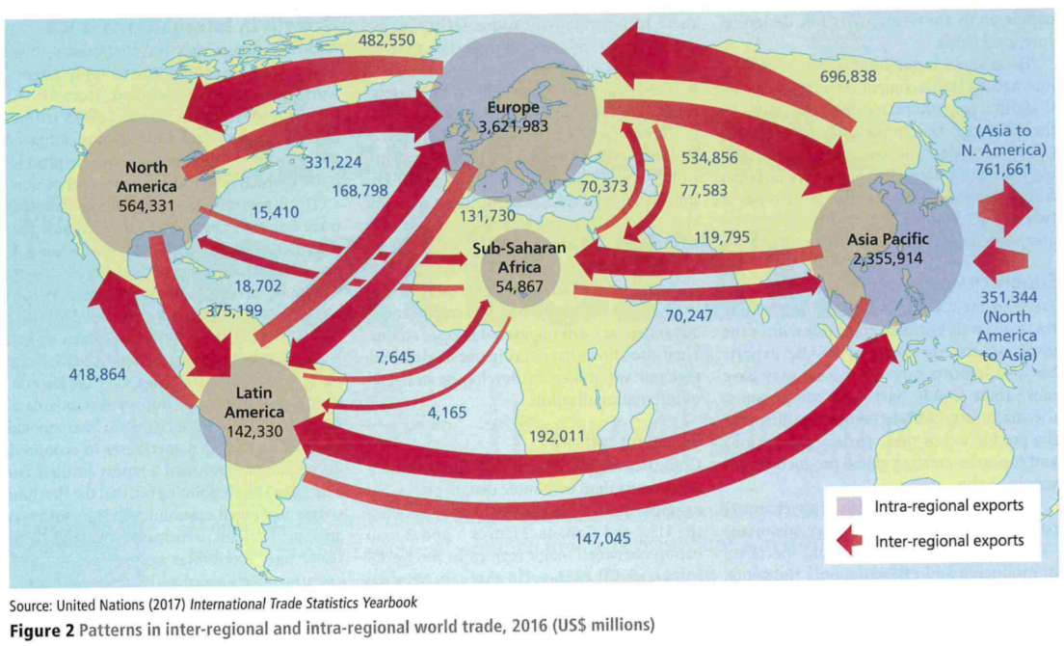
Trade relationships and patterns
Trade has become more regionalised since 1990, particularly in Asia. What might be the reasons for this?

Slide 5
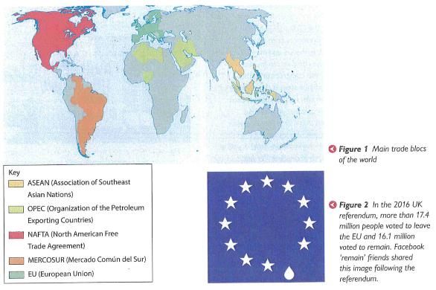
Trade agreements and principles
Trade is drawing in an increasing number of countries – the WTO had 124 members when it started in 1995, and it has grown to 164 members today. Expansion of the WTO membership and world trade has been accompanied by the formation of regional trade ‘blocs’ like the EU, which support free trade agreements between member countries without incurring tariffs or charges.
The groupings of emerging nations are becoming increasingly important, e.g. ASEAN and APEC
Opponents of trade blocs argue that by offering unfair advantages to member countries, they restrict the development of the global economy.
Similar trade agreements between LDEs are weaker and achieve limited advantages. The largest trade blocs benefit further, and as a result this can create conflict.

Slide 6
Usa and eu (hde)
In the booklet, read the information about HDEs, EMEs and LDEs. Answer the questions and at the end take notes in the relevant tables to summarise their trading relationships and how these are evolving as we become more globalised.

Slide 7
Highly Developed Economies (HDE)
USA
EU
Traditionally a protectionist country.
Up to 2020, the Trump administration favoured protectionist policies, e.g..
USA withdrew from the Trans-Pacific Partnership negotiations the Transatlantic Trade and Investment Partnership collapsed in 2016
USA pursued bilateral trade with other countries.
The EU negotiates trade deals as a bloc.
65% of trade in the EU is intra-regional.
Bilateral trade deals do exist (e.g. with Australia, New Zealand and Japan).
Recent trade deals include Canada-EU 2017, EU-Mercosur (South
American trading bloc) 2019 (awaiting full ratification), post-Brexit EU-UK trade deal.

Slide 8
Larger Trade deals - issues
Growing anti-globalisation results in threats to larger trade deals such as the Doha Round, the Trans-Pacific Partnership (TPP) and even Brexit – countries want to protect their growth and ensure the best deals for their citizens, workers and businesses based within their country, group or trade bloc.
The failure to achieve an outcome from the WTO’s Doha Round is largely because of disagreements between the EU and USA together arguing with emerging economies such as China and India.
  The agreement's purpose was to boost the economic growth of developing countries. It centred on reducing subsidies for developed countries’ agricultural industries. That would allow developing countries to export food, something they were already good at producing. In return, the developing countries would open up their market to services, particularly banking. That would provide new markets to the developed countries’ service industries. It would also modernize these markets for the developing countries.

Slide 9
Larger trade deals - issues
Larger trade deals no longer on the horizon (see Hodder page 303, Oxford page 22).
  The once proposed Trans-Pacific Partnership (TPP) involving free trade between the USA and countries in Asia and South America - a multilateral agreement
  The Transatlantic Trade and Investment Partnership (TTIP) between the USA and EU (known as a bilateral trade agreement). On 15 April 2019, the negotiations have been declared "obsolete and no longer relevant" by the European Commission
The development of the both TTP and TTIP agreements was a strategic move by the USA to make deals with both the West and the East and a response to the emerging threat of China as an economic superpower and driver of trade.

Slide 10
Changes in global trade patterns
Huge changes are taking place: trade involving EMEs has grown rapidly, so much so that trade within regions is more important than trade with HDEs.
Developed nations are exporting less to each other and more proportionately to the EMEs.
Asia-Pacific has high exports to North America and Europe, but does not import as much. This has led to large trade deficits between Western Countries and Asia, especially China. This has fuelled some anti-globalisation views that have intensified since 2016.
Not everyone is happy with the way trade patterns and relations are changing –’anti-globalisation’
TASK read the Geography Review article ‘Anti-globalisation trends’:
  Use highlighters to distinguish the CAUSES and IMPACTS of anti-globalisation in the article.
  Answer the questions in the booklet.

Slide 11
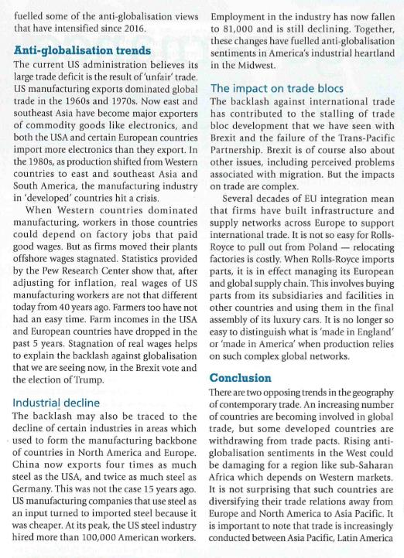
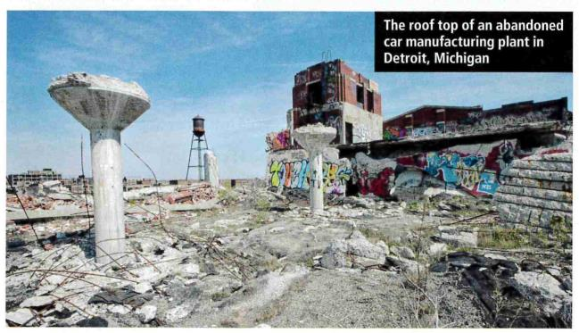
Why does the US administration have a large trade deficit?
What has happened to the steel industry in developed economies? Explain how this may have led to a feeling of anti-globalisation.

Slide 12
Anti-globalisation
Causes:
Growth of East and SE Asia as major exporters of commodities such as electronics
Trade deficit growing for US and EU
Global shift of manufacturing in the 1980s
Decline of the steel industry in developed countries
Foreign steel becomes cheaper than domestic steel for manufacturing in US leading to further impacts
Impacts
Job losses in manufacturing in US and Europe
Real wages of manufacturing workers are not that different today as they were 40 years ago
Past 5 years – farm workers in US and Europe have reduced incomes
Brexit vote
Election of Trump (promises to protect US jobs)
Jobs in US steel industry fall from 100,000 to 81,000. – fuelling anti-globalisation in industrial heartland – DETROIT (refer to case study)
Stalling of trade bloc development – larger trade deals that promote free trade are affected e.g. the TPP

Slide 13
China and india (eme)
A case study of expanding trade and changing trade relationships. Several thousands of TNCs have outsourced to China, making it a hub for manufacturing. While this has largely benefitted the Chinese economy, there have been concerns over the social well-being of workers and impacts of outsourcing on environmental sustainability.

Slide 14
Emerging Major Economies
China
India
China has emerged as the world's major trading power, responsible for nearly 20 per cent of all global exports and around 15 per cent of all global imports there has been a clear pattern of importing mainly raw materials from developing countries, primarily from Latin America and Sub-Saharan Africa, and exporting processed metals such as steel and manufactured electronic consumer goods to developed countries, particularly those in Europe and North America
The export of cheaply produced, state-subsidised steel onto the world market has triggered a trade war with the USA, which has escalated to include imposition of high tariffs on traded goods between the two countries; some analysts argue that this is the main cause of current static growth of world trade
India has enjoyed sustained and rapid industrial growth over the past 25 years. Arguably, India has a more diverse economy with a more globally integrated commercial and services sector. India has a demographic dividend of a large, young workforce that has attracted investment for industrial development
India has traditionally been more westward looking in terms of trading partners and this is still largely the case, possibly as a result of a high proficiency of English language amongst its population. However, trade with emerging markets in Asia and the Middle East has expanded significantly.
Top exports are refined petroleum, chemicals, gold and diamonds, rice, cars and textiles. Top imports are crude oil (for refining and exporting), coal briquettes and gas.
India's imports have expanded faster than its exports, so balance of payments problems make the economy vulnerable. In 2018, there was a deficit of US $166 billion.

Slide 15
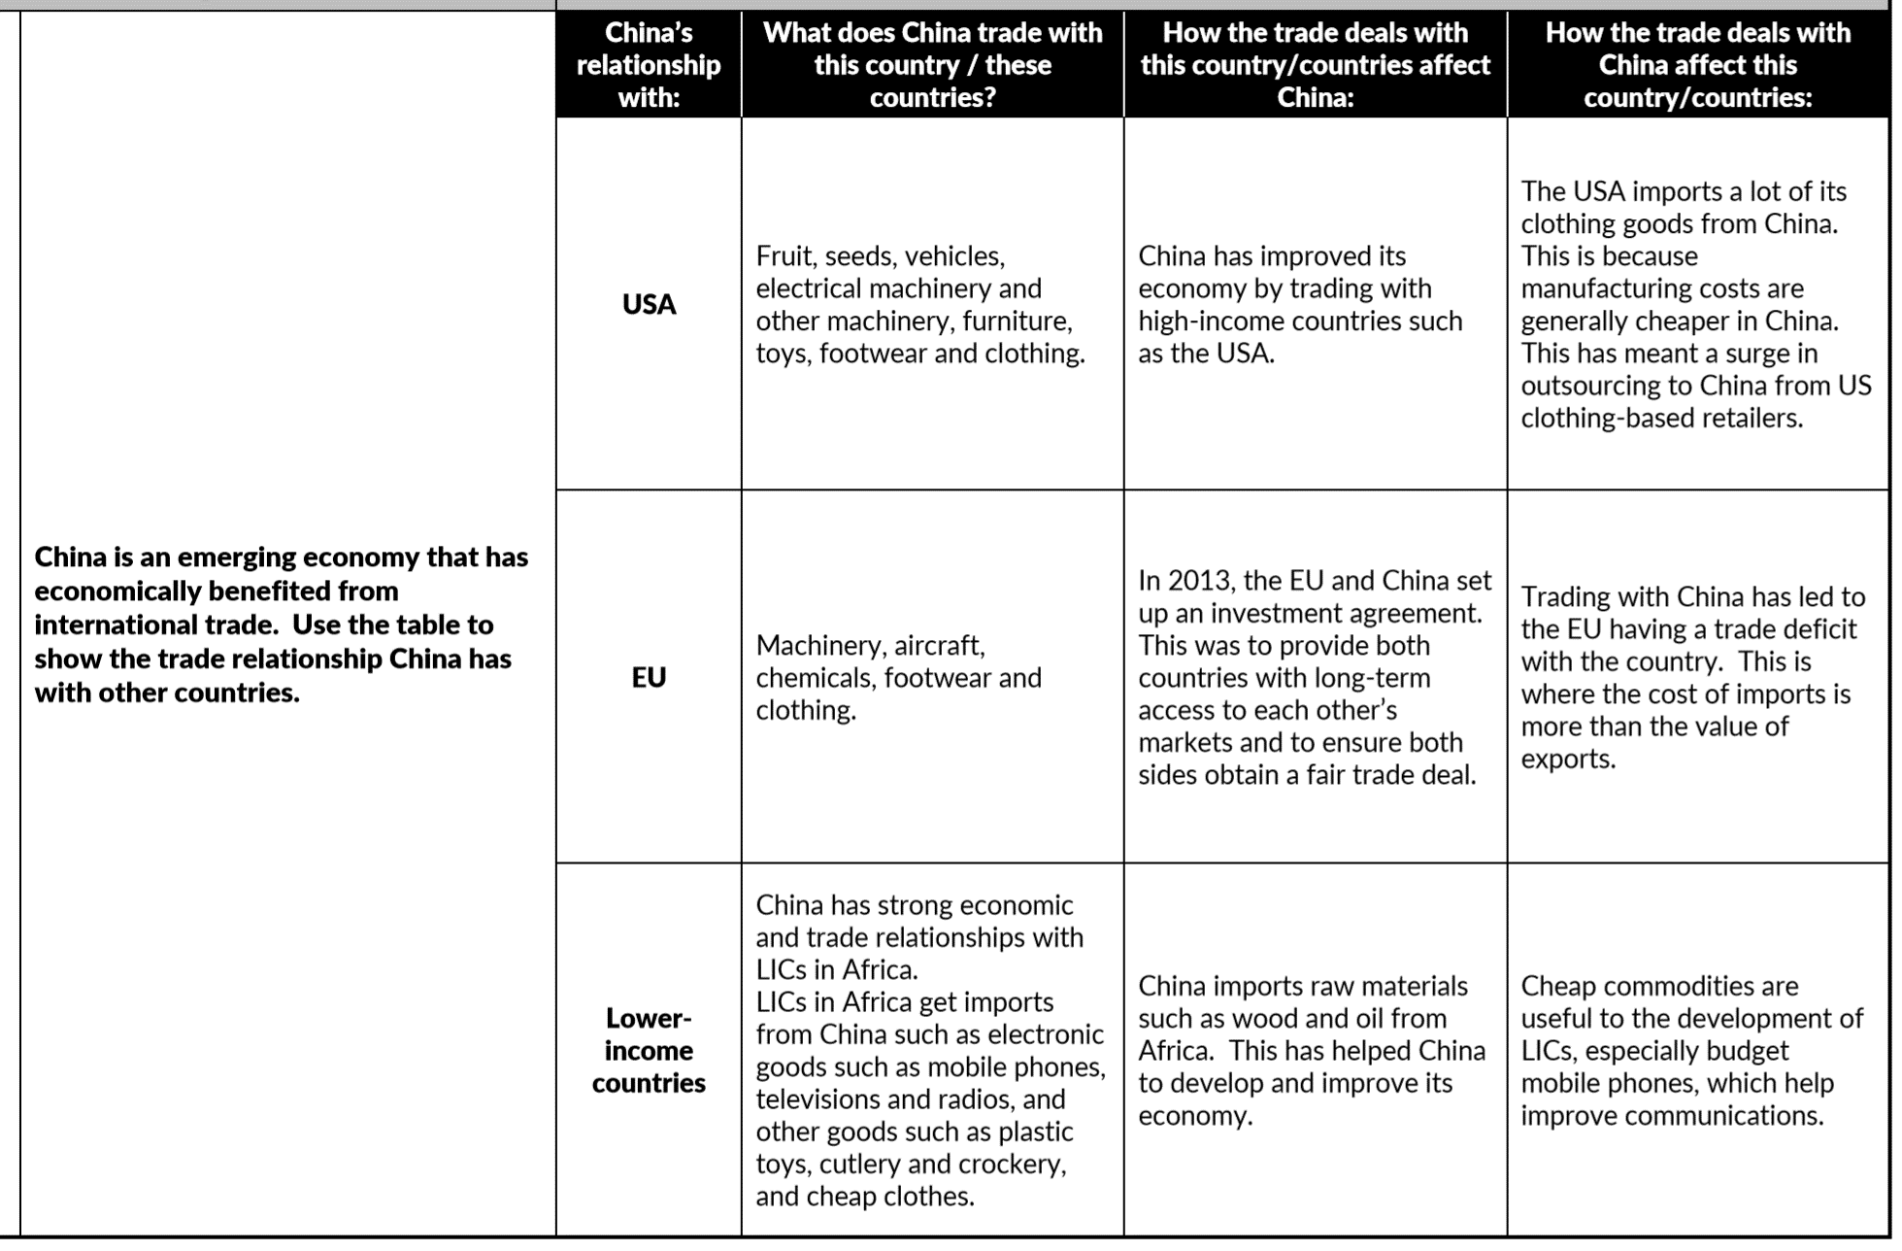
How are China’s trading patterns and relationships changing? What are the key patterns?
China’s phenomenal economic growth rate in the last 25 years has been based on the expansion of manufacturing of consumer goods for richer ‘Western’ countries
China’s influence as an economic superpower has enabled the Chinese to spread their wealth and influence by investing in other parts of the world, including in Africa.

Slide 16
Task
Using the blank outline map of the world and an atlas, plot the main export destination and origin of imports for China and India. Use a key to distinguish import origin from export destination for China and for India:
Compare the destinations of exports from China and India.
Comment on the main origins of imports for China and India.

Slide 17
The role of china in africa
The rapid industrialisation of China has offered opportunities for some regions, particularly Africa, to improve terms of trade(the cost of goods that a country has to import, compared with the price at which they can sell the goods they export.) but this is not an equal power relationship.
https://www.youtube.com/watch?v=d4EkznawTXg
China-Africa Relations: Deepening ties focus on partnerships for economic development – YouTube 2023
Ade Adepitan in Africa:
https://godalming.planetestream.com/net4 (16121)
https://www.newsweek.com/china-us-wants-world-itself-thats-why-cant-accept-beijing-role-africa-861019

Slide 18
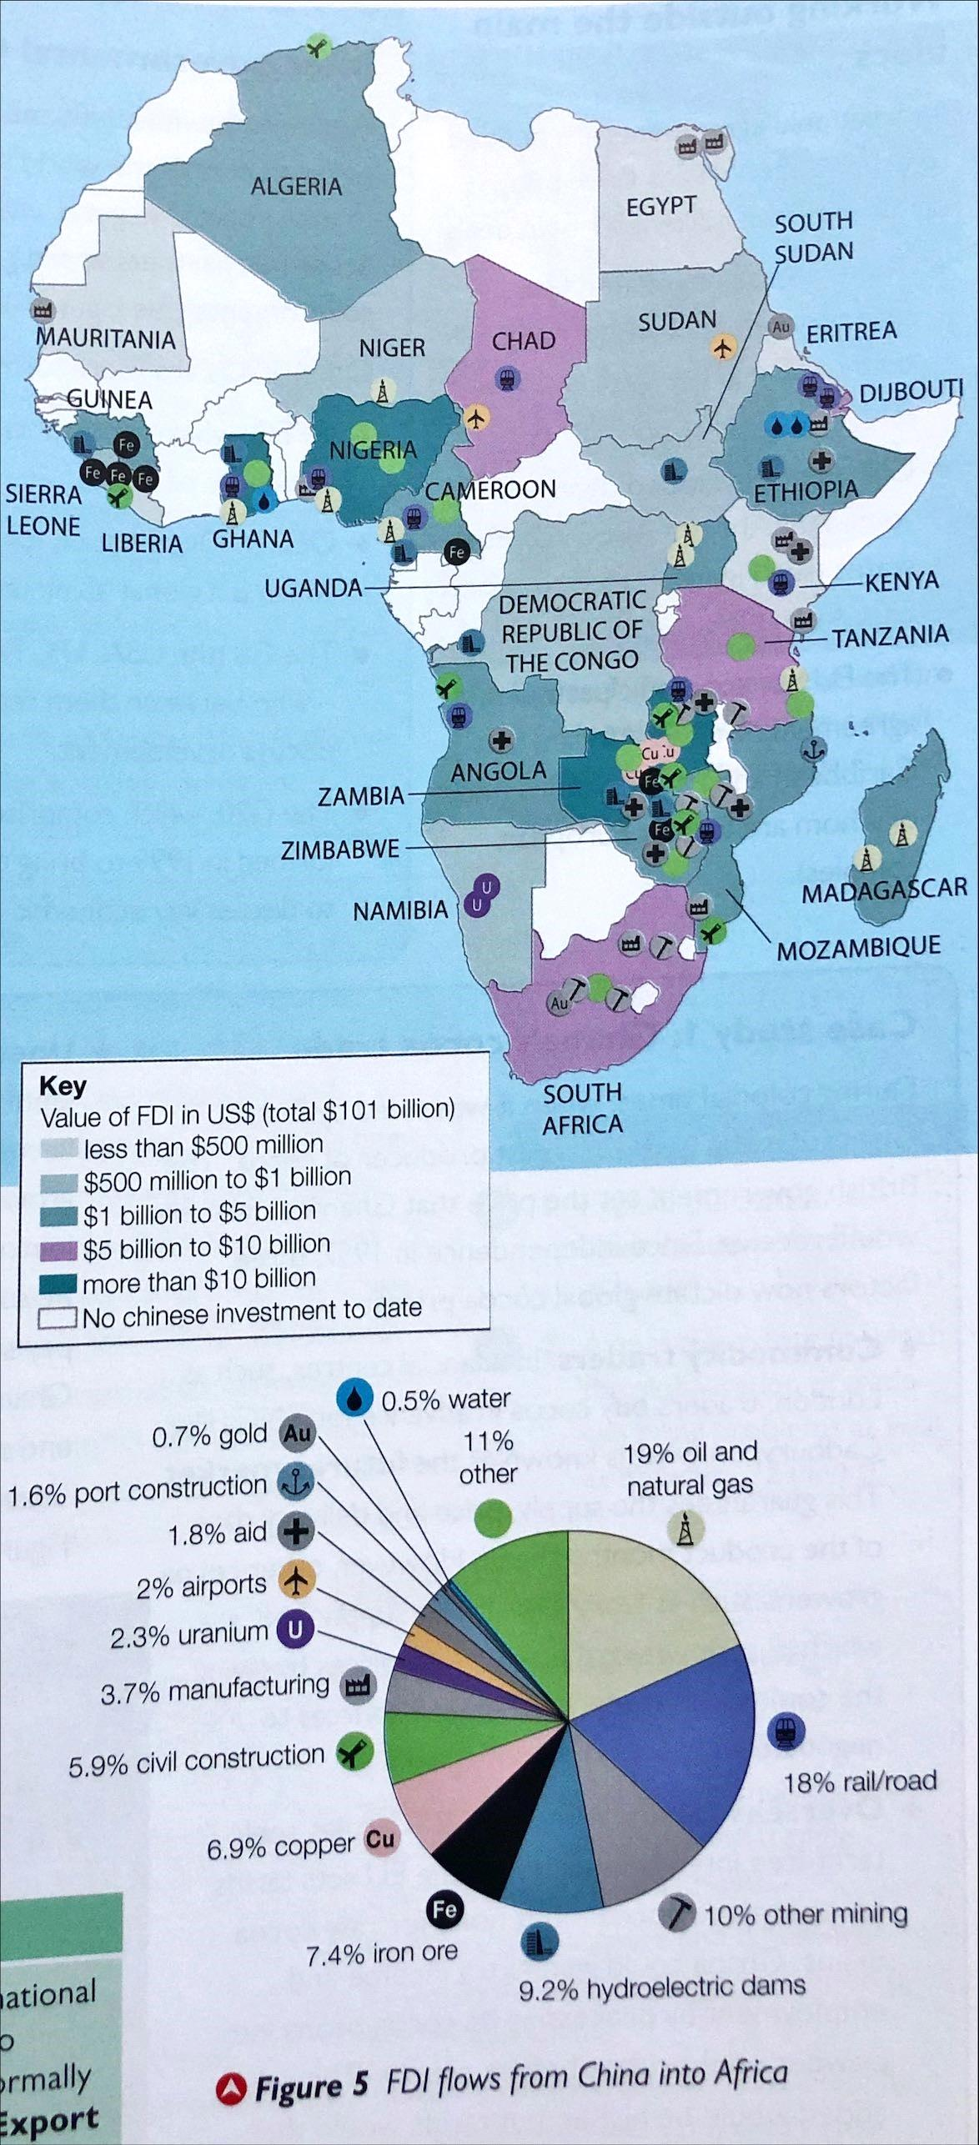
FDI flows from China into Africa
Analyse the data on the map and the pie chart to show patterns of FDI flows from China to Africa

Slide 19
Supporting industrial expansion in China

Slide 20
Ldes and world trade
Less Developed Economies (LDEs)or Low Income Countries (LICs) are increasing their role in global trade, forming their own trade blocs (e.g. MERCOSUR in South America).

Slide 21
Less Developed Economies
Latin America
Mercosur is a single market and customs union and tries to emulate the EU. It is called the 'Common Market of the South' and allows the free movement of labour between member states.
The most exported products are raw materials, energy, mineral and food resources, which enable Mercosur to trade globally, but mean it is vulnerable to fluctuating global trade prices.
With the exception of mineral exports to China, Mercosur tends to view the EU and North America as its main markets. Its proposed trade deal with the EU will be a major development once it is ratified.
Sub-Saharan Africa
There is minimal intra-regional trade and Africa's main exports remain primary resources and commodities such as minerals, energy and food resources.
Lack of skills, poor transport and energy infrastructure and widespread corruption have discouraged investment into industrial development that would enable African countries to add value to their exports. They rely on imports of most manufactured goods.
Traditionally, Africa's main trading partner has been Europe, but this has changed with China's involvement in the continent.
Africa is a larger, poorer and more divided continent than South America. There are many more language, ethnic and cultural divisions.

Slide 22
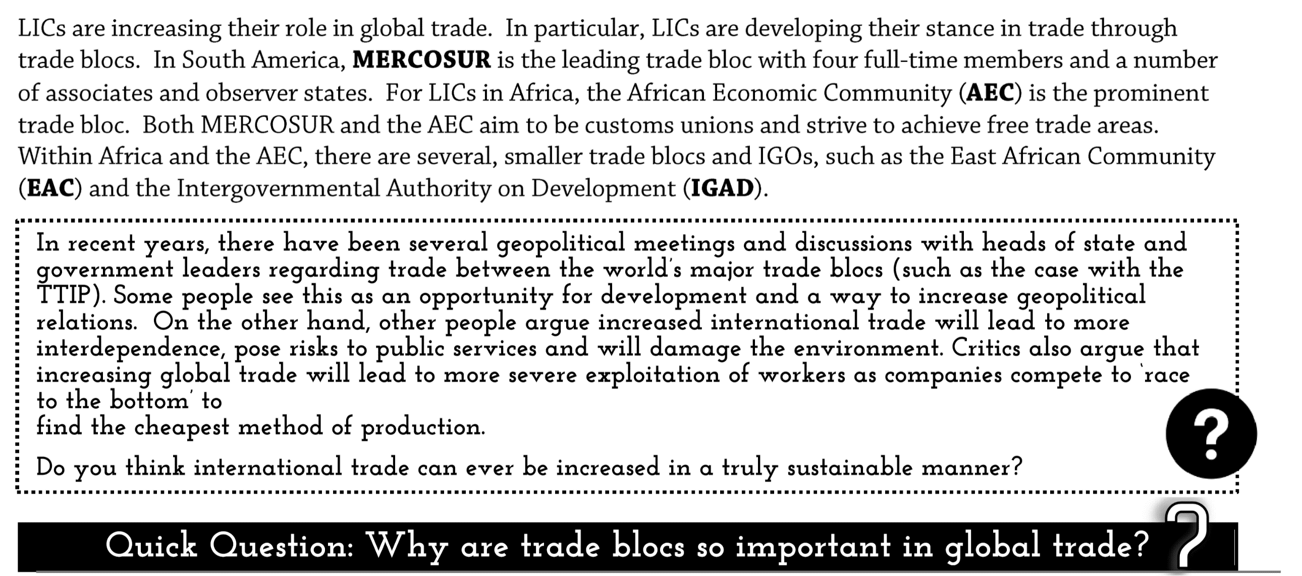
Low Income Countries and world trade
African countries have low intra-regional trade, and this can hinder their growth:
https://www.youtube.com/watch?v=GRh8s6zb1bg
Trade increases employment. Through the upward multiplier effect this leads to economic growth as there is more affluence, more spending and more investment from the government. Trade leads to infrastructure development, which leads to further economic growth. As countries develop and their investment in business, education and training increases, further investment takes place from within the country and beyond, furthering overall economic development.

Slide 23
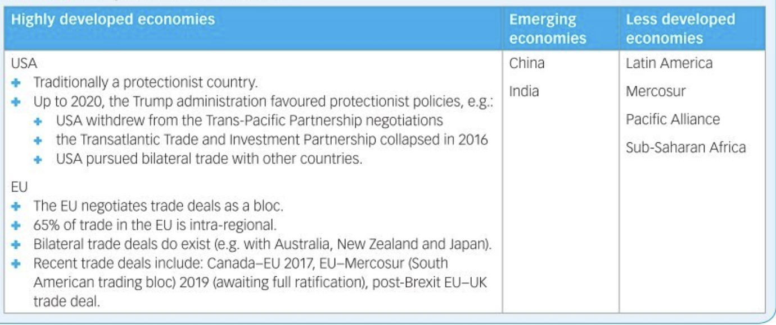
Summary Task
The table below sets out a summary of current trading relationships and patterns. Information on HDEs has been added. Complete your own notes / table by writing your own bulleted revision points for emerging economies and LDEs from the booklet and Hodder Textbook online – see VLE book.

Slide 24
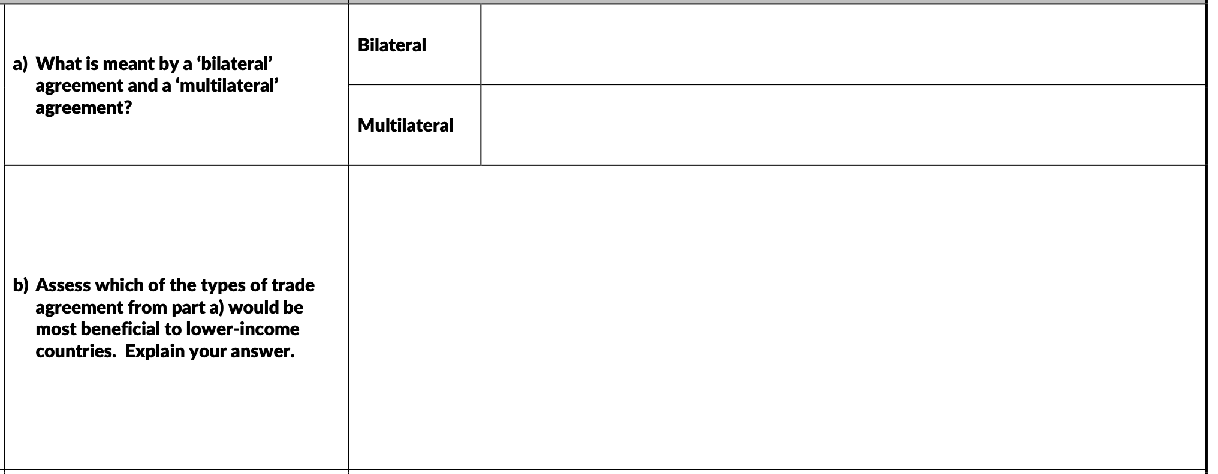
Additional Q&A

Slide 25
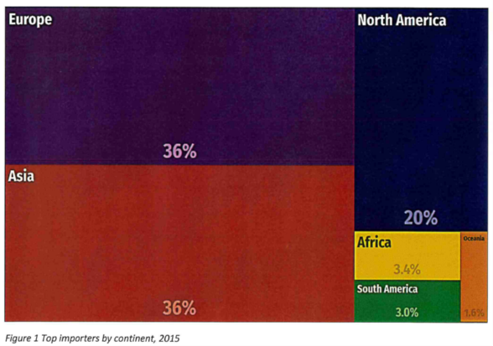
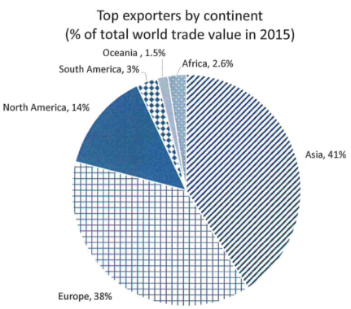
Exam Style Question
P – Pattern
A – Anomalies
D – Data (manipulation)
L - Links
The total value of world trade in 2015 was $15.7 trillion. Using figures 1 and 2 analyse the trading relationships of world trade. (6 marks)
Zig Zag Exam Question Paper A

Slide 26
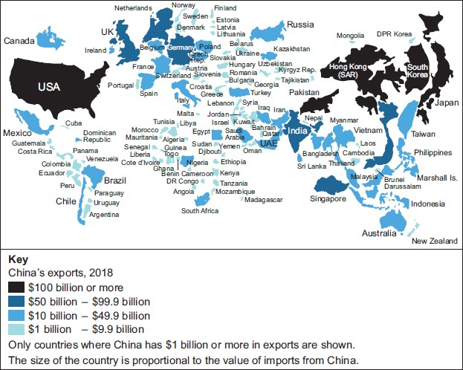
Q1. The map shows the destination of China’s biggest exports by total value in 2018.
Using the map and your own knowledge, assess the importance of geographical location in trading relationships between major economies such as China and smaller less developed economies.
[6 marks]

