Slide 1
International trade
And markets

Slide 3
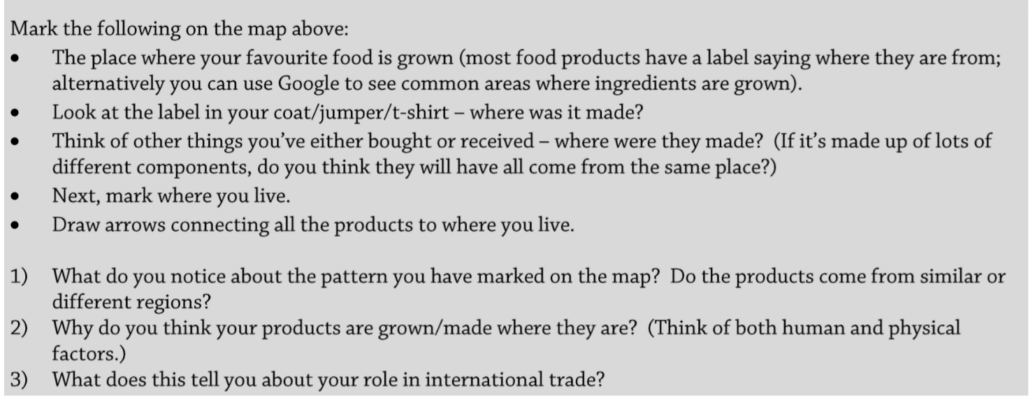
Activity – your role in trade

Slide 4
INTERNATIONAL TRADE AND ACCESS TO MARKETS
Learning Objectives:
Students consider how international trade and global systems directly affect them.
Students are able to recognise that differential access to markets is associated with levels of economic development and trading agreements
Students understand that differential access to markets impacts on economic and societal well-being of nations.
Students can identify a number of strategies that seek to deal with these issues:
Special and Differential Trading agreements
Free-Trade Areas (FTAs), e.g. north region of Mexico
Fair Trade
KEY WORDS:
Maquiladora
Free Trade Areas
Fair trade
Special and Differential Treatment (SDT)

Slide 5
Differential access to markets
Discuss the costs and benefits of trading relationships. (https://www.bbc.co.uk/news/av/business-37585477/is-international-trade-always-good-for-the-economy)
Trade has played an important role in promoting economic development in LDEs and differential access has allowed many countries to diversity their economies, achieve economic take-off and lift some of their population out of poverty. https://www.youtube.com/watch?v=Ap-M30CRGtI
However, the global pattern of trade is one of great inequality, with many developing countries, or regions of countries, having limited access to global markets
Differential access to markets impacts on economic and societal wellbeing – there are consequences for all countries at different levels of development, but the poorer countries tend to suffer the most.

Slide 6
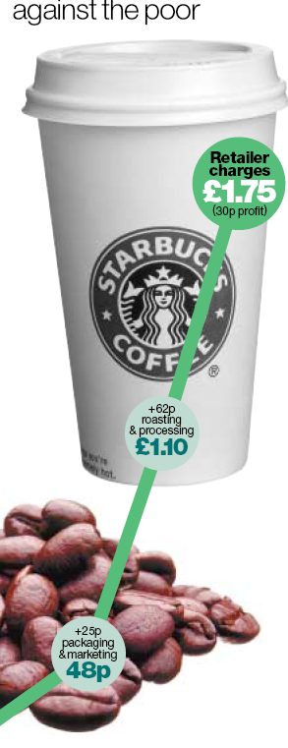
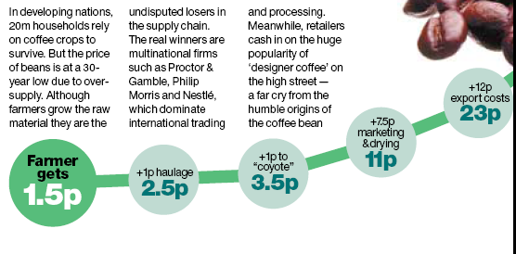
Subsidies
Tariffs
Quotas
Protectionist policies
Dumping
Trade barriers
Collapsing commodity prices
MAKE NOTES AS YOU WATCH
UNFAIR TRADE –
Click to watch video
LDEs – access to markets: https://www.youtube.com/watch?v=b-ekEZTypF8

Slide 7
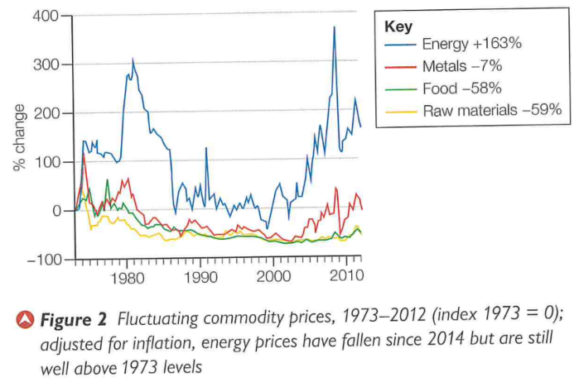
What are terms of trade?
Despite efforts of the WTO to liberalise trade, there are many aspects about trade that are unfair.
‘Terms of trade’ refers to the cost of goods that a country has to import, compared with the price at which they can sell the goods they export.
HDEs tend to import primary products from LDEs and subsequently turn these into manufactured goods for export to world markets – in other words, the value of the product increases as it passes through the hands of HDEs (Figure 1). In addition, Supply chains drive trade (lots of foreign input into the product), and therefore, the real nature of interdependence among economies can only be understood if trade is measured in terms of value added by each location in the production process.
Global Value Chains / Supply Chains: https://www.youtube.com/watch?time_continue=23&v=RZKX-0SK41U
In general, the prices of manufactured goods have increased, whereas the prices of primary products have fluctuated. This means LDEs need to export increased volumes of primary products to purchase the manufactured goods they require. Terms of trade are less favourable for LDEs. Figure 2.

Slide 8
Access to markets for Less Developed economies is hard – why?

Slide 9
Impacts on economic and societal well-being
Differential access to markets impacts on economic and societal wellbeing – there are consequences for all countries at different levels of development, but the poorer countries tend to suffer the most.
There are winners and losers as a result of international trade and access to markets. Rich countries generally have greater market access and high value exports compared with poorer countries. Many low income countries export low value products (such as agricultural products, e.g. unprocessed coffee beans) and workers in low income countries generally receive low wages. In contrast, the same product may be processed or refined in a high income country, adding value to the good. Many workers in high income countries receive competitive incomes, and so levels of wealth in high income countries are much greater than in low income countries. Consequently, the goods that a person from a low income country can afford to buy are much less varied, and a higher proportion of their expenditure is on essential goods (food, clothing and energy, for example. In contrast, for those in high income countries, a lower proportion of their earnings is spent on essential goods, and more on 'luxury' goods or inessentials.

Slide 10
Impacts on economic and societal well-being
Limited revenue from exports and business taxes means lack of money for investment or development
Some Chinese manufacturing companies have moved their factories to Ethiopia because Chinese workers have become more expensive to hire. This means that Ethiopia is now trading merchandise and not just raw materials.
The well- being of 30,000 workers in Port Talbot in Wales was threatened when India’s Tata announced closure of the steel works.
Poor access to markets deters foreign investment.
Many developed countries tax agricultural imports in order to protect their own farmers. This impacts negatively on the well- being of LDC farmers.
Quality of life can be poor for LDC farmers because agricultural trade is very competitive
Use the information to summarise the impacts that trade has on countries at different stages of development.
﻿﻿In the worst situations, a lack of ability to trade can even threaten food or energy security
Limited investment, growth and development will cause unemployment and poverty.
Alongside trade, China is increasingly lending SWF money to LDCs which helps build health and education infrastructure.
The EU imposes trade tariffs on imports of much produce that can also be grown within the EU, making it hard for LDC farmers to sell here.
There is a limited range and a lack of affordability of imported goods for consumers.
Skilled Chinese workers earn around US$600 a month producing increasingly sophisticated devices for developed country consumers.
Apple shareholders in the USA also benefit greatly from sales of goods made in China.

Slide 11
Special and Differential treatment (SDT) agreements
It was recognized by the WTO that not all countries were benefitting from free trade rules and therefore, special agreements were drawn up for the poorest countries to give preferential access to developed markets in trade agreements. They also have the right to restrict imports to a greater degree than developed countries and are allowed additional freedom to subsidise exports.
Special and Differential Treatment (SDT) agreements – post war agreement for developing countries to enable the poorest countries to:
Tackle low levels of income, help with the export of primary goods and vulnerability to export price volatility
Engage in world trade by providing incentives for export diversification, to allow more stable export revenues
Promote faster income growth and development through trade links

Slide 12
Sdts – their problems

Slide 13
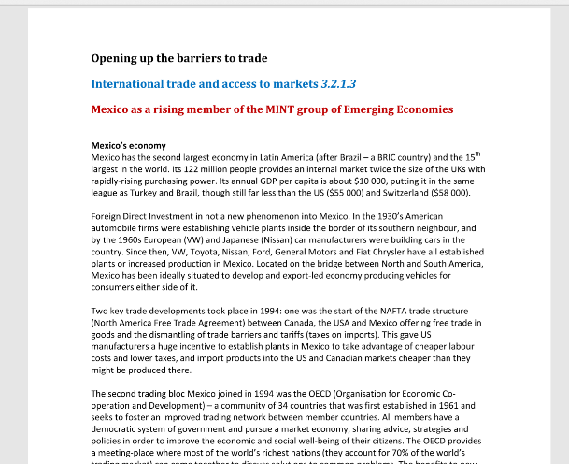
Mexico – Free Trade Areas
In many cases, SDTs have been replaced by unilateral trade agreements between poorer countries and richer trading partners. E.g. Mexico now a member of NAFTA (now USMCA)
Other groupings exist in Asia, Latin America (MERCOSUR) and Africa. They enhance negotiating leverage of their members and offer more to LDCs long term
TASK: Read the case study on Mexico as an emerging economy (54 International trade and access to markets CS.pdf), Make notes on the benefits that accrue a country as part of a trade bloc.
Be aware that Mexico also has huge inequalities (differential access to trade within the region), as only regions in the northern border and central states to the south of it benefit from manufacturing and trade through NAFTA.
Explain how differential access to markets can impact on the people within Mexico as different areas are affected by their trading relationship with the USA.
Maquiladora – manufacturing industries operating in a Mexican free trade zone close to the USA/Mexico border, where factories import material and equipment on a tariff-free basis for assembly, processing or manufacturing. The products are then re-exported back to the USA and Canada.

Slide 14
What are the benefits that may accrue a national economy that enters a trade bloc or becomes a member of an international trading organisation? (4 marks)
This will be a point-mark response. One mark is awarded for each point of knowledge or understanding. Extra marks are allowed for the development of points.
Points that may be included:
Opportunity to trade with fewer tariff barriers or quotas so goods from your country avoid import taxes as they enter foreign markets, creating a larger market. (EU, NAFTA etc.)
Cheaper goods can increase the market for contributing businesses, improving their profitability and encouraging expansion/labour recruitment.
Tariffs and trade protection may be installed around the whole bloc, protecting businesses inside from external competition (as with the EU).
Agreed regulations, standards and trading laws for all members of the bloc/organisation so it’s a ‘level playing-field’ for all contributors.
FDI may be forthcoming from within the bloc/other members so the level of economic activity is higher than the investment from internal finance could sustain. Increases tax revenues.
Possibly certain conditions/standards of political and economic measures are required for membership, so acceptance is a recognition of quality standards being achieved within a country.
Economic peaks and troughs can be filtered by the bloc/group to provide a more even business environment with fewer shocks to the system.

Slide 15
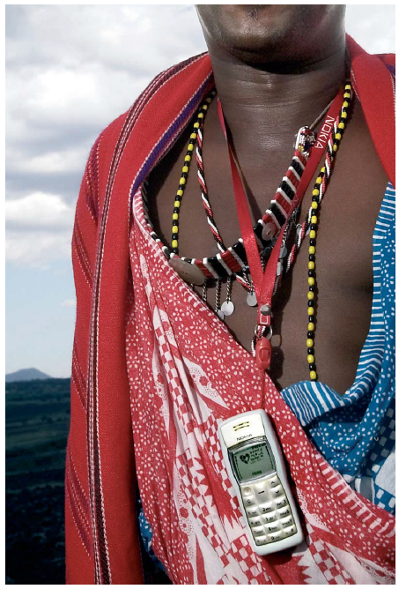
Access to services
Just as trade in goods can boost developing countries economies, so can opening up services.
Reliable banking facilities help attract incoming investment, ensure local savings are turned into local investment and enable small businesses to get credit.
When one out of 10 people get access to a mobile phone in a developing country, it is estimated that national earnings rise by 0.6%
Source: DFID Report
Further research:
https://www.theguardian.com/global-development/2017/jun/07/i-finally-own-something-wives-of-india-rickshaw-drivers-steer-the-finances
Microfinance: empower or impoverish? https://www.youtube.com/watch?v=U_lgCLmvRQo&feature=emb_logo

Slide 16
Fair trade
https://www.youtube.com/watch?v=JoIZWd2q2Ec

Slide 17
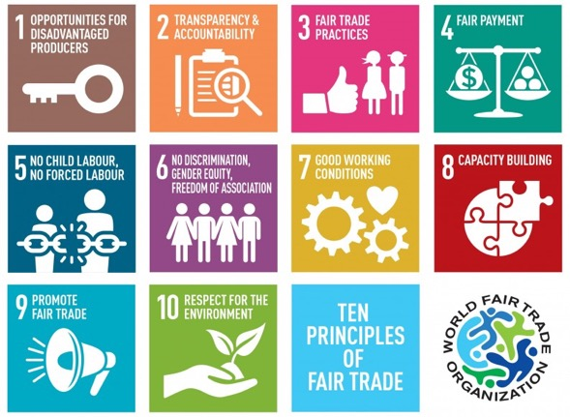

Slide 18
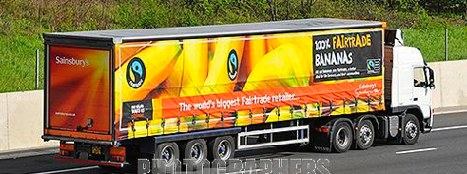
Fair Trade
We source our Fairtrade bananas from farmers in Central & South America, the Caribbean and West Africa.
Fairtrade premiums are crucial to many smallholder farmers and workers who would otherwise see their livelihoods threatened by global competition.
Fairtrade is about better prices, decent working conditions, local sustainability, and fair terms of trade for farmers and workers in the developing world. By requiring companies to pay sustainable prices (which must never fall lower than the market price), Fairtrade addresses the injustices of conventional trade, which traditionally discriminates against the poorest, weakest producers. It enables them to improve their position and have more control over their lives.

Slide 19
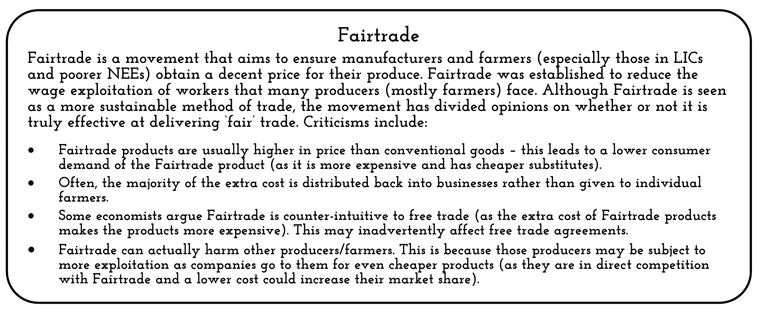
Fair trade – pros and cons

Slide 20
Benefits to LDEs
Using the example of tea in Kenya and small banana producers in Ecuador, how can fairtrade help people in LDEs? M&S Fair trade: https://www.youtube.com/watch?v=1Ssz_WtHiQk
List some of the key points

Slide 21
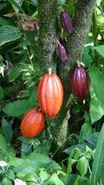
Is Free Trade the same as Fair Trade?
Free Trade | Fair Trade
Free Trade is the reduction of regulations and other constraints on businesses to increase international trade. | Fair Trade is about making sure that farmers are paid a fair wage for their produce.
Tariffs and quotas are removed, so countries can respond to market forces. | Fair trade gives farmers a guaranteed price for their products, no matter what the market does. This helps them plan and budget for the future.
It is based on the theory that every country will be better off if it specialises in producing goods which is comparatively more efficient. | Fair trade encourages farmers to cooperate. This allows better conservation of the natural environment. It also encourages investment in local amenities.

Slide 23
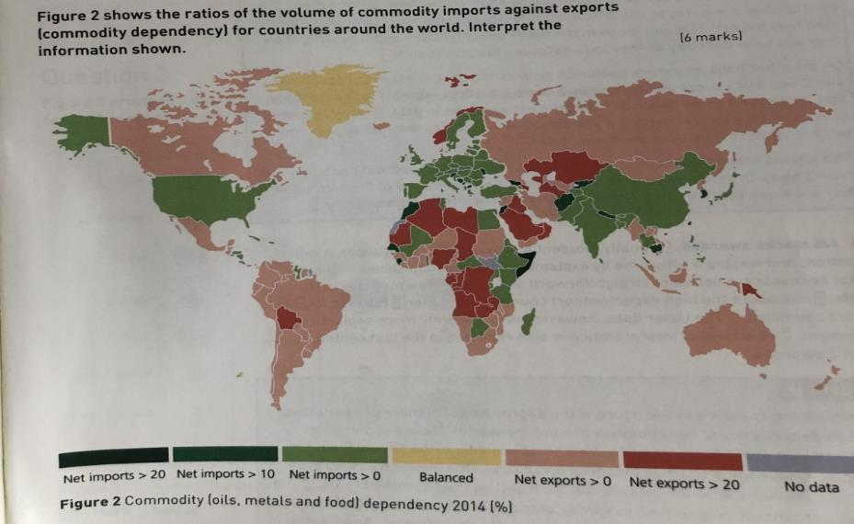
Exam questions
Outline the main features of international trade [4 marks]
Analyse the data given in Figure 2 [6 marks]

Slide 24
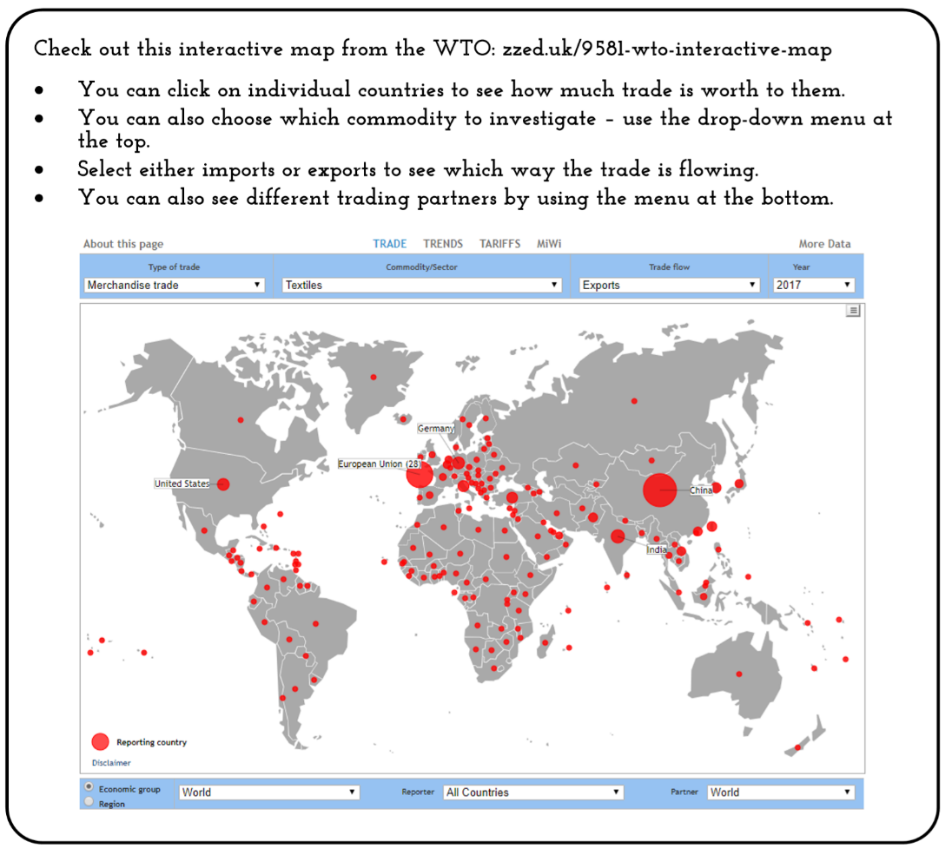
Extension

