Slide 1
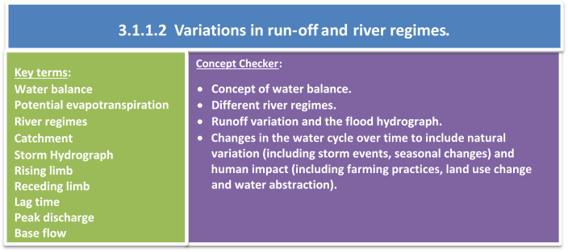

Slide 2
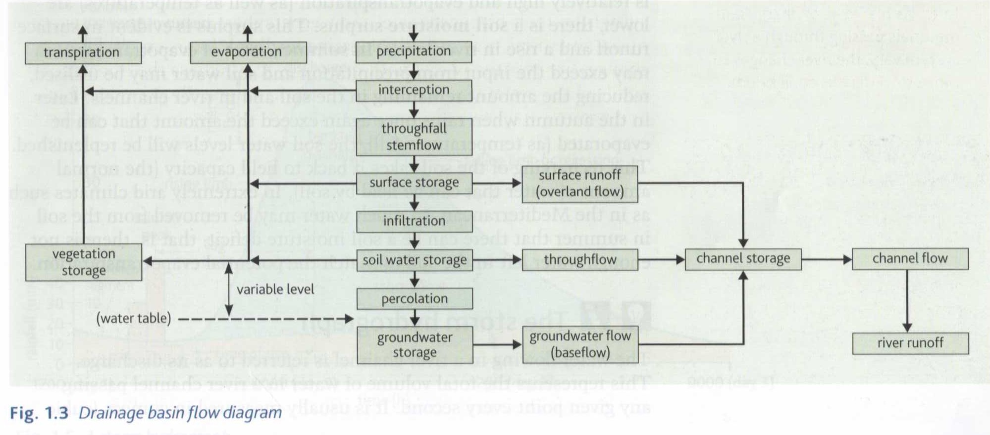
Can you identify the missing elements? Describe one possible pathway of water to the river channel once it has infiltrated into the soil.

Slide 3
Describe one possible pathway of water to the river channel once it has infiltrated into the soil.

Slide 4
 | Water stored underground in bed rock
 | Water lands on plants and runs down their stems
 | When water is caught by trees and plants
 | Water stored deep in the ground
 | Anywhere water flows over the land surface
 | Movement of water down through the soil
 | When water enters into soil
 | When water enters permeable rock
 | Rain, snow, hail and sleet
 | Water held between soil particles
 | Where water vapour comes out of leaves
 | Water rises as vapour from the ground and released from leaves.
 | When water flows through the ground/rock
 | Lakes, ponds and puddles
Notes:
Add arrows as required.

Slide 5
Aquifer | Water stored underground in bed rock
Stemflow | Water lands on plants and runs down their stems
Interception | When water is caught by trees and plants
Groundwater | Water stored deep in the ground
Overland flow | Anywhere water flows over the land surface
Through flow | Movement of water down through the soil
Infiltration | When water enters into soil
Percolation | When water enters permeable rock
Precipitation | Rain, snow, hail and sleet
Soil water | Water held between soil particles
Transpiration | Where water vapour comes out of leaves
Evapotranspiration | Water rises as vapour from the ground and released from leaves.
Groundwater flow | When water flows through the ground/rock
Surface water | Lakes, ponds and puddles
Notes:
Add arrows as required.

Slide 6
Runoff variation
The amount of water in the river (and flowing into the sea therefore), is known as runoff.
This varies widely...
  Between different rivers – depends on things like the size of the drainage basin, amount of rain that falls and the geology of the area
  In one river throughout the course of a year – seasonal rainfall amounts, snowfall (smow can be stored on the surface for many months before it melts)

Slide 7
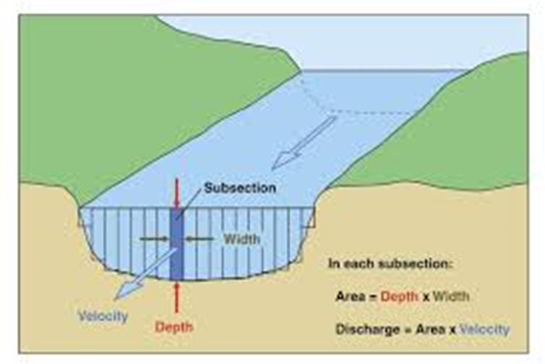
The level of runoff at a given time is studied by measuring river discharge.
  What is river discharge?
  Imagine standing on a bridge looking down on a fast-flowing river. The volume of water passing beneath you is the river’s discharge.
  How is it calculated?
  River discharge values are expressed in
  ‘cumecs’ (cubic metres per second).
  It is usually calculated in this way:
  Discharge (m3 per second) = cross-sectional area (m2) x velocity (metres per second)

Slide 8
Compare the two river basins below. In your own words explain the reasons behind the differences in runoff.

Slide 9
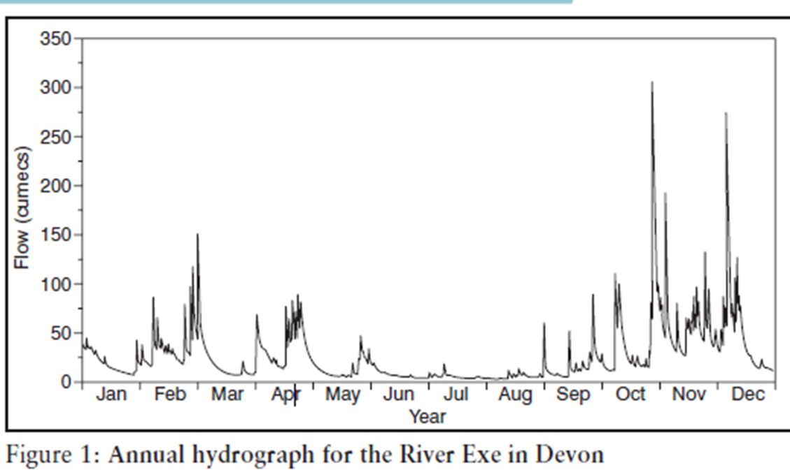
River regimes
River levels rise and fall, often showing an annual pattern (the river’s regime). A river regime can be defined as:
The variability in a river’s discharge throughout the course of a year in response to precipitation, temperature, evapotranspiration and drainage basin characteristics.

Slide 10
TASK: Compare these two regimes, River Avon, UK, on the left and Mohawk River, USA, on the right. Use the statements below to complete the text boxes.
UK
USA

Slide 12
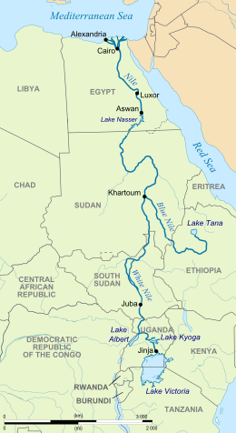
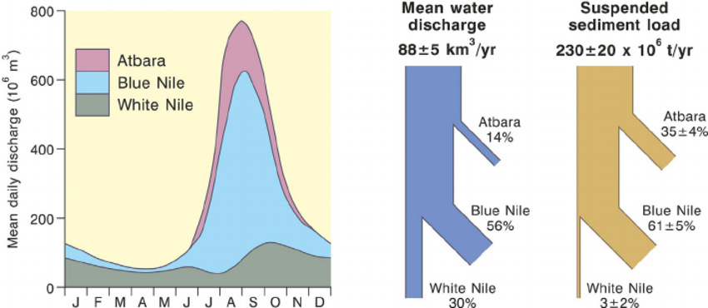
The Nile Regime:
The three main tributaries of the Nile, the White Nile, Blue Nile and the Atbara, provide water for the Nile, with each tributary having a different regime.
The White Nile has a constant flow water throughout the year while the Blue Nile, originating in the Ethiopian Highlands, is far more seasonal, with the highest discharge being during the rainy season in Ethiopia (June-September).

Slide 13
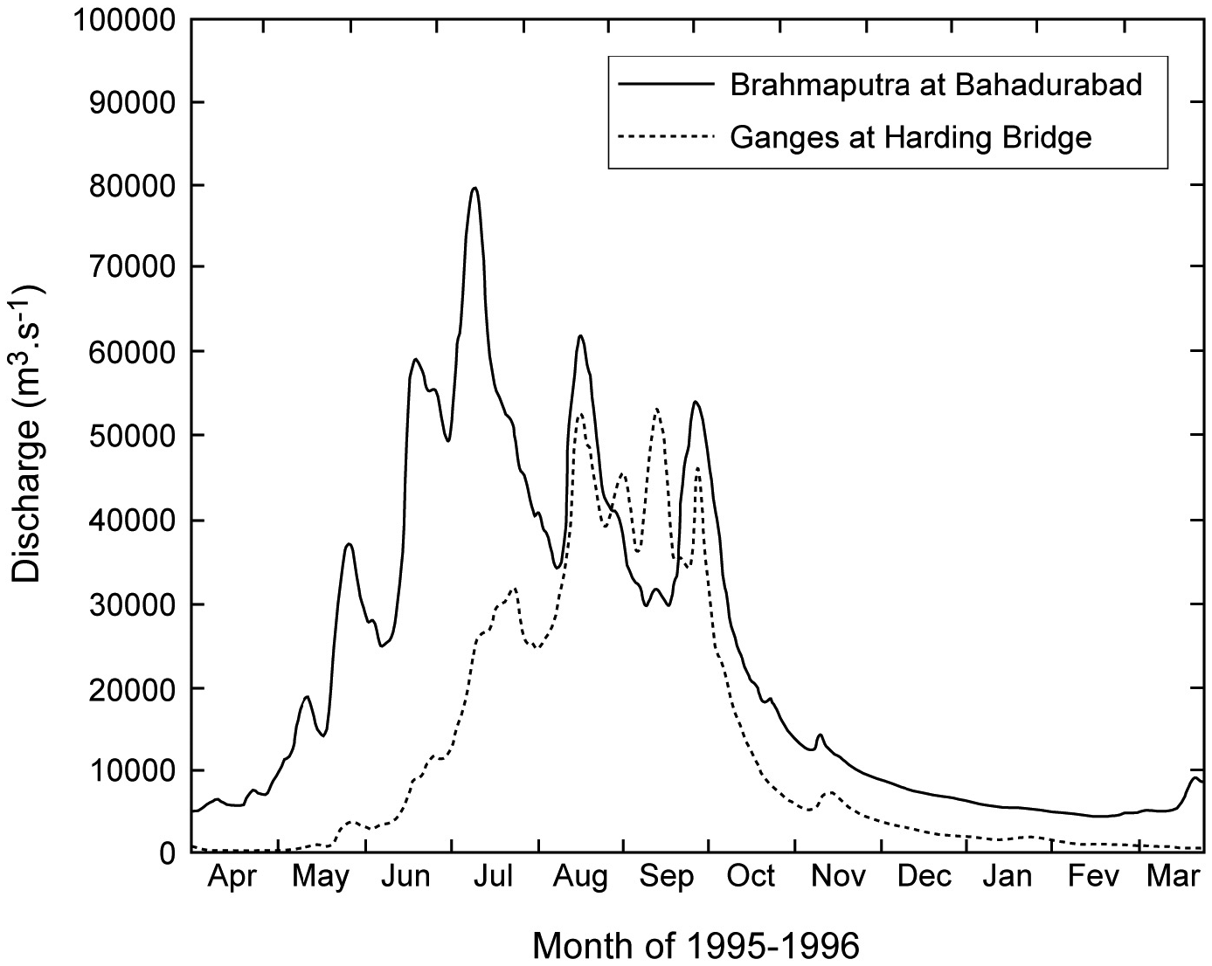
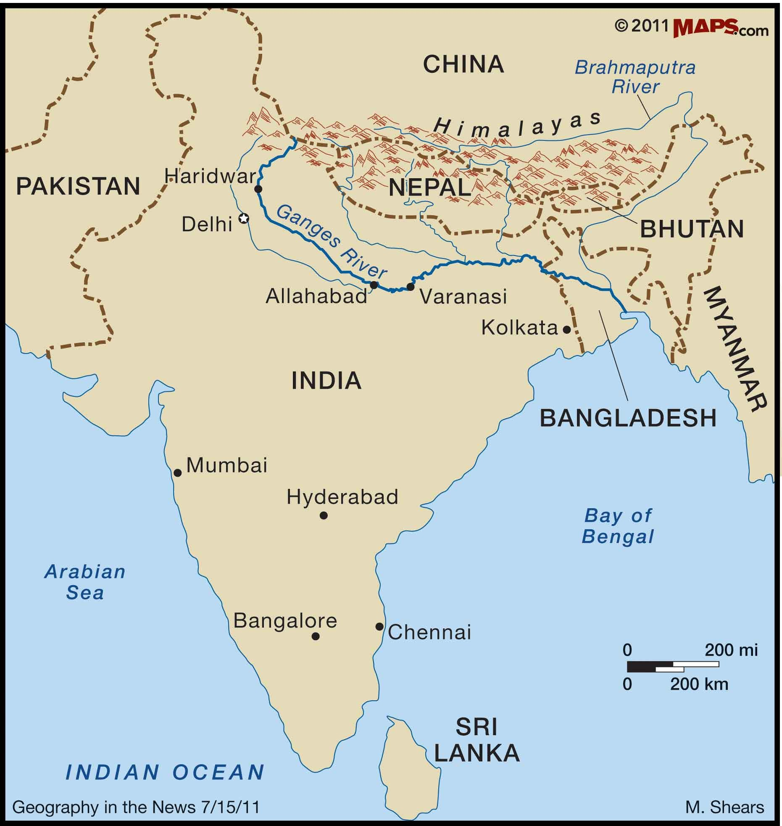
The Ganges regime:
The river’s predominant pattern is for a low-flow dry season from January to May and a wet season from July to November, with peak flows usually occurring in August.

Slide 14
Compare the variation in run-off for the River Lambourn and River Ock. They are neighbouring catchments with the same climatic conditions but different geology. The Lambourn is supplied by chalk springs while the Ock drains an impermeable clay catchment.
What is the general pattern of flow of the River Lambourn, how and why does this differ to the Ock?

Slide 15
Explain and assess the role the following factors play in causing variations in runoff: (Hodder textbook pages 17-19 will help you – the scanned pages of the textbooks are in the first folder in the Water and Carbon and Water folder on GoL)
Type and intensity of precipitation (type of precipitation = rain, sleet, snow and hail)
Temperature
Soil type
Rock type
Human activities (such as dam building, land use change and urbanisation).

