Slide 1
Powerpoint 2
3.1.1.3 Carbon Cycle
Learning Objectives
Factors driving change in the magnitude of these stores over time and space - photosynthesis, respiration, decomposition, combustion, carbon sequestration in oceans and sediments, weathering. To include flows and transfers at plant, sere and continental scales.
Concept Checker:
To describe and explain the flows and transfers of carbon on a local (plant) sere and continental scale
To describe and explain the processes involved in the transfers of carbon to include fast and slow transfers
Key words:
Lithosphere
Hydrosphere
Cryosphere
Biosphere
Atmosphere
Pedosphere

Slide 2
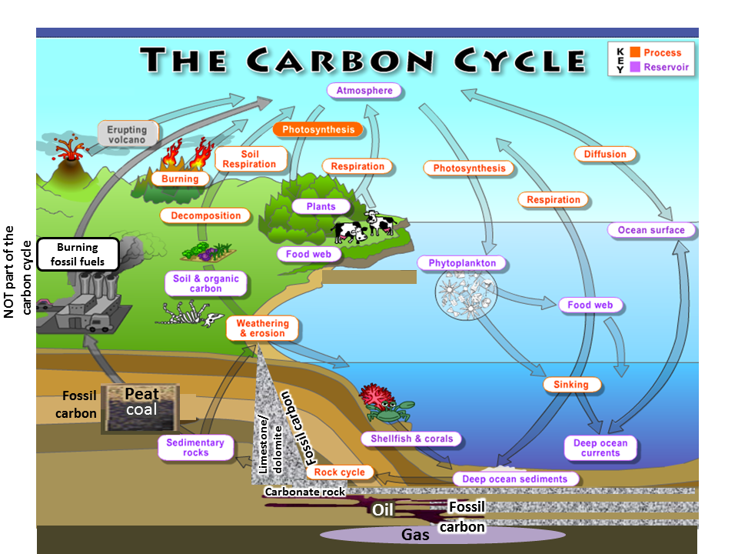
Movement of carbon
Carbon moves from one source to another in a continuous cycle
The processes by which carbon moves between these stores are known as transfers or fluxes. If more carbon enters a store than leaves it, that store is considered a net carbon sink. If more carbon leaves a store than enters it, that store is considered a net carbon source.

Slide 3
The factors driving change in the carbon cycle are:-
Photosynthesis
Respiration
Decomposition
Combustion
Ocean-atmosphere exchange
Biological carbon pump
Carbon sequestration in oceans and sediments
(Burial and compaction)
Weathering
photosynthesis, respiration, decomposition, combustion, carbon sequestration in oceans and sediments, weathering

Slide 4
The fast and slow carbon cycles
Fast carbon cycle | Slow carbon cycle
The time it takes carbon to move through the fast carbon cycle is measured in a lifespan. Includes - photosynthesis, respiration, decomposition, biomass combustion, ocean-atmosphere exchange and biological carbon pump | This can take place over many tens and hundreds of million years Includes - burial and compaction, geological carbon cycle and weathering
The Short-Term Carbon Cycle (timeforgeography.co.uk)

Slide 5
Make notes on the following using Oxford p27-28
Photosynthesis 6CO2 + 6H2O + light energy = C6H12O6 (glucose) + 6O2
Respiration C6H12O6+602 = 6CO2 + 6H2O + energy
Decomposition
Biomass combustion

Slide 6
Carbon pump definition
A mechanism that drives carbon from one zone to another . It generates transfers of carbon from place to place and possibly from one carbon store to another.
There are two pumps that you need to know about that are part of the fast carbon cycle.
  The ocean-atmosphere exchange
  The biological carbon pump

Slide 7
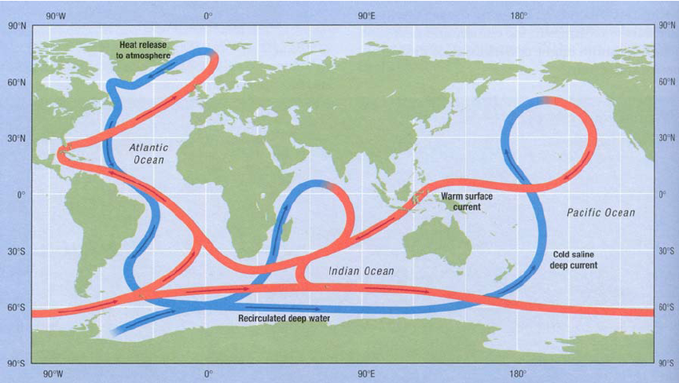
Water is able to dissolve CO2. At the surface of the ocean there is always an exchange of CO2; some dissolves into the water and some is vented out into the air above. This is known as the oceanic carbon pump. Carbon is carried by the oceans on the thermohaline circulation/cycle.
The ocean – atmosphere exchange
There is a negative correlation between the temperature of the water and the amount of CO2 that can be dissolved.
Warm water in oceanic surface currents is carried from the warm tropics to the cold polar regions. Here the water is cooled, making it dense enough to sink below the surface layer (downwelling), sometimes all the way to the ocean bed (vertical mixing).
When cold water returns to the surface (upwelling) and warms up again, it loses carbon dioxide to the atmosphere.
This enormous carbon pump gives the ocean a lot more carbon than it would have if the surface water was not being constantly replenished.
Watch the clip about ocean currents from the DVD ‘Power of the Planet – Ocean’ (estream 3495) 33 – 40 minutes https://estream.godalming.ac.uk/Default.aspx?search=3495&page=1&fp=0
There is evidence that the thermohaline cycle is weakening. What effect might this have on carbon storage in the oceans?
What impact might global warming have on oceanic carbon stores?

Slide 8
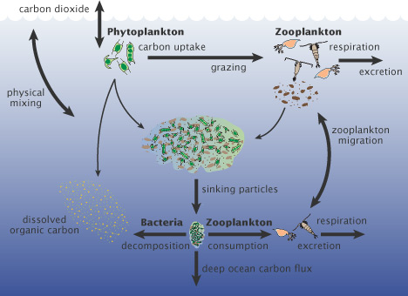
The biological carbon pump
Living things in the ocean move carbon from the atmosphere into surface waters then down into the deeper ocean and then eventually into rocks
This action of organisms moving carbon in one direction is often called a biological pump
Carbon gets incorporated into marine organisms as organic matter or structural calcium carbonate
When organisms die, their dead cells, shells and other parts sink to the deep water. Some material sinks right to the bottom, where it forms layers of carbon-rich sediments.
Over millions of years, chemical and physical processes may turn these sediments into rocks. This part of the carbon cycle can lock up carbon for millions of years. (This part of the biological carbon pump is part of the slow carbon cycle)
Phytoplankton require nutrients in vast quantities and rely on the existing ocean temperatures and currents to maintain this supply. This is done through the thermohaline circulation

Slide 9
Burial and compaction (Slow carbon cycle)
This is where organic matter is buried by sediments and becomes compacted. Over millions of years, these organic sediments containing carbon may form hydrocarbons such as coals and oil.
Coral and shelled organisms take up carbon dioxide from the water and convert it to calcium carbonate, used to build their shells. When they die, the shells accumulate on the seabed. Some of the carbonates dissolve, releasing carbon dioxide. The rest become compacted to form limestone, storing carbon for millions of years.

Slide 10
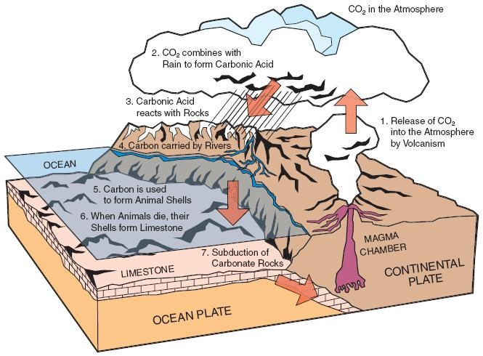
The geological carbon pump is a natural cycle that moves carbon between land, oceans and atmosphere and is part of the slow carbon cycle
The Long-Term Carbon Cycle (timeforgeography.co.uk)
Explain the role of volcanoes and weathering in the geological carbon cycle (6 marks)

Slide 11
Weathering is the weakening and breakdown of rocks in situ. Chemical weathering occurs when CO2 combines with rain to form carbonic acid. This acid then dissolves the rocks and releases carbon into the atmosphere. Rivers can also carry the carbon into the sea which is then taken in by animals to form shells. The shells are later deposited on the sea bed and become carbonate rocks. Over time, these carbonate rocks could be subducted at a destructive plate margin and when the plate melts CO2 is released through volcanic activity. This is part of the geological carbon cycle.

Slide 12
Carbon sequestration
The process of sequestration involves capturing CO2 from the atmosphere and putting it into long-term storage.
Terrestrial or biologic sequestration occurs when plants capture CO2 from the atmosphere and store it in the stems and roots of the plants as well as the soil. The peatlands of the River Exe is a good example of sequestration.
Ocean carbon sequestration occurs through the atmosphere-ocean exchange and through photosynthesis of phytoplankton.
(There is another form of carbon sequestration called carbon capture. This is when CO2 is captured at source e.g. from power plant emissions and then injected in liquid form into stores underground. This will be discussed further in a later lesson)

Slide 13
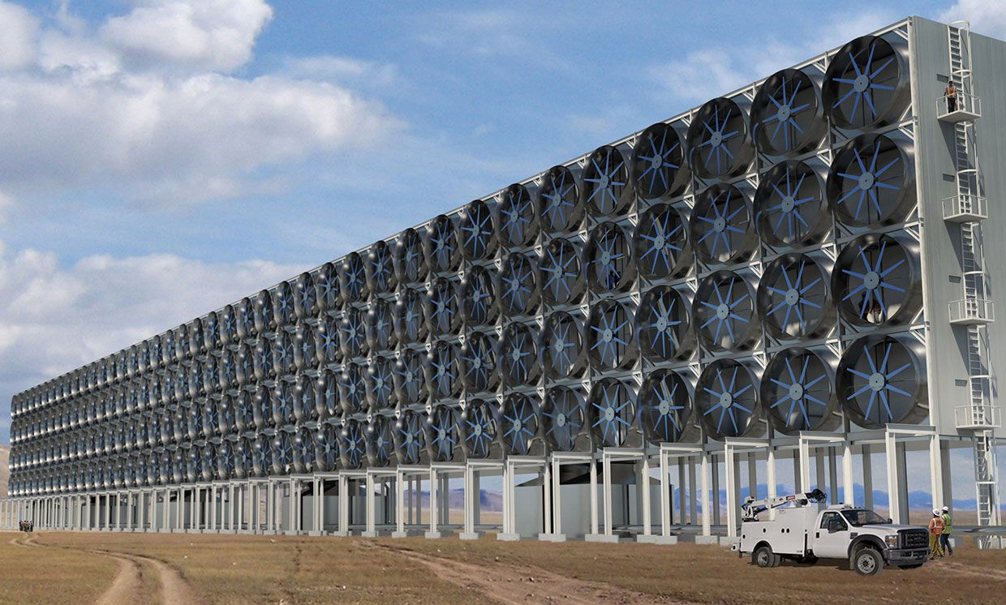

Slide 14
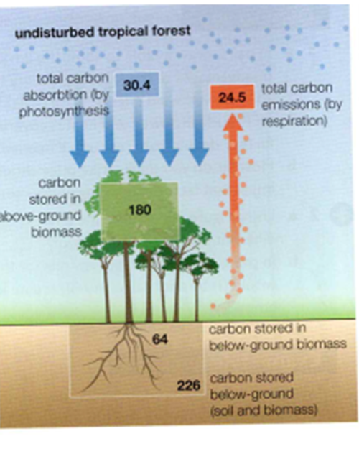
The carbon budget – the balance of exchanges between the four major stores of carbon
The carbon budget uses data to describe the amount of carbon that is stored and transferred within the carbon cycle. If the amount coming in and the amount going out is the same then the carbon cycle is in equilibrium.

Slide 15
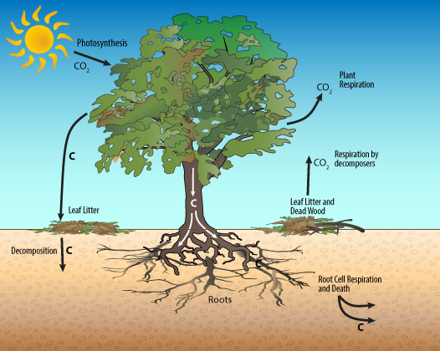
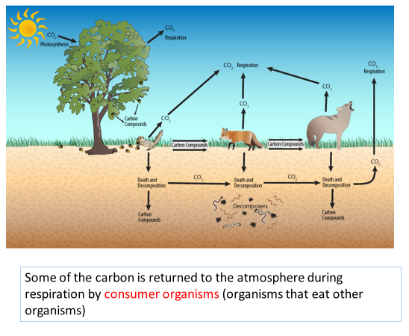
The transfer between the carbon stores can occur at a range of scales
Local scale
Carbon fixation is the process that turns gaseous CO2 into living organic compounds that grow. The amount of carbon stored within a tree, woodland or forest depends on the balance between photosynthesis and respiration
Think back to what you have already studied. What might cause a tree to be a net carbon sink or a net carbon source?
What different stores of carbon are there on these diagrams?
Why is the role of soil important in the carbon cycle?

Slide 16
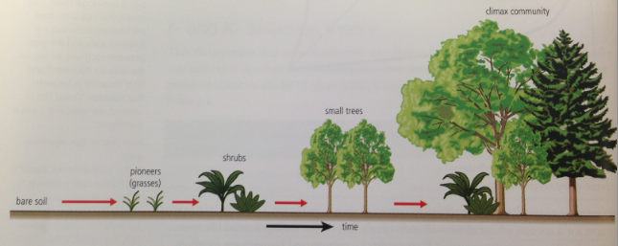
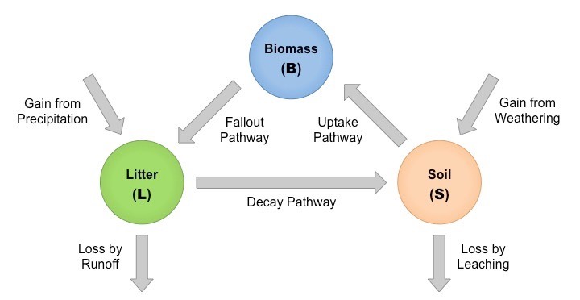
Bacterial decomposition releases CO2 back into the atmosphere
A seral scale (complete vegetation succession)
Plants take in CO2 from the atmosphere and stores it as biomass
Carbon is transferred to the soil via leaf litter, roots and plant debris upon decomposition
As the amount of soil builds up each new seral stage will show an increase in both the height of the plants and in the number of species.

Slide 17
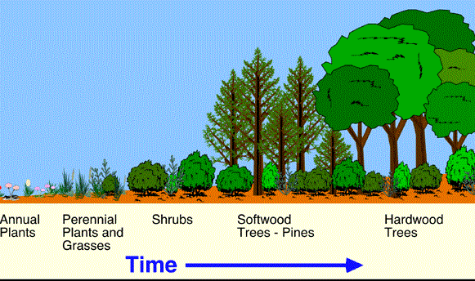
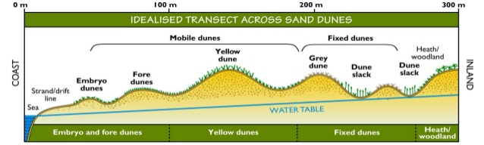
Seres – a transfer of carbon (seral scale)
This sequence of changes is called a vegetation succession.
A succession that relates to a specific environment is called a sere.
A lithosere is a vegetation succession that occurs on bare rock.
A psammosere is a vegetation succession that occurs on a coastal sand dune.
Eventually the final stage of a sere is reached when a state of environmental equilibrium or balance is achieved. This is usually in response to the climate and is therefore termed the climatic climax.
The climax vegetation for a lithosere in the UK will usually be a deciduous woodland.

Slide 18
The Global Scale

Slide 19
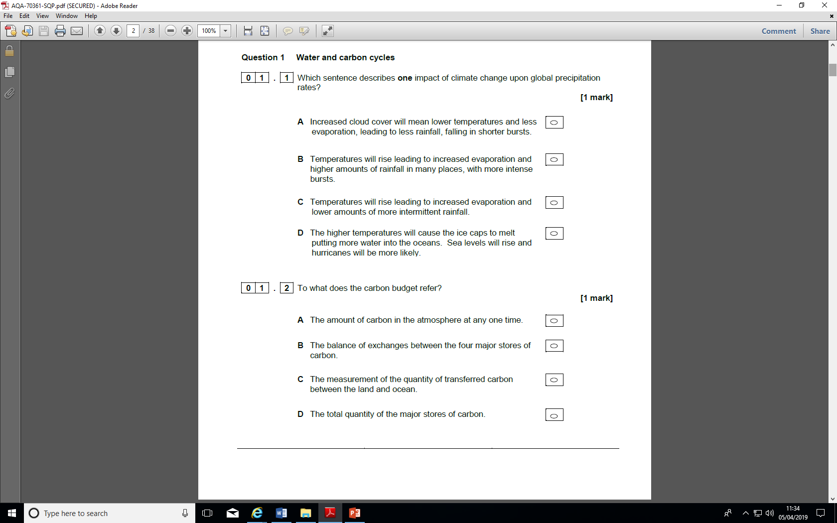

Slide 20
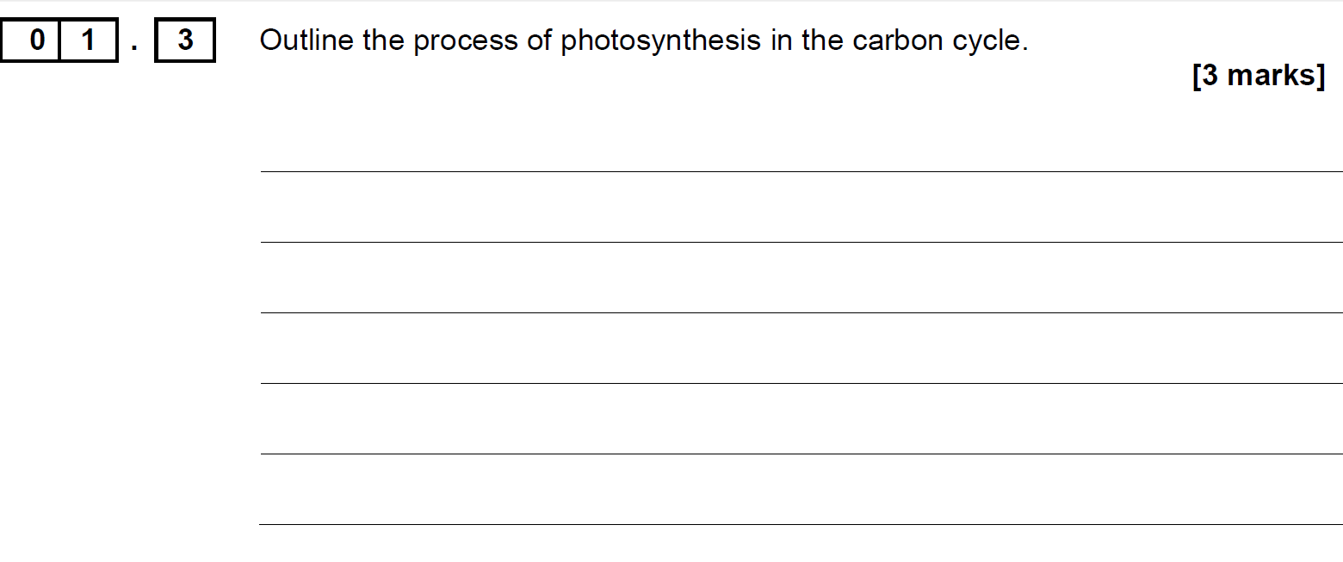

Slide 21
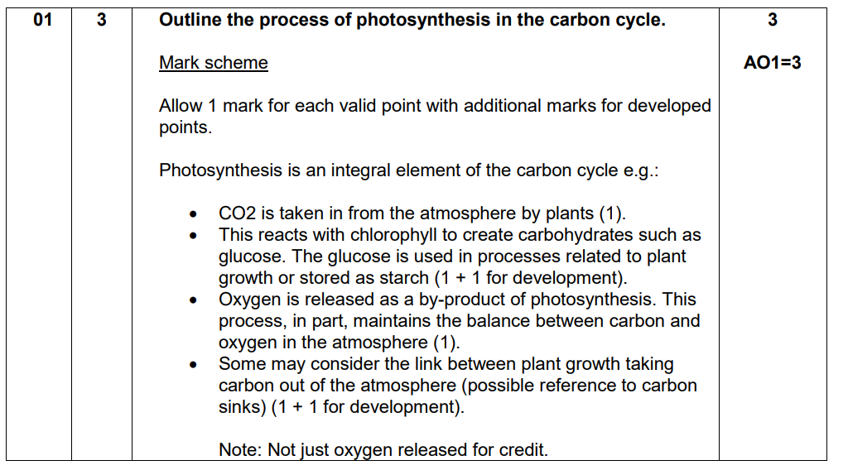

Slide 22
