Slide 1
AQA
AS Level
Computer Science
Paper 2
Wireless networking, CSMA and SSID
Unit 6
Communication: Technology and consequences

Slide 2
Objectives
Explain the purpose of Wi-Fi
Describe the components required for wireless networking
Explain how wireless networks are secured
Explain the wireless protocols CSMA/CA and RTS/CTS
Describe the purpose of SSID

Slide 3
The purpose of Wi-Fi
Wi-Fi is a wireless networking technology providing high-speed Internet and network connections
Devices connect to the Internet via a Wireless network Access Point (WAP)
Wi-Fi ‘hot spots’ can often be found in:
Cafes
Hotels
Libraries
Other public places

Slide 4
Connecting to a wireless network
What’s needed?
ISP (Internet Service Provider)
Modem and wireless router (Often combined)
Device with a network interface card (NIC), also known as a network interface controller

Slide 5
Connecting to a wireless network

Slide 6
Wireless components
Wireless Network Interface Card (NIC)
A station consists of a computer and an NIC
Stations share a radio frequency channel
Wireless Access Point (WAP) requires a connection to a router, and the router requires a connection to a modem
The WAP and the modem are often built into the router

Slide 7
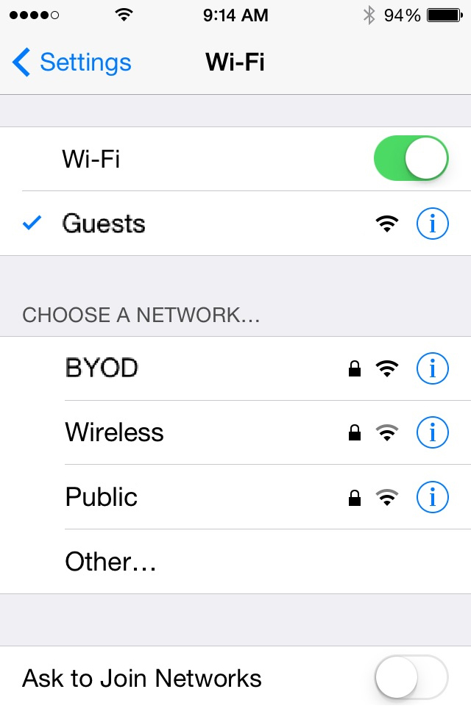
Service Set IDentifier (SSID)
Identifies each network by a unique name
Must be used by all devices on that network
Can be set manually or automatically
Can be hidden to make it harder to detect
Can be set to broadcast to wireless devices in range of an access point

Slide 8
Securing a wireless network
Wireless networks can be less secure than wired ones
Unauthorised users can be hard to spot and transmitted data can easily be intercepted
Security measures include:
WPA
WPA2

Slide 9
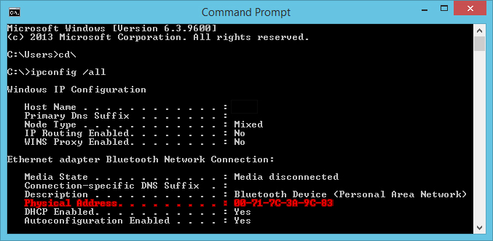
Securing a wireless network
MAC address whitelists

Slide 10
Worksheet 4
Now write answers to Task 1 on the worksheet

Slide 11
Two stations transmitting…
Several devices may be able to transmit via a single WAP
What happens if two devices transmit simultaneously?
A protocol is needed to prevent this from happening

Slide 12
Collision avoidance
Start
Assemble a frame
Channel
Idle?
No
Wait a random time
Yes
Transmit data
Stop

Slide 13
CSMA/CA
The flowchart on the previous slide shows the protocol Carrier Sense Multiple Access with Collision Avoidance (CSMA/CA)
Collisions are avoided by each station transmitting only when the channel is idle

Slide 14
Hidden node problem
Node A
WAP
Node B
The Wireless Access Point hears Nodes A and B
Nodes A and B are hidden from each other

Slide 15
CSMA/CA using RTS/CTS
Start
Assemble a frame
No
CTS (Clear to send) received?
Channel
Idle?
Yes
No
Wait a random time
Transmit data
Yes
Stop
Transmit RTS (Request to send)

Slide 16
Recap
Describe the components required for wireless networking
Explain how wireless networks are secured
Explain the wireless protocols CSMA/CA and RTS/CTS

