Slide 1
3.1.1.4 Carbon Cycle
Learning Objectives
To able to explain the importance of the carbon and water cycle in supporting life on earth with particular reference to climate. To understand how the carbon and water cycles are linked and their relationship in the atmosphere.
Concept Checker:
How are carbon and water essential for life?
How are the carbon cycle and water cycle linked
What are the links between the carbon and water cycle and our climate?
How do both positive and negative feedback systems affect global climates?
Key words:
Positive feedback
Negative feedback
Dynamic equilibrium

Slide 2
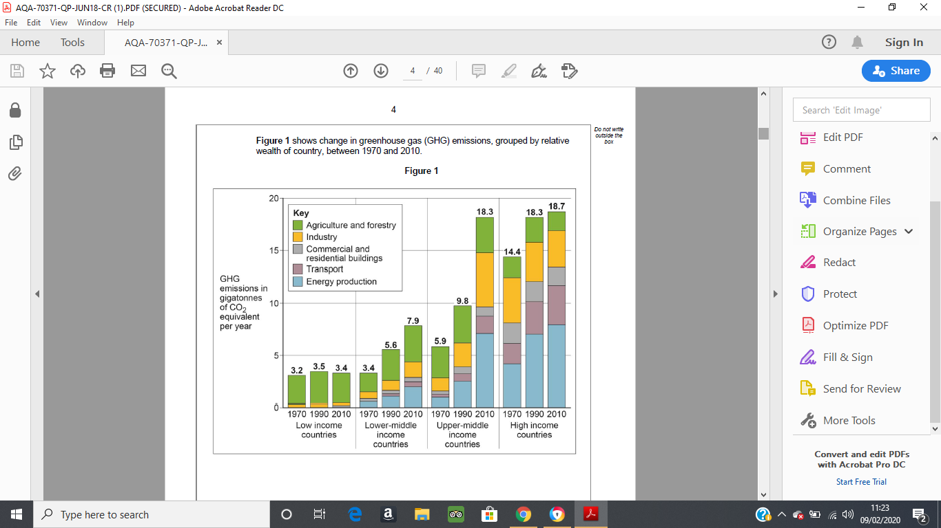
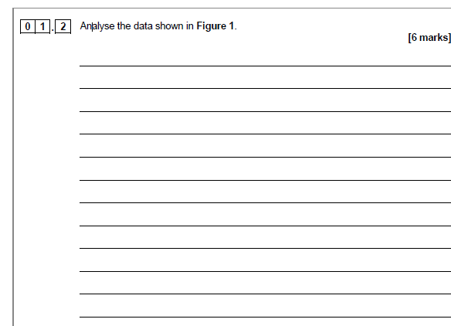

Slide 3
Notes for answers.
AO3
Level 1 responses are likely to simply describe the data without clear attempt to analyse, for instance by manipulating data or spotting trends.
The graph shows that high income countries are still the biggest contributors to GHG production but that there has been little growth between 1990 and 2010 in particular (0.4 Gigatonnes of CO₂).
It is upper-middle income countries which have seen the fastest rates of growth of the time periods. For instance, there has been an almost doubling from 98 to 18.3 gigatonnes of CO₂ produced. Industry appears to have more than doubled in its contribution to GHG in this group of countries (from approximately to 2 to around 5 gigatonnes).
Low and low-middle income countries contribute relatively little to the overall GHG emissions. For instance, combined in 2010 they produced only 11.3 gigatonnes, 7.4 gigatonnes less than high income countries. These countries greatest contribution comes through agriculture (especially for low income countries) with very little through energy use and transport.
Some may conclude that the poorest countries in the world are largely not responsible for the vast majority of the GHG emissions and that this contribution, if anything, is shrinking.
AO3 = 6
[Total 6 marks]

Slide 4
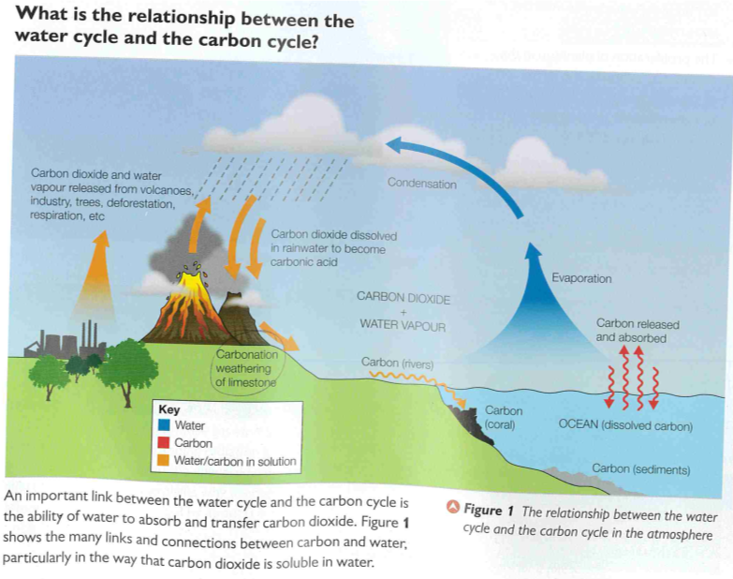

Slide 5
The role of carbon and water in supporting life – research (internet and Oxford textbook) and see if you can come up with 10 roles for each
Water | Carbon

Slide 6
Place the following elements in the appropriate part of the venn diagram to show whether they are primarily elements of the water cycle, carbon cycle or both
Precipitation
Photosynthesis
Transpiration
Decomposition
Chemical weathering of rocks by running water
Channel flow
Soil storage of precipitation
Carbon
cycle
Water
cycle
Explain the role of each element and justify why you have placed it where you have.

Slide 7
Possible answers for venn diagram
Precipitation - is a key transfer in the water cycle but is also essential for the weathering of terrestrial rocks containing carbon in the slow carbon cycle as acid rain.
Photosynthesis – the main way carbon is transferred between the atmosphere and the biosphere (plants) both on land and in the seas (phytoplankton). It’s a gas transfer that doesn’t involve the water cycle directly.
Transpiration – a transfer of moisture from plants to the atmosphere. A key element of the hydrological cycle.
Decomposition – as bacteria break down organic matter (both plant and animal) carbon gas is emitted as they digest biomass. When air is present CO2 is released, when air is absent CH4 (methane) is released.
Chemical weathering of rocks by running water – carbonic acid (precipitation plus CO2) dissolves rocks such as calcium carbonate, transferring carbon to the oceans.
Channel flow – is key to transferring water between land and oceans in the hydrological cycle, and carbon between land and oceans in the carbon cycle.
Soil storage regulates the speed at which water is recycled within the hydrological systems. It may influence whether decomposition is aerobic or anaerobic in the carbon cycle but it is not a key determinant of whether carbon is released or not – just its form.

Slide 8
Summary
The water and carbon cycles do not act completely independently within the atmosphere. One of the key connections involves the absorption of carbon in rainwater, which facilitates key processes and affects the magnitude of both stores and transfers.
The cycling of water and carbon are central to the continued health of life on Earth with which they are intimately connected. There are challenges in maintaining these cycles, and the consequences of changes with them will impact on climate change, water security and flooding – all significant global issues today. The level of water availability influences the ecosystem that develops within an area.
Which biomes (large ecosystems) contain the most carbon?

Slide 9
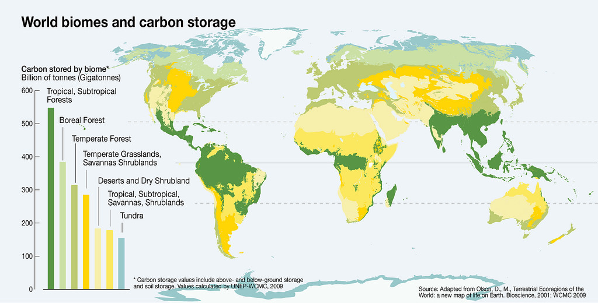

Slide 10
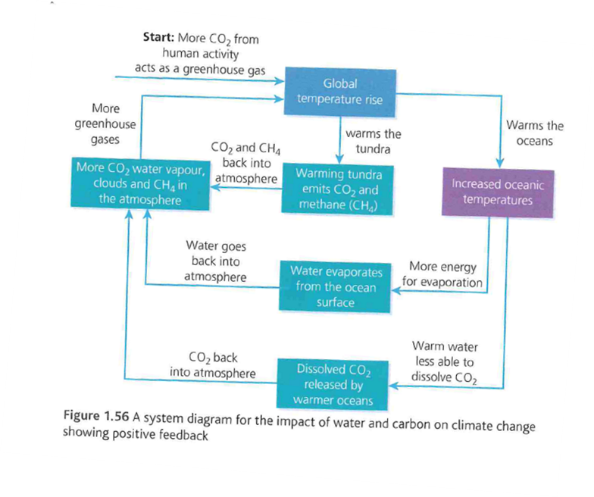

Slide 11
Card sort activity
Positive feedback - a cyclical sequence of events that amplifies or increases change.
Negative feedback – a cyclical sequence of events that damps down or neutralises the effects of a system.
Use the cards to create 2 positive and 1 negative feedback systems.
Copy the feedback systems into your handout once it has been confirmed that they are correct.

Slide 12
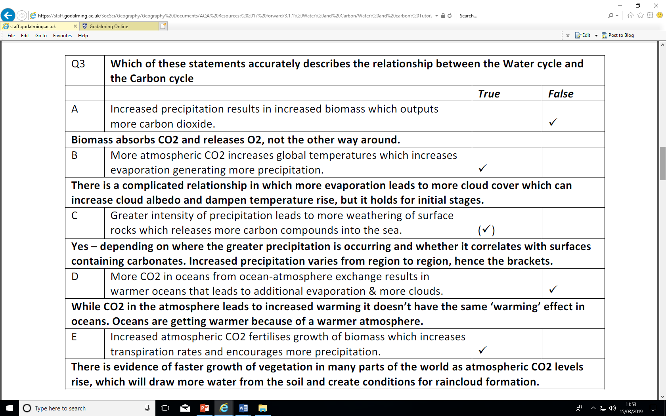

Slide 13
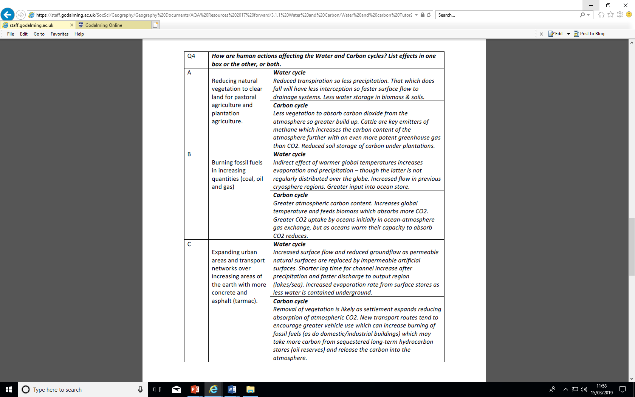

Slide 14
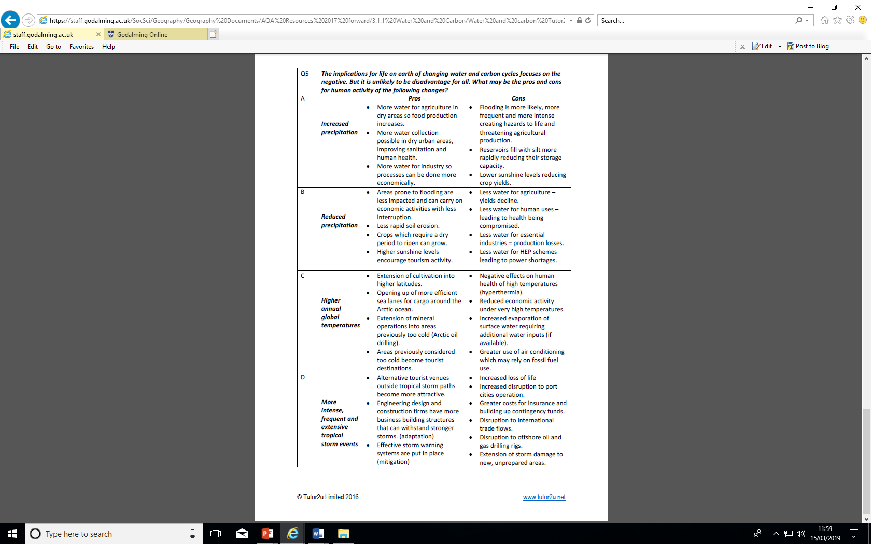

Slide 15
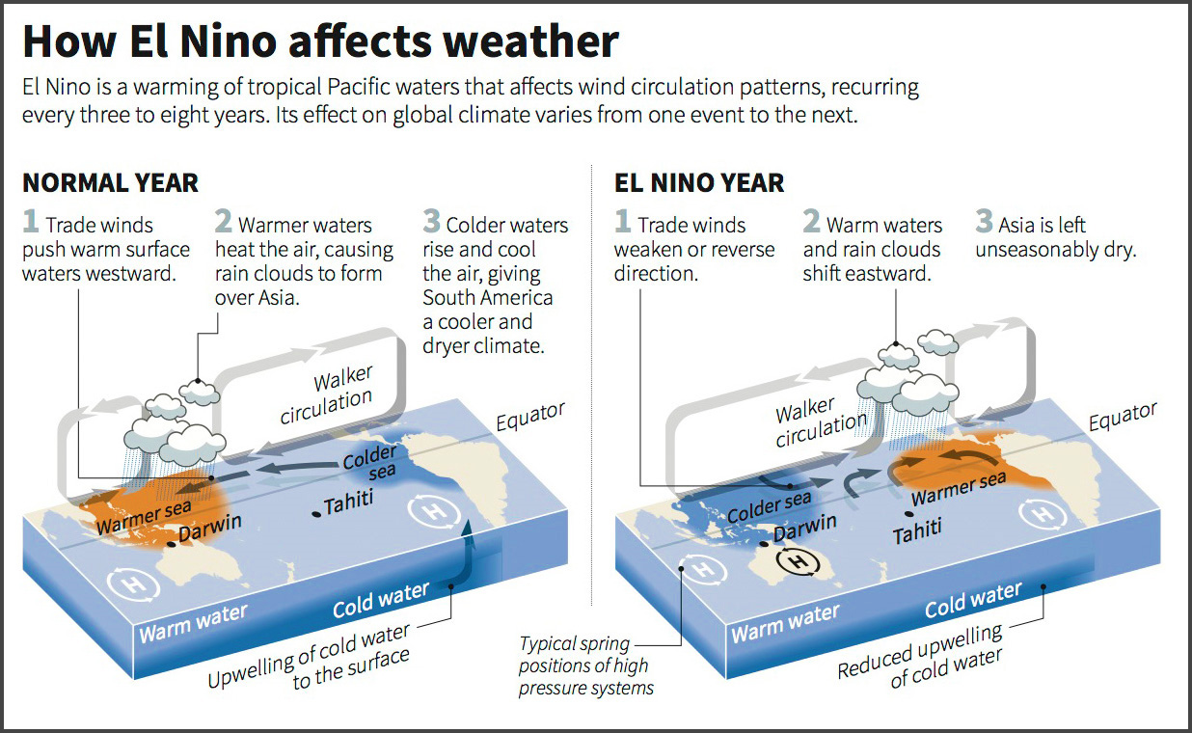
Computer modelling shows that as greenhouse gases warm the planet:
Different regions of the world will warm at different rates
La Nina (the reverse of El Nino) and El Nino events will become more extreme
Regions bordering the Pacific will see flood seasons following drought, and vice versa
https://www.youtube.com/watch?v=WPA-KpldDVc

Slide 16
Read p41-43 Oxford textbook
1) Make notes on how the melting ice in the Arctic and the growth of phytoplankton in the oceans impacts global climates. Include a description of the processes that are taking place for each and whether it is an example of positive or negative feedback.
2) Explain how the melting of permafrost could be both a positive or negative feedback loop.

Slide 17
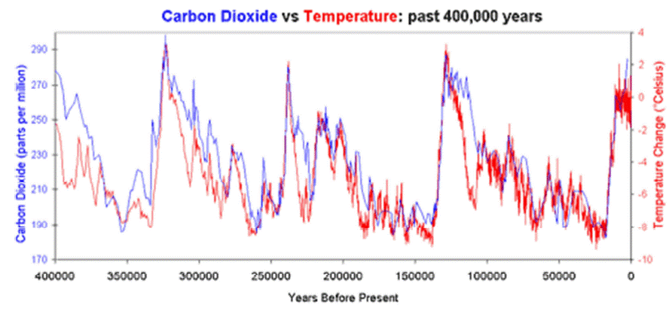
Is there a causal link between carbon dioxide and temperature in explaining glacial cycles?
Read through the extension task p33 Oxford textbook
  What do they think causes the time delay between carbon dioxide and temperature?
  What impacts does rising temperature have on the oceans, land surfaces and the enhanced greenhouse effect?

Slide 18
Exam style question
Assess the extent to which rising global temperatures may result in a positive feedback cycle (20 marks)
Reminder definition of assess – Consider several options or arguments and weigh them up as to come to a conclusion about their effectiveness or validity. (Remember to use PEEL)

Slide 19
Assess the extent to which rising global temperatures may result in a positive feedback cycle of yet higher carbon content in the atmosphere (20 marks)
Possible introduction
Why are global temperatures rising? What are positive feedback loops? What are negative feedback loops?
Positive feedback cycles
(P) Thawing of permafrost in the tundra. (Explain) The release of methane causes temperatures to rise resulting in more thawing and releasing of methane. Evidence the remains of frozen woolly mammoths are being found in Siberia. Permafrost is estimated to contain twice the entire atmospheric carbon content. (L) This gives evidence that positive feedback is occurring, however, further research is indicating that the thawing may not have as significant impact as previously thought.
(P) Ocean carbon stores (Explain) Ocean atmosphere exchange occurs on the ocean surface. Approximately 92Pt enters the oceans and 90Pt leaves making the oceans a carbon sink. As temperatures warm the ability to hold carbon is reduced and therefore less carbon is absorbed. This could have a significant positive feedback in the future, however, it is not thought to be occurring at present.
Negative feedback cycles
(P) Thawing of the permafrost. (Explain) The warmer temperatures have stimulated plant growth and areas of the tundra are seeing vegetation grow. This vegetation sequesters the CO2 and helps balance CO2 levels in the atmosphere. (L) This weakens the argument that climate change is causing increased CO2 levels (This point can also be argued on all land surface where increased vegetation may be seen as well as the tundra).
(P) Increased phytoplankton in the oceans. (Explain) Phytoplankton populations associated with warmer temperatures and more sunshine could increase. Phytoplankton produce a chemical called Dimethylsulphide (DMS) that may promote the formation of clouds. These clouds reduce the amount of solar radiation reaching the earth and therefore reducing temperatures. However, phytoplankton do not grow as well in very warm oceans due to the reduced carrying capacity of the water, therefore it may not have a significant impact on carbon stores and change.
What is the scientific evidence showing? Sea level rise, record warm temperatures, increase in CO2 levels from pre industrial levels of 280 ppm to 400 ppm in 2015 (418ppm today). This would indicate that positive feedback is occurring and, whilst negative feedback may also be occurring, it is not sufficient to balance the greenhouse gases humans are creating.
Link back to the question. Assess the extent to which rising global temperatures may result in a positive feedback cycle.

Slide 20
(P)Increased temperatures (Explain) melting of ice – reduced albedo due to darker surfaces – greater heating – further melting. (Evidence) in the last 35 years satellites monitoring sea ice in the Arctic have measured its retreat by 40%. Sea levels are rising at a rate of 3.5mm/year since the 1990s. (L) This gives strong evidence that positive feedback is occurring. (WATER)
( (P) Increased temperatures will see more evaporation. (Explain) More clouds will mean that more of the sun’s rays will be reflected back into space and less will reach the earth’s surface making it cooler. (L) This may result in negative feedback. (WATER)
Conclusion
Link back to the question. To what extent do you agree? What is the scientific evidence showing? Sea level rise, record warm temperatures, increase in CO2 levels from pre industrial levels of 280 ppm to 400 ppm in 2015. This would indicate that positive feedback is the stronger force and, whilst negative feedback may be occurring, it is not sufficient to balance the greenhouse gases humans are creating.

