Slide 1
Structure of prokaryotic cells and viruses
3.2.1.2

Slide 2
GCSE prior knowledge
A bacterial cell consists of cytoplasm and a membrane surrounded by a cell wall
The genes are not in a distinct nucleus.

Slide 3
Specification
Prokaryotic cells are much smaller than eukaryotic cells.
They also differ from eukaryotic cells in having :-
  Cytoplasm that lacks membrane bound organelles
  No nucleus-just circular DNA molecule free in cytoplasm
  A cell wall that contains murein a glycoprotein
  In addition prokaryotes may have one or more plasmids, a capsule surrounding the cell, one or more flagella
Structure of virus particles

Slide 4
https://www.youtube.com/watch?v=qCn92mbWxd4

Slide 5
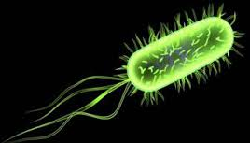
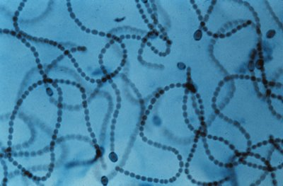
A prokaryotic cells are smaller and simpler
Commonly known as bacteria
0.1-10µm in length
Single-celled(unicellular) or
Filamentous (strings of single cells)
Notes:
filamentous cyanobacteria, those that build chains of cell, utilize a different strategy, that of spatial separation, some cells being involved in nitrogen fixation and others in photosynthesis.

Slide 6
Prokaryotic cells are simply built
They do not have any membrane bound organelles

Slide 7
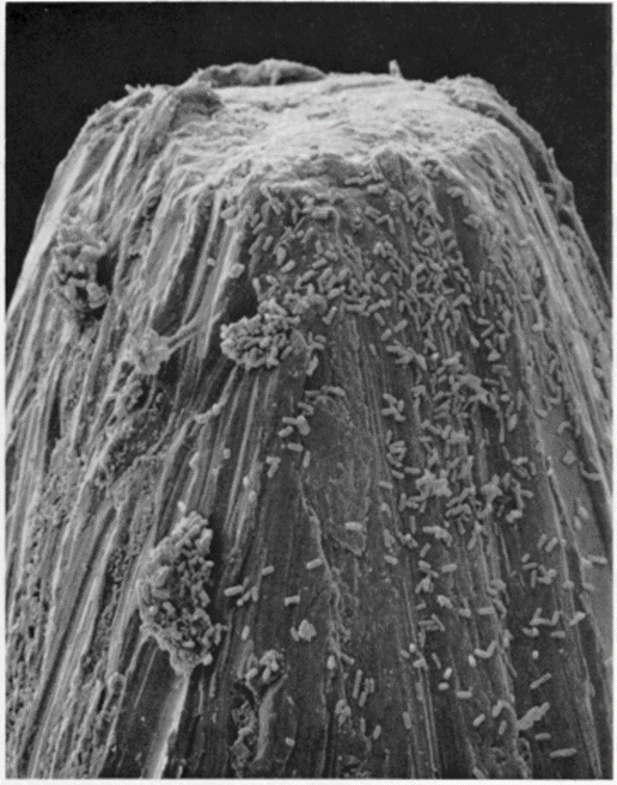
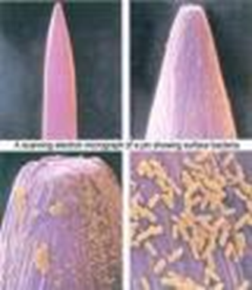
These are prokaryotic bacteria (E.coli) on the head of a steel pin

Slide 8
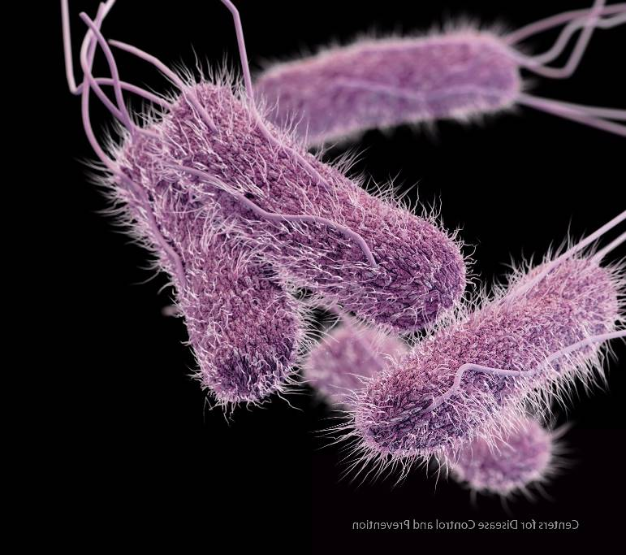
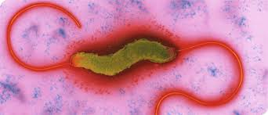
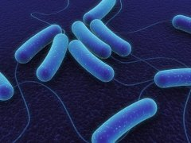
Gut bacteria
Salmonella Campylobacter
E.coli 0157
Notes:
Salmonella typhi and E.coli 015 produce a capsule

Slide 9
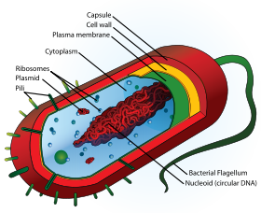
Prokaryotic cells e.g. A bacterium
Rigid cell wall
containing murein – a polysaccharide
Plasmids lie free
in cell, usually confersome benefit e.g. antibiotic resistance
Flagellum if
present lacks
microtubules rotates to move bacterium
70s ribosomes
Circular strand of DNA contains genetic material
http://www.cellsalive.com/cells/bactcell.htm
9

Slide 10
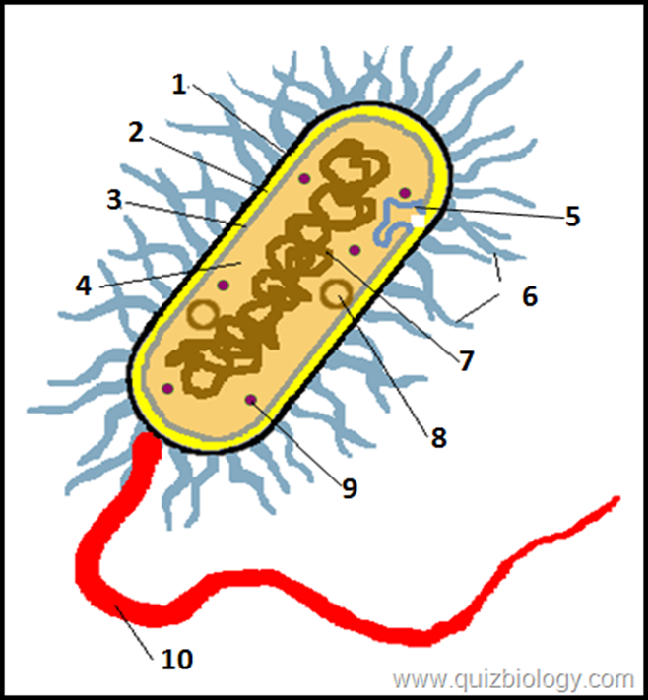
Label diagram in your pack

Slide 11
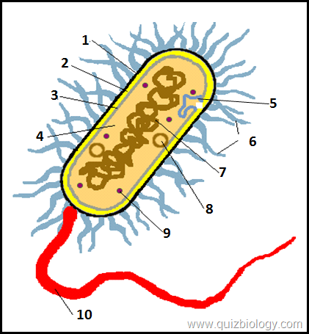
Answers
Capsule
Cell Wall
Cell membrane
Cytoplasm
Mesosome
Pilus
Circular DNA
Plasmid
70s Ribosomes
Flagella

Slide 12
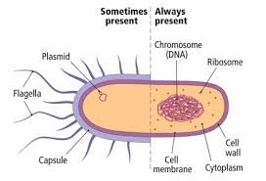
Sometimes vs always present

Slide 13
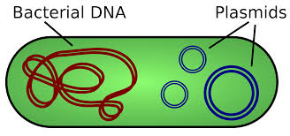
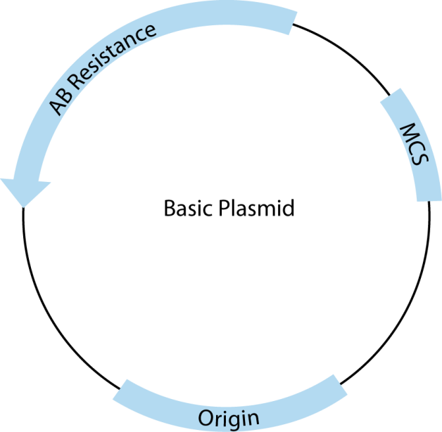
Plasmids
Why are plasmids important?
Possess genes that may aid the survival of bacteria in adverse conditions eg Confer antibiotic resistance
What are antibiotics?
They are a group of medicines that stop or slow down bacterial growth e.g penicillin inhibits cell wall synthesis leading to cell lysis.
How do they break down antibiotics??
The contain a gene that codes for an enzyme/s that break down the antibiotics (known as an antibiotic resistance gene)
Notes:
NB remember to mention that antibiiotics do not affect eukaryotic cells as usually work on cell wall which is not present in host cells.

Slide 14
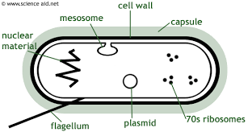
Function of cell wall, capsule, and Large circular DNA
What is the role of the cell wall?
  Physical barrier that excludes certain substances and protects against mechanical damage and osmotic lysis. Supports the cell.
What is the role of the capsule?
  Protects bacterium from other cells, specifically from attack from the cells of the immune system and helps groups of cells to stick together for further protection
Notes:
https://www.youtube.com/watch?v=rNfmew9C508
Biofims 2.min-4.20

Slide 15
Function of cell wall, capsule, and Large circular DNA
What is the role of the large circular DNA?
  Possess the genetic information for the replication of bacterial cells
What is the role of the cell membrane?
  Acts as a differentially permeable layer, which controls entry and exit of chemicals

Slide 16
Activity
In pairs and on your white boards try and write 8 differences between a eukaryotic cell and a prokaryotic cell

Slide 17
Comparison of Eukaryotic and prokaryotic
Prokaryotic cells | Eukaryotic cells
No true nucleus, only an area where DNA is found | Distinct nucleus, with a nuclear membrane
DNA not associated with proteins | DNA associated with proteins called histones
Some DNA may be in the form of circular strands called plasmids | There are no plasmids and DNA is linear
No membrane bound organelles | membrane bound organelles such as mitochondria are present
No chloroplasts, only bacterial chlorophyll associated with the cell surface membrane in some bacteria | Chloroplasts present in plants and algae
Ribosomes are smaller (70s) | Ribosomes are larger 80s
Cell wall made of murein (peptidoglycan) | Where present cell wall made mostly of cellulose or chitin in fungi
May have outer mucilaginous layer called a capsule | No capsule

Slide 18
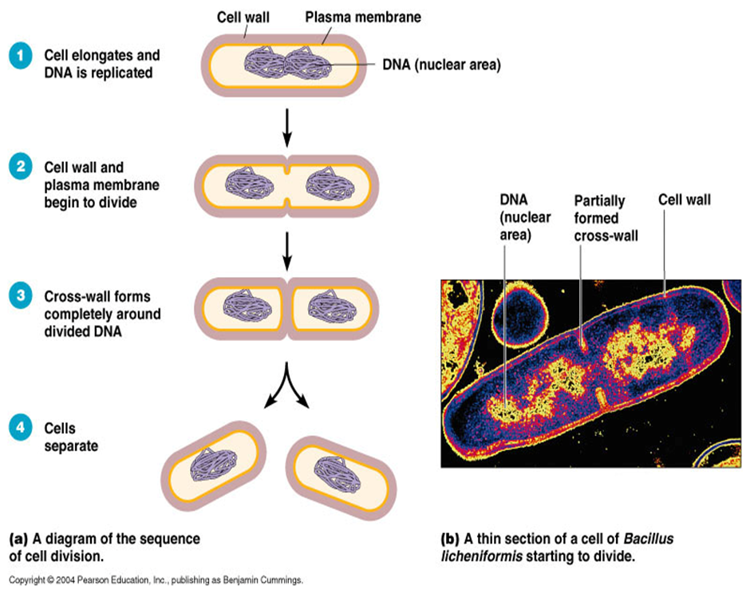
Replication of prokaryotic cells
By a process called Binary fission
Produces identical daughter cells each with a copy of the circular DNA and a variable number of the plasmids
Covered in Mitosis
https://www.youtube.com/watch?v=PkgriMIxwCM

Slide 19
Steps of Binary Fission
1. Parent cell grows to its maximum size.
2.Cell duplicates its chromosome (a process called replication) so that two exact copies of the genetic material exist inside the parent cell. These two molecules of DNA are attached to the cell’s plasma membrane.
3.The cell then grows, increasing the distance between the two duplicated chromosomes that are attached to the plasma membrane.
4.In prokaryotes (bacteria and Archaea), a new cell wall, called a septum, begins to grow across the middle of the cell, bisecting it producing two identical daughter cells
Remember the daughter the cells may have different numbers of plasmids.
https://www.youtube.com/watch?v=j8_xoM8Wwgs

Slide 20
Exam style question
A scientist investigating the cause of an outbreak of food poisoning has found a type of bacterium in a faeces sample that he thinks is causing the illness. A diagram of the bacterium is shown below:
C
A
B
D
Name the features labelled A-D
Suggests why features B and D make ths bacterium well adapted to living in the gut
Describe how genetic material is arranged in the cell

Slide 21
Answers
A=cell wall, B=capsule, C=plasmid, D=flagellum
Feature B-helps prevent attack from host’s immune system, Feature D as allows bacterium to move through the gut
Circular DNA free in cytoplasm, not attached to histones. Small loops of DNA called plasmids which can contain antibiotic resistance genes

Slide 22
Application question
Remember read the question-they usually give you clues to the answer!
Penicillins are a group of antibiotics that are only effective against prokaryotic cells. They work by inhibiting cell wall synthesis, leading to cell lysis (bursting)
Explain why penicillin antibiotics can clear bacterial infections in humans without harming the infected individuals cells
  Bacteria are prokaryotic so penicillin inhibits synthesis of their cell wall causing lysis. Human cells are eukaryotic-no cell wall so penicillin will not affect these cells
  Antibiotics can be used to target other features of prokaryotic cell-give an example and explain why
    Capsule as human cells don’t have it

Slide 23
Viruses-not prokaryotic or eukaryotic
Viruses are a cellular, non-living particles.
They are smaller than prokaryotes (20-300nm). Can only be seen by EM
They contain nucleic acids such as DNA or RNA.
They can only replicate (multiply) inside a host cell.
The nucleic acid is enclosed within a protein coat called a caspid.
Some viruses like HIV or Influenza are surrounded by a lipid envelope derived from the host cell..

Slide 24
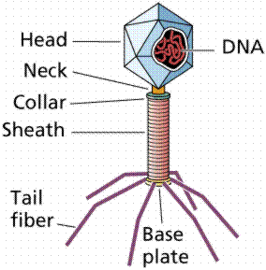
Viruses - Non cells
Why are viruses considered non cells/particles?
  No cytoplasm, no organelles, made up of a core of nucleic acid surrounded by protein coat, the capsid, and in some cases an envelope.
Bacteriophage, a type of virus that attacks bacteria has DNA. Others have RNA.
24

Slide 25
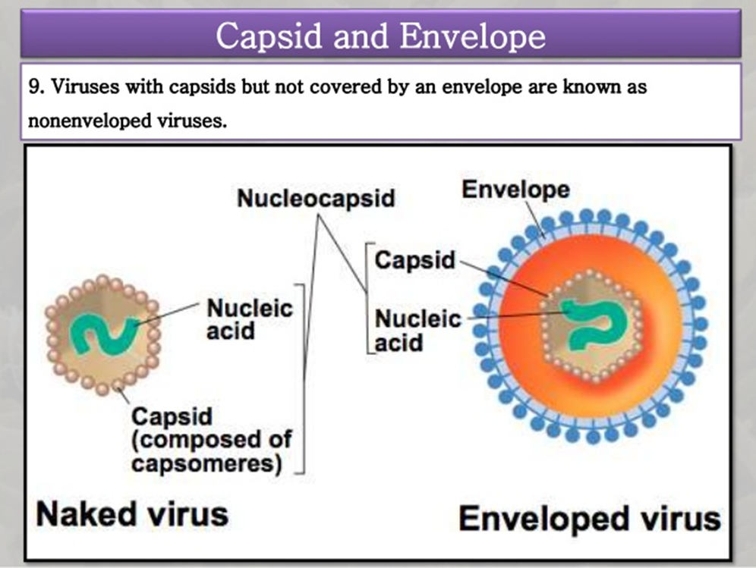
Naked and enveloped viruses
Examples HIV, Influenza, HPV, and
polio

Slide 26
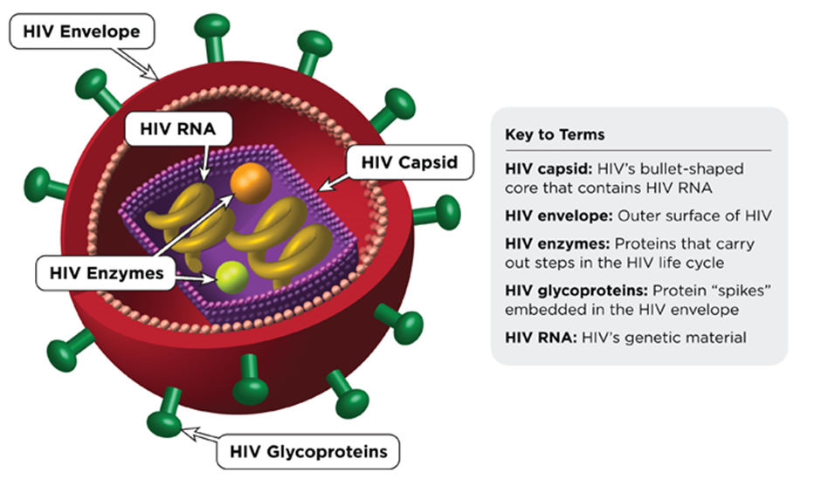
The lipid envelope
The envelopes are derived from portions of the host cell membranes (so is made up of phospholipids and proteins), but it includes some viral glycoproteins, which are essential for attachment to the host cell.
Function : The lipid envelope helps the virus avoid the host’s immune system

Slide 27
https://www.youtube.com/watch?v=Rpj0emEGShQ

Slide 28
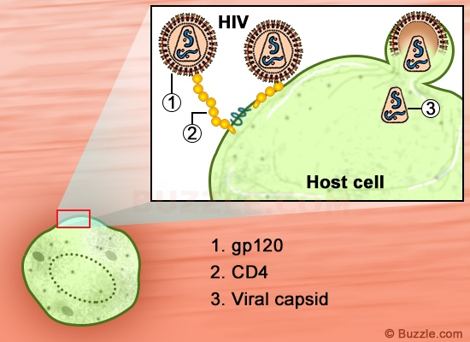
Attachment proteins
Found in the lipid envelope in enveloped viruses or in naked viruses found in the capsid
Glycoproteins
Specific-bind to complimentary host receptors eg HIV glycoprotein binds to CD4 receptor found only in T cells (A type of white blood cell).
Attach virus to host cell
Why are they important? own
NB host receptor proteins have a normal function within the host cell e.g. the CD4 receptor is important in the immune system as it activates T cells to release chemical signals that activate phagocytes
Notes:
Viruses cant replicate on
their own

Slide 29
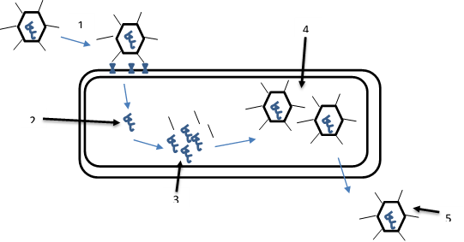
Replication-also covered in 3.7
There are 5 stages in viral replication
Stage 1-Virus attaches to host cell receptor proteins via the attachment glycoproteins found on its surface
Stage 2 -Genetic material is released into host cell and provides instructions for hosts metabolic processes to start producing viral components
Stage 3-Genetic material and proteins are replicated by host cell machinery
Stage 4-Viral components assemble into new viruses
Stage 5-Replicated virus released from host cell

Slide 30
Viral replication -videos
HIV
http://highered.mheducation.com/sites/0072495855/student_view0/chapter24/animation__hiv_replication.html
Bozeman https://www.youtube.com/watch?v=L8oHs7G_syI

Slide 31
Fact recall question
Where is murein used in prokaryotic cells?
  Cell wall
Name and describe the process by which prokaryotic cells reproduce
  Binary fission, large circular DNA replicates once but plasmids can replicate numerous times, large loops go to opposite poles, cytoplasm divides and new wall formed
What is a capsid?
  Protein coat that surrounds genetic material of virus
What is the role of the viral attachment proteins?
  Allow virus to attach to host cell via the complementary receptor proteins

