Slide 1
Methods of studying cells
3.2.1.3

Slide 2
Specification
The principles and limitations of optical micrscopes, transmission electron microscopes and scanning electron microscopes
Measuring the size of an object with an optical microscope
Principles of cell fractionation and ultracentrifugation and how they are used to separate cell components
Knowledge of artifacts

Slide 3
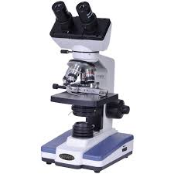
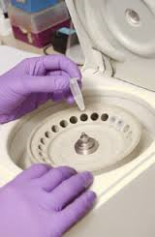
Methods of studying cells
Two methods used to study cells. These are:-
Microscopy
  Used to produce a magnified image
Cell fractionation
  A method to obtain large numbers of organelles which can then be studied

Slide 4
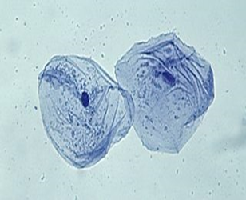
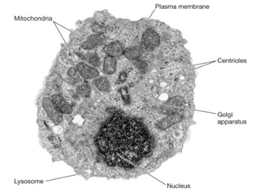
Microscopy
The cell is the basic unit of life.
However with a few exceptions cells are not visible to the naked eye.
Therefore microscopes are used to produce a magnified image.
Two types of microscope are used;
  Light microscope
  Electron microscope
What can you tell immediately about the differences you see in these two images?
Can see organelles in EM image
Light microscope image
Electron microscope image

Slide 5
Units
Unit | Symbol | Equivalent in metres
Kilometre | Km | 10³
Metre | M | 1
Millimetre | Mm | 10⁻³
Micrometre | µm | 10⁻⁶
nanometre | nm | 10⁻⁹
When measuring the real size of organelles we use the Log scale of measurement.
Notes:
Log scale: explain

Slide 6
Size of organelles
You will often be asked to work out the magnification of or size of an organelle from a microscope picture
You should know roughly what the size of each organelle is.
Worksheet

Slide 7
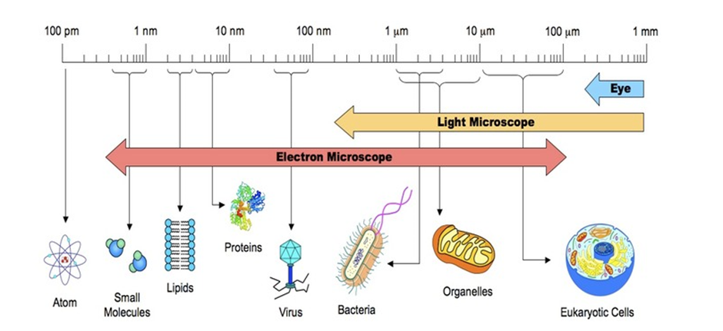
Size of objects

Slide 8
How small is a cell?
Notes:
Teacher notes
Note that the slider uses a logarithmic scale.

Slide 9
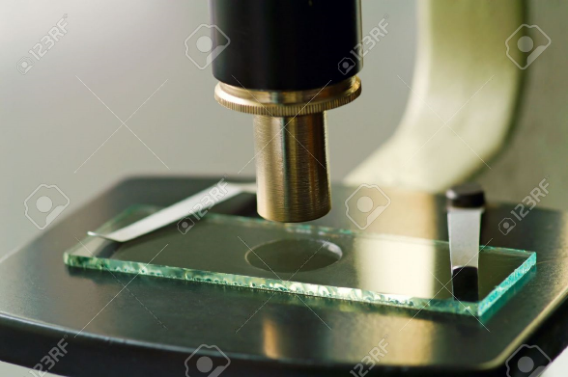
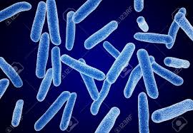
Object and Image
Definition Object: the material put under the microscope
Definition Image: The material viewed under the microscope

Slide 10


Same Magnification but Different Resolutions
Magnification: is the increase in the apparent size of the object-the extent to which it has been enlarged
Resolution: is the ability to distinguish between two points that are close together.
An electron microscope has higher resolution than a light microscope.
Why? The electron beam has a shorter wavelength therefore can resolve objects well

Slide 11
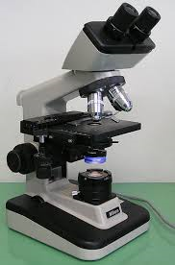
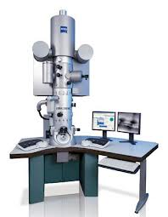
Magnification and resoluton
Light microscope
  Resolution is 200nm and magnification is x 1500
Electron microscope
  resolution is 0.1nm, and magnification is x 150000
However increasing magnification does not always lead to an increase in resolution in fact the image can become more blurred.

Slide 12
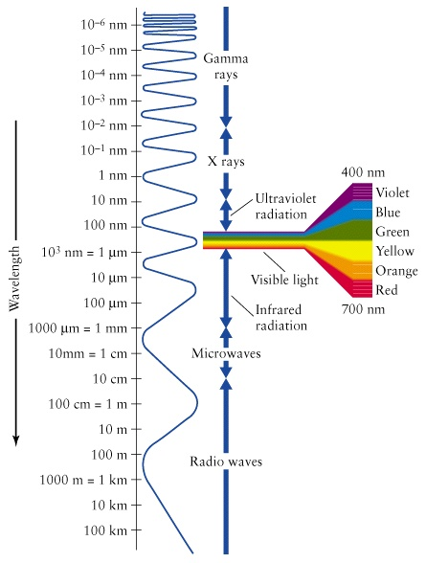
Why does increasing magnification cause blurring of the image?
Any object less than half the wavelength of the microscope illumination source is not visible.
Light microscope has a minimum wavelength 400nm
  Never see an object smaller than 200nm
Electron microscope has a minimum wavelength 1000x shorter (0.008nm)
  Only see an object up to 0.1nm in size
  Why?-Technology
Notes:
X rays emmited by electrons

Slide 13
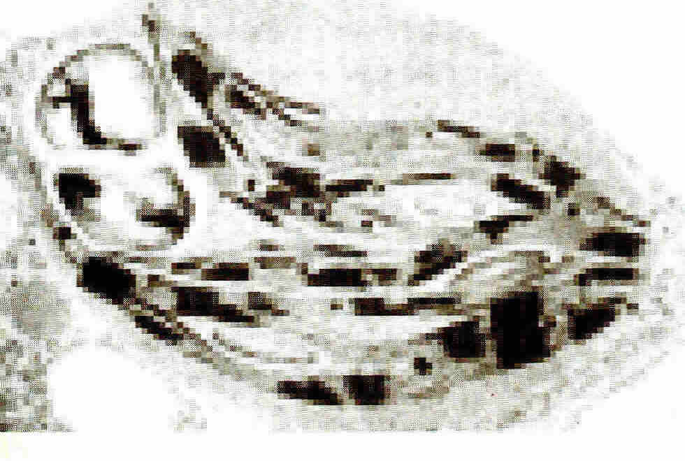
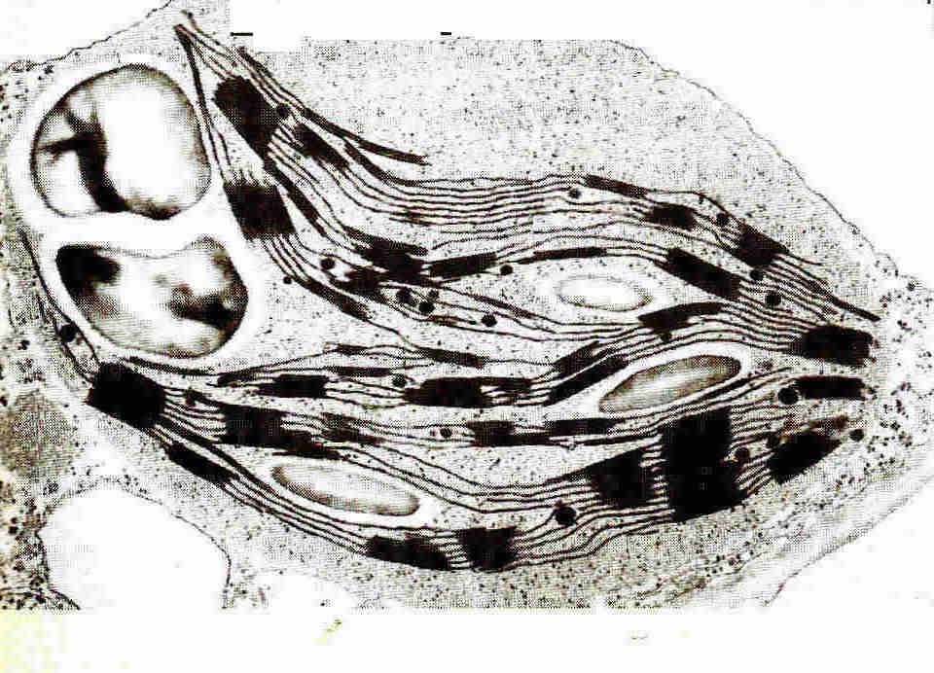
Same Magnification but Different Resolutions

Slide 14
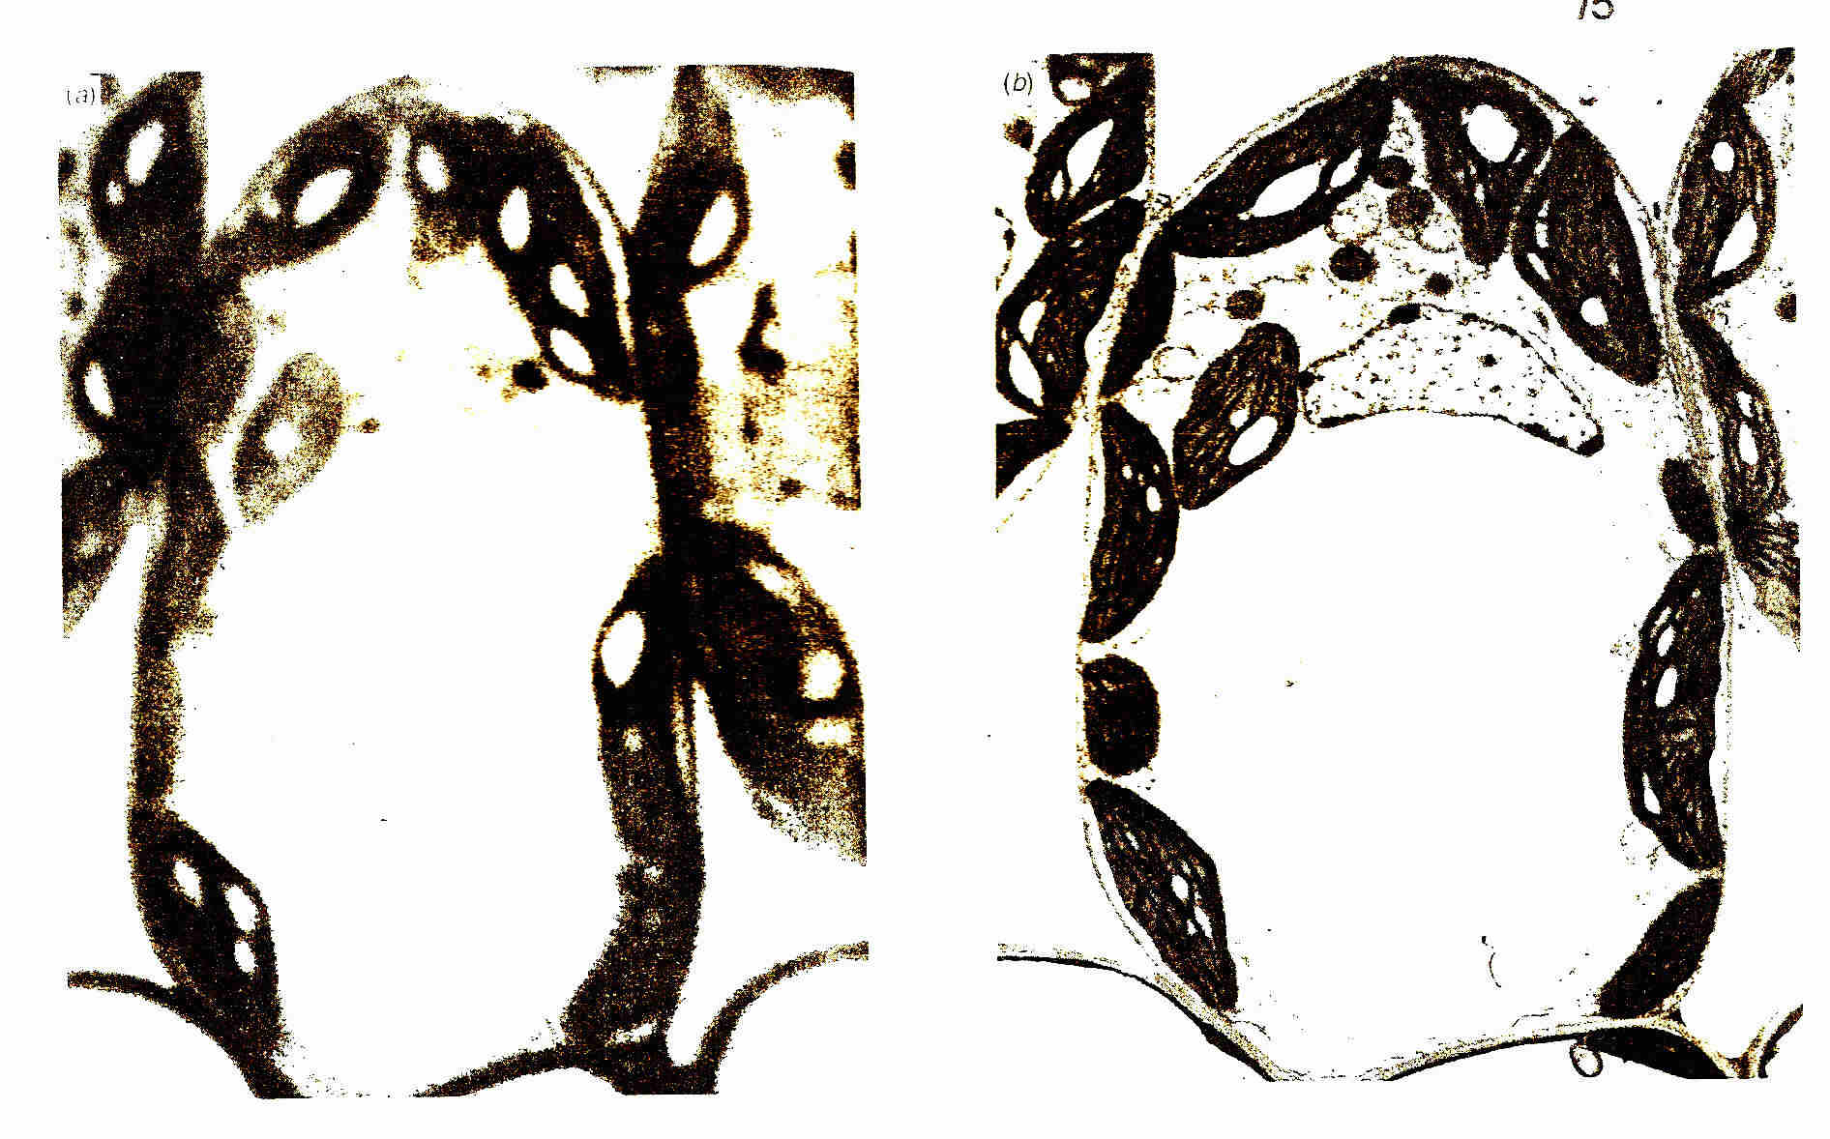
Same Magnification but Different Resolutions

Slide 15
Size of organelles
You will often be asked to work out the magnification of or size of an organelle from a microscope picture
You should know roughly what the size of each organelle is.
Worksheet

Slide 16
Standard form
Standard form: A general term meaning "written down in the way most commonly accepted"
http://www.icoachmath.com/math_dictionary/standard_form.html
In Biology standard form is used for very large numbers or very small numbers
When using standard form the first number always has to be between 1 and 10
67x 10⁴ is not standard form
What would standard form of 67x 10⁴ be?
6.7x 10⁵
In Biology you use standard form, but you can also convert the answer into different units. In these practice questions you will need to convert some measurements using standard form.
Notes:
.i.e. Instead of writing 0.0001m, you would write 1x10⁻⁴ m or instead of 5000km you would write 5x10³

Slide 17
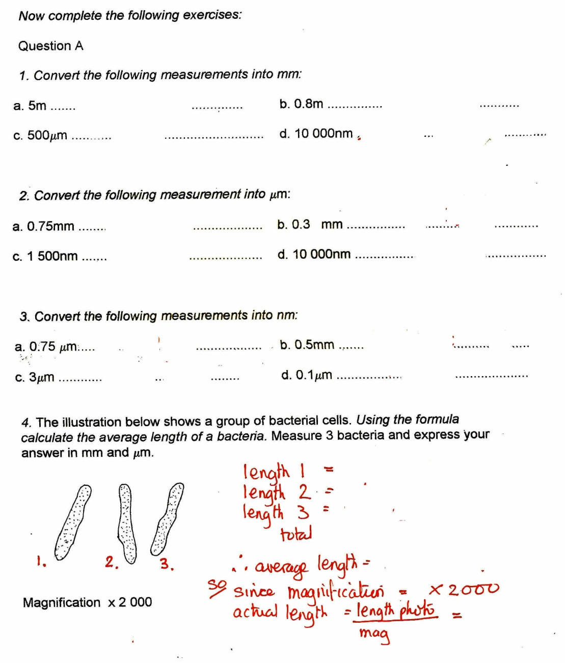
Calculations
Answers under box
1 a) 5 000 mm b) 800 mm,
c) 0.5 mm d) 0.01 mm
2 a) 750 μm b) 300 μm
c) 1.5 μm d) 10 μm
3 a) 750 nm b) 500 000 nm
c) 3 000 nm d) 100 nm

Slide 18
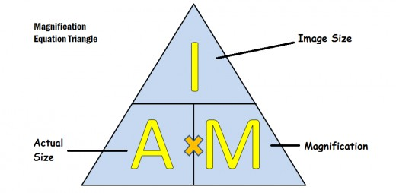
Working out object size and magnification from an image

Slide 19
Calculating the size of organelles
To calculate the real size of an organelle you must:-
measure the photograph of the organelle in mm and x1000 to get um
The measured length must be divided by the magnification of the photograph:
e.g. length of organelle = 44 mm
magnification of photograph = x11, 000
Size of real object =length in mm (log scale) x 1000
magnification of photograph
44mm x 1000 = 0.000004 m = 4µm (convert to standard form) 11, 000

Slide 20
Calculating magnification from an image
measure the actual length of the scale provided in mm
multiply this length by x1000 to convert to µm
Divide this figure by the scale value
e.g.actual length of scale = 16 mm
scale value = 0.1um
magnification = actual length of scale x 1000 (size of image) scale value (real object size)

Slide 21
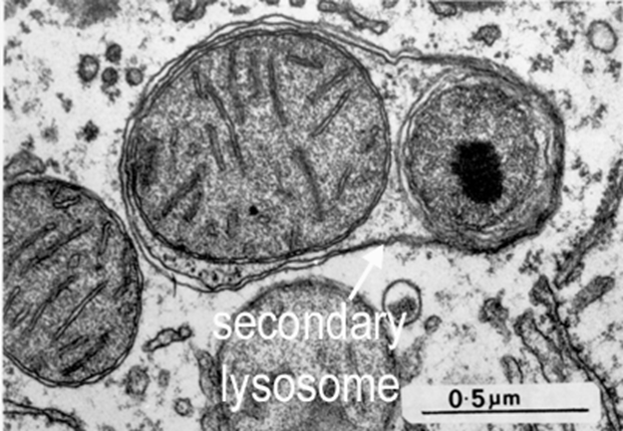
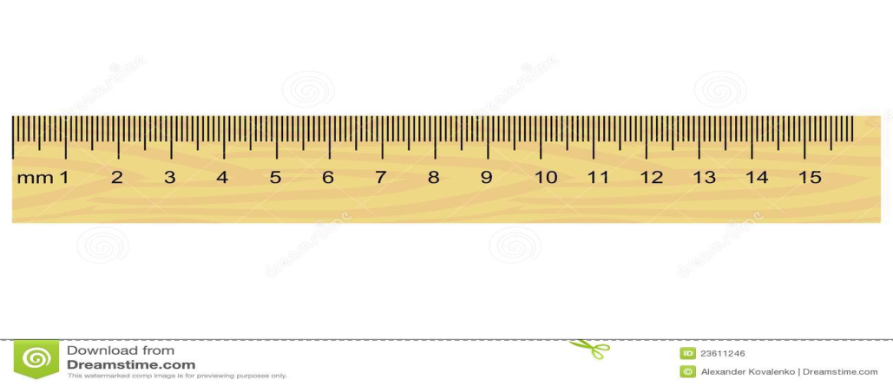
Scale value
Actual length of scale 4cms
What is the magnification?
4x1000/0.5 =x8000

Slide 22
Activity in work booklet
Work out calculations
Answers:
250mm x1000/30,000 = 8.3um
60mmx1000/1000 = 60um
28mmx1000/5000 = 5.6um
10x1000/1 = x10 000
18x1000/5= x3600

Slide 23
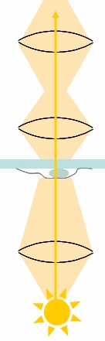
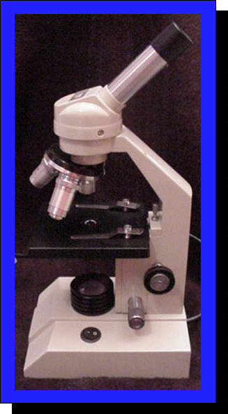
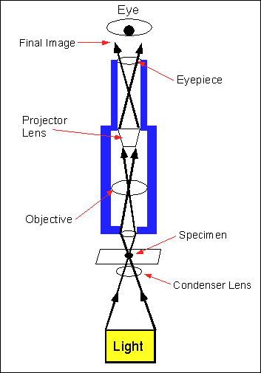
The Light (Optical) Microscope – How does it work?
Eyepiece lens which magnifies and focuses the image from the objective onto the eye
Objective lens which collects light passing through the specimen and produces a magnified image
Condenser lens which focuses light onto the specimen
Also known as a compound microscope
2 lenses are combined to give greater magnification
Eg Eyepiece x10, Objective x 5 = Magnification x500
Some optical microscopes provide Magnification up to x1500

Slide 24
How to Work Out the Magnification You are Using With a Light Microscope
The magnification of the specimen under the microscope is the value of the objective lens’s magnification multiplied by the value of the eyepiece lens’s magnification.
Put a title: Working Out the Magnification of the Microscope Image then copy and complete the following table:
Eyepiece Lens | Objective Lens | Magnification
X 10 | X 4
 | X 4 | X 20
X 10 | X 10
X 10 |  | X 400

Slide 25
Answers
Eyepiece Lens | Objective Lens | Magnification
X 10 | X 4 | X 40
X 5 | X 4 | X 20
X 10 | X 10 | X 100
X 10 | X 40 | X 400

Slide 26
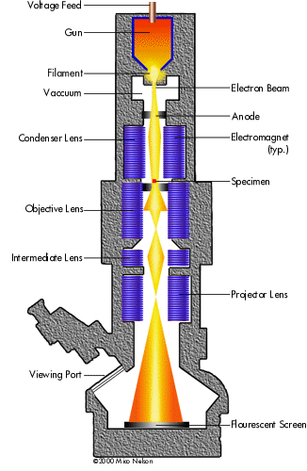
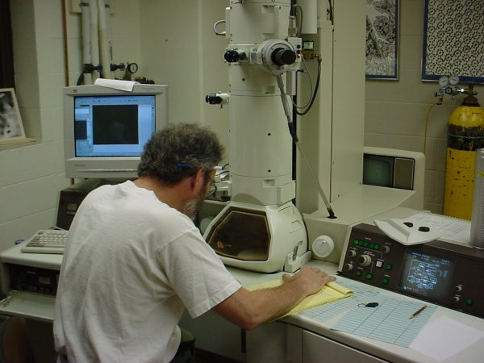
Electron microscopy
Uses a beam of electrons to give a resolution of 1nm
Electrons have a charge
Uses electromagnets to focus beam
Needs a vacuum as electrons are absorbed or deflected by molecules in the air
Magnification of up to 500 000 times
Many biological molecules are larger than 1nm so can be seen by EM
Invented in 1930’s and changed face of biology
Two types….TRANSMISSION and SCANNING.
https://www.youtube.com/watch?v=fToTFjwUc5M

Slide 27
Preparation of specimens
Biological samples can’t be viewed on electron microscopes whilst alive.
Instead, the samples must undergo complex preparation steps to help them withstand the environment inside the microscope.
The preparation process kills the tissue
There are two reasons why living things can’t survive in an electron microscope:
  The power of the electron beam that’s directed at the sample. (High energy can reach 150ºC-too hot for specimen to survive)
  The vacuum inside the microscope (electrons would be deflected by air).
Notes:
The electron beam inside a transmission electron microscope (TEM) causes problems for biological samples because of its high energy. It needs to have enough energy to pass right through the sample and out the other side. The temperature can get up to 150°C where the beam hits the sample. This temperature is far too high for living cells to survive. Scanning electron microscopes (SEMs) use a lower-energy electron beam, but it can still be damaging to the sample.
The vacuum inside an electron microscope is important for its function. Without a vacuum, electrons being aimed at the sample would be deflected (knocked off course) when they hit air particles. But liquid water, which is abundant in biological samples, evaporates immediately in a vacuum. If this happened, a biological sample would vaporise in front of your eyes!
To be visualised by an electron microscope, biological samples need to be:
fixed (stabilised) so the electron beam doesn’t destroy them
dried thoroughly so the vacuum doesn’t affect them.

Slide 28
Sample preparation
To be visualised by an electron microscope, biological samples need to be:
  Fixed (stabilised) so the electron beam doesn’t destroy them
  Dried thoroughly so the vacuum doesn’t affect them (water vaporises in a vacuum-most biological samples high percentage of water).

Slide 29
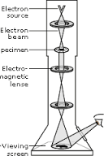
Transmission Electron microscope
Beam of electrons is produced by an electron gun
The beam of electrons is focused onto the specimen by a condenser electro magnet
The beam passes through the specimen.
Parts of the specimen absorb electrons and appear dark
Other parts allow electrons to pass through and so appear bright
An image is produced on a screen and a photograph can be taken which is called a photomicrograph

Slide 30
TEM
Resolving power is 0.1nm but this is not achieved because:-
  Difficulties preparing the specimen,
  A higher electron beam is required that could destroy the specimen
What are the main limitations of TEM?
P43-45 AQA Biology AS-please complete in your booklet

Slide 31
Limitations of TEM
The whole system must be in a vacuum –living specimens can not be observed
Complex staining process-images not in colour
Specimens thin
Image may contain artefacts

Slide 32
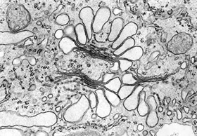
TEM
Specimens are very thin to allow electrons to penetrate
2D flat image
Can build a 3D image by taking a series of sections through a specimen
Complicated and slow

Slide 33
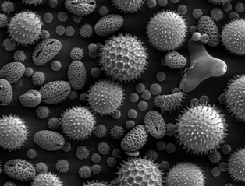
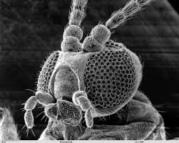
Scanning electron microscope (SEM)
Specimens not thin as electrons do not penetrate specimen
Directs beam electrons onto the surface of the specimen from above
The electrons are scattered by the specimen
Build up a 3D image
Lower resolving power (20nm) than TEM but its still better than light microscope

Slide 34
Disadvantages and advantages of TEM vs SEM
 | TEM | SEM
Advantages
Disadvantages

Slide 35
Disadvantages and advantages of TEM vs SEM
 | TEM | SEM
Advantages | gives high resolution images, so shows small objects | Can be used on thick specimens. Can be 3D
Disadvantages | Can only be used on thin specimens, can only be used on non living specimens | Give lower resolution images than TEMs. Can only be used on non living specimens

Slide 36
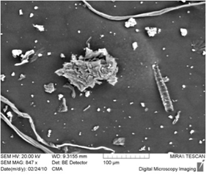
Artifacts
An artifact is something that can be seen that isn’t part of the specimen.
Can be dust, air bubbles, fingerprints or inaccuracies when preparing the sample
Usually made during preparation of the sample
Common in electron micrographs because specimens need a lot of preparation
Scientists overcame this problem by repeatedly preparing specimens in different ways
Notes:
Repeated in different ways so that if only seen in one prepartion and not another it was an artifact and not an organelle

Slide 37
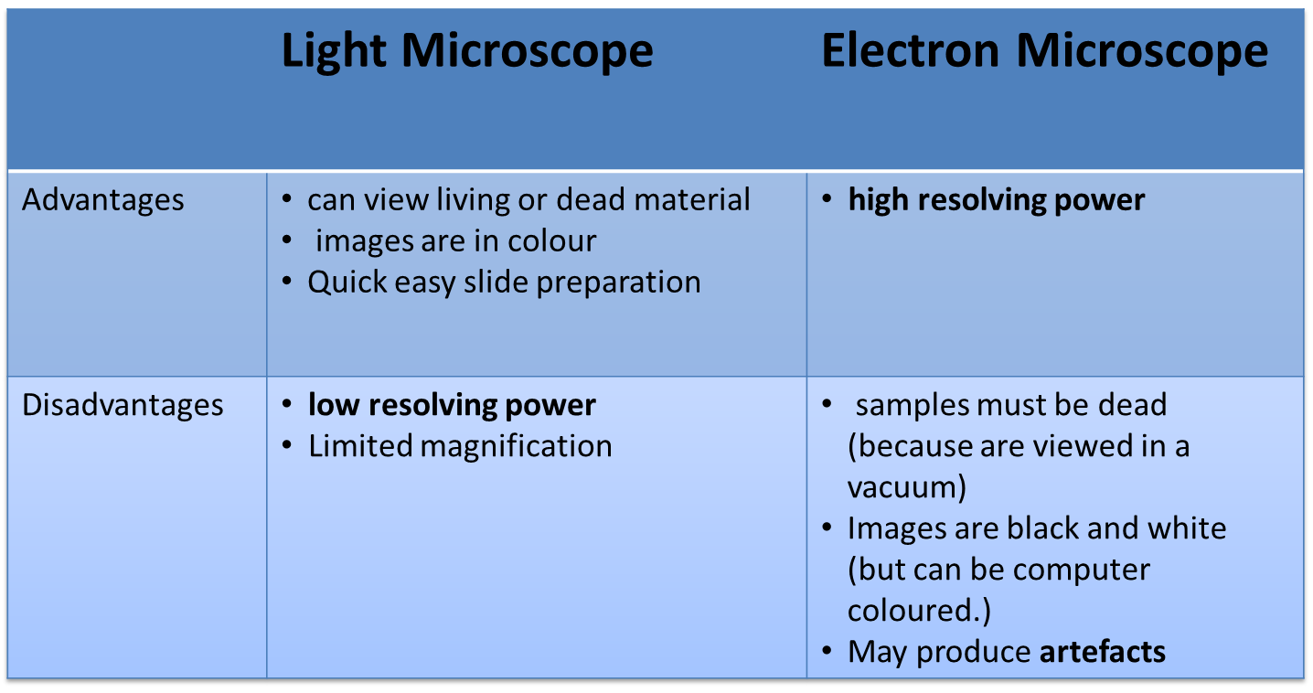
Advantages and Disadvantages of light and electron microscopes

Slide 38
Interactive website
http://sciencelearn.org.nz/Contexts/Exploring-with-Microscopes/Sci-Media/Interactives/Which-microscope
Excellent site

Slide 39
Cell fractionation
Process where cells are broken up and the different organelles they contain are separated out.
Used to help us study cell structure and function
Necessary because you need large numbers of organelles
Two stage process:
  Homogenisation
  Ultracentrifugation
    http://www.sumanasinc.com/webcontent/animations/content/cellfractionation.html

Slide 40
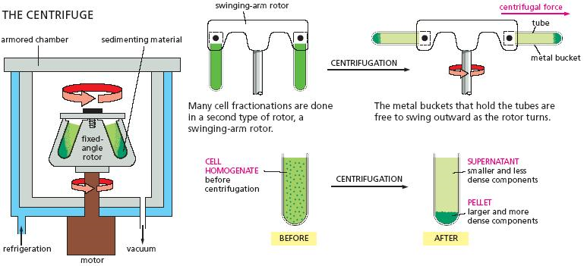
What is centrifugation?
Should remember from Topic 3.1.5.2 (DNA replication)?
The force is called a relative centrifugal force (RCF), expressed as a multiple of the force of Earth's gravitational force (x g). For example, an RCF of 1000 x g is a force 1000 times greater than Earth's gravitational force. When a particle is subjected to centrifugal force, it will migrate away from the axis of rotation at a rate dependent on the particle's size and density.
Notes:
In centrifugation, the lysate is rotated at a certain speed (expressed as rotations per minute (RPM)). This rotation imposes a force on the particles perpendicular to the axis of rotation. The force is called a relative centrifugal force (RCF), expressed as a multiple of the force of Earth's gravitational force (x g). For example, an RCF of 1000 x g is a force 1000 times greater than Earth's gravitational force. When a particle is subjected to centrifugal force, it will migrate away from the axis of rotation at a rate dependent on the particle's size and density.

Slide 41
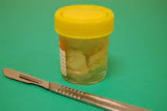
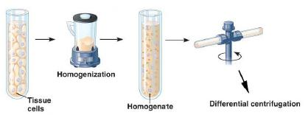
Method
First step is to cut the tissue in ice-cold isotonic buffer
Why?
Cold-reduces enzyme activity that might break down the organelles
Isotonic-to prevent organelles bursting or shrinking due to osmotic gain or loss
Buffer-to maintain constant pH
The next step is Homogenisation which breaks open the cells to release the organelles. Grind tissue in a blender to break open cells.
Tissue in cold isotonic solution
Homogenate is filtered to remove any complete cells and large pieces of debris
Notes:
(cold to stop enzyme reactions, isotonic to stop osmosis, buffer to stop pH changes DO N OT refer to cells bursting or shrinking-common error!!!!

Slide 42
Ultracentrifugation
Tissue to be studied is cut into small pieces (minced) and placed into a COLD ISOTONIC BUFFERED solution
These are then ground into smaller pieces using a Homogenizer
The homogenate is filtered to remove any complete cells and large debris ie cell wall/membrane
A suspension of homogenate is placed in a test tube and then centrifuged-The faster the speed at which the tube is spun, the greater the force generated
At slow speeds large fragments collect at the bottom of the tube and smaller ones remain near the top in a liquid called the SUPERNATANT
These larger fragments (SEDIMENT PELLETS) are then removed and the supernatant remaining is re-spun at a faster speed 9more force) and some of the smaller fragments collect at the bottom forming a new pellet
By continuing in this way smaller and smaller fragments will be recovered

Slide 43
Demonstration
Centrifugation of bitty orange juice
See pellet and supernatant

Slide 44
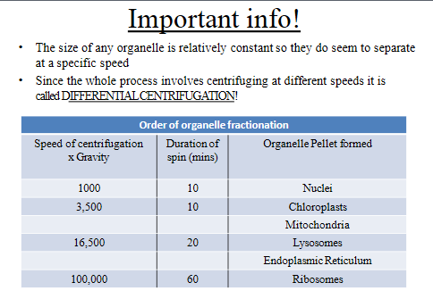

Slide 45
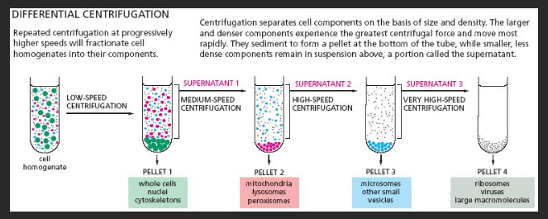
Differential centrifugation
In differential centrifugation, each centrifugation step results in the production of a pellet, usually containing a mixture of cellular components of the same size and/or density. The fluid resting above the pellet, the supernatant, can be removed and subjected to additional centrifugations to generate pellets containing other cellular components of lesser size and / or density.

Slide 46
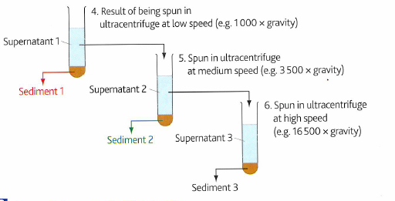
Question
Using the table below which organelle/organelles would be most likely to be found in
Sediment 1
Sediment 3
Supernatant 1
Supernatant 3
Organelle | Speed of centrifugation (g) | Duration of centrifugation (min)
Nuclei | 1000 | 10
Mitochondria | 3500 | 10
Lysosomes | 16500 | 20
Ribosomes | 100000 | 60

Slide 47
Answers
Sediment 1 : nuclei
Sediment 3 : lysosomes
Supernatant 1 :mitochondria, lysosomes and ribosomes
Supernatant 3 :ribosomes

Slide 48
Videos
https://www.youtube.com/watch?v=SCNEfR85aYk
https://www.youtube.com/watch?v=SjaFUJhzY9Q
http://www.accessexcellence.org/RC/VL/GG/cellBreak1.php (work sheets-revision)
http://homepages.gac.edu/~cellab/chpts/chpt8/ex8-1.html (Spinach practical)

