Slide 1
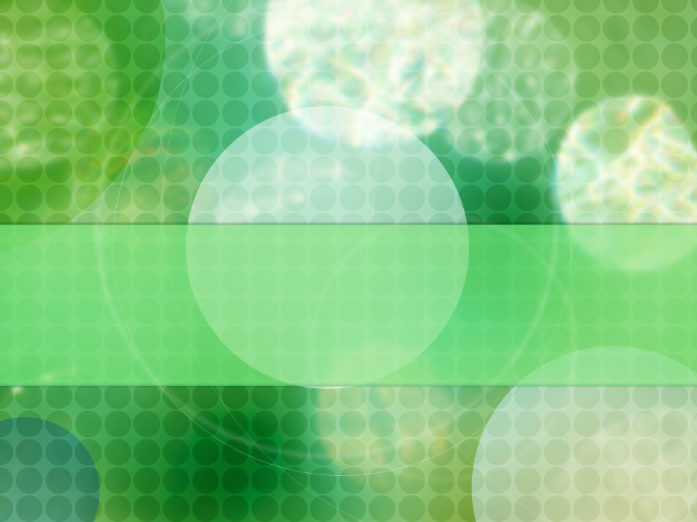
All cells arise from other cells
Unit 3.2.2

Slide 2

Specification content:
Within multicellular organisms, not all cells retain the ability to divide
Eukaryotic cells that do retain the ability to divide show a cell cycle
  DNA replication occurs during interphase
  Mitosis is the part of the cell cycle to produce two identical daughter cells
You need to know the role of chromosomes and spindle fibres during interphase, prophase, metaphase, anaphase and telophase
Cytokinesis produces two new cells
Students need to be able to recognise the stages of the cell cycle and explain the appearance in each stage
Uncontrolled cell division leads to cancer. Many cancer treatments are directed at controlling the rate of cell division
Binary fission in prokaryotes
Replication of viruses in a host cell
Required Practical Activity: Prepare and/or observe slides of root tip for mitosis and calculate mitotic index.

Slide 3
GCSE Recall
In body cells the chromosomes are normally found in pairs
Body cells divide by mitosis producing genetically identical body cells
Mitosis occurs during growth or to produce replacement cells

Slide 4
Mitosis
Bozeman Introduction
https://www.youtube.com/watch?v=1cVZBV9tD-A

Slide 5
Lessons 1 & 2 - Understanding the Cell Cycle and the Importance of Replicating DNA
At the end of this section you will be able to:
Explain what is meant by the cell cycle.
Explain when in the cycle DNA is replicated (copied) so there is a genetic copy for new cells.
Explain what is meant by Mitosis, Cytokinesis and Interphase.
Describe and draw the structure of a chromosome
Understand the terms: homologous pairs, alleles, diploid, haploid, centromere, chromatids and sister chromatids.
State the 4 stages of mitosis.

Slide 6
Structure of Chromosomes

Slide 7
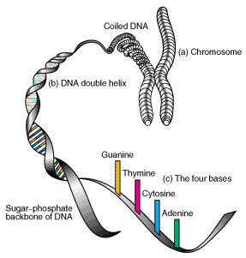
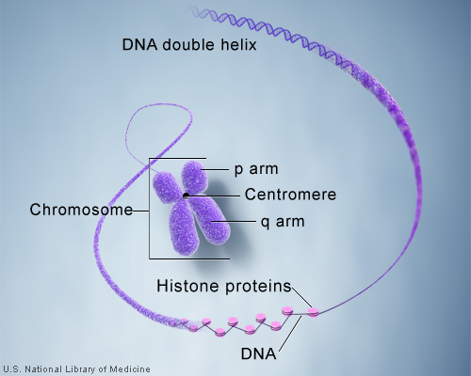
Chromosomes only occur in Eukaryotic cells
Composed of long strands of DNA tightly coiled many times around proteins called histones that support its structure and a small amount of RNA
The DNA is in the form of a double helix running up the center of the chromosome
Before division (in interphase) the DNA is partly uncoiled and appears as thin tangled threads. Individual chromosomes can not be seen. Described as chromatin

Slide 8
Chromosomes continued
After replication, but before cell division the chromosomes can be seen as double structures, attached by the CENTROMERE
The 2 strands are called Sister Chromatids
When the individual chromosomes can be seen like this, the thread of DNA and histones is highly folded and compacted ie CONDENSED, so can be resolved with a light microscope.
During Interphase the chromosomes become long and thin as they unfold again and cannot be seen individually.
When not distinguishable as individual chromosomes nuclear genetic material is termed CHROMATIN
Chromosomes can differ in length from 0.25μm to 50μm
centromere
chromatid
Chromosome
chromatid

Slide 9
Chromosomes and Chromatids Visually
One chromosome before replication
It is one long double helix of DNA
One chromosome after replication
It is two long double helices of DNA joined by the centromere. Each DNA helix is a chromatid
Note: the ‘Ladder’ shows a yellow half and a green half! The chromosomes REPLICATE by SEMI CONSERVATIVE replication which means that each strand of the double helix is copied and the two new chromosomes are made up of one old strand and one new strand.

Slide 10
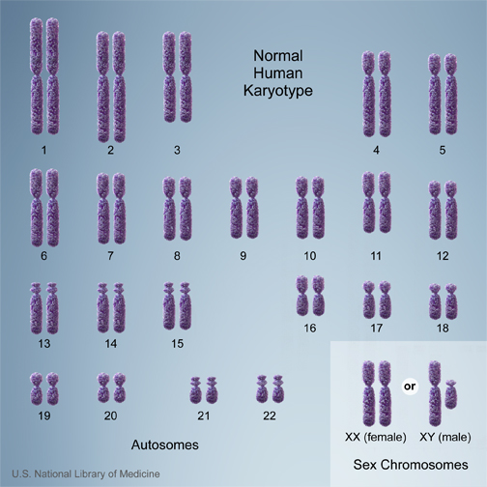
Chromosome Number in Humans
23 pairs of homologous chromosomes, each pair: one maternal, one paternal
n=23 (the haploid number)
2n = 46 (the diploid number)
23 chromosomes found in gametes, haploid number.
Human Karyotype Photo – the total chromosome complement in a typical body cell of a eukaryote

Slide 11
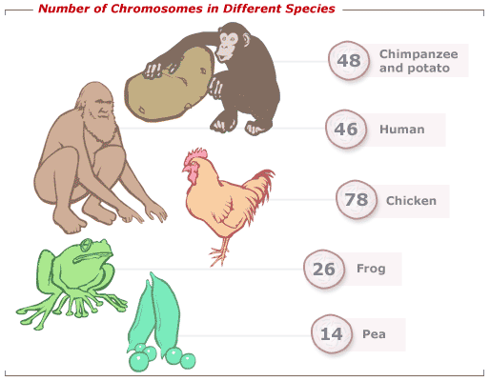
Chromosome Number
The total number of chromosomes in the cells of different species varies - known as the diploid number
Sex cells or gametes have half the diploid number - the haploid number

Slide 12
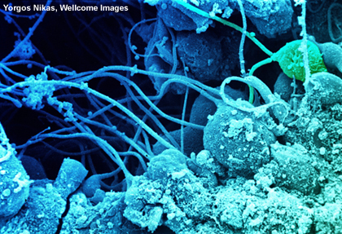

Mitosis and meisis
All cells are formed by division of existing cells. Eukaryotic cells always divide in one of two ways:
Mitosis: division into two daughter cells that are genetically identical to each other and to the parent cell.
Meiosis: division into four unique daughter cells with half the chromosomes of the parent cell. Genetically different. Produces the sex cells
All cells follow the same sequence of events between mitotic divisions, and this is known as the cell cycle.
Notes:
Photo credit: Yorgos Nikas, Wellcome Images
Sperm develop in the seminiferous tubules of the testis. The spermatids are embedded in the Sertoli cells with their tails projecting into the lumen of the tubule. These spermatids are in the advanced stages of maturation. One of the spermatids has two tails (top right, green).

Slide 13
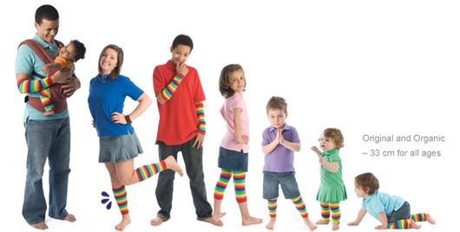
Mitosis
Produces two genetically identical daughter cells to themselves and to their parent cell.
Why is it important?
  Need new cells to repair damaged tissue
  Growth
  Asexual Reproduction

Slide 14
Significance of Mitosis
1.Genetic stability
  Mitosis produces cells that are genetically identical to the parent cell.
2.Growth
3 Repair
4. A sexual reproduction
  produce identical offspring that are ideally suited to a particular environment and so exploit favourable conditions.
Mitosis ensures that each new cell produced for growth
or cell replacement has an exact copy of the genes.

Slide 15
Disadvantage and advantages of identical offspring
Suggest and advantage and disadvantage of having offspring that are genetically identical to their parents
Advantages : All adapted to a stable environment, rapid
Disadvantages : Less able to adapt to environmental change, vulnerable to disease

Slide 16
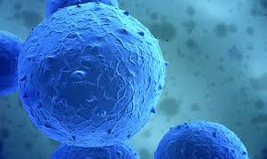
The Cell cycle
Only some cells in multicellular organisms retain the ability to divide continuously
  Does anyone know any examples?
  Ans: Stem Cells
Most cells once differentiated can not divide any more.
The ones that do have the ability to continuously divide follow a process called the cell cycle.

Slide 17
The Cell Cycle – General Information
The cell cycle involves not only mitosis when the nucleus of a cell undergoes division but also Interphase and Cytokinesis.
The cell cycle is split into three phases
Mitosis = division of the nucleus
Cytokinesis = division of the
cytoplasm ie when whole cell divides.
Interphase = time when cell is not
dividing but is doing other important things like replicating
it’s DNA.
Nuclear division and cytoplasmic division are
not distinctly separated
in animal cells, so are often lumped together under the general term mitosis

Slide 18

The cell cycle

Slide 19
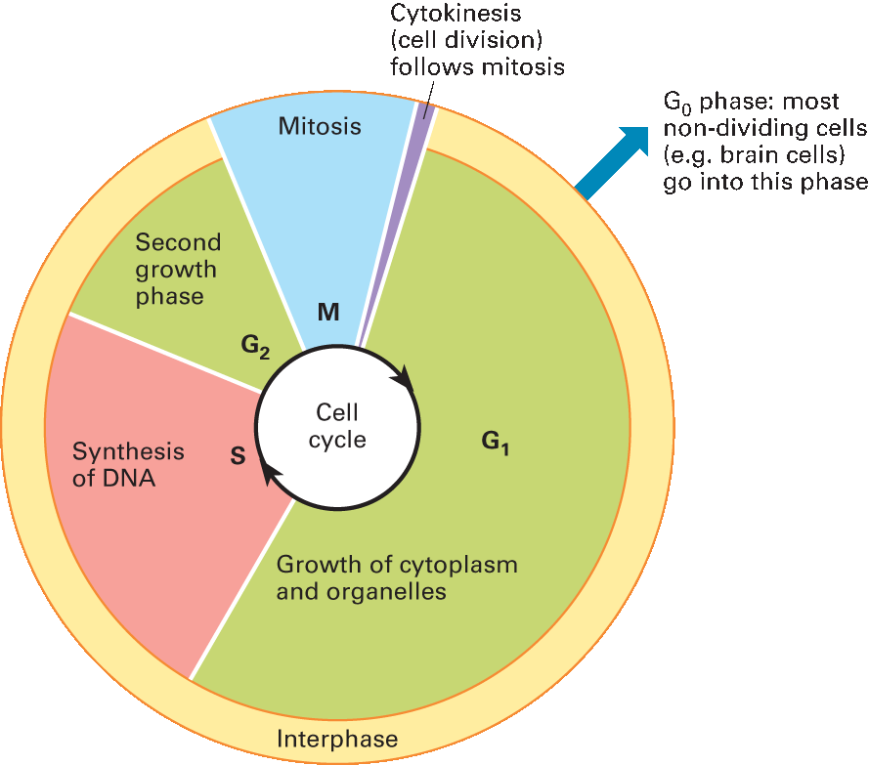
Cell Cycle
The cell cycle is the sequence of events which takes place in a cell between its formation and the time when it has divided, producing daughter cells.

Slide 20
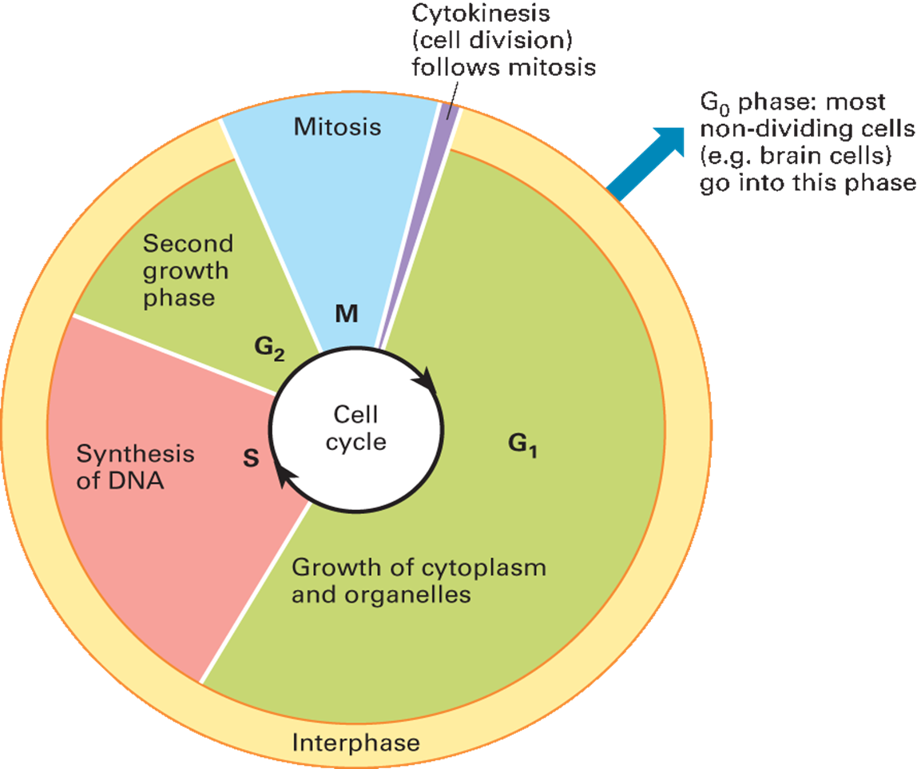
Interphase (Cell growth)
Occupies most of the cell cycle
Often called resting phase because no division takes place, however a lot of activity occurs in interphase
Subdivided into three separate growth phases Gap 1, Gap 2 and Synthesis phase

Slide 21
Processes That take Place During Interphase
Interphase is a very metabolically active period in a cell’s life. Processes that take place include:
Synthesis of DNA – amount of DNA is doubled as the chromosomes replicate and become two chromatids joined together at the centromere.
Synthesis of ATP – much metabolic activity occurs so ATP must be synthesised. (Much respiration occurs).
Synthesis of protein – for cell growth and also the proteins needed for mitosis itself such as those which will later make the spindle.
Replication of organelles – eg replication of mitochondria

Slide 22
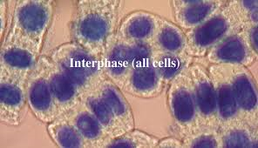
Interphase-sub dived into three separate growth phases
Gap 1 phase (G1)-cell grows and new organelles and proteins are made
Synthesis phase (S)-DNA replicates
Gap 2 phase (G2)-cell keeps growing and proteins needed for cell division are made

Slide 23
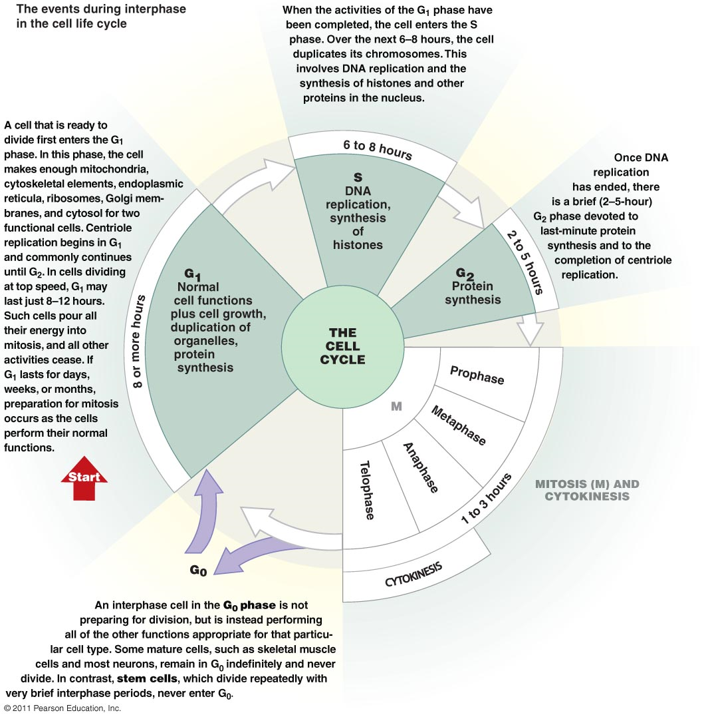

Slide 24
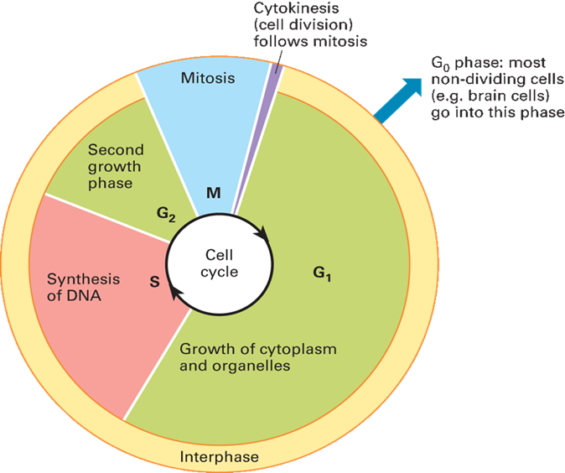
Mitosis
This is when the division of the nucleus occurs
Split into 4 phases
  Prophase
  Metaphase
  Anaphase
  Telophase

Slide 25
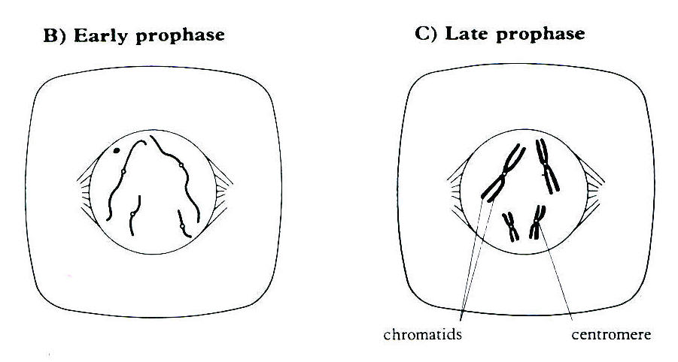
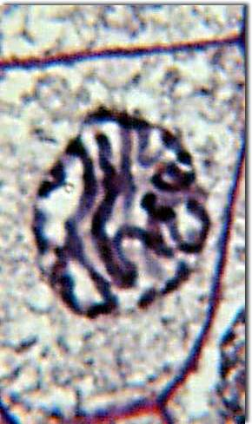
Prophase(prominent DNA)
Chromosomes condense (shorter and fatter) and become visible as pairs of chromatids joined at the centromere
Centrioles (present in animal cells) divide and migrate to opposite poles
Spindle fibres form from each centriole
Towards the end of prophase the nuclear membrane disintegrates and the nucleolus disappears
Pairs of chromatids can be seen clearly lying free in the cytoplasm
Plant cells lack centrioles but do develop spindle fibres therefore centrioles not essential for spindle fibre formation

Slide 26
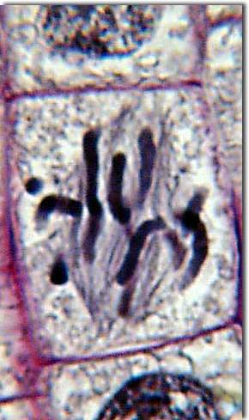
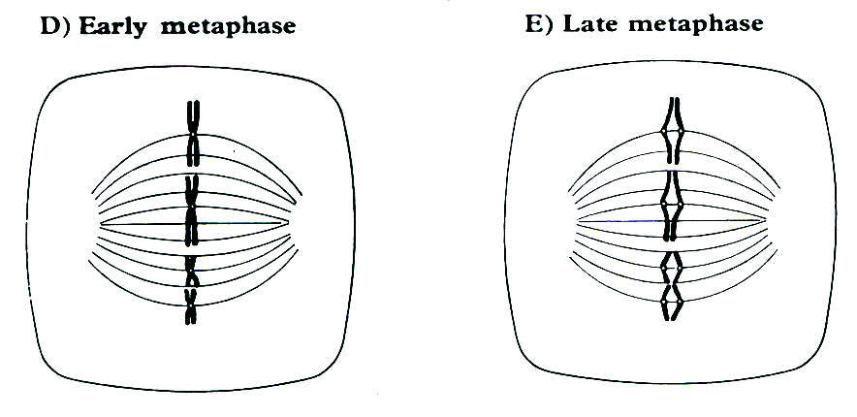
Metaphase
Metaphase –
The nuclear membrane has disappeared.
Chromosomes (consisting of sister Chromatids) line up on the EQUATOR (centre of cell at middle of spindle)
Spindle fibres attach to centromeres holding the pairs of sister chromatids together

Slide 27
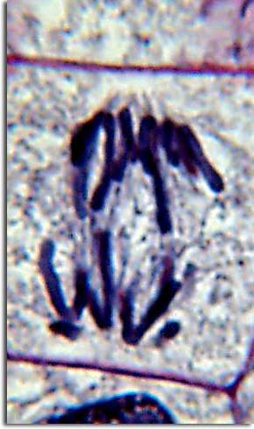
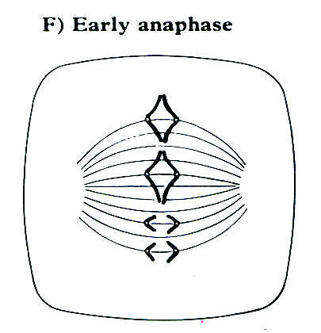
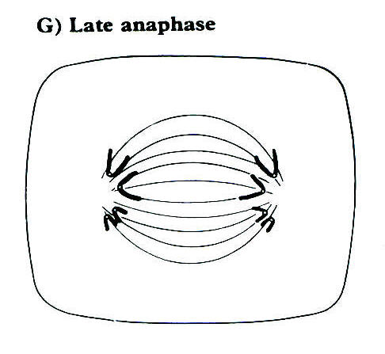
Anaphase
Anaphase –
The centromeres divide separating the sister chromatids
The spindle fibres contract pulling the sister chromatids apart to opposite poles.
Centromere moves first making the chromatids appear v-shaped

Slide 28
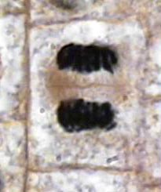
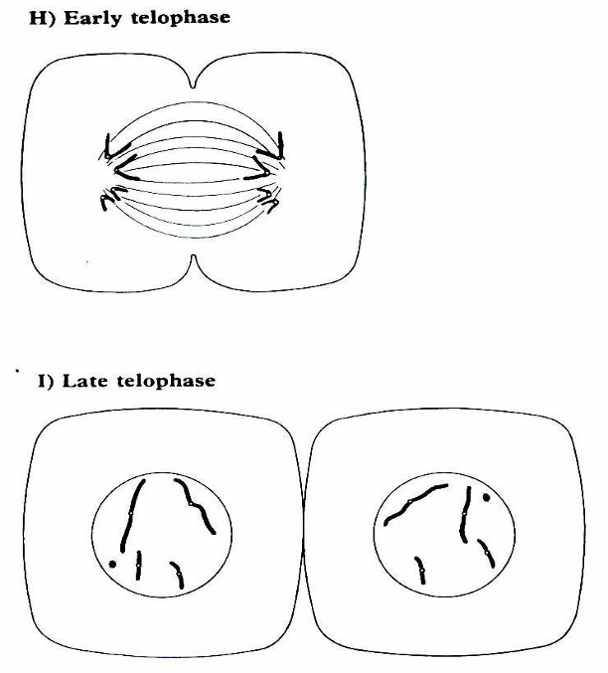
Telophase
Telophase
The chromatids have arrived at the poles and are now called chromosomes.
They become long and thin once more
A nuclear envelope reforms around each set.

Slide 29
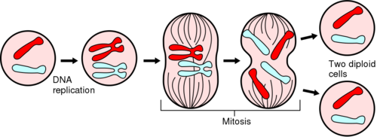
MITOSIS
use this animation to help you remember the stages
http://www.stolaf.edu/people/giannini/flashanimat/celldivision/crome3.swf

Slide 30
Anagram
I Interphase
Peed Prophase
Myself Metaphase
At Anaphase
Tesco’s Telophase
https://www.youtube.com/watch?v=AhgRhXl7w_g&list=PL781BA4A592A93165&index=2

Slide 31

Cytokinesis
The third phase in the cell cycle
It is the physical process of cell division
Parental cell cytoplasm divides
Production of two daughter cells
Extension : http://highered.mheducation.com/sites/9834092339/student_view0/chapter10/animation_-_cytokinesis.html

Slide 32
Cytokinesis – Division of the Cell into Two
Cytokinesis in Animal Cells
Cytokinesis may begin before mitosis is complete
Protein filaments (microfilaments) attach to the inside of the membrane around the centre region.
They pull the membrane inwards.
The cell cleaves into
two daughter cells
Microfilaments pull in cell surface membrane drawing it inwards
Nucleus in telophase, chromosomes now unwinding

Slide 33
Cytokinesis – Division of the Cell into Two
Cytokinesis in Plant
Cells
Golgi vesicles carrying
materials to make a
Cell wall accumulate in
the centre region of the
cell.
The Golgi vesicles fuse
and form a CELL PLATE.
Inside the vesicles a
middle lamella forms with
cellulose either side of it.
Two new separate cells
are formed
Cellulose cell wall
Golgi vesicle
Remaining spindle fibres
Cell surface membrane
Nucleus in telophase, chromosomes now unwinding

Slide 34
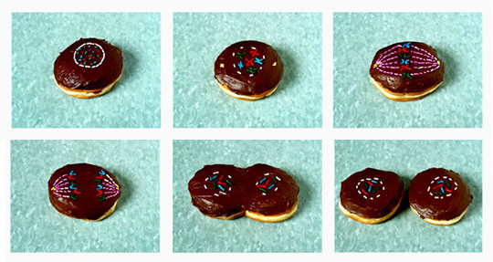
A way to remember!

Slide 35
Differences between Mitosis in Plant and Animal Cells
Animal Cell
Centriole acts as a focus for spindle fibres which form arcs
Cytokinesis is by CLEAVAGE (pinches in at centre and splits)
Plant Cell
No Centriole so spindle fibres are parallel rather than curved.
Cytokinesis is by CELL PLATE formation as Golgi vesicles secrete new cell wall.

Slide 36
Starter Questions
List the 4 stages of mitosis in the order they occur in.
List the 3 stages of the cell cycle.
At which stage during the cell cycle does DNA replication occur?
What do you expect to occur to the mass of DNA after replication?
Name the stage of mitosis when the chromatids move towards the poles.
What is the name of the structure that holds sister chromatids together?

Slide 37
Starter Questions – on wipey boards / rough paper
List the 4 stages of mitosis in the order they occur in.
Prophase, metaphase, anaphase, telophase
List the 3 stages of the cell cycle.
Interphase, mitosis, cytokinesis
At which stage during the cell cycle does DNA replication occur? interphase
What do you expect to occur to the mass of DNA after replication? It increases, doubles
Name the stage of mitosis when the chromatids move towards the poles. anaphase
What is the name of the structure that holds sister chromatids together? centromere

Slide 38
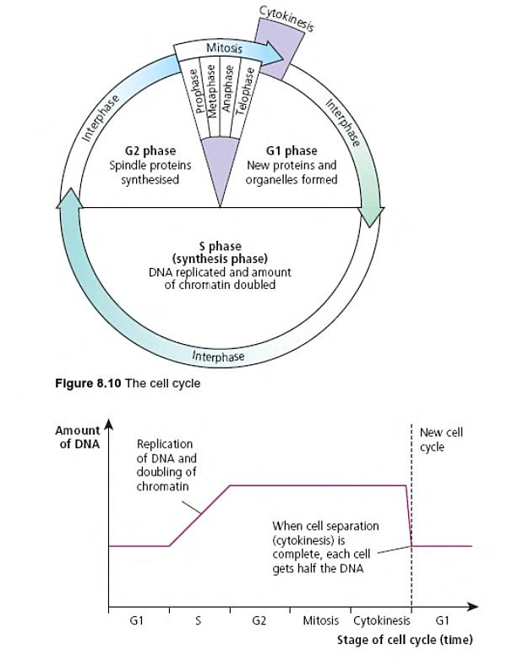

Slide 39
Matching activity

Slide 40
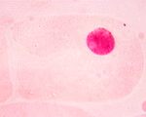
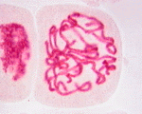
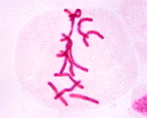
Answers to Mitosis Diagrams Matching Activity
Intense activity as:
All ATP is made for mitosis
All cell organelles replicate
But chromosomes are NOT visible
DNA replicates
CENTRIOLES migrate to poles
INTERPHASE
The cell prepares to divide by:
The DNA CONDENSES, getting shorter and fatter
This means the sister chromatids are VISIBLE
SPINDLE FIBRES form from pole to pole
Nuclear membrane disintegrates at the end of this phase.
PROPHASE
Chromatids move to the EQUATOR (middle of cell)
They attach to the spindle fibres by their CENTROMERES
METAPHASE

Slide 41
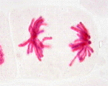
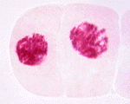
Answers to Mitosis Diagrams Matching Activity
(continued)
The spindle fibres contract
Pulling the chromatids apart
The centromeres split to separate the sister chromatids
Each chromosome moves to the opposite pole
ANAPHASE
A nuclear membrane forms around each set of chromosomes
The DNA elongates so chromosomes are not visible
In plant cell anew cell wall forms to separate cells – in animal cells the membrane ‘pinches’ inwards to separate (CYTOKINESIS)
TELOPHASE

Slide 42
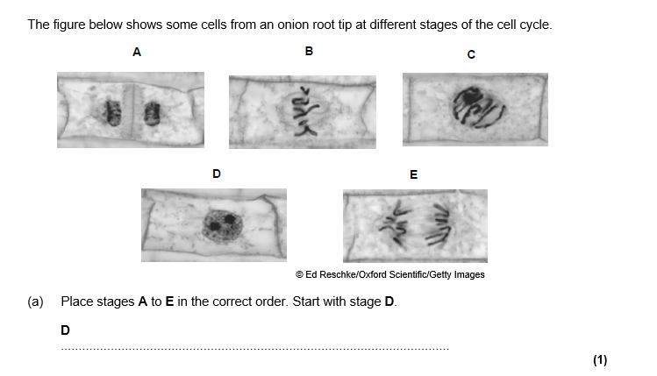
Exam Question
Answer DCBEA

Slide 43
Typical Mistakes
In questions about mitosis, candidates often make vague references to chromosomes.
Use specific language such as chromatid, spindle, centromere and pole.

Slide 44
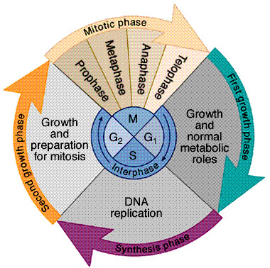
Cell Cycle timing in mammals and plants
Intestinal cells: every 8-10 hours
Liver: once per year
Skin epidermal cells: every 24 hours
Nerve cells: do not divide
Onion root tips: every 20 hours

Slide 45
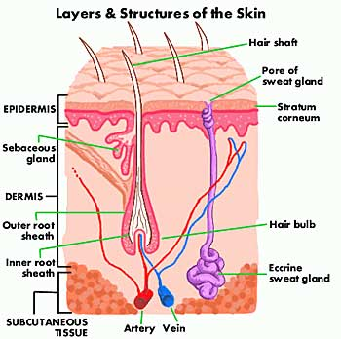
Mammalian skin cycle
Prophase: 35 minutes
Metaphase: 20 minutes
Anaphase: 10 minutes
Telophase: 40 minutes
Interphase: 21 hours 50 minutes

Slide 46
Question:
A scientist is looking at a tissue sample under a microscope. She counts 150 cells undergoing mitosis. Of those 12 cells are in prophase. One complete cycle lasts 0.70 days. How long do the cells spend in prophase? Give your answer in hours.
Proportion of cells in prophase = 12/150=0.08
Cell cycle lasts 0.7 days so 0.7 x 24=16.8hrs
The cells spend 0.08 x 16.8 = 1.3 hrs in prophase

Slide 47
Cancer
‘Candidates should be able to relate their understanding of the cell cycle to cancer and it’s treatment’
http://www.yourgenome.org/video/cancer-rogue-cells

Slide 48
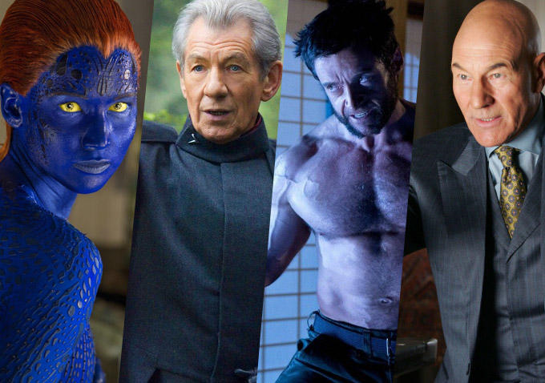
Definition Mutation
A permanent, heritable change in the nucleotide sequence in a gene or a chromosome
A mutant, or an individual exhibiting such a change.

Slide 49
Mutation
May get some variation during mitosis due to random mutation
A mutation is a permanent, heritable change in the nucleotide sequence in a gene or a chromosome
Due to :-
  Environmental factors e.g Sun
  Errors in copying of DNA during mitosis can lead to changes in DNA sequence
Mutations maybe harmless or pathogenic (sickle cell anaemia)

Slide 50
Mitotic index
Mitotic index : is the proportion of cells in a tissue sample that are undergoing mitosis
In root tip cells you would expect a high mitotic index
Other tissues you would not. A high mitotic index maybe due to repair of damaged tissue or cancerous growth
Mitotic index = number of cells with visible chromosomes
total number of cells observed
It is a method of predicting the future growth of cancer cells

Slide 51
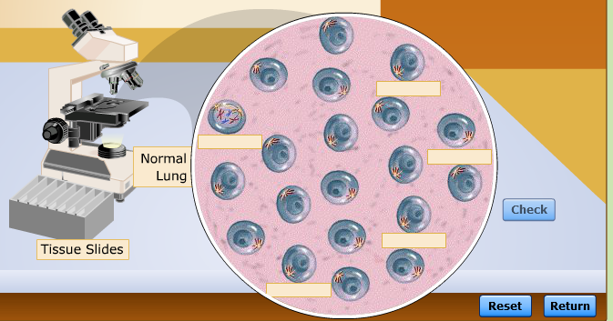
Virtual Lab-Activity
Virtual lab
http://www.mhhe.com/biosci/genbio/virtual_labs_2K8/labs/BL_03/index.html
Click on monitor to show video in class
Fill in activity sheet

Slide 52
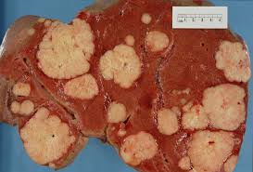
What causes cancer?
A mutation in a gene that controls the cell cycle
The Cell cycle is highly controlled
Growth disorder of cells
Cancer is a group of diseases (200)
Causes damage to the genes that regulate mitosis and the cell cycle causing uncontrolled growth
Leads to development of a tumour which constantly expands
Can occur in any organ but most common in lungs, prostate gland, breast, ovaries, stomach, oesophagus and pancreas.

Slide 53
Benign and Malignant Tumours - background knowledge but not part of specification
Tumour – A mass of abnormal cells that have developed by uncontrolled cell division
Benign Tumours – tumours that do not spread from their point of origin but they may still be painful because they compress surrounding tissues and displace them. Benign tumours are usually encased in a fibrous capsule and do not invade the tissue in which they originate. Do not cause cancer and do not metastasise
Malignant Tumours – divide in a more uncontrolled way than benign tumours and can be carried by the blood stream or lymphatic system to invade other tissues, causing secondary cancers. This process is called metastasis.
Both tumours may damage the organ concerned, may cause blockages and exert pressure on other organs

Slide 54
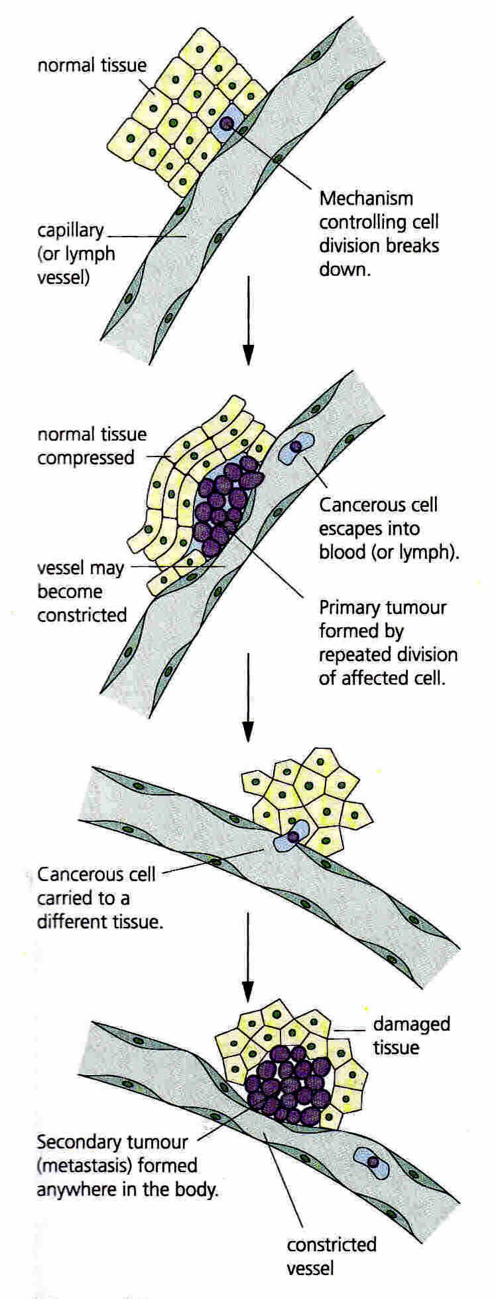
Cancer and Cell Division
- Development of a Malignant Tumour
1 Mechanisms controlling cell division breaks down
3 Cancerous cell escapes to blood or lymph.
2 Primary tumour formed by repeated division of affected cell
4 Cancerous cell carried to different tissue
5 Secondary tumour (metastasis) formed anywhere in the body

Slide 55
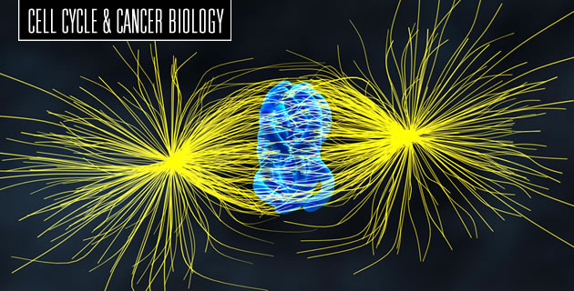
Genes control cell cycle
More than one hundred genes are specifically involved in cell cycle control
If there is a mutation (change in the sequence of DNA) in a gene that controls cell division, cells can grow out of control
Two families of genes that are involved in the control of the cell cycle
  Proto-oncogenes- stimulate cell division
  Tumour suppressor factors-stop cell division
http://www.yourgenome.org/video/role-of-cancer-genes
https://www.youtube.com/watch?v=eoWRZbtqB_s

Slide 56
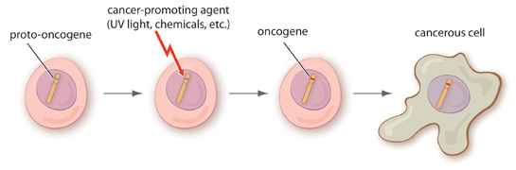
Role of proto oncogenes
A proto-oncogene is a gene that encodes a protein that is involved in regulation of cell growth or proliferation
Can be mutated into a cancer promoting oncogene where the gene is stuck in a state of constant activity
Uncontrolled growth leading to tumour development

Slide 57
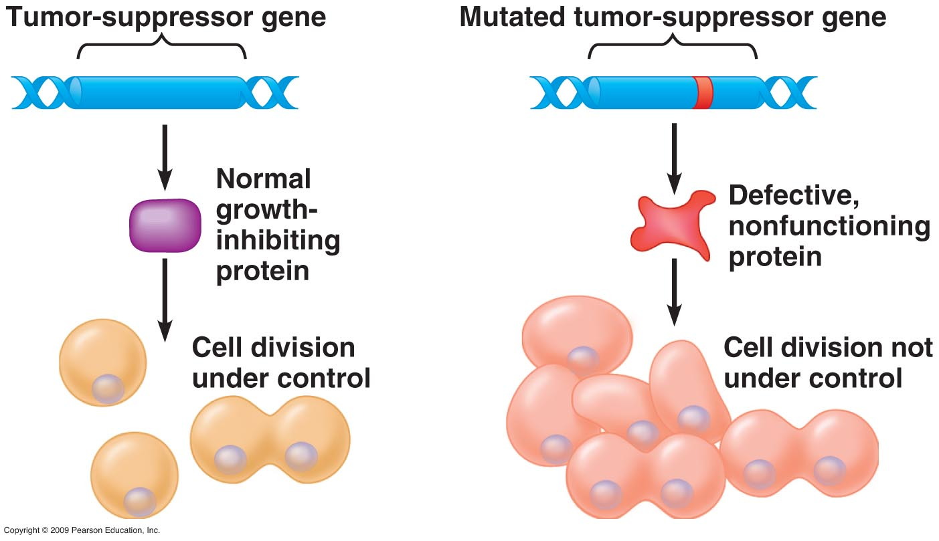
Role of tumour suppressor genes
Tumour suppressor genes encode proteins that inhibit cell proliferation.
Loss of these genes can contribute to the development of cancer

Slide 58
Treatments
Treatments for cancer are designed to control the rate of cell division in tumour cells by disrupting the cell cycle
Treatments will kill normal body cells which are dividing
Treatments more effective against cancerous cells as they are dividing more frequently (faster rate of division)
Why does hair fall out following cancer treatments?
  Ans: Hair cells are rapidly dividing like cells that line gut and are often affected by cancer treatments

Slide 59
Treatments for cancer
Three approaches to cancer treatment
  Surgery-removal of the tumour
  Radiotherapy-radiation damages the DNA and causes cells to kill them selves
  Chemotherapy- drugs are used to kill cancerous cells preventing them from dividing or damaging them so they kill themselves.

Slide 60
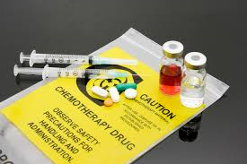
Drugs that control the cell cycle
Two types of drugs:-
1. Prevent the DNA from replicating
  Some drugs target G1 region in interphase
    Prevent the synthesis of enzymes needed for DNA replication and therefore cell is unable to enter S phase
  Some drugs target the S phase
    Includes radiation as DNA becomes so damaged cell will kill itself (checkpoints)
2.Inhibit the metaphase stage of mitosis by interfering with spindle formation

Slide 61
Treatment of cancer using chemotherapy
Suggest why:-
the drug was not given more frequently?
If frequency increased the healthy body cells would not have time to recover and numbers would decline and could kill the patient
2. The dose of the drug was not increased?
The increased dose would kill even more healthy cells and again numbers would decline rapidly after a few treatments-could kill patients
1st Dose
2nd Dose
3rd Dose
Number of cells/million
4th Dose
Normal cells
Cancerous cells
Time/weeks

Slide 62
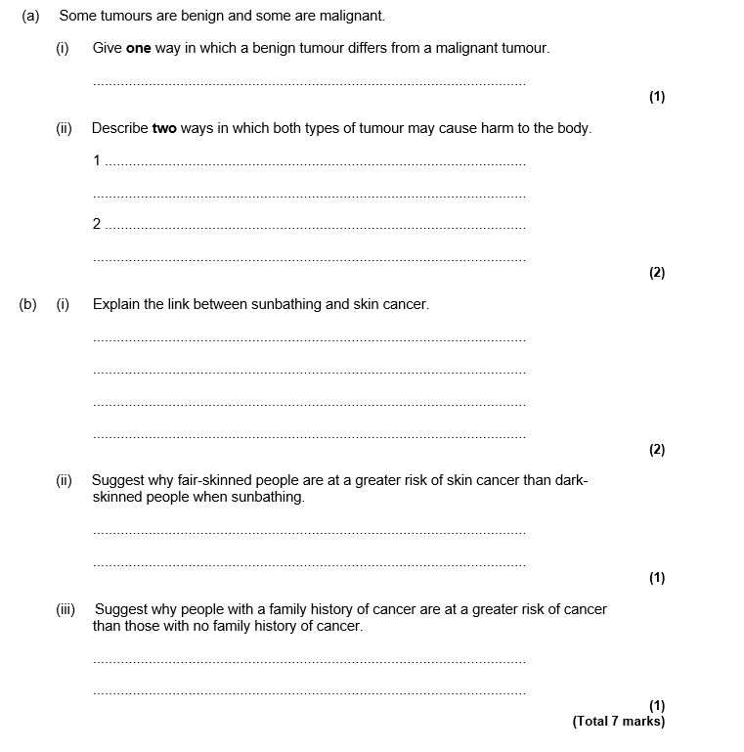
Exam question

Slide 63
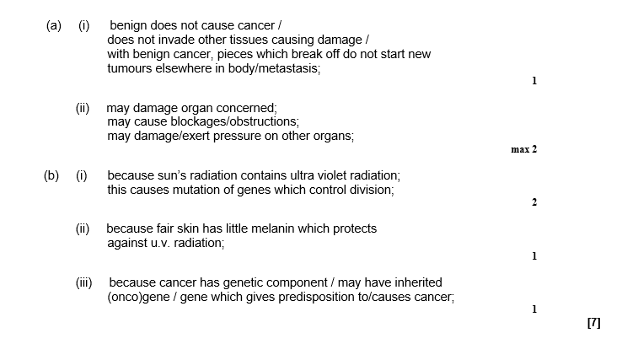
Answers

Slide 64
Question: DNA Content of a Cell Over Time
Where is replication of the chromosomes occurring?
Where is mitosis occurring?
Where is cytokinesis occurring?
Which parts represent Interphase?
Graph showing the DNA content of a cell over the time of a cell cycle.
What happens to the mass of DNA between times X and Y?
4
3
DNA content of Cell / arbitrary units
2
1
Time

Slide 65
Question: DNA Content of a Cell Over Time
Where is replication of the chromosomes occurring?
Where is mitosis occurring?
Where is cytokinesis occurring?
Which parts represent Interphase?
Graph showing the DNA content of a cell over the time of a cell cycle.
Mitosis
Replication of DNA
Cytokinesis
4
3
DNA content of Cell / arbitrary units
2
Interphase G1, S and G2
Interphase
1
Time

Slide 66

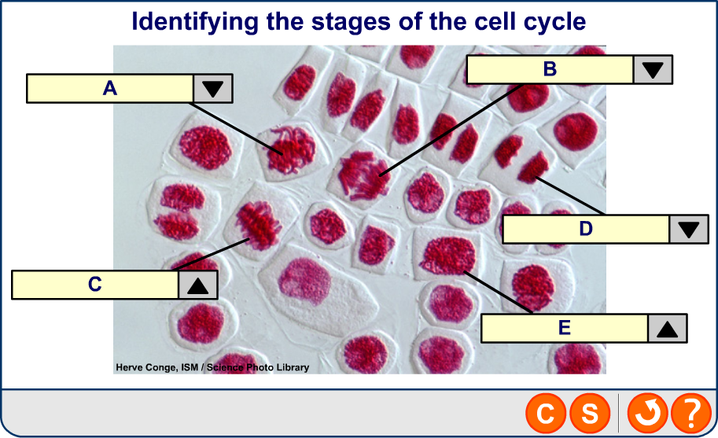
Stages of the cell cycle
of 32
© Boardworks Ltd 2008
Notes:
Photo credit: Herve Conge, ISM / Science Photo Library
Light micrograph of hyacinth root cells undergoing mitosis (nuclear division). Mitosis is the formation of two daughter nuclei from one parent nucleus. One cell at centre left is in metaphase. The chromosomes, which contain 2 identical chromatids and are made of deoxyribonucleic acid (DNA, red), are lining up along the centre of the cell. the chromatids are then separated during anaphase (upper centre). At left a cell is in telophase, the last stage of mitosis before cytokinesis (cellular division). The chromosomes have been separated and moved to opposite poles of the cell. The chromatids are divided equally between the daughter cells. Magnification: x280 at 10 centimetres wide.

Slide 67
watch this cancer link
http://www.youtube.com/watch?v=IeUANxFVXKc

Slide 68
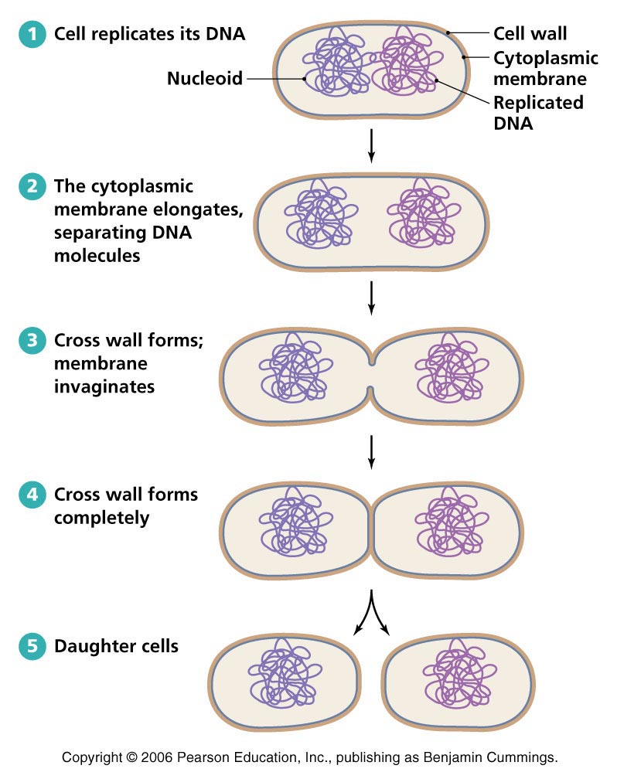
Cell division in prokaryotes
By Binary Fission
A sexual reproduction in unicellular organisms in which a single cell divides to form two identical daughter cells
Very similar to mitosis genetic material is replicated before the prokaryote splits Into two.
Replicated large loop of DNA attaches to cytoplasmic membrane. As cell grows the DNA is separated
The main DNA loop is only replicated once, but plasmids can be replicated numerous times
Daughter cells can contain variable numbers of plasmids

Slide 69
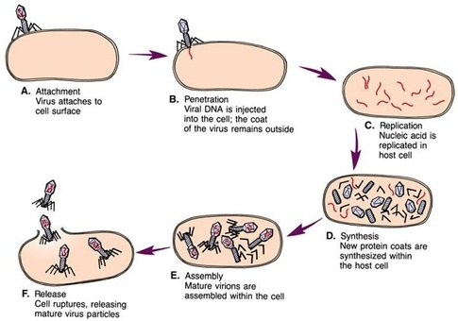
Viral replication- Recall
Attachment: The virus attaches to a host cell. In the case of the bacteriophage it will attach to a bacterium.
Entry: The virus forms a hole in the membrane or cell wall of the host. The nucleic acid of the virus enters the host cell.
Synthesis: The virus’ nucleic acid is used to make new viral nucleic acid and proteins for the new viruses being produced. (The host cells’ DNA becomes deactivated)
Assembly: New viruses are made inside the host cell.
Release: The host cell bursts to release the new viruses. The bursting is called lysis.
Being non living viruses do not undergo cell division. Host cell replicates the virus particles
https://www.youtube.com/watch?v=EICader2NWo

Slide 70
Garlic Root Tip Squash Practical

Slide 71
Meristems are regions of plant cells that are actively dividing by mitosis. They are small unspecialised cells forming a tissue called Meristematic tissue.
Meristematic tissue is found in growing regions of root tips, stem tips and in the cambium which is involved in thickening growth (between xylem and phloem tissue).
What are Meristems and Meristematic Cells?

Slide 72
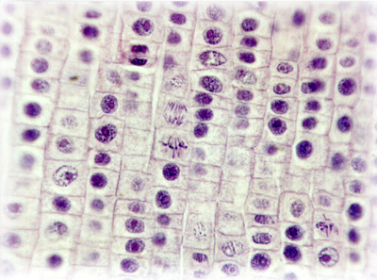
Example of a Root tip Squash
Interphase
Prophase
Metaphase
Telophase
Anaphase

Slide 73
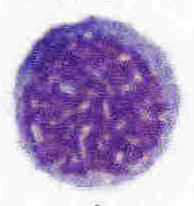
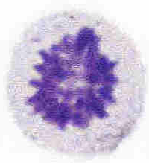
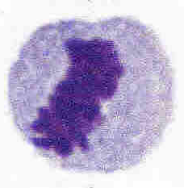





Practical: Root Tip Squash to Observe Mitosis in Meristematic Cells (Meristematic cells are actively dividing cells in plants)
Place a garlic clove in the bottle, so that the roots are submerged in the 55°C hydrochloric acid. (The hydrochloric acid breaks down the calcium pectate between the roots allowing the stain to penetrate.) Leave the roots in the acid for 5 minutes. – this is to soften the cell walls to let the stain into the cells.
Use a pair of sharp scissors on the garlic clove to cut off the root tips (5-10 mm at the pointed end) -mitosis is taking place near the tip!
Place the tips in the vial of acetic orcein - this is a red dye to stain the DNA and make the chromatids visible
Using forceps remove a root tip and place it on a microscope slide. Place on a coverslip.
Place paper towells over coverslip, then using your thumb, gently squash the root tip – this is to form a layer one cell thick making it easier to see dividing cells.
Calculate the mitotic index:
Mitotic index = number of cells containing visible chromosomes
divided by the total number of cells in field of view

Slide 74
Drawings-calculate EPU of cell
Write down the magnification
Draw in proportion
Label your drawing
Give your drawing a title
Use a sharp pencil
Don’t colour in or shade
Draw two lines and write a key to show equivalent EPU

Slide 75
Understanding the Cell Cycle and the Importance of Replicating DNA
At the end of this section you will be able to:
Explain what is meant by the cell cycle.
Explain when in the cycle DNA is replicated (copied) so there is a genetic copy for new cells.
Explain what is meant by Mitosis and Interphase.
Describe and draw the structure of a chromosome
Understand the terms: homologous pairs, diploid, haploid, centromere, chromatids and sister chromatids.
State the 4 stages of mitosis.

Slide 76
Mitosis videos
http://www.youtube.com/watch?v=L0k-enzoeOM crash course biology
http://highered.mcgraw-hill.com/sites/0072495855/student_view0/chapter2/animation__mitosis_and_cytokinesis.html about 2 minutes long. Clear but includes two features beyond specification including lengthening of unattached microtubules (spindle fibres) and use of term kinetochores rather than centromere.
http://www.cellsalive.com/mitosis.htm very quick visual. Clear no words.
http://www.johnkyrk.com/mitosis.html clear visual animation. No words.
https://www.youtube.com/watch?v=pOsAbTi9tHw/ mitosis rap

Slide 77
Stages of Mitosis
Prophase | Chromosomes coil (condensation) and become shorter and fatter Nucleolus disappears (actually just disperses so seems to disappear) Nuclear envelope disintegrates (dissociates into vesicles) Spindle fibres (protein fibres) form Centrioles divide and move to opposite ends of cell.
Metaphase | Chromosomes (consisting of sister Chromatids) line up on the EQUATOR (centre of cell at middle of spindle) Spindle fibres attach to centromeres holding the pairs of sister chromatids together.
Anaphase | Centromeres split Spindle fibres contract and shorten and pull sister chromatids apart and towards poles (opposite ends of the spindle. (The separated chromatids can now be regarded as chromosomes)
Telophase | Movement to poles is completed Chromosomes become long and thin again by uncoiling Nuclear envelope forms around each group of chromosomes Nucleoli reappear.

