Slide 1
Cell Recognition and the Immune System
Supporting slides
Notes:
Working on basis of 2 weeks theory (6 double lessons) plus one double lesson q pack consolidation work / mini test

Slide 2
Starter: What Do You Know/Remember from GCSE?
Which blood cells help defend the body against pathogens?
Name 3 ways they can do this.
What is a vaccination and what does it make the body do?
What vaccine is used against measles mumps and rubella?
If much of a population is immune to a pathogen, how is the spread of the pathogen affected?
Now write down as many facts as you know about the body’s defence against disease.

Slide 3
Starter: What Do You Know/Remember from GCSE?
Which blood cells help defend the body against pathogens? white
Name 3 ways they can do this. Ingesting the pathogen, producing antibodies, producing antitoxins.
What is a vaccination and what does it make the body do? Dead or inactive forms of pathogens that are introduced into the body, and which stimulate white blood cells to produce antibodies and form immunity to future infections of that particular pathogen.
What vaccine is used against measles mumps and rubella? MMR
If much of a population is immune to a pathogen, how is the spread of the pathogen affected? Very much reduced spread.
Gather additional facts from class.

Slide 4
Specification: section 3.2.4
Each type of cell has specific molecules on its surface that identify it. These molecules include proteins and enable the immune system to identify:
Pathogens
Cells from other organisms of the same species
Abnormal cells
Toxins
Definition of an antigen. The effect of antigen variability on disease and disease prevention.
Phagocytosis of pathogens. The subsequent destruction of ingested pathogens by lysozymes.
The response of T lymphocytes to a foreign antigen. (the cellular response).
The role of antigen-presenting cells in the cellular response.
The role of helper T cells (TH cells) in stimulating cytotoxic T cells (TC cells), B cells and phagocytes. The role of other T cells is not required.

Slide 5
Specification: section 3.2.4 continued
The response of B lymphocytes to a foreign antigen, clonal selection and the release of monoclonal antibodies (the humoral response).
Definition of antibody
Antibody structure
The formation of an antigen-antibody complex, leading to the destruction of the antigen, limited to agglutination and phagocytosis of bacterial cells.
The roles of plasma cells and of memory cells in producing primary and secondary immune responses.
The use of vaccines to provide protection for individuals and populations against disease. The concept of herd immunity.
The difference between active and passive immunity.
Structure of the human immunodeficiency virus (HIV) and its replication in helper T cells.
How HIV causes the symptoms of AIDS. Why antibiotics are ineffective against viruses.

Slide 6
Specification: section 3.2.4 continued
The use of monoclonal antibodies in:
Targeting medication to specific cell types by attaching a therapeutic drug to an antibody.
Medical diagnosis.
Details of the production of monoclonal antibodies is not required.
Ethical issues associated with the use of vaccines and monoclonal antibodies.
The use of antibodies in the ELISA test.
Students should be able to:
Discuss ethical issues associated with the use of vaccines and monoclonal antibodies.
Evaluate methodology, evidence and data relating to the use of vaccines and monoclonal antibodies.

Slide 7
Preparatory work
Watch the video Virtual Body – The Immune System on estream. (20 mins)
http://estream.godalming.ac.uk/View.aspx?id=1298~4u~vx7bUQN6&chapID=1582
Answer the questions about the video.

Slide 8
Answers to Questions from Video ‘The Immune System’
Give 4 mechanisms that are part of the body’s first line of defence.
  Skin (a physical barrier);
  mucus membranes lining orifices and hairs / cilia lining airways;
  chemical methods:- sweat, saliva, tears, stomach acid;
  our own harmless bacteria in and around our skin
State 3 chemical defence mechanisms. sweat saliva and tears
Name 2 white cells produced in the bone marrow? Phagocytes and lymphocytes
What is pus made up of? Dead phagocytes, destroyed bacteria and other cell debris.
What is an antigen? Any substance that triggers an immune response. Can be a protein or carbohydrate and can also be a toxin.
What is a toxin? A chemical released by certain invaders
Name a bacterium that releases a toxin. Tetanus bacterium
What is a toxoid? A toxin modified toxin able to be safely used in vaccinations.
How do killer T-cells kill pathogens and also infected body cells? Punch holes in the cells so they die.

Slide 9
Specific and Non specific responses
Two types of immune response

Slide 10
Non-Specific response –response to all invaders
Natural Barriers – Skins, Mucous Linings and Blood Clotting.
The human body is an ideal incubator for micro organisms. Many live in or on our bodies (commensals) causing no harm and benefiting. Pathogens are disease causing micro organisms and enter in two ways, either through the skin or natural openings.
Lysozyme in the eyes breaks down bacterial cell walls.
Phagocytosis
  DOES NOT target a particular type of invader. Phagocytic white blood cells e.g. MACROPHAGES ingest invading cells, destroying them.

Slide 11
SPECIFIC RESPONSES-response to a specific invader
Cellular Response / Cell Mediated Immunity
  DOES target a particular invader that has got inside cells.
  Involves T-lymphocytes (T-cells) which must be activated to produce clones but no antibodies are produced.
Humoral Response
  DOES target a particular invader or toxin that is outside cells but in body fluids (e.g. in blood stream, lymph or tissue fluid).
  Involves B-lymphocytes (B-cells) which must be activated to produce clones some of which produce antibodies.

Slide 12
Summary of Defence Mechanisms
Defence mechanisms
Non specific
response is immediate
and the same for all pathogens
Specific
response is slower and
specific to each pathogen
Physical barrier
e.g. skin
phagocytosis
Cell-mediated response
T lymphocytes
Humoral response
B lymphocytes
Antibody production
Notes:
Diagram based on fig 2 p103 (New spec.) T & T A level Biology and p 101 (Old Spec.) T & T AS Biology

Slide 13
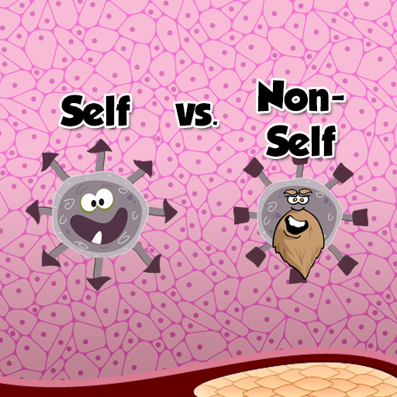
How does the body distinguish between self and non self (foreign) cells?
All cells have specific molecules on their cell surfaces that provide self identification. These are known as self antigens
Pathogens are organisms (usually microorganisms) that cause disease e.g. viruses, bacteria and fungi.
All pathogens have molecules on their surfaces that are identified as foreign antigens (simply called antigens) by the invaded body’s immune system cells.
These foreign antigens elicit an immune response.
http://arcade.gamesalad.com/g/123788
Self antigen
Foreign antigen

Slide 14
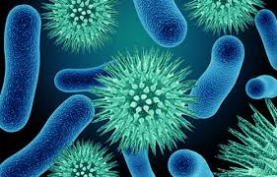
Antigen Definition - LEARN
What is an Antigen?
An antigen is any part of an organism or substance that is recognized as non-self (foreign) by the immune system and stimulates an immune response.
Antigens are usually large complex molecules such as proteins or glycoproteins
Notes:
Clostridium botulinum produces a toxin and the tetanus bacterium produces a toxin.

Slide 15
Molecules that act as antigens and trigger an immune response include:
  Pathogens for example HIV
  Non self material such as proteins that are part of the cell surface membrane of foreign cells as well as cell wall components.
  Cancerous cell antigens which are abnormal and act as foreign antigens.
  Toxins (poisonous molecules) eg those produced by bacteria such as Cholera.

Slide 16
Non Specific immune response
Phagocytosis

Slide 17
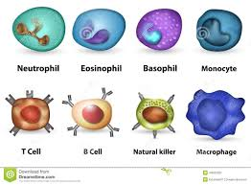
White blood cells
There are several types of white blood cells, each with a different function.
The two main groups are:-
Lymphocytes which includes B cells and T cells .
Phagocytes or monocytes/macrophages

Slide 18
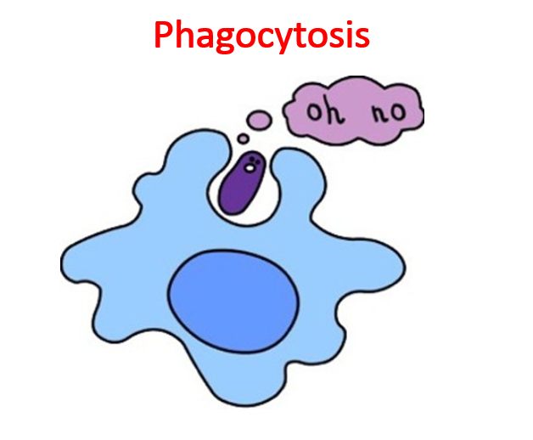
Phagocyte is a type of white blood cell that carries out phagocytosis (engulfment of pathogen
Found in blood and tissues and are first cell to respond to pathogens
https://www.youtube.com/watch?v=q3bOMmVy_xY

Slide 19
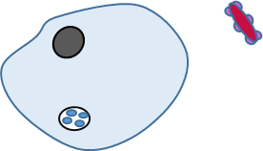
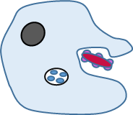
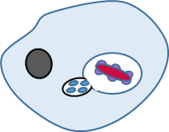
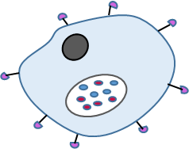
Phagocytosis
Phagocyte
Pathogen
nucleus
Antigens on surface of pathogen
Phagosome vacuole forming
Lysosome fuses with phagosome
Lysosome containing lysozyme enzymes
Chemical products of dead or damaged pathogen attract the phagoctye
http://www.dnatube.com/video/116/Neutrophil-attacts-on-bacteria
Real life (under a microscope)
Phagocyte presents antigens on its surface

Slide 20
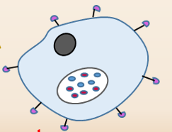
Antigen presenting cells
When a cell presents foreign antigens on it’s surface it is said to be an ANTIGEN PRESENTING CELL.
Self antigen
Foreign antigen
Nucleus
Phagolysosome containing lysozymes

Slide 21
Jumbled statements –use your white board an place them in the correct order
The phagocyte then presents the pathogen’s antigens – it sticks the antigens on its surface to activate other immune cells.
The phagocyte recognises the antigens on a pathogen and binds to it.
A lysosome (containing lysozymes) fuses with the phagocytic vesicle. The lysozymes hydrolyse the pathogen.
The cytoplasm of the phagocyte moves round the pathogen, engulfing it in a phagocytic vesicle within the cytoplasm.
A phagocyte moves towards a pathogen as it is attracted to chemicals released by the pathogen

Slide 22
The correct order
1. A phagocyte moves towards a pathogen as it is attracted to chemicals released by the pathogen
2. The phagocyte recognises the antigens on a pathogen and binds to it
3. The cytoplasm of the phagocyte moves round the pathogen, engulfing it in a phagocytic vesicle within the cytoplasm.
4. A lysosome (containing lysozymes) fuses with the phagocytic vesicle. The lysozymes hydrolyse the pathogen.
5. The phagocyte then presents the pathogen’s antigens (Antigen presentation) – it sticks the antigens on its surface to activate other immune cells.

Slide 23
Steps of Phagocytosis -Activity
Play doh animation (music and comments-make it fun and imaginative!) of phagocytosis showing the following steps :-
Notes:
The protective coating of the eye, and the tear ducts, are potential entry points for pathogens. The eyes are vulnerable to infection because the coverings are thin to allow light through. Lysozyme will break down the cell walls of any bacterial pathogens and so destroy them before they can cause harm. (ref p 612 New T&T text and p 247 Old spec T&T AS text)

Slide 24
Plenary
In the following passage fill in the missing word
  Pathogens that invade the body maybe engulfed by cells which carry out ……… The engulfed pathogen forms a vesicle known as a …………… Once engulfed the pathogen is broken down by enzymes called ……………….released from an organelle called ………
Among other places lysozymes are found in tears. Suggest a reason why

Slide 25
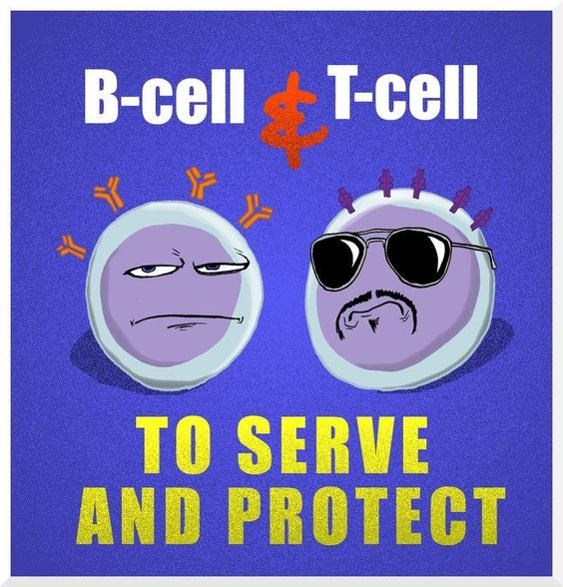
Specific Immune response
Humoral and cellular response

Slide 26
Types of specific response
Cell mediated Response
Humoral Response

Slide 27
Introductory video
http://highered.mheducation.com/sites/0072507470/student_view0/chapter22/animation__the_immune_response.htm
http://www.sbs.utexas.edu/psaxena/MicrobiologyAnimations/Animations/Cell-MediatedImmunity/micro_cell-mediated.swf (extension)

Slide 28
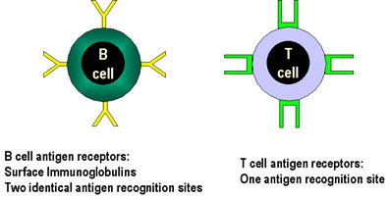
Lymphocytes ( Blood cells of the specific immune response)
10 million different types of lymphocyte in the body (either B or T cells)
Specific lymphocytes are not produced in response to infection but already exist.
As so many different types there is a high probability that when a pathogen enters the body one of these lymphocytes will have a protein on its surface complimentary to a specific protein on the pathogen.
i.e. The lymphocyte will ‘recognise’ the pathogen
T and B cells have receptor molecules on their membrane surfaces.
Notes:
In the foetus if a lymphocyte has receptors that exactly fit the body’s own cells they die

Slide 29
Difference between B and T lymphocytes
B Lymphocytes
  Mature in Bone Marrow
  Associated with Humoral response which produces ANTIBODIES
T lymphocytes
  mature in thymus gland
  Associated with the cell mediated immunity

Slide 30
Cell mediated Immunity
T Lymphocytes

Slide 31
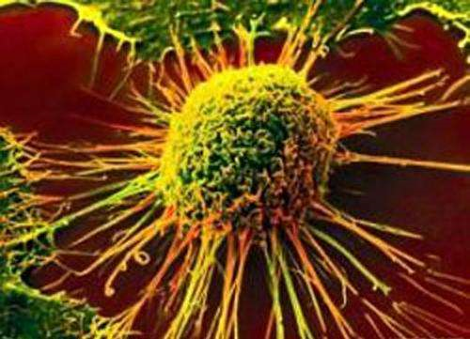
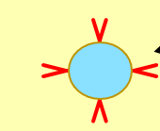
Cell mediated immunity-T lymphocytes
Receptors on the cell membrane of each T cell respond to a single antigen
T cell receptors are complimentary to non self antigens
Large numbers of different T cells, each one responding to a different antigen
Receptor molecule
T Cell

Slide 32
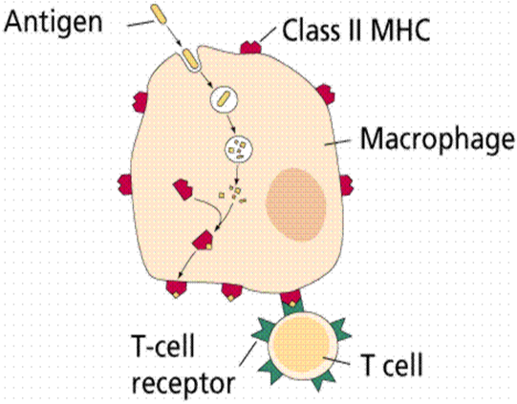
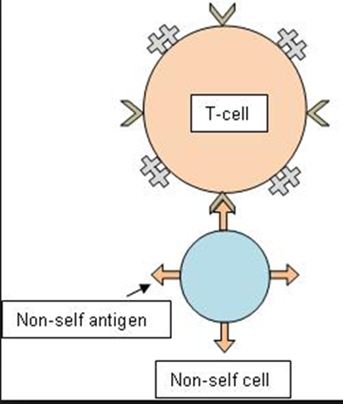
T cell recognition
http://www.biology-innovation.co.uk/pages/human-biology/the-immune-system/
T cells recognise:-
Antigen presenting cells -Phagocytes have engulfed them and are presenting foreign antigen on their cell surface membrane
Virus infected cells-Body cells invaded by a virus present viral antigens on their surface
Transplanted cells from the same species have different antigens on their cell surface membrane
Cancer cells are abnormal cells and present non self antingens on the cell surface membrane
Viral antigen
Virus infected cell
Cancer cell
Cancer cell antigens

Slide 33
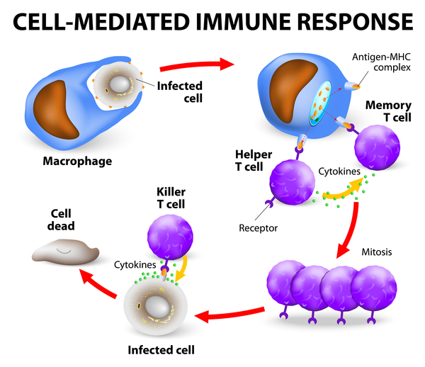
There are three different types of T cells;
T helper cell – stimulate B cells to divide and secrete their antibody and activate phagocytes
Memory T cell- cloned T cells that enable rapid response to future infections
Cytotoxic (killer) T cell – Kill infected or cancer cells

Slide 34
The Cell Mediated Response - Diagrammatic
1 Pathogen attacks body cell
2 Infected phagocyte cell PRESENTS invader’s antigens on its surface
3 A Helper T-cell (T_{H} cell) with complementary shaped receptors binds to the antigens
Phagocyte Cell eg macrophage
Infected Body Cell
Infected Body Cell
T-Cell
Antigen
4 The Helper T-cell is activated to divide by mitosis and produce many clones which do several things including:
New clones all have the same receptor molecules.
Some develop into Memory T-cells
Some stimulate phagocytes to engulf pathogens, others work as Helper T cells that stimulate B cells to divide
Some activate Cytotoxic T-cells (T_{C} cells)

Slide 35
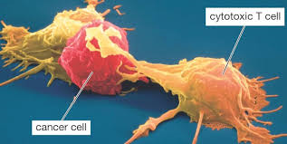
Cytotoxic T cells
Cytotoxic T-cells (T_{C} cells) destroy infected cells by punching holes in the cell surface membrane using a protein called perforin.
https://www.youtube.com/watch?v=ntk8XsxVDi0

Slide 36
Plenary: Put statements in the correct order
Receptors on certain T helper cells fit exactly onto these antigens.
The cloned cells:
  Stimulate phagocytes to engulf pathogens by phagocytosis.
  Kill infected cells.
  Stimulate B cells to divide.(for the humoral response)
  Develop into memory cells that enable a rapid response to future infections by the same pathogen.
The phagocyte places antigens on its cell-surface membrane.
This activates other T cells to divide rapidly by mitosis and form a clone.
Pathogens invade body cells or are taken in by phagocytes.

Slide 37
Plenary: Put statements in the correct order ANSWERS
Pathogens invade body cells or are taken in by phagocytes.
The phagocyte places antigens on its cell-surface membrane (antigen presentation).
Receptors on certain T helper cells fit exactly onto these antigens.
This activates other T cells to divide rapidly by mitosis and form a clone.
The cloned cells:
  Stimulate phagocytes to engulf pathogens by phagocytosis.
  Kill infected cells.
  Stimulate B cells to divide.(for the humoral response)
  Develop into memory cells that enable a rapid response to future infections by the same pathogen (a secondary response).

Slide 38
Humoral Immunity
B lymphocytes

Slide 39
Antibodies and The Humoral Response –B cells
Lesson Outcomes: You should be able to:
Draw and label the structure of an antibody.
Explain the specificity of an antibody to a particular antigen.
Explain how antibodies lead to the destruction of pathogens
Describe and explain the sequence of events in the humoral response.
Explain what is meant by a monoclonal antibody
Explain the roles of plasma cells in producing a primary response and memory cells in producing a secondary response.
Define the terms immunoglobulin, agglutination, plasma cell, memory cell, clonal selection, primary response, secondary response

Slide 40
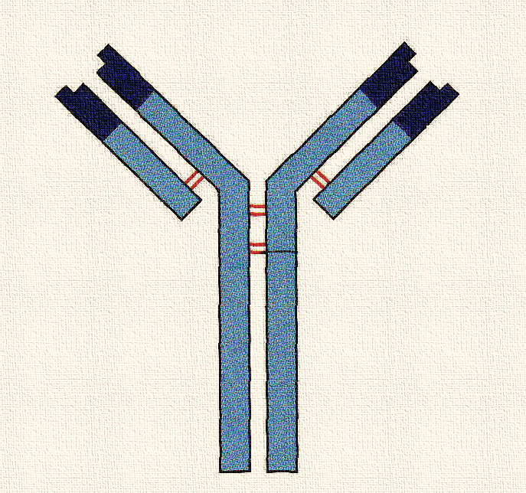
Antibodies and their Structure
Antibodies are specific GLOBULAR PROTEINS (IMMUNOGLOBULINS)
Made of 4 polypeptide chains secreted by B-lymphocytes (B-cells) in response to stimulation by an appropriate antigen.
Antibodies bind to the antigen to neutralise a pathogen.
Antigen binding site
Antigen binding site
Variable region
Light chain (short chain)
Disulphide bonds holding polypeptides together
Constant region
Heavy chain (long chain)
Receptor binding site – such as to a receptor on a B cell.

Slide 41
What type of molecule is an antibody? Globular proteins called immunoglobulins
Topic cross link Question: Does it have tertiary structure? Explain your answer
Yes because it is globular so is highly folded
Does it have Quaternary structure? Explain your answer.
Yes because it is made of more than one polypeptide chain
What type of cells produce antibodies? B-cells

Slide 42
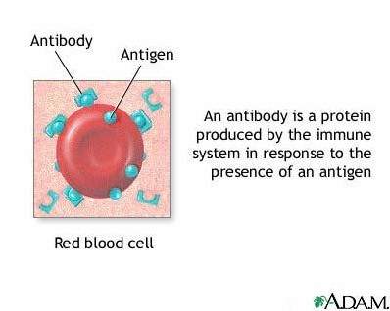
Antibody Definition - learn
An antibody is a protein produced by the immune system (B cells) in response to the presence of the appropriate an antigen.

Slide 43
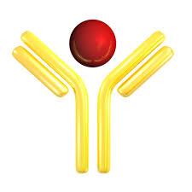
How do antibodies bind with antigens?
The antigen binding site in the antibody has a complimentary shape to a specific antigen
The antibody will bind to the specific antigen and form a antibody antigen complex.

Slide 44
Action of Antibodies.
Antibodies are produced through the Humoral Response by B lymphocytes.
They prepare the antigen for destruction so assist in its destruction!
They attach to antigens forming antigen-antibody complexes
The ways they prepare the antigen for destruction include:-
  Agglutination – clumping together of bacterial cells so phagocytes can easily engulf them in a group.
  Attach to bacterial cells and act as markers for the phagocytes to engulf the cells.
  Neutralisation – binding to critical parts of the pathogen preventing functioning. (EXTENSION -not mentioned in spec or text but on animation)

Slide 45
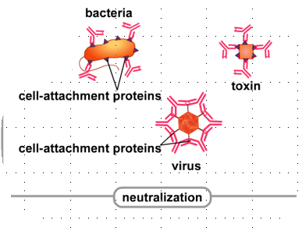
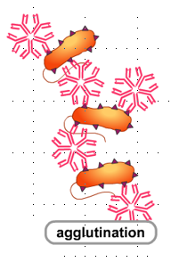
Antibody Actions snips from animation 2
Neutralisation - Bind to critical portions of toxins/bacteria/viruses or block proteins necessary for attachment to cells. (note this is not described in text only in animation)
Agglutination - Bind to more than one microbial cell causing clumping – known as agglutination

Slide 46
Antibodies are made of protein. They’re made up of chains of amino acid monomers linked by peptide bonds. The specificity of an antibody depends on its variable regions. Each antibody has a different shaped variable region (due to different amino acid sequences), that’s complementary to one specific antigen. The constant regions are the same in all antibodies.

Slide 47
Humoral Response
B-cell encounters an invader with antigens complementary to its receptors.
It attaches to the antigen, ingests, processes and presents the antigens, then gets activated to divide and make clones (by MITOSIS)
The invader could be a pathogen, foreign cell, damaged or abnormal cell, or toxin produced by the invader.
A T-helper cell with the appropriate surface receptors also attaches and aids the ACTIVATION of the B-cell to make clones.
The clones differentiate into PLASMA cells and MEMORY cells. Plasma cells are larger and have much RER and ribosomes necessary for making antibodies. The antibodies made are then secreted to attack many more invading cells.
B-cell
T-Helper cell

Slide 48
What is the main type of lymphocyte is involved in the humoral response?
B lymphocytes (B-cells)
By what process does this cell take up the antigens and then what does it do with the antigens?
It takes up the antigen by ENDOCYTOSIS then processes them and presents them on its surface
What other type of lymphocyte binds to the processed presented antigens and helps to activate the presenting cell (…B-cell…) to divide by mitosis?
T-helper cell

Slide 49

The Humoral Response Diagrammatically
1 B-cell receptor take up antigens of pathogen
2 A Helper T-cell attaches to the presented antigens on the B-cell and activates the B-cell
pathogen
B-cell
B-cell
T-Helper cell
Processed antigen
3 The B cell divides by mitosis to produce a clone of B- cells which differentiate into memory cells and Plasma cells.
Memory cell
Plasma cell
4 The plasma cells secrete antibodies into the blood.
Antibody
Processed antigen
Non self antigen found on pathogens surface

Slide 50
What is Clonal Selection?
Clonal selection refers to the way that specific antigens ‘select’ specific B cells with complementary antibodies on their surfaces, thus stimulating them to divide and form clones (with the help of helper T-cells)
Clones are identical copies of the original B cell
http://highered.mheducation.com/olcweb/cgi/pluginpop.cgi?it=swf::600::480::/sites/dl/free/0073532215/788107/Clonal_Selection.swf::Clonal%20Selection
Clear animation of B cell being stimulated by an antigen and being activated to divide (clonal selection).

Slide 51
Activity - Poster
https://www.youtube.com/watch?v=LsL_srFLcSg
Put it all together so link

Slide 52
Types of Immunity
Active Immunity - Results from your immune system producing memory cells following exposure to an antigen
Passive Immunity - Results from being given antibodies from a different organism (mother to baby via placenta or via blood injection eg to combat a tetanus infection)

Slide 53
Primary and Secondary Responses:
Occur with both B and T lymphocytes but normally discussed in relation to B cells and the production of antibodies. Involves the memory cells.

Slide 54
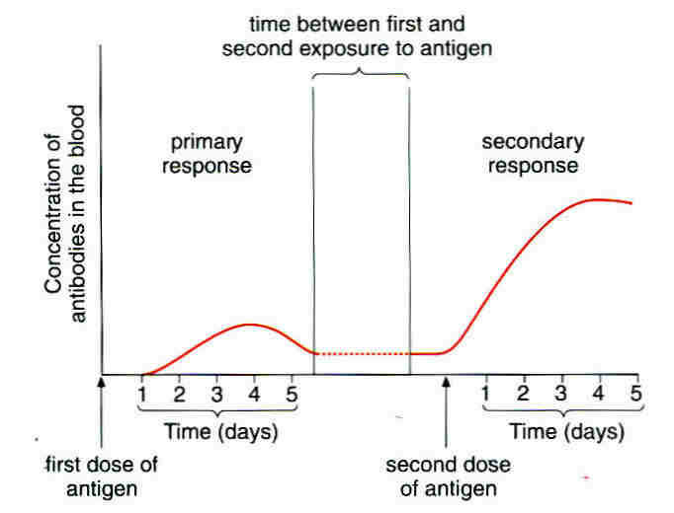
Primary and Secondary Responses Graphically
Primary response- Production of antibodies is relatively slow so disease may initially occur before antibodies get it under control-first contact
The secondary response is more rapid and more antibodies are produced.
Triggered by second or subsequent contact with an antigen
This results from the presence of Memory-B cells which divide very rapidly.
The infection is fought very quickly the second time around and no disease is observed.

Slide 55
Monoclonal antibodies
Uses in industry

Slide 56

What are Monoclonal Antibodies
Antibodies of a desired type, specific to a particular antigen. A single type of antibody that has been isolated and cloned
Produced by cultured HYBRIDOMA cells.
(cells fused from a B-cell and a human tumour cell).
Isolated B-cells cannot survive in a culture for us to extract desired antibodies.
HYBRIDOMA cells can survive in culture and produce the desired antibodies.
Q Why do we use a human tumour cell in the production?
Q Why can’t we just extract antibodies directly from blood stores?
Notes:
The tumour cell Humanises the hybrid cell so it’s antibodies won’t be rejected by the human recipient. Blood contains many different B-cells and it would be difficult to extract the right ones and get enough antibodies.

Slide 57
What are Monoclonal Antibodies Used for?
Medical Uses
To target specific cells and substances.
e.g. Antibodies specific to cancer cell antigens.
  They attach to receptors on cancer cells
  They block chemical signals that stimulate uncontrolled growth.
To Diagnose disease
  e.g. flu, hepatitis and chlamydia.
  To diagnose certain cancers e.g. prostate cancer
Pregnancy testing

Slide 58
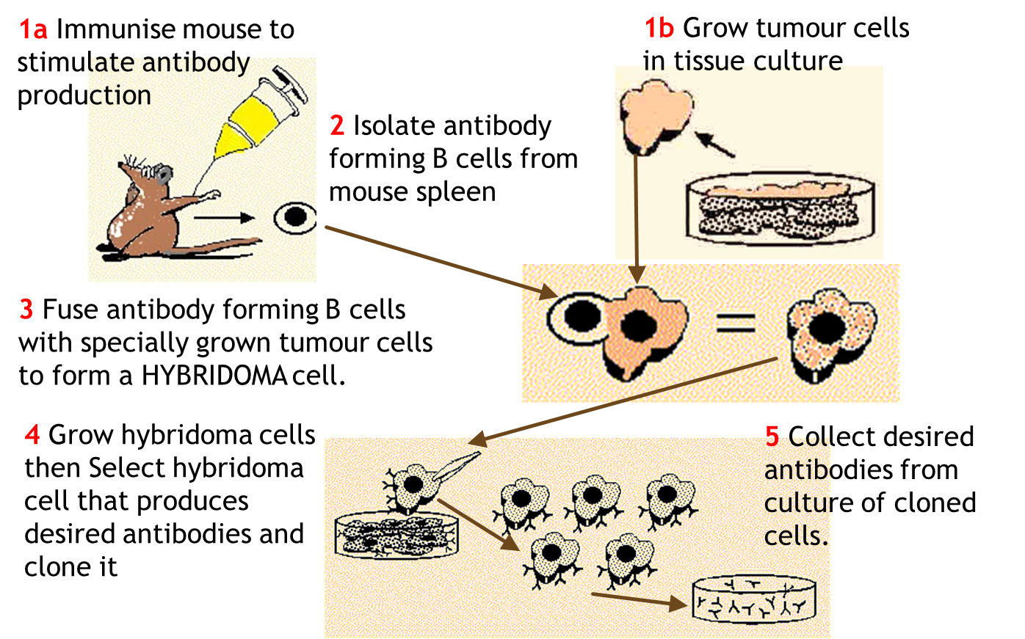
Extension/Background: Monoclonal Antibody Production
“Details of monoclonal antibody production is not required” AQA spec.
http://highered.mheducation.com/olc/dl/120110/micro43.swf Animation of how monoclonal antibodies are made.

Slide 59
How monoclonal antibodies work
Used on their own to activate the immune system
Attached to a drug
Attached to an enzyme that will illicit a colour change
Attached directly to a coloured particle

Slide 60
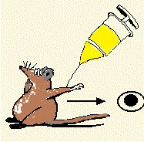
Monoclonal Antibodies – Ethical Issues
Squeak OW, OW, OW!
What are the ethical issues this procedure and its uses raises?
Discuss in groups and write down your ideas
Read T&T p 113 to elaborate and consolidate your ideas.
http://www.understandinganimalresearch.org.uk/schoolzone/rights-and-wrongs/#

Slide 61
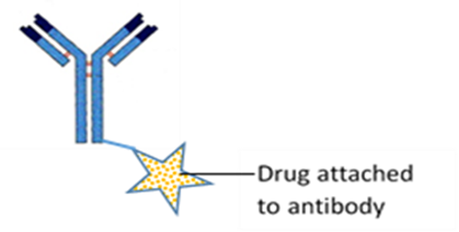
Cancer -Direct and indirect Monoclonal antibody therapy
Direct Antibody therapy
  Antibody is used on its own to stimulate the immune system
  E.g. Herceptin-monoclonal antibody used to treat breast cancer
  Advantage is non toxic
Indirect Antibody therapy
  A cytotoxic or radioactive drug is attached to the monoclonal antibody
  When the cancer attaches it kills the cell
  Known as magic bullets
  Advantage smaller doses, reduces side effects and is cheaper
https://www.youtube.com/watch?v=XLSQ7bInYbE
https://www.youtube.com/watch?v=8hBrex3-45M
http://www.cancerresearchuk.org/about-cancer/cancers-in-general/treatment/biological/types/about-monoclonal-antibodies

Slide 62
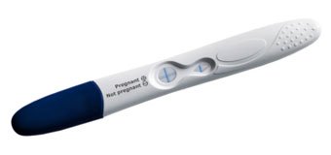
How monoclonal antibodies used in pregnancy testing
Pregnancy tests rely on monoclonal antibodies which bind to a hormone human chorionic gonadotropin (HCG)
HCG is made in the early stages of pregnancy.
Tiny amounts of the hormone are passed out of the body in the urine.
This is what is picked up by the monoclonal antibodies in the pregnancy test.
https://www.youtube.com/watch?v=aOfWTscU8YM

Slide 63
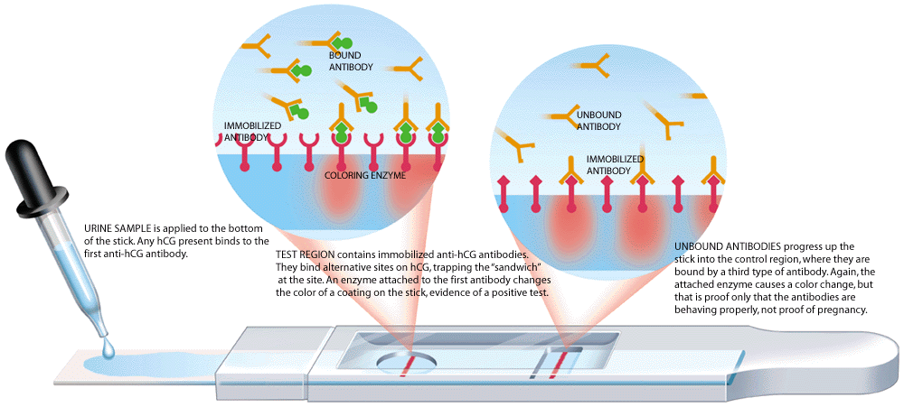
Prevents false negative results

Slide 64
Positive result seen in window
1st Anti HCG monoclonal antibody
HCG Hormone
Antibody binds to first anti HCG antibody. Proves test is working
Enzyme causing colour change or directly attached to blue latex
2nd Anti HCG monoclonal antibody-bound to strip

Slide 65
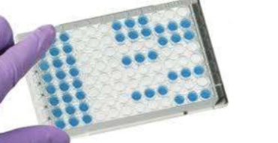
Enzyme–Linked Immunosorbant Assay (ElISA)
Two types of ELISA
  Direct ELISA
  Indirect ELISA
https://www.youtube.com/watch?v=q4dY52v-IsY

Slide 66
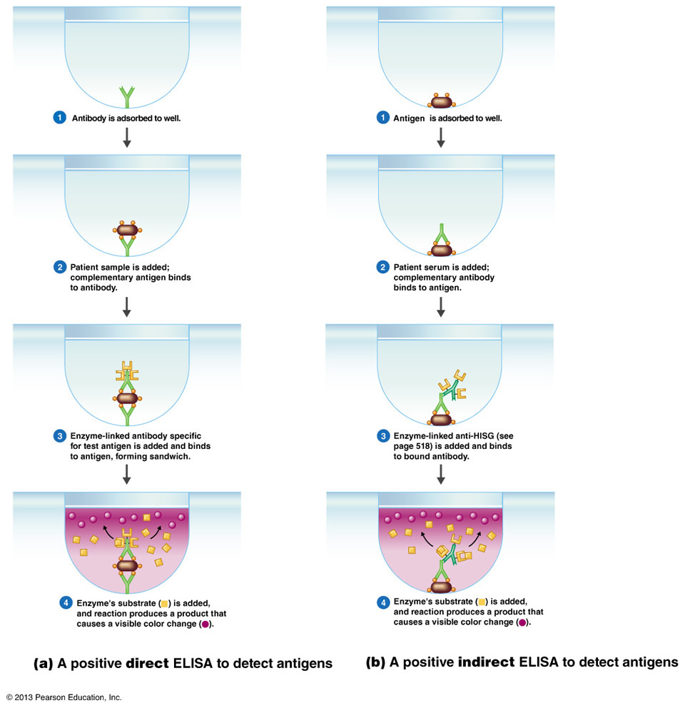

Slide 67
Washing
Between each step you have to wash the ELISA plate.
Why?
Wash steps are repeated between each step to remove unbound materials.
False positives

Slide 68
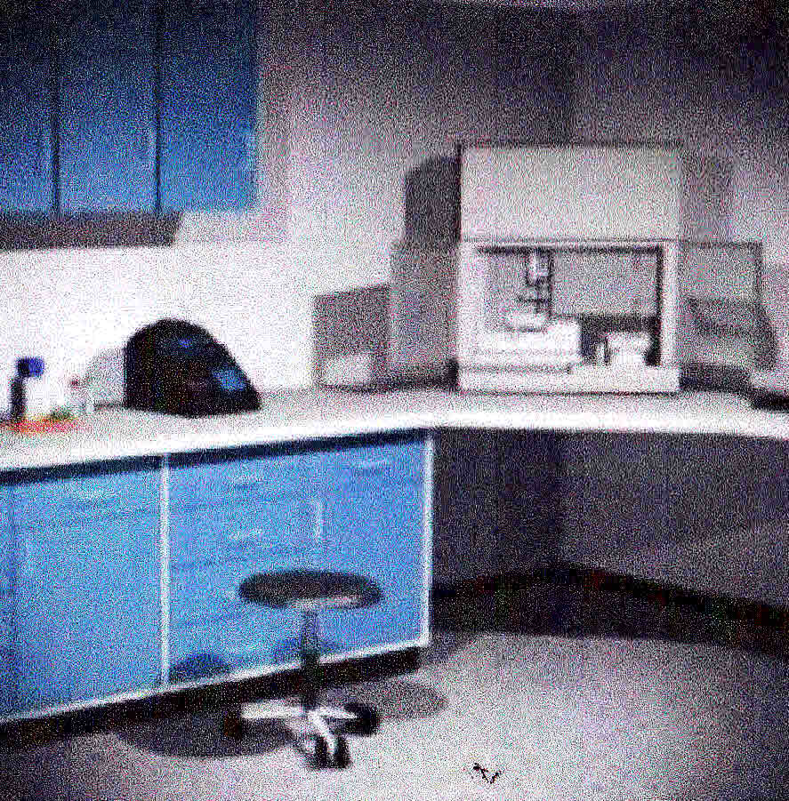
ELISA TEST Virtual Lab Activity
ELISA - Enzyme-Linked Immunosorbent Assay; this is an assay that uses an enzyme linked to an antibody. In this experiment, a colourless substrate is turned into a coloured product by the bound enzyme. The amount of activity of this enzyme (as determined by detection of the amount of coloured product) is used as a measurement of the amount of bound antibody.
http://media.hhmi.org/biointeractive/vlabs/immunology/index.html Howard Hughes Medical Institute Virtual lab exercise, performing an ELISA test on the blood serum of three patients and diagnosing which have the disease Lupus erythematosus, an autoimmune disease.
Notes:
Systemic Lupus Erythematosus (SLE) - Lupus is believed to be an autoimmune disease. The cause of lupus has yet to be determined. The immune system is your body's defense mechanism against foreign particles called antigens. Sometimes the immune system loses the ability to distinguish between its own body components and antigens. Instead of fighting antigens, the antibodies mistakenly fight the body's own cells. This is referred to as an autoimmune response (auto means self) and the body mistakenly makes autoantibodies. A systemic disease is one in which several different parts of the body may be affected. In systemic lupus, these include the skin, kidneys, nervous system, lungs, heart and/ or blood-forming organs.

Slide 69
Types of immunity and vaccination
Primary, secondary immune responses, herd immunity

Slide 70
Objectives
Extract from Specification
The primary and secondary response
The use of vaccines to provide protection for individuals and populations against disease. The concept of herd immunity.
The difference between active and passive immunity.
Students should be able to:
Discuss ethical issues associated with the use of vaccines and monoclonal antibodies.
Evaluate methodology, evidence and data relating to the use of vaccines and monoclonal antibodies.

Slide 71
Types of Immunity
Active Immunity - Results from your immune system producing memory cells following exposure to an antigen
Passive Immunity - Results from being given antibodies from a different organism (mother to baby via placenta or via blood injection eg to combat a tetanus infection)

Slide 72
Active immunity
They can be either be artificially or naturally acquired.
Naturally acquired active-when a pathogen enters the body and immune system is activated to produce antibodies
Artificially acquired active-vaccinations. This involves inducing an immune response in an individual, without them suffering the symptoms of the disease

Slide 73
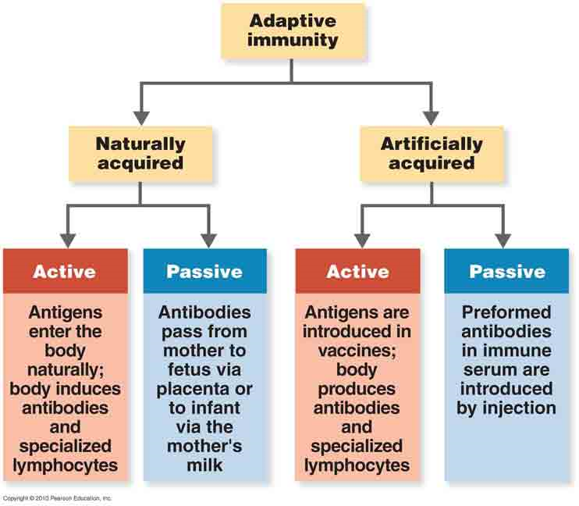

Slide 74
Comparison active and passive immunity
Features | Active Immunity | Passive Immunity
Requires exposure to an antigen
Requires time for immunity to develop
Memory cells produced
Protection is long term or short term

Slide 75
Comparison active and passive immunity
Features | Active Immunity | Passive Immunity
Requires exposure to an antigen | yes | No
Requires time for immunity to develop | yes | No
Memory cells produced | yes | No
Protection is long term or short term | long term | short term

Slide 76
What is a vaccine?
Definition : The introduction of a vaccine containing appropriate disease antigens into the body by injection or mouth to induce artificial immunity
A vaccine is a preparation of antigens from a pathogen.
Vaccines aim to give you an immunity against a particular disease by stimulating an immune response to a specific pathogen.
They cause the production of memory cells which can be rapidly activated on subsequent infections.
How can a vaccine be made harmless so it does not itself cause disease? Make a list of ideas in rough!

Slide 77

Vaccine Question Answer ref booklet p 11
How can a vaccine be made harmless so it does not itself cause disease?
  Killing the pathogen but leaving the antigens unaffected eg vaccine against cholera
  Weakening the pathogen (attenuation) eg Sabin oral vaccine against polio
  Removing the antigens from the surface of the pathogen and using purified antigens to make a vaccine eg vaccine against Hepatitis B

Slide 78
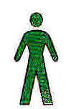
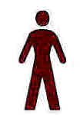
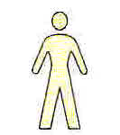
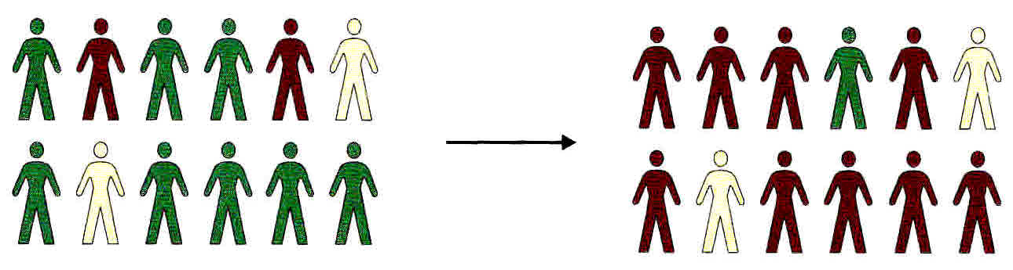
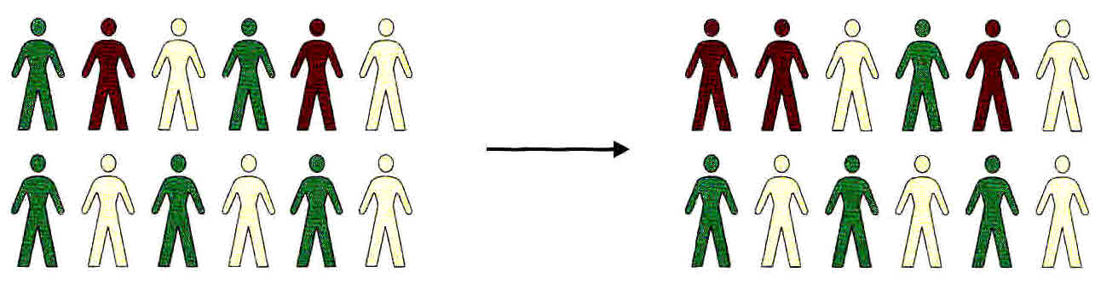
Herd Immunity: Why Does Vaccination of many people give protection to Unvaccinated Members of a population?
(Ref booklet p 10, new text p 116 old text p 112, CGP p 121)
Not vaccinated but still healthy
When few people are vaccinated, few unvaccinated people are protected.
Because there are many people close by to catch the disease from.
Infected
Vaccinated
When many people are vaccinated, many unvaccinated people are protected.
Because they are less likely to be in contact with an infected person.
http://ed.ted.com/on/3oaaKieN

Slide 79
Herd Immunity - Where unvaccinated people are protected because occurrence of a disease is reduced by the number of people who are vaccinated.

Slide 80
Ethics with vaccination-Group work
Produce a presentation in groups
You will be assigned a group and a title to research
What are the problems associated with controlling Cholera, TB and Flu? (Goup 1)
What are the Ethical issues surrounding the use of vaccines?
  Should we vaccinate as vaccines can cause side affects? –MMR vaccine, elephant drug trial (Group 2)
  On whom should vaccines be tested? –animals and or humans (Group 3)
  Should vaccination be compulsory? (Group 4)
When discussing ethical issues students should present a balanced view that reflects both sides of the debate. Arguments should be supported with relevant biological information”

Slide 81
Ethics of vaccination.
Before a vaccination can be used it must be tested on animals. How acceptable is this? What are the arguments?
Once tested on animals new vaccinations are then tested on humans. On whom should the vaccines be tested? How should the trials be carried out? What are the issues?
Vaccines have side effects that may sometimes cause long term harm. How can the risk of side effects be balanced against the risk of developing a disease that may cause even greater harm?.
To be fully effective the majority (preferably all) of the population should be vaccinated? What are the issues with this approach?
Should expensive vaccination programmes continue when a disease is fully eradicated?

Slide 82
How the Measles Virus ambushes the human immune system
https://www.youtube.com/watch?v=y0opgc1WoS4
Read about the MMR vaccine on page 113 in your text books

Slide 83
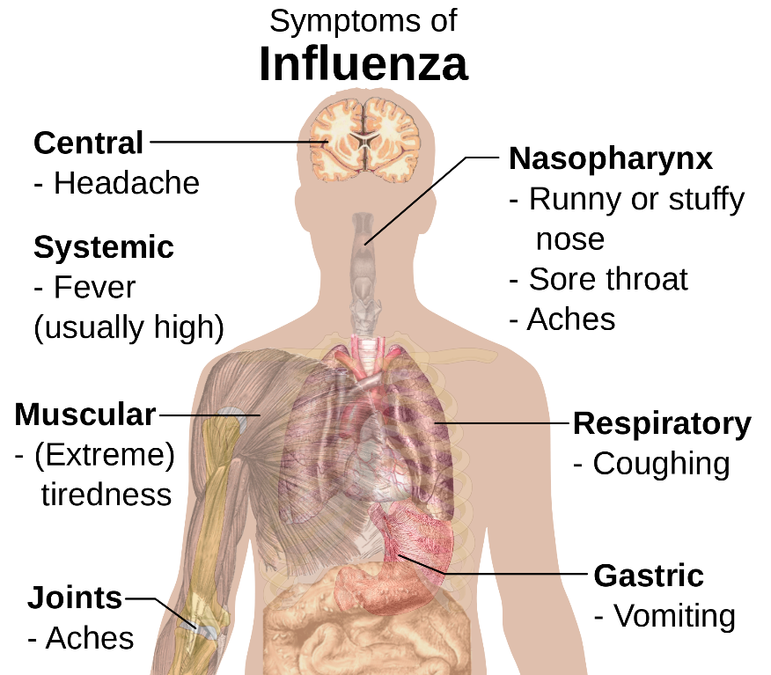
Why vaccines don’t always work-Antigen Variability
Memory cells explain why most of us develop diseases just one in a life time. The pathogens are a single type that can quickly be recognised.
But what about other diseases?
Notes:
Ref p 116 T&T new spec and p108 old spec

Slide 84
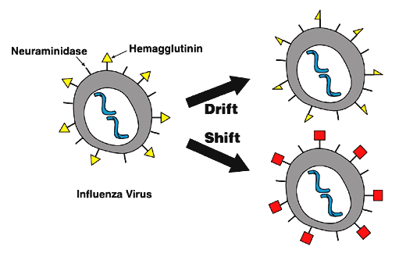
Antigen Variability
Some pathogens mutate often, so their antigens change regularly and suddenly. They exhibit Antigenic variability.
So the memory cells from the first infection will not recognise the variant antigens of the second.
The immune system must start from scratch with a new primary response.
Primary responses are slower than secondary responses, so you will show symptoms of the disease.
Notes:
Ref p 116 T&T new spec and p108 old spec

Slide 85
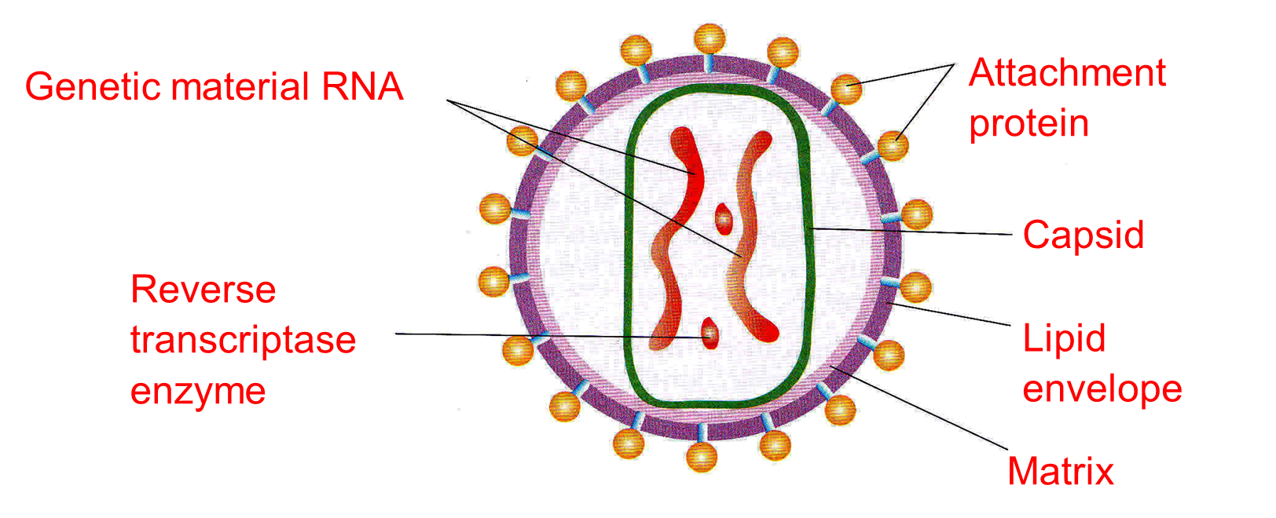
HIV Structure - Human Immunodeficiency Virus

Slide 86
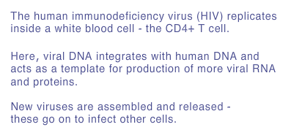
HIV Human Immunodeficiency Virus
https://www.youtube.com/watch?v=RO8MP3wMvqg
Great video but in more detail than required-stop before control of HIV

Slide 87
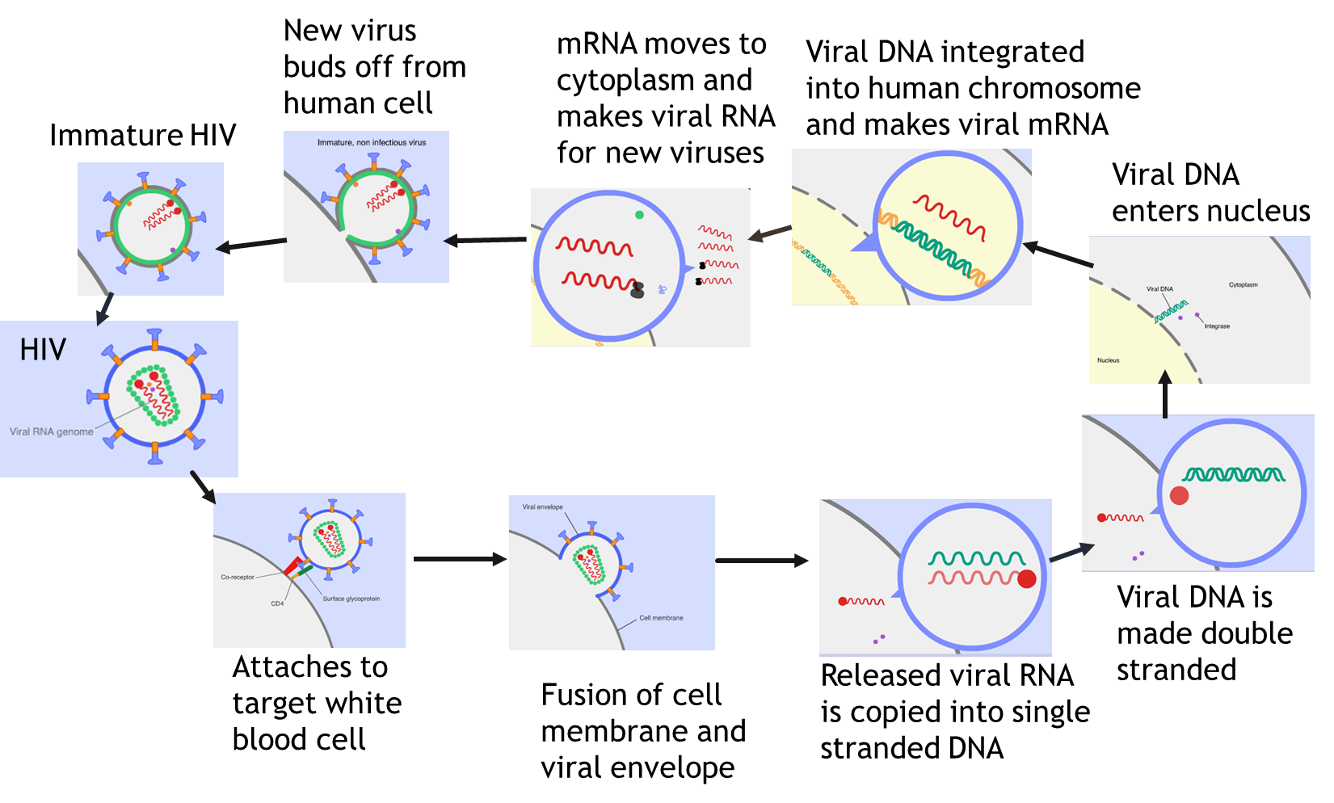
HIV Life Cycle
http://www.liquidjigsaw.com/science/animation/animations/hiv/hiv-lifecycle.html
Welcome trust link

Slide 88
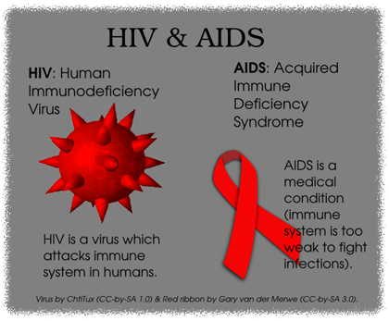
HIV and AIDS
AIDS: Acquired immune deficiency syndrome
The Human Immunodeficiency virus (HIV) causes the symptoms AIDS
HIV does not directly kill a person
It kills or interferes with the normal functioning of helper T-cells.
So the body cannot produce adequate numbers of B-cells to produce antibodies or Cytotoxic T-cells to kill infected cells.
So the body’s immune response is reduced and it is more susceptible to infections and cancer.
These secondary infections ultimately cause death.

Slide 89
Why are Antibiotics No Use Against Viruses?
First consider the structure of bacterial cells. Topic Crosslink!
  Bacterial cell wall made of ?
  Water enters by ?
  Cell wall prevents excessive expansion because it is ?
  Some Antibiotics inhibit enzymes needed for cell wall synthesis. This means the cell wall is weakened, too much water enters by osmosis and the cell suffers osmotic lysis. (death by osmosis!)
  Others bind to bacterial ribosomes, so inhibit protein synthesis.
  Some antibiotics inhibit DNA replication.
  Some work by disrupting cell membranes.
  IE they all interfere with the bacterial metabolism!
Do viruses have their own metabolic pathways and any of the above structures?

Slide 90
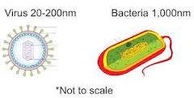
Why are Antibiotics No Use Against Viruses?
  ANSWER :
  Viruses do not have a cell wall made of murein
  Do not have metabolism of their own.
  They get the host cell to metabolise what they need and the antibiotics can't get into the host cell.

Slide 91
HIV Human Immunodeficiency Virus
Watch the animations
http://www.wellcome.ac.uk/Education-resources/Education-and-learning/Resources/Animation/WTDV026676.htm HIV Life Cycle video clip 5 min 12 s
http://highered.mheducation.com/olc/dl/120088/micro41.swf HIV Replication animation

Slide 92
ANSWER to Question
5.(a)Injection of antigens/toxoids;
(Antigen from) attenuated microorganism/non-virulent microorganisms/dead
microorganisms/isolated from microorganism;
Stimulates the formation of memory cells; max 2
(b) (i) Antibodies are specific to mumps antigen;
2nd antibodies specific to mumps antibody; 1
(ii) Removes unbound 2nd antibodies;
Otherwise enzyme may be present/may get colour change
anyway/false positive; 2
(iii) No antibodies to bind (to antigen);
Therefore 2nd antibody (with the enzyme) won’t bind;
No enzyme/enzyme-carrying antibody present
(after washing in step 4); max 2
[7]

Slide 93
Ted Ed talk on the immune system
http://ed.ted.com/on/uJ4BVyIr
http://www.sbs.utexas.edu/psaxena/MicrobiologyAnimations/Animations/HumoralImmunity/micro_humoral.swf (Link from AQA SOW) Good clear animation of humoral response. Can give overview or go into more detail using the 3 tabs on the screen. Detail given is a good level.
http://highered.mheducation.com/sites/0072507470/student_view0/chapter22/animation__the_immune_response.html 2 min. Shows Antigen Presentation, Action of Cytotoxic T cells (cell mediated response) and action of B- cells (Humoral response). (same AQA SOW link as shown in the cell mediated response)

