Slide 1
Cell Recognition and the Immune System
Supporting slides
Notes:
Working on basis of 2 weeks theory (6 double lessons) plus one double lesson q pack consolidation work / mini test

Slide 2
Specification: section 3.2.4
Each type of cell has specific molecules on its surface that identify it. These molecules include proteins and enable the immune system to identify:
Pathogens
Cells from other organisms of the same species
Abnormal cells
Toxins
Definition of an antigen. The effect of antigen variability on disease and disease prevention.
Phagocytosis of pathogens. The subsequent destruction of ingested pathogens by lysozymes.
The response of T lymphocytes to a foreign antigen. (the cellular response).
The role of antigen-presenting cells in the cellular response.
The role of helper T cells (TH cells) in stimulating cytotoxic T cells (TC cells), B cells and phagocytes. The role of other T cells is not required.

Slide 3
Specification: section 3.2.4 continued
The response of B lymphocytes to a foreign antigen, clonal selection and the release of monoclonal antibodies (the humoral response).
Definition of antibody
Antibody structure
The formation of an antigen-antibody complex, leading to the destruction of the antigen, limited to agglutination and phagocytosis of bacterial cells.
The roles of plasma cells and of memory cells in producing primary and secondary immune responses.
The use of vaccines to provide protection for individuals and populations against disease. The concept of herd immunity.
The difference between active and passive immunity.
Structure of the human immunodeficiency virus (HIV) and its replication in helper T cells.
How HIV causes the symptoms of AIDS. Why antibiotics are ineffective against viruses.

Slide 4
Specification: section 3.2.4 continued
The use of monoclonal antibodies in:
Targeting medication to specific cell types by attaching a therapeutic drug to an antibody.
Medical diagnosis.
Details of the production of monoclonal antibodies is not required.
Ethical issues associated with the use of vaccines and monoclonal antibodies.
The use of antibodies in the ELISA test.
Students should be able to:
Discuss ethical issues associated with the use of vaccines and monoclonal antibodies.
Evaluate methodology, evidence and data relating to the use of vaccines and monoclonal antibodies.

Slide 5
Introductory Video Overview / Preliminary Work.
Watch the video Virtual Body – The Immune System on estream. (20 mins)
http://estream.godalming.ac.uk/View.aspx?id=1298~4u~vx7bUQN6&chapID=1582
Answer the questions about the video.

Slide 6
Answers to Questions from Video ‘The Immune System’
Give 4 mechanisms that are part of the body’s first line of defence.
Skin (a physical barrier);
mucus membranes lining orifices and hairs / cilia lining airways;
chemical methods:- sweat, saliva, tears, stomach acid;
our own harmless bacteria in and around our skin
State 3 chemical defence mechanisms. sweat saliva and tears
Name 2 white cells produced in the bone marrow? Phagocytes and lymphocytes
What is puss made up of? Dead phagocytes, destroyed bacteria and other cell debris.
What is an antigen? Any substance that triggers an immune response. Can be a protein or carbohydrate and can also be a toxin.
What is a toxin? A chemical released by certain invaders
Name a bacteriuim that releases a toxin. Tetanus bacterium
What is a toxoid? A toxin modified toxin able to be safely used in vaccinations.
How do killer T-cells kill pathogens and also infected body cells? Punch holes n the cells so they die.
Message to Teachers. I don’t know where you might want this slide in order to avoid students simply copying the answers instead of doing the preparatory work! Maybe on your own versions of the P/pt not accessible to student? The answers are in the Teacher booklet anyway!
Kay

Slide 7
Lessons 1 & 2: Antigens, Specific and non-specific Immune Responses and Phagocytosis
Lesson Outcomes – You should be able to:-
Define the words antigen, phagocyte, pathogen, toxin, lysozymes, phagosome, antigen presentation.
Explain the difference between the specific and non-specific immune responses.
Describe in detail how a pathogen that enters the body can be destroyed by phagocytosis.
Explain the role of lysozymes in the destruction of pathogens.
Explain the purpose of antigen presentation following destruction.

Slide 8
Starter: What Do You Know/Remember from GCSE?
Which blood cells help defend the body against pathogens?
Name 3 ways they can do this.
What is a vaccination and what does it make the body do?
What vaccine is used against measles mumps and rubella?
If much of a population is immune to a pathogen, how is the spread of the pathogen affected?
Now write down as many facts as you know about the body’s defence against disease.

Slide 9
Starter: What Do You Know/Remember from GCSE?
Which blood cells help defend the body against pathogens? white
Name 3 ways they can do this. Ingesting the pathogen, producing antibodies, producing antitoxins.
What is a vaccination and what does it make the body do? Dead or inactive forms of pathogens that are introduced into the body, and which stimulate white blood cells to produce antibodies and form immunity to future infections of that particular pathogen.
What vaccine is used against measles mumps and rubella? MMR
If much of a population is immune to a pathogen, how is the spread of the pathogen affected? Very much reduced spread.
Gather additional facts from class.

Slide 10
Summary of Defence Mechanisms (ref old T&T p 101, new T&T p 103)
Defence mechanisms
Non specific
response is immediate
and the same for all pathogens
Specific
response is slower and
specific to each pathogen
Physical barrier
e.g. skin
phagocytosis
Cell-mediated response
T lymphocytes
Humoral response
B lymphocytes
Notes:
Diagram based on fig 2 p103 (New spec.) T & T A level Biology and p 101 (Old Spec.) T & T AS Biology

Slide 11
Immune System Defence Mechanisms
NON SPECIFIC RESPONSE
Phagocytosis
DOES NOT target a particular type of invader. Phagocytic white blood cells e.g. MACROPHAGES ingest invading cells, destroying them.
SPECIFIC RESPONSES
Cellular Response / Cell Mediated Immunity
DOES target a particular invader that has got inside cells.
Involves T-lymphocytes (T-cells) which must be activated to produce clones but no antibodies are produced.
Humoral Response
DOES target a particular invader or toxin that is outside cells but in body fluids (e.g. in blood stream, lymph or tissue fluid).
Involves B-lymphocytes (B-cells) which must be activated to produce clones some of which produce antibodies.

Slide 12
Pathogens and the Body’s Defence Mechanisms
All cells have specific molecules on their cell surfaces that provide self identification. The organism recognises its own surface molecules as self antigens
Pathogens are organisms (usually microorganisms) that cause disease e.g. viruses, bacteria and fungi.
All pathogens have molecules on their surfaces that are identified as foreign antigens (simply called antigens) by the invaded body’s immune system cells.
These foreign antigens elicit an immune response.

Slide 13
Self and Non-Self Antigens
Self antigens – ‘own’ molecules ie part of your body
Self-antigens – molecules on the surface of your own cells. No immune response occurs.
Muscle cell
Liver cell
Non-Self antigens – not part of body
Non-self-antigen – molecules on a virus or bacteria that trigger an immune response from your immune system
bacterium
Note: If someone else receives your cells as a transplant, your self antigens are foreign to the recipient so trigger an immune response in that person.

Slide 14
Antigen Definition
An antigen is any part of an organism or substance that is recognized as non-self (foreign) by the immune system and stimulates an immune response. (Definition Ref. p 106 new T&T, p 104 old T&T)
Molecules that act as antigens and trigger an immune response include:
Proteins that are part of the cell surface membrane (in some cases carbohydrates on the membrane) of invading cells e.g. pathogens
Cell walls of invading cells
Cancerous cell antigens which are abnormal and act as foreign antigens.
Toxins (poisonous molecules) eg those produced by bacteria.
Cell surface membrane molecules from cells of individuals of the same species.
Notes:
Clostridium botulinum produces a toxin and the tetanus bacterium produces a toxin.

Slide 15
What are the B-Cells and T-cells mentioned in the overview map on slide 12 (this slide is not in the student booklet!)
They are a lymphocytes (a type of white blood cell) that have receptors on their membrane surfaces like antibodies.
They are involved in the specific immune response.
Each cell’s receptors are complementary to a SPECIFIC antigen, so each can target only one type of antigen.
So we usually draw the B-cells and T-cells like this with antibodies sticking outwards from the membrane

Slide 16
Phagocytosis Web Links
http://www.microbelibrary.org/images/tterry/anim/phago053.html interactive roll mouse over explanation of phagocytosis. (link used in old AQA spec)
http://www.edumedia-sciences.com/en/a82-phagocytosis sample animation, very clear trial sample but have to register to get full version. (link used in old AQA spec)
http://highered.mheducation.com/sites/0072495855/student_view0/chapter2/animation__phagocytosis.html 1 min detailed animation of phagocytosis including coating with complement (opsonisation) to enhance phagocytosis. (link from AQA SOW)
http://www.dnatube.com/video/116/Neutrophil-attacts-on-bacteria 1 min video clip of neutrophil chasing a bacterium and then engulfing it by phagocytosis. (link from AQA SOW)

Slide 17
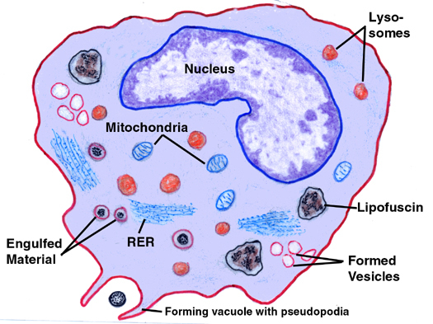
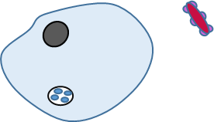
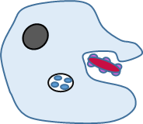
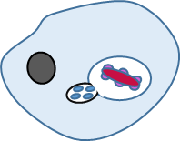
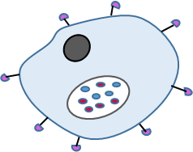
Phagocytosis
Phagocyte
Pathogen
nucleus
Antigens on surface of pathogen
Phagosome vacuole forming
Lysosome fuses with phagosome
Lysosome containing lysozyme enzymes
Phagocyte presents antigens on its surface

Slide 18
Phagocytosis continued
The lysozymes (lytic enzymes) breakdown the pathogen.
The pathogen’s antigen molecules are moved to the phagocyte’s cell surface and displayed.(antigen presentation)
They act as markers to the specific immune system to activate other immune system cells.
Note: The enzyme lysozyme is also found in tears! Why might this be so?
(answer is on notes pane below)
Notes:
The protective coating of the eye, and the tear ducts, are potential entry points for pathogens. The eyes are vulnerable to infection because the coverings are thin to allow light through. Lysozyme will break down the cell walls of any bacterial pathogens and so destroy them before they can cause harm. (ref p 612 New T&T text and p 247 Old spec T&T AS text)

Slide 19
Plenary
Answer the summary questions from pages 101 and 103 T&T AS Old spec text or from pages 103 and 105 New spec text.

Slide 20
Lessons 3 & 4: The Cellular Response and the Role of T-Lymphocytes.
Lesson Outcomes: You should be able to:
Explain what is meant by the specific immune response.
Describe and explain the sequence of events of the cell mediated (cellular) response.
Explain the roles played by Helper T cells.
Define the words lymphocyte, T-lymphocyte, B-lymphocyte, cytotoxic T cell (T_{C} cell), helper T cell (T_{H} cell), antigen presenting cell, cytokines, perforin

Slide 21
Starter Activity
Draw and label an antigen presenting cell on a white board.(Label the presented antigen molecules and the self antigens)
What types of cells may display foreign antigens on their surfaces?
What type of cells will respond to cells that display foreign antigens? (Ref T&T Old spec AS p 105 / T&T New spec p 107.)
What is meant by the specific immune response?
Read p 105 /107 T&T.

Slide 22
Answers to starter activity
Self antigen
Antigen presenting cell e.g. a phagocyte
Foreign (non-self) antigen displayed on cell surface
Cell surface membrane
Infected body cells and phagocytic white blood cells (macrophages).
T-lymphocytes
The specific immune response is the response of lymphocytes to specific pathogens. Each lymphocyte is specific to a particular pathogen. In contrast phagocytes attack and engulf any foreign invader. They are non specific.

Slide 23
Animations of the Cellular Response
http://highered.mheducation.com/sites/0072507470/student_view0/chapter22/animation__the_immune_response.html 2 min. The Immune response giving overview of Antigen Presentation, Action of Cytotoxic T cells (cell mediated response) and action of B- cells (Humoral response). (link from AQA SOW)
http://www.sbs.utexas.edu/psaxena/MicrobiologyAnimations/Animations/Cell-MediatedImmunity/micro_cell-mediated.swf 4 min. Good animation of actions of Helper T cells and Cytotoxic T cells. (link from AQA SOW)
Screen shots of this are on next slide.
Extension Animation
http://highered.mheducation.com/olc/dl/120110/micro34.swf Cytotoxic T-cell Activity against Target cells. Animation 1 min Extension. More detail than needed.

Slide 24
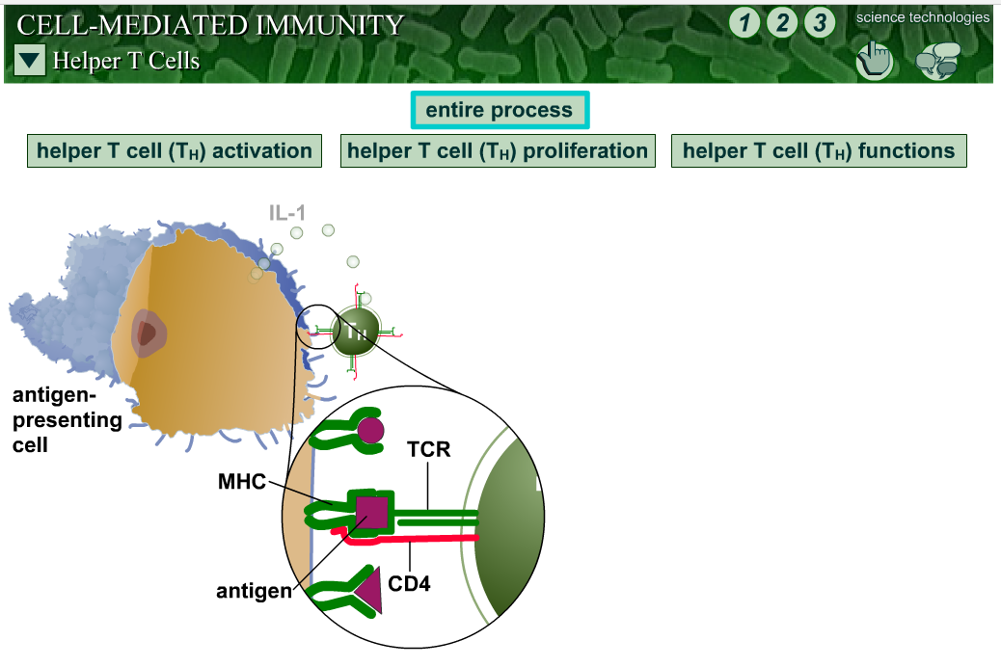
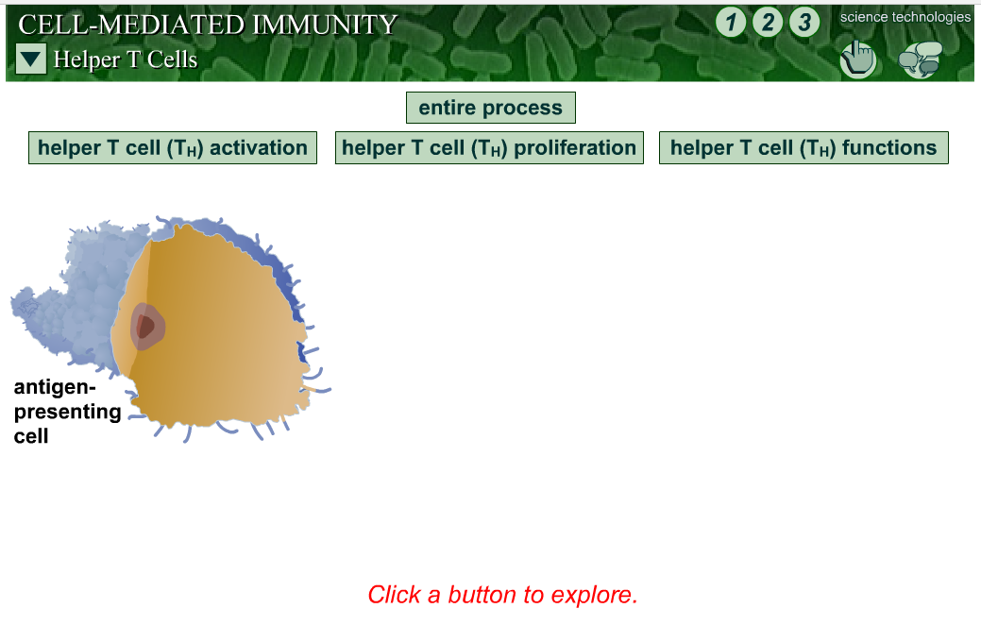
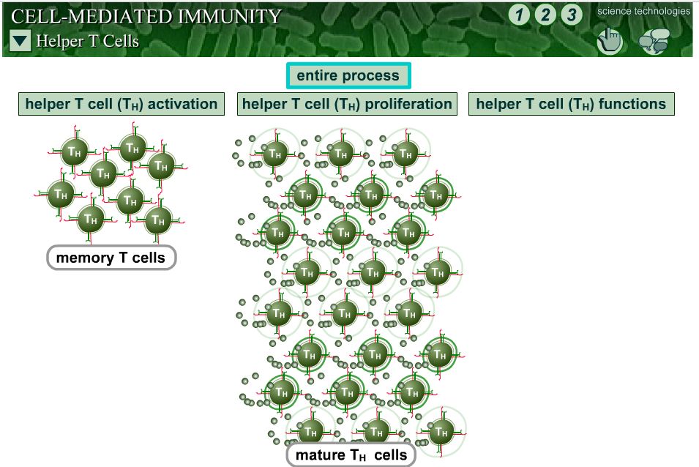
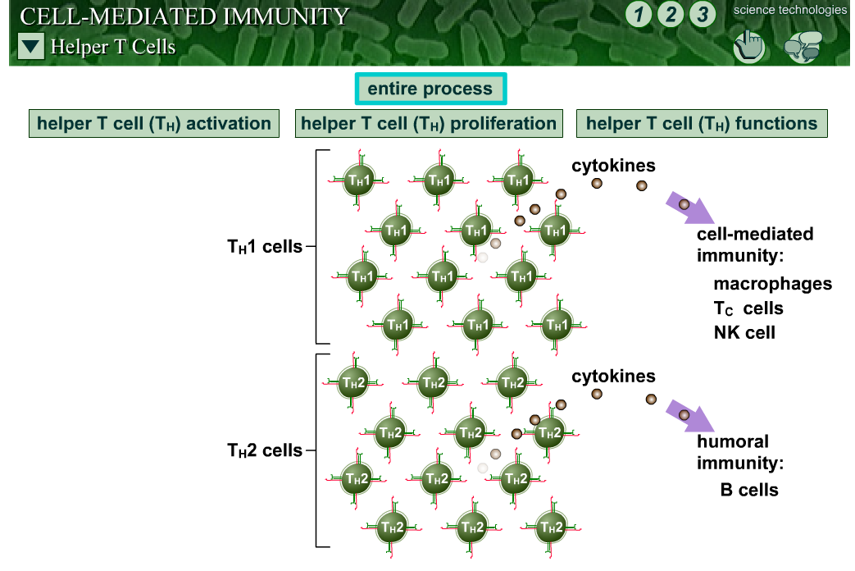
Antigen Presenting Cell Activates T-cell Proliferation (clone production).

Slide 25
The Cell Mediated Response - Diagrammatic
1 Pathogen attacks body cell
2 Infected body cell PRESENTS invader’s antigens on its surface
3 A Helper T-cell (T_{H} cell) with complementary shaped receptors binds to the antigens
Body Cell eg macrophage
Infected Body Cell
Infected Body Cell
T-Cell
Antigen
4 The Helper T-cell is activated to divide by mitosis and produce many clones which do several things including:
Some develop into Memory T-cells
Some stimulate phagocytes to engulf pathogens, others work as Helper T cells that stimulate B cells to divide
Some activate Cytotoxic T-cells (T_{C} cells)

Slide 26
Cell-Mediated Response - continued
Each T-lymphocyte can only respond to one type of antigen. Its surface receptors are complementary in shape to one specific antigen.
It responds to antigens that are PRESENTED on the surface of INFECTED BODY CELLS.
Infected body cells place the foreign antigens on their own membranes.
This is called ANTIGEN PRESENTATION and acts as a marker to the T-cells.
The T-cell binds to these presented antigens via its receptor molecules (complementary shapes again!) and gets activated to divide and form clones.
The clones differentiate to perform different functions.

Slide 27
Summary of the Roles of T – cell Types
Helper T-cells (T_{H} cells) help activate both B-cells and T-cells to divide and make clones as well as activating phagocytes. They do this by producing chemicals called CYTOKINES.
Cytotoxic T-cells (T_{C} cells) then destroy infected cells by punching holes in the cell surface membrane using a protein called perforin.

Slide 28
Activity – essay practice, Planning

Slide 29
Activity – Model making – plasticine plus photo video making?

Slide 30
Plenary: Put statements in the correct order
Receptors on certain T helper cells fit exactly onto these antigens.
The cloned cells:
Stimulate phagocytes to engulf pathogens by phagocytosis.
Kill infected cells.
Stimulate B cells to divide.(for the humoral response)
Develop into memory cells that enable a rapid response to future infections by the same pathogen.
The phagocyte places antigens on its cell-surface membrane.
This activates other T cells to divide rapidly by mitosis and form a clone.
Pathogens invade body cells or are taken in by phagocytes.

Slide 31
Plenary: Put statements in the correct order ANSWERS
Pathogens invade body cells or are taken in by phagocytes.
The phagocyte places antigens on its cell-surface membrane (antigen presentation).
Receptors on certain T helper cells fit exactly onto these antigens.
This activates other T cells to divide rapidly by mitosis and form a clone.
The cloned cells:
Stimulate phagocytes to engulf pathogens by phagocytosis.
Kill infected cells.
Stimulate B cells to divide.(for the humoral response)
Develop into memory cells that enable a rapid response to future infections by the same pathogen (a secondary response).

Slide 32
Lessons 5&6: Antibodies and The Humoral Response
Lesson Outcomes: You should be able to:
Draw and label the structure of an antibody.
Explain the specificity of an antibody to a particular antigen.
Explain how antibodies lead to the destruction of pathogens
Describe and explain the sequence of events in the humoral response.
Explain what is meant by a monoclonal antibody
Explain the roles of plasma cells in producing a primary response and memory cells in producing a secondary response.
Define the terms immunoglobulin, agglutination, plasma cell, memory cell, clonal selection, primary response, secondary response

Slide 33
Starter Activity: Glossary Term Matching
Glossary work – Match the terms of the first page of your glossary to the statements provided. Write them into your glossary.

Slide 34
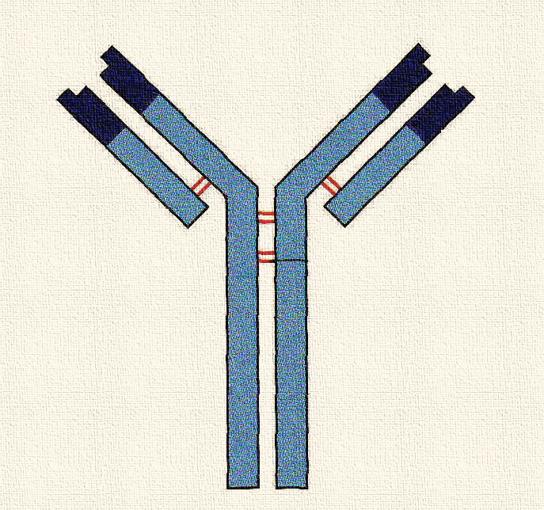
Antibodies and their Structure
Antibodies are specific GLOBULAR PROTEINS (IMMUNOGLOBULINS)
Made of 4 polypeptide chains secreted by B-lymphocytes (B-cells) in response to stimulation by an appropriate antigen.
Antibodies bind to the antigen to neutralise a pathogen.
Antigen binding site
Antigen binding site
Variable region
Light chain (short chain)
Disulphide bonds holding polypeptides together
Constant region
Heavy chain (long chain)
Receptor binding site – such as to a receptor on a B cell.

Slide 35
Antibody Definition
An antibody is a protein produced by the immune system in response to the presence of an antigen.

Slide 36
The Humoral Response Web Links
http://highered.mheducation.com/sites/0072507470/student_view0/chapter22/animation__the_immune_response.html 2 min. Shows Antigen Presentation, Action of Cytotoxic T cells (cell mediated response) and action of B- cells (Humoral response). (same AQA SOW link as shown in the cell mediated response)
http://www.sbs.utexas.edu/psaxena/MicrobiologyAnimations/Animations/HumoralImmunity/micro_humoral.swf (Link from AQA SOW) Good clear animation. Can give overview or go into more detail using the 3 tabs on the screen. Detail given is a good level.
Screen shots of this animation on next 2 slides

Slide 37
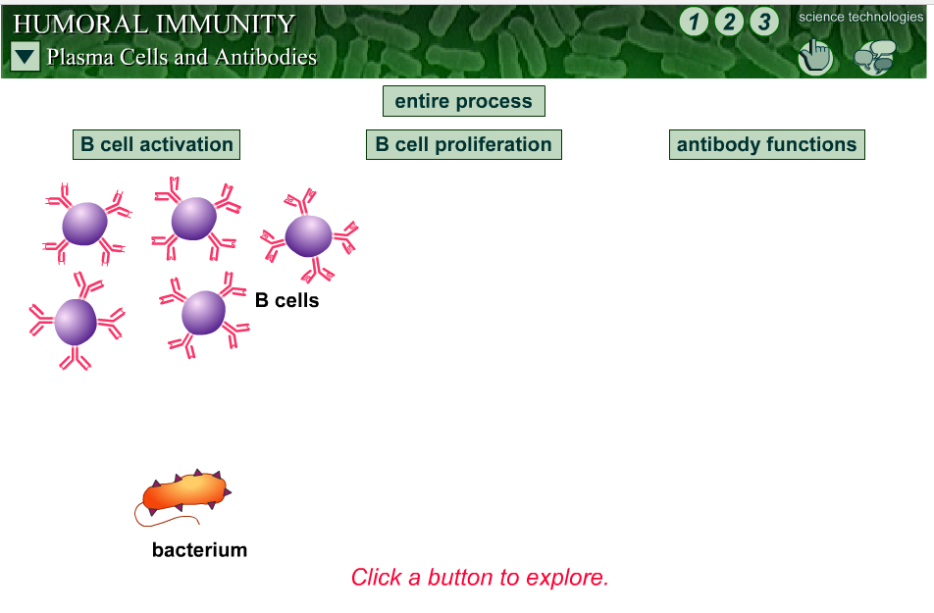
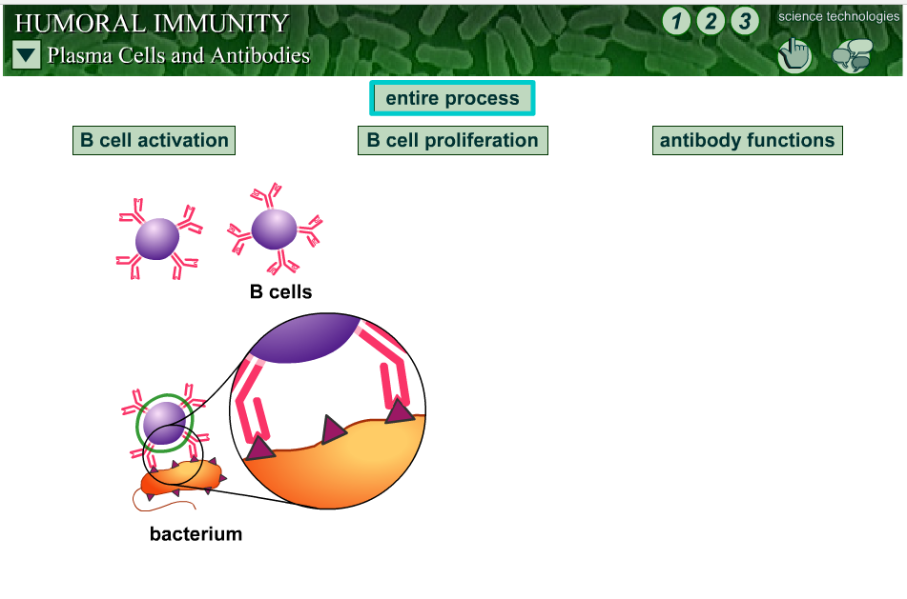
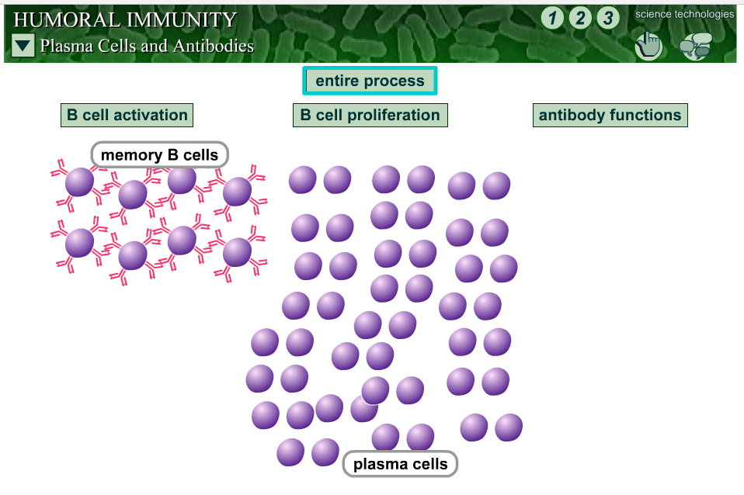
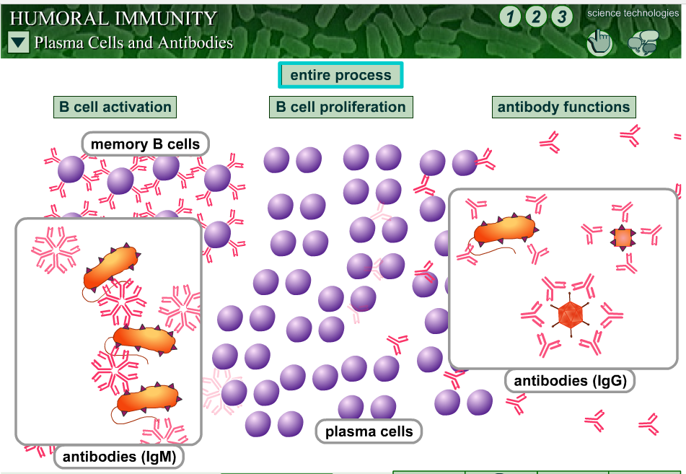
See animation 2 and booklet p 8
Notes:
See animation and booklet p 7

Slide 38
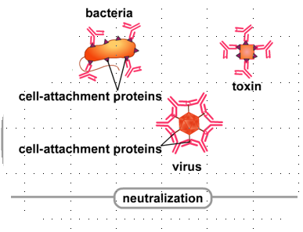
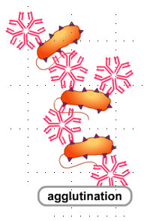
Antibody Actions snips from animation 2
Neutralisation - Bind to critical portions of toxins/bacteria/viruses or block proteins necessary for attachment to cells. (note this is not described in text only in animation)
Agglutination - Bind to more than one microbial cell causing clumping – known as agglutination

Slide 39
Action of Antibodies. (Booklet p 7)
Antibodies are produced through the Humoral Response by B lymphocytes.
They prepare the antigen for destruction so assist in its destruction!
They attach to antigens forming antigen-antibody complexes
ways they prepare the antigen for destruction include:-
Agglutination – clumping together of bacterial cells so phagocytes can easily engulf them in a group.
Attach to bacterial cells and act as markers for the phagocytes to engulf the cells.
Neutralisation – binding to critical parts of the pathogen preventing functioning. (EXTENSION -not mentioned in spec or text but on animation)

Slide 40
The Humoral Response Diagrammatically Booklet p 8
1 B-cell receptor take up antigens of pathogen
2 A Helper T-cell attaches to the presented antigens on the B-cell and activates the B-cell
B-cell
B-cell
T-Helper cell
3 The B cell divides by mitosis to produce a clone of B- cells which differentiate into memory cells and Plasma cells.
Memory cell
Plasma cell
4 The plasma cells secrete antibodies into the blood.

Slide 41
Humoral Response in more Detail could add to notes to accompany page 8 booklet.
B-cell encounters an invader with antigens complementary to its receptors.
It attaches to the antigen, ingests, processes and presents the antigens, then gets activated to divide and make clones (by MITOSIS)
The invader could be a pathogen, foreign cell, damaged or abnormal cell, or toxin produced by the invader.
A T-helper cell with the appropriate surface receptors also attaches and aids the ACTIVATION of the B-cell to make clones.
The clones differentiate into PLASMA cells and MEMORY cells. Plasma cells are larger and have much RER and ribosomes necessary for making antibodies. The antibodies made are then secreted to attack many more invading cells.
B-cell
T-Helper cell

Slide 42
What is Clonal Selection? Booklet p 8 (ref p109 new spec text – not in old text)
Clonal selection refers to the way that specific antigens ‘select’ specific B cells with complementary antibodies on their surfaces, thus stimulating them to divide and form clones (with the help of helper T-cells)
http://highered.mheducation.com/olcweb/cgi/pluginpop.cgi?it=swf::600::480::/sites/dl/free/0073532215/788107/Clonal_Selection.swf::Clonal%20Selection Clear animation of B cell being stimulated by an antigen and being activated to divide (clonal selection).

Slide 43
What are Primary and Secondary Responses? Booklet p9
Primary Response - Is the immune response triggered by the body’s FIRST contact with a particular antigen.
Production of antibodies is relatively slow during so disease may initially occur before antibodies get it under control
Secondary Response – Is the immune response triggered by the SECOND or SUBSEQUENT contact with an antigen that has previously triggered a primary response.
B-memory cells specific to the antigen are present and are activated to produce antibodies more quickly and for a longer period than the original response. So disease is usually avoided.

Slide 44
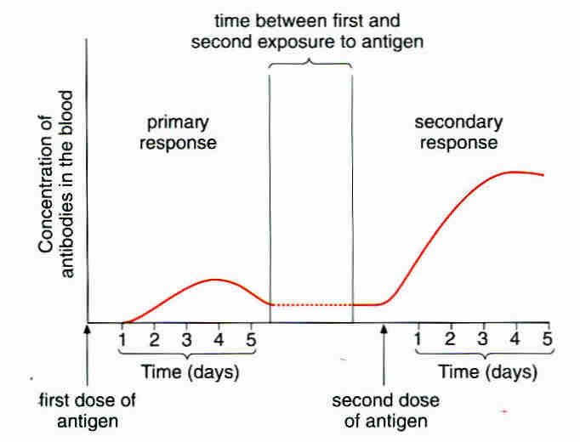
Primary and Secondary Responses Graphically booklet p 9
The secondary response is more rapid and more antibodies are produced.
This results from the presence of Memory-B cells which divide very rapidly.
The infection is fought very quickly the second time around.

Slide 45
Group work Activity: Each Group to Consider One Question and present to the Class.
Why is the cell mediated response able to destroy body cells which have turned cancerous?
Would the humoral response be used during a viral infection? Explain your answer.
Why does the secondary immune response mean that pathogens are destroyed before they are able to make you ill?
Define what an antibody is.
Explain the importance of the variable region of antibodies.
Explain the structure of antibodies in terms of the hierarchy of protein structure level.

Slide 46
Individual Activity
Answer summary questions on page 110 T&T new spec text / p 108 T&T old spec text.

Slide 47
Lesson 7&8: Antigen Variability, Active And Passive Immunity, Herd Immunity and Vaccines
Lesson outcomes: You should be able to:
Define the words antigenic variation, active immunity, passive immunity, herd immunity, vaccine,
Explain why some diseases can be caught more than once
Explain how mutations can cause antigen variability and how this can cause new strains of pathogen

Slide 48
Starter Activity: Card Sort of Immune Response Type to Consolidate Previous lessons
Sort card statements as humoral or cell mediated
Put statements into comparison table of humoral and cell mediated responses. Forgot to put this in booklet so you would have to make a blank table! K
There are 10 sets already prepared if you want to do this activity. I’ve put a plastic wallet of them in the card magazine boxes where I put all the class copies of articles I made. (between my old desk and Jackie’s, on the shelf!)

Slide 49
Starter Activity: Card Sort of Immune Response Answers
Cell Mediated Response | Humoral Response
A T_{H} cell meets an antigen presenting cell with complementary antigens and binds to the presented antigens. | The surface antigens of an invading pathogen are taken up by a B-cell.
The attachment activates the T_{H} cell to divide by mitosis and produce clones | The B cell processes the antigens and presents them on its surface
Some clones differentiate into memory T cells. | Helper T cells attach to the processed antigens on the B cell, activating it.
Some clones stimulate phagocytes to engulf pathogens | The B cell divides by mitosis and proliferates into clones.
Some clones stimulate B cells to divide in the Humoral response and secrete antibodies | Some of the clones become Plasma B cells and some become memory B cells
Some clones activate cytotoxic T cells. | The Plasma B cells produce and secrete antibodies complementary to the antigens that originally triggered the process.

Slide 50
Antigen Variability Overview Explanation
Some pathogens mutate often, so their antigens change regularly and suddenly. They exhibit Antigenic variability.
So the memory cells from the first infection will not recognise the variant antigens of the second.
The immune system must start from scratch with a new primary response.
Primary responses are slower than secondary responses, so you will show symptoms of the disease.
An example of a pathogen that regularly changes its antigens (has antigen variability) is the influenza virus.
Notes:
Ref p 116 T&T new spec and p108 old spec

Slide 51
What are Active and Passive Immunity? Booklet p 10, Old T&T p 112, New T&T p 115
Active Immunity - Results from your immune system producing memory cells following exposure to an antigen
Passive Immunity - Results from being given antibodies from a different organism (mother to baby via placenta or via blood injection eg to combat a tetanus infection)
Herd Immunity - Where unvaccinated people are protected because occurrence of a disease is reduced by the number of people who are vaccinated.

Slide 52
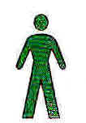
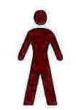
Herd Immunity: Why Does Vaccination of many people give protection to Unvaccinated Members of a population? (Ref booklet p 10, new text p 116 old text p 112, CGP p 121)
Not vaccinated but still healthy
When few people are vaccinated, few unvaccinated people are protected.
Because there are many people close by to catch the disease from.
Infected
Vaccinated
When many people are vaccinated, many unvaccinated people are protected.
Because they are less likely to be in contact with an infected person.

Slide 53
What are Vaccines, How Do they Work? Ref booklet p 11 and texts
A vaccine is a preparation of antigens from a pathogen.
Vaccines aim to give you an immunity against a particular disease by stimulating an immune response to a specific pathogen.
They cause the production of memory cells which can be rapidly activated on subsequent infections.
How can a vaccine be made harmless so it does not itself cause disease? Make a list of ideas in rough!
Answers on next slide or below in notes pane.
Notes:
Killing the pathogen but leaving the antigens unaffected eg vaccine against cholera
Weakening the pathogen (attenuation) eg Sabin oral vaccine against polio
Removing the antigens from the surface of the pathogen and using purified antigens to make a vaccine eg vaccine against Hepatitis B

Slide 54
Vaccine Question Answer ref booklet p 11
How can a vaccine be made harmless so it does not itself cause disease?
Killing the pathogen but leaving the antigens unaffected eg vaccine against cholera
Weakening the pathogen (attenuation) eg Sabin oral vaccine against polio
Removing the antigens from the surface of the pathogen and using purified antigens to make a vaccine eg vaccine against Hepatitis B

Slide 55
Herd Immunity
http://www.ovg.ox.ac.uk/herd-immunity Good simple animation of the protection and problems of herd immunity and written information page.
http://www.nhs.uk/conditions/vaccinations/pages/how-vaccines-work.aspx nhs information on vaccines including 2 short (2 min) animations .Animation 2 explains herd immunity.
https://www.youtube.com/watch?v=dxhNY6jkn80 WSPA animation explaining herd immunity in dogs and asking for immunisation of dogs against rabies.
Notes:
First 2 animations put into student booklet

Slide 56
Ethical issues Concerning the Use of Vaccines (Booklet p 12)
Read the article from BIR p 113 (the black textbook) ‘To Vaccinate or Not? A Parent’s Dilemma’.
The article is also online in the resources file.
Read the information on ethical issues from the textbook p 117 new T&T p 115 old T&T
Notes:
We have lots of copies of this text book but there is also a pdf file of the 2 pages.

Slide 57
Lessons 9&10: HIV, Monoclonal Antibodies and the ELISA test
Lesson Outcomes - You should be able to:
Explain what is meant by a monoclonal antibody
Explain how the specificity of monoclonal antibodies can be used in medical diagnosis and targeting of medication at particular cell types.
Explain the use of monoclonal antibodies in the direct and indirect ELISA techniques.
Interpret information to explain the accuracy and results of tests which use the ELISA technique
Explain the structure of HIV in infecting and replicating inside helper T-cells
Explain the distinction between being HIV positive and developing AIDS
Explain how HIV causes the symptoms of AIDS
Explain why antibiotics are ineffective against viruses (and crosslink to cell structure)

Slide 58
What are Monoclonal Antibodies (Booklet p 13, ref new text p 112, old text p 110 CGP p 124)
Antibodies of a desired type, specific to a particular antigen.
Produced by cultured HYBRIDOMA cells. (cells fused from a B-cell and a human tumour cell).
Isolated B-cells cannot survive in a culture for us to extract desired antibodies.
HYBRIDOMA cells can survive in culture and produce the desired antibodies.
Q Why do we use a human tumour cell in the production?
Q Why can’t we just extract antibodies directly from blood stores?
Notes:
The tumour cell Humanises the hybrid cell so it’s antibodies won’t be rejected by the human recipient. Blood contains many different B-cells and it would be difficult to extract the right ones and get enough antibodies.

Slide 59
What are Monoclonal Antibodies Used for?
Medical Uses
To target specific cells and substances.
e.g. Antibodies specific to cancer cell antigens.
They attach to receptors on cancer cells
They block chemical signals that stimulate uncontrolled growth.
To Diagnose disease
e.g. flu, hepatitis and chlamydia.
To diagnose certain cancers e.g. prostate cancer
Pregnancy testing

Slide 60
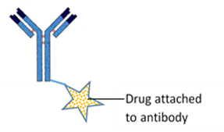
Two Ways Monoclonal Antibodies are Used against Cancer
Attaching a cytotoxic drug to the antibodies. It only targets the cancer cells to which it attaches.
Binding directly to a cancer cell and blocking it receiving chemical signals that stimulate uncontrolled growth.
For additional Information see “Biofactsheet 219 Monoclonal Antibodies - an Update”

Slide 61
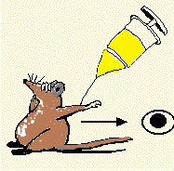
Monoclonal Antibodies – Ethical Issues
Squeak OW, OW, OW!
What are the ethical issues this procedure and its uses raises?
Discuss in groups and write down your ideas
Read T&T p 113 to elaborate and consolidate your ideas.

Slide 62
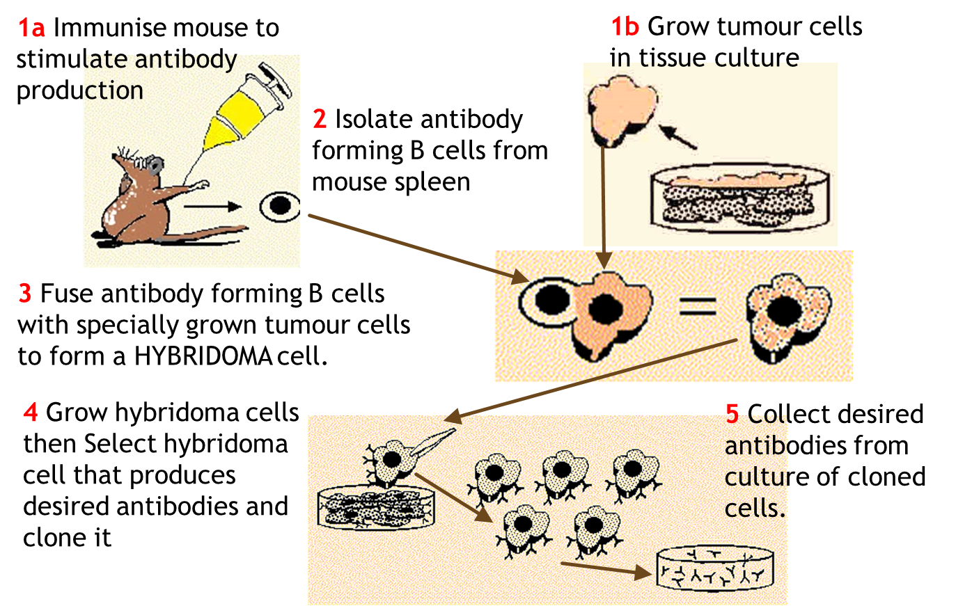
Extension/Background: Monoclonal Antibody Production
“Details of monoclonal antibody production is not required” AQA spec.
http://highered.mheducation.com/olc/dl/120110/micro43.swf Animation of how monoclonal antibodies are made.

Slide 63
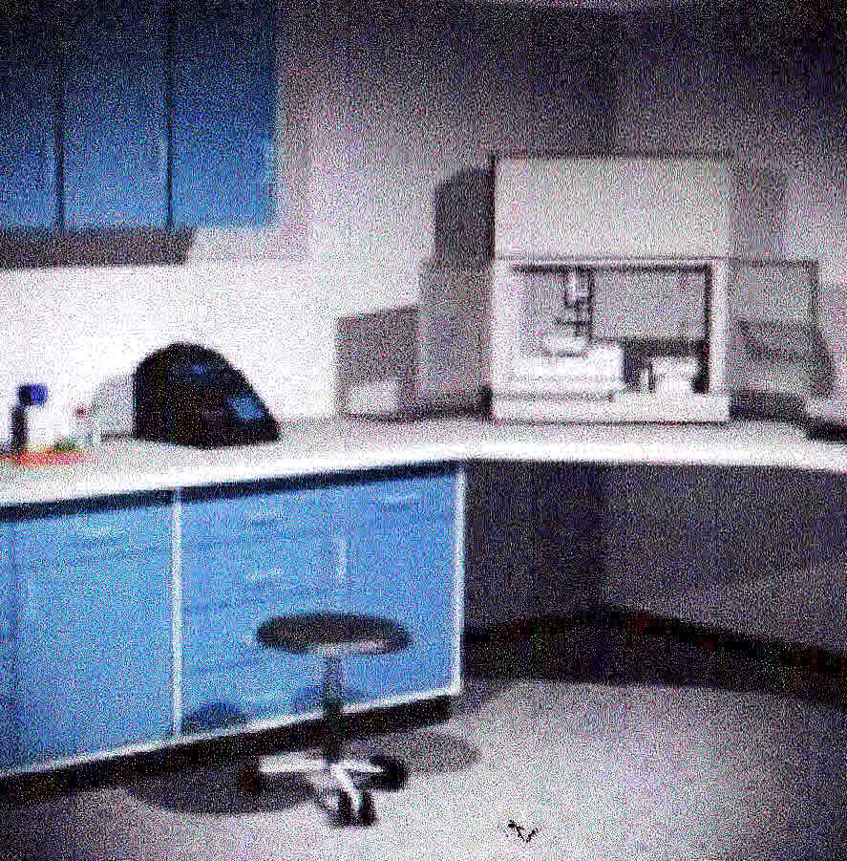
ELISA TEST Virtual Lab Activity
ELISA - Enzyme-Linked Immunosorbent Assay; this is an assay that uses an enzyme linked to an antibody. In this experiment, a colourless substrate is turned into a coloured product by the bound enzyme. The amount of activity of this enzyme (as determined by detection of the amount of coloured product) is used as a measurement of the amount of bound antibody.
http://media.hhmi.org/biointeractive/vlabs/immunology/index.html Howard Hughes Medical Institute Virtual lab exercise, performing an ELISA test on the blood serum of three patients and diagnosing which have the disease Lupus erythematosus, an autoimmune disease.
Notes:
Systemic Lupus Erythematosus (SLE) - Lupus is believed to be an autoimmune disease. The cause of lupus has yet to be determined. The immune system is your body's defense mechanism against foreign particles called antigens. Sometimes the immune system loses the ability to distinguish between its own body components and antigens. Instead of fighting antigens, the antibodies mistakenly fight the body's own cells. This is referred to as an autoimmune response (auto means self) and the body mistakenly makes autoantibodies. A systemic disease is one in which several different parts of the body may be affected. In systemic lupus, these include the skin, kidneys, nervous system, lungs, heart and/ or blood-forming organs.

Slide 64
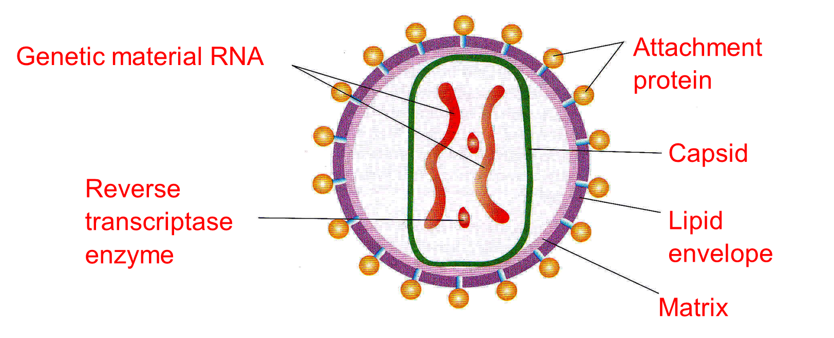
HIV Structure - Human Immunodeficiency Virus (booklet p 16)

Slide 65
Action of HIV in the Body Human Immunodeficiency Virus
The Human Immunodeficiency virus (HIV) causes the symptoms AIDS
It kills or interferes with the normal functioning of helper T-cells.
So the body cannot produce adequate numbers of B-cells to produce antibodies or Cytotoxic T-cells to kill infected cells.
So the body’s immune response is reduced and it is more susceptible to infections and cancer.
These secondary infections ultimately cause death.

Slide 66
HIV Human Immunodeficiency Virus
Watch the animations
http://www.wellcome.ac.uk/Education-resources/Education-and-learning/Resources/Animation/WTDV026676.htm HIV Life Cycle video clip 5 min 12 s
http://highered.mheducation.com/olc/dl/120088/micro41.swf HIV Replication animation

Slide 67
HIV Human Immunodeficiency Virus – snip from Welcome trust Video – Good Overview!

Slide 68
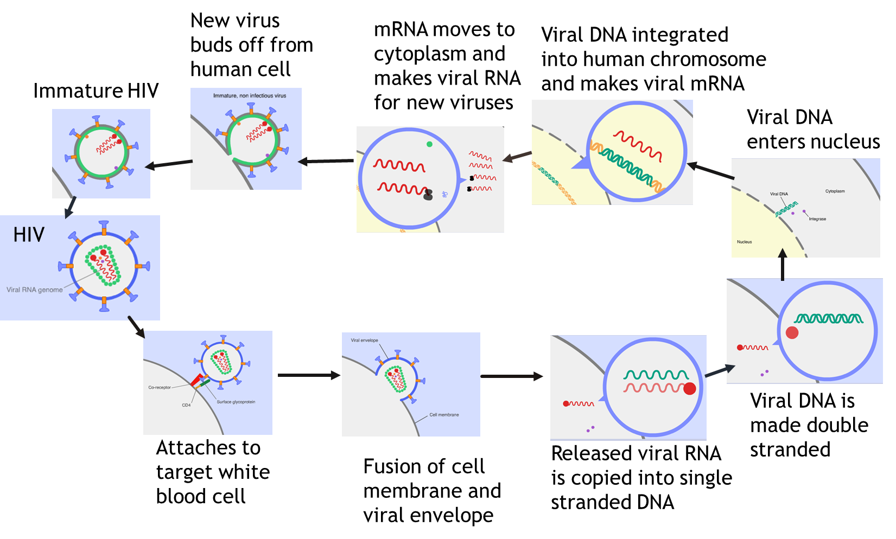
HIV Life Cycle – snips from Welcome Trust Video (Booklet p 17)

Slide 69
Why are Antibiotics No Use Against Viruses? (Booklet p 18)
First consider the structure of bacterial cells. Topic Crosslink!
Bacterial cell wall made of ?
Water enters by ?
Cell wall prevents excessive expansion because it is ?
Some Antibiotics inhibit enzymes needed for cell wall synthesis. This means the cell wall is weakened, too much water enters by osmosis and the cell suffers osmotic lysis. (death by osmosis!)
Others bind to bacterial ribosomes, so inhibit protein synthesis.
Some antibiotics inhibit DNA replication.
Some work by disrupting cell membranes.
IE they all interfere with the bacterial metabolism!
Do viruses have their own metabolic pathways and any of the above structures?

Slide 70
Why are Antibiotics No Use Against Viruses?
First consider the structure of bacterial cells. Topic Crosslink!
Bacterial cell wall made of Murein. (a peptigoglycan)
Water enters by osmosis.
Cell wall prevents excessive expansion because it is inelastic
Do viruses have their own metabolic pathways or the above structures?
Viruses do not have a cell wall made of murein and do not have metabolism of their own. They get the host cell to metabolise what they need and the antibiotics can't get into the host cell.

Slide 71
Lessons 11&12: Ethical issues and Question pack Consolidation
Lesson Outcomes: You should be able to:-
Discuss ethical issues associated with the use of monoclonal antibodies.
Evaluate methodology, evidence and data relating to the use of monoclonal antibodies
Apply knowledge to the contexts given in exam questions.

Slide 72
Mini Test

