Slide 1
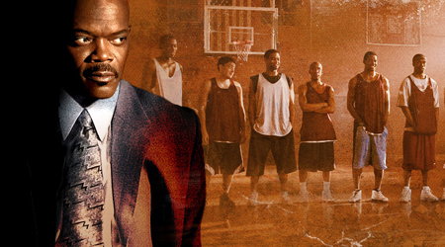
Unit 13: Sports Leadership
Lesson 1

Slide 2
Learning Outcomes
After completing the unit you should be able to achieve the following outcomes:
Understand the qualities, characteristics and roles of effective sports leaders
Understand the importance of psychological factors in leading sports activities
Be able to plan sports activities
Be able to lead sports activities effectively

Slide 3
Learning Outcome 1
Understand the qualities, characteristics and roles of effective sports leaders

Slide 4
What is a Leader?
‘the behavioural process of influencing individuals and groups towards set goals’

Slide 5
Who Are Sports Leaders?
Coaches
Teachers
Captains
Youth / Community Workers.
Parents.
Managers
Facility Staff
Sports Development Staff

Slide 6
What makes a good sports leader?
LEADERSHIP
Establishing Interpersonal Relationships
Giving Feedback
Knowledge of goals & objectives
Decision Making
Directing a group effectively
Motivational Techniques

Slide 7
3 Categories
Relevant Qualities
Relevant Characteristics
Ability to undertake a variety of roles.

Slide 8
Qualities of Sports Leaders.
Knowledge of sport skills,
Knowledge of sport rules and laws
Knowledge of physical needs of the participants
Knowledge of the mental needs of participants
Notes:
1) Knowledge of Sport skills – process is not instant, but requires practice.
Health and safety – emergency procedures and awareness of facilities being used as well as having basic first-aid knowledge
Fitness Components – how they can be improved
In-depth understanding of sport – knowledge of rules and laws so can be effective. knowledge of how to use equipment properly and safely themselves and be able to show others the correct way to use it.
Knowledge of group – specific illnesses is important is case of potential incident, also knowledge of opponents so that you can expose their weaknesses.
Knowledge is gained through experience, but can be improved through undertaking NGB awards.
2) Organisation of facilities and equipment- consideration taken in planning, eg, availability of equipment and whether there is enough for the group. Is it in safe working condition and after use is it in same condition.
3) Time Management – sports leaders take on many responsibilities, so to be successful they must manage their time wisely. Linked to good organisational skills. Need to be able to prioritise when required.
4) Personal qualities – good appearance, having ambition, being positive, showing empathy, being motivated, being confident, having enthusiasm.
5)Managing a group – can be conflict, but sports leader must ensure group work together. Effective management will get the best out of them.
6) Decision Making – many decisions involved, right decision comes through relevant experiences. What to do and why?
7) Evaluation – own and other performances. Help you to improve in future sessions, what went well, what can be improved and how the session could be more enjoyable in the future.
8) Communication – most important skill, sharing info with others and is difficult to learn.
Types of communication – verbally, non-verbally, by listening, by demonstrating, by assisting
Verbal – be clear, concise and avoid jargon. Be constructive and positive, as being negative or critical can upset performers and affect motivation.
Non-verbal – used when difficult to be heard. Body language, gestures, hand signals and facial expressions.
Listening – vital part of communication process.
Demonstrating – keep simple, do correctly so incorrect techniques are not picked up.
Assisting – helping those who cannot perform a skill correctly to aid understanding.

Slide 9
Examples of Characteristics:
Patience
Approachability
Empathy
Discretion
Persistence
Objectivity
Notes:
Patience – leaders need to be controlled and responsible in every situation, especially when: people are slow to learn, have annoying habits, people disrupt the group. As a leader you need to develop a way of coping with these problems.
Approachable – accessible to a range of people, people need to feel they can ask the leader about a variety of issues: difficulty in learning a new technique, personal, health-related problems, conflict with group members, not understanding a task and asking for extra explanation.
Leaders should consider how they appear to others not just the group!!!
Empowering – inspire and motivate a group eg prizes, fun, targets or general praise. (slide 3)
Empathy – ability to understand the needs of others. Mixed ability – identify with them so that all can benefit from the experience, by questionnaire or interview.
Discretion – develop policies and procedures to keep things confidential esp. If need to gather info about the group. Data Protection Act – info will not be divulged.
Persistence – If group fails to meet objectives, leaders must re-evaluate target or intended achievement. A different approach normally works!!
E.g. A group of tired kayakers close to finishing trip, but must cross a busy shipping lane at end. All are capable but as they become tired they are reluctant. Leader must find a way of persuading them whilst ensuring safety is not compromised.
Objectivity - taking a range of factors into account. Capability, Weather/environment, conflict in group. Take a bigger picture view when deciding on course of action.

Slide 10
Characteristics of sports leaders
Watch the clip from Kes:
https://www.youtube.com/watch?v=v3cayRMnVb8
How might this PE teacher improve four characteristics of effective leadership?

Slide 11
Roles include:
Instructor – autocratic style
Teacher/Educator (transfer of learning through demonstration, modelling or instruction, teach emotional and social skills).
Guardian (protecting performers from injury, promoting their health and well being).
Role Model (source of inspiration & knowledge that people look up to and admire)
Friend (supporting the performer).
Administrator (organising/planning sessions & competitions)
Counsellor

Slide 12
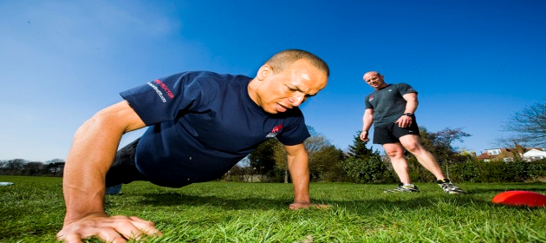
Instructor

Slide 13
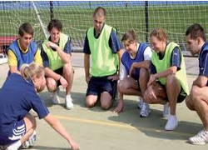
Teacher

Slide 14
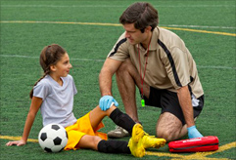
Guardian

Slide 15
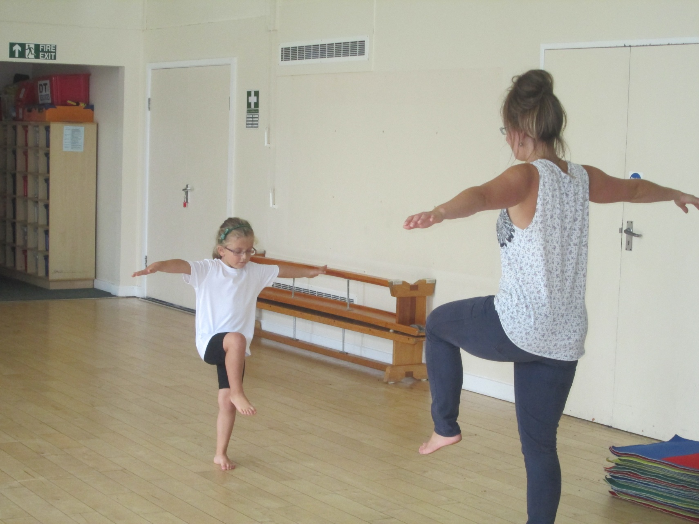
Role model

Slide 16
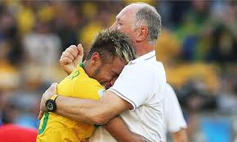
Counsellor

Slide 17
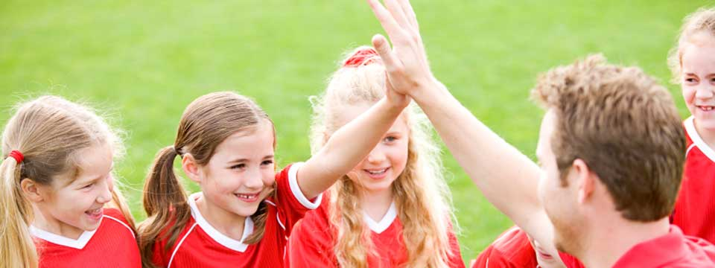
Friend

Slide 18
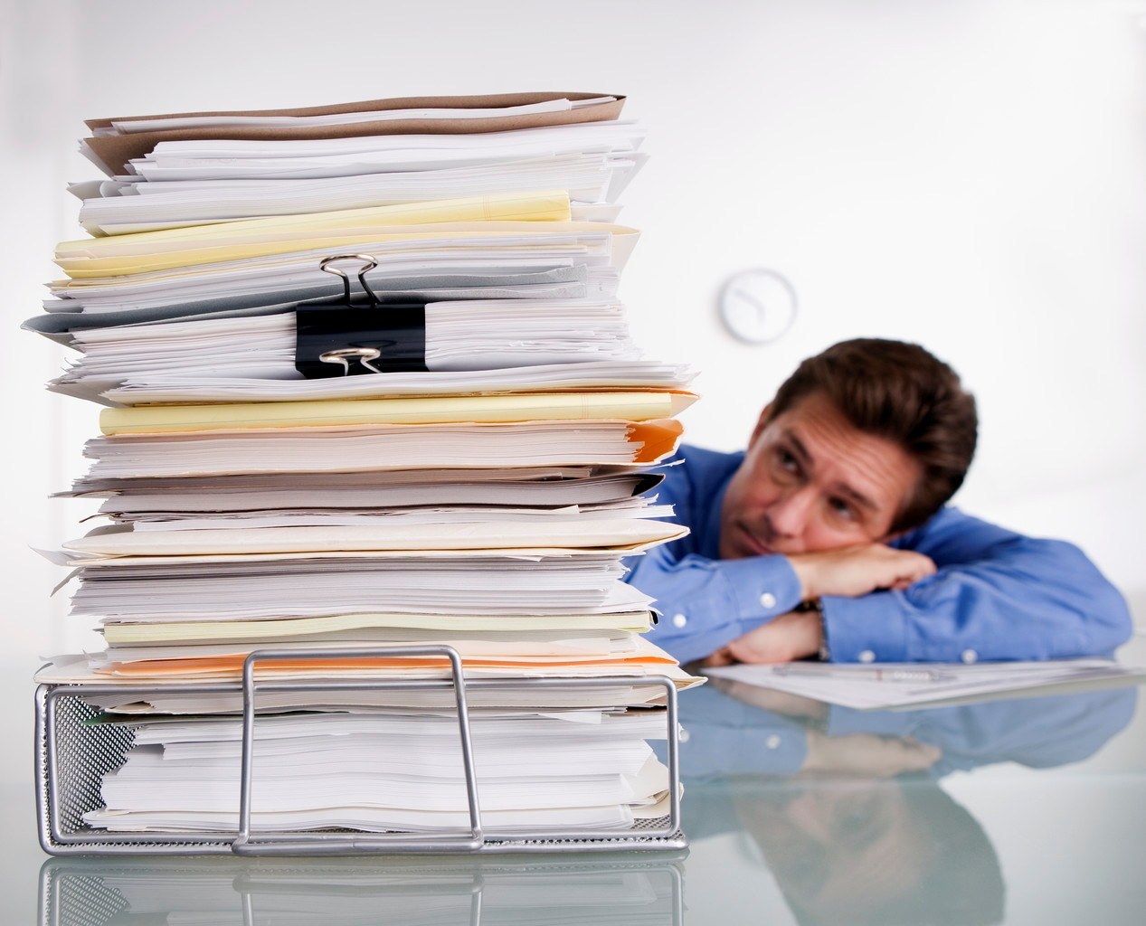
Administrator/ organiser

Slide 19
Task 1
(P1) Describe 4 qualities common to effective sports leaders.
Define what each quality is and how does a leader show evidence of possessing it?
(M1):Explain the four qualities of effective sports leaders.
Explain why each quality is relevant as a sports leader (Give examples).
(D1):Analyse the four qualities of effective sports leaders.
Rank your four qualities in order of importance and justify why you have placed them in that order. Why is one more important than the others in your opinion.
REPEAT THIS TO INCLUDE 4 CHARATERISTICS & 4 ROLES ALSO!!!!!

