Slide 1
Required Practical 1
Investigation into a named variable on the rate of an enzyme controlled reaction

Slide 2
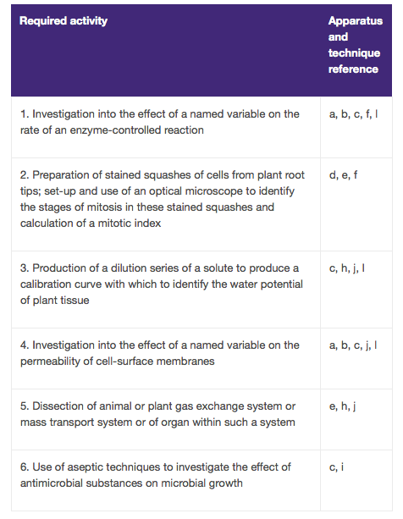


Practical 1
AQA Practical
Handbook
6 Required Practicals
in AS year

Slide 3
Learning Objectives
To develop practical skills a, c, l and begin to demonstrate competencies 1a and 4a
To investigate the affect of temperature on the rate of an enzyme-controlled reaction
To calculate the mean and standard deviation

Slide 4
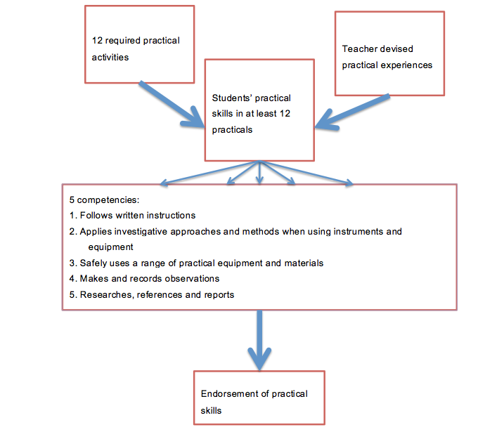
Competencies
AQA Practical
Handbook

Slide 5
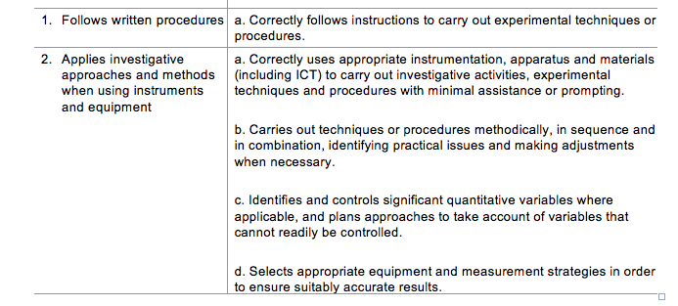
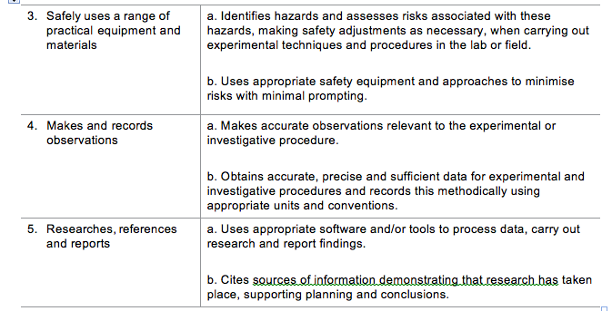
Each
competency
has sub sections

Slide 6
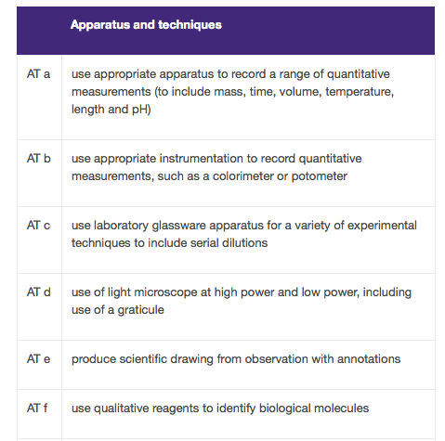
AQA Practical Handbook: Skills

Slide 7
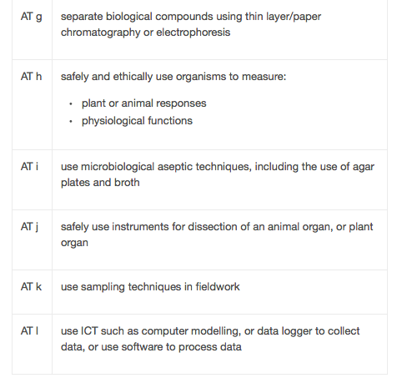
PreviousPractical
Standard
deviation
can be
calculated
using software or a
calculator

Slide 8
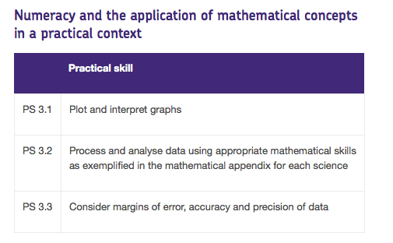
Maths skills

Slide 9
Self reflection
Student reflection: Have the learning objectives been achieved?
Designed to show the examiner that competencies and skills are being developed over the course of the year
Teacher’s comments
Teacher certification
Certification entered on spreadsheet

Slide 10
Making and recording Observations:
Tables and Graphs

Slide 11

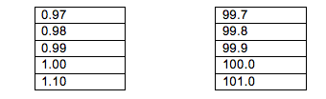
“Tables should have a title and clear headings with units indicated using a forward slash before the unit”. “The same number of significant figures should be used throughout”
The number of
significant figures
should be determined
by the resolution
of the device or the
uncertainty in the
measurement.
What is the resolution of the
thermometer and the
stop watch?

Slide 12
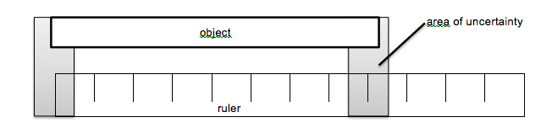
Uncertainties
Students should know that every measurement has some inherent uncertainty.
The uncertainty in a measurement using a particular instrument is no smaller than + or - half of the smallest division or greater. For example, a temperature measured with a thermometer is likely to have an uncertainty of ± 0.5 °C if the graduations are 1 °C apart.
Students should be aware that measurements are often written with the uncertainty. An example of this would be to write a volume was (22.0 ± 0.5) ml.

Slide 13
Table to show how the time taken for the cross to become visible varies with the temperature of the milk/rennin/buffer solution
Temperature of the milk/trypsin/buffer mixture /degree C | Trial 1 | Trial 2 | Trial 3 | Mean | Max | Min | Range (max-min)
20
30
40
50
60
Time taken for the cross to become visible /s

Slide 14
Table to show how the time taken for the cross to become visible varies with the temperature of the milk/rennin/buffer solution
Temperature of the milk/trypsin/buffer mixture /degree C | Trial 1 | Trial 2 | Trial 3 | Mean | Max | Min | Range (max-min)
20
30
40
50
60
Time taken for the cross to become visible /s

Slide 15
Table to show how the time taken for the cross to become visible varies with the temperature of the milk/rennin/buffer solution
Temperature of the milk/trypsin/buffer mixture /degree C | Trial 1 | Trial 2 | Trial 3 | Mean | Max | Min | Range (max-min)
20
30
40
50
60
Time taken for the cross to become visible /s

Slide 16
Rules for Graphs
The graph should have a title that links the x and y axes e.g. “Graph to show how the y axis (use label) varies with the x axis (use label)”
The dependent variable should be on the y axis and the independent variable on the x axis
Scales: students should attempt to spread the data points on a graph as far as possible without resorting to scales that are difficult to deal with (e.g multiples of 3,7,11 ). In exams, the plots should cover at least half of the grid supplied for the graph.

Slide 17
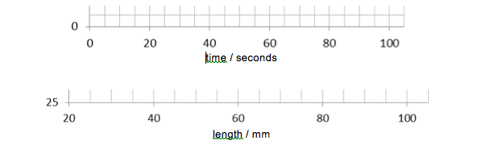
Rules for Graphs
Axes should always be fully labelled with the quantity being measured and the units. These should be separated with a forward slash mark:
If you are plotting mean values then you should clearly state this in your label.
nb these are not fully labelled!

Slide 18
Rules for Graphs
Data points: should be marked with a cross (Error bars can take the place of data points where appropriate) using a sharp pencil.
Do not extrapolate the line beyond the range within which you measured. A common mistake is to try and force the line through the origin.
Where data falls a long way from zero, a broken axis will save space.

Slide 19
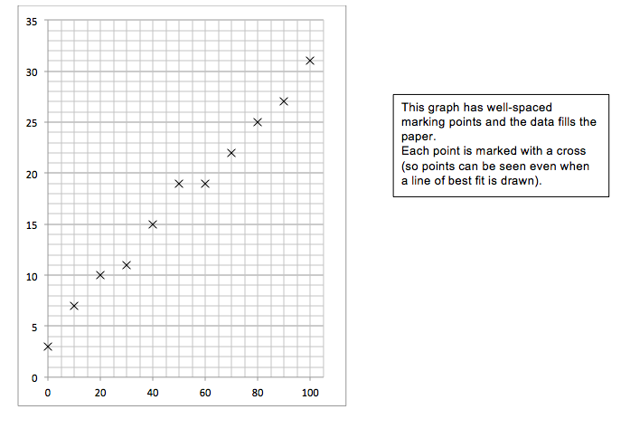

Slide 20
Graphs- Lines of best Fit
Lines of best fit should be drawn when appropriate. Alternatively use a cross to cross ruled line. Students should consider the following when deciding where to draw a line of best fit:
Are the data likely to have an underlying equation that it is following (for example, a relationship governed by a physical law)? This will help decide if the line should be straight or curved.
Are there any anomalous results?
Are there uncertainties in the measurements? The line of best fit should fall within error bars if drawn.

Slide 21
Anomalous Results
At GCSE, students are often taught to automatically ignore anomalous results. At A-level students should think carefully about what could have caused the unexpected result.
In presenting results graphically, anomalous points should be plotted but ignored when the line of best fit is being decided.
Anomalous results should also be ignored where results are expected to be the same (for example in when repeat readings of pH are taken of the same sample).
Where there is no obvious error and no expectation that results should be the same, anomalous results should be included. This will reduce the possibility that a key point is being overlooked.
Please note: when recording results it is important that all data are included. Anomalous results should only be ignored at the data analysis stage.
It is best practice whenever an anomalous result is identified for the experiment to be repeated. This highlights the need to tabulate and even graph results as an experiment is carried out.

Slide 22
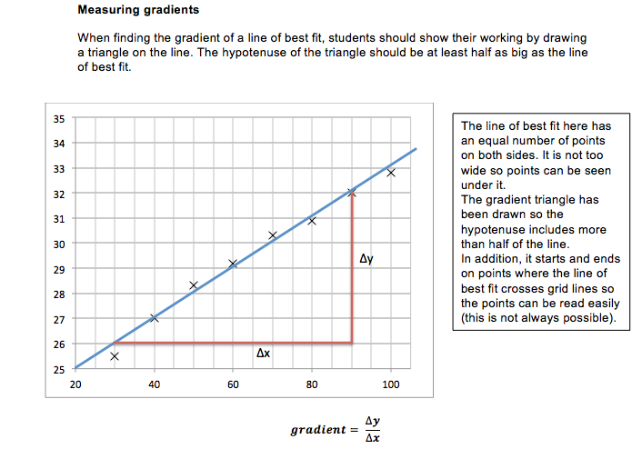
Gradients

Slide 23
Adding Range bars and Error bars to graphs
A way of indicating level of certainty
in the
positioning
of your
points

Slide 24
3 types
Mean + Range
Mean +/- SD (standard deviation)
Mean +/- SE (standard error)
http://jcb.rupress.org/content/177/1/7.full.pdf+html An article on error bars in experimental biology - extracted from the journal of cell biology - extension reading.

Slide 25
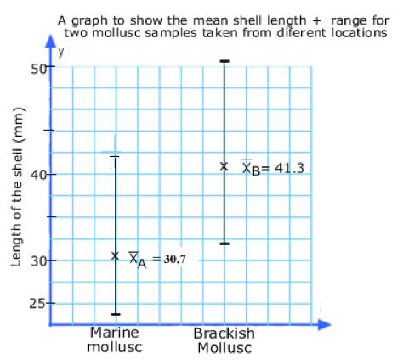
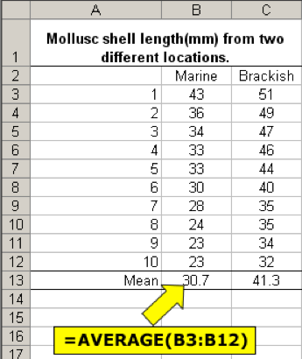
If we plot the mean with the range (max-min value) then we can see the spread (variance/dispersion) of data around the mean

Slide 26
Now Plot the range bars onto your graph!

Slide 27
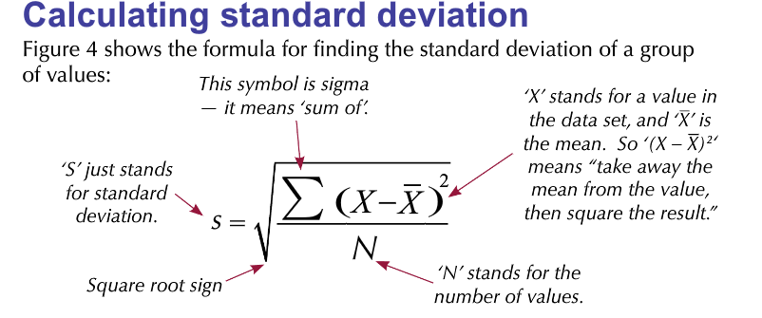
Standard deviation
The standard deviation is used to assess how far the values are spread around the mean.
Watch Bozeman: http://www.bozemanscience.com/standard-deviation/

Slide 28
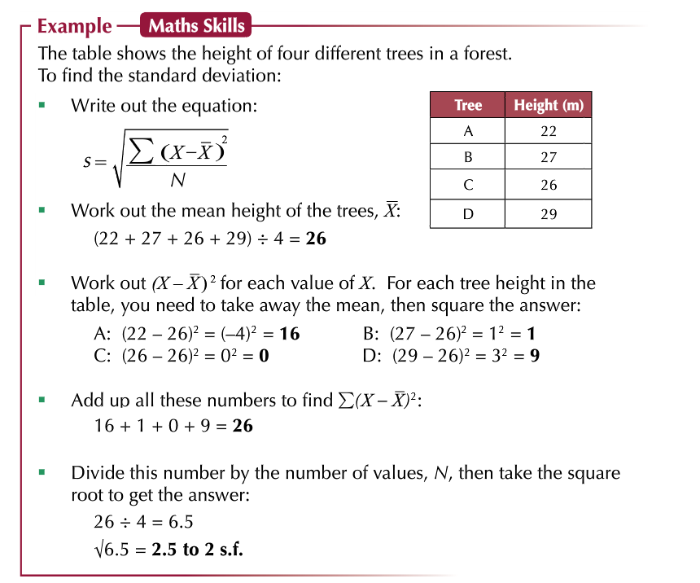

Slide 29
Standard deviation
“Students may be tested on their ability to calculate standard deviation and their ability to understand why standard deviation is a useful measure of dispersion for a given set of data eg an outlying result”
“We would expect students to perform calculations during class work, but students will not be asked to calculate the standard deviation of a mean in an examination”

Slide 30
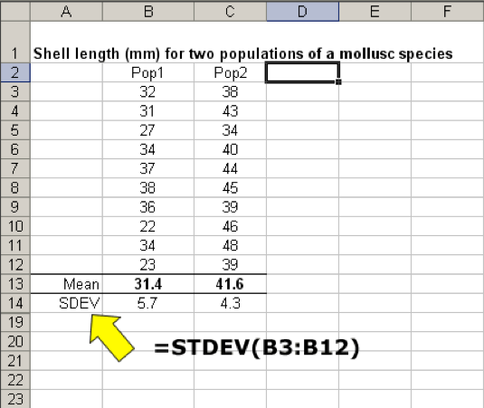
Standard deviation
Standard deviation can be used to plot error bars. A small standard deviation indicates that the data is clustered closely around the mean value. Conversely, a large standard deviation indicates a wider spread around the mean.

Slide 31
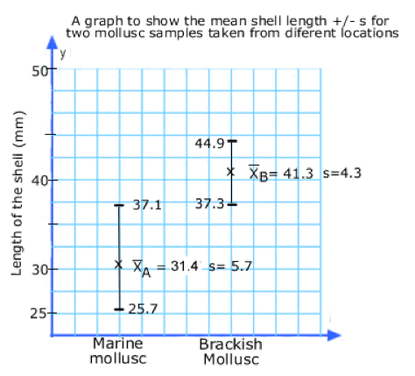
Plotting the mean +/- one SD

Slide 32
Overlapping Error Bars
If the error bars overlap then it cannot be concluded that the values are truly different. In biology we state the values are not significantly different.

Slide 33

Range bars and Error bars compared
The Standard deviation graph has removed any extremes of variation in the data set . The range graph with its extreme values perhaps misleads us to think the data is similar. Notice the error bars are symmetrical above and below the points. The length of the bars now represents not the max/min values but the mathematical spread of the data.

