Slide 1
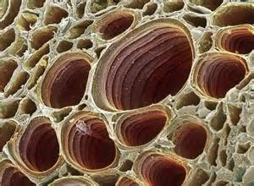
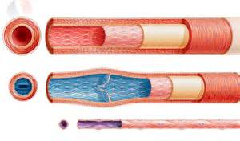
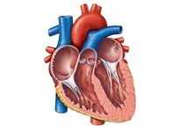
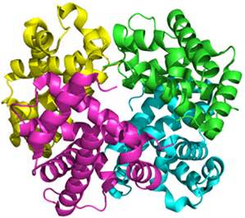
Mass Transport

Slide 2
Specification 3.3.4.1
Mass Transport in Animals
The haemoglobins are a group of chemically similar molecules found in many different organisms. Haemoglobin is a protein with a quaternary structure.
The role of haemoglobin and red blood cells in the transport of oxygen. The loading, transport and unloading of oxygen in relation to the oxyhaemoglobin dissociation curve. The cooperative nature of oxygen binding to show that the change in shape of haemoglobin caused by binding of the first oxygens makes the binding of further oxygens easier. The effects of carbon dioxide concentration on the dissociation of oxyhaemoglobin (the Bohr effect).
Many animals are adapted to their environment by possessing different types of haemoglobin with different oxygen transport properties.

Slide 3
Specification 3.3.4.1
Mass Transport in Animals
The general pattern of blood circulation in a mammal. Names are required only of the coronary arteries and of the blood vessels entering and leaving the heart, lungs and kidneys.
The gross structure of the human heart. Pressure and volume changes and associated valve movements during the cardiac cycle that maintain a unidirectional flow of blood.
The structure of arteries, arterioles and veins in relation to their function.
The structure of capillaries and the importance of capillary beds as exchange surfaces. The formation of tissue fluid and its return to the circulatory system.

Slide 4
Specification 3.3.4.1
Mass Transport in Animals
Students should be able to:
analyse and interpret data relating to pressure and volume changes during the cardiac cycle
analyse and interpret data associated with specific risk factors and the incidence of cardiovascular disease
evaluate conflicting evidence associated with risk factors affecting cardiovascular disease
recognise correlations and causal relationships.

Slide 5
07 February 2016
Tissue fluid formation
Objectives:
To understand the importance of capillary beds as exchange surfaces.
To explain how hydrostatic pressure causes tissue fluid formation.
To understand the importance of return of tissue fluid to the circulatory system.
Notes:
Practical/demo ideas
Syringe with holes along it is nice to demo hydrostatic pressure forcing fluid out capillaries

Slide 6

Starter: Arteries, capillaries and veins

Slide 7
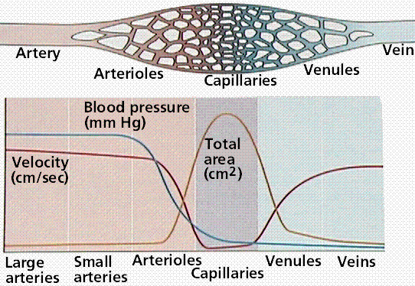
The Blood Vessel System
Describe the changes in blood pressure as blood moves from arteries to veins
Describe the changes in the speed of transport as blood moves from arteries to veins
Where is the total surface area the highest?
Explain the changes you have described

Slide 8
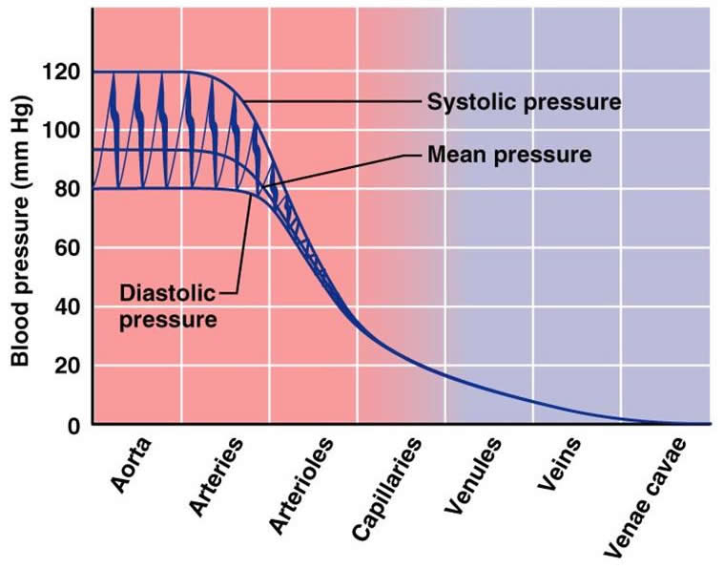
Blood pressure through the circulatory system
Blood Pressure is highest in the aorta.
Pressure in the arteries and arterioles is pulsed i.e. it rises and falls due to the beating of the heart. In systole, the elastic fibres expand to allow blood through. In diastole, the pressure drops but elastic recoil will force blood onwards.
Pressure in the capillaries and veins is low and constant.

Slide 9
What is tissue fluid?
Cells are bathed in or surrounded with a fluid that has come from the blood containing a supply of the materials they require and possessing an ability to absorb materials that needs to be removed from the cells. This fluid is known as TISSUE FLUID.
What substances do you think tissue fluid contains?
Glucose, amino acids, fatty acids, ions in solution and oxygen

Slide 10
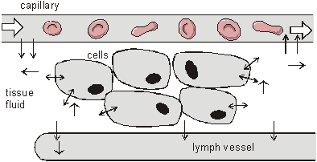
Tissue fluid is the means by which materials are exchanged between the blood and cells. Materials are supplied to cells and waste substances removed.
Tissue Fluid is very similar in consistency to blood plasma without the large plasma proteins
Tissue fluid is also known as intercellular fluid and interstitial fluid

Slide 11
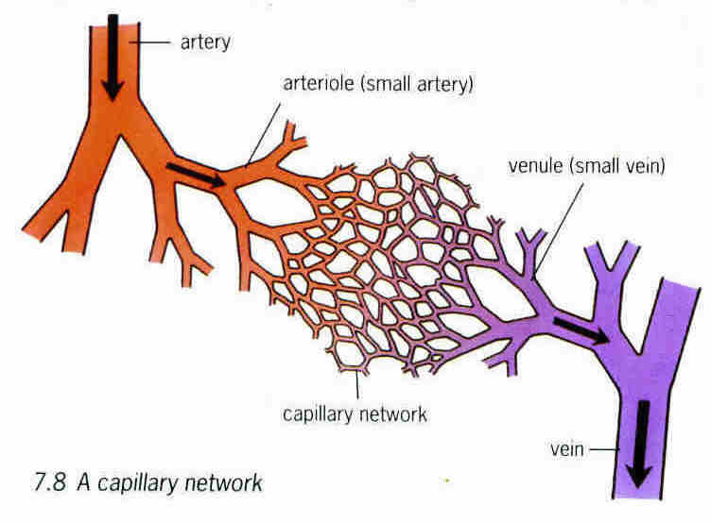
Capillaries and Capillary Beds
Arteries divide into arterioles which branch into capillary networks. These are sometimes called capillary beds. Capillaries permeate through all tissues so all cells are close to a capillary. They rejoin into venules then these rejoin into veins.

Slide 12
How the Structure and Functioning of Capillaries Satisfies Fick’s Law and Ensures Efficient Exchange of Materials by Diffusion
Fick’s Law states that:
Diffusion rate ∝ surface Area x Concentration Gradient
Diffusion Distance
Capillaries only 5 – 20 μm in diameter so have a large surface area to volume ratio. Also there are many small capillaries providing a large surface area.
Capillaries only made of ONE LAYER of ENDOTHELIAL cells and therefore have a very short diffusion distance
Capillaries are very narrow so blood flows slowly allowing maximum time for diffusion to occur

Slide 13
Formation of Tissue Fluid
Collective memory task
Demo

Slide 14
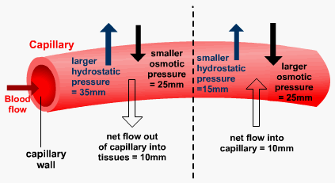
Formation of tissue fluid
arterial end of capillary bed
venous end of capillary bed
ext

Slide 15
Arterial End of Capillary Bed
Hydrostatic pressure high (because of pumping from heart and elastic recoil of arteries)
Therefore the fluid part of blood forced out through capillary walls into spaces between cells
This outflow is opposed by the reduced water potential of the blood, created by the presence of the plasma proteins. This osmotic pressure tries to draw water into the capillary
Because hydrostatic pressure is greater than osmotic pressure the net flow of water is outwards
As water moves through the wall it takes solutes with it

Slide 16
Return of Tissue Fluid to Blood
At the venous end of the capillary bed
Hydrostatic pressure low
Osmotic pressure greater than hydrostatic pressure
Fluid moves back into the capillary because the water potential gradient causes a net inward flow
Most of the fluid that leaves the blood at the arterial end of the capillary bed returns at the venous end

Slide 17
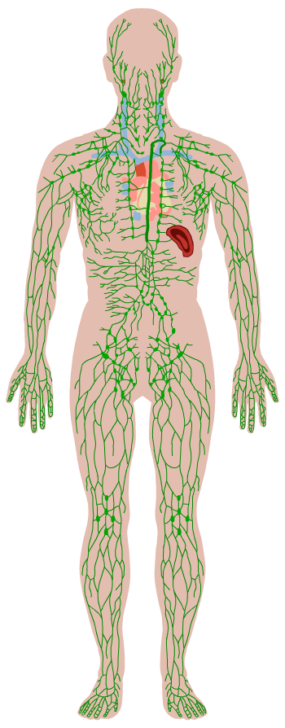
The lymphatic system
http://www.bing.com/videos/search?q=tissue+fluid+formation+a+level&&view=detail&mid=DB285F6CA7FDDA6DBA40DB285F6CA7FDDA6DBA40&FORM=VRDGAR
The fluid that does not return to the capillaries drains into the lymphatic system. It is returned eventually to the bloodstream via the thoracic duct which empties into a veins near the heart
The lymphatic system is a secondary circulatory system and a major part of the immune system. It consists of:
lymphatic capillaries and vein-like lymph vessels, containing valves
lymph nodes – sac-like organs that trap pathogens and foreign substances, and which contain large numbers of white blood cells
lymphatic tissue in the spleen, thymus and tonsils – these also contain large numbers of white blood cells and are involved in their development.
Movement of lymphatic contents: there is no pump to move the contents so it flows by
Hydrostatic pressure of the tissue fluid that has left the capillaries
Contraction of body muscles which squeeze the lymph vessels moving fluid in the direction of the heart.
Notes:
Teacher notes
Lymph moves through the lymphatic system via the action of skeletal muscles and the use of valves to prevent backflow.
Lymphatic tissues and lymph nodes are the site of development and maturation of lymphocytes.
Lymphatic filariasis is a parasitic disease caused when thread-like nematode worms (transmitted by mosquitoes) become lodged in the lymphatic system. In extreme cases, this causes elephantiasis – a swelling and thickening of skin and underlying tissue, usually in the legs or genitals.

Slide 18
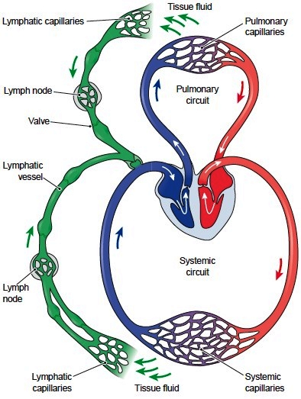

Slide 19
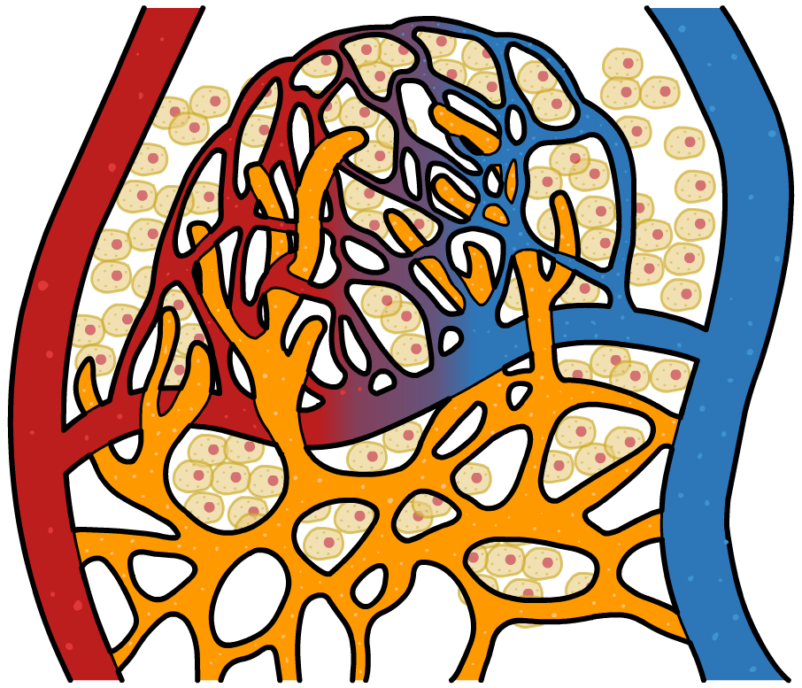
Names of Fluid
In the blood = plasma
Surrounding the cells = tissue fluid or intercellular fluid or interstitial fluid
In the lymphatic system = lymph
lymphatic capillaries

Slide 20
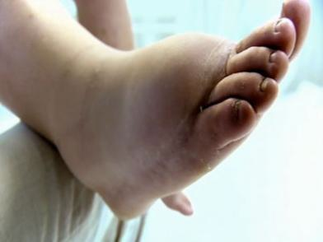
Lymphoedema - disruption to the lymph system

Slide 21
Knowledge Check
Complete the summary questions in your booklet
a) elastic tissue allows recoil and hence maintains blood pressure/smooth blood flow/ constant blood flow
b) muscle can contract, constricting the lumen of the arterioles and therefore controlling the flow of blood into capillaries
c) valves prevent flow of blood back to the tissues and so keep it moving towards the heart/keep blood at low pressure flowing in one direction
d) The wall is very thin, making the diffusion pathway short and exhange of material rapid
a C; b B; c E; d D; e A
Hydrostatic pressure 9due to pumping of the heart)
Via the capillaries and via the lymphatic system

Slide 22
07 February 2016
Risk factors associated with cardiovascular disease
Objectives:
To analyse the risks factors that could lead to cardiovascular diseases.
To evaluate conflicting evidence associated with risk factors affecting CVD
To investigate the effect of caffeine on the heart rate of Daphnia and analyse results in respect to risk factors.
Notes:
Practical
Investigating caffeine on heart rate of Daphnia – looking into whether this is class prac or demo

Slide 23
Specification 3.3.4.1
Mass Transport in Animals
Students should be able to:
analyse and interpret data associated with specific risk factors and the incidence of cardiovascular disease
evaluate conflicting evidence associated with risk factors affecting cardiovascular disease
recognise correlations and causal relationships.

Slide 24
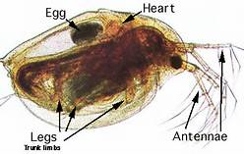
Investigation into heart rate and caffeine
Aim: To investigate if caffeine affects the heart rate of Daphnia (water fleas)
https://www.youtube.com/watch?v=cb0eZ63EUs0
Short video that helps student identify the heart

Slide 25
Experiment
Read the background information on Daphnia and make a hypothesis for this experiment.
Collect your equipment
Carry out the experiment
Remember: do not leave the Daphnia under the microscope too long. Return them to the stock solution

Slide 26
Results
Add your results to the table and calculate the mean.
Write your analysis
Video of Daphnia without caffeine
http://www.youtube.com/watch?v=ruh23xyMxQk
Video of Daphnia with 0.5% caffeine
http://www.youtube.com/watch?v=71UO1ja__H0

Slide 27
Results that can be used
 |  | Number of heartbeats in 15 seconds
Length of time in solution/minutes |  | 2 | 4 | 6 | 8 | 10
Treatment | Caffeine | 49 | 53 | 49 | 44 | 48
 | Caffeine | 54 | 54 | 57 | 51 | 55
 | Caffeine | 54 | 59 | 55 | 61 | 64
 | Caffeine | 59 | 65 | 64 | 68 | 62
 | Mean
 | Control | 57 | 55 | 59 | 50 | 58
 | Control | 58 | 60 | 54 | 58 | 60
 | Control | 56 | 56 | 58 | 57 | 59
 | Control | 60 | 64 | 61 | 66 | 62
 | Mean

Slide 28
Cardiovascular Disease and Risk Factors
Activity – play the risk game

Slide 29
Risk and Cardiovasular Disease (CVD)

Slide 30
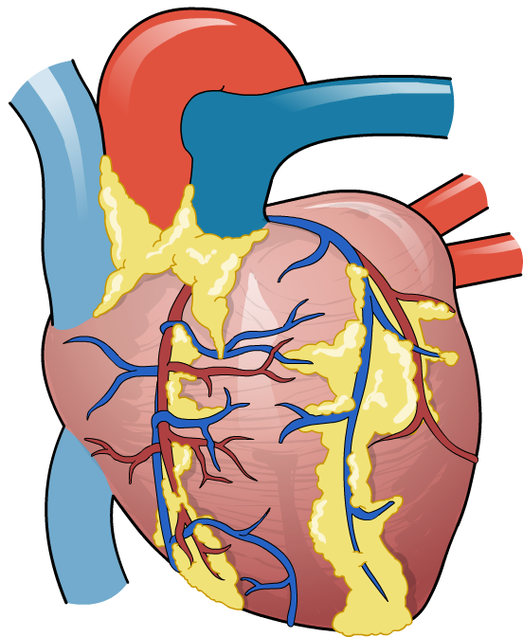
Effects of CHD: heart attack
The most dangerous symptom/result of CHD is a heart attack, known as a myocardial infarction (MI).
An MI occurs when the blood supply to part of the heart muscle (myocardium) is interrupted. This causes oxygen deprivation and subsequent tissue damage.
The most common symptom is
chest pain, but shortness of breath, excessive sweating, nausea and weakness may also be present. Loss of consciousness and death can occur.
Notes:
Teacher notes
Students should be made aware that myocardial infarction is not the same as cardiac arrest or heart failure (see Glossary for more details).
‘myocardial’ = relating to the myocardium (heart muscle tissue); ‘infarction’ = suffocation caused by oxygen deprivation.
As many as one in four MIs are ‘silent’ – that is, without chest pain or other symptoms.

Slide 31
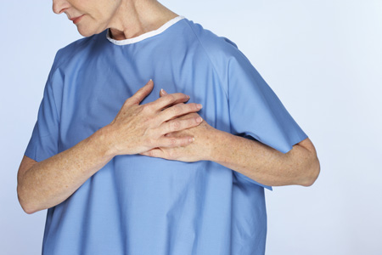
Effects of CHD: angina
A less severe symptom of CHD is angina pectoris. This is a tight, gripping chest pain or ache, similar to indigestion, which commonly occurs during physical activity.
The narrowing of the coronary arteries results in inadequate blood and oxygen supply, forcing the heart to respire anaerobically, and causing a build-up of lactic acid.
The pain normally subsides with rest, once the demand on the heart has dropped and it can respire aerobically.
Notes:
Photo credit: Jupiterimages Corporation

Slide 32
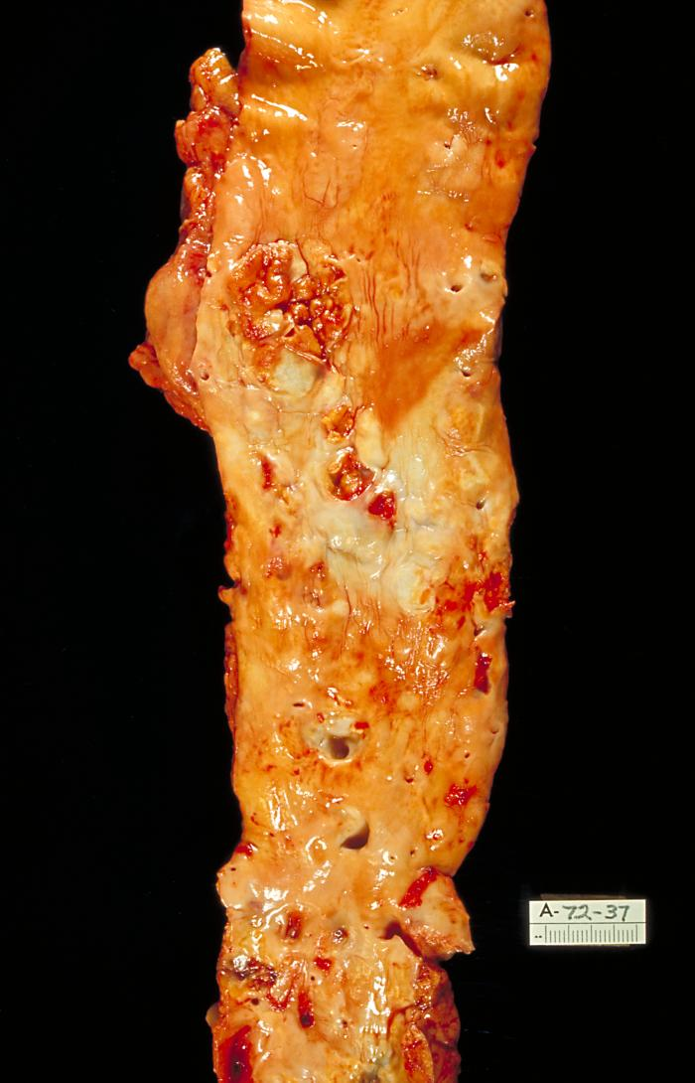
What is coronary heart disease?
Coronary heart disease (CHD) is a disease of the arteries supplying the heart (coronary arteries). Almost one-fifth of all deaths in the UK in 2005 were due to CHD.
The major cause of CHD is atherosclerosis: a thickening of arteries caused by a build-up of fatty plaques (atheromas) on the inside walls.
Atherosclerosis can eventually lead to a reduced blood supply (ischaemia) to tissues, with potentially fatal consequences.
Notes:
Photo credit: CDC / Dr Edwin P Ewing, Jr
Autopsy specimen of aorta has been opened lengthwise to reveal luminal surface studded with lesions of atherosclerosis.
Teacher notes
Other names for coronary heart disease include coronary artery disease, ischaemic heart disease and atherosclerotic heart disease.
Congenital heart disease is sometimes abbreviated as CHD.
Atherosclerosis should not be confused with arteriosclerosis, which is a hardening of the arteries, although arteriosclerosis does occur in atherosclerosis.
See the ‘The Heart’ and ‘Circulation and blood’ presentations for more information about the structure of the heart and arteries.

Slide 33
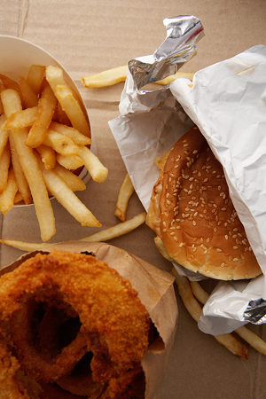
Risk factors
A risk factor is anything that increases the chance of developing a disease.
Hundreds of risk factors for CHD and stroke have been identified. The major ones are:
Modifiable
Non-modifiable
high blood pressure
advancing age
high blood cholesterol
male gender
tobacco smoking
family history of the disease
physical inactivity
ethnicity/race
obesity
diabetes mellitus
others: stress, alcohol
Can be prevented and controlled. These are essentially environmental or lifestyle risk factors
Cannot be prevented or controlled.
Notes:
Teacher notes
Much of the understanding of the effect of factors such as diet and exercise on the risk of CHD arose from the Framingham Heart Study, an ongoing longitudinal study that began in 1948 and studied over 5,000 people in the US town of Framingham, Massachusetts. The study is now monitoring its third generation of participants.
Students could be encouraged to find out more about the study, its methodology and key findings. More information is available at http://www.framinghamheartstudy.org.
Students could also find out more about longitudinal and other types of studies such as case-control, cross-sectional, cohort, etc.

Slide 34

Correlation versus Cause
Risk factors are correlational with a disease, not necessarily causal. For example, international travel is a risk factor for malaria, but it is not the travel itself that causes malaria – it just increases the chance of coming into contact with the malarial parasite.
Correlation:
When a change in one factor is reflected in a change in another factor
Cause:
When a change in one factor is responsible for the change in another factor
Notes:
Photo credit: Jupiterimages Corporation
Teacher notes
It is important to note that correlation does not imply causation.
Students could be asked to comment on how the media reports research that ‘links’ a particular food or activity with an increased risk of developing a disease.

Slide 35

Smoking
Carbon monoxide combines with haemoglobin which reduces the amount of oxygen reaching the heart and brain which can lead to heart attack or stroke
Nicotine makes platelets sticky, increasing the chance of blood clots forming which increases the risk of CVD.
Nicotine can also stimulate the pulse to increase and the blood vessels to narrow thus increasing blood pressure
Smoking decreases the amount of antioxidants in the blood, these are important to protect the cells from damage. Fewer antioxidants means the risk of damage to artery walls is higher

Slide 36
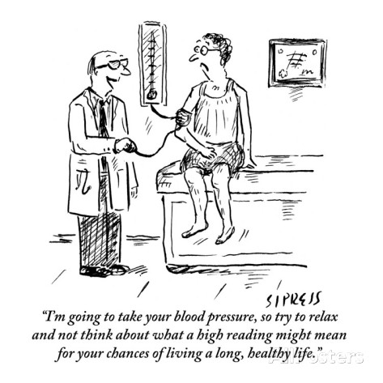
High Blood Pressure (Hypertension)
High blood pressure can increase the risk of heart disease for the following reasons:
High pressure in the arteries means the heart must work harder to pump blood into them and is more prone to failure,
High blood pressure puts more strain on the heart and blood vessels, increasing the risk of aneurysm or thrombosis. It is sometimes called the ‘silent killer’ because it can develop without symptoms.
To resist high blood pressure, walls of arteries become thickened and harden (atherosclerosis) which can restrict blood flow and lead to CVD

Slide 37
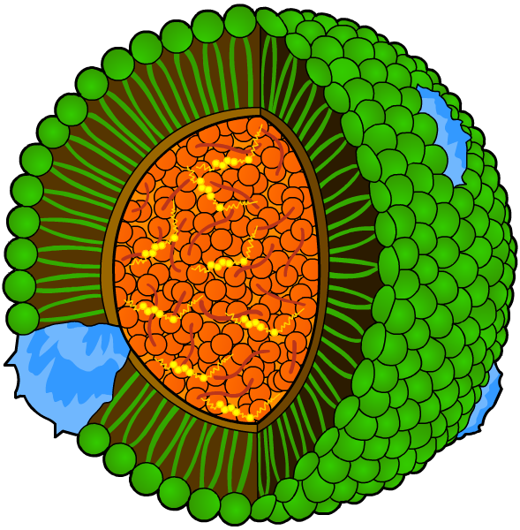
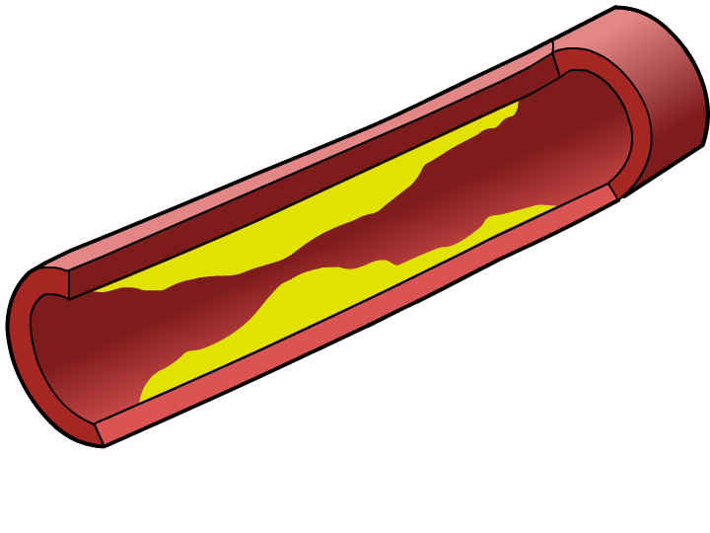
Blood Cholesterol and lipoproteins
Cholesterol is a soft waxy lipid that has a vital role as a component of cell membranes, where it regulates fluidity.
Cholesterol is insoluble in blood, so it is transported by lipoproteins. These are spherical complexes consisting of:
an outer layer of phospholipids, studded with proteins
an inner core of trigylcerides and cholesterol.
Low-density lipoprotein (LDL)
Transport cholesterol from the liver to the tissues including artery walls. In high levels, it contributes to atherosclerosis.
High-density lipoprotein (HDL).
Remove cholesterol from tissues and transport it to the liver for excretion. They help protect arteries against heart disease
Notes:
Teacher notes
The density of lipoproteins is a relative measure of how much protein and lipid is present. The more protein and less lipid in a lipoprotein, the smaller and more dense it will be. So LDL contains relatively more lipid/cholesterol than HDL and relatively less protein.
See the ‘Cell Membranes’ presentation for more information about cholesterol in cell membranes.

Slide 38
Diet
Diet can have many aspects that increase the risk of CHD both directly and indirectly.
High in saturated fat increases the risk of CVD
This is because it increases LDL levels and there for the blood cholesterol level. This will increase atheroma formation which can lead to formation of blood clots, which can cause a heart attack, stroke or deep vein thrombosis.
LDL cholesterol levels can be reduced by regular exercise, eating plenty of fibre and a diet rich in polyunsatured fats.
High in salt also increases the risk of CVD
This is because it increases the risk of high blood pressure
Foods high in antioxidants e.g. vitamin C can reduce the risk of heart disease

Slide 39
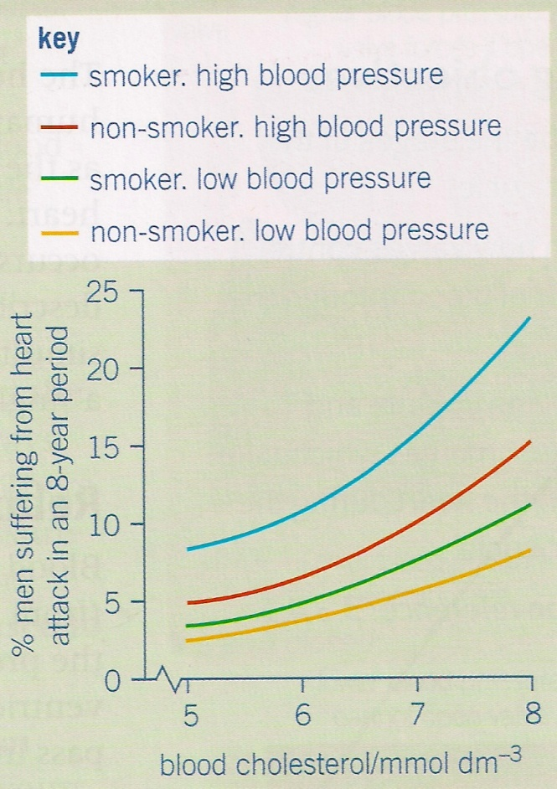
Taking a risk – evaluating risk based on data
There are many risk factors that increase the chance of CVD when they are combined together the risk becomes disproportionately greater.
Calculating risk – answer the question in your booklet

Slide 40
Question Answers
Reducing blood pressure – for any given cholesterol level, this will reduce the risk more than giving up smoking, e.g. at 8 mmdol-1 the risk falls from 23% to 15% by giving up smoking but falls to 12% by lowering blood pressure.
At 5 mmoldm-3, the risk is 5%. At 8 mmoldm-3 the risk is 15%. The risk is therefor 15 ÷ 5 = 3 times greater.
The man who increases his blood cholesterol level is at greater risk. The risk of the man who starts to smokle invreases from 2.5% to 3.5% = ±1%. The risk of the man who increases his cholesterol level increases from 2.5% to 5.5% = ± 3%

Slide 41
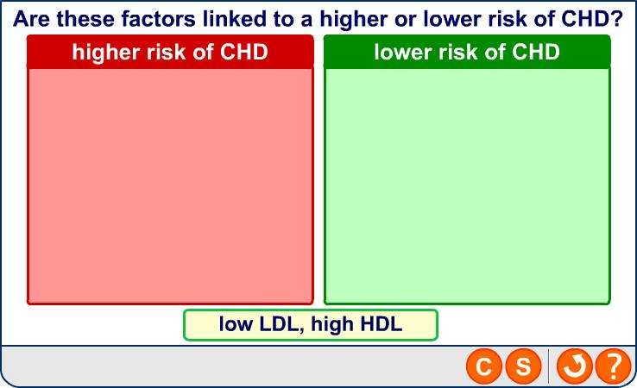
Plenary: Identifying CHD risk factors

Slide 42
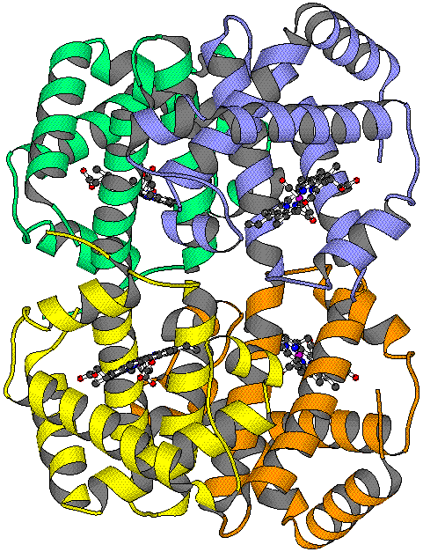
07 February 2016
Transport of Oxygen and Haemoglobin
Objectives:
To describe the structure and function of haemoglobins and explain the differences between haemoglobins in different organisms including the properties of haemoglobins in relation to the ecology of the organism.
To explain what loading and unloading of oxygen is in relation to the oxyhaemoglobin dissociation curve.
To explain the effect of carbon dioxide on the concentration on the dissociation of oxyhaemoglobin.

Slide 43
Starter
MWB – pairs
draw a generalised structure of an amino acid.
Write down what you know about proteins (brainstorm)

Slide 44
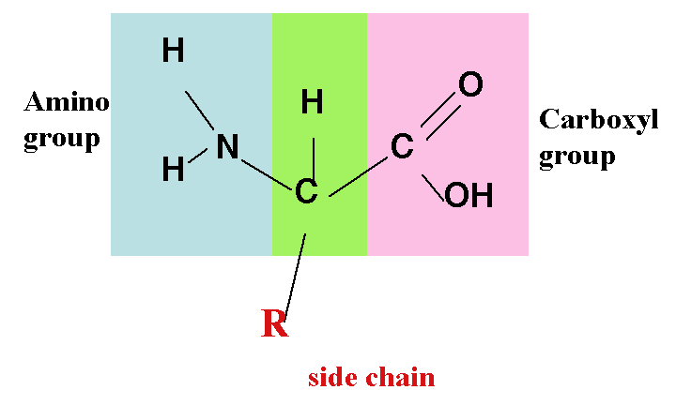
What are proteins?
Proteins are made up of C, H, O, N and some S and P
Transport proteins such as haemoglobin carry oxygen.
The monomer molecules making up proteins are called amino acids.
There are 20 different naturally occurring amino acids.
All amino acids have the same general structure:
A carboxyl group (-COOH)
An amino group (-NH2) attached to a C atom
A variable group called R
Proteins have an ordered
Structure organised as:
Primary
Secondary
Tertiary
Quarternary

Slide 45
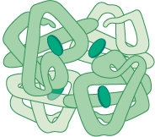
Haemoglobin Molecules
Globular proteins = round, compact,
soluble, can be transported in fluids.
Primary structure – sequence of amino acids in the 4 polypeptide chains.
Secondary structure – each polypeptide chain coiled into a helix
Tertiary structure – each chain folded into a precise shape
Quarternary structure – all 4 polypeptide chains linked together to form spherical molecule. Each chain with a haem group (contains Fe²⁺ ion). Each haem group can combine with 1 O₂ molecule.

Slide 46
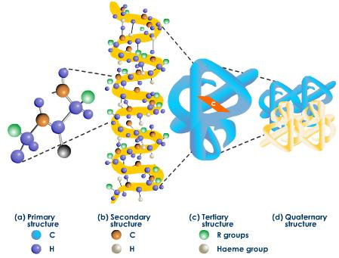

Slide 47
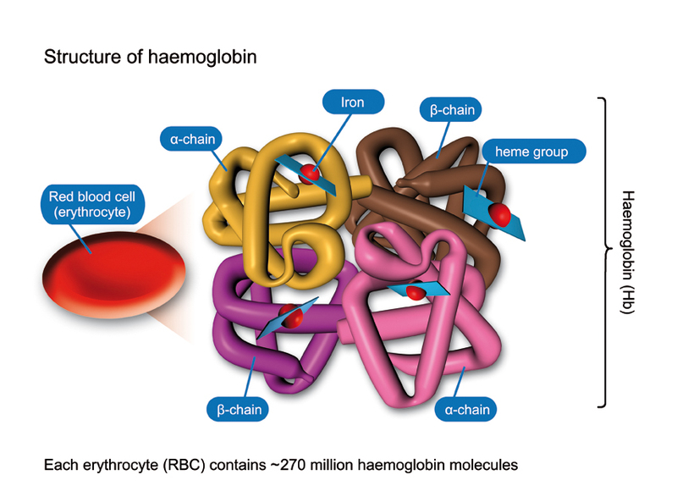
Notes:
Task: Haemoglobin – true/false piles regarding structure, role, different types, affinity, load and unload. Attached.

Slide 48
Loading and Unloading Oxygen
Haemoglobin binding to oxygen = loading/associating (in lungs)
Haemoglobin releasing oxygen = unloading/dissociating (in tissues)
Haemoglobins with a high affinity for O₂ take up O₂ more easily but release it less easily.
Haemoglobins with a low affinity for O₂ take up O₂ less easily but release it more easily.

Slide 49
The Role of Haemoglobin
To transport oxygen
Haemoglobin must:
  combine (associate) with oxygen at the gas exchange surface.
  release (dissociate) the oxygen at tissues that need oxygen.
The structure of haemoglobin enables it to do these 2 things. This is because it can change its shape under different conditions and can be more loosely or more tightly bound to the oxygen molecules. (If it is more loosely bound it will release the oxygen more readily)

Slide 50
Haemoglobin Oxygen Affinity
High Affinity for Oxygen – easy to take up O₂ (load / Associate) but less easy to release O₂ (unload / dissociate)
Low affinity for Oxygen – less easy to take up O₂ but easier to release O₂
Region of Body | Oxygen concentration | Carbon dioxide concentration | Affinity of haemoglobin for oxygen | Result
Gas Exchange surface | High | Low | High | Oxygen associates
Respiring tissues | Low | High | Low | Oxygen dissociates

Slide 51
Different Haemoglobins
Different species have different haemoglobins due to slightly different amino acid sequences that change the tertiary and quarternary structure.
  Haemoglobins with a high affinity for oxygen. These take up oxygen more easily but release it less readily
  Haemoglobins with a low affinity for oxygen. These take up oxygen less readily but release it more readily

Slide 52
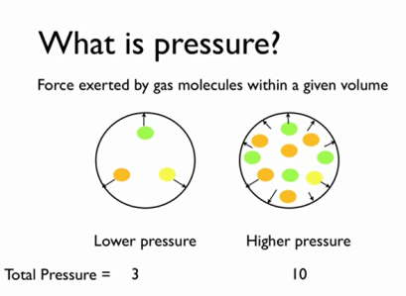
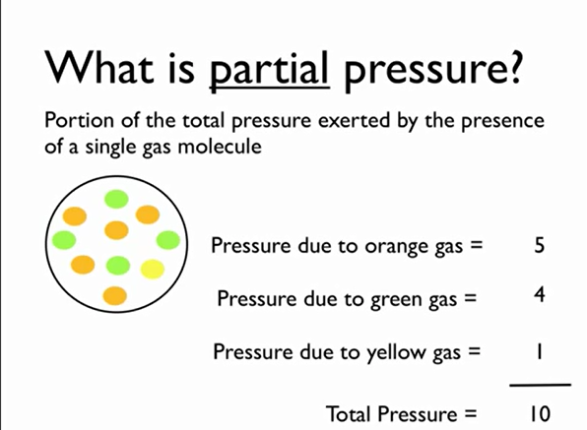
Partial Pressures
Partial Pressure of O₂
The partial pressure of oxygen (pO₂) is a measure of oxygen concentration.
Where will pO₂ will be high In the body?
in the lungs
Where will pO₂ be low in the body?
in body tissues such as muscle.
http://www.youtube.com/watch?v=yiaZ8-aMT_A
http://www.answers.com/topic/dalton-s-law#ixzz2Niu25dBPhttp://highered.mcgraw-hill.com/sites/0072437316/student_view0/chapter44/animations.html

Slide 53
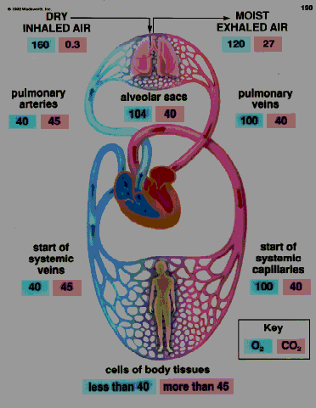
Blood arriving at the lungs has a lower pO₂ than that in the lungs. There is therefore a diffusion gradient and oxygen will move from the alveoli into the blood. The O₂ is then loaded onto the Hb until the blood is about 96% saturated with oxygen. The Hb is now called oxyhaemoglobin (HbO₂).
The blood is then taken to tissues where the cells are respiring all the time, using oxygen. The pO₂ will be low. As the red blood cell enters this region, the Hb will start to unload the O₂, which will diffuse into the tissues and be used for further respiration. Since much of the Hb will have unloaded the O₂, a much lower percentage of the blood will be saturated with O₂.
Oxygen will move from high to low partial pressure of oxygen.
Oxygen
Carbon dioxide

Slide 54
Oxygen Dissociation Curves
When haemoglobin is exposed to different partial pressures of O₂ it does not bind evenly.
A graph to show the relationship between saturation of haemoglobin with O2 and the partial pressure = oxygen dissociation curve

Slide 55
An Oxygen Dissociation Curve Shows Haemoglobin’s Affinity for Oxygen
3. It takes a smaller increase in pO₂ to bind the 2nd O₂ molecule than it did the first one = positive cooperativity. The gradient of the curve steepens
4. After 3rd o2 molecule binds it becomes harder for the 4th one to. This is due to probability as most of the binding sites are occupied to its less likely that a single O2 molecule with find an empty site. The curve reduces and flattens
90
Saturation of Haemoglobin with Oxygen / %
2. After 1 O₂ molecule binds, haemoglobin changes shape and it is easier for other O₂ molecules to bind.
1. Haemoglobin shape = difficult for 1st O₂ molecule to bind as the polypeptide chains are close together. Low O₂ = shallow curve
0
0
Partial pressure of oxygen / kPa
15

Slide 56
The Effect of Carbon Dioxide:
To complicate matters the CO₂ concentration also affects how haemoglobin functions.
Haemoglobin gives up its oxygen more readily (reduced affinity) at high partial pressure of CO₂ (pCO₂). This is called the Bohr effect. This enables more oxygen to get to cells that are respiring at a high rate.
When cells respire they produce CO₂, therefore increasing pCO₂

Slide 57
Bohr Effect
At higher partial pressures of carbon dioxide the oxygen curve shifts to the right.
When oxygen reaches respiring tissues (muscle) the high partial pressure of carbon dioxide enables oxygen more readily.

Slide 58

The Effect of CO₂ on the Oxygen Dissociation Curve
How much oxygen is transported by a molecule of haemoglobin also depends on partial pressure of carbon dioxide.
100
Show hide CO₂ line
80
CO₂
60
Saturation of Haemoglobin / %
From the graph we see that at high partial pressures of carbon dioxide, the oxygen dissociation curve shifts to the right.
This is called Bohr’s shift.
Higher partial pressure of carbon dioxide increases the dissociation of oxyhaemoglobin.
40
20
0
0
2
4
6
8
10
12
Next
Partial Pressure of Oxygen/ kPa

Slide 59
The Effect of CO₂ on the Oxygen Dissociation Curve
What is the significance of this in the body?
Answer
100
80
CO₂
60
Saturation of Haemoglobin / %
When oxyhaemoglobin reaches the tissues, the high partial pressure of carbon dioxide from respiration causes oxyhaemoglobin to release its oxygen more easily. So oxygen is released where it’s needed.
40
20
0
0
2
4
6
8
10
12
Next
Partial Pressure of Oxygen/ kPa

Slide 60
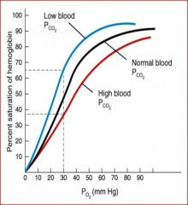
Bohr Effect Summary
At gas exchange surfaces
CO₂ low.
Affinity for O₂ increases.
High O₂ levels in lungs = O₂ readily loaded by haemoglobin.
Curve shifts to the left.
In respiring tissues
CO₂ high.
Affinity for O₂ reduces.
Low O₂ levels in muscles = O₂ readily unloaded by haemoglobin.
Curve shifts to the right.

Slide 61
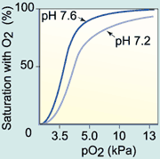
Carbon Dioxide and pH
Remember levels of carbon dioxide go up when rates of respiration increase.
Carbon dioxide dissolves in the blood to form carbonic acid.
This change in blood pH changes the shape of the haemoglobin causing them to lose their oxygen more readily.

Slide 62
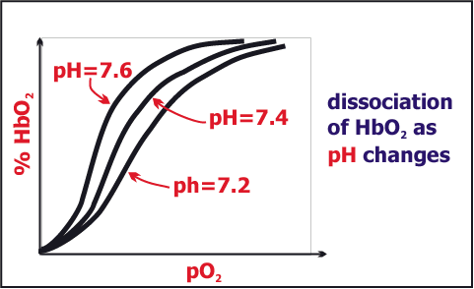
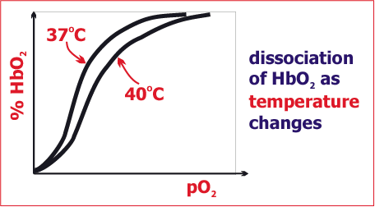
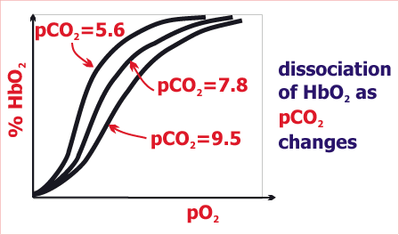
Factors affecting Disassociation
Respiratory Response to Exercise
This means that more oxygen is being uploaded from the haemoglobin at tissue level.
BLOOD TEMPERATURE
increased blood temperature
reduces haemoglobin affinity for O₂
hence more O₂ is delivered to warmed-up tissue
BLOOD Ph
lowering of blood pH (making blood more acidic)
caused by presence of H⁺ ions from lactic acid or carbonic acid
reduces affinity of Hb for O₂
and more O₂ is delivered to acidic sites which are working harder
CARBON DIOXIDE CONCENTRATION
the higher CO₂ concentration in tissue
the less the affinity of Hb for O₂
so the harder the tissue is working, the more O₂ is released
Notes:
Factors Affecting Haemoglobin Saturation – Blood Acidity If the blood becomes more acidic the dissociation curve shifts right.
This means that more oxygen is being uploaded from the haemoglobin at tissue level.
See overhead.
Factors Affecting Haemoglobin Saturation – Blood Acidity
The rightward shift of the curve is due to a decline in pH. This is referred to as the BOHR effect.
Factors Affecting Haemoglobin Saturation – Blood Acidity
The pH in the lungs is generally high.
So haemoglobin passing through the lungs has a strong affinity for oxygen, encouraging high saturation.
At the tissue level, however the pH is lower, causing oxygen to dissociate from haemoglobin, thereby supplying oxygen to the tissues.
Factors Affecting Haemoglobin Saturation – Blood Acidity
With exercise, the ability to upload oxygen to the muscles increases as the muscle ph decreases.
Factors Affecting Haemoglobin Saturation – Blood Temperature Increased blood temperature shifts the dissociation curve to the right, indicating that oxygen is uploaded more efficiently. Factors Affecting Haemoglobin Saturation – Blood Temperature Because of this, the haemoglobin will upload more oxygen when blood circulates through the metabolically heated active muscles.
In the lungs, where the blood might be a bit cooler, haemoglobin’s affinity for oxygen is increased. This encourages oxygen binding.

Slide 63
Summary
Below is list of stages that ensure that respiring tissues always have sufficient oxygen.
Place them in the correct order
The greater the haemoglobin shape changes
The higher the rate of respiration
The more oxygen is available for respiration
The lower the pH
The more carbon dioxide the tissues produce
The more readily oxygen is unloaded

Slide 64
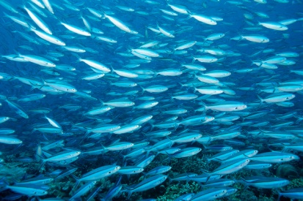
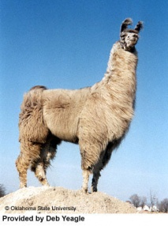
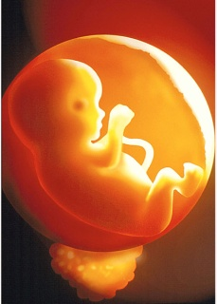
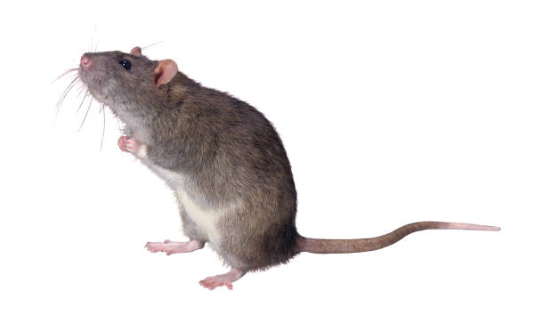
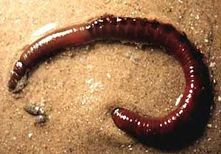
Where you live, What you do and your size is important.
Consider the oxygen problems and likely adaptations of the haemoglobin molecule for each of the 3 situations – ideas on MWB
1 environmental conditions,
2 activity levels
3 size

Slide 65
Organisms Need Adaptations to Survive in Particular Environments
Organisms that live in extreme conditions may have specialised haemoglobins.
      High altitude living – low O₂ availability so needs Hb with a high affinity for O₂ in order to pick up the little available.
      Sandy burrows on sea / shore boundary. Low O₂ levels in burrow. Needs to have Hb with high affinity.
      Amniotic sac in uterus – so needs Hb to have higher O₂ affinity than mother’s so it can get oxygen from the mother’s blood (mother’s blood and foetal blood are in close proximity at the placenta).
These organisms need haemoglobin with a high affinity for oxygen so they can pick up the little available. The dissociation curve is to the left.

Slide 66
Organisms Need Adaptations for their Lifestyles
Certain lifestyles are energy demanding.
      Swallows spend most of their time in flight. Respiratory rates must be high to supply active flight muscles
      Mackerel must swim very fast to escape predators.
      Mice are both active and have are small with a high surface area to volume ratio.
These organisms need haemoglobin with a low affinity for oxygen so it can rapidly be released to respiring tissues. The dissociation curve is to the right.

Slide 67

Why have different haemoglobins?
Different types of haemoglobins have different affinities for oxygen.
Some have a high affinity for oxygen (take up oxygen very easily - but do not release it as readily)
Some have a low affinity for oxygen (do not take up oxygen easily - but release it more readily)
Organisms with less O2 in their environment (e.g. fish) need haemoglobin with a high affinity for O2
Animals with a high metabolic rate need haemoglobin with a low affinity for O2 so that O2 released more easily at the respiring tissues

Slide 68
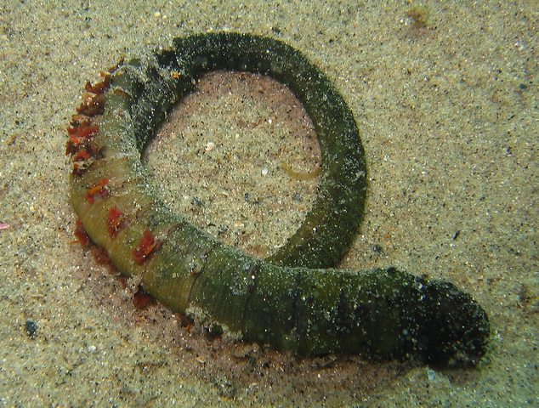
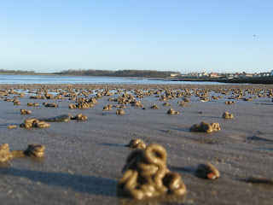
Lugworm
Normally buried in sand (worm casts at low tide)and so levels of oxygen are low
Pumps seawater through its burrow giving access to the limited amount of oxygen
To enable it to load oxygen more easily it has haemoglobin with an oxygen dissociation curve to the left of human haemoglobin

Slide 69

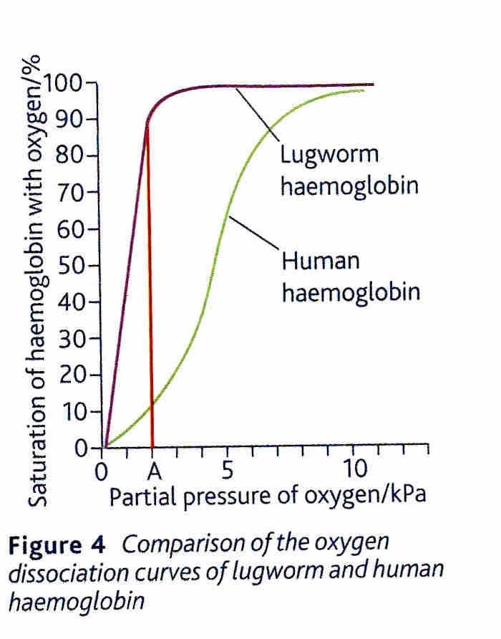
Comparing Lugworm and Human Haemoglobin

Slide 70
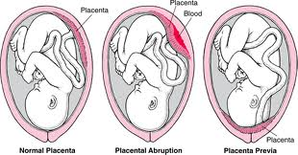
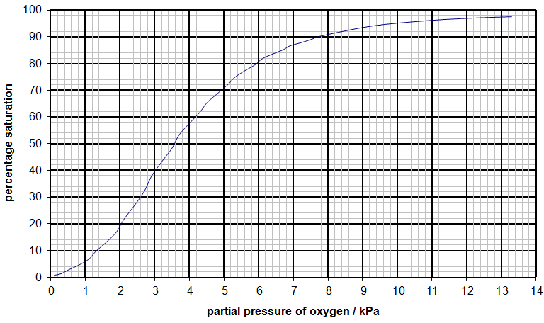
Foetal haemoglobin.
Foetal haemoglobin has a higher affinity for oxygen than maternal haemoglobin

Slide 71
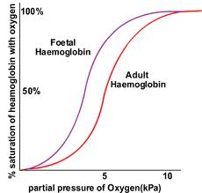
Foetal Haemoglobin:
This means maternal haemoglobin will dissociate itself in the placenta and the foetal haemoglobin will load with oxygen.
Explain why it is essential for the survival of the foetus that the foetal curve is to the left of the maternal curve.

Slide 72
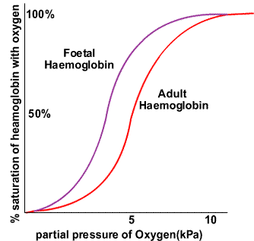
The blood of the foetus and the mother flow closely together but rarely mix.
Foetal Hb is structurally different from its mother’s Hb.
This increases its affinity for oxygen.
The oxygen dissociation curve therefore moves to the left.

Slide 73
Higher affinity for oxygen
Foetal Heamoglobin
Loading tension
50
4
Unloading tension

Slide 74
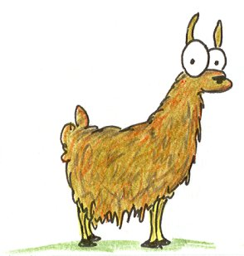

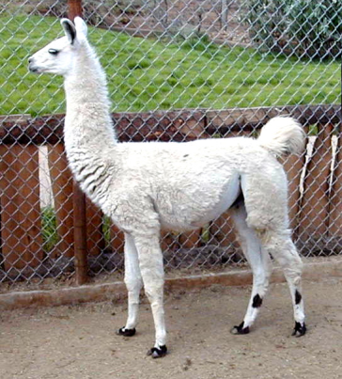
Animals at altitude eg Llama
At high altitude there is a drop in atmospheric pressure
Therefore the partial pressure of oxygen is less high
The Llama has haemoglobin that loads more readily with oxygen
Its oxygen disassociation curve is to the left of humans
At high altitude the number of red blood cells in the blood of mammals increases

Slide 75

Llamas.
Live at high altitudes where there is less oxygen.

Slide 76

Llamas – high altitude, little O_{2.}
Need higher affinity Hb – picks up O₂ more readily, but releases it less readily.
Curve also shifted to left for other organisms inhabiting low O₂ environments – only releasing O₂ when pp very low.

Slide 77

Altitude sickness
Caused by acute exposure to low partial pressure of oxygen at high altitude
Compensated by altitude acclimatisation – body combats it by producing more red blood cells.

Slide 78

Smaller animals – have a high metabolic rate.

Slide 79
Smaller animals (shrews/mice) and birds have curves shifted to the right.
Have high metabolism so need O2 to be released readily.

Slide 80


Slide 81


The Oxygen Dissociation Curve of an Athlete in Training
100
The further left the curve shifts, the easier it is for haemoglobin to pick up oxygen.
80
60
Saturation of Haemoglobin / %
40
The further the oxygen dissociation curve shifts to the right, the easier it is for the haemoglobin to give up its oxygen.
20
0
0
2
4
6
8
10
12
Next
Partial Pressure of Oxygen/ kPa

Slide 82
5 minute summary of lesson
http://www.youtube.com/watch?v=wLPgxfBqtOM
Watch these videos after the lesson to help you understand this topic
Oxygen dissociation curve
http://www.youtube.com/watch?v=MKGhoC1Bf-I&feature=related
The Bohr effect
http://www.youtube.com/watch?v=-rCpkvE7uzo&feature=fvwrel

Slide 83
Describe how haemoglobin loads and unloads oxygen in the blood. (4)
Oxygen loads onto haemoglobin at high partial pressure.
In the lungs haemoglobin has a high affinity for oxygen.
Tissues have a low partial pressure of oxygen as it has been used in respiration.
In tissues haemoglobin has a lower affinity for oxygen.
Haemoglobin unloads oxygen at low partial pressure.

Slide 84
Explain how oxygen is loaded, transported and unloaded in the blood. (6)

Slide 85
Haemoglobin carries oxygen (or has a high affinity for oxygen, or oxyhaemoglobin;
In red blood cells;
Loading of oxygen takes place in the lungs;
At high p.O2;
Unloads oxygen to respiring cells or tissues;
At low p.O2;
Unloading linked to higher carbon dioxide (concentration);

