Slide 1
Unit 14: Exercise, Health & Lifestyle

Slide 2
Learning Outcomes
On completion of this unit a learner should:
1 Know the importance of lifestyle factors in the maintenance of health and wellbeing
2 Be able to assess the lifestyle of a selected individual
3 Be able to provide advice on lifestyle improvement
4 Be able to plan a health-related physical activity programme for a selected individual.

Slide 3
Lifestyle factors that affect Health & Well-being
Unit 14

Slide 4
Daily recommendations for young people aged 5-18
60 minutes of physical activity every day – ranging from moderate activity, such as cycling and playground activities, to vigorous activity, such as running and tennis
AND on three days a week, these activities should involve exercises for strong muscles, such as push-ups, and exercises for strong bones such as jumping and running.

Slide 5
Physical activity recommendations for adults 19-64
2 ½ hours of moderate intensity activity over a week. E.g. 30 minutes on 5 days a week. Moderate intensity is strenuous but able to carry on a conversation e.g. brisk walking/cycling
Focus on muscle strength at least 2 times a week (E.g. Exercising with weights, carrying heavy loads)

Slide 6
Physical activity - The Stats
At least 66% of the adult population are not meeting the recommended minimum levels of activity.
Physical inactivity shortens life expectancy and increases the risk of serious health conditions. It causes:
6% of the burden of CHD
7% of type 2 diabetes
10% of breast cancer
10% of colon cancer
9% of premature death (5.3 million deaths worldwide each year)
Estimated to cost the English economy £8.3 billion per year with the cost to the NHS between £1-1.8 billion per year
If physical inactivity decreased by 10% or 25% more than 533,000 to 1.3 billion deaths could be prevented every year worldwide.

Slide 7
Benefits of physical activity
Reduced risk of diseases like coronary heart disease, strokes and type 2 diabetes
Helps maintain a healthy weight
Helps maintain ability to perform everyday tasks with ease
Improves self-esteem
Reduces symptoms of depression and anxiety

Slide 8
Why does exercise reduce the risk of coronary heart disease, stroke and type 2 diabetes.
 | What is it? | Why does exercise reduce the risk of getting it?
Coronary Heart Disease (CHD) | Narrowing of the coronary arteries(the blood vessels that supply oxygen and blood to the heart). | Helps to burn fat and remove high density lipoproteins from the blood stream so arteries are less blocked
Stroke | A stroke is a serious, life-threatening medical condition that occurs when the blood supply to part of the brain is cut off. | Physical activity causes blood pressure to be reduced and less blockages in arteries.
Type 2 diabetes | This is when the pancreas produces insulin but the body becomes resistant to it so glucose stays in the blood rather being absorbed. | Type 2 diabetes is limited by helping to remove excess sugars by burning them in calories.

Slide 9
Why does exercise help to maintain a healthy weight?
Exercise helps to burn extra calories that are taken in.

Slide 10
Why does exercise help the ability to perform everyday tasks?
By increasing muscle strength you slow down the rate of bone and muscle loss from ageing. This reduces the chances of falling.
By being more flexible can improve posture, reduce aches and pains and lower the risk of injury so enabling you to continue carrying out everyday tasks better.

Slide 11
Why does exercise improve self-esteem?
Fitness and appearance improve which raises self-esteem.
Also exercise releases endorphins ‘the feel good’ chemical.

Slide 12
Why does exercise reduce the symptoms of depression and anxiety?
Depression (major depressive disorder or clinical depression) is a common but serious mood disorder. It causes severe symptoms that affect how you feel, think, and handle daily activities, such as sleeping, eating, or working.
Releasing feel-good brain chemicals
Reduces immune system chemicals
Increasing body temperature
Boosts self confidence.
Takes your mind off worries.
Get more social interaction.
Helps you cope in a healthy way.

Slide 13
What is alcohol?
Alcohol is a colourless flammable liquid which is produced by the natural fermentation of sugars and is the intoxicating part of wine, beer, spirits, and other drinks.

Slide 14
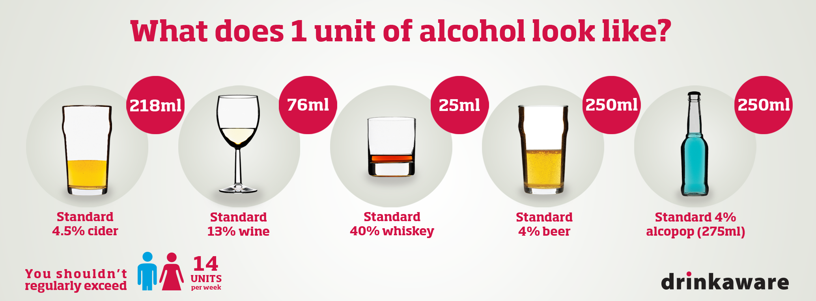
Alcohol Recommendations & Guidelines
What is a unit?
National guidelines = no more than 14 units a week spread over 3 or more days.
Alcohol free days = 3 or 4 a week

Slide 15
Alcohol – the stats
Alcohol misuse is a contributing factor in more than 60 medical conditions
Alcohol consumption has nearly doubled since the 1950s
31% of men and 16% of women drink over the guideline amounts per week (this is equal to over 10 million people in England alone)
The annual cost of alcohol misuse to the English economy is around £20 billion
The annual cost of alcohol misuse to the NHS is around £2.7 billion pounds

Slide 16
Risks associated with excessive drinking
Stroke
Cirrhosis
Hypertension
Depression
Cancer
Many others

Slide 17
What is a stroke and why does excessive alcohol consumption cause a stroke?
Uncontrolled high blood pressure
Strain on vessels (including those to brain)
Vessels weaken causing bleeding in the brain
Causes lack of blood to the brain
This is a stroke
Alcohol causes high blood pressure. A stroke is a serious, life-threatening medical condition that occurs when the blood supply to part of the brain is cut off.

Slide 18
What is cirrhosis and why does excessive alcohol consumption cause a cirrhosis?
Alcohol is the main cause of liver cirrhosis
Cirrhosis is scarring of the liver caused by continuous long-term liver damage. Scar tissue replaces healthy tissue in the liver and prevents the liver working properly.
Alcohol affects the way the liver handles fat so your liver cells get stuffed full of it. Your liver swells as a result.
Alcohol can damage our intestines which lets toxins from our gut bacteria get into the liver. These toxins can also lead to inflammation and scarring.
Liver tries to break down alcohol and the chemical reaction caused can damage its cells. This can lead to inflammation and scarring as the liver tries to repair itself.

Slide 19
What is hypertension and why does excessive alcohol consumption cause it?
Hypertension is high blood pressure and means your heart has to work harder to pump blood around the body.
Alcohol also interferes with the liver's ability to make the hormones renin and angiotensin- these are important for blood pressure maintenance.
Alcohol contains excess calories which can cause unwanted weight gain which increases blood pressure.
When Alcohol is present in the blood stream it covers the blood vessels and artery walls thereby increasing their tension and thereby increasing the blood pressure.
Frequent alcohol consumption reduces magnesium levels which can increase blood pressure

Slide 20
What is depression and why does excessive alcohol consumption cause it?
Depression (major depressive disorder or clinical depression) is a common but serious mood disorder. It causes severe symptoms that affect how you feel, think, and handle daily activities, such as sleeping, eating, or working.
Alcohol is a depressant, which means it can disrupt that balance, affecting our thoughts, feelings and actions – and sometimes our long-term mental health.
This is partly down to ‘neurotransmitters’, chemicals that help to transmit signals from one nerve (or neuron) in the brain to another.

Slide 21
What is depression and why does excessive alcohol consumption cause it?
Alcohol causes chemical changes in the brain. As you drink more, more of the brain starts to be affected. High levels of alcohol causes a negative emotional response.
Regular drinking lowers the levels of serotonin in your brain – a chemical that helps to regulate your mood.

Slide 22
What is cancer and why does excessive alcohol consumption cause it?
20 percent of all alcohol-related deaths are due to cancer.
Cancer is when abnormal cells divide in an uncontrolled way. Some cancers may eventually spread into other tissues.
Alcohol in your body is converted into a toxic chemical called acetaldehyde. This can damage your DNA and stop your cells from repairing any damage, which can lead to cancer.
Alcohol drinkers tend to have lower levels of folate, an important vitamin that helps our cells produce new DNA correctly. Some studies have found that cancer is more common in people with low levels of folate in their blood.
Alcohol can increase the levels of oestrogen, which is linked to breast cancer.

Slide 23
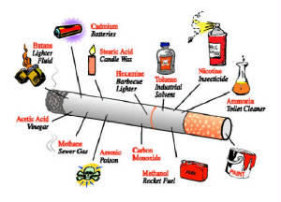
Smoking
Smoking refers to the inhalation and exhalation of fumes from burning tobacco in cigars, cigarettes and pipes.

Slide 24
Smoking – the stats
Smoking can significantly increase the risk of a variety of cancers not just lung cancer. Also it causes other respiratory and cardiovascular diseases.
Currently 15.5% of adults in England smoke
In 2015, there were around 79,000 deaths caused by smoking. This is about 16% of all deaths in that year.
In 2015/16 there were around 474,000 hospital admissions due to smoking.
The annual cost of smoking to the English economy is around £5.2 billion
The annual cost of smoking to the NHS is around £2.7 billion pounds

Slide 25
What is coronary heart disease and why does smoking cause it?
Coronary heart disease (CHD) is a disease in which a waxy substance called plaque builds up inside the coronary arteries.
Limits the amount of oxygen your heart gets due to the nicotine and carbon monoxide, so speeds up the heart rate and raises blood pressure.
The chemicals in the cigarettes also damage the inside of your vessels leading to furring.

Slide 26
What is cancer, what cancers can smoking cause and why does smoking cause it?
Cancer is when abnormal cells divide in an uncontrolled way.
Body may be able to repair this damage at first. But with each repeated exposure, normal cells that line your lungs are increasingly damaged.
Over time, the damage causes cells to act abnormally and eventually cancer may develop.
Smoking damages the cells that line the lungs.
Cigarettes are full of carcinogens (cancer causing substances. This change the lung tissue.

Slide 27
What are emphysema, bronchitis and pneumonia and why does smoking cause them?
Smoking reduces the cilia action.
It makes mucous thicker and amount increases. Mucous is therefore not cleaned out as well, clogs airways and gets easily infected.
Airways become narrow and reduce the air flow. Even one or two cigarettes cause irritation and coughing. Your lungs age faster. Number of air spaces and blood vessels in the lungs decreases. Less oxygen is carried to your body. The natural defenses your lungs have against infection do not work well.
Chronic obstructive pulmonary disease (COPD) is the name for a group of lung conditions that cause breathing difficulties.
emphysema – damage and enlarged alveoli in the lungs
chronic bronchitis – long-term inflammation of the airways
Pneumonia – inflammation of the alveoli where they fill with pus

Slide 28
What is stress?
A state of mental or emotional strain or tension resulting from adverse or demanding circumstances

Slide 29
What is hypertension and why does stress cause it?
Hypertension is high blood pressure and means your heart has to work harder to pump blood around the body.
There's no proof that stress by itself causes long-term high blood pressure. It may be that other behaviours linked to stress — such as overeating, drinking alcohol and poor sleeping habits — cause high blood pressure.
However, short-term stress-related spikes in your blood pressure added up over time may put you at risk of developing long-term high blood pressure.
Your body produces a surge of hormones when you're in a stressful situation. These hormones temporarily increase your blood pressure by causing your heart to beat faster and your blood vessels to narrow.

Slide 30
What is angina and why does stress cause it?
It usually happens because the arteries supplying the heart become hardened and narrowed.
Thought to be from Cardiac syndrome X (also known as microvascular angina) usually occurs when you're exerting yourself, through emotional upset such as when stressed.
Angina is chest pain that occurs when the blood supply to the muscles of the heart is restricted.

Slide 31
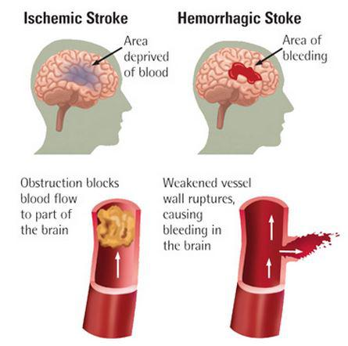
What is a stroke and why does stress cause a stroke?
A stroke is a serious, life-threatening medical condition that occurs when the blood supply to part of the brain is cut off.
Stress causes uncontrolled high blood pressure puts a strain on blood vessels all over the body, including vital arteries in the brain. This strain can cause vessels to weaken or become clogged up, which in turn can lead to blockage of the blood vessels taking blood to the brain or bleeding into the brain.
Either way it can result in a stroke.

Slide 32
What is a heart attack and why does stress cause it?
A heart attack happens when there is a sudden loss of blood flow to a part of your heart muscle. Most heart attacks are caused by coronary heart disease.
Coronary heart disease (CHD) is when your coronary arteries (the arteries that supply your heart muscle with oxygen-rich blood) become narrowed by a gradual build-up of fatty material within their walls.
If a piece of this fatty material (atheroma) breaks off it may cause a blood clot (blockage) to form. If it blocks your coronary artery and cuts off the supply of oxygen-rich blood to your heart muscle, this is a heart attack. It raises your blood pressure, and it's not good for your body to constantly be exposed to stress hormones (cortisol). Studies also link stress to changes in the way blood clots, which makes a heart attack more likely.

Slide 33
What is a stomach ulcer and why does stress cause it?
Ulcers are holes or breaks in the protective lining of the duodenum (the upper part of the small intestine) or the stomach -- areas that come into contact with stomach acids and enzymes.
Excess production of stomach acid through stress will encourage the stomach and duodenum to eat away at itself causing an ulcer.

Slide 34
Effects stress Can have on your behavior and mood? How can someone react if they are clinically stressed?
Memory Problems
Poor Judgement
Inability to Concentrate
Indecision
Starting many tasks but achieving little
Self doubt
Increase Intake in Alcohol, Cigarettes and Caffeine to Relax
Isolating Yourself from Others
Sleeping too Little or too Much
Demotivated
Loss of sense of humour
Increase in alcohol intake
Depression
Moodiness
Irritability
Fatalistic Thinking
Panic
Cynicism
Anxiety
Feeling Overwhelmed
Frustration

Slide 35
Sleep
Sleep can have a big effect on health so it is important to get the right amount and quality of sleep
Benefits of sleep include:
Help to enhance the function of the immune system
Reduce the risk of obesity, diabetes and cardiovascular disease
Enhance mood and mental well-being
Increase fertility
Helps in memory, brain processes and learning
Most adults need around 8 hours of sleep per night.
About 1 in 3 adults in the UK suffer from poor sleep
Sleep loss costs the UK economy around £1.6 billion a year or £280 for each worker.

Slide 36
What is diet?
a pattern of eating

Slide 37
Benefits of a Healthy diet
Benefits of a healthy diet
Lower cholesterol
Feel better
Get toned, carry less excess fat
Clearer skin
More energy

Slide 38
Poor nutrition– the stats
Around 70% of the UK population do not consume the right amount of fruit and vegetables
Poor nutrition causes up to 70,000 premature deaths each year
1/3rd of cancers can be due to poor diet
Ill health from a poor diet costs the NHS up to £6 billion each year

Slide 39
obesity – the stats
In 1993 13% of men and 16% of women were obese. By 2015 this had risen to 27% of both men and women were obese and 41% of men and 31% of women were overweight.
In 2000 the average man was 7.7kg heavier than in 1986 and the average woman was 5.4kg heavier.
Being overweight (BMI 25 to less than 30) reduces life expectancy by 3 years
Being obese (BMI over 30) reduces life expectancy by 10 years
Around 1 in 11 deaths in the UK is caused by carrying excess fat, 50% more than in France.
Obesity costs the English economy £15.8 billion per year
Obesity costs the NHS £4.2 billion per year, nearly double that of smoking.

Slide 40
What is a nutrient deficiency and why does an unhealthy diet cause it?
If we consume the wrong kinds of food or lack essential foods in the diet we can be nutrient deficient.
A nutrient deficiency is a lack of any vitamin or mineral in the diet
E.g. Lack of iron causes anaemia
E.g. Lack of calcium causes osteoporosis
E.g. Lack of vitamin D causes ricketts

Slide 41
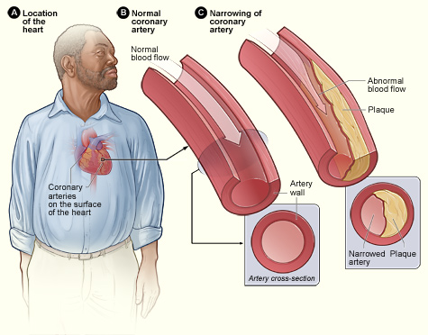
What is a coronary heart disease and why does an unhealthy diet cause it?
Excess calories we consume get stored as fat so eating more than we need plus the wrong kinds of food (saturated fats and sugars) will cause plaque to build up.
CHD is where fatty deposits build up on arteries.
This narrows arteries increasing heart rate

Slide 42
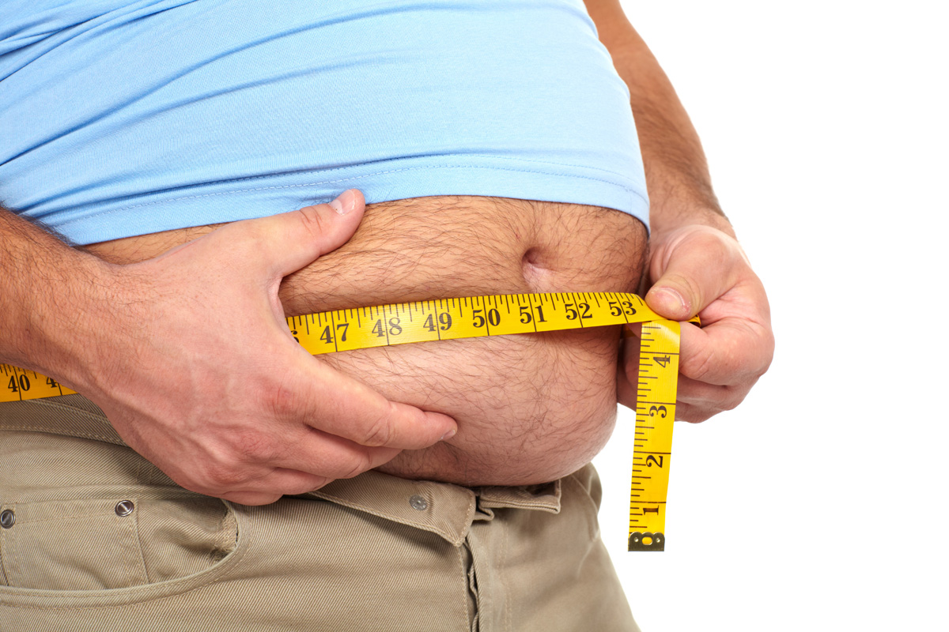
What is obesity and why does an unhealthy diet cause it?
Excess calories we consume get stored as fat so eating more than we need plus the wrong kinds of food (saturated fats and sugars) will you to become obese.
Obesity is having a high body fat compared to lean tissue.
It is when BMI is greater than 30.

Slide 43
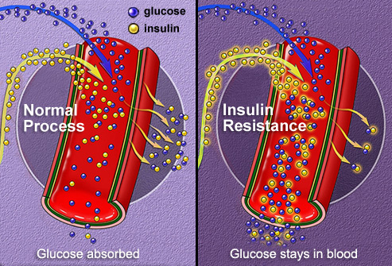
What is Type 2 diabetes and why does an unhealthy diet cause it?
Consuming a high sugar diet can cause the pancreas to not work efficiently so producing resistance to glucose in the blood.
Type 2 diabetes is where the pancreas produces insulin but the body becomes resistant to it. Glucose therefore stays in the blood rather than being absorbed.

Slide 44
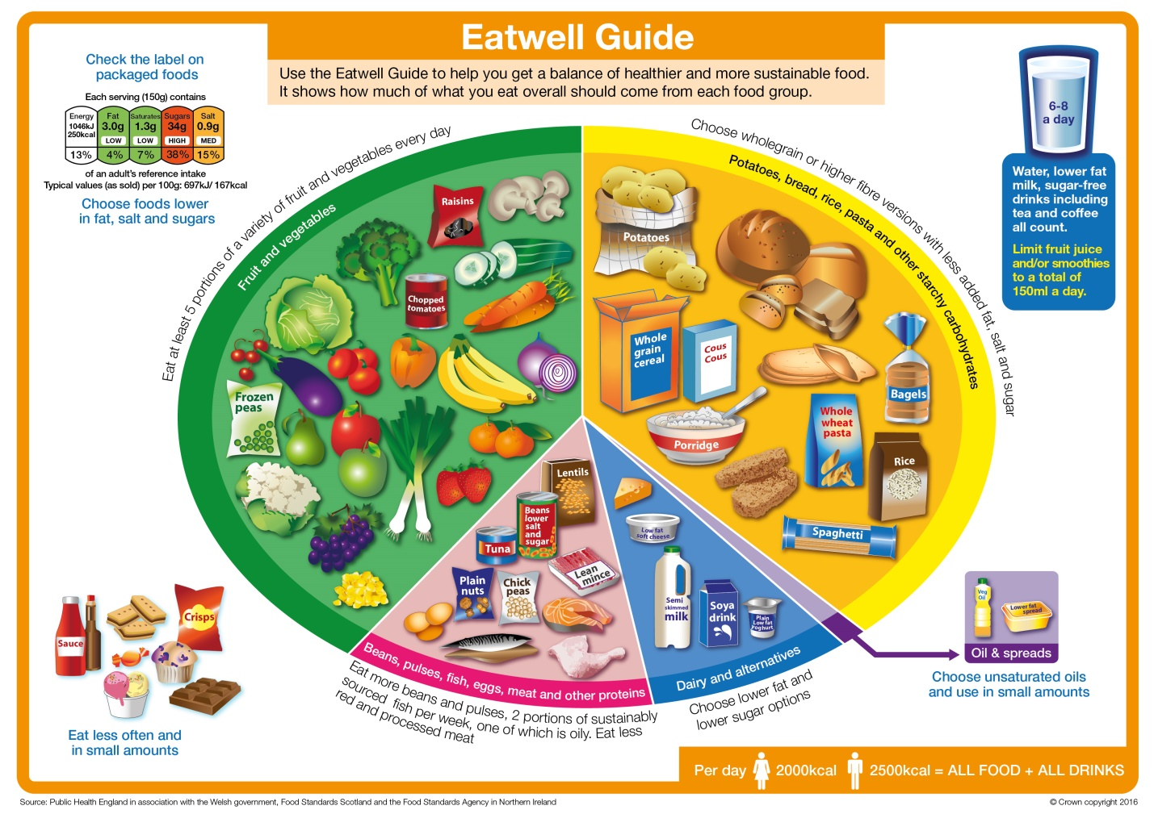
Diet recommendations & guidelines
In September 2007 the Food Standards Agency introduced the Eatwell Plate as guidelines for proportions and content of a healthy diet. This is shown below.

