Slide 1
Psychological factors of leadership
Session 1: Cohesion

Slide 2
What is Group Cohesion?
Group Cohesion is the attraction of the group to its members (and the resistance to leaving it), the sense of team spirit, and the willingness of its members to coordinate their efforts.
Group cohesion is the degree to which group members exhibit a desire to reach a common goal.

Slide 3
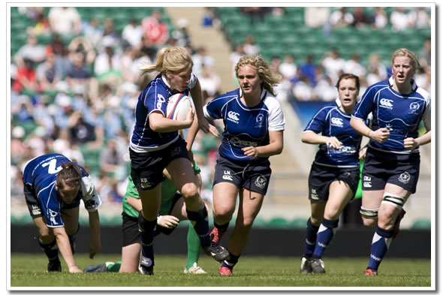
Types of Cohesion: Social versus task
 | Co-acting | Interactive
Example?
Task Cohesion (The level of team work when completing a task) | Low | High
Social Cohesion (Personal relationships for support & friendship) | High | Low

Slide 4
Factors affecting Team Cohesion
Carron (1993)
Situational factors
Individual
factors
Leadership
factors
Team
factors

Slide 5
Factors affecting Team Cohesion
Size of Group
The Ringlemann Effect
External Threats
Forces team members to ignore internal differences.
Individual Characteristics
Are the members motivated, experienced, confident etc?
Style of Leadership
Is the style of leadership well suited to the members?

Slide 6
Factors affecting Team Cohesion
Stability
The longer a team are together, the more likely they are to become cohesive.
Collective Goals
Are all members trying to achieve the same team goals?
Good Communication
Do the members listen well, speak the same language etc?
Success
The more success, the more cohesion (usually)
Similarity
More cohesive if team members have similar characteristics.

Slide 7
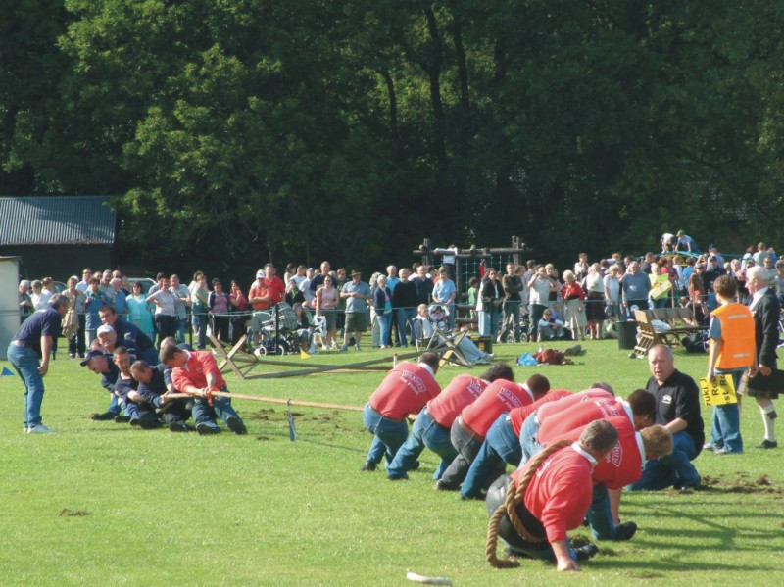
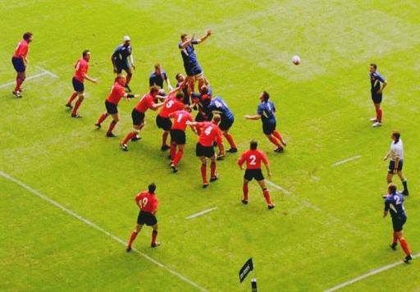
The Ringlemann effect
A breakdown in cohesion caused
by loss of co-ordination.
Losses occur when operational effectiveness of the group cannot be sustained.
https://www.youtube.com/watch?v=ie86AKyBhPM
The larger the group = more likely problems occur.
Eg. A Rugby team will be more likely to experience problems than a badminton doubles team.

Slide 8
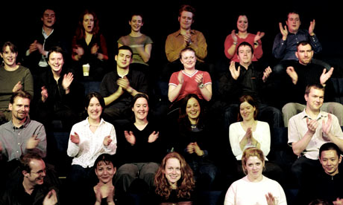
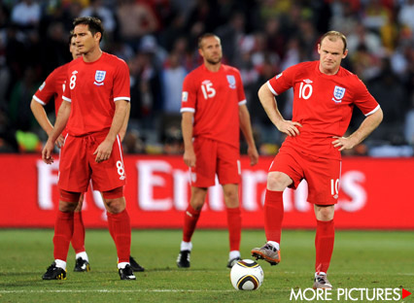
Social loafing
Relates to a loss of motivation causing an individual in a group to withdraw effort and ‘coast’.
Would anyone notice if I stopped clapping?
Why do players loaf?
Lack of accountability/ personal responsibility
I am not valued/ I have no role
Perception that others in team are not trying
Lack of confidence
Incorrect tactics by coach

Slide 9
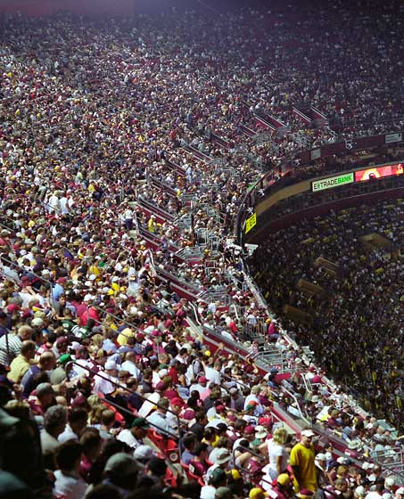
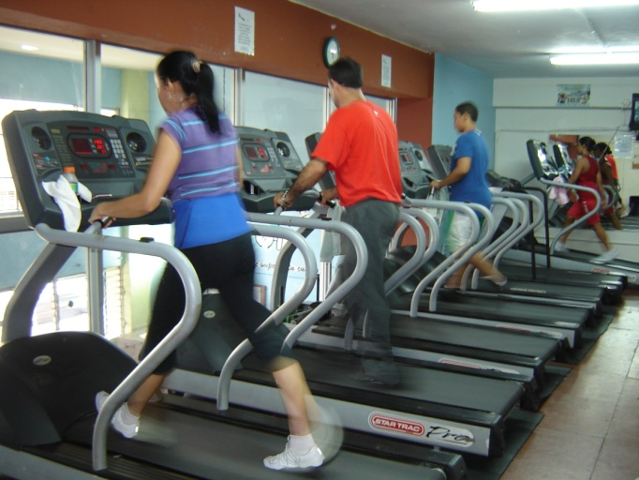
Is this a group? Why?

Slide 10
What are the key features of a team?
The six I’s!
Interaction
Interdependence
Interpersonal Relationships (mutual attraction)
Identical goals, norms, values
Identity
Independence

Slide 11
Tuckman’s stages of group development
How is a team formed?
Stage 1 – Forming
Individuals become familiar with one another
Stage 2 – Storming
Period of conflict as members compete for power and may question status of their roles (e.g. leader).
Stage 3 – Norming
Group instability begins to disappear and members
start to work together. Cohesion begins to appear.
Stage 4 – Performing
Members are aware of their own roles and other group members. Group directs energy towards shared goals and objectives.

Slide 12
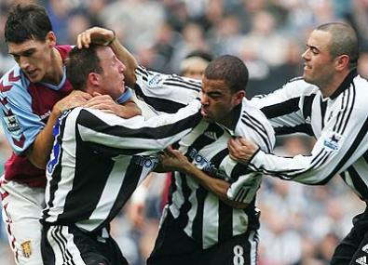
What negative influences can cause dysfunctional group behaviour?
Poor group communication
(e.g. players who do not listen)
Losing
Unfamiliar weather
or surroundings
Injury/illness
Anxiety
Perceived/
actual low ability
Effects of a
Crowd/
observers
learned helplessness
http://www.youtube.com/watch?v=u7_ygd9k24w
Off-the-pitch’ problems – poor social relationships
Attributing failure to
stable, internal factors
Negative past experience

Slide 13
Factors affecting the development of a cohesive group or team
Reduce Social loafing by…
Reduce Ringlemann effect by…
Reinforce/reward teamwork
Combat Ringlemann effect by splitting into small sub groups to practice e.g. backs and forwards
Punish social loafing
Work on co-ordination practices – eg back four stepping up at the same time
Monitor individual performance
Explain tactics & strategies fully to all team players
Improve communication between team players
Plus:
Explain how personal performance effects team cohesiveness
Encouragement team building & foster friendships
Encourage group identity/ belonging
Highlight individual performance e.g. Praise for assists
Pick ‘team players’
Clarify individual responsibility/ roles
Set appropriate goals (team and individual)

Slide 14
Factors affecting Participation in a group
Allocation of clear roles for each individual of the team.
This makes each individual feel valued within the group.
Awareness of other roles with in the group.
Development of mutual understanding between individuals.
Team-building exercises for both task and social cohesion.
Increases cohesiveness and offset the negative effect of large groups.
Evaluating each member’s performance.
Reduces loss of motivation of each individual.
Punishment of non-cohesive players.
Highlights the importance of cohesion.
Promotes team cohesion.
Selection of team players
Development of team goals.
Clarifies how team standards encourage effectiveness.
Reinforcement of team success.
Success attributed to the achievement of group.
Strong leadership.
Encourages group cohesion.

