Slide 1
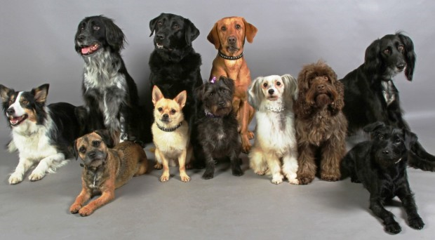
Genetic Diversity and Natural selection Why are organisms different from one another? What factors influence genetic diversity?
3.4.7

Slide 2
Specification 3.4.7 (Part new)
Genetic diversity as the number of different alleles of genes in a population.
Genetic diversity is a factor enabling natural selection to occur.
The principles of natural selection in the evolution of populations.
• Random mutation can result in new alleles of a gene.
• Many mutations are harmful but, in certain environments, the new allele of a gene might benefit its possessor, leading to increased reproductive success.
• The advantageous allele is inherited by members of the next generation.
• As a result, over many generations, the new allele increases in frequency in the population.
Directional selection, exemplified by antibiotic resistance in bacteria, and stabilising selection, exemplified by human birth weights.
Natural selection results in species that are better adapted to their environment. These adaptations may be anatomical, physiological or behavioural.
Students should be able to:
use unfamiliar information to explain how selection produces changes within a population of a species
interpret data relating to the effect of selection in producing change within populations
show understanding that adaptation and selection are major factors in evolution and contribute to the diversity of living organisms.

Slide 3
The tree of life-David Attenborough
https://www.youtube.com/watch?v=H6IrUUDboZo

Slide 4
Why are organisms different?
Proteins make organisms different from one another
DNA determines which proteins are made by an organism
Similarities and differences between organisms means variations in the DNA sequence.
Genes code for amino acids to make polypeptide chains
Members of the same species will have the same genes

Slide 5
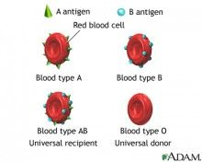
Example:
Human blood group –
All humans have the same genes for blood group.
Which blood group a person has depends on which ALLELES of the gene they possess.
Think and Link: What is an antigen?
Why universal donor and universal recipient?

Slide 6
Definitions:
What is an Allele?
What is meant by recessive and dominant?
What is meant by heterozygous and homozygous?

Slide 7
How are different alleles formed?
Mutations.
Substitution
Deletion

Slide 8
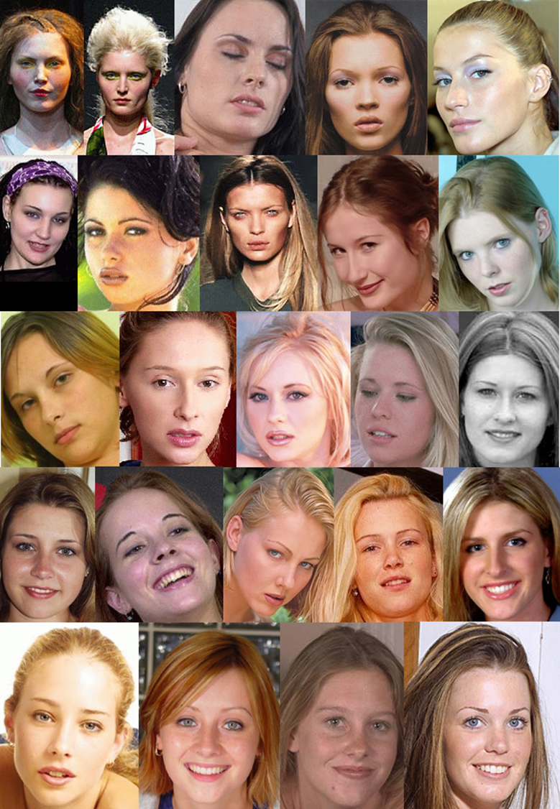
Organisms of the same species differ in their alleles NOT their genes
The combination of alleles makes individuals of the same species different from each other.

Slide 9
Genetic Diversity - Terms
Genetic diversity is described as the total number of different alleles in a population.
A population is a group of individuals of the same species that live in the same place and can INTERBREED
A species is a group of individuals that are capable of interbreeding to produce fertile offspring. A species can consist of one or more populations.
Population bottleneck (or genetic bottleneck) = an evolutionary event in which a significant percentage of the population or species is lost leading to decreased genetic diversity
Gene pool – the total number of alleles present in an interbreeding population at a specific time

Slide 10
Genetic diversity
The greater the number of different alleles within all members of a species, the greater the genetic diversity.
The greater the genetic diversity the more likely the species will be able to adapt to changes.
Why?
The greater the genetic diversity , the more likely some individuals in a population will survive environmental change. (wider range alleles therefore a wider range characteristics)
This gives rise to a greater probability that some individual will possess a characteristic that suits the new environment
If a population has a low genetic diversity the whole population could be wiped by a single event (e.g. disease)

Slide 11
This illustration shows the rat species Rattus nativitatis, which went extinct on Australia's Christmas Island by 1908. In a new study of museum DNA samples, researchers report that the likely cause of the animals' extinction was an introduced disease.
What about Homo sapiens? 1918 flu pandemic, Ebola outbreaks have pushed Gorillas nearly to extinction

Slide 12
How is genetic diversity increased within a population?
Mutations in DNA form new alleles
These can be advantageous while others could lead to problems (deleterious)
Different alleles can be introduced into a population when individuals from another population migrate into it and reproduce.
This is known as gene flow and this increases genetic diversity
Allele frequency is the number of times (frequency) that an allele is found within a population.
This can vary for example the A antigen in blood groups has a frequency of, while the B antigen only has a frequency of

Slide 13
What factors can reduce genetic diversity within a population?
Genetic bottlenecks
Selective breeding
The founder effect

Slide 14
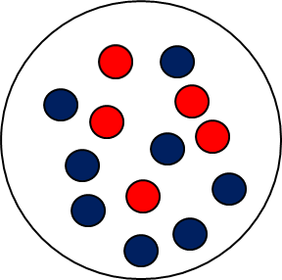
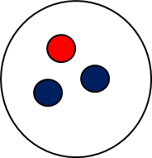
1. Genetic bottlenecks
Large number of the population dies
Reduced population some alleles are lost from the original population
Original population with different alleles
New population Genetic diversity greatly reduced

Slide 16
Genetic bottlenecks
This is an event which causes a big reduction in a population so large numbers of the population die before reproducing.
This reduces gene pool and therefore reduces the genetic diversity
Eg. King Penguin on Macquarie
http://www.earthtimes.org/conservation/king-penguins-genetic-diversity-macquarie-island/1836/

Slide 17
2. Selective breeding (Extension)
Also called artificial selection
Choosing individuals with desired characteristics and ONLY allowing them to reproduce.
Offspring without the desired characteristics are killed or prevented from reproducing.
Unwanted alleles are bred out of the population

Slide 18
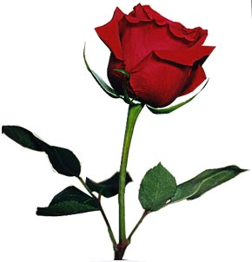
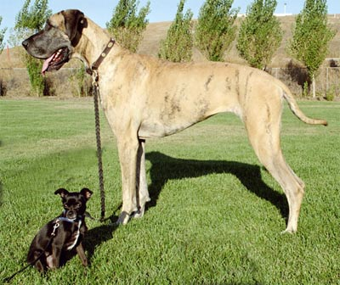
Variety of alleles is reduced to the desired number
What does this do to the genetic diversity?
When would you use selective breeding?

Slide 19
3. The founder effect
What is the definition of founder?
A person who establishes an institution, company, society or new community.
Occurs when a few individuals from a population colonise a new region
What does this mean in terms of alleles? Will all of the alleles in the population be present in the founders?
What does this mean for the genetic diversity of the new colony?

Slide 20
The Founding Effect
Original population with different alleles
Original population maintains a high level of genetic diversity
New population Genetic diversity is greatly reduced. The frequency of red allele is increased in the new population
Founding population with different alleles

Slide 21
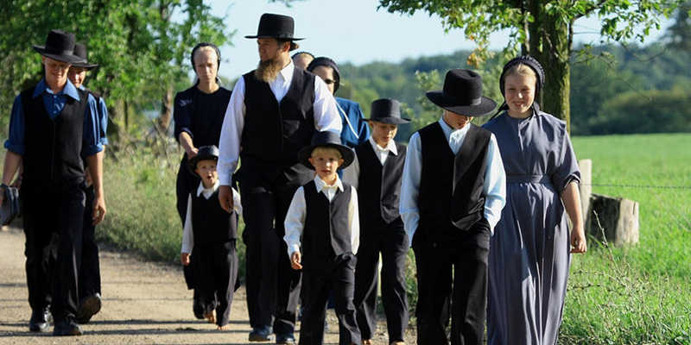
Example
The Amish population – all descendents from a small number of swiss who migrated there (200)
Little genetic diversity
Remained isolated due to their religious beliefs ( no interbreeding)
High incidence of certain genetic disorders. One form of dwarfism, Ellis-van Creveld syndrome, involves not only short stature but polydactyly (extra fingers or toes), abnormalities of the nails and teeth, and, in about half of individuals, a hole between the two upper chambers of the heart.

Slide 22
Try and fit what happened with the Amish into this diagram

Slide 23
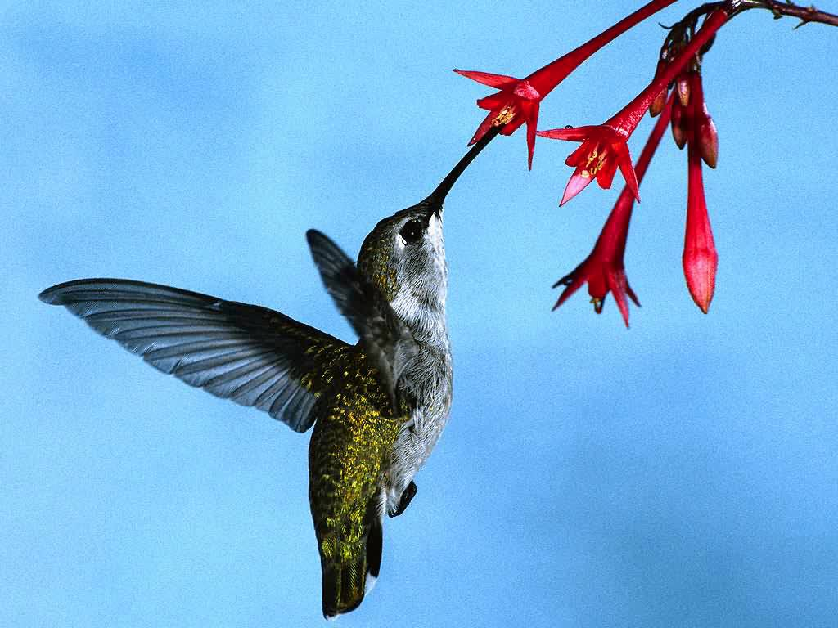
Genetic diversity allows for Natural selection which drives evolution
https://www.youtube.com/watch?v=hOfRN0KihOU – What is evolution?
Humming birds demonstrate natural selection
http://www.youtube.com/watch?v=xkwRTIKXaxg

Slide 24
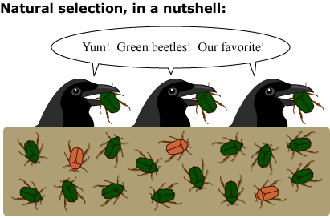
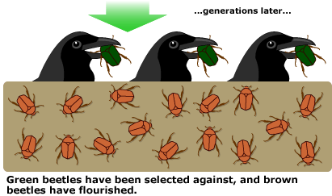
Natural selection
Not all alleles of a population are equally likely to be passed to the next generation.
This is because only certain individuals are reproductively successful and so pass on their alleles. This is known as differential reproductive success
Therefore differences between the reproductive success of individuals affects the allele frequency in a population.

Slide 25
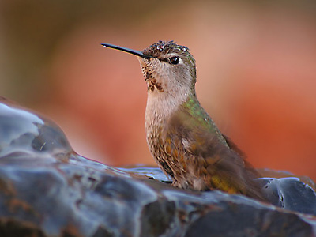
The process of natural selection
Within a population there will be a gene pool containing a wide variety of alleles.
Random mutation of alleles within this gene pool may result in a new allele of a gene which in most cases will be harmful
However in certain environments the new allele may give the possessor an advantage over other individuals in the population
These individuals will be better adapted and therefore more likely to survive in their competition with others
These individuals are more likely to obtain the available resources and grow more rapidly, live longer and breed successfully producing more offspring
Only those individuals that reproduce successfully will pass on their alleles to the next generation
Humming birds compete for nectar - natural selection has driven changes in wing shape and bill length and shape

Slide 26
Example caribou
Caribou taken from arctic to an area with a warmer climate
1810 average length of fur was 3.5cm
1960 average length 2.1cm
Explained by natural selection
How?
Variation in fur length in pop Caribou
Mutations mean allele for long fur and allele for short fur
Caribou shorter fur better adapted , more likely to survive and breed successfully
Greater proportion of next generation will inherit the allele for short fur, allele frequency will increase from generation to generation
Over many generations this leads to evolution

Slide 27
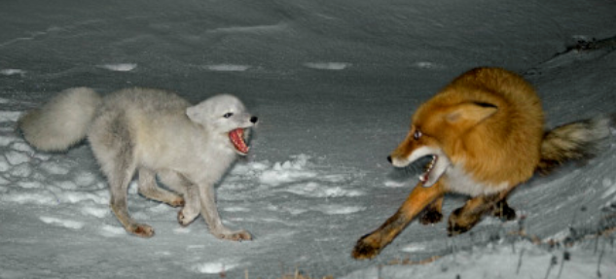
Types of adaptation
Behavioural – how an organism acts to increase its chance of survival
Playing dead-possum
Coutship eg scorpians dance before mating -
Physiological – These are processes inside an organism that increase it’s chance of survival
Oxidation of fat rather than carbohydrate in kangaroo rats produces additional water in a desert environment
Anatomical -These are structural features of an organism that increases it’s chance of survival
Shorter ears and thicker fur in arctic foxes compared to foxes in warmer climates
https://www.youtube.com/watch?v=4nt0cgShnMo
26.14 spider dance

Slide 28
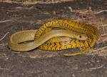
Question
There re many different species of rat snake, all found in different habitats and with slightly different colourings. The black rat snake lives in woodland habitat and has a dark, brown black colouring.
Describe how natural selection could explain the evolution of a rat snake with black colouring in a wooded area? (6 marker)

Slide 29
Answer
As a result of a mutation some individuals in the population have dark colouring
Blend into background
Avoid predators
More likely to survive and reproduce
Pass allele on for dark colouring
Frequency of dark allele will increase in the population so that after many generations most organisms in that population will carry the dark gene allele

Slide 30
Types of Natural selection
Directional
Neck of a giraffe
Antibiotic resistance in bacteria
Moth colour (melanin)
Camoflage/Mimics
Stabilising
Human birth weight
Disruptive (not on the specification)
http://ed.ted.com/videos/?search=directional selection&video=64JUJdZdDQo

Slide 31
1. Directional selection
What is the genotype?
The genetic composition of an organism
What is the phenotype?
The characteristics of an organism, often visible, resulting from both it’s genotype and the effects of the environment
https://www.youtube.com/watch?v=zjR6L38yReE

Slide 32
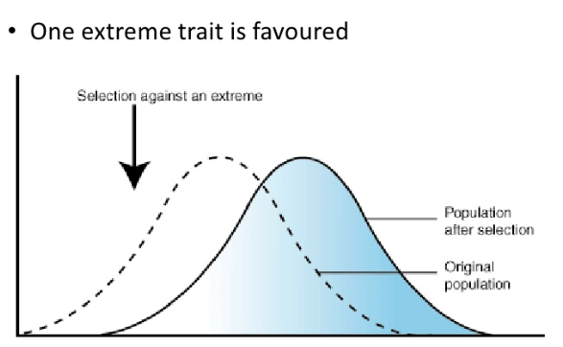
What is directional selection?
If the environment changes, the phenotype that are best suited to the new conditions are more likely to survive.
Some individuals that fall to the left or the right of the mean will have a new phenotype more suited to the new conditions
More likely to survive and breed passing on the advantageous allele to the next generation.
Over time the mean will move in the direction of these individuals
e.g. length giraffe neck- select against short length neck, mean length of neck will gradually change over time

Slide 33
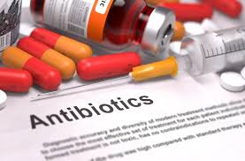
Example need to know is antibiotic resistance What are antibiotics?
Antibiotics are antimicrobial agents produced naturally by other microbes
Antibiotics most commonly act by inhibiting enzymes that are unique to prokaryotic cells, usually enzymes involved in cell wall synthesis.
This weakens the cell wall, killing bacterial cells by osmotic lysis
First developed after 2nd world war, however within a few some bacteria became resistant to antibiotics
Resistance first develops due to a mutation.
Most mutations are fatal, but some may alter enzyme shape changing it’s substrate specifity so it can now break down the antibiotic
Remember the development of antibiotic resistance is a random event
Bacteria replicate by binary fission where they replicate their DNA so can therefore pass on the resistance gene to all offspring and forming a new strain of bacteria.
If there is no antibiotic present in your gut this mutated strain may well die out due to competition with all the other bacteria, and the mutation will be lost again.
If you are taking antibiotic the resistant bacteria will now have a selective advantage
These cells can then reproduce rapidly without competition and will colonise the whole environment.
This a good example of natural selection at work.

Slide 34
Directional selection in Bacteria
Mean shifts

Slide 35
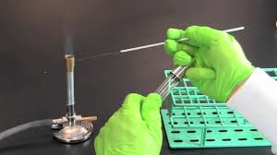
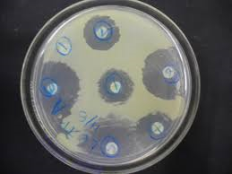
Required Practical 6
Aseptic technique
Zones of inhibition

Slide 36
Aseptic technique
https://www.youtube.com/watch?v=bRadiLXkqoU

Slide 37
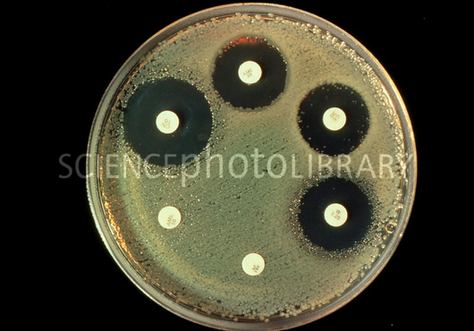
Identifying antibiotic resistance
Spread the bacteria on a clear nutrient jelly using aseptic technique
In a dish called a Petri dish
Small discs, each possessing a different antibiotic
are placed on the agar.
As the bacteria grow they from a cloudy covering
over the whole dish.
Any where the bacteria can’t grow can be seen as a clear patch in the lawn of bacteria. This is called the inhibition zone
The size of the inhibition zone tells you how well the antibiotic has worked
To work out the area of inhibition you need to use the following equation
Area = πr² to obtain the radius you will need to use a ruler to measure the diameter
To get rid of contaminated material use an autoclave (heats up to 121ºC)

Slide 38
Using your work book calculate the zones of inhibition
Picture guide:
A. Erythromycin
B. Chloramphenicol
C. Cephalothin
D. Tetracycline
E. Vancomycin
F. Novobiocin
G. Streptomycin
H. Penicillin

Slide 39
Key Points
Diffusion of antibiotics from the disc into the agar
Understand Aseptic technique
Use disinfectants to wipe surfaces before and after you start your work
Flame inoculation loop to kill any microbes on loop
Use sterile media
Flame neck glass container- that draws air to move out of container so microbes can not be drawn in.
Sterilse all glassware before and after use using an autoclave
Why do you use aseptic technique –prevent contamination

Slide 40
Working out zones of inhibition
https://www.youtube.com/watch?v=COrmrfiX230
https://www.youtube.com/watch?v=Ll_FmrMSkAM

Slide 41
Stabilizing selection
Stabilizing selection is a type of natural selection that favours the average individuals in a population.
This process selects against the extreme phenotypes and instead favours the majority of the population that is well adapted to the environment.
Stabilizing selection is often shown on a graph as a modified bell curve that is narrower and taller than the norm
Diversity is decreased
Usually works on traits that are polygenic

Slide 42
Human birth weight-Example
Why is a low and high birth weight detrimental?
Karn & Penrose (1951) showed that birth weight follows a normal distribution, that mortality for newborns is greater for those either under- or over-weight, and that the mean birth weight (7 lbs) coincides with that showing minimum mortality. That is, natural selection reduces the variance in birthweight, in such a way that the distribution has become stabilized around the optimum size for maximum survival.

Slide 43
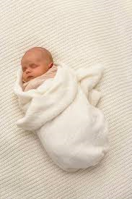
Why do small/large babies have a higher mortality rate?
Small babies have high SA to Vol ratio which means they find it hard to maintain their body temperature.
This puts pressure on their respiratory and cardiac systems, which can be fatal.
Giving birth to very large babies can be difficult which can lead to complications for mother and baby

Slide 44
What type of selection- stabilising or directional?
Australian snakes with big heads being able to eat the poisonous Cane toad, resulting in death of those with large heads;
Directional
Fossilised ferns showing little difference to modern day ferns
Stabilising
H/W see if you can find any more examples bring to next lesson

Slide 45
Plenary
https://www.youtube.com/watch?v=aTftyFboC_M (crash course)
http://wps.pearsoncustom.com/wps/media/objects/3014/3087289/Web_Tutorials/17_A02.swf (examples of the three different modes of natural selection)

Slide 46
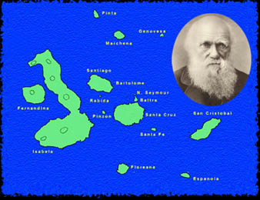
Darwin- for further interest http://science.discovery.com/video-topics/earth-science/galapagos-beyond-darwin-charles-darwin.htm
https://www.youtube.com/watch?v=uz7U4k522Pg&list=PL83C60B30FEEB25D2
David Attenborough on Darwin
Galapagos islands
observe, describe and classify the plants and animals
collect fossils
read essay

