Slide 1
Stress
What is stress?
What is arousal and how does it affect performance?
What is meant by the drive theory?
What is meant by the inverted u theory?
What is anxiety? What is the difference between state and trait anxiety?

Slide 2
What is stress?
‘A substantial imbalance between demand and response capability, under conditions where failure to meet that demand has important consequences.’

Slide 3
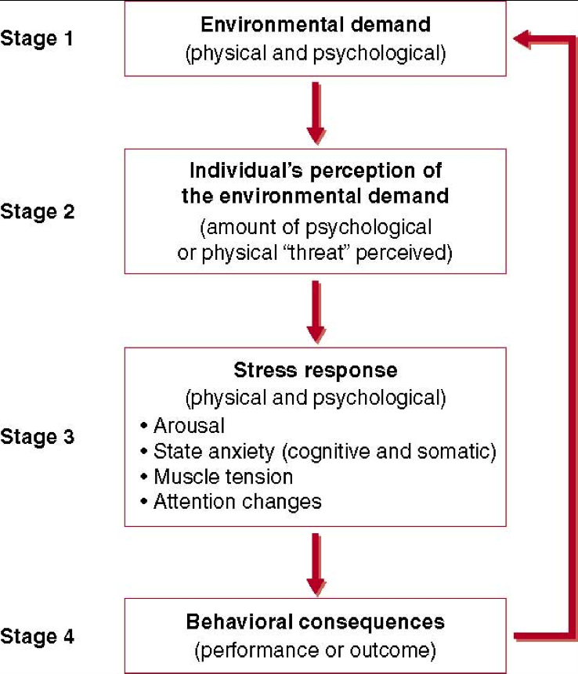
The stress process

Slide 4
What is arousal?
‘ a general physiological and psychological activation varying from deep sleep to intense excitement’.
Can be split into somatic arousal and cognitive arousal.

Slide 5
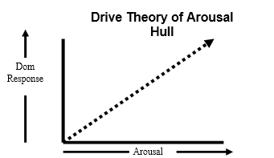
Drive theory

Slide 6
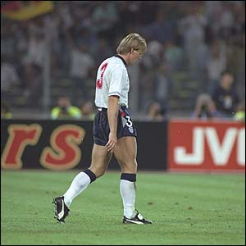
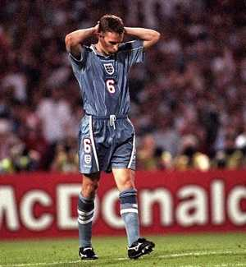
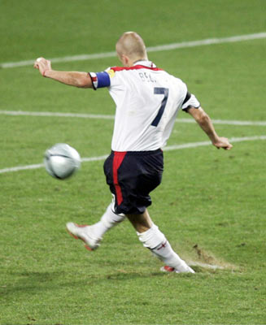
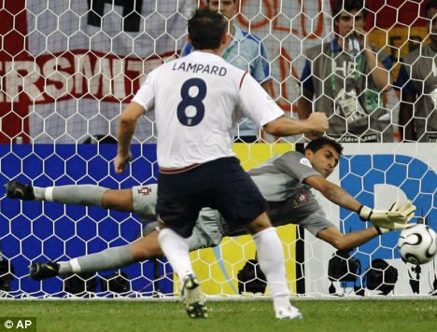
A case study in control of arousal:
England Penalty-taking at major tournaments
16
Psych
1990
World Cup
1996
European
Championships
2004
European
Championships
2006
World Cup
View | Portugal vs England Penalty shoot out | World Cup 2006
View | World Cup Penalty Shoot Out 1990 | Germany vs England
View | EM 1996 Germany vs England | Euro Cup penalty shoot out
View | Euro 2004 - Portugal vs England | Penalty shoot out
Watch E-stream clip: 2051

Slide 7
Inverted U theory of Arousal
As arousal increases so too does the quality of performance up to a critical or optimal point after this threshold if arousal continues to increase performance will deteriorate
Inverted U Hypothesis
Arousal
High | Factors causing differences in Optimal Arousal | Low
Extrovert | Personality | Introvert
Simple | Task Type | Complex
Autonomous/ expert | Stage of Learning/ experience | Associative/ novice

Slide 8
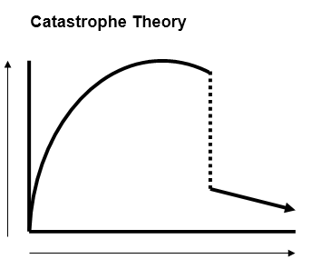
Catastrophe theory of arousal
Catastrophe Theory
The prediction of performance in relation to arousal follows the inverted U Theory up to the threshold of arousal. According to Catastrophe Theory just after this point there is a rapid decline in performance (a catastrophe occurs). The performer must regain control of their emotional state in order to return to the optimal state.

Slide 9
Anxiety = a negative emotional state with feelings of nervousness, worry, and apprehension associated with arousal in the body.
16
Psych
Cognitive anxiety
Thought component.
Worry, apprehension, fear of
failure, negative evaluations
Somatic anxiety
Physical component –triggered by
cognitive component.
Sweaty palms, butterflies,
increased HR.
State anxiety
Situational. Temporary unstable response.
Trait anxiety
General disposition –
part of personality.
Stable.
Watch e-stream clip 6680 – ‘Rory McIlroy Choking’

Slide 10
Homework questions
Why does a leader need to know about the drive theory and how will it influence my session?
Why does a leader need to be aware of the inverted u theory and how will it influence my session?
How can a sport leader control arousal in sports performers? Make reference to your led session.
Describe three stress management techniques and explain how they work.

