Slide 1
Transport
Phloem
Xylem
Haemoglobin

Slide 2
Key concepts
Solutes are dissolved substances.
Like xylem, the phloem is arranged as cells in a tube arrangement.
Sieve tube elements and companion cells.
Translocation is the movement of solutes.
The source is where the sugars come from, and the sink is where they go to.
Sugar is made in the leaves, so they are the source, and transported to the roots, so they are the sink.
In early spring, the leaves need energy to grow, so they sugars are transported from the roots (now the source) to the leaves (now the sink)

Slide 3
Enzymes maintain concentration gradients between sources and sinks.
Eg – in potatoes, sucrose is converted into starch in the sink area.
This means there is also a lower concentration of sucrose at the sink end than in the phloem.
Thus ensuring a constant supply of new sucrose reaches the sink from the phloem.
Links here to starch being insoluble so does not affect the water potential so a cell. – Good storage molecule.
Enzymes!!!!!!

Slide 4
Mass flow hypothesis.
How is sucrose loaded into the phloem at the source?
Hydrogen ion (H+) are actively transported from the companion cells into the surrounding tissues
the H+ will then diffuse back into the companion cells as it does, it brings in Sucrose with it via a co-transporter protein
sucrose builds up in the companion cell, then diffuses into the sieve tube via the plasmodesmata

Slide 5
How is sucrose transported along the phloem?
When sucrose enters the sieve tube, it lowers the water potential
Therefore, water follows and enters the sieve tube by osmosis
The water applies hydrostatic pressure and moves the sucrose by mass flow through the phloem (up or down the plant)

Slide 6
How is sucrose unloaded from the phloem at the sink?
The sucrose will move out of the sieve tube/phloem into the surrounding tissue by diffusion
This lowers the water potential of the surrounding tissue, so the water from the phloem follows by osmosis

Slide 7
Evaluating evidence: For mass flow
Uses phloem:
Radioactively labelled carbon on CO2 used in photosynthesis will be found in the phloem (in the sucrose)
Ringing of a tree, removing the phloem, leads to a build up of sugar above the ring
Aphid feeding on plants will have their mouth-parts connected to the phloem

Slide 8
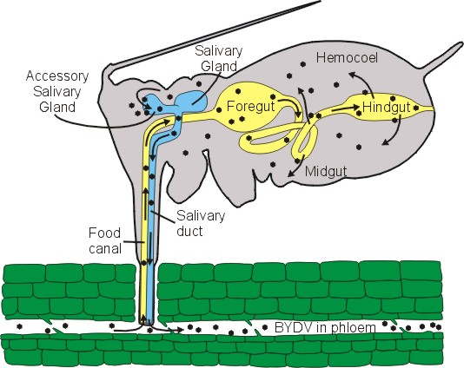
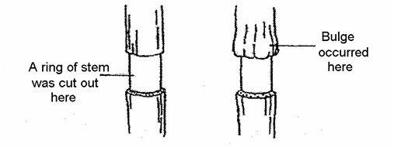

Slide 9
Uses ATP
Companion cells have many mitochondria
Metabolic poisons that inhibit respiration will stop translocation
Rate of flow of sugars in phloem is very fast
Uses H+
pH of companion cells higher than surrounding cells (loses H+, less acidic)

Slide 10
Against mass flow
solutes in phloem move at different rates
role of sieve plate unclear

Slide 11
Radioactive tracers.
Using radioactive carbon dioxide: because the carbon will be incorporated into organic substances.
The movement of these organic substances can then be tracked using autoradiography.
Plant is killed, the sample is then placed on a photographic film – the film will turn black wherever radioactive substance is found.
So autoradiography on plants that have been killed at different times show an overall movement from source to sink. Eg products of photosynthesis move from leaves towards the roots.

Slide 12
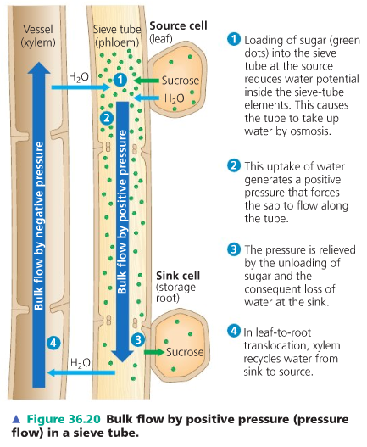
Task
You are given the following picture – you must write a description of what is happening at each number 1-4

Slide 13
Answers

Slide 15
1 mark

Slide 21
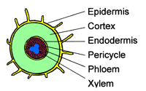
Make sure you can label these

Slide 22
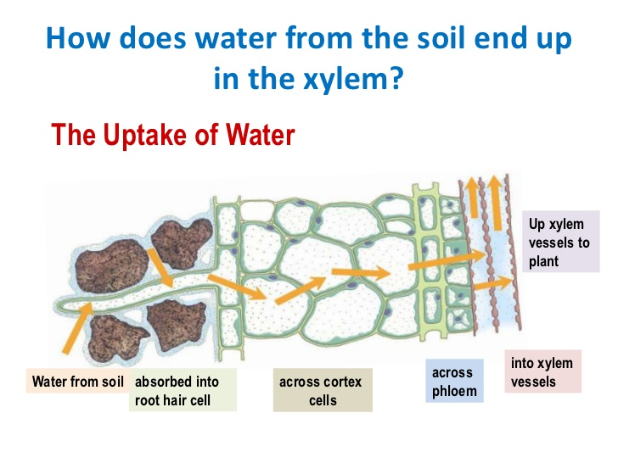
Adaptations of root hair cells
Symplast /Apoplast routes

Slide 23
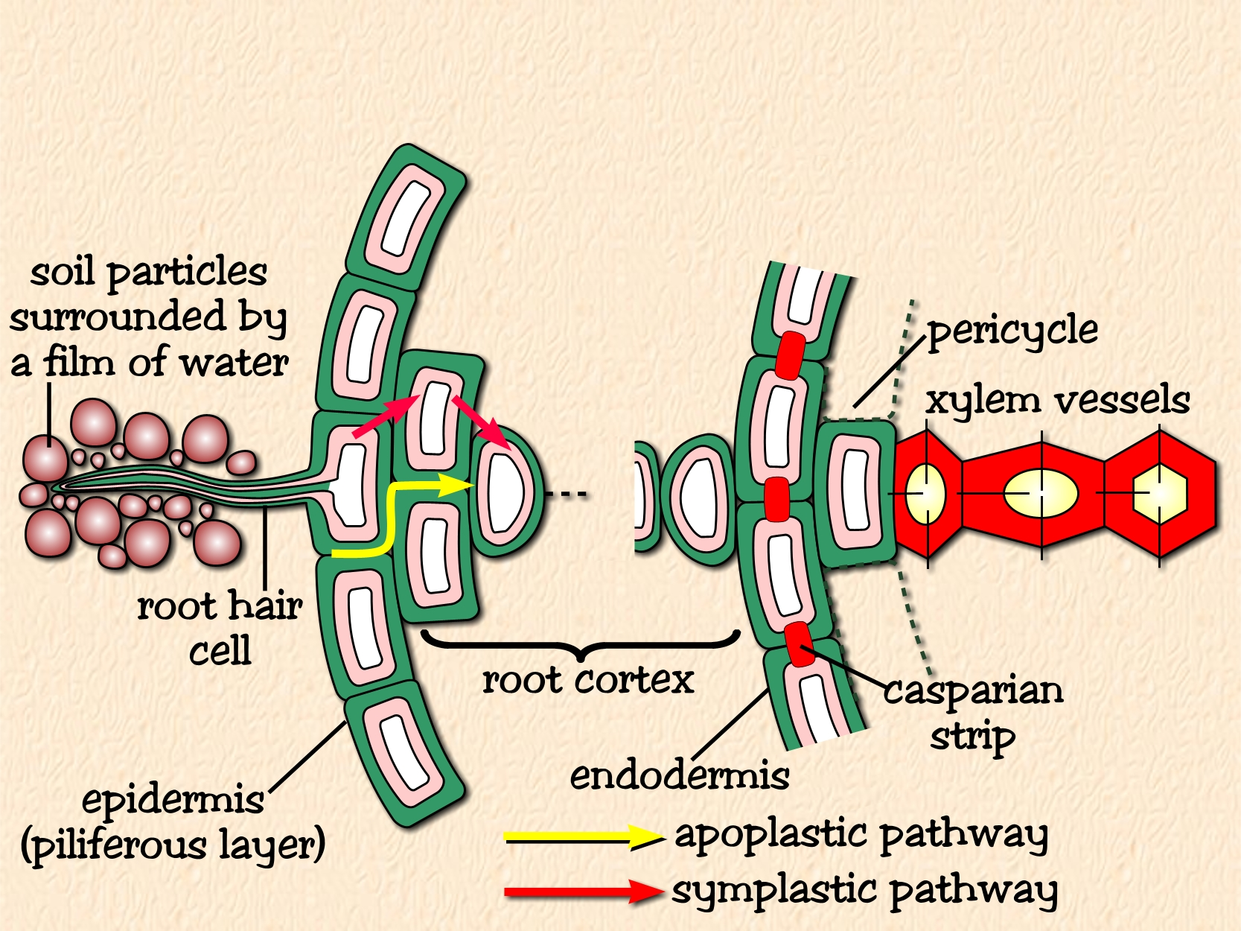

Water Transport Across The Root
Mineral ions are actively transported into the
root hair cells lowering the Water potential so it is lower than that in the soil.
Water therefore enters root hair cells from the soil solution by osmosis
(i.e. along a water potential gradient)

Slide 24
Root pressure.
Ions are actively transported from the endodermis to the xylem.
This lowers the water potential of the xylem.
Water moves from the roots into xylem by osmosis!!!!!.

Slide 25
How does water move up the xylem (in the stem)?
Cohesion and tension help to transport water from the roots to leaves against gravity:
Water evaporates from the leaves at the “top” of the xylem through transpiration stream
This creates tension (suction) which pulls more water into the leaf (think of a straw)
Water molecules are cohesive (stick together H-bonding), adhesion water molecules are attracted to the walls of the xylem.
So a column of water moves upwards through the xylem

Slide 29
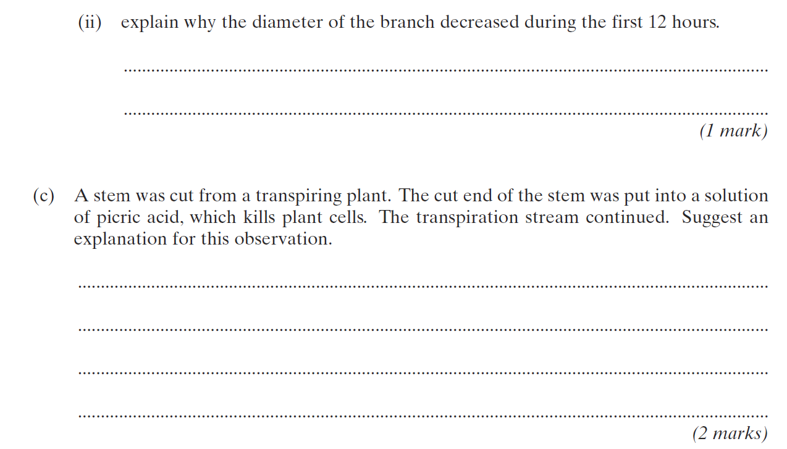

Slide 33
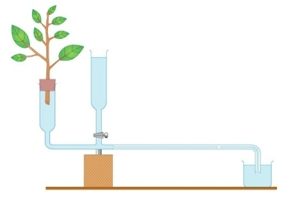
Measuring rate of transpiration?
Use a potometer
Measures rate of water uptake by a plant
Presume, rate of water uptake = rate of transpiration
Healthy leaf and shoot of plant is used

Slide 34
Other questions
Why add stem under water?
What is the purpose of the reservoir?
How can we compare different plants.
Light intensity why have a beaker of water in front of the lamp?
Why does the bung need to be air tight.
What measurements do we need to take to calculate the rate of transpiration?
The final rate will be an overestimate of transpiration. Why?

Slide 35
Why add stem under water?
What is the purpose of the reservoir?
Why does the bung need to be air tight.

Slide 36
What measurements do we need to take to calculate the rate of transpiration?
The final rate will be an overestimate of transpiration because:

Slide 37
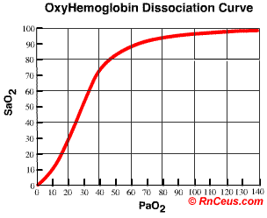
Oxygen dissociation curve
There is a relationship between haemoglobin saturation & oxygen partial pressure which is shown by the oxygen dissociation curve:

Slide 38
Oxygen Dissociation Curve
The first oxygen molecule to combine, alters the shape of haemoglobin making it easier for the next molecule to join, and so on.
The same thing happens in reverse: it becomes progressively harder for the oxyhaemoglobin to give up its oxygen
These facts account for the ‘S-shape’ curve: a small increase in pO₂ in the alveoli causes blood to become rapidly saturated with O2, & a small drop in oxygen level of respiring tissues will result in oxygen being readily unloaded

Slide 39
Loading and unloading of oxygen.
In the Lungs,
Affinity is High, due to High partial pressure (concentration) of O2 and Low pp of CO2 [occurs by ventilation]
Therefore, oxygen becomes associated with haemoglobin, it is loaded onto the
haemoglobin, the haemoglobin becomes saturated.
In the Body Cells,
Affinity is Low
Due to Low pp O2 and High pp CO2 [occurs by respiration]
Therefore, oxygen becomes dissociated from haemoglobin, it is unloaded from
Haemoglobin, it is delivered to the body cells, the haemoglobin becomes unsaturated

Slide 40
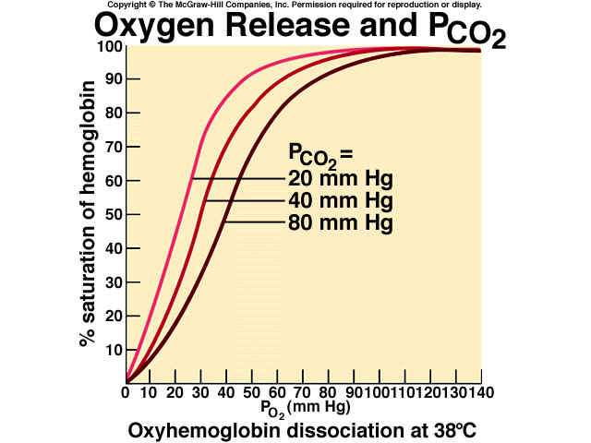
Graph – Bohr Shift
MORE O₂ is released from haemoglobin at lower pH (higher CO₂ concentration)
Lets imagine a cell with an oxygen tension of 30mmHg
At high PCO₂ (80mmHg), haemoglobin is less saturated (30%) – it releases its O₂ more readily
At low PCO₂ (20mmHg), haemoglobin is still 75% saturated, and releases O₂ less readily

Slide 41
EXPLAIN THE SIGNIFICANCE OF THE BOHR EFFECT. 2 MARKS
Answer:
As the carbon dioxide concentration increases the curve shifts to the right, this means oxygen is released to the tissues.
What's is worth?

Slide 42
EXPLAIN THE SIGNIFICANCE OF THE BOHR EFFECT. 2 MARKS
Answer:
As the carbon dioxide concentration increases the curve shifts to the right, this means oxygen is released to the tissues.

Slide 43
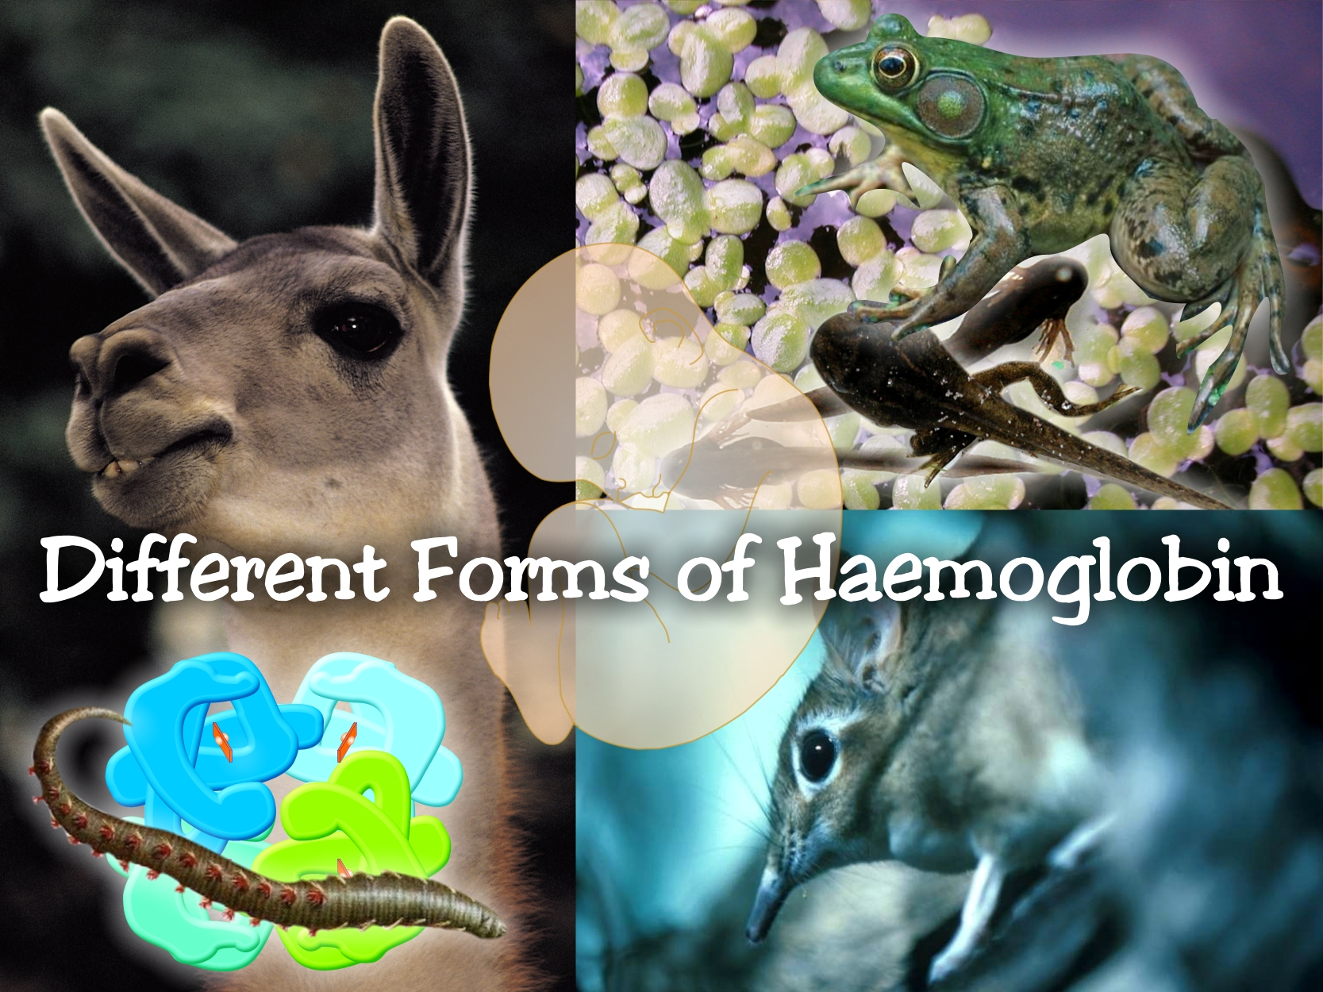


Slide 44
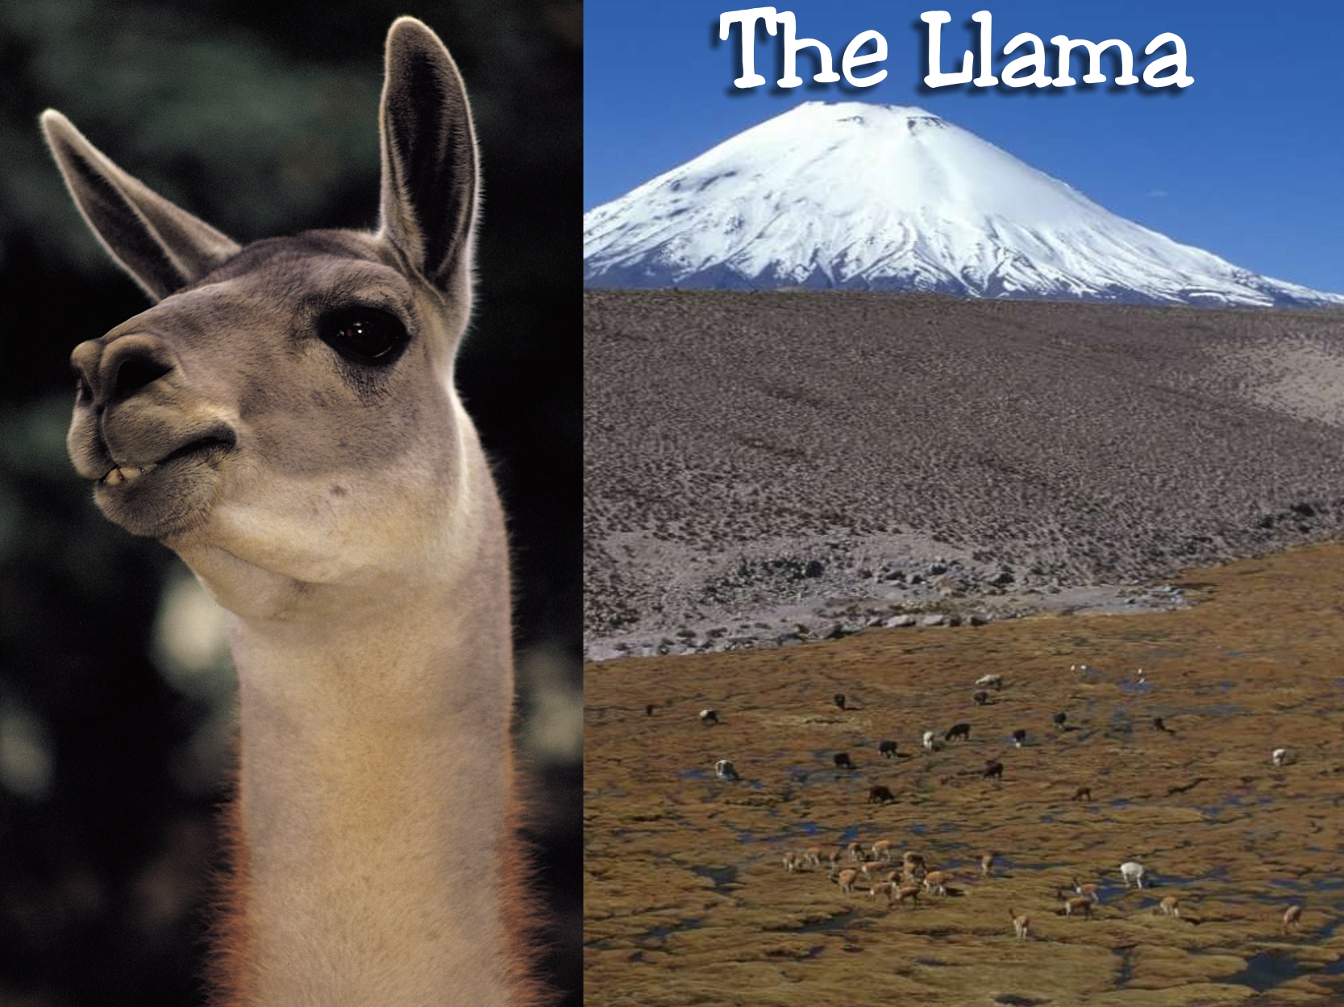

The Llama lives at high altitude in the Andes of South America, where the low partial pressures of oxygen have favoured the evolution of a form of haemoglobin with a high affinity for oxygen; this enables the Llama’s blood to load oxygen at the low pressures that prevail in its environment

Slide 45

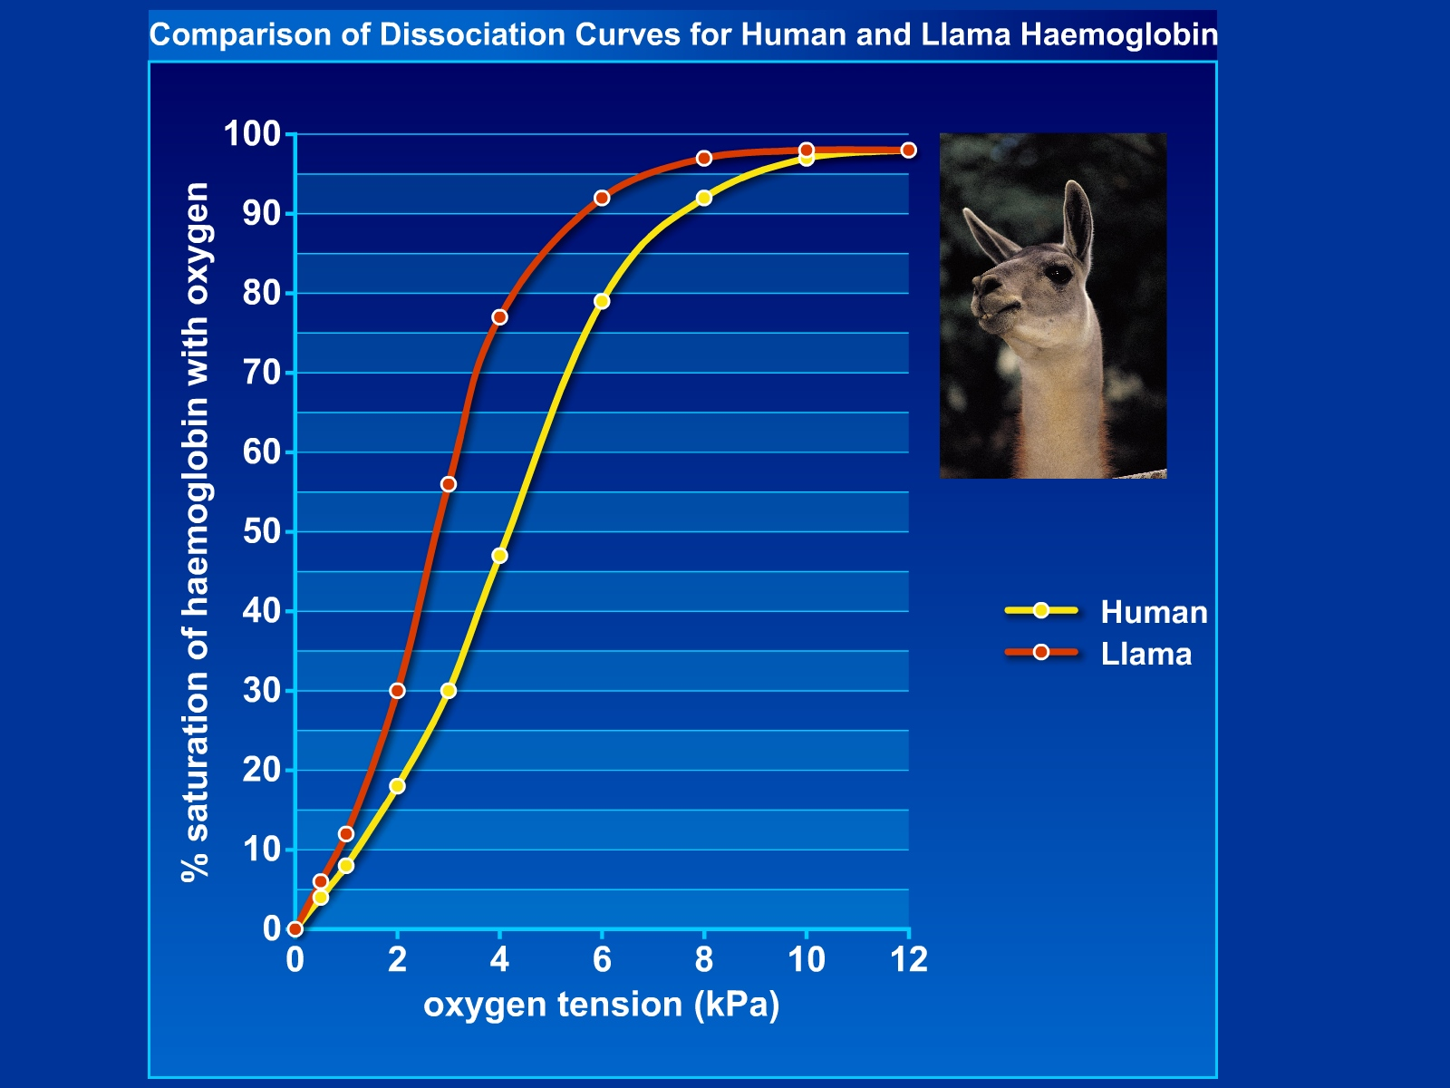
The dissociation curve for Llama haemoglobin is located to the left of that for humans (and the usual range for mammals); this higher affinity of Llama haemoglobin for oxygen adapts this mammal to high altitude environments where oxygen pressures are low

Slide 46
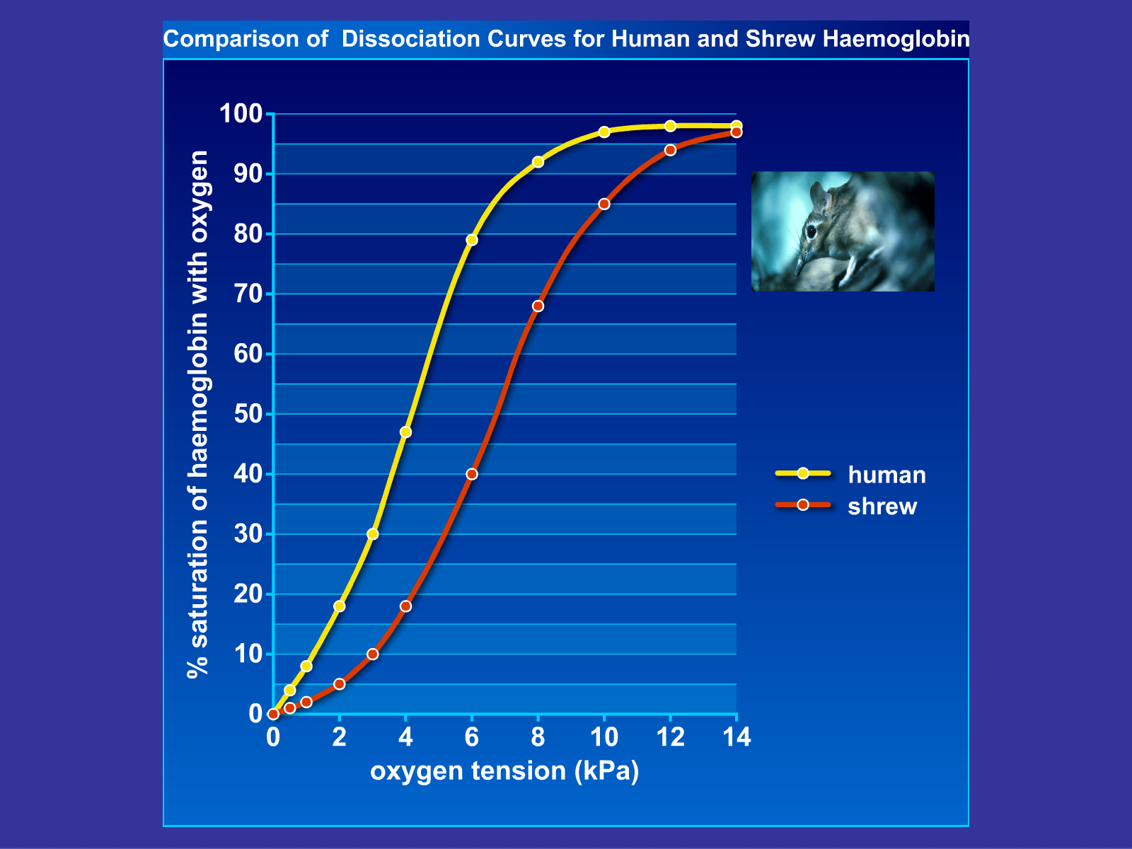

The dissociation curve for shrew haemoglobin is located to the right of that for humans; the lower affinity of shrew haemoglobin for oxygen ensures that oxygen is delivered rapidly to the tissues; this lower affinity for oxygen is NOT a disadvantage when loading with oxygen, as full saturation is readily achieved in atmospheric air
(O₂ tension = 21 kPa)

Slide 47
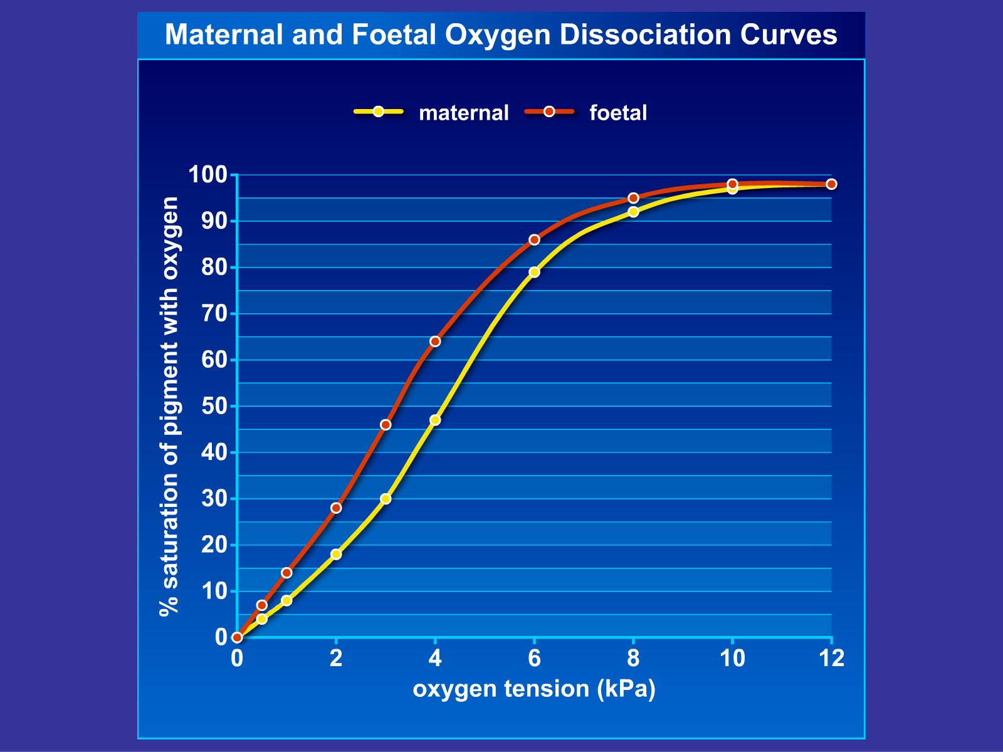
Foetal haemoglobin displays a dissociation curve to the left of that of the mother; the affinity for oxygen is therefore greater than that of maternal haemoglobin enabling transfer of oxygen across the placenta

Slide 54
Experiments: Answer these.
Why do we calculate ratios or percentages with data?
Why do we take a large sample size?
Why do we take random samples?
Why do we take repeats?
Why do we have controls?
How do we treat control groups?
Evaluate the conclusion, what should you look for?

Slide 55
Why do we calculate ratios or percentages with data?
Why do we take a large sample size?
Why do we take random samples?
Why do we take repeats?

Slide 56
Why do we have controls?
How do we treat control groups?
Evaluate the conclusion?

