Slide 1
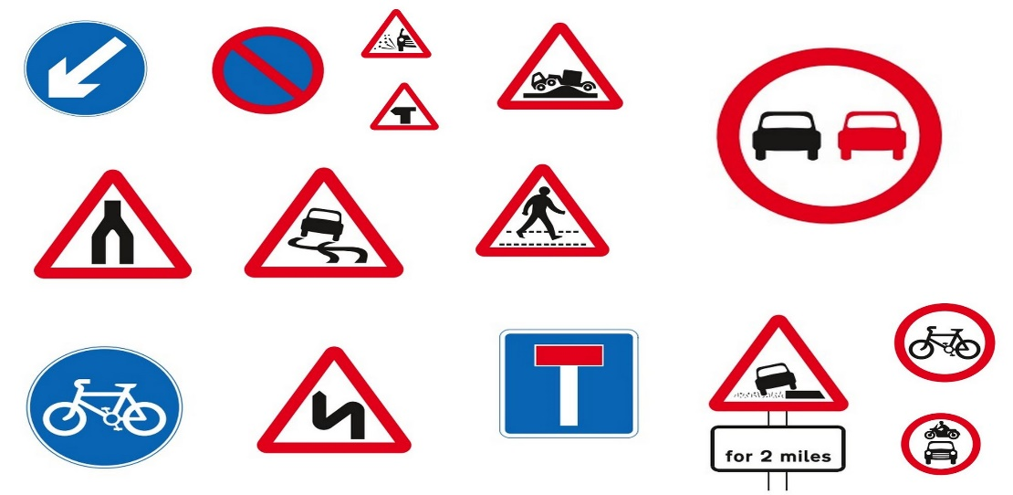
Research Investigation
Sign Test

Slide 2
Inferential statistics (Statistical tests)
The purpose of statistical tests is to see whether differences or relationships have occurred due to chance or whether something significant has been found.
ie…..whether the IV has had a significant effect on the DV (in an experiment) or the relationship between co-variables is significant (in a correlational study)

Slide 3
Probability
Measures the likelihood that a difference or relationship between two sets of data is a real (significant) difference/relationship or whether it has just occurred by chance.
It is expressed either as a percentage or on a scale from 0 to 1.
In Psychology, if the likelihood that results were down to chance is less than 5% or 0.05, the result is regarded as significant.
This means there is a 5% probability that the results in a study occurred by chance and a 95% probability that the results were due to the IV (if it was an experiment).

Slide 4
Significance
Significance refers to whether the results of a study will be accepted as down to chance or as an effect of the IV.
The accepted cut off point in Psychology at which findings will be regarded as significant is 5%. This leaves a 5% possibility of error.
5% or 0.05 is therefore known as the accepted level of significance.
Sometimes researchers need to be more confident that results were not due to chance eg where there could be a serious negative effect on individuals such as drug testing.
They therefore may use a 1% or 0.01 level of significance as this leaves only a 1% chance of error.

Slide 5
The criteria for a Sign Test
Difference or Correlation? Difference
Type of data: Nominal
Experimental design: Repeated Measures

Slide 6
Quantitative data: Levels of measurement
Nominal data – category data ie counting the number of people within each category. Eg how many say yes v. no
Ordinal data – ranked data eg who finished 1st, 2nd, 3rd in a race etc. Rating scales are also regarded as ordinal data.
Interval / ratio data – measurements on a scale of equal intervals eg time, weight, temperature. Interval and ratio are classed together but the difference is that ratio has an absolute zero point (eg weight).

Slide 7
What will we aim to find out?
To investigate whether having an audience inhibits performance
IV – No audience Vs Audience
DV – Correct or incorrect

Slide 8
Standard Preparation for investigations:
Write a consent form.
This contains information on the study and any relevant ethical issues.
Write standardised instructions for the participants.
These explain in detail exactly what the participant will have to do.
Write a debrief form.
This explains the full aim of the study and reminds participants of their ethical rights.
Carry out a pilot study.
Ethical issues are considered, and whether alterations need to be made to the procedure.
Produce a table to record participants scores in each condition

Slide 9
Conducting the Investigation
Members of the class will be participants
Divide into 3 groups of 6 or 7 members
Within your group, one person can act as the experimenter and construct a table to record everyone’s score within two different conditions
You will all be given 5 minutes to learn the first verse of “Good King Wenceslas”
You will then need to recite this song.
Condition A: One person (the experimenter) watching you
Condition B: At least 6 people watching you.
Half the participants should do A followed by B and half B followed by A to counterbalance any order effects.

Slide 10
Table to show audience effects: mark correct or incorrect in each condition and then place + sign in final column if performance better in “no audience” condition and place – in final column if performance better in “audience” condition.
Participants | No Audience | Audience | Plus / Minus
1
2
3
4
5
6

Slide 11
Analysing your data DESCRIPTIVE RESULTS
What would be an appropriate Measure of Central Tendency for the data?
What would be an appropriate graph for the data?

Slide 12
Median sensation seeking scores

Slide 13
Selecting your statistical test? INFERENTIAL RESULTS
Difference or Correlation?
Type of data?
Experimental design?
Notes:
The stat’s test is Wilcoxons

Slide 14
Calculating your statistical test
To calculate a sign test, follow the instructions on pg 300 of Lawton et al or pg 199 of Flanaghan et al.

Slide 15
Interpretation of significance
Once you have calculated your observed value, turn to pg 198 of the Flanaghan text book or pg 300 of the Lawton text book.
Refer to the critical table to determine whether your result is significant – you need to know:
Level of Significance?
Number of Ps in EACH group?
Whether your hypothesis was directional (one tailed test) or Non-directional (two tailed test)
If your observed value is equal to or less than the critical value at the 5% level of significance, you accept your experimental hypothesis and reject the null hypothesis. If greater than the critical value, you must accept the null hypothesis and reject the experimental hypothesis.
N | Level of significances | Observed value | Critical Value | Significant?

Slide 16
Significant?
N | Level of significances | Observed value | Critical Value | Significant?
 | P ≤ 0.05
Interpreting the Inferential Results
Are your results significant?
What does this mean for your Experimental/Alternative Hypothesis?

Slide 17
Task
You need to write a brief Results section:
Firstly cover the descriptive statistics – central tendency and graph
Secondly cover the inferential statistics – say why you have chosen the Sign test and give a statement of significance.

