Slide 1
Distribution of Data
Normal v Skewed

Slide 2
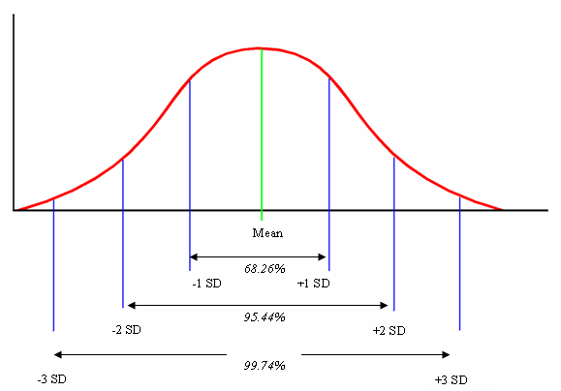
Normal Distribution Curve

Slide 3
Bell Shaped Curve
Characteristics such as height, weight or IQ within a large population form a bell shaped curve when plotted on a frequency polygon (line graph). This creates a symmetrical shape and is is known as normal distribution.
Normal distribution occurs when the data is continuous, the result of randomly distributed effects and there are large numbers of randomly selected scores.
The mean, median and mode are the same in a normal distribution.

Slide 4
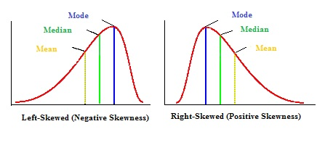
Skewed Distribution

Slide 5
Skewed distribution
Sometimes data can be skewed by outlying scores.
Positive skew: most of distribution is concentrated towards the left therefore most participants scored on the low side of average.
Negative skew: the opposite.
When this occurs the mode remains towards the highest peak, the median comes next and the mean has been dragged the furthest from the centre.

Slide 6
Skewed distribution can result from:
A small number of scores being taken
A biased sample
One end of the scale has a cut off point eg reaction time as at the fast end it is not possible to better 0 seconds.

Slide 7
Task:
Collect the heights of all class members and place them in a raw data table.
Plot the heights on a line graph and identify the type of distribution.

