Slide 1
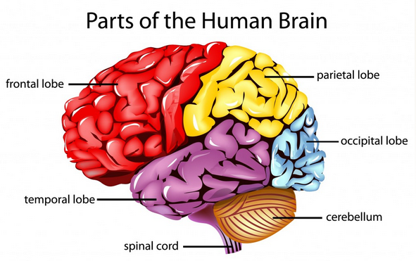
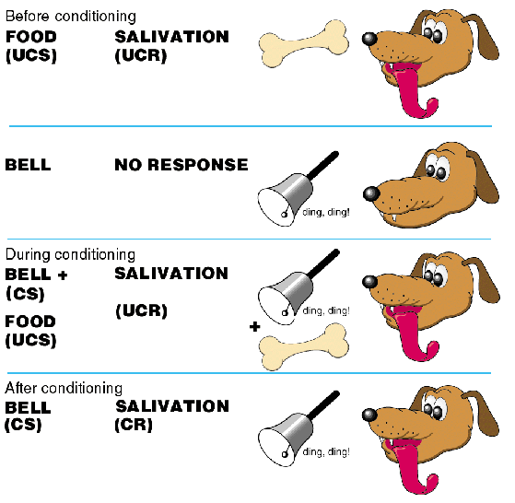
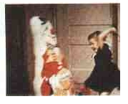
AS PSYCHOLOGY: Paper 2
APPROACHES IN PSYCHOLOGY

Slide 2
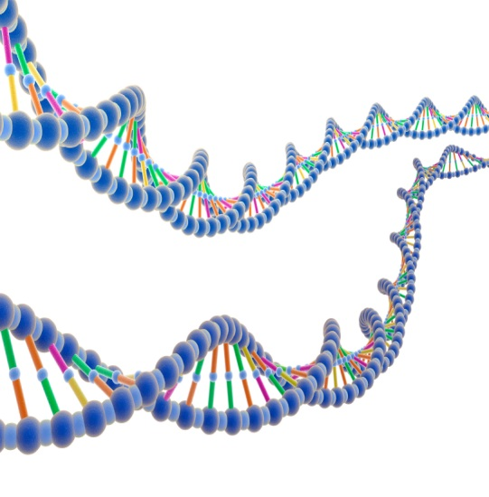
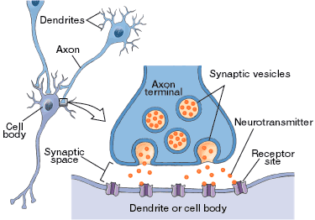
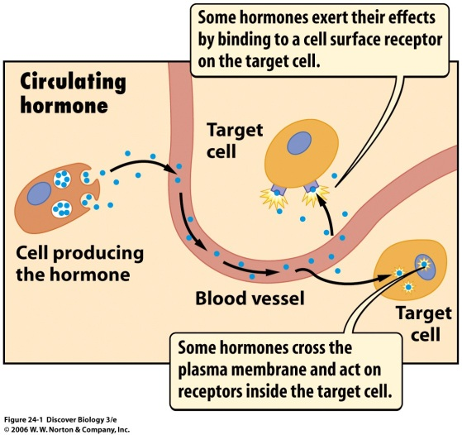
BIOLOGICAL APPROACH

Slide 3
Specification says…
The basic assumptions of:
The biological approach:
The influence of genes,
Genotype and phenotype, genetic basis of behaviour, evolution and behaviour.
The influence of biological structures and neurochemistry on behaviour.

Slide 4
The Biological Approach:
Assumption of Biological Approach:
All our thoughts, emotions and behaviours are ultimately based in biology
Carousel of Activities
In groups you will rotate tables to complete activities on each of the different aspects of the Biological Approach.
Table
Genotypes and Phenotypes
Twin Studies
Evolution and Behaviour
The Brain
Neurons and the Nervous System
Neurotransmitters and Hormones

Slide 5
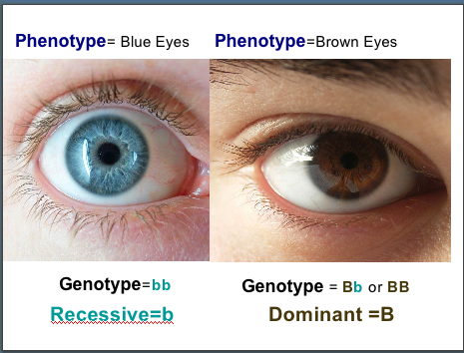
The Biological Approach: Influence of genes on behaviour
Assumption of Biological Approach:
All our thoughts, emotions and behaviours are ultimately based in biology
Genotype and Phenotype
Genotype is our genetic makeup.
Phenotype is the combination of the genotype and environment interacting, which results in a persons physical appearance.

Slide 6
The Biological Approach: Influence of genes on behaviour
Genotype and Phenotype
How might the following images be explained in terms of genotype and phenotype?
Rita and Holly are identical twins who were separated at birth. When they finally met each other at the age of 35, they were surprised at how different their personalities were. Rita is much more social and out-going than Holly.
Use your knowledge of genotype and phenotype to explain this difference in their personalities.
Genotype to have defined muscles; but working out at the gym means the genotype is expressed in his phenotype (very muscley!)
Genotype to be tall; but eating a nutritional diet means the genotype has been expressed in his phenotype (very tall!)
Genotype for skin that tans; but has had to be sitting in the sun for the genotype to be expressed (very tanned!)

Slide 7
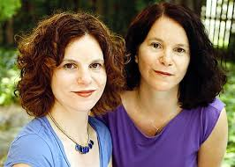
The Biological Approach: Influence of genes on behaviour
APPLICATION Q: Genotype and Phenotype
Susan and Jennifer are identical twins who were separated at birth. When they finally met each other at the age of 35, they were surprised at how different their personalities were. Susan is much more social and out-going than Jennifer.
Use your knowledge of genotype and phenotype to explain this difference in their personalities.
.

Slide 8
Susan and Jennifer have identical genotype as they are MZ twins.
They have the predisposition to develop the same personalities as each other unless another factor(s) intervenes.
For them to have developed different personalities over time, this must have been influenced by being in different environments.
Their phenotypes – personalities achieved – are different, presumably because Susan was encouraged to be sociable and lively and Jennifer was not

Slide 9
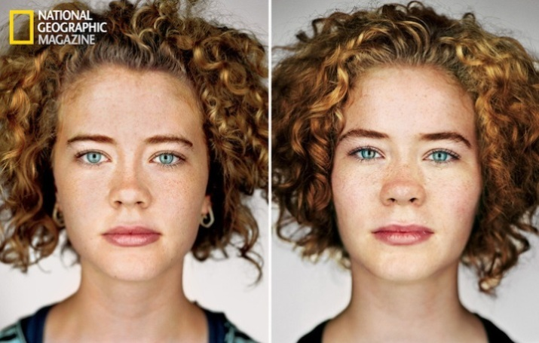
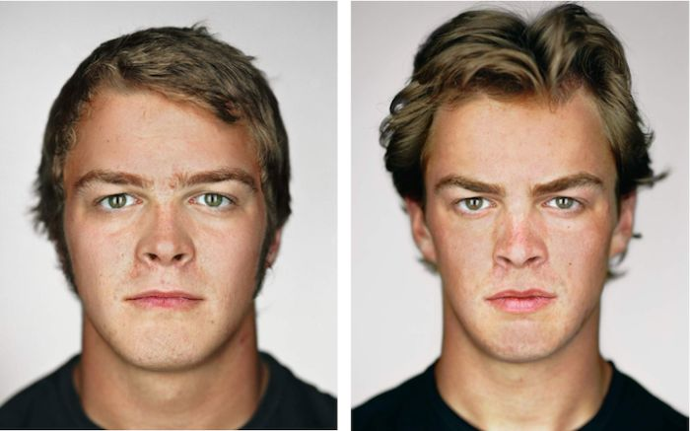
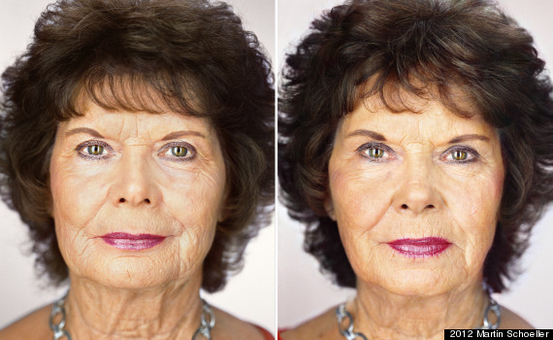
The Biological Approach: Influence of genes on behaviour
Genetic Basis of Behaviour
Claimed that behavioural characteristics are determined by our unique genetic make-up in the same way as physical characteristics.
The more a trait is determined by genetics the greater its heritability – this is why offspring ‘take after’ their parents, as they have inherited their behavioural characteristics
Expression of genes is also dependent on the interaction of the genes with other genes and with the environment
Explains why although identical twins have identical genotype, they can still show subtle differences in their phenotype

Slide 10
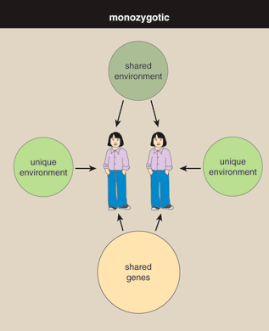
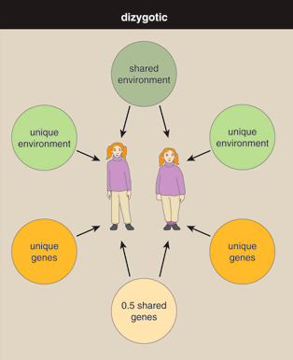
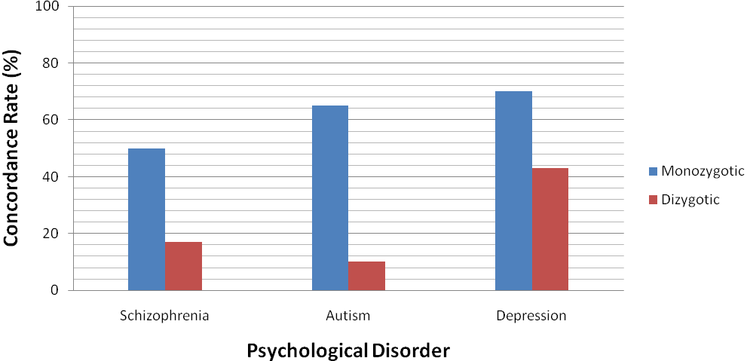
The Biological Approach: Influence of genes on behaviour
Genetic Basis of Behaviour - RESEARCH
Twin Studies help to determine the extent to which a behavioural characteristic has a genetic basis
Monozygotic (MZ) twins (identical) = 100% genetic info shared
Dizygotic (DZ) twins (non-identical) = Approx 50% genetic info shared
Both sets of twins are assessed to see if both twins in the pair share the same behavioural characteristic. This provides researchers with a concordance rate.
If MZ twins have a higher concordance rate than DZ twins it indicates a genetic basis for that behaviour

Slide 11
Twin studies
Try the quiz

Slide 12
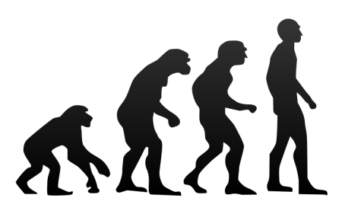
The Biological Approach: Influence of genes on behaviour
Evolution and Behaviour
Claimed that behavioural characteristics have evolved just like physical characteristics
Process of Natural Selection - behavioural characteristics which were more adapted to the environment (i.e. they helped the individuals to survive and to reproduce) were the ones which were passed on through genes onto successive generations
For example greater intelligence and aggression increased the chances of survival. Individuals possessing these traits would have been reproductively successful and so passed on why these characteristics, generation after generation, which is why they are still seen amongst the population today.
Conversely individuals without these adaptive characteristics were unable to survive and reproduce .

Slide 13
Write a paragraph in your own words explaining the process of evolution.
Explain how the following behaviours could promote survival, according to an evolutionary psychologist.
Phobias
Obsessive compulsive disorder
Prejudice

Slide 14
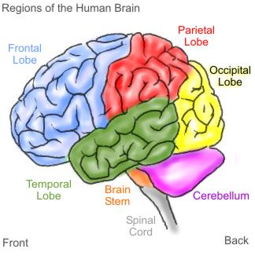
The Biological Approach: Influence of biological structures on behaviour
The Brain
Divided into different structures
Brainstem - vital functions such as breathing and heartbeat
Limbic System - responsible for sexual and emotional behaviour
Cerebrum- higher order functions like thinking and language
Cerebrum is further divided into two hemispheres - right and left each further divided into four lobes
Frontal Lobe; Occipital Lobe; Parietal Lobe and Temporal Lobe.
Claimed that activation of certain areas of the brain is linked with certain behaviours

Slide 15
Go to GoL and download the “brain” activity to your own user area.
Fill in the gaps, and save the completed version.

Slide 16
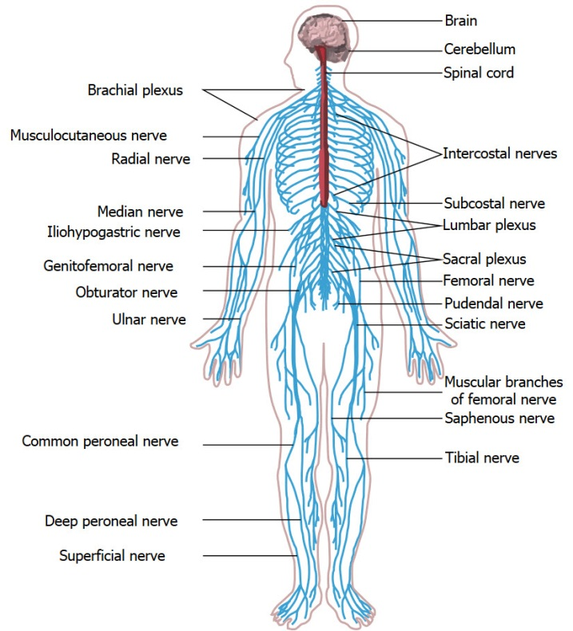
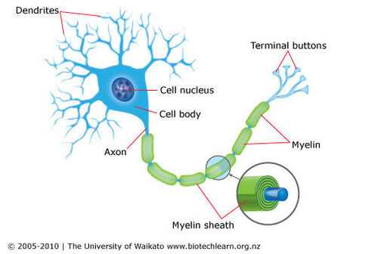
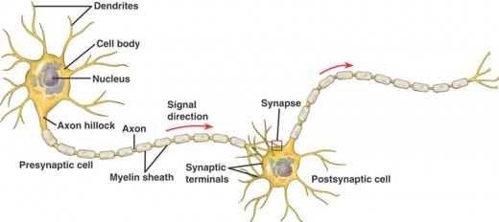
The Biological Approach: Influence of biological structures on behaviour
Neurons and the Nervous System
CNS consists of the brain and spinal cord
PNS consists of all other neurons across the body
Messages throughout the CNS and PNS are sent via neurons. These are nerve cells which communication with one another via electrical and chemical signals.
Central Nervous System
Neuron (Nerve Cell)
Neurons communication via Synapse
Peripheral Nervous System

Slide 17
The Biological Approach: Influence of neurochemistry on behaviour
Neurotransmitters
Neurons communicate via chemicals called neurotransmitters.
Some neurotransmitters are excitatory neurotransmitters = activate an electrical signal in the receiving neuron
Some neurotransmitters inhibitory neurotransmitters = don’t activate the receiving neuron
Claimed activity and levels of these neurotransmitters can influence people’s behaviours.

Slide 18
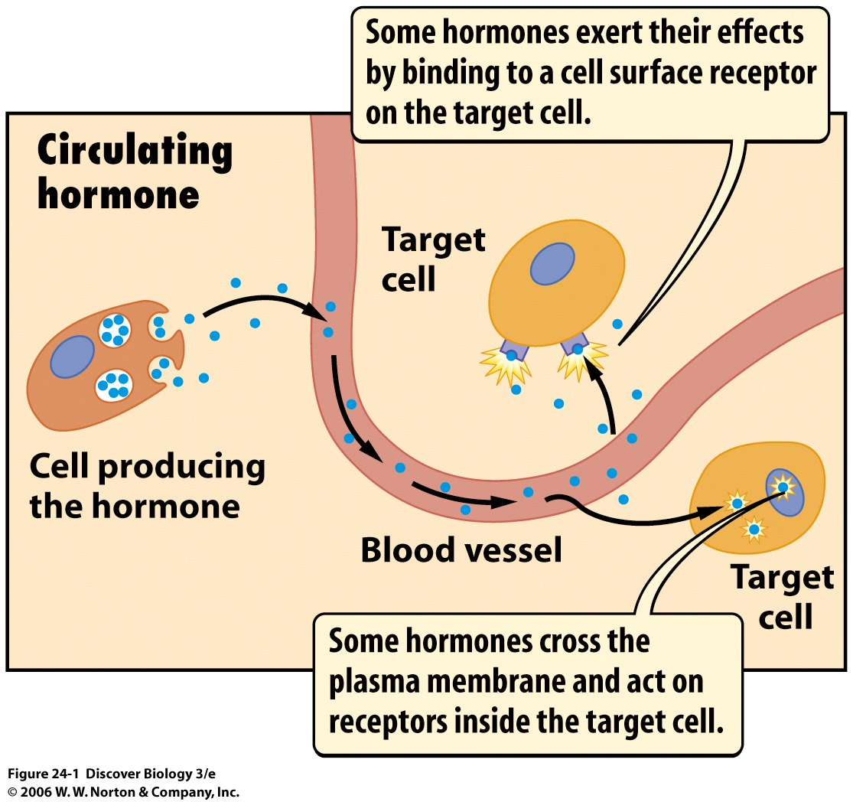
The Biological Approach: Influence of neurochemistry on behaviour
Hormones
Chemicals which transmit messages in the body are called hormones
Hormones are produced by glands of the endocrine system
Hormone release is triggered by a signal from the brain. Causes the hormone to be secreted into the blood stream. Travels to the required site in the body and has its action.
Claimed level of hormones in a person’s system can influence their behaviour

Slide 19
HORMONES
1. Download the overview of the endocrine system (on GoL) and label it.
2 Write up a definition of “hormone” in your own words.
3. Find out what the function of two hormones are (could choose adrenaline, testosterone, oxytocin…)

Slide 20
The Biological Approach: Evaluation of the Biological Approach
Scientific approach - uses controlled experimental methods and advanced technology to collect objective data about the brain or the levels of neurotransmitters, such as brain scanning. Data = more valid as it is not open to bias Furthermore studies can be replicated to assess the reliability of the results.
Real-life application. Drugs have been developed to alter the activity or levels of neurotransmitters in order to reduce symptoms of psychological conditions such as Depression and Schizophrenia. As a result people suffering with these conditions have been able to function more successfully in their lives.
Too reductionist. Reductionism involves explaining complex behaviours by focusing on their smallest components, such as genes or hormones and claiming these are the cause. In doing this other important influences are overlooked, such as cognitive, social or emotional influences.
Specific problems. Genetic explanations often suffer from the problem of separating the influence of genes and environment. Evolutionary explanations are impossible to test (unfalsifiable) and are therefore difficult to draw clear conclusions about their validity in explaining specific behaviours (such as aggression).

