Slide 1
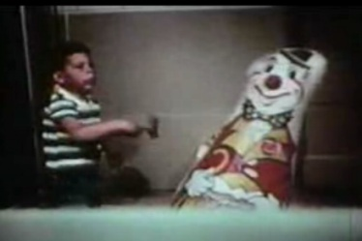
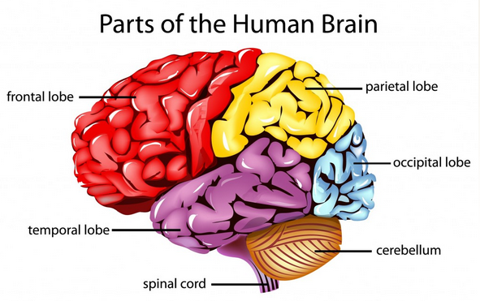
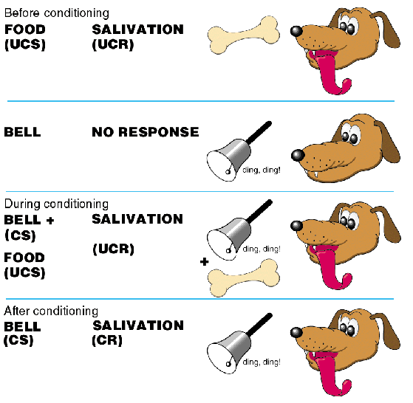
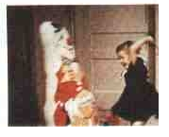
AS PSYCHOLOGY: Paper 2
APPROACHES IN PSYCHOLOGY

Slide 2
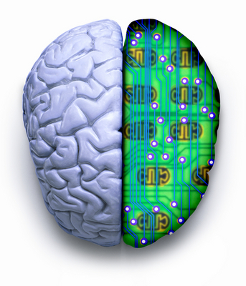
COGNITIVE APPROACH

Slide 3
Specification says…
The basic assumptions of:
The cognitive approach:
The study of internal mental processes, the role of schema
The use of theoretical and computer models to explain and make inferences about mental processes.
The emergence of cognitive neuroscience.

Slide 4
The Cognitive Approach: The study of internal mental processes
Assumption of Cognitive Approach:
All our behaviour is governed by our internal mental processes; our thoughts and emotions.
In pairs, can you make a list of some of our internal mental processes Cognitive Psychologists might be interested in?
Perception
Attention
Decision making
Language
Memory
Learning
Forgetting
Problem-solving
Thinking

Slide 5
The Cognitive Approach: The study of internal mental processes
According to Neisser, cognition involves "all processes by which the sensory input is transformed, reduced, elaborated, stored, recovered, and used. It is concerned with these processes even when they operate in the absence of relevant stimulation, as in images and hallucinations”.
Given such a sweeping definition, it is apparent that cognition is involved in everything a human being might possibly do; that every psychological phenomenon is a cognitive phenomenon.
Source: http://psychology.about.com

Slide 6
The Cognitive Approach: The study of internal mental processes
The cognitive approach is different from the Behaviourist approach in that these internal mental processes cannot be DIRECTLY observed; instead psychologists have to make inferences about how they are directing our behaviour.
What is meant by an ‘inference’?
Going beyond the immediate evidence/findings of a study to make assumptions about one or more mental processes that cannot be directly observed.

Slide 7
The Cognitive Approach: The study of internal mental processes
Can you read both/either of the following?
Aoccdrnig to rscheearch at Cmabrigde Uinervtisy, it deosn't mttaer in waht oredr the ltteers in a wrod are, the olny iprmoetnt tihng is taht the frist and lsat ltteer be at the rghit pclae. The rset can be a toatl mses and you can sitll raed it wouthit a porbelm. Tihs is bcuseae the huamn mnid deos not raed ervey lteter by istlef, but the wrod as a wlohe.

Slide 8
The Cognitive Approach: The study of internal mental processes
Watch the video and follow the instructions

Slide 9
The Cognitive Approach: The study of internal mental processes
What internal mental processes are at work when reading those passages and watching the video?
What inferences can we make about how our minds work based on these passages and the selective attention video?
Perception
Memory
Thinking
Attention
Decision making
Shows we automatically (without the need for conscious processing) filter sensory stimuli. Our minds selectively attend to relevant information and they ignore unimportant/irrelevant information. Good as it makes our minds efficient! However, it can means we make errors about events.

Slide 10
The Cognitive Approach: Stroop Test
Google search stroop test online
Second link Stroop Effect
https://faculty.washington.edu/chudler/java/ready.html
Open this link
Record your two reaction times

Slide 11
The Cognitive Approach: Stroop Test – Data Analysis
What was your reaction time for the first test - Congruent Words and Colours? What was your reaction time for the second test - Incongruent Words and Colours?
Calculate an appropriate measure of central tendency for each condition (need to ensure all results are converted into seconds)
What inferences can we make about how our minds work based on the results of this experiment?

Slide 12
The Cognitive Approach: The role of Schema
Schema are…
Organised packages of knowledge built through experience which help us process and interpret the world.
They are scripts of typical expectations for a given situation, person, event
New info can be
added to an existing Schema, or…
we can make a new Schema.

Slide 13
You will be shown an image for a short period of time. You need to draw the image when it disappears
DRAW it now !!!

Slide 14
Read the sign…
Write down the sentence in the sign

Slide 15
What does this image show?

Slide 16
Actual Roman Numerals
= I
= II
= III
= IV
= V
= VI
What do you notice about Roman Numeral 4?

Slide 17
Read the sign again (carefully!)…Is it what you have written?

Slide 18
Can we be sure? Do we know or are we making assumptions?
What does this image show?

Slide 19
The Cognitive Approach: The role of Schema
Cohen (1993) Suggested there were 5 main ways Schema could distort our perception of events
1) Ignore aspects which don’t fit into the activated schema
2) Only need to store central features not exact features
3) Make sense of an event by ‘filling in’ the missing info
4) Distort memories to fit in with expectations
5) Use Schema to make a ‘best guess’

Slide 20
The Cognitive Approach: The use of theoretical and computer models to explain and make inferences about mental processes.
Cognitive Psychologists often use the computer as an analogy for how the human mind might work
.
The cognitive approach tries to model how, by trying to identify and map each of the stages of information processing between a stimulus and the persons response.
INPUT
Receive some form of ‘input’ from our senses This is a Coding stage (Transferring input into a useable format)
INFORMATION PROCESSING Recognising information; contextualising information with previous knowledge; making decisions
OUTPUT
Produce a given ‘output’ in the form of a behavioural response

Slide 21
The Cognitive Approach: The use of theoretical and computer models to explain and make inferences about mental processes.
In pairs read through the article
Why do some critics disagree with the computer analogy of the mind?
Try to identify 3 key arguments why critics claim the computer might not be a good analogy for our mind. How does the author counter each of these claims?
What other argument does he put forward for revisiting the computer as an analogy for how our minds work?
.

Slide 22
The Cognitive Approach: The use of theoretical and computer models to explain and make inferences about mental processes.
The cognitive approach tries to model how our minds might work, by trying to identify and map each of the stages of information processing between a stimulus and the persons response.
Read the Moral Dilemma - the Stimulus
Make a decision about what you would do in that situation – the Response
In small groups produce a ‘model’ of your decision making processes
Consider the stages you went through in order to arrive at your response and try to plot these in a sequence

Slide 23
The Cognitive Approach: The use of theoretical and computer models to explain and make inferences about mental processes.
A possible theoretical model for Moral Decision Making
Identify problem
Recognise the ethical dilemma.
Determine facts
Consider the information. Consider previous knowledge/personal experiences.
Develop options
Brainstorm all possible actions you could take
Consider consequences
Evaluate who or what will be affected? What good or harm could come from your choice?
Choose action
Make choice. Reflect whether it was the right one - whether you would choose differently next time.

Slide 24
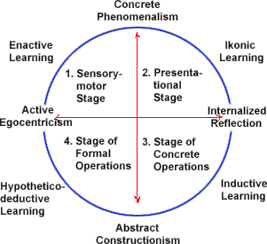
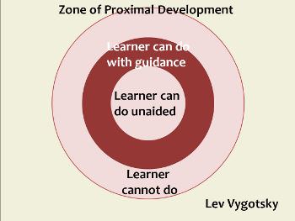
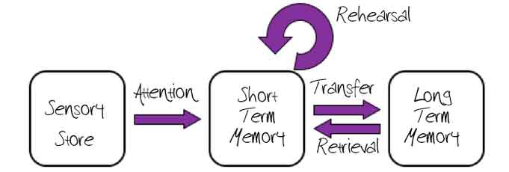
The Cognitive Approach: The use of theoretical and computer models to explain and make inferences about mental processes.
Some examples of models of cognitive processes
Vygotsky’s Zone of proximal development
Piaget’s model of cognitive development
Atkinson & Shiffrin’s model of memory

Slide 25
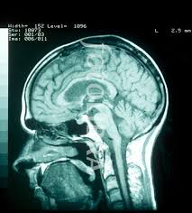
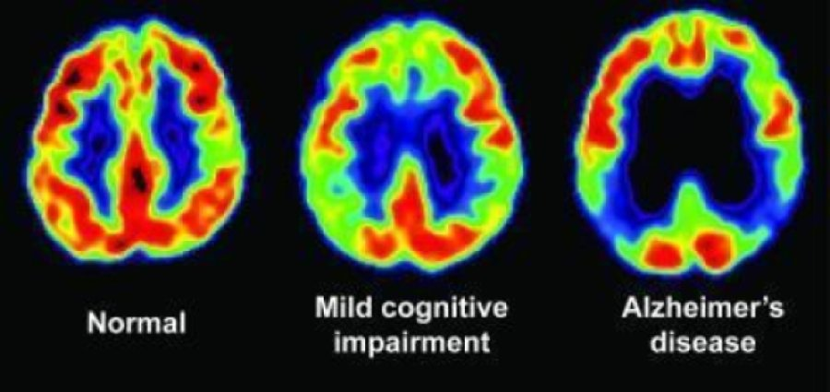
The Cognitive Approach: Emergence of Cognitive Neuroscience
Cognitive neuroscience is the study of how biological processes and structures might influence our thought processes.
Advances in technology (such as functional Magnetic Resonance Imaging and Positron Emission Topography scans) have enabled scientists to map the living brain to make inferences about how activation of certain areas are linked with a specific mental processes.
Recent research into this field has involved the use of computer-generated models which can ‘read’ the brain which has led to the ideas of brain mapping and ‘brain fingerprinting’

Slide 26
The Cognitive Approach: Evaluation of the Cognitive Approach
A strength of the Cognitive approach is that it has been able to identify and describe many of the internal mental process which occur in response to given stimuli. This has been useful and had practical application in fields such as the treatment of psychological disorders like Depression.
The cognitive approach is also viewed as being less deterministic than some other approaches, such as the Biological or Behaviourist approaches. This is because it allows the individual to ‘think’ about how they wish to respond meaning it allows for a degree of free will in our behaviour.
A weakness of Cognitive approach is that much of the research is conducted using highly controlled and artificial settings, using artificial stimuli. This is a problem because is questions whether the mental processing which occurs to these artificial stimuli is truly representative of how we process everyday information. This mean the research in this field may lack external validity.
Other critics of the approach have argued that the use of a ‘computer analogy’ of the human mind is too simplistic. They argue that this machine-reductionism often means that role of emotion and how it influences our thoughts is overlooked and that this is a crucial difference between humans and machines.

Slide 27
The Cognitive Approach: Practice Questions
1. Psychologists investigating theoretical models of cognitive processing study human cognitive processing. They sometimes give participants problems to solve then ask them about the experience afterwards. Typical participant responses are as follows:
Response A: ‘There were too many things to think about at the same time.’
Response B: ‘I had to do one task at a time, then do the next task, and so on.’
Briefly suggest how each of these responses might inform psychologists investigating models of human cognitive processing. (2 marks)
2. In a laboratory study of problem-solving, cognitive psychologists asked participants to solve problems presented in different colours of ink. They found that it took longer to solve problems presented in green ink, than it did to solve problems presented in other colours. They inferred that the mental processing of problems is made more difficult when a problem is presented in green ink.
Explain what is meant by ‘inference’ in relation to this study. (2 marks)
Marks for this question: AO2 = 2
1 mark for response A: processing is restricted by capacity (when performing demanding/novel tasks)
1 mark for response B: processing is sequential (when performing demanding/novel tasks).
Marks for this question: AO2 = 2
1 mark for an explanation of inference: going beyond the immediate evidence to make assumptions about mental processes that cannot be directly observed.
1 mark for a application to the study; clear description about what is being inferred (problem difficulty/more difficult processing) on the basis of what is being measured (time taken to solve the problem in the different conditions).
Award 1 mark only for answers where knowledge of inference and application are only partially clear.

