Slide 1
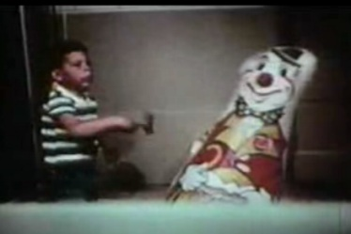
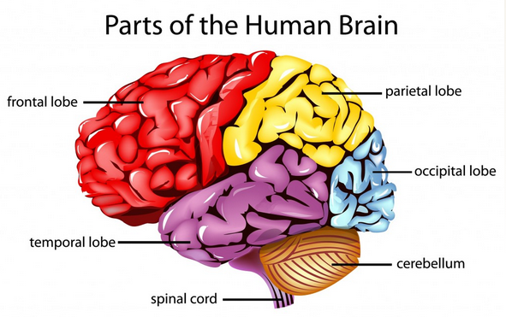
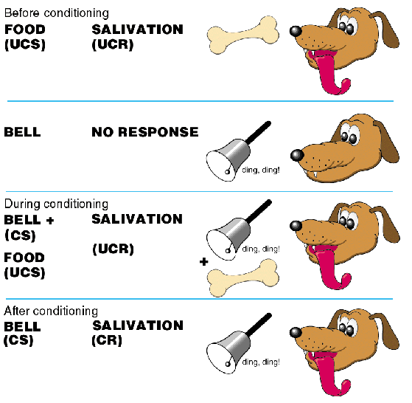
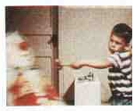
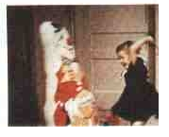
AS PSYCHOLOGY: Paper 2
APPROACHES IN PSYCHOLOGY

Slide 2
APPROACHES IN PSYCHOLOGY
How might these behaviours be explained?
In small groups discuss the possible causes/antecedents of these acts – try to elaborate on your ideas where possible.
This is the amazing moment around 100 commuters came to a trapped unicyclist's aid, lifting a double decker bus off him after a collision in east London

Slide 3
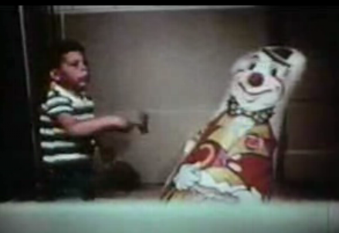
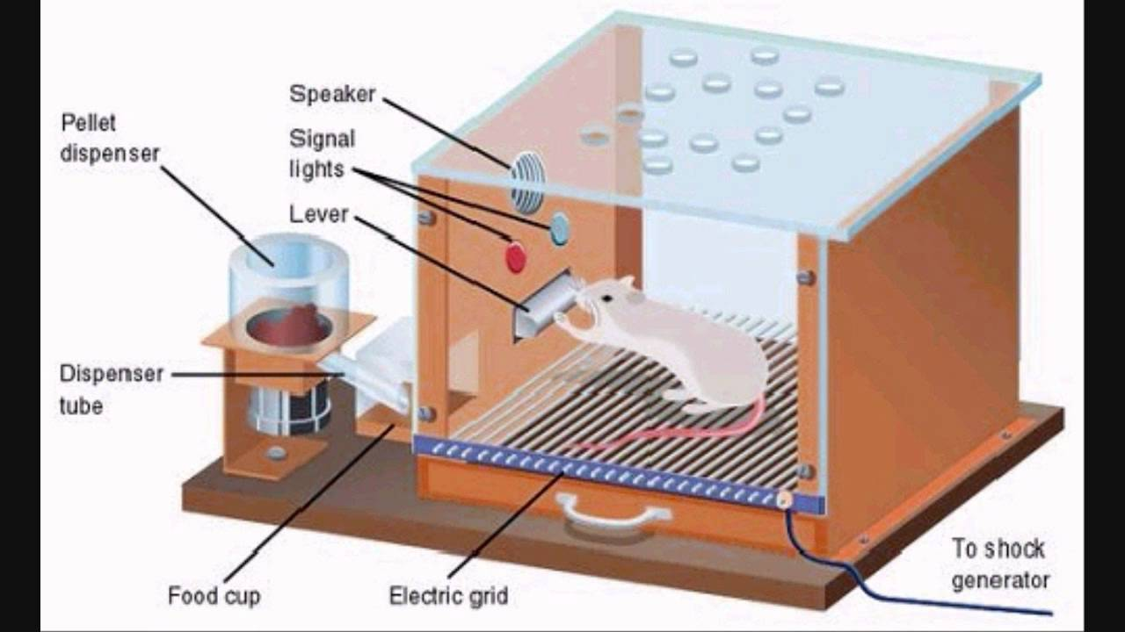
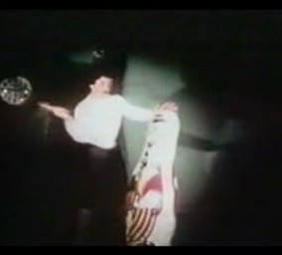
LEARNING APPROACHES

Slide 4
Specification says…
The basic assumptions of Learning approaches:
The Behaviourist Approach
Classical conditioning and Pavlov’s research
Operant conditioning, types of reinforcement and Skinner’s research
Social Learning Theory
Imitation, identification, modelling, vicarious reinforcement, the role of mediational processes
Bandura’s research.

Slide 5
The Behaviourist Approach:
Assumptions of Behaviourist Approach
We are born a ‘blank slate’ – Tabula Rasa
All behaviour is learned from experience
All animals (including humans) learn via the same basic processes
Only behaviours which are directly observable and can be scientifically measured should be studied.

Slide 6
The Behaviourist Approach: Classical Conditioning
Learning by association
Based on the reflex response
BEFORE CONDITIONING
DURING CONDITIONING
AFTER CONDITIONING
Unconditioned Stimulus (UCS)
Unconditioned Response (UCR)
(innate/unlearned reflex)
Neutral Stimulus (NS)
No Response
Unconditioned Stimulus (UCS)
is paired repeatedly with
Unconditioned Response (UCR)
Neutral Stimulus (NS)
This is where an association (link) is formed – between the UCS and the NS
Neutral stimulus is now called the Conditioned Stimulus (CS)
Conditioned Response (CR)

Slide 7
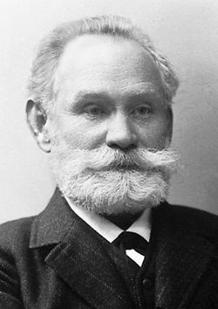
The Behaviourist Approach: Classical Conditioning Pavlov’s Research
Click on Pavlov for video link

Slide 8
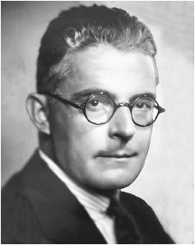
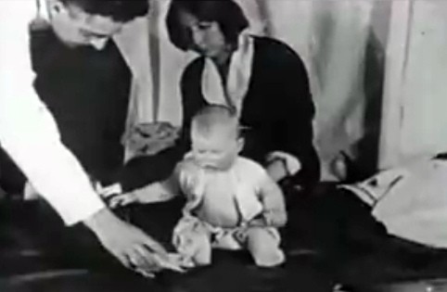
The Behaviourist Approach: Classical Conditioning Watson’s Research
Little Albert Experiment
As you watch the video clip see if you can work out what is the UCS, the UCR, the NS/CS and the CR
Click on Watson for video link

Slide 9
The Behaviourist Approach: Classical Conditioning Watson’s Research
BEFORE CONDITIONING
Unconditioned Stimulus (UCS) Unconditioned Response (UCR) (innate/unlearned reflex)
Neutral stimulus (NS) No response
DURING CONDITIONING
Unconditioned Stimulus (UCS)
Unconditioned Response (UCR) Neutral stimulus (NS)
AFTER CONDITIONING
Conditioned stimulus (CS) Conditioned response (CR).
Loud noise
Fear/Crying
White Rat
Loud noise
Fear/Crying
White Rat
White Rat
Fear/Crying

Slide 10
The Behaviourist Approach: Shaping Behaviour
I need two volunteers
The volunteers
Wait outside the classroom (quietly) I will come an get you shortly.
The class
We are going to try to make them draw similar pictures on the whiteboard using only feedback from you
We need to decide on a simple image you could get them to draw
I will instruct them to start drawing/making shapes on the whiteboard and to look to you for feedback as to whether they are doing what they need to
The rules!
You cannot tell them what they are trying to draw. You cannot tell them what to draw
You can only encourage/discourage what they have drawn
You need to raise the green tick side of your feedback board if you think what they have drawn is good/relevant/useful in producing the image
You need to raise the red cross side of your feedback board if you think what they have drawn is not useful/should be erased or changed

Slide 11
The Behaviourist Approach:
You are going to be asked to produce an image of something that has been decided by the class
They will raise the green tick side of your feedback board if you think what they have drawn is good/relevant/useful in producing the image
They will raise the red cross side of your feedback board if you think what they have drawn is not useful/should be erased or changed
Good luck!

Slide 12
The Behaviourist Approach: Operant Conditioning
Learning through consequences
‘Shaping’ behaviour
Positive Reinforcement is when a behaviour is rewarded which makes it more likely to reoccur in the future.
Can you think of an example of a positive reinforcement you have received in the past?
Negative Reinforcement is when a behaviour avoids/removes a negative consequence which makes the behaviour more likely to reoccur in the future.
Can you think of an example of a negative reinforcement you have received in the past?
Punishment is a negative consequence in response to the behaviour which makes the behaviour less likely to reoccur in the future.
Can you think of an example of a punishment you have received in the past?

Slide 13
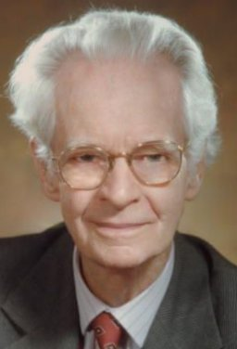
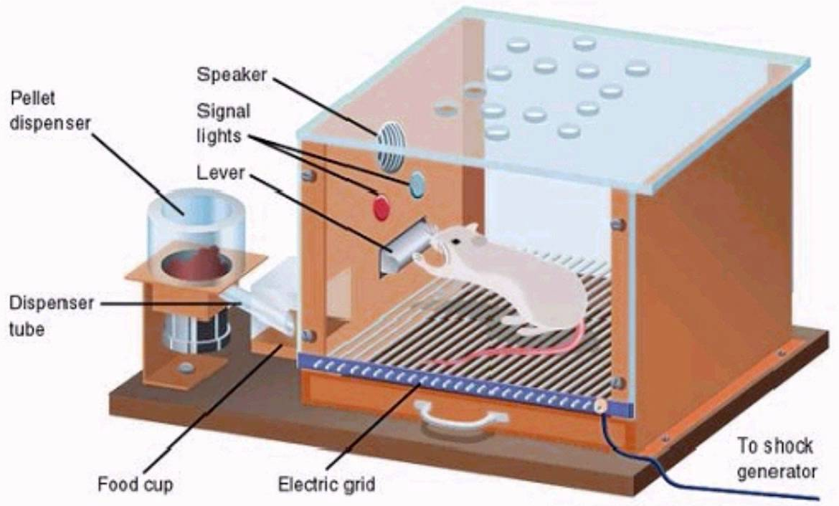
The Behaviourist Approach: Operant Conditioning Skinner’s Research
Skinner Box
Click on Skinner box for video link
Click on Skinner for video link

Slide 14
The Behaviourist Approach: Evaluation of Research into Classical and Operant Conditioning
In pairs discuss the research of Pavlov, Watson and Skinner
Can you think of any strengths or weaknesses of their studies
You might want to consider
the research methods used
the participants used
the ethics of the research

Slide 15
The Behaviourist Approach: Evaluation of the Behaviourist Approach
Scientific approach – focus on observable and measurable behaviours and the use of well controlled laboratory methods to conduct research. Easier to draw conclusions about cause and effect in relation to stimulus-response links and the influence of consequences of behaviour.
Views all behaviour as learned – it therefore assumes behaviours can also be unleaded by the same processes. Real life application in modifying behaviour. For example in teaching children positive behaviours; in prisons to maintain order; by therapists to alter maladaptive responses such as phobias.
Overlooks free will. Claims our behaviours are determined by learned stimulus-response associations or from learning the consequences of our actions. However people often demonstrate unique or spontaneous behaviours, which are hard to explain using the behaviourist approach.
Much of the research has been conducted on non-human animals. Behaviourists claim that animals and humans learn using similar processes, however critics argue that humans are much more complex and therefore they question the validity of this research in explaining human behaviours.

Slide 16
The Social Learning Theory:
Same as Behaviourist Approach as it assumes behaviour is learned from the environment and our experiences
Social Learning Theory is an extension of the behaviourist approach
It claims that we can learn indirectly from others by observing their behaviour and its consequences.
Views cognitive processes as being important in learning too (overlooked by Behaviourists).

Slide 17
The Social Learning Theory: Imitation, identification, modelling, vicarious reinforcement, the role of mediational processes
TASK 1
In pairs – Try to match up the SLT term with the correct definition

Slide 18
The Social Learning Theory:
TERM | DEFINITION
Role models | People significant to us who we might watch (e.g parents, friends, celebrities)
Vicarious (indirect) reinforcement | When a role model’s behaviour is positively reinforced this acts as an indirect reinforcement for the observer, making it more likely the behaviour will be imitated.
Imitation | Where the observers copies/repeats the behaviour shown by the role model
Modelling | Combined process of observing and subsequently imitating a behaviour shown by a role model.
Vicarious (indirect) punishment | When a role model’s behaviour results in a negative consequence this acts as an indirect deterrent for the observer, making it less likely the behaviour will be imitated.
Mediational processes | Internal cognitive processes which create a mental representation of the behaviour These processes include paying attention to the behaviour and its consequences; remembering the behaviour and its consequences; believing they have the required motor reproduction skills to reproduce the same behaviour; all which affect the observer’s motivation to perform the behaviour.
Identification | When the observer views themselves as similar to the role model (e.g. in gender, ethnicity etc) or they view the role model as having higher status to which they aspire (e.g. more expertise, a celebrity), then they are more likely to imitate their behaviour.

Slide 19
The Social Learning Theory: Imitation, identification, modelling, vicarious reinforcement, the role of mediational processes
Some examples of SLT
Children See Children do
Big Daddy
Dancing baby
TASK 2
Try to find a video clip/example/image showing someone copying the behaviour of someone else
Use your SLT terms to make notes explaining the behaviour in your clip/image/example.

Slide 20
The Social Learning Theory: Bandura’s research
Bobo Doll – Bandura et al (1961)
Ps = 4 year children - 36 boys and 36 girls.
Either watched an aggressive model - an adult behaving aggressively towards a bobo doll by punching and hitting it with a hammer, or a non-aggressive model.
The children were frustrated by being shown toys they couldn’t play with
They were then moved to another room with other toys, including a hammer and a bobo doll.
Their behaviour was observed through a one-way mirror.
Findings
Aggressive model – Children reproduced much of the physical and verbal aggressive behaviour shown by the model.
Boys showed higher levels of aggression than the girls.
Boys and girls were more likely to imitate aggressive behaviour if the model was the same gender.
Children in the non-aggressive group exhibited virtually no aggression toward the doll.
What do these findings suggest?

Slide 21
The Social Learning Theory: Evaluation of the Social Learning Theory
A strength of the Social Learning Theory is that it takes into account cognitive factors in the learning process. Neither classical nor operant conditioning alone are sufficient to explain the learning of human behaviours. Therefore Social Learning can provide a more comprehensive explanation of learning, especially of novel behaviours (e.g. starting smoking).
Social Learning theory also helps us to understand why there are cultural variations in human behaviour. This is because the role models we are exposed to are specific to our culture. This means that the cultural norms are perpetuated through the continuous observation and imitation of behaviours within the culture.
A weakness of Social Learning Theory is that it can’t explain behaviour for which there is no role model. For example certain individuals will demonstrate completely unique behaviours (e.g. psychopathic behaviours), this may mean these behaviours are more likely to have an underlying biological cause.
Much of the research on which the social learning theory is based was controlled laboratory research. This type of research has been criticised for being too artificial and being subject to demand characteristics – meaning the children showed the aggressive behaviour because that was what they thought they were supposed to do. This questions the validity of the research and therefore the validity of the theory in explaining learning

