Slide 1
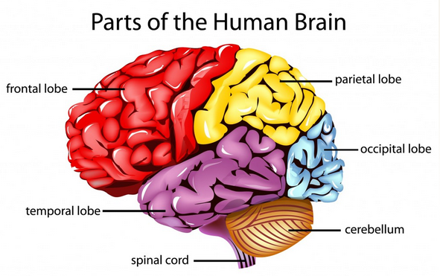
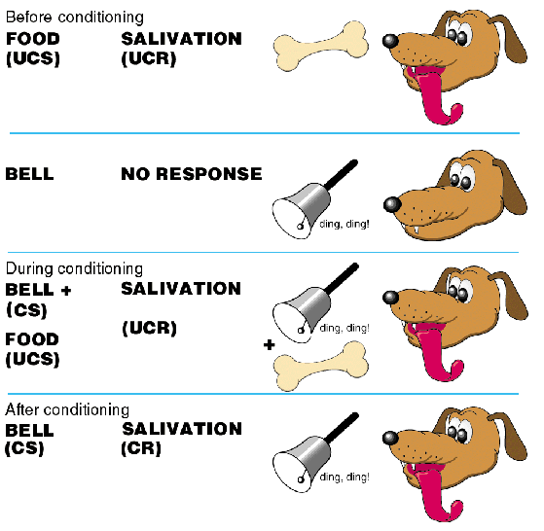
AS PSYCHOLOGY: Paper 2
APPROACHES IN PSYCHOLOGY

Slide 2
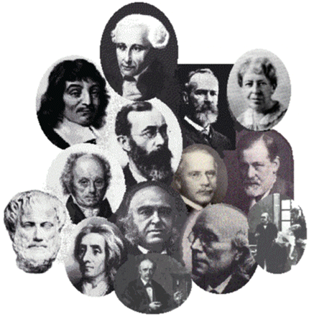
ORIGINS IN PSYCHOLOGY

Slide 3
Specification says…
Origins of psychology:
Wundt and introspection
The emergence of psychology as a science.

Slide 4
Origins of psychology: The emergence of Psychology as a Science
Psychology spans a period of over 2000 years from the ancient Greeks to the present day
Only in the last 150 years has Psychology emerged as a separate subject with its own methods of investigation and questions about the nature of human existence.
Rene Descartes (1596 - 1650)
Theory of dualism, he made a distinction between
the mind - thinking, knowing and remembering and
the body - the physiological processes.
John Locke founded the Empiricist Movement
Rejected philosophical debate on the nature of human existence – Instead advocated systematic and objective observation of human behaviour
Helmholtz and Fechner
Investigated the nature of visual perception
Early 1800s
Physicists were investigating the structure and function of the nervous system
1879
Wilhelm Wundt established the first psychological laboratory was founded in Leipzig, Germany
Since then…and until present day
Psychologists have studied behaviour from many different approaches

Slide 5
Origins of psychology: The emergence of Psychology as a Science
In small groups you will be asked to research a key person or movement in psychology to feedback to the class
You will need to provide details on :
Who they are/name of the movement
When the person was working/movement emerged
Key ideas/assumptions of the person/movement (N.B. do not make this overly detailed – it should be perhaps 3 or 4 bullet points of their key ideas/assumptions)
You will also need to find an image (expand to A4 size) of the person/representation of the movement.
You can use reputable sites on the internet or AS textbooks as your sources of information.
You will be feeding back the details of your person/movement onto the timeline of the History of Psychology.
You have 20 minutes to complete your research.

Slide 6
Origins of psychology: The emergence of Psychology as a Science
People/movements to research
Rene Descartes
Wilhelm Wundt (1875)
Sigmund Freud & Psychodynamic Approach (1896)
John Watson & Behaviourist Approach
Humanistic Approach
Cognitive Approach
Social Learning Theory
Biological Approach
Cognitive Neuroscience

Slide 7
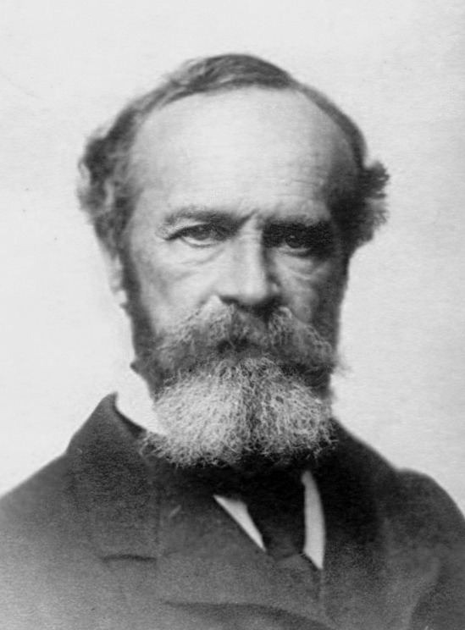
Origins of psychology: The emergence of Psychology as a Science
Wilhelm Wundt
Established psychology as a separate science from the discipline of philosophy. Wundt founded the first psychology laboratory in 1879
Wundt concentrated on three areas of mental functioning; thoughts, images and feelings. These are the basic areas studied today in cognitive psychology. This means that the study of perceptual processes can be traced back to Wundt. Wundt’s work stimulated interest in cognitive psychology.
He developed the technique of introspection to study experiences objectively. Introspection is the study of analytic (i.e. investigative) self reflection.

Slide 8
Origins of psychology: The emergence of Psychology as a Science
Introspection Activity
You will each be given a stimulus
You need to write down your self-reflections in relation to this stimulus – please do not confer with others during your reflection.
You will not have to share them if you don’t want to, but please be honest in what you write.
Your reflections might make reference to some or all of the following:
What feelings have you experienced since receiving the stimulus?
What thoughts have you had since receiving the stimulus?
What sensations (e.g. emotional; sensory etc) have you experienced since receiving the stimulus?

Slide 9
Origins of psychology: The emergence of Psychology as a Science
Wilhelm Wundt
Introspection
This is the self-observation and reporting of conscious inner thoughts, desires and sensations.
It is a conscious, mental and usually purposive process relying on thinking, reasoning, and examining one's own thoughts , feelings, and, in more spiritual cases, one's soul
Wundt trained his students in introspection. They were then given a stimulus (such as a ticking metronome) and would reflect on the experience. They would report what the stimulus made them think and feel. The same stimulus, physical surroundings and instructions were given to each person.

Slide 10
Origins of psychology: The emergence of Psychology as a Science
Wilhelm Wundt – Evaluation
Wundt’s emphasised controlled investigation into the mind. He used laboratory settings, standardised instructions and the same stimulus for each participant. Enabling replication of his research. His influence has helped to make the discipline of Psychology ‘scientific’ in nature.
Wundt’s introspection was considered by his critics to be too subjective (based on the individuals’ interpretations). People’s feelings and emotions varied greatly from person to person, which meant it was too difficult to draw general principles on the nature of the mind.
By the very nature of thoughts and feelings they are ‘non-observable’, private experiences. Individuals can experience them, but they cannot be directly observed or measured by a researcher. Critics stated that this made them unscientific.

Slide 11
Origins of psychology: The emergence of Psychology as a Science
Exam Questions
In pairs write an answer to one of the following Qs
Explain what in involved in the technique of Introspection (3 marks)
Briefly describe the emergence of Psychology as a Science (4 marks)
Evaluate the contribution made by Wundt to the emergence of Psychology as a separate science discipline (4 marks)
Upload your answers to GOL – Student database

Slide 12
Approaches – Prep task
Tutorial 1: Research into Behaviourist Approach
Upload a copy of your notes and questions onto GOL, also bring a copy to the lesson.

