Slide 1


WELCOME BACK
Psychology
Department
TO A Level PSYCHOLOGY!!

Slide 2
A level: An Overview…
A level units consist of Paper 1, Paper 2 and Paper 3 (which makes up your whole A level grade at the end of the two years)
Students wishing to continue to with the full A level in Psychology (after the summer AS results) should ideally:
  Achieve a D or above in AS Psychology.
  Demonstrate a good work ethic during the AS course (along with the next 4 weeks – to demonstrate you can cope with the second year)

Slide 3
A Level Psychology
Paper 1 – Introductory Topics in Psychology | Paper 2 – Psychology in Context | Paper 3 – Issues and Options in Psychology
Social Influence Memory Attachment Psychopathology | Approaches in Psychology Biopsychology Research Methods | Issues and Debates Gender Schizophrenia Aggression

Slide 4
A level: An Overview…
Paper 1: Introductory Topics in Psychology (what you have already covered). 33.3% of the total A Level
  2 hour exam
  Assessment: Multi-choice, short answer and extended writing questions. The largest question will now be 16 marks.
  Topics:
    SOCIAL INFLUENCE
    MEMORY
    ATTACHMENT
    PSYCHOPATHOLOGY

Slide 5
A level: An Overview…
Paper2: Psychology in context (a large part of which you have covered already)
  33.3% of the total A level
  2 hour exam
  Assessment: Multi-choice, short answer and extended writing questions. The largest question will now be 16 marks
  Topics:
    Approaches: Learning, Cognitive, Biological, Psychodynamic, Humanistic
    Biopsychology: All previous content plus ways of studying the brain and the key parts of the brain that determine behaviour. Also biological rhythms.
    RESEARCH METHODS: All previous knowledge plus two additional methods and more statistical testing

Slide 6
A level: An Overview…
Paper 3: Issues and options in Psychology (entirely new content) 33.3% of the total A Level
  2 hour exam
  Assessment: Multi-choice, short answer and extended writing questions. The largest question will now be 16 marks.
  Topics:
    ISSUES AND DEBATES
    GENDER
    SCHIZOPHRENIA
    AGGRESSION

Slide 7
Second year: An Overview…
Course Structure (From Sept )
Timing (Approx) | Tutor 1 (2.25 hours per week) | Tutor 2 (2.25 hours per week) | Exams
AUTUMN TERM (first half) | Research Methods Aggression (paper 3) | Approaches/ biopsychology (paper 2) Gender (paper 3)
AUTUMNTERM (second half) | Research Methods Aggression | Gender Research Methods
SPRING TERM (first half) | Schizophrenia (paper 3) | Issues and Debates (paper 3)

Slide 8
A level: An Overview…
IMPORTANT DIFFERENCES BETWEEN AS AND A level:
Different expectations of YOU...
  Work more independently than at AS
  Many HW tasks will cover descriptive PREPARATION to be completed BEFORE each lesson. (e.g. Godalming Online tutorial or assignment or reading an article or a section of a textbook and making independent notes). This will be consistent across the Psychology department.
  The main focus of lesson time will be to cover challenging evaluative / analytical / applied aspects. The style of assessment remains similar however 16 mark questions require a greater proportion of evaluation.
YOUR notes will be very important to revise from. Non-completion of preparatory work will result in exclusion from part of the lesson; Non-completion of homework generally will require compulsory attendance at ‘catch up sessions’ and most importantly a lack of understanding and progression in the course!

Slide 9
On your CIS Self Page:
Answer the following questions:
1. How consistently did you work throughout the year?
2. How many hours did you devote to revision in the run up to the AS exams?
3. What worked most effectively for you when carrying out revision? What would you do again / do differently next year?
4. What grade do you think you achieved?

Slide 10
A level post AS exams
Timing (Approx) | PAPER 2 (2.25 hours per week) | PAPER 2 (2.25 hours per week)
SUMMER TERM (post AS) | Approaches / Biopsychology | Research Methods

Slide 11
Post AS Exams
Paper 2 – Psychology in Context
Approaches:
Psychodynamic Approach
Biopsychology:
Ways of studying the brain
Biorhythms – Circadian, Infradian, Ultradian
Endogenous Pacemakers & Exogenous Zeitgebers
Research Methods:
Content Analysis & Coding
Features of a Science
Levels of Measurement, probability & significance
Spearmans Rho

Slide 12
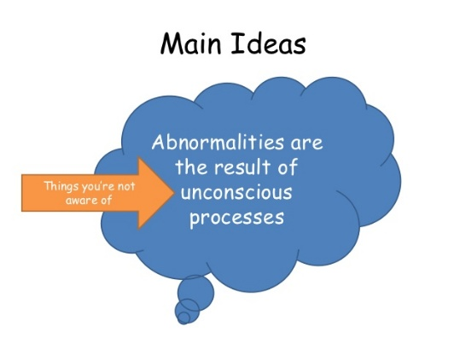
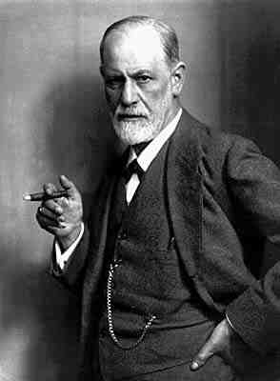
A Level Paper 2
Psychology in Context
Approaches in Psychology
The Psychodynamic Approach
The Psychodynamic Approach is a perspective that describes the different forces, mostly unconscious, that operate on the mind and direct human behaviour and experience

Slide 13
The Psychodynamic Approach
Specification:
The Role of the Unconscious
The Structure of the Personality – Id, Ego & Superego
Defence Mechanisms – Repression, Denial & Displacement
Psychosexual Stages of Development

Slide 14
A bit of history...
The psychodynamic approach is one of the earliest approaches in psychology, originating in the 19th century.
The main figure in
psychodynamic theory is
Sigmund Freud
What do you know about Freud?

Slide 15
The Role of the Unconscious
The Conscious. The small
amount of mental activity we
know about. (e.g. thoughts, perceptions) ‘The tip of the Iceberg’
The Preconscious. Just bubbling under the surface of the conscious mind-includes thoughts or ideas we may become aware of during dreams or through ‘slips of the tongue’ (parapraxes)
The Unconscious. Things we are unaware of – biological drives & instincts that influence our behaviour & personality. Also includes disturbing memories that have been repressed.

Slide 16

The Structure of the Personality
Freud argued there are 3 aspects of your personality that determine how you behave
Task:
Find out the key characteristics of the Id, Ego & Superego and summarise them on your handout.
id ego Superego
Notes:
Id – unconscious set of instincts which we are born with. Operates on the pleasure principle (completely selfish). Driven by an innate drive to seek immediate satisfaction.
Ego – by the end of the infants 1st year the ego develops. The conscious rational part of the mind (personal moral authority). Develops as a consequence of reality because you can’t always get what you want. Controls the fights between the id & the superego.
Superego – (around 5) last part to develop (later in childhood) and is concerned with what is right and wrong (morality driven). It develops through the process of socialization when people learn moral standards and expectations.

Slide 17



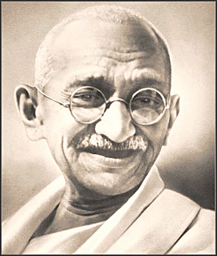
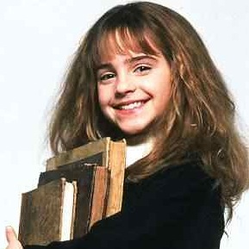
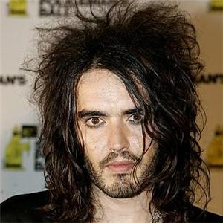
The Structure of the Personality
Id
Ego
Superego
‘Pleasure Principle’ – Unconscious selfish aggressive instincts that demand immediate gratification
‘Morality Principle’ - Internalised sense of right and wrong
‘Reality Principle’ – balances the conflicting demands of the Id & Superego
Russell does and says what he wants he is impulsive and does things to gratify himself
Hermione is very rational and aware of the consequences of the actions.
Ghandi acted on his morals he did what he thought was the right thing to do.

Slide 18
The Structure of the Personality
Freud argued there are 3 aspects of your personality that determine how you behave
Task:
Read the scenarios on the handout and apply your knowledge to explain what the Id, Ego and Superego would say.
id ego Superego
Notes:
Id – unconscious set of instincts which we are born with. Operates on the pleasure principle (completely selfish). Driven by an innate drive to seek immediate satisfaction.
Ego – by the end of the infants 1st year the ego develops. The conscious rational part of the mind (personal moral authority). Develops as a consequence of reality because you can’t always get what you want. Controls the fights between the id & the superego.
Superego – (around 5) last part to develop (later in childhood) and is concerned with what is right and wrong (morality driven). It develops through the process of socialization when people learn moral standards and expectations.

Slide 19
The Structure of the Personality
Task:
Read each of the character profiles most of which will be familiar to you.
In reality we all display a mixture of Id Ego and Super ego
These profiles have been written to exaggerate the characteristic on one of the three elements for each
Sort them into three piles: Id; Ego; and Superego.

Slide 20
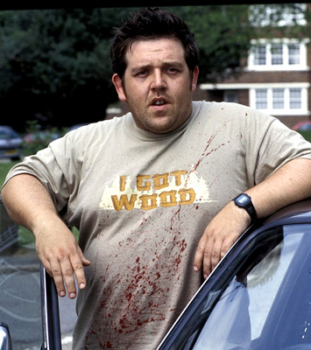
Ed from Shaun of the Dead
Ed doesn’t have a job. He sponges off his mate Shaun. He likes eating pizza and playing computer games like “Grand Theft Auto”
At the end of the film Shaun of the Dead he manages to survive as a zombie locked up in the shed at the bottom of the garden with little impact and still playing computer games.

Slide 21
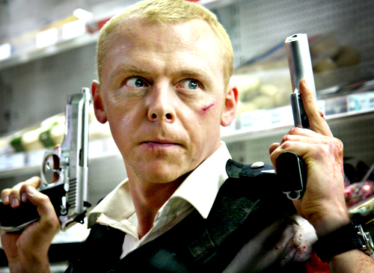
Sergeant Nicholas Angel
Sergeant Angel in the film “Hot Fuzz”, has been decorated for gallantry. He is obsessive about work and does not have a social life
He is obsessively tidy
A man of conscience
People don’t like him because he can’t relax and have fun.

Slide 22

The Dark Knight
Works to maintain justice in Gotham
Will sacrifice all of himself for justice
Very black and white in his views
He is haunted by his conscience when he makes a mistake
Some would say has psychopathic tendencies

Slide 23
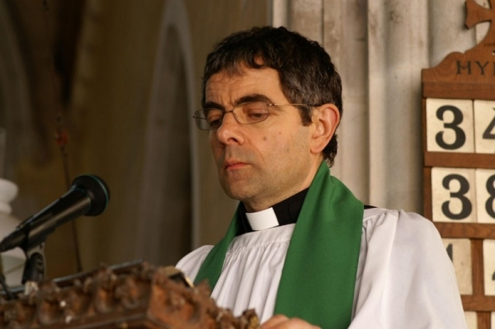
Walter Goodfellow
In the film “Keeping Mum” he is obsessed with writing a good sermon.
Sees the good in everything
Is rational, calm and does not get involved in tittle tattle, gossip or anything which is hurtful.

Slide 24
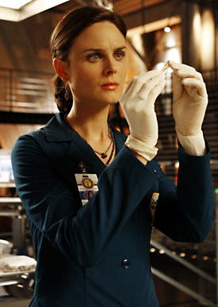
Temperance “Bones” Brennan
Extremely rational and scientific
She does not let her emotions interfere with her work and until recently she did not have personal relationships

Slide 25
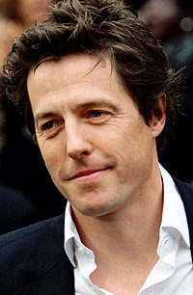
Daniel Cleaver
In the Bridget Jones films he is indulgent, two timing selfish cad who loves having a good time
He has virtually no morals
He loves seducing as many women as possible and does not care who he hurts

Slide 26
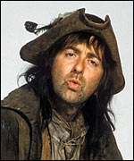
Baldrick
The world of baldrick is extremely small and smelly.
He exists to eat and sleep and avoid painful beatings
He has no desire to better himself and is happy with a turnip

Slide 27
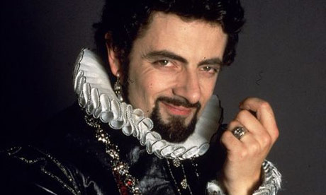
Sir Edmund Blackadder
He is extremely rational and chooses his moves carefully
He tries to use his intellect and cunning to win the Queen’s affections and beat Lord Melchet

Slide 28
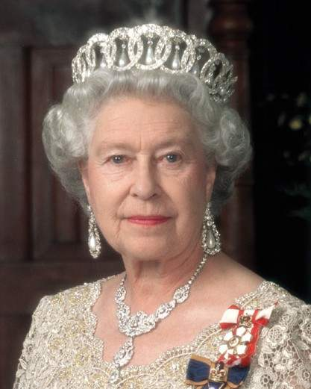
The Queen
Has a lifelong sense of duty honed over 60 years as the serving monarch
She finds it distressing when her children’s behaviour let her down
She always keeps her commitments and has a strong sense of right and wrong.

Slide 29

James Bond
Clear headed, rational and doing his duty always
Would like the world to be a better place but understands well the reality of it and the necessity of his job.

Slide 30
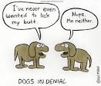
Defence Mechanisms https://www.youtube.com/watch?v=ov-a1mGSEMc https://www.youtube.com/watch?v=kJR7TDos9xg (First 6 mins)
The Ego uses a number of defence mechanisms to help reduce the conflict between the demands of the Id and Superego:
Repression
Denial
Displacement
These defence mechanisms are unconscious and ensure that the ego is able to prevent us from being overwhelmed by temporary threats or traumas.
However, they involve some distortion of reality and as a long term solution are regarded as unhealthy. Excessive use of defence mechanisms may lead to psychological disorder.

Slide 31
Defence Mechanisms
Use textbooks/the internet to complete the table below:
Defence Mechanism | Description | Effect on Behaviour
Repression
Denial
Displacement

Slide 32
Defence Mechanisms
Defence Mechanism | Description | Effect on Behaviour
Repression | An unpleasant memory is pushed into the unconscious mind where it is not accessible to the conscious mind and therefore cannot cause anxiety. It does, however, still affect behaviour in the unconscious mind. | There is no recall of the event or situation
Denial | There is a refusal to accept the reality of an unpleasant situation. This reduces anxiety caused by that situation. | Someone may think that the situation is not negative and that therefore should not cause anxiety. This is not positive thinking, merely a resistance to accept reality.
Displacement | This is when the focus of a strong emotion is expressed onto a substitute person or object. This reduces anxiety by allowing expression of that emotion | Someone may exhibit very strong emotion but focus it onto an uninvolved person or object.

Slide 33
Example of Defence Mechanisms
Maria has a very unpleasant boss who makes her angry.
Maria may use repression to protect the ego so that she simply may forget her boss has been unpleasant to her
Denial might mean that she would believe that what her boss was actually saying to her was pleasant.
Displacement may prompt her to take her anger out on family or friends, or simply slam a door.

Slide 34
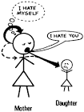
Defence Mechanisms Activity
In small groups you have 10 minutes develop a role play that incorporates these 3 defence mechanisms.
Be prepared to perform your role play and the rest of the class will attempt to identify these defence mechanisms

Slide 35
The Structure of the Personality
Task:
Circle True or False. If the answer is false, correct it.
Freud suggested there were 4 aspects to our personality. | True False
2) The ego works on the pleasure principle. | True False
3) The superego works on the morality principle. | True False
4) The id is the first part of the personality to develop. | True False
5) The personality develops through the first 10 years of childhood. | True False
6) The ego is the part of the personality which develops last. | True False
7) For the adult personality to be balanced, the ego manages the needs of the id and ego. | True False
8) The id works on the reality principle. | True False
9) Defence mechanisms do not help balance the id, ego and superego. | True False
10) When the balance is lost, neuroses can occur. | True False

Slide 36
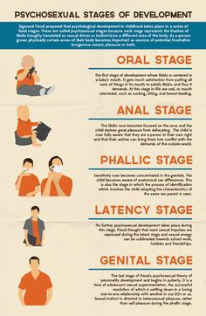
Psychosexual Stages of Development https://www.youtube.com/watch?v=M5_8uYRZfns
Freud claimed that child development occurred in 5 stages
The underlying unconscious drive is sexual
Each stage (apart from Latency) is characterised by a different conflict that the child must resolve in order to progress successfully to the next stage
Any unresolved conflict leads to fixation where the child becomes ‘stuck’ and carries these conflicts with them into adult life

Slide 37
Psychosexual Stages of Development
Task:
In small groups you will be allocated one psychosexual stage of development to research:
Oral
Anal
Phallic
Latency
Genital
Present this information in a clear, informative and original way
Be prepared to feed back to the rest of the group
Find out:
The age the stage occurs at
The characteristics of the stage
The consequences of unresolved conflict

Slide 38
Psychosexual Stages of Development
Stage & Age | Description | Consequences of unresolved conflict
Oral
Anal
Phallic
Latency
Genital

Slide 39
Psychosexual Stages of Development
Stage & Age | Description | Consequences of unresolved conflict
Oral 0 – 1 | Focus of pleasure is the mouth, mother’s breast is the object of desire | Oral fixation – smoking, biting nails, sarcastic, critical
Anal 1 - 3 | Focus of pleasure is the anus. Child gains pleasure from withholding and expelling faeces. | Anal retentive – perfectionist, obsessive Anal expulsive – thoughtless, messy
Phallic 3 - 5 | Focus of pleasure is the genital area Child experiences Oedipus or Electra Complex | Phallic personality – narcissistic, reckless, possibly homosexual
Latency 6 - 11 | Earlier conflicts are repressed – a relatively calm time | No fixation occurs – i.e. no effect on adult personality
Genital 12 | Sexual desires become conscious, alongside the onset of puberty | Difficulty forming heterosexual relationships

Slide 40
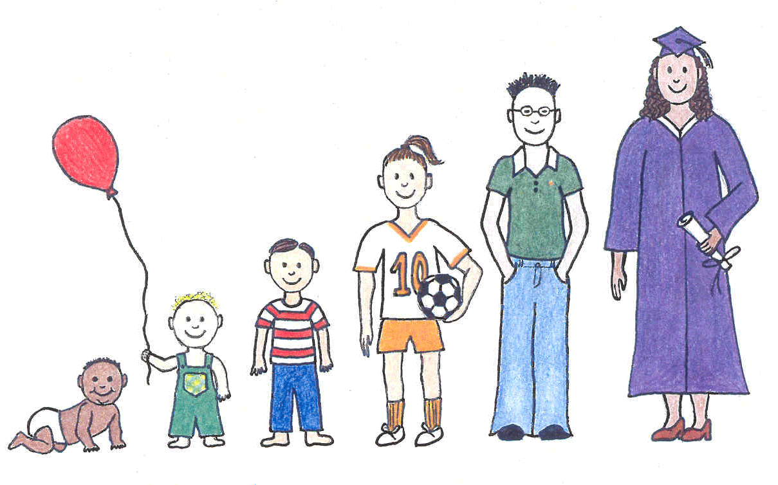
Timeline Activity – Annotate the timeline with the 5 psychosexual stages of development

Slide 41
Psychodynamic Approach – Evaluation
Strengths
Elaborate the following evaluation points:
State | Describe | Explain i.e. what does this mean/suggest?
Freud’s theory has had a huge influence on Psychology today
The psychodynamic approach highlights the importance of childhood experience on later development
The Psychodynamic approach has useful practical applications in terms of therapy

Slide 42
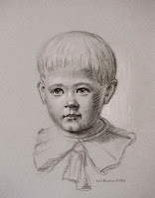
Psychodynamic Approach – Evaluation
Limitations
Elaborate the following evaluation points:
State | Describe | Explain i.e. what does this mean/suggest?
Freud’s concepts are difficult to test
Most supporting evidence is based on case studies e.g. Little Hans https://www.youtube.com/watch?v=twZet50f9SQ
There is mixed evidence on the effectiveness of psychotherapy

Slide 43
Psychodynamic Approach – Evaluation
Strengths
State | Describe | Explain i.e. what does this mean/suggest?
Freud’s theory has had a huge influence on Psychology today (despite some of his assumptions being very controversial) | It has remained the dominant force in Psychology, alongside behaviourism, throughout the 20th Century. | This means it must have useful explanatory power in terms of explaining some behaviours e.g. personality and abnormal behaviour
The psychodynamic approach highlights the importance of childhood on later development | It emphasises how childhood experiences, especially conflict, influences behaviour later on in adulthood. | This strengthens the case for children’s rights reform and suggests that children should be nurtured as their childhood will have such a big influence on their experiences in adulthood
The Psychodynamic approach has useful practical applications in terms of therapy | Psychoanalysis uses a range of techniques such as hypnosis and dream analysis which have been found to be effective in the treatment of some disorders | This widespread use of psychoanalysis, therefore, enhances the credibility of the Psychodynamic Approach

Slide 44
Psychodynamic Approach – Evaluation
Limitations
State | Describe | Explain i.e. what does this mean/suggest?
Freud’s concepts are difficult to test scientifically | Concepts such as the Id, ego & Superego are vague & unobservable, occurring in the unconscious | This means that the Psychodynamic Approach does not meet the scientific criterion of falsification as it is not open to scientific testing.
Most supporting evidence is based on case studies e.g. Little Hans | The case studies that Freud used were of single individuals, and were culturally specific, coming from the more wealthy people in Viennese society | This means that his research lacked reliability and his findings cannot be generalised to the general population
Psychoanalysis as a therapy has been widely criticised | They have been criticised as being sometimes harmful, causing distress, and also no more effective than if no treatment had been used (i.e. compared to spontaneous remission; Eysenck, 1952) | This would suggest that psychoanalysis may not suit everyone and that it may not be suitable for more serious disorders such as schizophrenia

