Slide 1
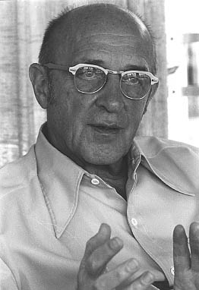
A Level Paper 2 Psychology in Context
Approaches in Psychology
The Humanistic Approach
Abraham Maslow
Carl Rogers
‘The Third Force’

Slide 2
The Humanistic Approach
Specification:
Free Will
Self Actualisation & Maslow’s Hierarchy of Needs
Focus on the Self, Congruence &The Role of Conditions of Worth
The Influence on Counselling Psychology

Slide 3
Origins & History
Humanistic Psychology emerged in the USA in the 1950’s as a result of the work of Carl Rogers & Abraham Maslow
It became known as ‘The Third Force’ – alongside Behaviourist & Psychodynamic Approaches
It focused on explanations of ‘healthy’ growth in individuals and stressed uniqueness and free will

Slide 4
Key Assumptions
Every individual is unique – we are all different and should be treated as such (an idiographic approach)
Free Will – we have the ability to choose what we do and are in control of our behaviour
People should be viewed holistically – i.e. we should not just look at one aspect of an individual
Scientific method is not appropriate to measure behaviour – methods employed should measure subjective experience

Slide 5
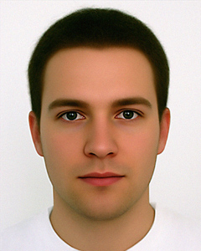
Why did Simon commit the crime? Use your knowledge of the approaches (Biological, Cognitive, Behaviourist, SLT, Psychodynamic, Humanistic) to help you answer this question
Simon came home to find his girlfriend with his best friend in the lounge. He immediately became suspicious and acted in an aggressive way.
A big argument occurred and Simon ended up shoving his girlfriend onto the sofa and punching his best friend in the face.
When Simon was 12 his dad was arrested and charged with GBH. He was found guilty and was sentenced to 2 years in prison.

Slide 6
Did any of you consider whether Simon is responsible for his own actions?

Slide 7
Simon’s crime – FREE-WILL or DETERMINISM?
Guilty or not-guilty?

Slide 8
Free Will
Determinism
Simon has the FREE-WILL to act in the way that he wants to
Simon can choose how to act
Humanistic Approach
There are reasons for Simon’s behaviour.
There are things that DETERMINE Simon’s behaviour
Biological, Cognitive, Behaviourist, (including SLT), Psychodynamic Approaches

Slide 9
Free Will
The humanistic approach to explaining behaviour assumes that we have free will
It is often referred to as a person centred approach in Psychology
All other approaches claim our behaviour is shaped by forces over which we have no control and that we have no choice
Humanists argue that we are active , self determining agents and have the ability to determine our own actions and development
This has implications for the legal system as this places responsibility with the individual

Slide 10
Self-Actualisation & Maslow’s Hierarchy of Needs
The desire to grow psychologically & fulfil one’s own potential – becoming what you are capable of
Self-Actualisation:
This refers to a belief that everyone has an innate tendency to achieve their full potential
Rogers and Maslow argue individuals self-actualise in their own unique way
They argue it is a drive we all have, but we do not all achieve it
Self-actualisation represents the uppermost level of Maslow’s Hierarchy of Needs
Sheffield (1995) found a positive correlation between an individual’s level of self-actualisation & their psychological health
Task – Can you identify any celebrities who may be described as ‘self-actualisers’?

Slide 11
Self Actualisation & Maslow’s Hierarchy of Needs
Maslow’s Hierarchy of Needs:
Maslow argued that self-actualisation could be achieved through a series of stages – these are called hierarchy of needs
These arise in order, and if the first need is not met then all other needs cannot be fulfilled
The drive to reach self-actualisation means that we are all working through these needs
The state of self actualisation is not permanent and if all 5 do not remain in place, an individual can move out of the state until all the other needs are back in place

Slide 12
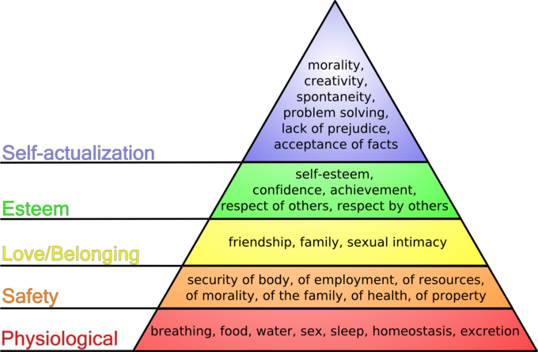
Maslow’s hierarchy of Needs https://www.youtube.com/watch?v=RfDS9r4Tz_g
In some countries, where food is scarce, it will be difficult to move past physiological needs; in war afflicted countries it may be difficult to move past safety needs; for some people in Western countries, where they are well fed, safe etc, lack of self esteem may prevent them from self-actualising

Slide 13
Maslow’s hierarchy of Needs
Tasks:
Complete the Questionnaire online to assess your hierarchy of needs:
http://similarminds.com/maslow.html
2a. Draw and label a pyramid which shows Maslow’s Hierarchy of Needs
b. Find 5 pictures of adverts that promise to fill each of Maslow’s 5 Needs (e.g. advert of food satisfies physiological). Stick these onto your pyramid

Slide 14
Focus on The Self & Congruence
The Self:
Rogers suggested we have 3 selves which need to integrate in order to achieve self-actualisation:
The Self Concept – the self you feel you are. Similar to self-esteem
The Ideal Self – the self you wish to be – it is who you are aiming to be
The Real Self – the self you actually are. This is difficult to measure as it is based on subjective experience

Slide 15
Focus on The Self & Congruence
Task:
Write a list of 5 of your perceived faults (e.g. I smoke cigarettes; I procrastinate on written assignments; My nose is too large). This is your self-concept.
Rewrite the statements in terms of your ideal self (e.g. My ideal self is a non-smoker; My ideal self does written assignments promptly rather than at the last minute; My ideal self has a smaller nose)
You do not have to share this with anyone else!

Slide 16
Focus on The Self, Congruence & Conditions of Worth
Congruence:
Rogers argued to achieve self-actualisation an individuals self concept and ideal self should be similar or congruent.
However, congruence is difficult to achieve and may prevent an individual from reaching self actualising
Conditions of worth:
Conditions of worth are requirements that the individual feels they need to meet to be loved e.g. I will only love you if…….
An individual needs ‘unconditional positive regard’ i.e. they need to feel loved and accepted, without proviso. This can come from parents, other family members, friends, a partner etc
If an individual does not experience unconditional positive regard, it may also prevent an individual from reaching self-actualisation

Slide 17
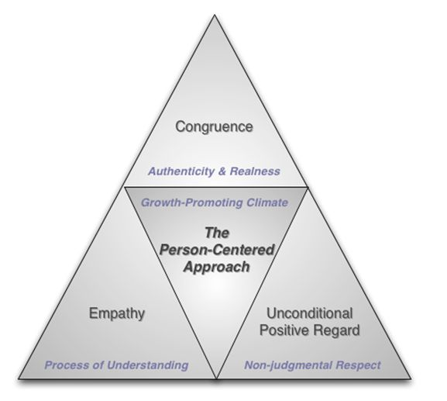
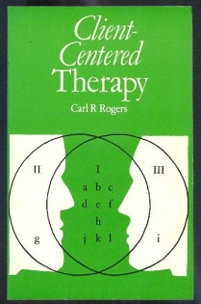
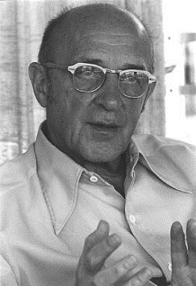
The Influence on Counselling Psychology
The influence of humanistic approach on counselling was extensive throughout the 1960’s and 70, waned a bit in the late 1970’s, but has been significant again since the 1990’s.
Rogers’ client centred therapy is non-directive, and the client (patient) is encouraged towards the discovery of their own solutions.
There is an emphasis on a warm, supportive, non-judgemental therapeutic setting.
The aim of therapy is to increase the person’s feelings of self worth and reduce the incongruence between the self-concept and the ideal self.
Elliott (2002) showed in a meta-analysis of 86 studies, that humanistic therapies were more effective leading to an improvement in clients when compared to people not receiving treatment

Slide 18
The Influence on Counselling Psychology
Have a go!
In pairs - follow the instructions on your task sheet and develop your listening skills
Make sure you swap over after a few minutes so that the counsellor becomes the client and vice versa

Slide 19
Humanistic Approach – Evaluation Strengths Elaborate the following evaluation points:
State | Describe | Explain i.e. what does this mean/suggest?
The humanistic approach is not reductionist
Client Centred Therapy developed from this approach is effective
The humanistic approach is a positive approach focusing on free will & the uniqueness of every individual

Slide 20
Humanisitic Approach – Evaluation Limitations Elaborate the following evaluation points:
State | Describe | Explain i.e. what does this mean/suggest?
The concepts of the approach & the subjective experiences of people are hard to test scientifically
The humanistic approach has a cultural bias
The Humanistic approach has limited real-world application

Slide 21
Humanistic Approach – Evaluation Strengths
State | Describe | Explain i.e. what does this mean/suggest?
The humanistic approach is not reductionist | Humanistic psychologists advocate a holistic approach, in contrast to other approaches which attempt to break down behaviour into smaller components | This means the approach may have more validity than other approaches
Client Centred Therapy developed from this approach is effective | Elliott (2002) found that humanistic therapies were more effective leading to an improvement in clients when compared to people not receiving treatment | This means that its popularity as a therapy has increased in recent years
The humanistic approach is a positive approach | It focuses on free will and the uniqueness of every individual, emphasising personal development | It therefore recognises that individuals should be free to work towards the achievement of their potential and also be in control of their lives

Slide 22
Humanistic Approach – Evaluation Limitations
State | Describe | Explain i.e. what does this mean/suggest?
The concepts of the approach & the subjective experiences of people are hard to test scientifically | Concepts such as ‘self-actualisation’ and ‘congruence’ may be useful therapeutic tools but would be problematic to test experimentally | This means there is a lack of empirical evidence to support the approach
The Humanistic approach has a cultural bias | Many concepts such as autonomy & personal growth are associated with individualistic, western cultures e.g. USA | These concepts therefore are less applicable to collectivist cultures e.g. India which emphasise the needs of the group/community
The Humanistic approach has limited real-world application | It is lacking a sound evidence-base and is seen by some to be little more than an abstract set of concepts | This means that apart from counselling, Humanistic Psychology has had little impact on the discipline of Psychology as a whole

Slide 23
Sample Questions
Explain what humanistic psychologists mean by conditions of worth. Give an example. (3 marks)
Outline and briefly evaluate the influence of humanistic psychology on counselling. (5 marks)
Outline what is meant by free will. (2 marks)
Nathan has always worked really hard at school. He is ambitious and wants to become a solicitor. His parents are very proud of him and celebrate his successes. However, of late, his grades at school have slipped. Nathan is feeling miserable and anxious.
How do conditions of worth explain Nathan’s feelings? (3 marks)
5. Outline and evaluate the humanistic approach. (16 marks)

