Slide 1
Paper 2-psychopathology
Phobias

Slide 2
The Bigger Picture.
Psychopathology:
Definitions and limitations of abnormality, including deviation from social norms, failure to function adequately, statistical infrequency and deviation from ideal mental health
The behavioural, emotional and cognitive characteristics of phobias, depression and obsessive compulsive disorder (OCD).
The behavioural approach to explaining and treating phobias: the two-process model including classical and operant conditioning; systematic desensitization, including relaxation and use of hierarchy; flooding
The cognitive approach to explaining and treating depression: Beck’s negative triad and Ellis’s ABC model; cognitive behavioural therapy (CBT), including challenging irrational thoughts.
The biological approach to explaining and treating OCD; Genetic and Neural explanations; Drug therapy

Slide 3
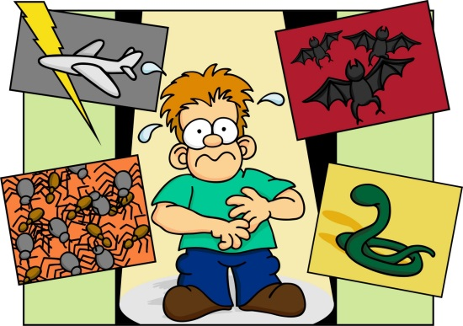
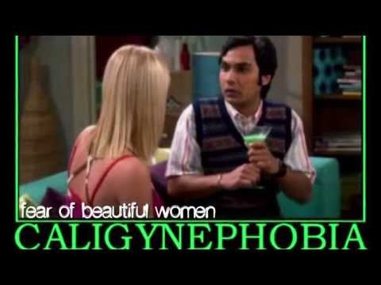
Guess the Phobia
BACTERIOPHOBIA
EISOTROPHOBIA
TRYPANOPHOBIA
IATROPHOBIA
HEMAPHOBIA
AMATHOPHOBIA
SINISTROPHOBIA
OCTOPHOBIA
In pairs/threes:
You have 10 minutes to write down what you think these phobias might be

Slide 4
Guess the Phobias - Answers
BACTERIOPHOBIA-FEAR OF BACTERIA
EISOTROPHOBIA- FEAR OF LOOKING AT ONESELF IN THE MIRROR
TRYPANOPHOBIA- FEAR OF INJECTIONS
IATROPHOBIA-FEAR OF GOING TO THE DOCTORS
HEMAPHOBIA- FEAR OF BLOOD
AMATHOPHOBIA- FEAR OF DUST
SINISTROPHOBIA- FEAR OF LEFT HANDED OBJECTS
OCTOPHOBIA- FEAR OF THE NUMBER EIGHT

Slide 5
Specification
Characteristics of phobias
  Behavioural
  Cognitive
  Emotional
Explanation of phobias:
  The Behaviourist approach
Behaviourist therapies:
  Systematic desensitisation
  Flooding

Slide 6
Discussion
Think/pair/share:
How might an individual with a phobia behav?
How might they feel?
What kinds of thoughts might they have?

Slide 7
Those questions link to….
The characteristics of phobias
  Behavioural
  Emotional
  Cognitive

Slide 8
Research poster task
In groups:
You will be allocated a type of characteristic.
Find at least three different characteristics within that area
Create a poster with relevant information
You have 30 minutes
Be ready to feed back to the rest of the class

Slide 9
Specification
Characteristics of phobias
  Behavioural
  Cognitive
  Emotional
Explanation of phobias:
  The Behaviourist approach
Behaviourist therapies:
  Systematic desensitisation
  Flooding

Slide 10
Behavioural explanation to phobias
It uses the dual process model to explain phobias
Created by Hobart Mowrer (1947)
Proposes that phobia are:
  Initiated by Classical conditioning
  Maintained by Operant conditioning
What are these two types of conditioning?

Slide 11
Initiation – Classical conditioning
Before conditioning: UCS [ loud noise ] = Fear
During Conditioning: UCS [ loud noise ] + NS [ rat ] = Fear
After Conditioning: CS (Rat) = Fear (CR)

Slide 12



Before Conditioning:
During conditioning:
After conditioning:
UCS

Slide 13
Using Pc’s – create your own
In pairs:
How would classical conditioning cause the initiation of a different phobia?
Create the conditioning process like above but for a different phobia

Slide 14
Maintenance – Operant conditioning
Shaping behaviour through the consequences of actions
REINFORCEMENT – Makes it more likely a behaviour will be repeated.
POSITIVE REINFORCEMENT – Person received a reward.
NEGATIVE REINFORMENT – Behaviour leads to the removal of something unpleasant e.g. anxiety associated with situation.
PUNISHMENT – makes it less likely a behaviour will be repeated.

Slide 15
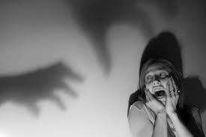
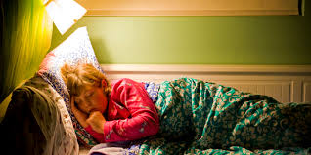

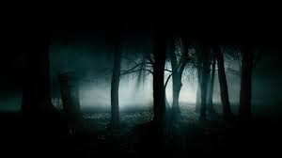
Negative reinforcement is key in the maintenance of phobias.
For example:

Slide 16
Explanation of this……
Fear of the dark as a result of a traumatic experience such as being attacked in the dark
Therefore:
To reduce the fear response associated with being in the dark the person might sleep with the light on (this acts as a negative reinforcement).
The use of this avoidance response leads to the phobia being resistant to extinction.

Slide 17
Create your own illustration
Using the Pc’s:
Create an illustration of how an individual might carry out a anxiety avoidance situation which continues to negatively reinforce their phobia

Slide 18
Evaluation Task
In the following groups:
Find scientific evidence to support
How might this approach be useful?
Can this model solely account for the development of phobia? (refer to the diathesis-stress model)
Find contradictory evidence
Be prepared to feedback to the rest of the group

Slide 19
Recap – exam question
Suggest how the behavioural approach might be used to explain Kirsty’s phobia of balloons (4 marks)
You have 5 minutes to complete this question

Slide 20
Specification
Characteristics of phobias
  Behavioural
  Cognitive
  Emotional
Explanation of phobias:
  The Behaviourist approach
Behaviourist therapies:
  Systematic desensitisation
  Flooding

Slide 21
Treating psychopathology
Behavioural Therapies

Slide 22
I need 3 volunteers!!!
You will review the session at the end so ensure you make good notes and pay attention

Slide 23
Behavioural Therapies
Aim:
Behaviourists propose that phobias arise from faulty learning
Therapies therefore, work on the basis of unlearning this faulty learning and re-learning appropriate behaviour

Slide 24
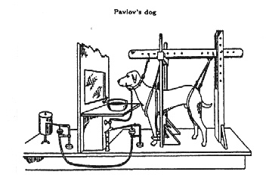
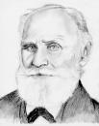
Behavioural Therapy
Based on Classical Conditioning & the work of Pavlov

Slide 25
Behavioural Therapy
    Systematic Desensitisation
    Flooding

Slide 26
A. Systematic Desensitisation
Used to treat phobias
The therapist teaches client relaxation skills
Both the therapist and client draw up a “hierarchy” of frightening experiences linked to the phobia
These experiences are faced one by one with the help of the relaxation techniques either in real life or through imagination

Slide 27
How does it work?
Step 1: The patient is taught to relax their muscles completely.
Step 2: The therapist and patient create a desensitisation hierarchy (a series of imagined scenes).
Step 3: The patient then works through the hierarchy, visualising each anxiety inducing event, whilst still engaging in a completely relaxed state (reciprocal inhibition – two emotional states can’t co exist).
Step 4: The patient moves on to the next step once they have successfully remained relaxed whilst imagining the event in the previous step.
Step 5: The patient will eventually master the feared situation that led them to seek help in the first place.

Slide 28
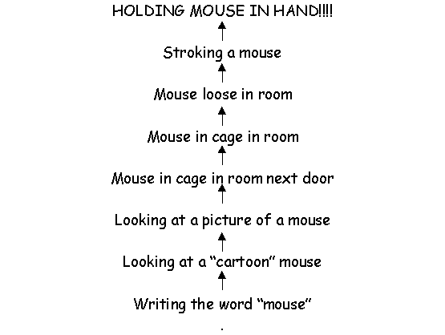
Example of a “Hierarchy”

Slide 29
A. Systematic Desensitisation: Activity
In pairs, construct a hierarchy that could be used to overcome a non-animal phobia – choose your phobia!
Include about 10 steps

Slide 30
Evaluation
In groups of three you will be given one of the following evaluation points:
  Is it appropriate for everyone?
  The problem of symptom substitution
  Reduced effectiveness for some phobia
  How Effective is it?
  Are there quicker alternatives
  Does it require you to have an imagination

Slide 31
Evaluation task:
Answer the following questions with reference to your evaluation point:
  1. What do you think the evaluation point is referring to?
  2. Is it a positive or negative evaluation point?
  3. How would you elaborate your point?
  You have 5 minutes

Slide 32
What did you come up with?
You may now use the texts books to complete/correct your evaluation point.
Once you have done this and your point is fully elaborated, be ready to feed back on the board.

Slide 33
Lesson Review

Slide 34
Exam questions
Becky is frightened of moths and butterflies and seeks help to overcome this fear. It is decided that systematic desensitization would be the most appropriate.
  a) Which approach to psychopathology would advocate the use of systematic desensitization? (1 mark)
  b) Explain how systematic desensitization might be used to cure Becky’s fear of moths and butterflies (4 marks)

Slide 35
Answers
a: The behavioural approach
b:
  Becky would first be taught to relax.
  She and the therapist construct a hierarchy beginning with a cartoon till the butterfly is in her hair.
  She works through the stages whilst practising relaxation, once relaxed at one step, she moves onto the next step.
  Because fear and relaxation are incompatible (reciprocal inhibition) eventually she would have overcome her fear.

Slide 36
B. Flooding
  Also used to treat phobias
  Involves facing the fearful object immediately ie going straight to the top of the hierarchy of fear!
  Breaks the association with fear

Slide 37
B. Flooding: Activity
How could flooding be used to treat:
Claustrophobia
Arachnophobia
Aerophobia
Agoraphobia ?
What problems could occur with flooding?
What limitation are brought to light, regarding flooding as a therapy?

Slide 38
Evaluation Task
In pairs you will be given an evaluation point from the ones we have discussed as a class.
Your Task:
    Use the textbook to help you fully elaborate your evaluation point.
    Once you have done this upload it on to the database on GOL under the file (Evaluation of flooding).
You will have access to a range of evaluations on GOL now when ever you need them for therapies of abnormality.

