Slide 1
Explanations for Forgetting

Slide 2
Recap
Exam Questions:
In relation to the working memory model, explain what is meant by the terms Phonological Loop and Visuo-spatial sketchpad. (2 + 2 marks)
Outline one limitation of the working memory model. (2 marks)

Slide 3
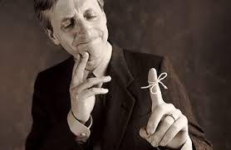
Discussion Questions
What kind of information do we often forget?
Why do we sometimes forget?

Slide 4
Interference Theory
Interference occurs when 2 pieces of information conflict with each other, resulting in forgetting of one or both pieces of information, or some distortion of memories
Two types of Interference:
Proactive Interference - forgetting occurs when older memories, already stored, disrupt the recall of newer memories – interference works forwards from old to new…….E.G?
Retroactive Interference – forgetting occurs when newer memories disrupt the recall of older memories already stored – interference works backwards from new to old…….E.G?

Slide 5
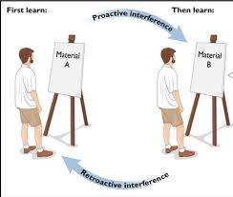
Proactive & Retroactive Interference
https://www.youtube.com/watch?v=jyXbdLIBhQo
(

Slide 6
Proactive & Retroactive Interference
Using your textbook and/or your booklet:
Identify and describe 1 piece of supporting evidence for Interference as an Explanation of Forgetting
Identify and explain 1 strength and 1 limitation with this evidence
(

Slide 7
Class Experiment

Slide 8
Instructions
You will see a number of Countries
Please write down the capital city for each country
Do NOT confer
You MUST conduct this experiment in silence
Ready? Then we’ll begin

Slide 9
Germany

Slide 10
Australia

Slide 11
USA

Slide 12
Spain

Slide 13
Netherlands

Slide 14
Greece

Slide 15
China

Slide 16
Japan

Slide 17
Portugal

Slide 18
Instructions
You will now see the same list of countries but the first letter of each capital city will be given to you as a prompt.
Have another look and see if you can get any more answers.
Make sure you note which ones you were able to get when you had the prompt

Slide 19
Germany - B

Slide 20
Australia - C

Slide 21
USA - W

Slide 22
Spain - M

Slide 23
Netherlands - A

Slide 24
Greece - A

Slide 25
China - B

Slide 26
Japan - T

Slide 27
Portugal - L

Slide 28
Now check your answers...
Germany – Berlin
Australia - Canberra
USA – Washington DC
Spain – Madrid
Netherlands – Amsterdam
Greece – Athens
China – Beijing
Japan – Tokyo
Portugal - Lisbon

Slide 29
How did you answers compare first and second time around?
Why was this?

Slide 30
Retrieval Failure
Retrieval failure occurs when we don’t have the necessary cues to access memory. The memory is available but not accessible unless a suitable cue is provided.
Tulving (1983) proposed the Encoding Specificity Principle which argues if cues available at encoding or retrieval are different or absent there will be some forgetting.

Slide 31
There are two types of retrieval failure….
Context
State
What could each of these mean?

Slide 32
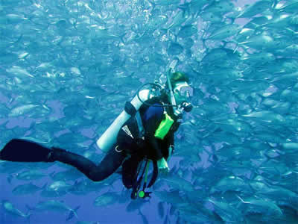
Retrieval Failure
https://www.youtube.com/watch?v=8ubt4zmPyOI
(Context dependent forgetting – Godden & Baddeley)
http://estream.godalming.ac.uk/View.aspx?ID=1052~4i~hewCA9j8&from=AuthSuccess
(State-dependent forgetting – Mindfield – 11mins20secs – 17 mins30secs

Slide 33
Independent study task…
Research the following using either your textbook or the internet and write it up in your notes:
What is mean by context dependent forgetting?
What is meant by state-dependent forgetting?
Describe the procedure and findings of 1 piece research evidence to support both context dependent forgetting and state dependent forgetting.
4) Outline 1 strength and 1 limitation with each study.
In your notes try and use the following format:
‘Godden & Baddeley (1975)….. found that….. This supports the theory of Cue Dependent forgetting, because…... One strength of this study is……..this means that………One weakness of this study is……….this means that…………

Slide 34
Practical Applications Retrieval Failure
How could you use this theory to help patients with dementia?
How could you use this theory to help eyewitnesses recall events?

Slide 35
Practical Applications
Helping Patients with Dementia??
http://news.bbc.co.uk/1/hi/england/7870132.stm
Improving Eyewitness Testimony
The Cognitive Interview – See later notes

Slide 36
Additional Limitations
Problems with Context Effects Baddeley (1997) argues context effects are actually not as strong in real life. It would be hard to find an environment as different from land as underwater.
Recall versus Recognition Godden & Baddeley (1980) replicated their underwater experiment, but used a recognition test instead of recall. When recognition was tested, there was no context-dependent effect.
Problems with the Encoding Specificity Principle
The Encoding Specificity Principle is not testable.
See Pages 14-15 in Booklet for more detail.

Slide 37
Application Question
Caleb saw a film about Zombies a while ago, and went to see a different one recently. A friend, Ashton, asked him some questions about the first film, but Caleb found he had trouble recalling the details accurately. A second friend, Mark, then joined in and wanted to know about the recent film Caleb had seen. But again, Caleb seemed to forget some parts of it.
Outline the Interference theory of forgetting, referring to Caleb’s experience in your answer.

Slide 38
Application Question
Answer the ‘Apply it - A Sticky Problem’ Questions on p57 of AQA Psychology – Cara Flanagan

