Slide 1
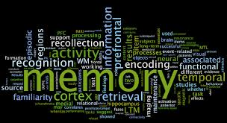
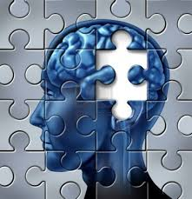
Memory

Slide 2
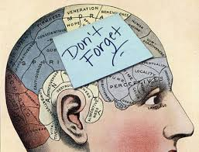
Memory overview:
The Multi-store model, including SR, STM & LTM; Coding, Capacity & Duration
Types of Long Term Memory – Episodic, Semantic & Procedural
The Working Memory Model
Explanations for Forgetting – Proactive & Retroactive Interference; Retrieval Failure
Eyewitness Testimony – Leading Questions, Post Event Discussion & Anxiety
Improving the Accuracy of EWT – Cognitive Interview

Slide 3
Discussion questions
What information do you tend to remember?
What information do you tend to forget?
Can you explain these differences?
Have you heard of different types of memories?
Why is memory so important?

Slide 4
Sensory Register, Short Term Memory & Long Term Memory
Sensory Register (SR)
Short term memory (STM)
Long term memory (LTM)
These differ in terms of:
Coding
Capacity
Duration

Slide 5
Sensory Register, Short Term Memory & Long Term Memory
 | What does this mean? | Sensory Memory | Short term memory | Long term memory
Coding
Capacity
Duration

Slide 6
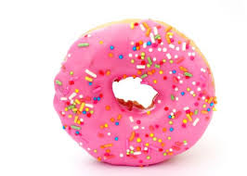
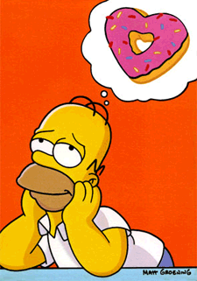
“Coding”
How the information gets into the memory – the format or code it needs to be in
You could encode the information visually e.g. think of an image of a doughnut
You could encode the information acoustically e.g. repeating doughnut over & over (doughnut, doughnut, doughnut…)
You could encode the information semantically (by meaning) e.g. think about Homer Simpson’s favourite food

Slide 7
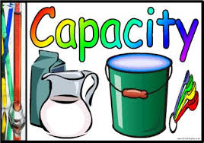
“Capacity”
How much information can fit into the memory

Slide 8
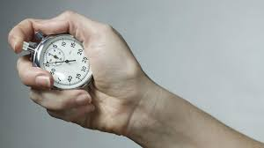
“Duration”
How long the information stays in the memory

Slide 9
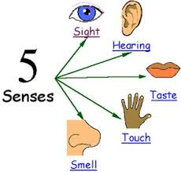
Sensory Memory
You will see a grid of letters that will flash up on screen very briefly.
Try to recall as many letters from the grid as possible.

Slide 10
X H S M
L V G W
R K C B

Slide 11
Sensory Memory
Try and recall as many letters you saw

Slide 12
Sensory Memory
X H S M
L V G W
R K C B
If you managed to recall any of the letters this is evidence that there is a brief memory store than can hold information after only fractions of a second

Slide 13
Sensory Register
Capacity: Sperling (1960):
Presented a grid of letters for less than a second
People recalled on average 4 letters
Coding: Crowder (1993)
Supports idea of SR being coded into several stores – Echoic store for auditory Information & Iconic store for visual information
Duration: Walsh & Thompson (1978)
Iconic Store has a duration of 500 milliseconds

Slide 14
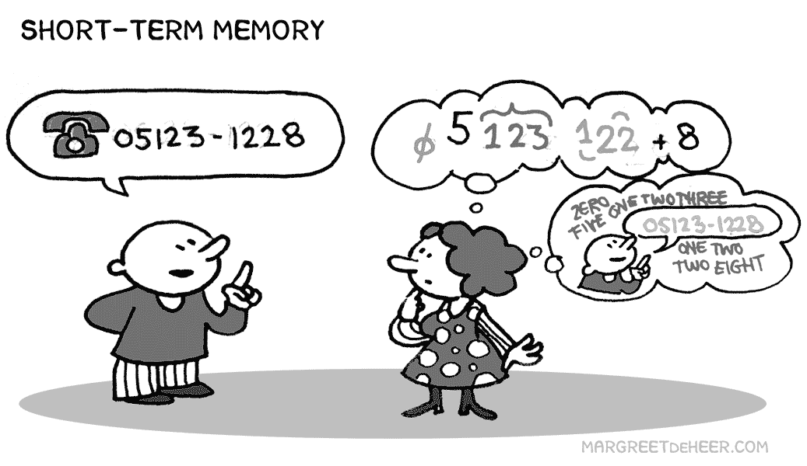
STM Capacity
You will see a list of numbers. Once complete, try and recall as many as possible in the correct order:

Slide 15
7

Slide 16
9

Slide 17
3

Slide 18
5

Slide 19
8

Slide 20
1

Slide 21
2

Slide 22
4

Slide 23
0

Slide 24
6

Slide 25
STM Capacity
How many could you successfully recall?
The numbers were: 7,9,3,5,8,1,2,4,0,6
Psychologists would predict your STM reaches its capacity (i.e. it is ‘full’) at around 7 items
Miller (1956) STM capacity = 7 + / - 2 items

Slide 26
STM Capacity
However, try and remember the following in order:
1,0,6,6,1,9,3,9,1,9,5,2,2,0,1,0
Difficult? Information retained can be increased by ‘chunking’ – packaging this information into larger items or units.
Therefore the previous list can become…
1066, 1939, 1952, 2010
Though STM can still only retain 7 +/- 2 of these ‘chunks’

Slide 27
STM Duration
If capacity is limited, duration, by nature, should also be limited.
Peterson & Peterson (1959) tested the duration of STM with the following experiment:

Slide 28
Instructions
You will see a series of ‘trigrams’ (3 consonants that do not form a word) after this has been presented you will be given an interference task of counting backwards in 3’s from a given number. You will then have to recall the trigram.

Slide 29
BHJ

Slide 30
Count backwards in 3’s from
762

Slide 31
What was the trigram?
BHJ
Next one…

Slide 32
GFQ

Slide 33
Count backwards in 3’s from
939

Slide 34
What was the trigram?
GFQ
Next one…

Slide 35
KVP

Slide 36
Count backwards in 3’s from
240

Slide 37
What was the trigram?
KVP
Next one…

Slide 38
TZW

Slide 39
YJK

Slide 40
Count backwards in 3’s from
772

Slide 41
What was the trigram?
YJK

Slide 42
STM Duration
Peterson & Peterson found that after 18 seconds the percentage of correctly recalled trigrams falls to 10%
Why was an interference task needed?
This research suggests STM duration is around 18 seconds or less.

Slide 43
STM Coding
Coding is the process that changes the sensory input into a form or code to be processed by the memory system
There are three possible modalities:
Visual
Acoustic
Semantic

Slide 44
STM Coding
We shall investigate the process of encoding used by STM
Replicating an experiment by Conrad (1964) you will see a series of letters that you will have to recall.

Slide 45
L

Slide 46
Z

Slide 47
K

Slide 48
F

Slide 49
X

Slide 50
H

Slide 51
W

Slide 52
STM Coding
The list was: L,Z,K,F,X,H,W
How did you recall this information?
Visually? – Did you ‘see’ the letters as stored in memory?
Acoustically? – Did you ‘hear’ the stored information?
Semantically? – Did you remember the letters because of their associated meaning?
The previous experiment will now be repeated using different letters

Slide 53
P

Slide 54
C

Slide 55
V

Slide 56
T

Slide 57
G

Slide 58
B

Slide 59
D

Slide 60
STM Coding
The letters in this list were: P,C,V,T,G,B,D
Was the second list harder to recall than the first?
The letters in the second list were acoustically similar. Conrad (1964) demonstrated that participants found it harder to recall a series of letters that were acoustically similar.
This provides evidence that STM utilises acoustic coding.

Slide 61
Short Term Memory
Duration: Peterson & Peterson (1959)
Approx 18 secs
Capacity: Miller (1956)
7 +/- 2 items
Encoding: Conrad (1964)
Acoustic (i.e. based on sound)

Slide 62
Long term memory
Duration: Bahrick et al (1975)
Can last many years, although loss is fast to begin with and then loss slows down
Tested US graduates and showed them classmates photos years later. Found 90% accuracy for remembering faces and names 34 years after graduation.
Capacity: Wagenaar (1986)
Enormous - maybe infinite as studied through recall of diary of events over 6 years

Slide 63
Long term Memory
Coding: Baddeley (1966)
Gave participants 2 lists to recall:
List A: similar meaning words (eg great, big, huge)
List B: non-similar meaning words (eg run, easy, bright)
20 mins after seeing the words, list B was recalled better than list A
Why?
Long-term memory uses a semantic code (ie codes according to the meaning)
Words in List A mean something similar and therefore cause confusion and are recalled more poorly

Slide 64
Research Studies
Coding
Conrad (1964) – STM
Baddeley (1966) - LTM
Capacity
Miller (1956) – STM
Wagenaar (1986) - LTM
Duration
Peterson & Peterson (1959) - STM
Bahrick et al (1975) - LTM
For each of the studies above summarise (in your own words!) the procedure, findings, conclusion and 2 evaluation points. Use your memory Booklet p 2-5

Slide 65
Research Studies
Coding
Baddeley (1966) - LTM
Duration
Peterson & Peterson (1959) - STM
Bahrick et al (1975) - LTM
For each of the studies above identify:
The IV
The DV
EV’s
For each of the above write a directional and non-directional hypothesis

Slide 66
Recap
Exam Question:
Outline one research study into the duration of short term memory. In your answer include what the researchers did and what they found out. (4 marks)

Slide 67
Multi-Store Model of Memory
Atkinson & Shiffrin (1968)

Slide 69
Lab Experiment Primacy and Recency Effect The Serial Position Curve
Task
A list of 18 words will be read out to you.
You must remember as many as possible but you must not write them down!
Immediately after the list has been read out, you will be asked to write down as many words as possible in any order

Slide 70
Questions
Construct a graph of the pooled class data – what does it show?
How could these results be used to support the multi-store model of memory?
Identify a) the IV
b) the DV
What was the experimental design used in this experiment?
Identify any extraneous variable that may have affected the results.

Slide 71
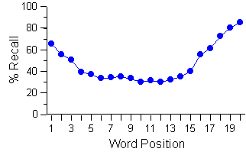
The “serial position effect”: (Glanzer & Cunitz, ’66)
“PRIMACY EFFECT”:
these words were the first heard- they’ve been rehearsed, so we can recall them from our LTM
“RECENCY EFFECT”:
these words are the most recently heard - so we can recall them as they’re still in our STM

Slide 72
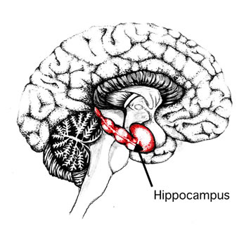
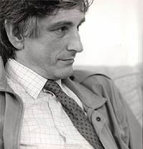
Case Study Evidence
Several cases of patients who have suffered brain damage to their hippocampus & have memory deficits:
H.M.
Clive Wearing
K.F
E.g. H.M. has good LTM before his accident but cant transfer new information from STM to LTM

Slide 73
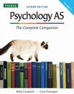
Evaluation Multi-Store Model
Task
Use the textbook to identify 2 additional strengths and 2 weaknesses of the multi-store model
Eye Book p90-91
Or
Cat Book p10-11

Slide 74
Evaluation Multi-Store Model
Strengths
Experimental evidence – primacy and recency effect
Evidence from brain damaged patients for distinction from STM and LTM e.g. good LTM for events before accident, but cannot transfer new memories from STM to LTM e.g. Case Studies - Clive Wearing
Practical applications of primacy/recency effect e.g. teaching, adverts
Weaknesses
Experimental research is artificial – lacks ecological validity
Model is too rigid and simplistic. Memory is more complex (see working memory notes)
Coding processes not fully explained – how it changes information from acoustic in STM to semantic in LTM
Maintenance rehearsal not always necessary to transfer information to LTM – meaningfulness of information may be more important

Slide 75
Application Question
An experiment was carried out to investigate the duration of STM. Two groups of participants were given a list of words to learn. Both groups were given 30 seconds to do this. Group A had to recall as many words as they could after a 6 second delay. Group B was given a 20 second delay.
Identify the independent and dependent variables in this study. (2 marks)
Identify the experimental design used in this study. (1 mark)
The researcher wanted to find the average number of words recalled for each group. What would be the most appropriate measure to use? Justify your answer. (2 marks)
The experimenter found that Group B recalled fewer words than Group A. Does this support the MSM? Explain why or why not. (3 marks)

Slide 76
Application Question
Two students were chatting about their forthcoming exams. They were not Psychology students or they would have know better!
The first student said “I always learn stuff by just repeating it over and over to myself until I remember it”.
“Yes I agree” replied the second student. “It’s by far the best way to revise, no question”.
Use the multi-store model to explain the comments made by the two students.

Slide 77
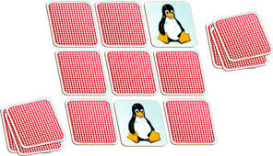
Application Question
Pelmanism is a card game where cards are in pairs. You shuffle them and then put them face down on the table. The first player turns two cards over. If they match, the pair is theirs and they have another go. If they don’t match, turn them back over and try to remember where they are for your next turn.
Explain why it is a test of STM capacity and duration.

Slide 78
The Man with a 7 second memory:
http://estream.godalming.ac.uk/View.aspx?ID=560~3y~HplSbS

