Slide 1
Working Memory Model
Annotate your own notes from GOL Tutorial

Slide 2
Why do we need another model of memory?
One key criticism of MSM is it is too simplistic.
Baddeley & Hitch developed the idea of the STM. Instead of just being a brief store for information they suggested it actively processed information and decided what to do with it - hence ‘Working’ Memory.
Components differ in terms of capacity & coding

Slide 3

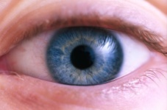
Working Memory Model
Central Executive
Visuo-Spatial Sketchpad
Phonological loop
Episodic buffer
Visual
Episodic
Language
Long-Term memory

Slide 4
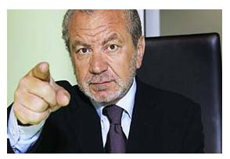
Central Executive
Decides what information to attend to.
Organises the ‘slave’ systems.
It has a limited capacity and deals with demanding cognitive tasks

Slide 5
Phonological Loop
This deals with auditory information – coding is acoustic
Phonological Store: (Inner Ear) stores the words you hear
Articulatory Process (inner voice) allows maintenance rehearsal (repeating sounds in a loop to keep them in WM). The capacity of this loop is approx 2 seconds worth of what you can say

Slide 6

Visuo-Spatial Sketchpad
Stores and rehearses visual and spatial information – coding is visual
Limited capacity – Baddeley (2003) argued it was 3-4 objects

Slide 7

Episodic Buffer
Added to model by Baddeley in 2000
Temporary store for information, integrating visual, spatial & verbal information – visual & acoustic coding
It is the storage component of the central executive and has a limited capacity of approx. 4 chunks (Baddeley, 2012)
The episodic buffer links WM to LTM

Slide 8
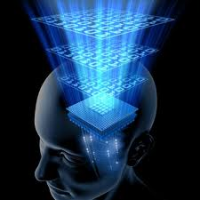
Working Memory Model
http://www.youtube.com/watch?v=rmAZPBHyW2g
http://www.youtube.com/watch?v=mT0NLihOK30

Slide 9
Activity
Count the total number of windows in your house
How did you do it? Which of the ‘slave systems’ did you use to perform that task?
Both – Episodic Buffer

Slide 10
Is there any evidence to support the WMM? Try these…
Work in 2/3s. Do both activities within a task at the same time. The other person times how long the tasks take.
Task One
  Draw a picture of snowman
  Hum the tune to ‘Rudolph the Red Nose Reindeer’
Task Two
  Draw a picture of a flower in a pot
  Trace the letters of your name using your finger
Task Three
  Say la,la,la,la,la repeatedly for 30 seconds
  Tap out the tune to ‘Happy Birthday’ on the desk

Slide 11
What did you find…?
Which tasks were easier to do?
Why do you think some tasks more difficult?
How would the WMM account for why some tasks were easy and some tasks were difficult?
- Slave systems are overloaded

Slide 12
Evaluation: Positive
Dual Task Experiments - Baddeley et al (1975)
Clinical Evidence - Shallice & Warrington (1972) KF’s Long-term memory was intact, however his short term memory for auditory letters or digits was much worse than for visual stimuli, suggesting there are different parts of the STM.
STM is explained in more depth than in the MSM
The idea that we are able to process visual and sound information together has face validity
WMM views memory as an active process, whereas the MSM views it as a passive process

Slide 13
Evaluation: Negative
Lack of clarity over Central Executive - Very little explanation of the role, capacity, abilities of this component
Problems with Supporting Evidence – e.g. Experimental evidence predominately lab based – therefore may lack ecological validity
Further research needed to clarify the exact role of each component
Does not explain how information moves into a Long Term store
Very conceptual model therefore difficult to disprove as it is very difficult to test the existence of the components

Slide 14

Summary – Models of Memory
Include:
Duration , capacity & coding in SR, STM & LTM (including research studies)
Multi-store Model
Types of Long Term Memory
Working Memory Model
Include description (AO1) and evaluation (AO3)
Use format of your choice e.g. mind map.
One side of A3

