Slide 1
Eyewitness Testimony

Slide 2
Recap
Exam Questions:
Explain Retrieval Failure as an Explanation of Forgetting (4 marks)
Describe one study in which interference as an explanation of forgetting was investigated. Indicate in your answer the method used and the results obtained. (6 marks)

Slide 3
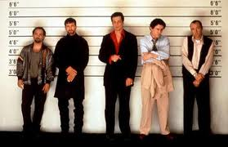
Eyewitness Testimony
http://www.youtube.com/watch?v=v_QbTX2qS10
Would you make a good eyewitness?
What factors might affect the reliability of eyewitness testimony?
What ethical issues were present in this study?
Could you identify the murderer?

Slide 4
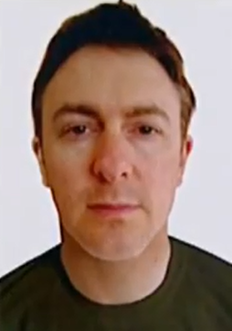
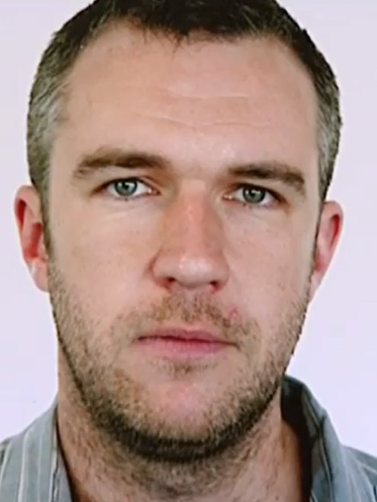
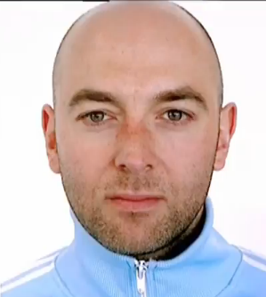
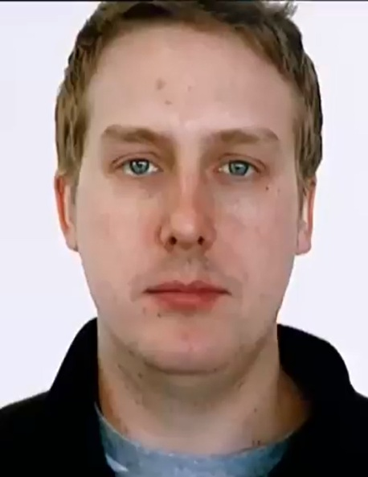
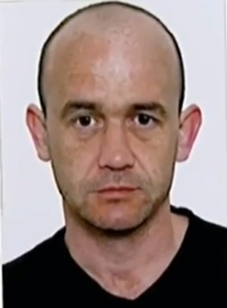
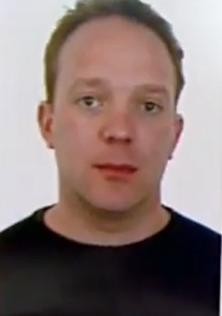
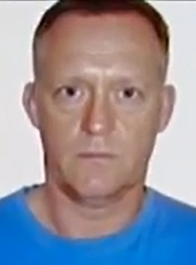
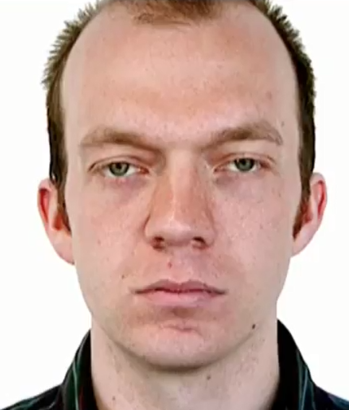
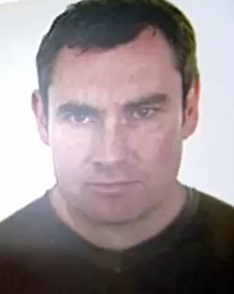
1 2 3 4 5
Do you recognise anyone. What part did they play? http://www.youtube.com/watch?v=VZhcp6dOKds http://www.youtube.com/watch?v=7JlzeUh5rts
6 7 8 9 10

Slide 5
Research into EWT
UNRELIABLE
Anxiety – Weapon Focus
Leading Questions and Post Event Discussion
RELIABLE
Anxiety - Real Life Events
Cognitive interview

Slide 6
Eyewitness Testimony
Eyewitness testimony (EWT)
Factors affecting the accuracy of EWT – Misleading Questions

Slide 7
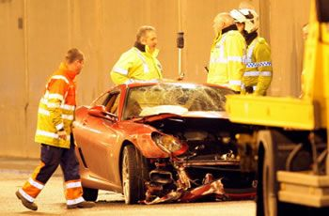
Watch the following clip then answer the questions on the sheet you have been given

Slide 8
Misleading post event information
Loftus and Palmer (1974) showed that information given after an event supplemented or changed recollection.

Slide 9
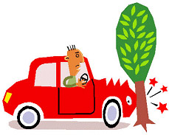
Leading questions
Can you give me an example of a leading question?
Why might this type of questioning be a problem for eye witness testimony?
Loftus found that the choice of words in questions altered the recollection
Bumped vs smashed

Slide 10
Loftus and Palmer (1974)
P’s shown film of a car accident
Asked “How fast were the cars going when they hit each other?”
I.V = Everyone asked same type of question but the word ‘hit’ was replaced with:
‘Collided’
‘Smashed’
‘Bumped’
‘Contacted’

Slide 11
Loftus and Palmer (1974)
What experimental design do you think they used?
What do you think they found?

Slide 12
Loftus and Palmer (1974)
‘Smashed’ produced highest estimate – 40.8 mph
‘Contacted’ produced lowest estimate

Slide 13
Loftus and Palmer (1974)
Evaluation
What do these findings tell us about the reliability of eye witness testimony? (implications/Conclusions)
What is good/bad about using video clips to study EWT?

Slide 14
Video clip 1 (9:20 – 12:10)
What was the name of the newspaper seen in the clip?
What is the name of the female bartender?
How old is she?
How many people were playing the quiz machine?
How many youths were wearing hoodies at the start of the clip?
Did you see the dog in the pub?
What drink did officer Angel order?

Slide 15
Video clip 2 (1:37 – 1:41) http://estream.godalming.ac.uk/View.aspx?ID=3227~4o~oqjUKpy9&from=AuthSuccess
How many policemen were wearing helmets?
What time was shown on the CCTV camera?
What was ‘Trolley boys’ real name?
Over which eye did he have a plaster?
Where did this scene take place?
What did the female police officer use to hit the other woman?
What items were thrown at the policemen out of baskets at the end of the clip?

Slide 16
Video clip 1 (9:20 – 12:10)
What was the name of the newspaper seen in the clip? Sandford citizen
What is the name of the female bartender? Mary
How old is she? 53
How many people were playing the quiz machine? None - there wasn’t one there! (misleading question)
How many youths were wearing hoodies at the start of the clip? 6
Did you see the dog in the pub? There wasn’t one (misleading question)
What drink did officer Angel order? Cranberry juice

Slide 17
Video clip 2 (1:37 – 1:41)
How many policemen were wearing helmets? 4
What time was shown on the CCTV camera? 10:50
What was ‘Trolley boys’ real name? Michael
Over which eye did he have a plaster? right
Where did this scene take place? Somerfield
What did the female police officer use to hit the other woman? Slippery surface sign
What items were thrown at the policemen out of baskets at the end of the clip? Fruit

Slide 18
EWT Studies
Complete ‘Research into EWT’ handout using the references provided.
Description of Research
Include Procedure and Findings
Evaluation of Research
Include 2 strengths and 2 limitations
(NOT Cognitive Interview)

Slide 19
Evaluation of EWT Studies
For your study:
Identify strengths and weaknesses
Consider:
Research Method
Experimental design
Sample
Date of research
Practical applications i.e. could the police/courts use this information?

Slide 20
Application Question
Clifasefi et al (2013) gave participants a document that claimed to be a personalised food and drink profile. This was supposedly put together by powerful computer software based on the participants earlier responses to a questionnaire. For one group their profiles included the false information that they had once, under the age of 16, drunk so much alcohol they were sick. Later participants completed a memory test in which a leading question asked when they had become sick from drinking too much alcohol. The researchers found that a significant number of participants ‘recalled’ being sick due to drinking too much alcohol before the age of 16.
Using your knowledge of the effects of misleading information, explain the findings from the study.

Slide 21
Application Question
Answer the ‘Apply it-Labrynth of Horror’ Questions on p 61 AQA Psychology – Cara Flanagan

Slide 22
Video - EWT
http://estream.godalming.ac.uk/View.aspx?ID=5643~4s~tetezAqi

