Slide 1
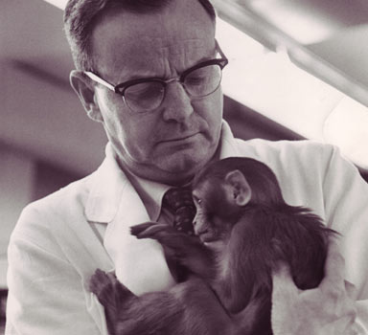
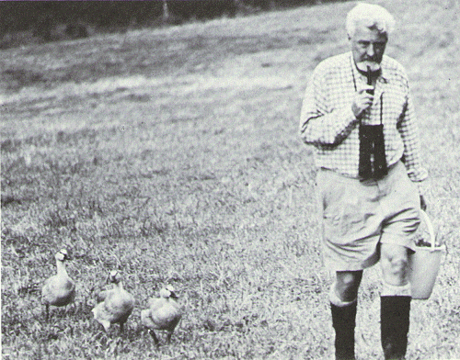
Animal Studies of Attachment https://www.youtube.com/watch?v=Ui9th4nhvoY (Fly Away Home Trailer)
Animal studies are those carried out on non-human animal species rather than humans, either for ethical or practical reasons
Imprinting – a form of attachment where offspring follow the first large moving object they see

Slide 2
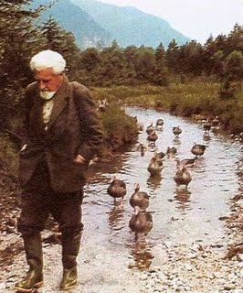
Lorenz (1935): Imprinting
Procedure:
Lorenz carried out an experiment with grey lag geese.
He set TWO experimental conditions.
CONDITION 1: Eggs were kept in an incubator and Lorenz was the first moving object seen by the goose chicks after they hatched
CONDITION 2: Eggs were placed with the mother and allowed to hatch naturally. The mother goose was the first moving object seen by the chicks after they hatched

Slide 3
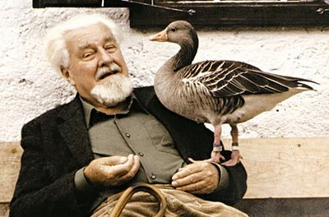
Lorenz (1935): Imprinting
Findings:
The chicks who saw him before anything else, followed him as if he was their mother. When they were adult, they performed mating displays to him, and ignored other geese.
The chicks who saw their mother first, followed her when young, and performed mating rituals to other geese in adult life.
Lorenz also found that goose chicks seemed to have a ‘CRITICAL PERIOD’ of just a few hours in which to imprint (form an attachment).
Lorenz suggested imprinting was innate and If they didn’t imprint within the critical period, they never would.
http://estream.godalming.ac.uk/View.aspx?ID=1016~4i~hewCA5jc
http://www.youtube.com/watch?v=2UIU9XH-mUI

Slide 4
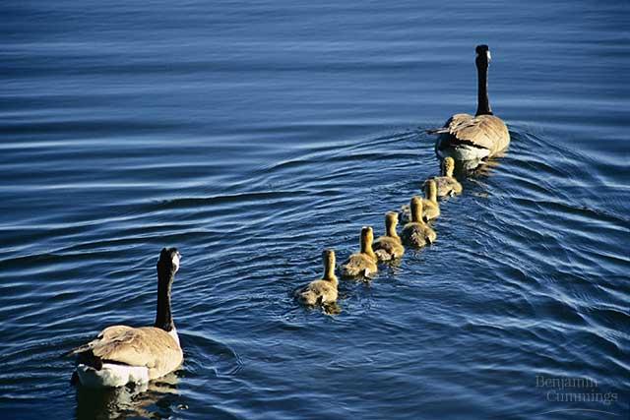
Evaluation: Lorenz Strengths
Supporting Evidence – Guiton (1966) found that chicks who were exposed to a yellow washing up glove for the first few weeks became imprinted on the glove.
The idea of a critical period was developed by Bowlby in his theory of attachment in babies (see later notes)

Slide 5
Evaluation: Lorenz Weaknesses
There is a problem generalising from birds to humans e.g. human behaviour is more influenced by emotions
Guiton (1966) also found that despite the chicks imprinting on yellow gloves, they eventually learned to prefer to mate with chickens and not yellow gloves as Lorenz would have predicted.

Slide 6
Sample Questions
What is meant by the term imprinting? (2 marks)
Outline Lorenz’s animal studies of attachment. In your answer outline what he did and what he found. (4 marks)

Slide 7
Harlow and Harlow (1958) https://www.youtube.com/watch?v=_O60TYAIgC4

Slide 8
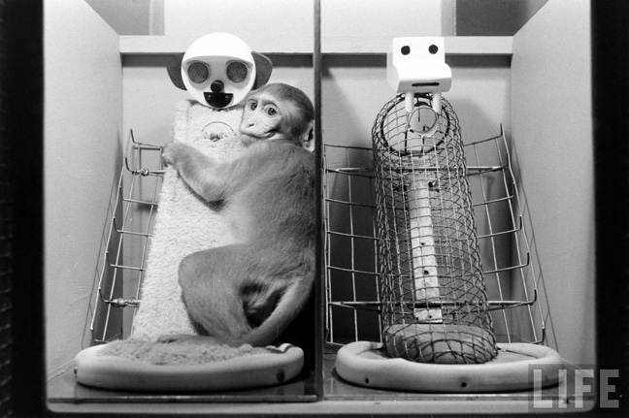
Choice of two mothers

Slide 9
Contact comfort…….

Slide 10
Or food……

Slide 11
They became most attached to the cloth monkey
Also supported idea of critical period – a mother had to be introduced to the infant monkey within 90 days for an attachment to form
The effects of early attachment are long lasting – the motherless monkeys developed abnormally and froze or fled when approached by other monkeys, and were unable to care for their own offspring

Slide 12
Ethical Issues?
Can this research be justified?

Slide 13
Harlow and Harlow (1958)
Use p 4-5 of your blue attachment booklet to summarise:
Aims
Procedure
Findings
2 Strengths
2 Weaknesses

Slide 14
Sample Questions
Describe one study by Harlow related to attachment. (4 marks)
Describe and evaluate animal studies of attachment (12 marks)

