Slide 1
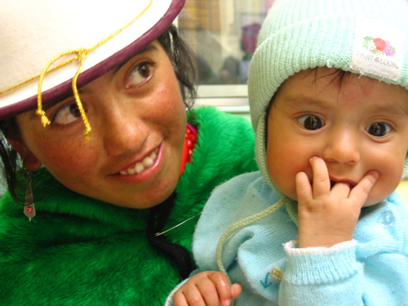
Cross Cultural Differences in Attachment

Slide 2
Ethnocentrism
Ethnocentrism is the tendency to believe that one's ethnic or cultural group is centrally important, and that all other groups are measured in relation to one's own.
In what way could the Strange Situation be seen to be ethnocentric?
  Participants?
  Researchers?
  Conclusions?

Slide 3
Cross Cultural studies of Attachment
Van Ijzendoorn and Kroonenberg (1988)
A meta-analysis of 32 Strange Situation experiments conducted in 8 different countries

Slide 4

Meta-Analysis
Where the researcher looks at the findings from a number of different studies in order to reach a general conclusion.

Slide 5

Van Ijzendoorn and Kroonenberg
Aim:
  To investigate the reported rates of different infant attachment types in a range of cultures

Slide 6
Van Ijzendoorn and Kroonenberg
Procedure
  A meta-analysis of other Strange Situation studies
  All of the selected studies had
    Observed only mother-infant pairs (not fathers or other caregivers
    Classified infants into the 3 attachment types (A, B and C)
  They also excluded any studies
    that looked at children with special needs (such as Down’s syndrome),
    any study with less than 35 mother-baby pairs,
    any study using children older than 2 years
  What was the purpose of these restrictions?

Slide 7
Findings
?

Slide 8
Van Ijzendoorn and Kroonenberg
Evaluation
Sample bias
Ethnocentric definitions of attachment types
Influence of culture –
  Most of the experiments took place in “Westernised” cultures
  Differences in child rearing practices e.g. in German culture, childrearing practice involves keeping a distance between parent and child so infants do not display proximity seeking behaviours
Bigger differences within a culture than between cultures.

Slide 9
Differences within a Culture
There was a one and a half times greater variation within a culture than between a culture. For example:
  One of the German samples was as different from another German sample as it was different from an Israeli kibbutzim or from a US sample
  One of the Japanese samples was more similar to two of the US samples than to the other Japanese sample.
  The Israeli city sample was more like the US than it was to the Israeli kibbutzim sample.

Slide 10
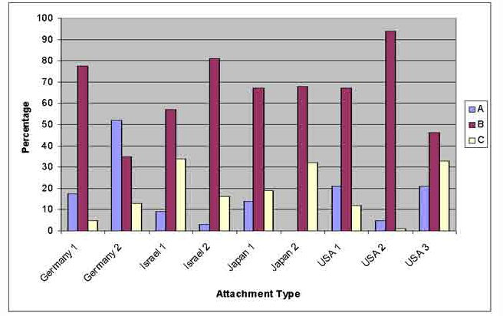
Differences within a Culture

Slide 11

Other Research Studies
Cross cultural similarities e.g. Tronick et al (1992), Fox (1977)
Cross cultural differences e.g. Grossman & Grossman (1991),
Make notes using the Cat Book p44-45 on one study in each category

Slide 12
Sample Question
Outline and evaluate research into cross-cultural variations in attachments.
(12 marks)

