Slide 1
Paper 1:
Developmental Psychology

Slide 2
Unit 1: Developmental Psychology
Attachment
Caregiver-infant interactions in humans: Reciprocity and interactional synchrony, Stages of attachment identified by Schaffer & Multiple attachments and the role of the father
Animal studies of attachment: Harlow & Lorenz
Explanations of attachment, including learning theory, Bowlby’s theory and the concepts of a critical period and an internal working model.
Types of attachment: secure attachment, insecure-avoidant and insecure resistant and the use of the “Strange Situation” in attachment research
Cultural variations in attachment including Van Ijzendoorn and Kroonenberg
Bowlby’s theory of maternal deprivation: Romanian orphan studies and the effects of institutional care.
The influence of early attachment on child and adult relationships including the role of the internal working model

Slide 3
Caregiver-infant interactions in humans
Reciprocity and interactional synchrony
Stages of attachment identified by Schaffer & Multiple attachments
The role of the father

Slide 4
Discuss…
What do you think is meant by the term Attachment in developmental psychology?
Can you think of anything/body you are attached to?
What observable behaviours do you think might indicate whether people are/are not attached?
Why do you think we might make attachments?

Slide 5
Caregiver-infant interactions in humans
Reciprocity and interactional synchrony
Stages of attachment identified by Schaffer & Multiple attachments
The role of the father

Slide 6
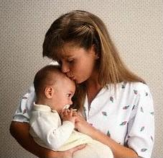
What is an attachment?
  “A strong emotional and reciprocal bond between two people, especially between an infant and its caregiver”

Slide 7
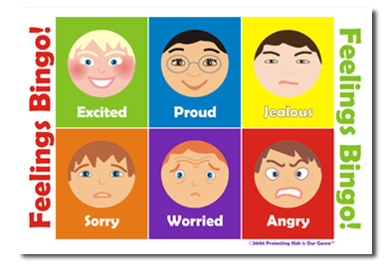
What is a bond?
“A collection of feelings that tie one individual to another”

Slide 8
Attachment behaviours
Seeking proximity: A young baby may watch their caregiver carefully and cry if they move too far away. An older baby may crawl after their attachment figure.
Separation distress: A young infant may show distress when the caregiver leaves the room.
Joy on reunion: Welcome back their attachment figure.
Stranger anxiety: Wariness of those not known to them.
General orientation towards the caregiver: The baby may direct their attention towards their caregiver who will reciprocate

Slide 9
Activity: Using whiteboards
Caregiver-infant interactions in humans. Reciprocity and interactional synchrony
Identify the attachment behaviour being displayed in the following images

Slide 10
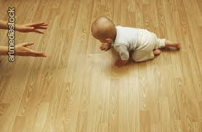

Slide 11
Seeking proximity:

Slide 12
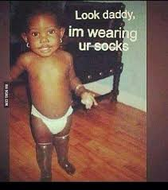

Slide 13
Orientation towards caregiver:

Slide 14
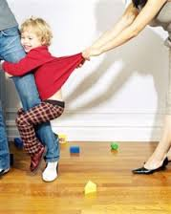

Slide 15
Separation distress:

Slide 16
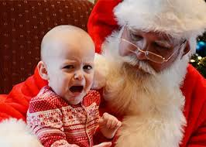

Slide 17
Stranger Anxiety:

Slide 18
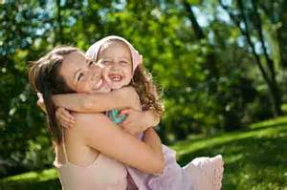

Slide 19
Joy on reunion:

Slide 20
Attachment Recap
Developmental Psychology. Types of Attachments
Define the following terms…WITHOUT NOTES!!
Attachment
Stranger Anxiety
Separation Anxiety
Reunion Behaviour

Slide 21
Attachment Recap
On the mini-whiteboard define the following terms…WITHOUT NOTES!!
Attachment
  A strong emotional and reciprocal bond between an infant and its caregiver which develops over time and through interactions
Attachment Behaviours:
  Stranger Anxiety
    The distress/avoidance behaviours shown when a child is in the presence of a stranger
  Separation Anxiety
    The distress shown when a child is separated from its attachment figure (e.g. Mother)
  Reunion Behaviour
    The behaviour shown when the child and attachment figure (e.g. mother) are reunited

Slide 22

What behaviours are observable in this video clip?

Slide 23
Reciprocity and interactional synchrony - Interaction
Research Task:
Identify what the following terms mean and how they influence attachment between the main caregiver and the infant
Interactional synchrony
Reciprocity
Bodily contact

Slide 24
Application
Much of the research into caregiver-infant interaction has been carried out by the means of observation.
If the observation was video taped , how would this increase the validity of the study (2 Marks).
Explain how could the reliability of the observation be checked. (2 marks)
What would be the benefits of conducting research on interaction in a laboratory. (2 marks)

Slide 25
Evaluation of interaction
Why does the use of observation strengthen the validity of the research into infant-caregiver interaction?
Is there variation in interactional synchrony between different infants?
How can we be sure that the infant imitations of adult signals are conscious and deliberate?

Slide 26
Research by Meltzoff & Moore
Meltzoff & Moore (1977) observed the beginnings of interactional synchrony in infants as young as 2 weeks. An adult displayed one of three facial expressions or one of three distinctive gestures.
The child’s response was filmed and identified by independent observers. An association was found between the expression or gesture the adult had displayed and the actions of the babies.
In a later study Meltzoff & Moore demonstrated the same synchrony with infants only three days old.

Slide 27
Further research
Isabella et.al found that securely attached mother infant pairs had shown more instances of interactional synchrony in the first year of life suggesting that strong emotional attachments are associated with high levels of synchrony.
Heimann showed that infants who demonstrate a lot of imitation from birth onwards have been found to have a better quality of relationship at 3 months. However, it isn’t clear whether the imitation is a cause or an effect of this early synchrony.

Slide 28
Exam Practise
In pairs write an answer to the following question:
Discuss infant-caregiver interactions. Refer to reciprocity and interactional synchrony in your answer (12 marks AS, 16 marks A level).
Use your notes from class and find evaluation points using the textbooks. Ensure your evaluation points are clear and well elaborated
(you have 25 minutes)

Slide 29
Apply it
Proud father Abdul was talking to his friend, as they were both watching Abdul’s wife, Tasneem, interacting with their baby daughter, Aisha.
“It’s amazing really” said Abdul. “Tasneem smiles, Aisha smiles back. Tasneem moves her head, Aisha moves hers, perfectly in time with each other”
“Yes”, agreed the friend “Its almost as if they are one person”.
With reference to Abdul’s conversation with his friend, outline two features of caregiver interaction ( 4 marks)

Slide 30
Answer: 4 marks
One example of the caregiver interaction shown is when Aisha smiles to Tasneem which is a social releaser as it makes Aisha, the baby more desirable, to be played with, showing secure attachment.
Another example, is imitation as Aisha imitates Tasneem’s behaviour like smiling and moving her head. This causes a close bond between Tasneem and Aisha as they spend longer time together doing the same behaviours.

Slide 31
Caregiver-infant interactions in humans
Reciprocity and interactional synchrony
Stages of attachment identified by Schaffer & Multiple attachments
The role of the father

Slide 32
Stages of attachment identified by Schaffer & Multiple attachments

Slide 33
Research Task
Using your phones:
Research the following study by Schaffer and Emerson Glasgow baby study.
Answer the following questions:
1.How was the study carried out?
2. What did they find?
You have 10 minutes – be ready to feedback

Slide 34

Background
Schaffer and Emerson observed babies for 18 months.
They looked at the interactions between the baby and its carer’s
What sort of interactions were the researchers looking for?

Slide 35
Schaffer’s (1996) stages in the attachment process
Based upon these findings Schaffer proposed a four stage model:
  Stage 1: Asocial phase, 0-8 weeks.
  Stage 2: Indiscriminate attachment phase, 4 months to 6 months
  Stage 3: Specific attachment phase, 7 months onwards.
  Stage 4: Multiple attachment phase, 10/11 months onwards
  In pairs: generate ideas regarding the changes that you think take place at each of these stages of attachment.

Slide 36

The four stages of attachment…
Stage 1:
Up to 3 months old: This phase is known as ‘indiscriminate attachments’
The baby is not predisposed to a particular caregiver
Babies respond equally to all caregivers

Slide 37

After four months…
Stage 2:
Preference for certain people/the beginnings of attachment
Infants learn to distinguish primary and secondary caregivers but accept care from anyone. They do NOT yet display stranger anxiety. This stage is characterised by general sociability (enjoyment of being with people.

Slide 38
After 7 months…
Stage 3:
Specific/discriminate attachment.
The baby looks to particular people for security, comfort and protection.
The baby will show fear of strangers (stranger anxiety) and distress when separated from a special person (separation anxiety).
This is a good thing as it illustrates that an attachment has been formed.

Slide 39
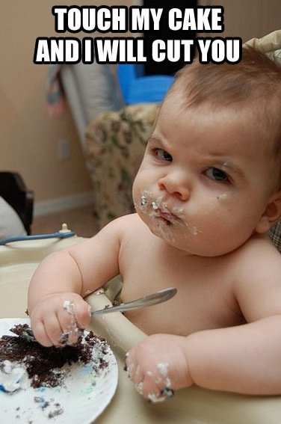

Slide 40
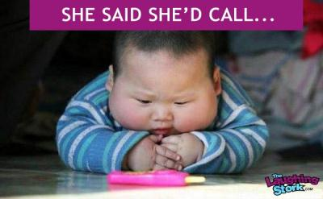
After 9 months
Stage 4:
Multiple attachments
The baby becomes increasingly independent and forms several attachments.

Slide 41
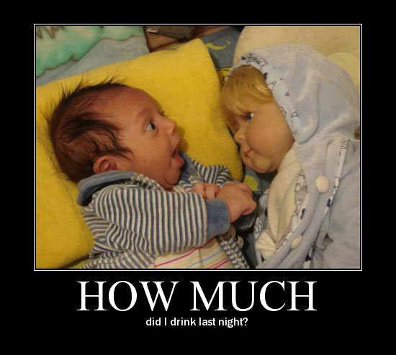
Evaluation

Slide 42
Unreliable data
The data collected by the researchers was based on mothers’ reports of their infants
What is the problem with this and how could it have affected the results?

Slide 43
Out of date research
This study was conducted in the 1960’s
What has changed since this time that could result in this study not being applicable anymore?
If the study was repeated today would we get the same results?

Slide 44
Problems with a stage model
This theory offers four stages to describe the development children go through in their attachments.
But what if, in some cultures, multiple attachments occur before single attachments? Does this make this culture abnormal? Are they bad parents?
The problem is families are judged based on these inflexible stages. If their child's attachment do not follow the stages it could reflect badly on them.

Slide 45
12 mark question planning
Describe and evaluate the stages of attachment identified by Schaffer and Emerson (12 marks)
Description (6 marks) A01
Evaluation (6 marks) A03
Positive | Negative

Slide 46
Caregiver-infant interactions in humans
Reciprocity and interactional synchrony
Stages of attachment identified by Schaffer & Multiple attachments
The role of the father

Slide 47


Preparation Task: The role of the father
Use the following textbooks
p74 of AQA Psychology – Cara Flanagan
P107-108 of AQA endorsed psychology book- Jean Marc-Lawton
Include:
At least two studies that explore the role of the father in attachment.
At least two evaluation points, well elaborated.

Slide 48
Feedback of Preparation Task: The role of the father
Pair / share:
Examine your partners H/W on the role of the father and see if you can gather anymore research or evaluation points to increase the depth/breadth of your work on the role of the father.
Share/ compare your notes with another pair.
Feedback to the group

Slide 49
The role of the father in attachment :
True or False?
Some researchers are interested in the role of the father as secondary attachment figures whereas other psychologists are more concerned with the father as the primary attachment figure.

Slide 50
True or False?
Schaffer & Emerson found that fathers were far more likely than mothers to be the primary attachment figure.

Slide 51
True or False?
Research has suggested that fathers behavioural style (how they interact/behave) with their children is different to that of mothers.

Slide 52
True or False?
Fathers are more likely to engage in comfort and support for the baby whereas mothers are more involved in physical play and taking risks.

Slide 53
True or False?
Lamb et.al has argued that a father’s role in their involvement can be assessed by 3 factors: a) interaction (how much the father engages with the infant); b) accessibility (how physically and emotionally accessible he is) and c) responsibility: the extent to which he takes on caretaking tasks.

Slide 54
True or False?
There is some evidence to suggest that when fathers take on the role of being the primary caregiver they adopt behaviours more typical of mothers.

Slide 55
True or False?
In recent times fathers have spent less time on looking after children.

Slide 56
True or False?
There are cultural variations in the role of the father.

Slide 57
True or False?
Freeman et al found that male children are more likely to prefer their father as an attachment figure than female children.

Slide 58
True or False?
Women are biologically adapted to feed the infant and produce the nurturing hormone oestrogen which may explain the different roles of father and mother.

