Slide 1
Minority Influence: Consistency, Commitment, Flexibility

Slide 2
Minority Influence:
A form of social influence in which a minority of people, or one individual, persuade others to adopt their beliefs, attitudes or behaviours. It leads to internalisation or conversion in which private attitudes are changed as well as public behaviours.

Slide 3
How minorities exert pressure and influence social change
Consistency – minorities exert most influence when consistent as it increases the amount of interest. This may be synchronic consistency (within a group) or diachronic consistency (over time). Consistency makes other people start to rethink their own views.
Moscovici supports consistency as an important process in minority influence

Slide 4
Moscovici et al (1969)
Aim:
To assess whether a minority group could influence the majority in a perception task

Slide 5
Moscovici et al (1969)
Procedure:
Tested in groups of 6
Asked to judge the colour of 36 slides (All were BLUE)
Two conditions: ‘Consistent Minority’ & ‘Inconsistent Minority’
Inconsistent Minority
2 of 6 participants were confederates
In 24 trials they judged the slides to be GREEN. In 12 trails they judged the slides as BLUE
Consistent Minority
2 of 6 participants were confederates
In all trials they judged the slides to be GREEN
A control group had no confederates

Slide 6
Findings:
Consistent condition
Genuine participants judged slides to be GREEN = 8.4% of trials
32% of genuine participants judged a slide to be GREEN at least once
Inconsistent condition
Genuine participants judged slides to be GREEN = 1.3% of trials
Control Group judged slides as GREEN on 0.25% trials

Slide 7
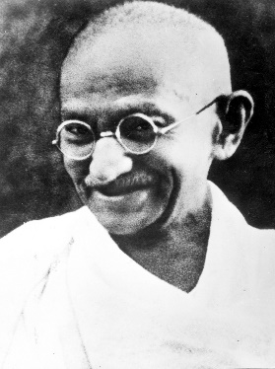
How minorities exert pressure and influence social change
Commitment - leaders of the minority/new movement need to be seen to be sacrificing some aspect of their lifestyle in order to demonstrate the importance of the ideals.
Eg Ghandi, Mandella

Slide 8
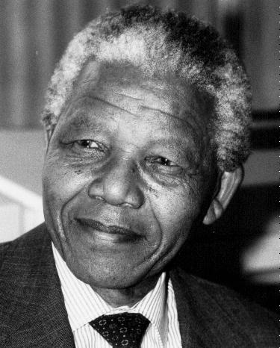
How minorities exert pressure and influence social change
Flexibility - minority groups must not appear to be unbending, rigid and dogmatic. Just repeating a message without reflecting on others beliefs is counterproductive.
Minorities need to adapt their point of view if a reasonable and valid counter argument is raised. They need to balance between consistency and flexibility.

Slide 9
Nemeth (1986)
groups of 3 participants and 1 confederate who had to decide how much compensation to pay the victim of a ski lift accident.
When the confederate argued for a low amount and refused to change his position, he had no effect on the majority.
When however he compromised a little and moved to offering a slightly higher amount, the majority changed their opinion to a lower amount.
This shows how minorities need to be flexible to be persuasive while at the same time questions the importance of consistency.

Slide 10
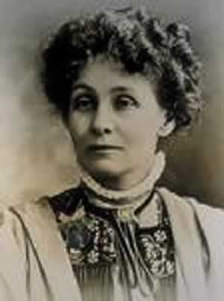
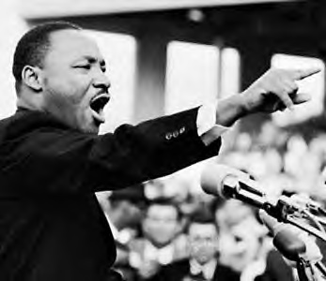
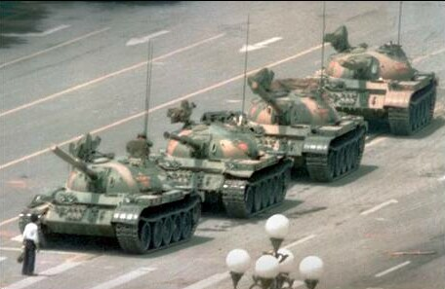
Examples of minority influence

Slide 11
Group poster activity
You will be allocated one of the following examples of minorities who have changed the views of the majority or you could think of your own example:
Martin Luther King
Ghandi
Greenpeace
Nelson Mandella (and the ANC)
The suffragettes (including Emily Pankhurst)
The disability rights movement
Which of the previous processes did they use? -Give examples
What particular events happened over time?

Slide 12
The Role of Social Influence Processes in Social Change
Social Influence is the process by which individuals and groups change each other’s attitudes and behaviours
Social change occurs when whole societies rather than just individuals adopt new attitudes, beliefs and ways of doing things eg gay rights, environmental issues.

Slide 13
The Role of Social Influence Processes in Social Change
At a certain point the minority view becomes the norm and the majority then conform through compliance.
For permanent social change to occur, people conform to the new viewpoint through identification involving a change in their belief systems.
Social change is usually a slow gradual process of cryptoamnesia so that change occurs in a non-disruptive manner to society.
Rapid change would cause conflict within society that could be harmful. A slow process allows new ideas to be carefully considered by the majority of society to ensure they are suitable.

Slide 14
Knowledge gained from conformity research:
Some health campaigns use normative social influence by providing information on what others are doing eg preventing young people from taking up smoking by telling them that most other young people do not smoke.
(+) Nolan et al (2008) hung messages on the front doors of houses in San Diego every week for one month:
The message said most residents were trying to reduce their energy usage. In a control condition, residents had a different message asking them to save energy but made no reference to other people’s behaviour.
Significant decreases in usage were found in the first group showing social change can occur through normative social influence.

Slide 15
Knowledge gained from obedience research
Milgram’s research demonstrates the importance of disobedient role models.
Additionally the process of gradual commitment can be used to create social change by making people obey a small instruction following which it gets harder to resist obeying instructions and people gradually move towards a new kind of behaviour.

