Slide 1
CW | Centripetal Acceleration | 22/06/2016
Write down a simple statement of what Centripetal force is and how its caused. How confident are you with your answer?
Share with your partner
From my learning today I will be able to:
Key: | State how Centripetal Acceleration and Force are caused C/B
Boost: | Calculate values for Centripetal Acceleration and force B/A
Aspire: | Suggest how centripetal force
Objective

Slide 2
Centripetal acceleration (a)
An object moving along a circular path is continually changing in direction. This means that even if it is travelling at a constant speed, v it is also continually changing its velocity. It is therefore undergoing an acceleration, a.
This acceleration is directed towards the centre (centripetal) of the circular path and is given by:
v
v
a
a
r
v
r
a
r
a = v²
r
Notes:
2

Slide 3
v = r ω a = v² / r
Notes:
3

Slide 4
Proof of: a = v² / r
Consider an object moving at constant speed, v from point A to point B along a circular path of radius r.
Over a short time period, δt it covers arc length, δs and sweeps out angle, δθ.
As v = δs / δt then δs = v δt.
The velocity of the object changes in direction by angle δθ as it moves from A to B.
v_{A}
A
B
v_{B}
δθ
C
Notes:
4

Slide 5
The change in velocity, δv
= v_{B} - v_{A}
Which is equivalent to:
δv = v_{B} + (- v_{A})
A
B
δs
v_{B}
r
r
δθ
v_{B}
C
δv
δθ
If δθ is very small then δs can be considered to be a straight line and the shape ABC to be a triangle.
-v_{A}
Triangle ABC will have the same shape as the vector diagram above.
Therefore δv / v_{A (or B)} = δs / r
Notes:
5

Slide 6
but δs = v δt
and so:
δv / v = v δt / r
δv / δt = v² / r
As δt approaches zero, δv / δt will become equal to the instantaneous acceleration, a.
Hence: a = v² / r
In the same direction as δv, towards the centre of the circle.
v_{B}
δv
δθ
-v_{A}
Notes:
6

Slide 7
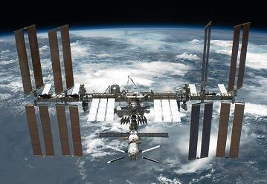

ISS Question
For the International Space Station in orbit about the Earth (ISS) Calculate:
  the centripetal acceleration
  linear speed
Data:
orbital period = 90 minutes
orbital height = 400km
Earth radius = 6400km
A*/A
If the mass of the ISS is 419,455 kg, what force is required to keep it in this orbit?
Notes:
7

Slide 8
ω = 2π / T
= 2 π / (90 x 60 seconds)
= 1.164 x 10⁻³ rads⁻¹
a = r ω²
= (400km + 6400km) x (1.164 x 10⁻³ rads⁻¹)²
= (6.8 x 10⁶ m) x (1.164 x 10⁻³ rads⁻¹)²
centripetal acceleration = 9.21 ms⁻¹
(b) v = r ω
= (6.8 x 10⁶ m) x (1.164 x 10⁻³ rads⁻¹)
linear speed = 7.91 x 10³ ms⁻¹
(7.91 kms⁻¹)
Notes:
8

Slide 9
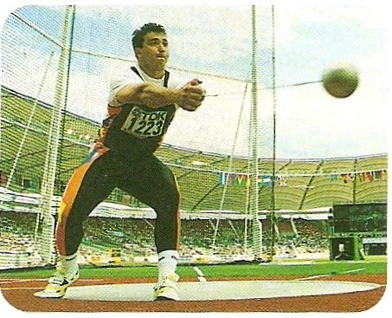
From AS:
Centripetal Force
Therefore centripetal acceleration requires a resultant force directed towards the centre of the circular path to keep it in circular motion– this is CENTRIPETAL FORCE.
Newton’s first law:
An object at rest stays at rest and an object in motion stays in motion with the same speed and in the same direction unless acted upon by a resultant force
Newton’s second law:
The acceleration of an object produced by a resultant force is directly proportional to the magnitude of the net force, in the same direction as the net force
Tension provides the CENTRIPETAL FORCE required by the hammer thrower.

Slide 10
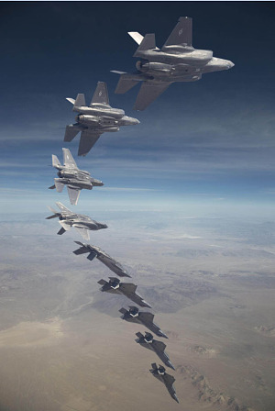
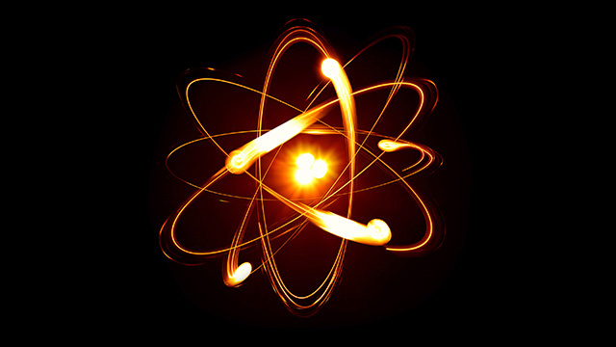
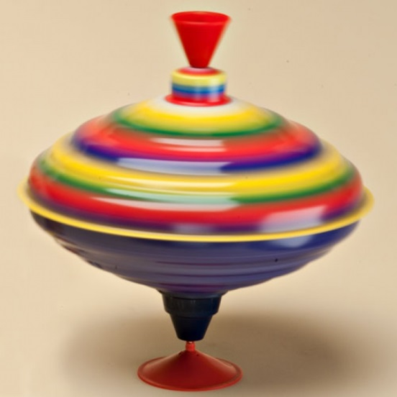
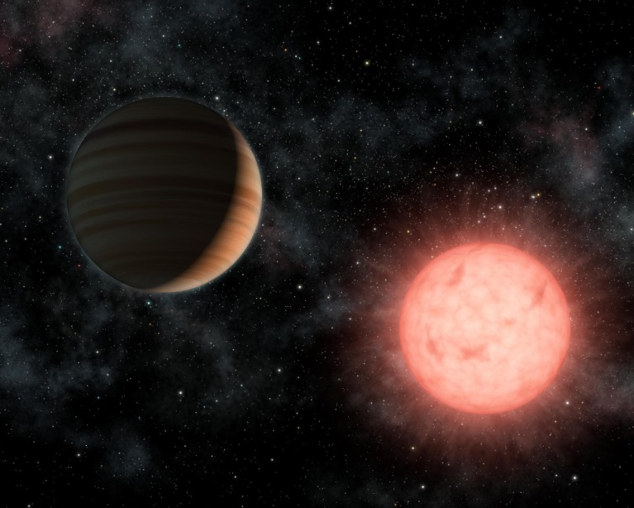
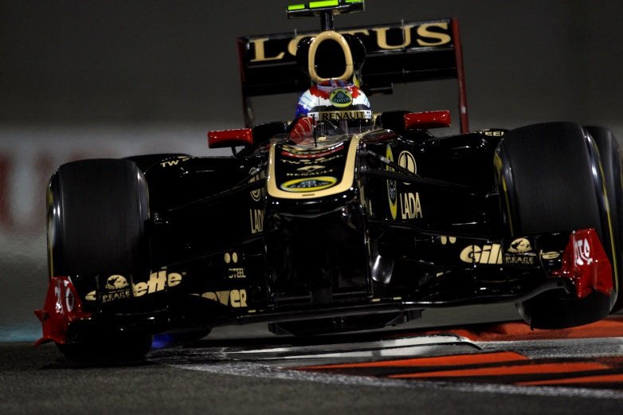
Other examples of centripetal forces

Slide 11
Using your equations, derive an equation for centripetal force
Newton’s first law:
An object at rest stays at rest and an object in motion stays in motion with the same speed and in the same direction unless acted upon by a resultant force
Newton’s second law:
The acceleration of an object produced by a resultant force is directly proportional to the magnitude of the net force, in the same direction as the net force

Slide 12
Equations for centripetal force
From Newton’s 2nd law of motion:
ΣF = ma
If a = centripetal acceleration
then ΣF = centripetal force
and so:
ΣF = m v² / r
ΣF = m r ω²
ΣF = m v ω
Notes:
12

Slide 13
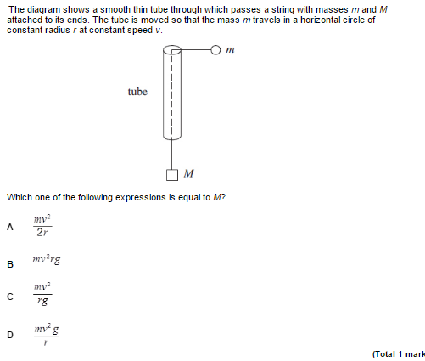
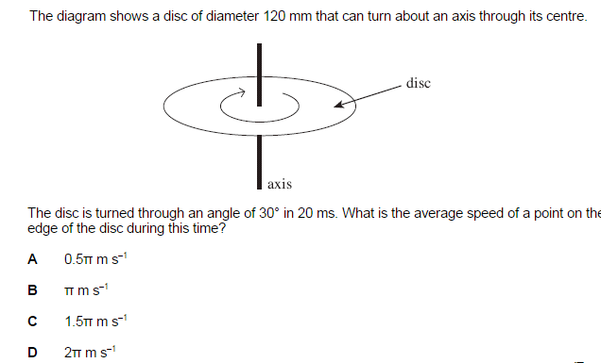
When done complete the Exam Question

Slide 14



Complete Work Sheet
Explain why motion along a circular path implies centripetal acceleration.
State equations showing how centripetal acceleration is related to (a) speed and radius; (b) angular speed and radius.
What is meant by ‘centripetal force’? Give three examples.
State equations showing how centripetal force is related to (a) speed and radius; (b) angular speed and radius.
Calculate the centripetal force acting on a mass of 600g being whirled around a horizontal circle of radius 40cm at (a) a speed of 3.0ms⁻¹ and (b) an angular speed of 4.0 rads⁻¹.
Use the hand out to Derive the equation a = v² / r.

Slide 15
Homework for Next lesson
Read through Page 276 and 277 make notes
Answer questions on page 277
Answer Exam Questions

