Slide 1
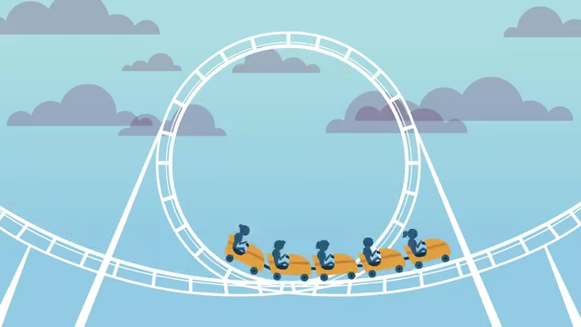
Centripetal Acceleration

Slide 2
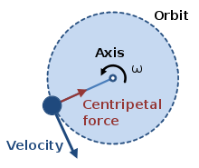
Centripetal acceleration
An object that moves in a circle is constantly changing velocity but not speed.
Its direction component is changing but the magnitude stays the same.
For circular orbits this is due to a constant acceleration towards the centre of the circle. This must be due to a force, perpendicular to the motion, towards the centre of the orbit.

Slide 3
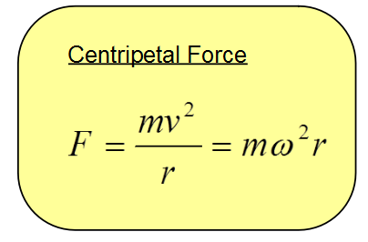
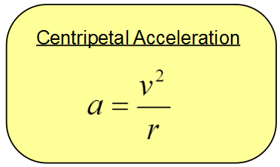
Useful formulae

Slide 4
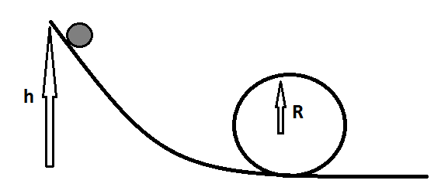
Making a loop-the-loop successfully
Question – If you were to roll a ball down a slope and then attempt a loop-the-loop how high would your initial drop need to be from? (assuming no friction)

Slide 5
Worked example
Assuming a radius of 13cm in the previous question we can equate the centripetal force to be equal to gravity (hence the object will just make it around the loop without leaving the track) (9.81 ms⁻²)
Now we know the speed that the object must travel to perform the loop then mechanics can calculate the height needed:

Slide 6
Summary
Circular orbits do change velocity but not speed (only the direction changes)
This is always due to a centripetal force acting towards the centre of the circle
This is causes a centripetal acceleration towards the centre of the circle

Slide 7
Extension activity
The Earth is about 6400km in radius. How fast does an object have to travel so that its height remains constant above the ground? (i.e. so that its centripetal acceleration is 9.81ms⁻²)
How many times would this object orbit the Earth in a day?
The International Space Station orbits the Earth 16 times / day!

