Slide 1
Relating structure of cells to function
By looking at a cells ultrastucture you should be able to define how that cell is specialised for its function.
In your booklet there are a number of pictures of specialised cells.
Look at its ultrastructure and identify the key features i.e. can it move, is it abundant in certain organelles?
Looking at the key features can you see how structure is related to function i.e. is it secretory?

Slide 2
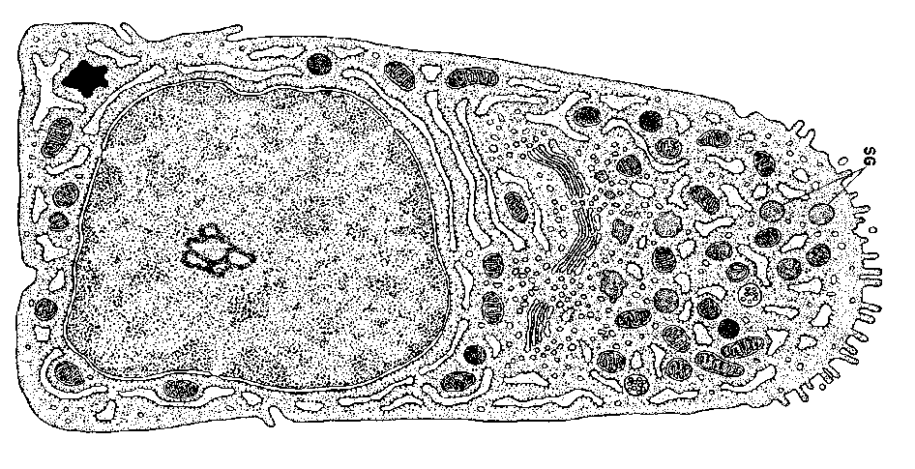
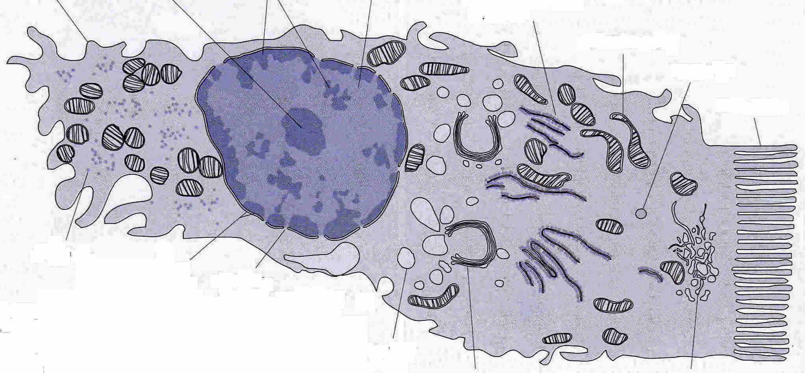
What Can a Cell’s Organelles Suggest About Its Functions?
Two Specialised Cells: eg. Epithelial cells Lining the Intestine
What can you see!
Q Are there large numbers of mitochondria?
Q Is part of the membrane highly folded into microvilli?
Q Are there many vesicles approaching the membrane?
Q Is there a lot of RER?
Q Are there many Golgi bodies and vesicles.

Slide 3
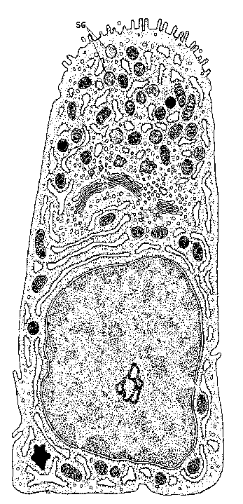
What Can a Cell’s Organelles Suggest About Its Functions?
What can you see!
Q Are there large numbers of mitochondria? If so the cell may be involved in energy consuming processes and need to do much aerobic respiration.
Q Is part of the membrane highly folded into microvilli? This suggests an absorptive function as microvilli provide a large surface area for absorption.
Q Are there many vesicles approaching the membrane? This suggests a secretory activity.
Q Is there a lot of RER? This suggests much protein synthesis so maybe the cell makes a lot of something.
Q Are there many Golgi bodies and vesicles. Again this suggests a secretory function.
Answers

Slide 4
Spermatozoa
Key Features : it has a tail and
contains lots of mitochondria
Small and thin, head contains
an acrosome
Function:
1. Motile so can get to ovum
2. Lots mitochondria as needs energy to propel the cell.
3. Head contains Acrosome which is a specialised lysosome that releases enzymes so sperm cell can penetrate the ovum.
4. Also shape (small and thin) aids movement

Slide 5
Neutrophil
Structure: Lobbed nucleus and lots of lysosomes
Function: They have large amount lysosomes to ingest and destroy invading microorganisms.
Lobed nucleus which allows for greater flexibility to allow it to squeeze between cells

Slide 6
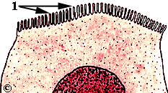
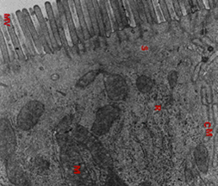
Microvilli
Structure
Microscopic folds in the plasma membrane.
Only found in some types of epithelial cells.
Function
Increase the surface area of cell surface membrane for absorption and secretion of enzymes.
If a cell is absorbing nutrients it requires active transport which requires what????
If a cell is secretory which organelles will it have in large numbers?
10/09/11
12
6

Slide 7
Red Blood Cell
Structure: no nucleus, biconcave
Function: Red blood cells carry oxygen from the lungs to respiring tissues.
Need large amounts of haemoglobin so many of the organelles including the nucleus are not present so more space for haemoglobin.
Shape is biconcave which maximises surface area

Slide 8
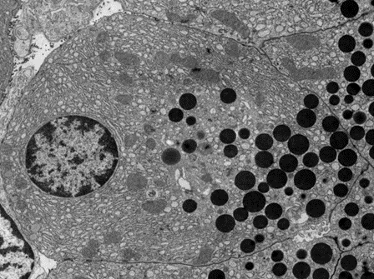
Pancreatic cell
Structure : large numbers of ribososmes, rough endoplasmic reticulum , golgi bodies and vesicles.
Function: Pancreatic cells are secretory cells making large amounts of digestive enzymes therefore they need large numbers of tRNA, and ribososmes lots of rough endoplasmic reticulum to fold the protein, lots of golgi to modify and package the proteins and lots of vesicles for secretion.

Slide 9
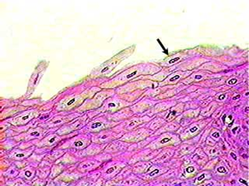
Squamous Epithelium cell
Flat cells that form a single smooth layer that lines tubes where diffusion occurs
large surface area and a small diffusion pathway.
Found in alveoli, some blood vessels

Slide 10
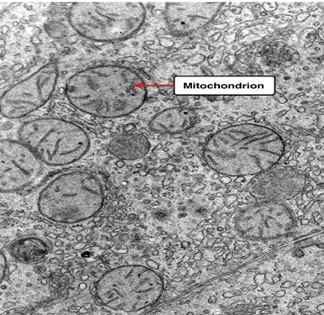
Liver Cell
Structure related to function:
Large amounts of smooth ER as liver cells detoxify products of natural metabolism.
Large amounts of mitochondria as metabollicaly active (main source of heat in our body).
Liver cells also have secretory function can have large number of smooth ER and golgi apparatus.
What other type of cell are metabolically active?
Muscle cells

Slide 11
Exam style question

Slide 12
Answer

Slide 13
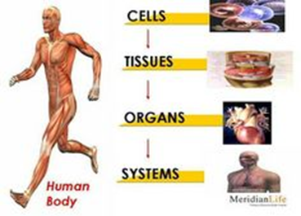
Cell Organisation
https://www.youtube.com/watch?v=i5tR3csCWYo
Crash course To 1.42sec
Multicellular organisms cells are specialised to perform specific functions.
Similar cells are grouped together into tissue,
Tissues are grouped together to form organ, and organs grouped together to form a system

Slide 14
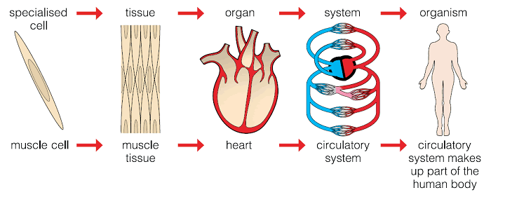
Cellular organisation

Slide 15
How do cells specialise as they all contain the identical genes?
Once an egg is fertilized all cells produced are the product of mitosis so they contain identical genes.
So how do the cells become specialised i.e. different ? …
Only some of the genes are switched on (expressed) in any one cell at any time. i.e a different set of genes is switched on in a neuron compare to an epithelial cell. This is known as differentiation

Slide 16
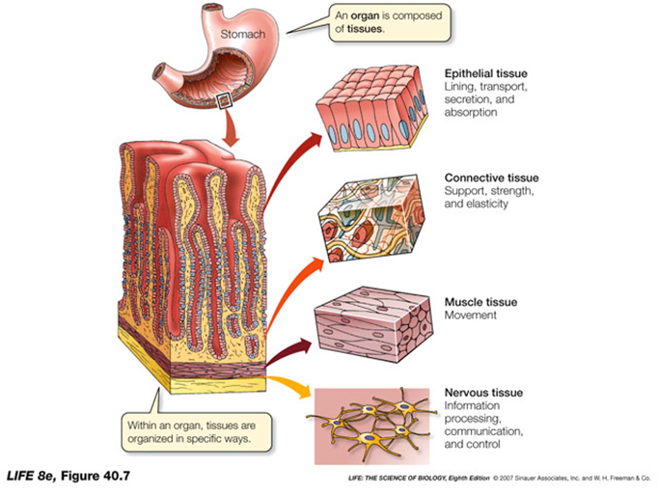
Tissues
Animal cells and plant cells can form tissues, such as muscle tissue in animals.
In animals there are four types of tissues:-
1. Connective,
2. Muscular,
3. Nervous
4. Epithelial - line and cover internal surfaces. Function is protection, secretion, absorption and filtration.
In plants:-
Xylem, phloem, epidermis, meristematic

Slide 17
Epithelial tissue
Type of Epithelial cell | Where it is found, function related to structure
Squamous epithelium | Flat thin cells that line the organs where diffusion takes place e.g. lungs
Ciliated epithelium | Lines ducts such as the trachea. Cilia are used to move mucus over the epithelial surface
Simple columnar epithelial with microvilli | Increases the surface are of the cell by the folding of the plasma membrane. Lines area where absorption/secretion occurs such as the small intestine.

Slide 18
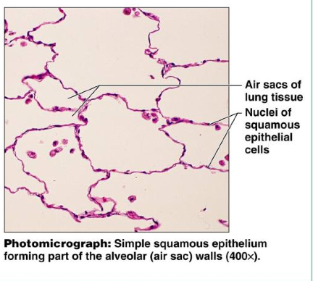
Thin, flattened cells allow easy diffusion of materials

Slide 19
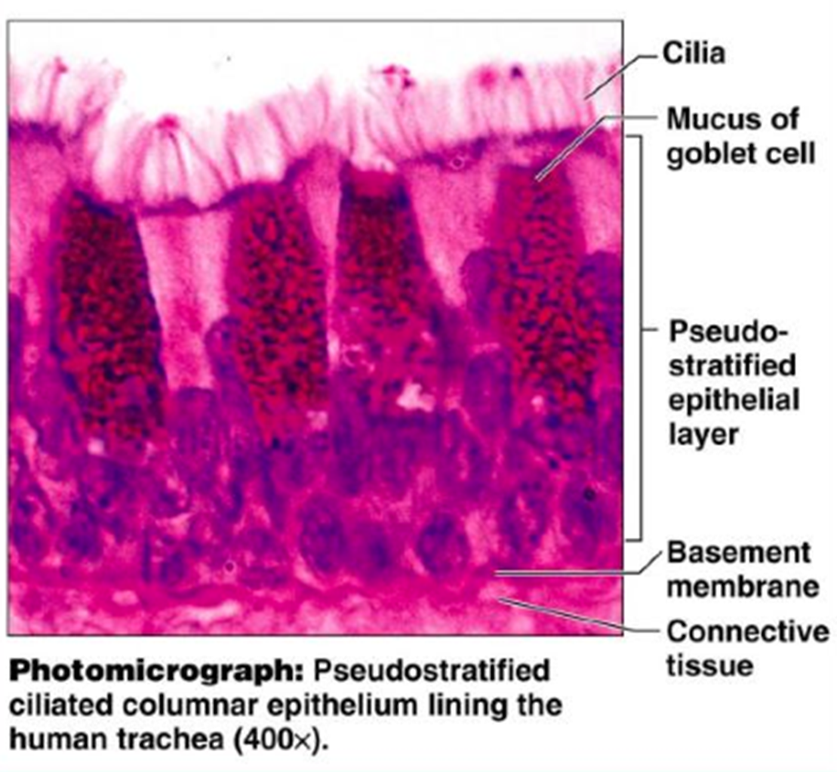
This single layer of tall cells may have cilia to propel the mucus and may contain mucus secreting cells (goblet cell) depending on where the cells are located lining the trachea

Slide 20
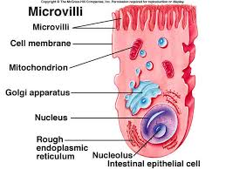
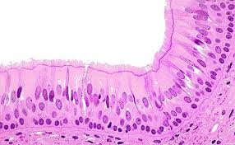
Columnar epithelial cells with microvilli.
Increases surface area of the cell for secretion/absorption

Slide 21
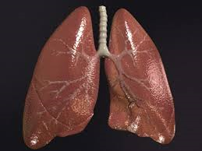
Organ
http://www.bbc.co.uk/education/clips/zyrg9j6
An organ is made from a group of different tissues, which all work together to do a particular job. Here are some examples of organs:
heart
lung
stomach
brain
leaf
root

Slide 22
Stomach is an organ made up of many different types of tissues

Slide 23
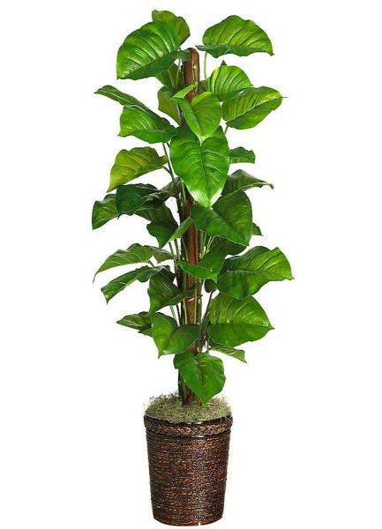
Plant tissues, organs and systems
Examples of plant tissues include:
epidermal tissues, which cover the plant
palisade mesophyll, which carries out photosynthesis
spongy mesophyll, which has air spaces to facilitate diffusion of gases
xylem and phloem, which transport substances around the plant.
Plant organs include stems, roots and leaves.
There are two plant systems- root system and the shoot system

Slide 24
Plant organ – the leaf

Slide 25
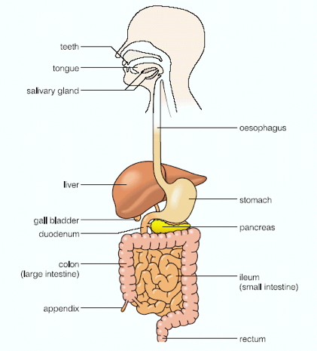
Systems
A System is where a group of organs work together to provide an additional level of organisation e.g the stomach is part of the digestive system
The digestive system is made up of all the organs involved in digestion and absorption of food (includes the small intestine, the large intestine and the liver)
Can you name some other systems? Nervous, reproductive, respiratory,

