Slide 1
Structure of prokaryotic cells and viruses
3.2.1.2

Slide 2
GCSE prior knowledge
A bacterial cell consists of cytoplasm and a membrane surrounded by a cell wall
The genes are not in a distinct nucleus.

Slide 3
Specification
Prokaryotic cells are much smaller than eukaryotic cells.
They also differ from eukaryotic cells in having :-
Cytoplasm that lacks membrane bound organelles
No nucleus-just circular DNA molecule free in cytoplasm
A cell wall that contains murein a glycoprotein
In addition prokaryotes may have one or more plasmids, a capsule surrounding the cell, one or more flagella
Structure of virus particles

Slide 4
https://www.youtube.com/watch?v=qCn92mbWxd4

Slide 5
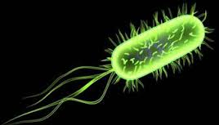
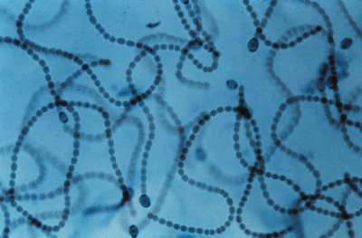
A prokaryotic cells are smaller and simpler
Commonly known as bacteria
0.1-10µm in length
Single-celled(unicellular) or
Filamentous (strings of single cells)
Notes:
filamentous cyanobacteria, those that build chains of cell, utilize a different strategy, that of spatial separation, some cells being involved in nitrogen fixation and others in photosynthesis.

Slide 6
Prokaryotic cells are simply built
They do not have any membrane bound organelles

Slide 7
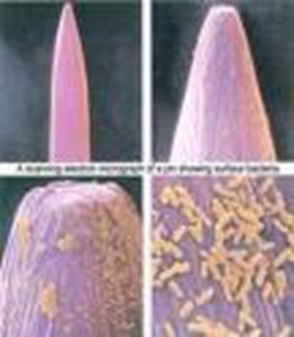
These are prokaryotic bacteria (E.coli) on the head of a steel pin

Slide 8
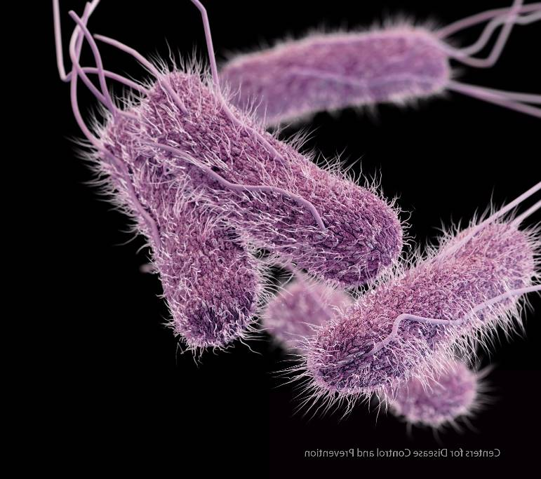
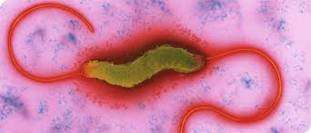
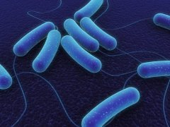
Gut bacteria
Salmonella Campylobacter
E.coli 0157
Notes:
Salmonella typhi and E.coli 015 produce a capsule

Slide 9
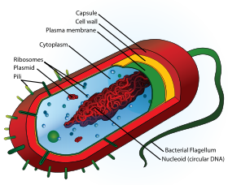
Prokaryotic cells e.g. A bacterium
Rigid cell wall
containing murein – a polysaccharide
Plasmids lie free
in cell, usually confersome benefit e.g. antibiotic resistance
Flagellum if
present lacks
microtubules rotates to move bacterium
70s ribosomes
Circular strand of DNA contains genetic material
http://www.cellsalive.com/cells/bactcell.htm
9

Slide 10
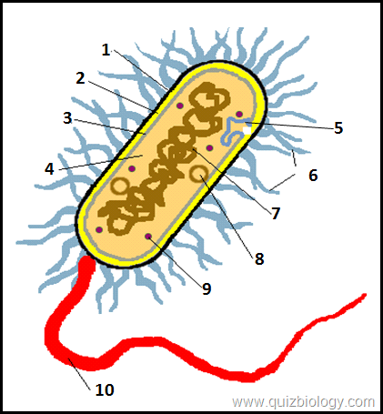
Label the diagram in your pack
Capsule
Cell Wall
Cell membrane
Cytoplasm
Mesosome
Pilus
Circular DNA
Plasmid
70s Ribosomes
Flagella

Slide 11
Sometimes vs always present

Slide 12
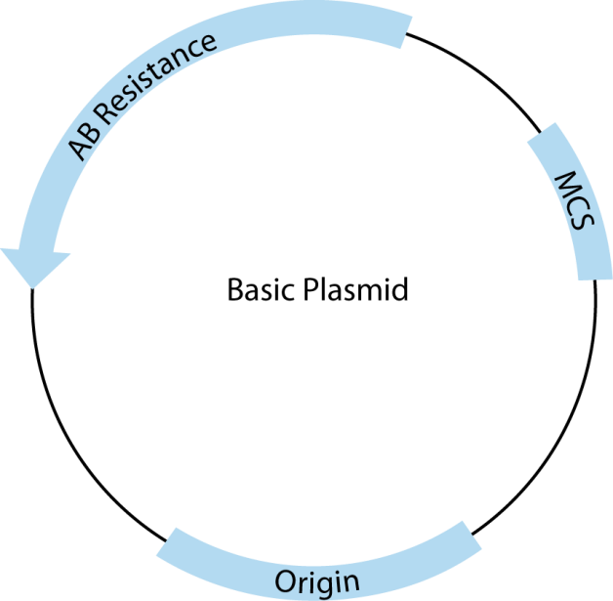
Plasmids
Why are plasmids important?
Possess genes that may aid the survival of bacteria in adverse conditions eg Confer antibiotic resistance
What are antibiotics?
They are a group of medicines that stop or slow down bacterial growth e.g penicillin inhibits cell wall synthesis leading to cell lysis.
How do they break down antibiotics??
The contain a gene that codes for an enzyme/s that break down the antibiotics (known as an antibiotic resistance gene)
Notes:
NB remember to mention that antibiiotics do not affect eukaryotic cells as usually work on cell wall which is not present in host cells.

Slide 13
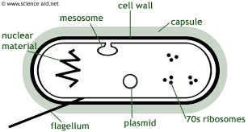
Function of cell wall, capsule, and Large circular DNA
What is the role of the cell wall?
Physical barrier that excludes certain substances and protects against mechanical damage and osmotic lysis. Supports the cell.
What is the role of the capsule?
Protects bacterium from other cells, specifically from attack from the cells of the immune system and helps groups of cells to stick together for further protection
Notes:
https://www.youtube.com/watch?v=rNfmew9C508
Biofims 2.min-4.20

Slide 14
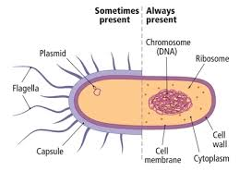
Function of cell wall, capsule, and Large circular DNA
What is the role of the large circular DNA?
Possess the genetic information for the replication of bacterial cells
What is the role of the cell membrane?
Acts as a differentially permeable layer, which controls entry and exit of chemicals

Slide 15
Activity
On scrap paper try to write 8 differences between a eukaryotic cell and a prokaryotic cell

Slide 16
Comparison of Eukaryotic and prokaryotic
Prokaryotic cells | Eukaryotic cells
No true nucleus, only an area where DNA is found | Distinct nucleus, with a nuclear membrane
DNA not associated with proteins | DNA associated with proteins called histones
Some DNA may be in the form of circular strands called plasmids | There are no plasmids and DNA is linear
No membrane bound organelles | membrane bound organelles such as mitochondria are present
No chloroplasts, only bacterial chlorophyll associated with the cell surface membrane in some bacteria | Chloroplasts present in plants and algae
Ribosomes are smaller (70s) | Ribosomes are larger 80s
Cell wall made of murein (peptidoglycan) | Where present cell wall made mostly of cellulose or chitin in fungi
May have outer mucilaginous layer called a capsule | No capsule

Slide 17
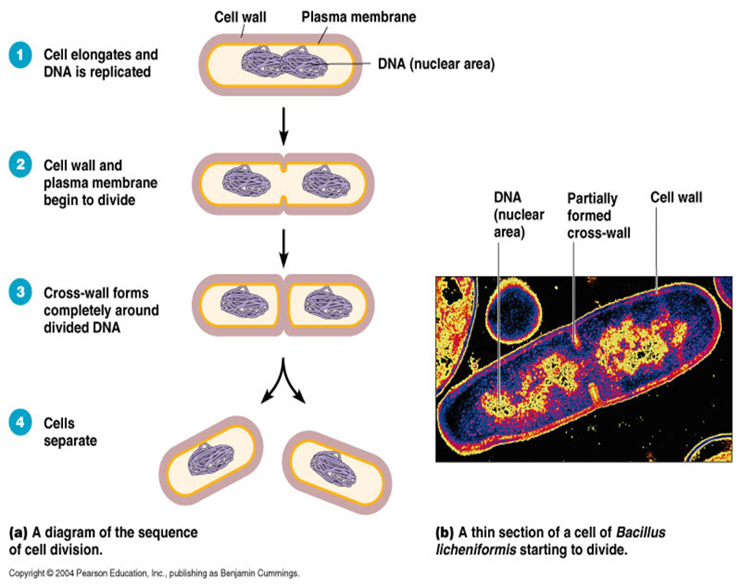
Replication of prokaryotic cells
By a process called Binary fission
Produces identical daughter cells each with a copy of the circular DNA and a variable number of the plasmids
Covered in Mitosis
https://www.youtube.com/watch?v=PkgriMIxwCM

Slide 18
Steps of Binary Fission
1. Parent cell grows to its maximum size.
2.Cell duplicates its chromosome (a process called replication) so that two exact copies of the genetic material exist inside the parent cell. These two molecules of DNA are attached to the cell’s plasma membrane.
3.The cell then grows, increasing the distance between the two duplicated chromosomes that are attached to the plasma membrane.
4.In prokaryotes (bacteria and Archaea), a new cell wall, called a septum, begins to grow across the middle of the cell, bisecting it producing two identical daughter cells
Remember the daughter the cells may have different numbers of plasmids.
https://www.youtube.com/watch?v=j8_xoM8Wwgs

Slide 19
Viruses-not prokaryotic or eukaryotic
Viruses are a cellular, non-living particles.
They are smaller than prokaryotes (20-300nm). Can only be seen by EM
They contain nucleic acids such as DNA or RNA.
They can only replicate (multiply) inside a host cell.
The nucleic acid is enclosed within a protein coat called a caspid.
Some viruses like HIV or Influenza are surrounded by a lipid envelope derived from the host cell..

Slide 20
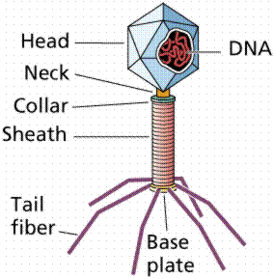
Viruses - Non cells
Why are viruses considered non cells/particles?
No cytoplasm, no organelles, made up of a core of nucleic acid surrounded by protein coat, the capsid, and in some cases an envelope.
Bacteriophage, a type of virus that attacks bacteria has DNA. Others have RNA.
20

Slide 21
Naked and enveloped viruses
Examples HIV, Influenza, HPV, and
polio

Slide 22
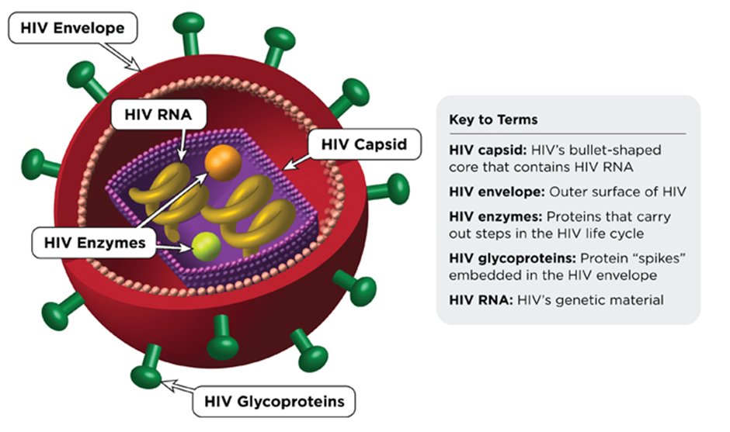
The lipid envelope
The envelopes are derived from portions of the host cell membranes (so is made up of phospholipids and proteins), but it includes some viral glycoproteins, which are essential for attachment to the host cell.
Function : The lipid envelope helps the virus avoid the host’s immune system

Slide 23
https://www.youtube.com/watch?v=Rpj0emEGShQ

Slide 24
Viral replication -videos
HIV
http://highered.mheducation.com/sites/0072495855/student_view0/chapter24/animation__hiv_replication.html
Bozeman https://www.youtube.com/watch?v=L8oHs7G_syI

Slide 25
Fact recall question
Where is murein used in prokaryotic cells?
Name and describe the process by which prokaryotic cells reproduce
What is a capsid?
What is the role of the viral attachment proteins?

