Slide 1
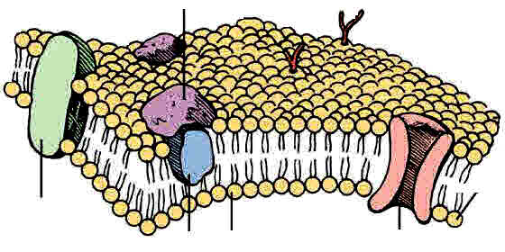
3.2.3 Transport Across Cell Membranes

Slide 2
Specification section 3.2.3
The basic structure of all cell membranes, including cell surface membranes and the membrane around the cell organelles of eukaryotes, is the same.
The arrangement and any movement of phospholipids, proteins, glycoproteins and glycolipids in the fluid mosaic model of membrane structure. Cholesterol may also be present in cell membranes where it restricts the movement of other molecules making up the membrane.
Movement across membranes occurs by:
Simple diffusion (involving limitations imposed by the nature of the phospholipid bilayer)
Facilitated diffusion (involving the roles of carrier proteins and channel proteins)
Osmosis (explained in terms of water potential).
Active transport (involving the role of carrier proteins and the importance of the hydrolysis of ATP)
Co-transport (illustrated by the absorption of sodium ions and glucose by cells lining the mammalian ileum).

Slide 3
Specification section 3.2.3 continued:
Cells may be adapted for rapid transport across their internal or external membranes by an increase in surface area of, or by an increase in the number of protein channels and carrier molecules in, their membranes.
Students should be able to:
Explain the adaptations of specialised cells in relation to the rate of transport across their internal and external membranes.
Explain how surface area, number of channel or carrier proteins and differences in gradients of concentration or water potential affect the rate of movement across cell membranes.
Required Practical 3: production of a dilution series of a solute to produce a calibration curve with which to identify the water potential of plant tissue.
Required practical 4: Investigation into the effect of a named variable on the permeability of cell surface membranes.

Slide 4
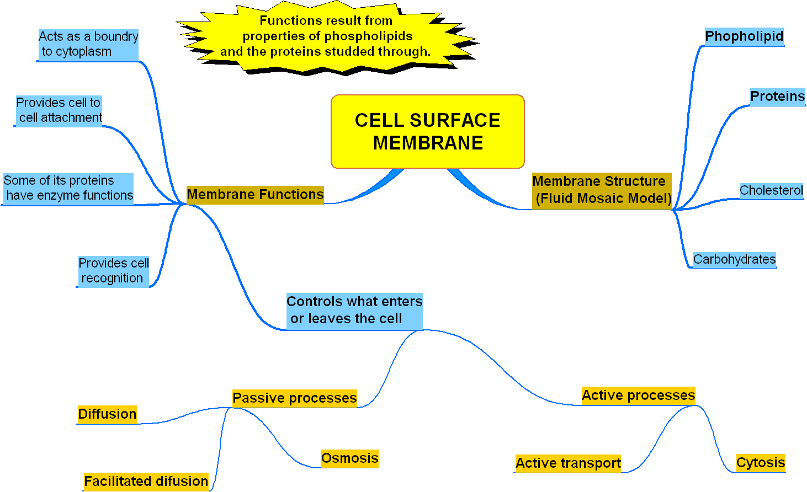
Overview of What We Study in the Membranes Unit

Slide 5
Lessons 1&2: Membrane Structure and Functions (slides 5 – 26)
Lesson outcomes – You should be able to:
explain the basic structure of a plasma membrane as a bilayer.
draw a simple diagram of a phospholipid bilayer and label it.
Understand what is meant by double and single membranes and state which organelles have a double membrane.
recognize and explain the pattern of banding shown by an electron micrograph of a membrane.

Slide 6
Starter: What Do You Know/Remember from GCSE? Should have done prior to lesson so only check over answers
Where are membranes found?
What is the purpose of cell membranes?
Do plants have cell membranes?
Do bacteria have cell membranes?
How can dissolved substances pass across membranes?
How can water pass across membranes?
Name 4 substances required by cells and what each is needed for
Name 3 end products of metabolic processes that may pass out of a cell.

Slide 7
Bozeman Introduction
Complete the questions on page 2-3
https://www.youtube.com/watch?v=y31DlJ6uGgE

Slide 8
Bozeman Video Review Questions
1. Why does soap dissolve the membranes easily?
2. What is selective permeability? How does the cell achieve this?
3. What are the 2 main molecules that make up cell membranes?
4. Phospholipids are described as AMPHIPATHIC. What does this mean?
5. What sort of particles do phospholipids allow to pass between themselves?
6. What is the role of many membrane proteins?
7. What is the role of cholesterol?
Soap can dissolve lipids, membranes are made of phospholipids
Only some substances are allowed in/out of the cell. This is because not all substances are soluble in the phospholipid bilayer. Other substances have to travel through channel or carrier proteins, which gives the cell control of entry/exit
Phospholipids and proteins
Have regions that are hydrophobic and hydrophilic
Small, non-polar
Allows large and charged particles to cross the membrane
Reduces the fluidity of the membrane, giving it stability. Also limits water loss through the membrane

Slide 9
Cells have many membranes
Revision slide, cross linking to your cells work.
plasma membrane
tonoplast
outer mitochondrial membrane
inner mitochondrial membrane
outer chloroplast membrane
nuclear envelope

Slide 10
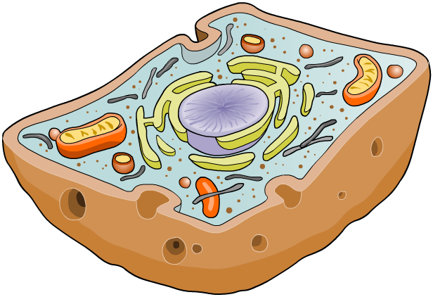
What are membranes? Booklet p3
Membranes cover the surface of every cell, and also surround most organelles within cells.
Functions of Outer cell membranes (also known as the cell surface membrane or plasma membrane)
define the boundary of the cell
controlling which substances pass into (nutrients & oxygen) and out of the cell (secretion).
play a role in cell recognition (immune system),
provide receptor sites for hormones, neurotransmitters and enzymes.
allowing a cell to change shape (be flexible)
Help cells stick together.

Slide 11
Membranes around organelles
Internal membrane Functions
Compartmentalisation: isolating organelles from the rest of the cytoplasm, allowing cellular processes to occur separately.
a site for biochemical reactions
control which substances pass into and out of organelles

Slide 12
Membranes allow cellular compartments to have different conditions
pH 4.8
Contains digestive enzymes, optimum pH 4.5 - 4.8
lysosome
Membrane acts as
a barrier
pH 7.2
cytosol

Slide 13
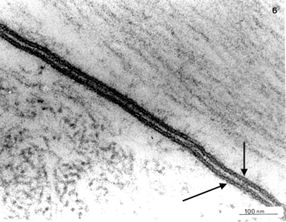
EM of a Cell Surface Membrane
What Does a membrane Look like?
In an EM it looks like 2 black lines with a lighter space between them
The cell membrane is also known as a plasma membrane
The structure of the membrane is known as the Fluid Mosaic Model of Membrane structure
Notes:
WHAT is meant by the letters EM? Answer electron micrograph.
What is an electron micrograph? Answer a photograph of an image taken with the electron micrograph.
Is this taken with a transmission or scanning electron microscope? Answer Transmission

Slide 14
Appearance of the Cell Membrane
Seen using a light microscope, the cell membrane appears as a thin line, but with an electron microscope, it appears as a double line.
Using the next few slides interpret what the dark lines and space in between represent.
} 7 – 8 nm

Slide 15
Here are 2 membranes next to each other

Slide 16
Composition of the Plasma Membrane - Fluid Mosaic Model
The main components of all membranes are:
Phospholipids
Proteins
But there are also modified proteins and phospholipids on the outer cell surface membrane surface. These are called:
Glycoproteins
Glycolipids
As well as cholesterol amongst the tails of the phospholipids.
What does the prefix ‘GLYCO’ suggest to you?
Hint: Think what type of molecules Glycogen / Glucose / are. Also Glycosidic bond. carbohydrate

Slide 17
Phospholipids
Allow lipid soluble substances to enter and leave the cell
Prevent water soluble substances entering or leaving the cell
Make the membrane flexible and self sealing.

Slide 18
Hydrophilic and Hydrophobic (cross ref to molecules unit)
Hydrophilic means attracted to water. Hydrophobic means repelled by water.
The phosphate heads are polar so have weak charges. This makes them attracted to water molecules.
Cytoplasm and Intercellular space are watery environments so the phospholipids have their polar hydrophilic heads next to these regions.
Phosphate group
polar ‘head’ of phosphate group is Hydrophilic
Note for chemists – a molecule like this which has a part that will mix with water and a part that will not is said to be AMPHIPATHIC
Glycerol
Fatty acid
Fatty acid
Non polar ‘tail’ of fatty acids is Hydrophobic

Slide 19
Why Does the Membrane form a Bilayer? (bimolecular layer)
OUTSIDE CELL: eg Tissue Fluid / Intercellular space – A watery environment
Hydrophobic tails are sandwiched in the centre away from the watery regions
Hydrophilic heads are next to the watery environment
INSIDE CELL: the cytoplasm – A watery environment
So a single membrane is a bilayer (double layer) of phospholipids.

Slide 20
Single and Double Membranes (cross ref to cell structure unit)
Remember organelles in the cell structure unit. Some have double membranes.
nucleus,
mitochondria
chloroplasts
3 cell organelles that are surrounded by double membranes. This means they are surrounded by a double bilayer.

Slide 21
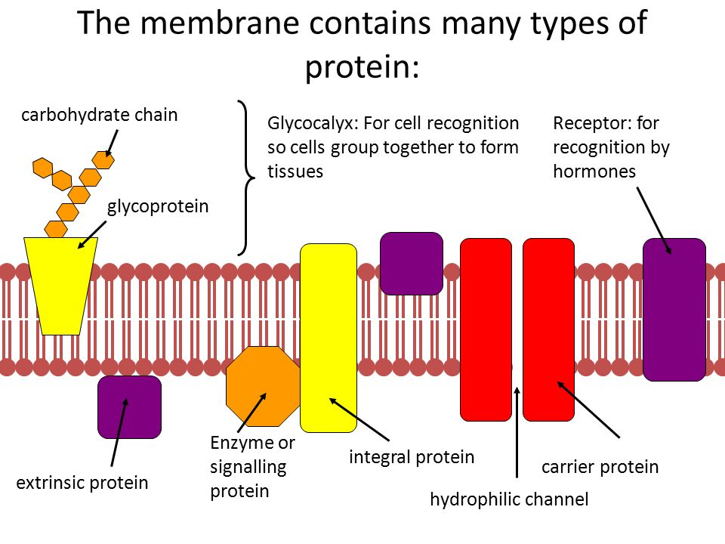
Proteins
For cell recognition or adhesion
Intrinsic protein

Slide 22
Extrinsic proteins
Occur in the surface of the bilayer. Do not extend across the membrane
Functions:
1) Provide adhesion between cells
2) Act as receptors for molecules (e.g. hormones)
3)Cell recognition

Slide 23
Intrinsic Proteins
Span the phospholipid bilayer
Functions:
1) Form protein channels – hollow tubes that allow water soluble molecules to diffuse across the membrane
2) Form carrier proteins that bind to smaller molecules and move them across the membrane by changing shape. Can be active (active transport) or passive (facilitated diffusion).

Slide 24
Specific Functions of Proteins in Membrane
Carriers/ channels transporting water soluble substances across the membrane.
Active Transport across the membrane by forming ion carriers for sodium, potassium etc
Recognition Sites by identifying cells
Cell adherence (stick) together.
Receptors eg to receive hormones. (remember molecules unit - proteins have specific shapes because of their tertiary structure so can have regions that are exactly complementary (matching) in shape to a particular molecule such as a hormone)
Structural support
Intrinsic
Usually Extrinsic
Note: Functions of the Cell surface membrane itself will obviously include the functions of the proteins that form part of the membrane.

Slide 25
Cholesterol
Occurs within the phospholipid bilayer. Cholesterol is very hydrophobic, so help play a role in preventing water loss from the cell.
Cholesterol adds strength to the membrane, by pulling the tails of the phospholipids (the fatty acids) together, limiting their movement.
Functions:
Reduce the lateral movement of the molecules in the membrane
Makes the membrane less fluid at higher temperatures
Prevents leakage of water and dissolved ions from the cell

Slide 26
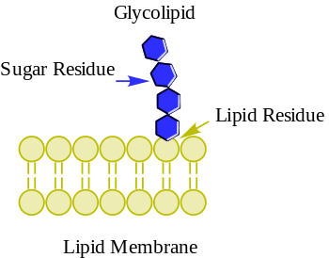
Glyocolipids
Carbohydrate bonded to a lipid. The carbohydrate group extends away from the membrane of the cell
Functions:
1) Acts as a recognition site
2) Helps maintain membrane stability
3) Helps attach cells together to form tissues

Slide 27
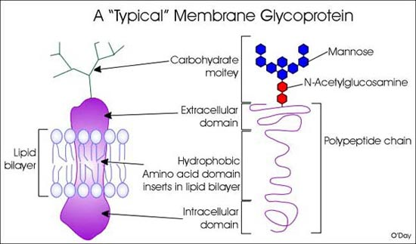
Glycoproteins
Carbohydrates (hence “glyco”) are attached to proteins, and extend away from the surface of the cell membrane.
Functions:
Act as recognition sites
Help cells attach to each other to form tissues
Used in cell recognition (LINK – immune system)

Slide 28
Functions of Different Membrane Molecules (in brief)
Glycolipids – act as cell to cell recognition sites.
Glycoproteins – act as recognition sites and antigens
Proteins – different types within the membrane e.g..
Transport proteins allow substances across the membrane (carrier and channel proteins and protein pumps)
Receptor proteins to bind with hormones
Enzyme proteins e.g. ATPase
Cholesterol – helps regulate membrane stability, rigidity and fluidity.
Phospholipids – act mainly as the membrane boundary and barrier to most molecules but allow transport of small non-polar molecules between themselves via diffusion.

Slide 29
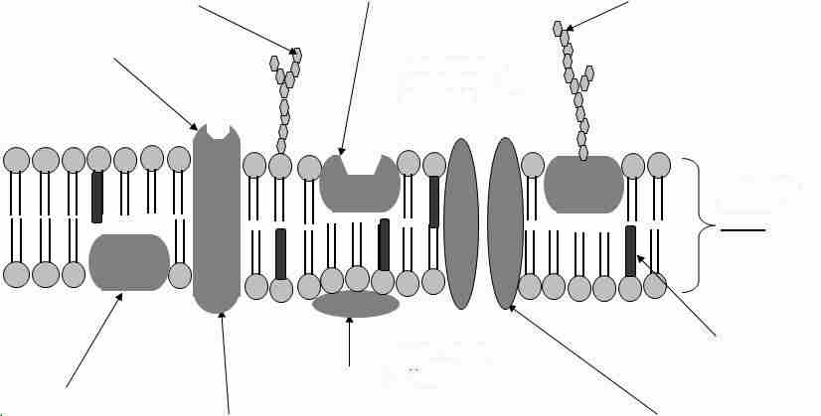
Fluid Mosaic Model of Plasma Membrane 2-D
Carbohydrate chain on phospholipid forming glycolipid
Carbohydrate chain on protein forming glycoprotein
Extrinsic protein with receptor site
Intrinsic protein forming carrier protein
The membrane forms a bilayer of phospholipids
Bilayer 7 – 8 nm
Cholesterol between and around the fatty acid tails
Extrinsic Protein embedded in one layer of phospholipids
Peripheral protein (extrinsic)
Intrinsic protein forming a channel protein

Slide 30
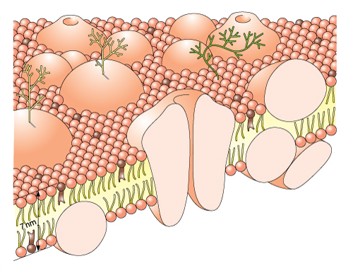
Fluid Mosaic model of Plasma Membrane 3-D
The fluid mosaic model of membrane structure is based on knowledge of the membrane’s physical and chemical properties.
Glycolipid – acts as a recognition site
Glycoprotein acts as a recognition site
7 – 8 nm
protein molecule partly embedded (extrinsic protein)
Hydrophilic heads of phospholipid molecules point outwards
Protein molecule lying on surface (extrinsic protein
Cholesterol adds stability, rigidity and flexibility
Hydrophobic tails of phospholipids point inwards
Protein molecule spanning the phospholipid layer – (intrinsic protein)

Slide 31
The Fluid Mosaic Model of Membrane Structure
We cannot see the tiny membrane molecules but we can model them based on knowledge of the membrane’s physical and chemical properties.
The name Fluid Mosaic means:
Fluid because the individual phospholipids can move laterally (sideways) and change places with each other.
Mosaic because when seen from above, the membrane is like a mosaic of phospholipids with proteins of different shapes and sizes embedded in it.

Slide 32
What structures are represented by the EM view of two dark lines and a space in between?
Understanding Check
Hydrophilic Phosphate heads of phospholipids
} 7 – 8 nm
Hydrophobic fatty acid tails of phospholipids

Slide 33
Recap slide: Functions of the Cell Surface Membrane
Define boundary to cytoplasm /Structural support
Taking in nutrients and other requirements and secretion of chemicals
active and passive transport mechanisms
Cell recognition (immune system)
Provide receptor sites eg for hormones
Allow cell to change shape (flexibility)
Cell to cell attachment.
Also some proteins of the membrane have enzyme functions

Slide 34
Useful Video Link e-stream
Cells and their Environment
http://estream.godalming.ac.uk/View.aspx?ID=7535~4u~vD7eUKN3 (start at 34.55 min or 2.35.09 of whole programme.) about 20 mins

Slide 35
Transport Across Membranes
The cell surface membrane (plasma membrane) controls what goes into and out of cells.
Materials cross a cell membrane by:
Diffusion a) simple (lipid diffusion)
b) facilitated
Osmosis
Active transport and Co-transport
Passive – no energy needed
Active – energy needed using ATP

Slide 36
Diffusion
The net movement of molecules or ions from a region where they are more highly concentrated to one where there concentration is lower , until evenly distributed.
Why do we talk about the NET movement of particles?
Particle motion is random, so can be in any direction. This means that there will be some particles that actually move from an area of lower concentration to an area of higher concentration, but they will be far outnumbered by those going in the opposite direction

Slide 37
Crash Course Biology
https://www.youtube.com/watch?v=dPKvHrD1eS4&list=PLE6EDE9CF5D37DA47

Slide 38
Diffusion Questions: Answer each of these on scrap paper before moving on to the next slide
Name 3 molecules that can pass through a membrane by simple diffusion.
Which part of a membrane does simple diffusion occur through, the proteins or the phospholipids?
Name 3 factors that affect the rate of diffusion.
Are polar molecules or non polar molecules more likely to pass through by simple diffusion?
What is meant by saying dynamic equilibrium is reached when talking about diffusion across a membrane.
Draw a diagram to represent diffusion across a membrane

Slide 39
ANSWERS
Small molecule
membrane
Name 3 molecules that can pass through a membrane by simple diffusion. O₂, CO₂, steroids, fat soluble vitamins, glycerol, ammonia, non polar molecules, small molecules.
Which part of a membrane does simple diffusion occur through, the proteins or the phospholipids? Between the phospholipids
Name 3 factors that affect the rate of diffusion through a membrane. Concentration gradient, distance over which it occurs / thickness of exchange surface, surface area, size of molecules, lipid solubility, temperature
Are polar molecules or non polar molecules more likely to pass through by simple diffusion? Non polar
What is meant by saying dynamic equilibrium is reached when talking about diffusion across a membrane. When the number of particles each side is the same but individual particle are continuously changing position.
Draw a diagram to represent diffusion across a membrane. diagram above

Slide 40
Fick’s Law on Diffusion Through a Membrane
Learning Aid
ROD = SAD
TOES
The rate of diffusion through a membrane (exchange surface) is proportional to:
Rate of Diffusion α Surface area X difference in concentration
thickness of exchange surface
(in this case a membrane)
Oxygen and Carbon dioxide can pass through the phospholipid bilayer of membranes by simple diffusion.
They are both soluble in lipids.
Extension Material
this equation is called Fick’s Law

Slide 41
Fick’s Law continued
The following factors will increase and decrease the rate of diffusion:
Surface area: - the greater the surface area, the faster the rate of diffusion
Difference in concentration: - the greater the difference in concentration, the faster the rate of diffusion.
Thickness of membrane: - the thicker the membrane the slower the rate of diffusion

Slide 42
Rate of Diffusion is Proportional to the External Concentration For Substances that Pass into the Cell by Simple Diffusion
Rate of uptake into a cell
As the external concentration of the substance increases, the concentration gradient between inside and outside of the cell increases.
so the rate of diffusion of the substance inwards increases.
External concentration

Slide 43
Osmosis
Lesson Outcomes - You should be able to:
Identify key variables which affect membrane permeability
Define osmosis in terms of water potential.
Explain the terms hypotonic, hypertonic and isotonic
Explain the movement of water due to osmosis in or out of cells
Explain the effect of osmosis on plant and animal cells
Use the words plasmolysed, incipient plasmolysis, turgid, flaccid, water potential and haemolysis correctly.

Slide 44
Osmosis
Definition – Osmosis is the passage of water molecules from a solution of high water potential (so a dilute solution) to a solution of lower water potential (so a more concentrated solution) through a selectively permeable membrane.
NET movement of Water
More concentrated solutions are called HYPERTONIC
Less concentrated solutions are called HYPOTONIC
Solutions of the same concentration are called ISOTONIC
http://highered.mcgraw-hill.com/sites/0072495855/student_view0/chapter2/animation__how_osmosis_works.html 1.5 min animation

Slide 45
What Causes Osmosis? - introducing water potential
Osmosis occurs because there is a difference in concentration of free water molecules either side of a selectively permeable membrane causing a water concentration gradient across it.
The movement of water molecules against the membrane causes a pressure called Water Potential.
The side with more free water molecules (dilute solution) has a higher water potential because more water molecules are trying to leave and get across the membrane to where there are fewer free water molecules (concentrated solution).
Free water molecule
water molecule bound to solute so not free
9 free water molecules
4 free water molecules

Slide 46
Osmosis and Water Potential
Water potential is the pressure created by water molecules trying to diffuse out of a solution down a gradient from a higher water potential to a lower water potential. (ref new spec text p89)
Water potential (Ψ or psi) is measured in units of pressure, usually kilopascals (kPa).
Pure water has a water potential of 0 at atmospheric pressure .
Water potential of solutions = LESS than pure water. ie negative. (All solutions effectively decrease the concentration of water molecules because some water molecules become bound to the solutes)
The more concentrated the solution the more negative the water potential.

Slide 47
Check your Understanding Look at these worked examples before trying the questions on page 15
Which has the higher water potential?
Is solution A hypertonic or hypotonic with respect to solution B.
If the solutions were separated by a partially permeable membrane, which direction would be the correct direction of water movement?
A to B
B to A
Solution A - 35 kPa
Solution B - 65 kPa
Solution A
hypotonic
A to B / a)
Notes:
Answers to this will appear one by one with each click if viewed as a slide show.

Slide 48
Check Your Understanding continued:
water
What has the highest water potential possible?
What is its value in kilopascals?
Which solution is more dilute,
one with a water potential of – 24 kPa or
one with a water potential of – 63 kPa?
Which way will water move, from (–24 to –63 kPa) or from (–63 to –24 kPa)?
Why does the presence of solutes lower the water potential of a solution?
zero
a. – 24kPa
( -24 to -63 kPa)
Some water molecules become bound to the solute molecules so are not free to effect a water potential
Notes:
Answers will appear one by one if viewed as a slide show with each mouse click

Slide 49
Which Ways Does the Water Move?
We can show the net movement of water by osmosis through cells of different water potentials.
Draw arrows on your diagram to show NET movement between cells
Cell A
Ψ = - 2.1 kPa
Cell B
Ψ = - 4.2 kPa
Cell C
Ψ = - 3.2 kPa

Slide 50
Which Ways Does Water Move? ANSWERS
Cell A
Ψ = - 2.1 kPa
Cell B
Ψ = - 4.2 kPa
Water moves from cell A to cell C and cell B and from cell C to cell B
Cell C
Ψ = - 3.2 kPa

Slide 51
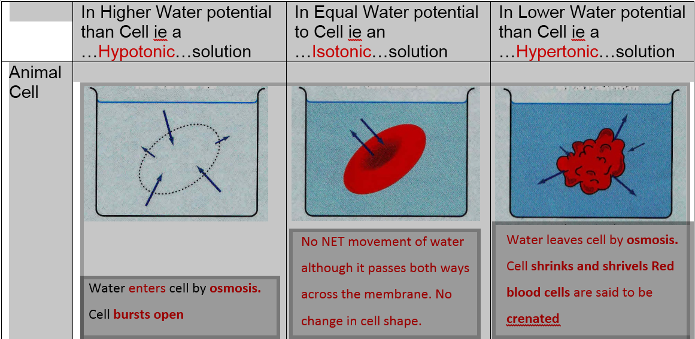

Slide 52
Is a plant cell wall permeable, impermeable or semi-permeable? …permeable……..
What is in the gap between the cell wall and the membrane in the cell in a hypertonic solution.......the external solution…………………………………………….
Why are arrows drawn both ways on the diagrams?…..membranes are permeable to water so it can move in either direction randomly, but if there is a water potential gradient there will be a net movement by osmosis down the gradient…………………
What is meant by the word PROTOPLAST…..the living part of a PLANT CELL, i.e. membrane, cytoplasm and its contents but not the cell wall…

Slide 53
Effect of External Solution on Red Onion Cells
Onion Cells in Distilled Water (Hypotonic to cell)
Onion Cells in a 5% Sodium chloride Solution (Hypertonic to cell)
The membrane surrounding the cytoplasm is pushed up against the cell wall so it can’t be seen.
The cell is TURGID.
Why does it not burst when in distilled water?
The cytoplasm and membrane around it has shrunk away from the cell wall as water has left the cell by OSMOSIS.
The cell is PLASMOLYSED.
What is present in the spaces between the wall and the cytoplasm?
NOTE: Purple cytoplasm is due to pigment – enables cytoplasm to be seen

Slide 54
Turgid and Plasmolysed Onion Cells Under a Microscope.
Turgid Onion Cells
At Incipient plasmolysis 50% cells are seen to be plasmolysed
Plasmolysed Onion Cells

Slide 55
Effect of Osmosis in Plant and Animal cells in Solutions of Different Water Potentials
 | In Higher Water potential than cell (hypotonic solution) | In Equal Water potential to cell (Isotonic solution) | In Lower water potential than cell (hypertonic solution)
Animal Cell | Water enters cell by osmosis. Cell bursts open. | No NET water movement although it moves both ways. No change in cell shape | Water leave cell by osmosis. Cell shrinks and shrivels
Plant Cell | Water enters cell by osmosis. Cell membrane is pushed tight against the cell wall. Cell is TURGID | No NET water movement although it moves both ways. No change in cell shape but protoplast is barely in contact with cell wall. Cell is in INCIPIENT PLASMOLYSIS | Water leaves cell by osmosis. Cytoplasm shrinks pulling membrane from cell wall. Cell is flaccid and said to be PLASMOLYSED
Note: shrivelled and shrunken red blood cells are said to be HAEMOLYSED

Slide 56
Facilitated Diffusion (passive –no energy required)
http://highered.mheducation.com/sites/9834092339/student_view0/chapter5/how_facilitated_diffusion_works.html
Hydrophilic polar molecules & large molecules such as glucose, sodium ions and chloride ions are not lipid soluble and do not diffuse readily through the phospholipids of cell membranes.
Instead they move passively down a concentration gradient by facilitated diffusion.
Facilitated diffusion involves either channel proteins or protein carriers.

Slide 57
Facilitated Diffusion (passive –no energy required)
Facilitated diffusion involves either channel proteins or protein carriers.
Hydrophilic polar molecules
Ions eg sodium ions
Large molecules eg glucose
Instead they move passively down a concentration gradient through the protein channels or carriers by facilitated diffusion.
Not lipid soluble so can’t diffuse through the membrane phospholipids

Slide 58
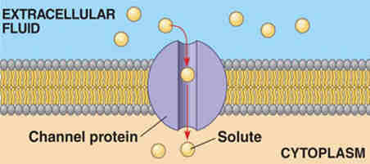
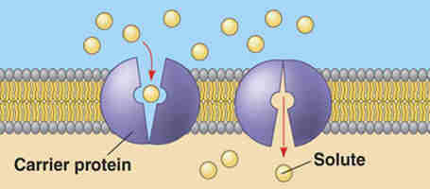
Facilitated Diffusion – Channel and Carrier Proteins
Channel Protein
High concentration of solute
Channel lined with POLAR groups forming a hydrophilic channel. This enables small polar and charged molecules to pass through. Are ‘gated’ so can be opened and closed to meet cell needs.
Low concentration of solute
Carrier Protein
Binding site of Carrier protein. Allows larger polar molecules such as sugars and amino acids to cross the membrane
NOTE: Each channel or carrier protein can transport only type of molecule / ion

Slide 59
Comparing Channel and Carrier Proteins (facilitated diffusion)
CHANNEL PROTEIN | CARRIER PROTEIN
Form water filled pores (lined with polar groups so the channel is hydrophilic) | Able to bind with a specific shaped molecule. The binding site is alternately open to both sides of the membrane
Charged substances (usually ions) diffuse through | Larger molecules such as glucose and amino acids are taken across.
Most channels can be gated so the cell can control entry and exit of ions. | The carrier changes shape to release the molecules the other side of the membrane.

Slide 60
Comparing Rate of Uptake Graphs: Diffusion and Facilitated Diffusion
Rate of uptake into a cell
Rate of Uptake Graph for a Molecule that enters a cell by Simple Lipid Diffusion
Rate of uptake into a cell
Rate of Uptake Graph for a Molecule that enters a cell by Facilitated Diffusion
External concentration
External concentration
Can you explain why these two graphs differ? Hint, through which part of a membrane does facilitated diffusion occur?

Slide 61
Active Transport
Lesson Outcomes - You should be able to:
Define what is meant by active transport
Explain the process of active transport
Compare and contrast active transport and facilitated diffusion.

Slide 62
Definition:
The movement of molecules or ions into or out of a cell from a region of lower concentration to a region of higher concentration using ATP and carrier proteins.

Slide 63
In active transport ATP is used to:
1) Directly move molecules
2) Indirectly move molecules using a concentration gradient that has already been set up by direct active transport. This is known as co-transport.

Slide 64
Active Transport - Pumping
Uses carrier proteins very similar to those of facilitated diffusion but needs energy to move substances against a concentration gradient.
The energy comes from ATP produced during RESPIRATION
Protein pumps are specific, some move one type of substance, others move one substance in and another substance out at the same time eg the sodium-potassium pump.
Direct Active Transport of One Specific Substance

Slide 65
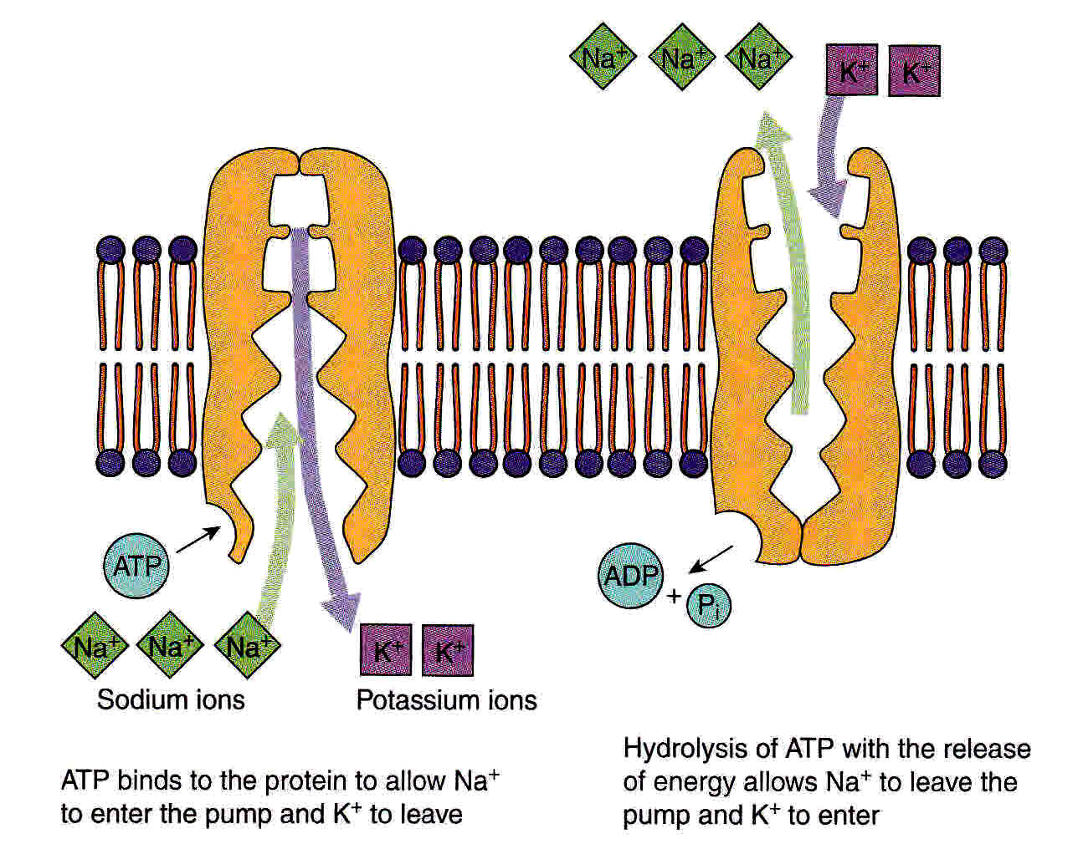
Active transport Example: the Sodium Potassium Pump
The protein has binding sites for sodium and potassium.
Sodium is actively removed from the cell while potassium ions are taken up
This is essential to many processes in the body including creation of nerve impulses.
NOTE: ATP stand for Adenosine triphosphate which you will learn more of in respiration
Pi stands for inorganic phosphate

Slide 66
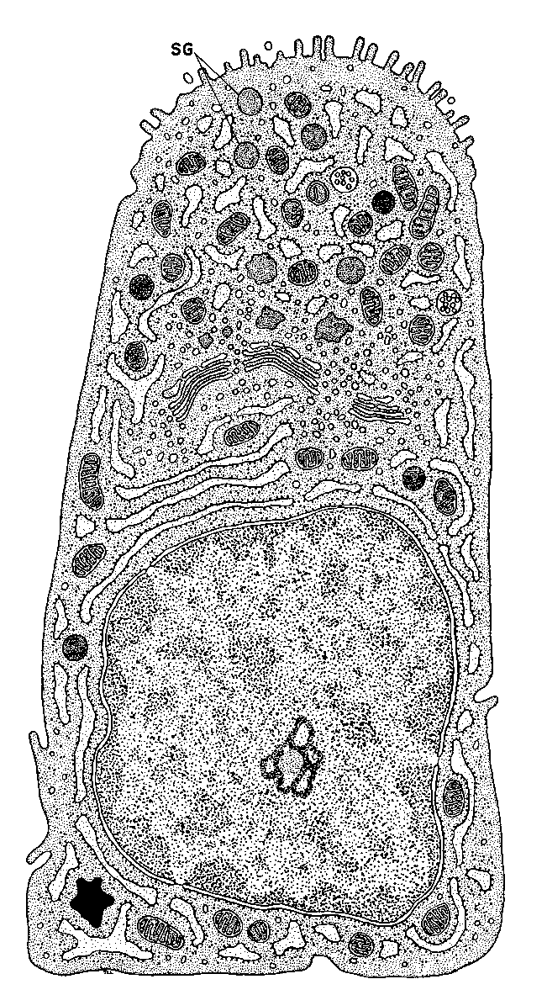
How are cells adapted for rapid transport across internal and external membranes?
Past Exam Question : The epithelial cells that line the small intestine are adapted for the absorption of glucose. Explain how. 6 marks
In pairs / groups discuss and list suggestions.
Use the diagram adjacent / in workbook to help you.

Slide 67
How are cells adapted for rapid transport across internal and external membranes?
Highly folded membranes eg microvilli of intestinal cells increase surface area for diffusion
Many mitochondria within cells produce much ATP to release energy for active transport
Presence of many carrier proteins for active transport and presence of co-transport proteins.
Presence of many channel and carrier proteins for facilitated diffusion

Slide 68
The Carrier protein spans the plasma membrane and binds to the molecule or ion to be transported. The molecule binds to a receptor site on the carrier protein. On the inside of the cell ATP binds to the protein causing it to split into ADP and a phosphate molecule. The phosphate molecule binds to the carrier protein (phoshorylating it) and as a result the protein molecule changes shape and opens to the opposite side of the membrane. The molecule or ion is released. The phosphate molecule is released from the protein which causes the protein to revert to it’s original shape. The phosphate molecule recombines with ADP. to form ATP during respiration.

Slide 69
3 main differences between passive and active transport
Passive – diffusion occurs from high to low concentration in passive transport, from low to high concentration in active transport
Passive does no require ATP, active transport requires ATP
More than one molecule or ion can be moved in the same direction is active transport using one carrier.

Slide 70
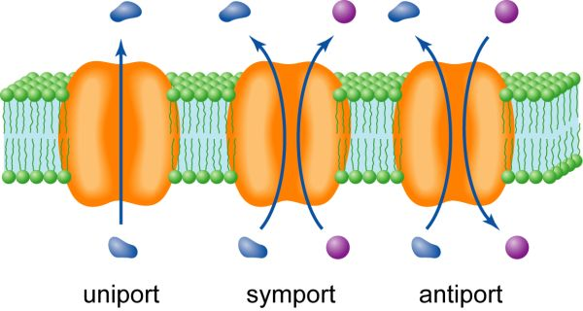
Co-Transport and Consolidation: extension

Slide 71
Co transport: e.g. in gut epithelium cells
Co transport is an indirect form of active transport where carrier proteins actively pump an ion such as Na+ one way in order to set up a concentration gradient that then causes the Na+ to be drawn back in passively but also PULLING through another wanted substance (eg glucose) at the same time.
Na⁺ are ACTIVELY transported OUT of intestinal epithelium cells into the blood.
This makes the concentration of sodium in the LUMEN (gut space) higher than in the epithelial cells.
So the sodium from the gut diffuses into the epithelial cells down its concentration gradient and pulls glucose back with it.

Slide 72
How Glucose Is Drawn In to the Epithelial cells by Co-transport
SMALL INTESTINE
BLOOD
Sodium ions are PASSIVELY transported into the cell down their concentration gradient. Glucose is drawn in too by CO-TRANSPORT
The concentration of Sodium ions in the cell remains low because it is being actively removed
Sodium ions are ACTIVELY transported out of the cell into the blood by the Sodium Potassium Pump

Slide 73
Membrane Transport Proteins in Intestinal Epithelial Cells
LUMEN of Small Intestine
Many mitochondria to provide lots of ATP for active absorption of nutrients
BLOOD
Sodium-Potassium pump, actively pumps Na+ out into blood and K+ into cell.
Sodium ions
Glucose molecule
Co-transporter protein transports Na + and glucose. Na+ diffuses down its gradient through the co– transporter and glucose is pulled with it against its gradient
Facilitated Diffusion Carrier protein transports glucose down its gradient into the blood

Slide 74
Revision Slides

Slide 75
The next slide has an example of a mind map used to consolidate and recap this presentation.
Practice reproducing your own mind map from memory, and use any gaps or terms you are unsure about as a starting point for your own revision

Slide 76
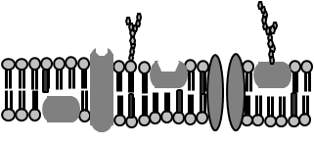
Phospholipids
Proteins
Glycoproteins
Glycolipids
Cholesterol
Bilayer made of:
Is fluid (component molecules are moving)
Simple diffusion through phospholipids
Facilitated diffusion through channel and carrier proteins
Osmosis
Structure
PLASMA MEMBRANES
(cell surface membrane)
Active transport through carrier proteins
Endocytosis (phagocytosis and pinocytosis) through membrane invagination
Exocytosis (secretion) by vesicles fusing with membrane.
Passive – no ATP required
Active – ATP required
Functions
Taking in nutrients (by various methods)
Secretion (by exocytosis)
Cell to cell recognition (by glycoproteins and glycolipids)
Acting as receptor sites eg for hormones (by glycoproteins)
Acting as enzymes (by certain enzyme proteins)
Acting as a boundary to the cytoplasm and cell contents

Slide 77
Osmosis and Water Potential Animations
http://highered.mcgraw-hill.com/sites/0072495855/student_view0/chapter2/animation__how_osmosis_works.html 1.5 min animation
https://www.youtube.com/watch?v=5KOkt9dyN1w 7 min 32 s Leslie Walters tutorial Water potential calculation explanation

