Slide 1
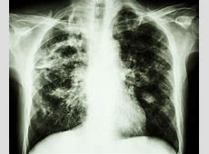
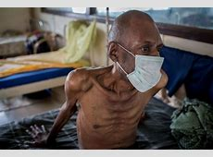
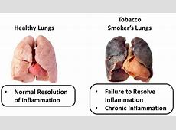
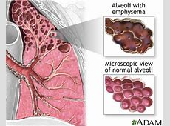
Lung Diseases

Slide 2
Objectives
Understand the symptoms and effects of tuberculosis and how the disease is transmitted
Understand the effects of asthma, fibrosis and emphysema on the lungs, and be able to explain how these diseases affect gas exchange and respiration.
Understand what is meant by a risk factor.

Slide 3
Pulmonary Tuberculosis

Slide 4
Pulmonary Tuberculosis (TB)
Tuberculosis is an infectious disease that can affect any part of the body, although it is usually found in the lungs as these are the first site of infection.
It kills approximately 2 million people each year.
The illness used to be called ‘consumption’ as the lung tissue and muscle tissue appear to be consumed – eaten away.

Slide 5
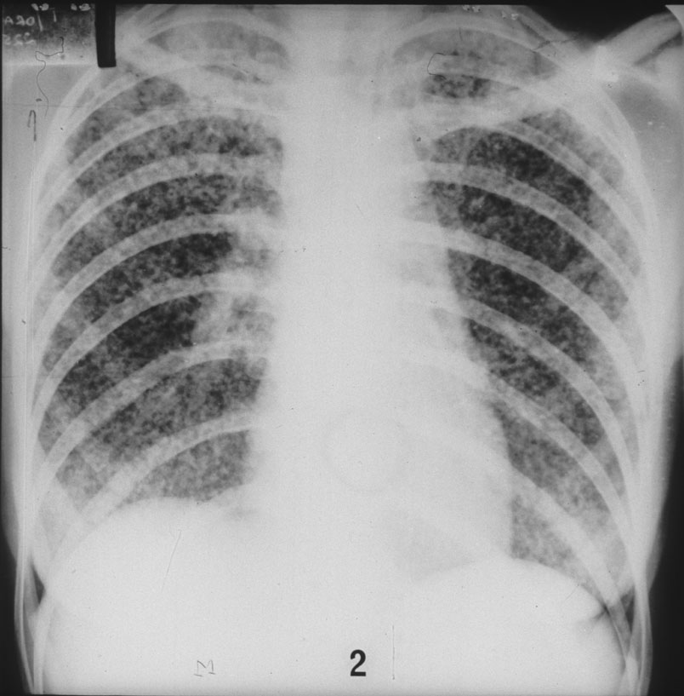
Pulmonary Tuberculosis (TB)
X-ray of a lung showing infection by a tuberculosis bacterium.
The lungs have a grainy appearance on the X-ray.

Slide 6
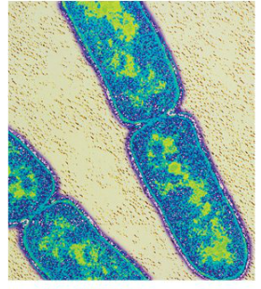
Pulmonary Tuberculosis (TB)
CAUSES
Caused by one of two species of bacterium
    Mycobacterium tuberculosis
    Mycobacterium bovis
SYMPTOMS
Persistent cough
Tiredness
Loss of appetite and weight loss
Fever
Coughing up blood

Slide 7
Pulmonary Tuberculosis (TB)
TRANSMISSION
Spread through the air by droplets when infected individuals cough, laugh, sneeze or talk.
Normally takes close contact over a period of time to be transmitted.
It is usually spread between family members, close friends, work colleagues and in crowded, poorly ventilated conditions.
TB can be spread from cows to humans (M. bovis infects cattle) and can be in milk.

Slide 8
Pulmonary Tuberculosis (TB)
TRANSMISSION
People at most risk:
Those in close contact with infected individual over a long period of time
Those in long term care facilities – live close together e.g. care homes, prisons, hospitals.
Those from areas where TB is common e.g. parts of Africa and Asia
Have reduced immunity - e.g very old or young, suffering from illness, malnourished.

Slide 9
Pulmonary Tuberculosis (TB)
COURSE OF INFECTION (1 of 2 pages)
Bacteria grow and multiply in upper regions of lungs – O2 plentiful
Bacteria produce small lumps like boils, called tubercles.
White blood cells accumulate at site of infection leading to inflammation (primary infection), and most bacteria are killed.
Secondary infection can occur (post-primary tuberculosis) as some bacteria can remain dormant until up to years later.

Slide 10
Pulmonary Tuberculosis (TB)
COURSE OF INFECTION (2 of 2 pages)
The bacteria grow, multiply and spread through the lungs creating cavities as the lung tissue is damaged, creating scar tissue and more cavities.
Fluid collects in the lungs and breathing becomes difficult.
Common symptoms include coughing up blood, chest pain and fever.
Without treatment the TB spreads to the rest of the body and the person may die.

Slide 11
Pulmonary Tuberculosis (TB)
TREATMENT
Antibiotic drugs are used to treat TB.
Vaccination – those not already immune to TB are injected with a weakened (attenuated) strain of Mycobacterium bovis. Due to a vaccination programme in Britain TB is relatively uncommon.
Social and economic measures:
Education on importance of completing courses of drug treatment for TB
More and better housing
Improved health facilities
Better nutrition to ensure that immune systems are not weakened

Slide 12
Pulmonary Tuberculosis (TB)
PROBLEMS
The BCG vaccination has been found to be ineffective (contains a live, attenuated strain of the TB bacterium).
It appears that in many people the immune system destroys the bacteria in the vaccine before the immune memory is formed.
It has also been discovered that strains of TB are resistant to most of the antibiotic drugs currently used to treat the disease.
An increasing number of the population could be at risk of TB infection.

Slide 13
Asthma

Slide 14
Asthma
Asthma affects approximately 5 million people in the UK. Asthma attacks can be triggered by a variety of allergens.
An allergen is a substance that triggers an allergic reaction
Examples of allergens include fur, feathers, pollen, tobacco smoke, pollutant gasses [SO₂, nitrous oxides], cold air, dust mites

Slide 15
Asthma Attacks
The muscle tissue in the walls of the bronchi and bronchioles contracts. This reduces the diameter of the airway
The epithelial cells lining the walls secrete larger quantities of mucus than normal, this obstructs the thinner tubes.
Mast cells secrete a chemical called histamine which makes the linings inflamed and swollen.
Blood vessels dilate and become more ‘leaky’. Fluid leaves the capillaries and enters the airways. This allows white blood cells to move to the tissue where they respond to the ‘invaders’.
The muscle surrounding the bronchioles contracts and so constricts the airways.

Slide 16
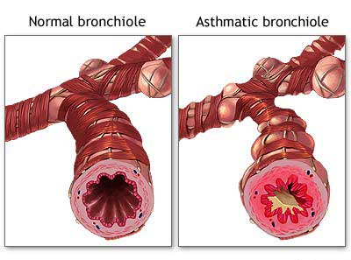

Slide 17
Asthma Symptoms
DIFFICULTY BREATHING
Constriction of bronchi and bronchioles, inflammation and additional mucus restrict how much air can enter.
WHEEZING
Sound caused by air passing through narrowed airways.

Slide 18
Asthma Symptoms
TIGHT FEELING IN CHEST
Pain caused by not being able to ventilate lungs properly – due to restrictions
COUGHING
Reflex response to obstructed bronchi and bronchioles to try and clear them.

Slide 19
Asthma Summary
There is restricted flow of air in and out of the alveoli making it difficult to ventilate the lungs and maintain a diffusion gradient across the exchange surface.
The volume of air reaching the alveoli and therefore the oxygen getting in to the blood is greatly reduced.
The person may turn bluish in colour – called cyanosis.
Reduced oxygen supply to the brain reduces respiration and is eventually fatal.

Slide 20
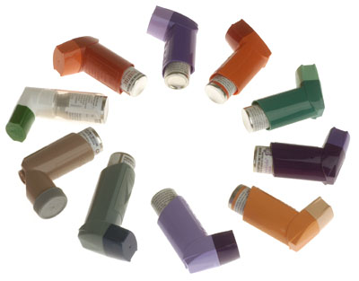
Asthma Treatment
Asthma sufferers can do two things:
    Avoid allergens as much as possible
    Use drugs that relax the muscles in the bronchial walls so that the airways open up again – taken using an inhaler. Other drugs can be taken to reduce the inflammation.

Slide 21
Pulmonary Fibrosis

Slide 22
Pulmonary Fibrosis
Pulmonary fibrosis occurs when scars form on the epithelium of the lungs.
The epithelium becomes irreversibly thickened.
The fibrosis also reduces the elasticity of the lungs therefore making it more difficult to breathe out and ventilate the lungs.

Slide 23
Pulmonary Fibrosis
There are large cells in the alveoli called macrophages that can engulf bacteria and foreign particles such as dust.
There are no cilia in this section to sweep out the mucus that normally traps tiny particles.
The macrophages move into the connective tissue round the alveoli by squeezing between cells of the alveolar walls.
They wrap around particles and remove them from the lungs.

Slide 24
Pulmonary Fibrosis
When there are large amounts of dust particles e.g. in occupations such as mining and quarrying, the macrophages can build up in the connective tissue and cause the formation of fibrous tissue that develops into hard lumps, reducing the elasticity of the lungs.

Slide 25
What is the effect on diffusion across the gas exchange surface?
The linings of the alveoli must be thin to allow efficient diffusion of respiratory gases. In patients with fibrosis oxygen diffuses into the blood at a slower rate as the diffusion pathway is increased.

Slide 26
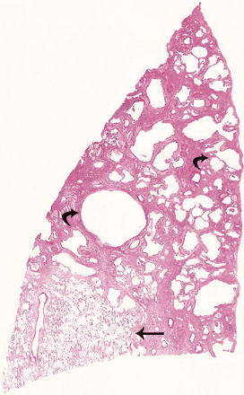
54-year-old man with severe (long term) pulmonary fibrosis
Extremely low-power view of specimen shows extensive honeycomb changes (curved arrows) and less severely affected areas (straight arrow).

Slide 27
Pulmonary Fibrosis Symptoms
SHORTNESS OF BREATH
Volume of air space in lungs reduced by fibrous tissue – less oxygen taken in.
Thickened epithelium – increased diffusion pathway therefore diffusion of O2 slow.
Loss of elasticity – ventilating lungs more difficult, hard to maintain diffusion gradient.

Slide 28
Pulmonary Fibrosis Symptoms
CHRONIC, DRY COUGH
Fibrous tissue creates an obstruction in airways. Reflex reaction in attempt to remove obstruction
PAIN IN CHEST
Fibrous tissue causes increased pressure and damages the lungs.
WEAKNESS AND FATIGUE
Reduced intake of oxygen into blood. Reduced release of energy by cellular respiration.

Slide 29
Emphysema

Slide 30
Emphysema
One in 5 smokers will develop the lung disease called emphysema.
This disease takes a long period of time to develop – typically 20 years or more. It is not usually diagnosed until the lungs have been irreversibly damaged.
Healthy lungs contain large quantities of elastic tissue made of the protein elastin. One effect of cigarette smoke is to stimulate white blood cells to release protein-digesting enzymes that gradually break down the walls of the alveoli leaving large open spaces.

Slide 31
Emphysema
One in 5 smokers will develop the lung disease called emphysema.
This disease takes a long period of time to develop (chronic disease) – typically 20 years or more. It is not usually diagnosed until the lungs have been irreversibly damaged.
Healthy lungs contain large quantities of elastic tissue made of the protein elastin. One effect of cigarette smoke is to stimulate white blood cells to release protein-digesting enzymes that gradually break down the walls of the alveoli leaving large open spaces.

Slide 32
Emphysema
One enzyme targets elastic tissue in the lungs. In emphysematous lungs the elastin has become permanently stretched. This loss of elasticity reduces the ability of the lungs to recoil after breathing in and so air cannot be forced out of the alveoli effectively. The surface area of the alveoli is reduced and they sometimes burst. Very little gas exchange can take place across the gas exchange surface as a result.

Slide 33
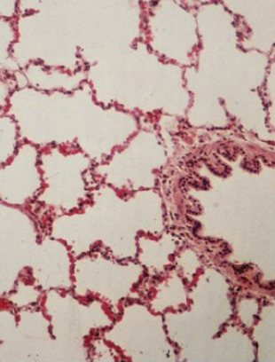
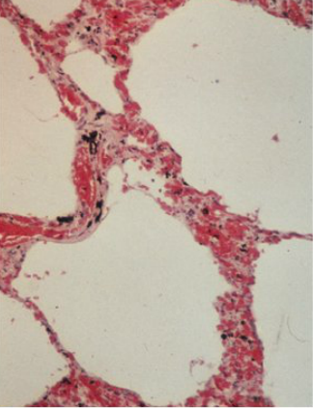
Emphysema
Normal
Emphysematous

Slide 34
Emphysema Symptoms
SHORTNESS OF BREATH
Loss of elasticity – ventilating lungs more difficult, more difficult to exhale air, hard to maintain diffusion gradient.
Smaller alveolar surface area results in lower levels of oxygen, so patient tries to breathe faster.

Slide 35
Emphysema Symptoms
CHRONIC COUGH
Reflex reaction in attempt to remove damaged tissue and mucus (which cannot be removed due to inactive/destroyed cilia).
BLUISH SKIN COLOURATION (cyanosis)
Reduced intake of oxygen into blood as a result of poor diffusion in the alveoli.

Slide 36
TASK
  Complete the summary table below by matching the disease with the lung function that it disrupts.
LUNG FUNCTION | DISEASE THAT DISRUPTS FUNCTION
Ventilate by exhalation
Ventilate by inhalation
Provide a large surface area
Provide a short diffusion pathway

Slide 37
TASK ANSWERS
LUNG FUNCTION | DISEASE THAT DISRUPTS FUNCTION
Ventilate by exhalation | Fibrosis and emphysema
Ventilate by inhalation | Asthma
Provide a large surface area | Emphysema
Provide a short diffusion pathway | Fibrosis

Slide 38
Risk Factors

Slide 39
Risk Factors
A risk factor is something, such as smoking, that correlates with an increased chance of suffering from a particular disease or condition.
For example, risk factors for lung disease include:
      Smoking
      Air pollution
      Genetic make-up
      Infections
      Occupation

Slide 40
Calculating Relative Risk
Find the ratio between the incidence of the disease in those exposed to the factor and the incidence in those not exposed.
For Example
Incidence of lung disease in smokers is 30 per 1000 per yr.
Incidence of lung disease in non-smokers is 10 per 1000 pr yr.
The relative risk is therefore 3.0
Smokers are 3 times more likely to develop the disease.

Slide 41
Smoking and Lung Cancer
In 1950, two epidemiologists, Doll and Hill studied patients in 4 UK hospitals. Two groups were selected: lung cancer sufferers and patients with other conditions.
Patients were questioned about their smoking habits.
Doll and Hill showed that a higher proportion of the lung cancer patients than the control group were regular smokers. This was not, however considered to be absolute proof that there was a link between smoking and lung cancer.
Why might the data be considered unreliable?

Slide 42
Smoking and Lung Cancer
In 1951 Doll and Hill conducted a further study and they decided to select a group of healthy people and monitor who developed the disease. They chose British doctors as their subjects.
The study ran for 50 years ending in 2001.
What were considered to be the advantages of using doctors as subjects in this study?

Slide 43
