Slide 1
3.4.5 Species, Classification and Taxonomy
Two organisms belong to the same species if they are able to produce fertile offspring. Courtship behaviour as a necessary precursor to successful mating. The role of courtship in species recognition.
A phylogenetic classification system attempts to arrange species into groups based on their evolutionary origins and relationships. It uses a hierarchy in which smaller groups are placed within larger groups, with no overlap between groups. Each group is called a taxon (plural taxa).
One hierarchy comprises the taxa: domain, kingdom, phylum, class, order, family, genus and species.
Each species is universally identified by a binomial consisting of the name of its genus and species, eg, Homo sapiens.
Recall of different taxonomic systems, such as the three domain or five kingdom systems, will not be required.
Students should be able to appreciate that advances in immunology and genome sequencing help to clarify evolutionary relationships between organisms.

Slide 2
Taxonomy Preparatory Work – The Next Bug Thing
Find the next bug thing article on GOL and answer the questions in your student booklet

Slide 3
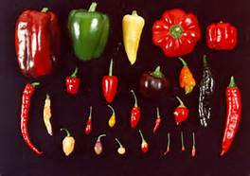
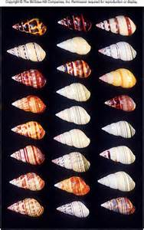
Variation
How many species of living things do you think are on Earth?
Best Guess = between 10 – 100 million
Currently identified as 1.8 million
99% of the species that have ever lived are now extinct

Slide 4
Species
Species are the basic unit of classification (but it is not always easy to define)
Organisms in the same species:
Are similar in appearance (morphology), behaviour and biochemistry, and have the same ecological niche
Can breed together in their natural environment to produce fertile offspring.
Share a common ancestor

Slide 5
The Binominal System of Naming Species
2 Names are used based on Latin or Greek names
1. Generic Name - gives the genus (like a surname)
2. Specific Name - gives the species (like a 1st name)
No two species share the same specific name
Always capital letter Always lower case letter
Homo sapiens
Always in italics
(or underlined handwritten)

Slide 6
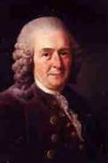
Carolus Linnaeus
What did he do?
Devised a hierarchical structure for classification
Similar organisms were organised into groups
These were contained within larger composite groups
There was no overlap between groups and a species can only appear once.

Slide 7
Courtship Behaviour
Reproduction is vital for the continuation of a species (or some would argue the continuation of genes).
Inherited (genetic) courtship behaviour allows:
recognition of members of their own species
identification of a mate that is capable of breeding
formation of a pair bond
synchronisation of mating
Become able to breed

Slide 8
Courtship Behaviour
In summary this allows viable mates to produce offspring that are fertile.
Males & (particularly) females can advertise to potential mates that they are ready to reproduce
http://www.youtube.com/watch?v=yC6JM8oZzwI
https://www.youtube.com/watch?v=W7QZnwKqopo
http://www.youtube.com/watch?v=pKKMAF_wt9Q
https://www.youtube.com/watch?v=kxuijR_KdPg

Slide 9
Questions
Using the table above identify which 2 ducks are the same species? Explain your answer.
Which duck is the closest related to the 2 ducks identified in question 1? Explain your answer.
Which duck is least related to the 2 ducks identified in question 1? Explain your answer

Slide 10
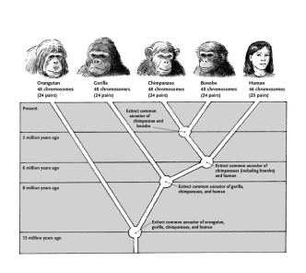
Classification
The organisation of living things into groups
Helps to bring order to our understanding of living organisms
Helps us to understand the origins of all life on Earth

Slide 11
Classification
There are 2 main forms of biological classification
Artificial | Natural/Phylogenetic
Grouped according to simple, observable differences e.g. colour, size, no. of legs | Based on evolutionary relationships
Analogous Characteristics = the same function with different evolutionary origins e.g. wings in butterflies & birds | Species classified into groups using shared features derived from ancestors
 | Groups are arranged into a hierarchy - i.e. groups into larger groups with no overlap
 | Based on homologous characteristics (same origin, different function e.g. wing of bat, arm of human

Slide 12
Taxonomy
A group of similar organisms at any level is called a taxon and the science of classification is called taxonomy.
Various characteristics are used to group organisms:
Morphology - visible structures
Ultrastructure - microscopic features (e.g. cell wall)
Embryology - stages of embryo development
Palaeontology - structure & age of fossils
Ethology - behaviour patterns (animals!)
Biochemistry - Metabolic pathways used by an organism
Molecular Biology - sequence of an organisms DNA/proteins

Slide 13
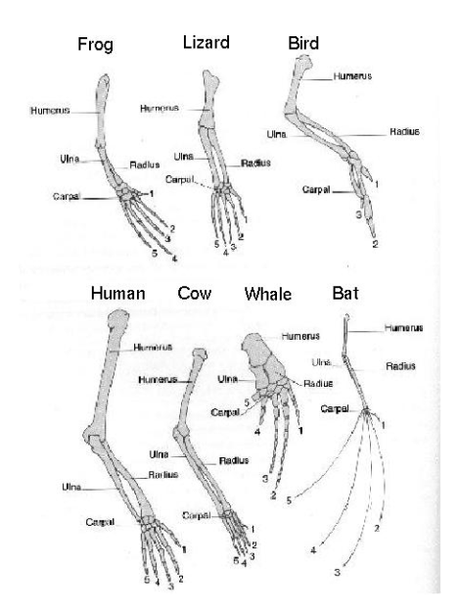
Pentadactyl Limb of Vertebrates
Homologous structures are structures with similar evolutionary origins regardless of their functions in the adult of a species .
A pentadactyl limb is any limb that has five digits (e.g. five fingers or toes)
Pentadactyl limbs are present in many species from many groups of organisms, including mammals, reptiles and amphibians
In these different species, the pentadactyl limb has a fairly similar bone structure but sometimes fulfils quite a different function
For example, the human hand is used for handling tools and other objects but the pentadactyl limb of a bat is highly adapted for flight
Although the individual bones of the pentadactyl limb in these two species are very different shapes and sizes, their layout is almost exactly the same
The high level of similarity in the bone structure of the pentadactyl limbs of mammals, reptiles and amphibians provides strong evidence that these groups all evolved from a common ancestor
Their limbs would most likely have had very different bone structures if they had all evolved from different ancestors.

Slide 14
Organising the groups of species - taxonomy
Each group within phylogenetic biological classification is called a taxon (plural taxa).
Taxonomy is the study of these groups and their positions in a hierarchical order.
They are based on evolutionary line of descent.
A domain is the highest taxonomic rank. There are 3 Bacteria, Archaea and Eukarya.

Slide 15
Taxonomic Groups
Hierarchy is defined as groups within groups with no overlap between the groups.
The hierarchy actually has 8 different ranks:
Domain
Kingdom
Phylum
Class
Order
Family
Genus
Species
The best way to remember these rank is with a mnemonic.
In your student booklet make up your own mnemonic to help you remember these
You only need to understand the principles of sorting species into groups - you won't have to remember all the details for any particular taxa.

Slide 16
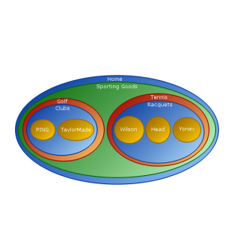
Hierarchy/taxonomc groups can be displayed as a tree or Venn diagram

Slide 17
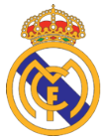
Work through the next slides to see how non-overlapping hierarchical groups are formed. (Some of the clubs may be in different division now since this presentation was made.) Could you sort these football clubs into a hierarchical groups?

Slide 18
They can be divided by country

Slide 19
They are all football clubs

Slide 20
And then by division

Slide 21
Each group we create could then be part of a much larger group

Slide 22
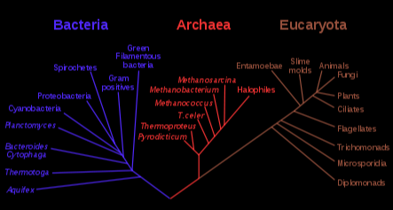
Domain Theory
Read the following slides to see how domain and kingdoms are classified. You do not need to memorise the information but it will be important to know the features of each of these groups
The three-domain system is a biological classification introduced by Carl Woese in 1977 that divides cellular life forms into archaea, bacteria, and eukaryote domains. In particular, it emphasizes the separation of prokaryotes into two groups, originally called Eubacteria (now Bacteria) and Archaebacteria (now Archaea). Woese argued that, on the basis of differences in 16S rRNA genes, these two groups and the eukaryotes each arose separately from an ancestor with poorly developed genetic machinery. To reflect these primary lines of descent, he treated each as a domain, divided into several different kingdoms.

Slide 23
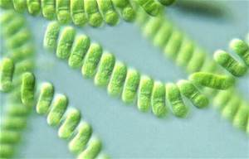
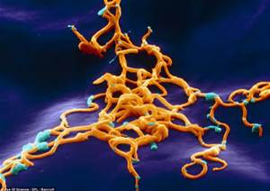
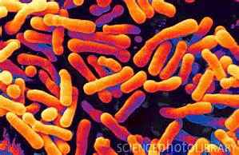
Bacteria Domain
Bacteria are single-celled prokaryotes that contain most know pathogenic organisms.
Their common features are:
Absence of membrane-bounded organelles such as nuclei or mitochondria.
Unicellular, although cells may occur in chains or clusters.
Ribosomes are smaller (70s) than in eukaryotic cells.
Cell walls are resent and made of murein (but never chitin or cellulose)
Some examples include:
Cyanobacteria – photosynthesizing bacteria
Spirochaete – bacteria that cause syphilis and Lyme disease
Firmicutes – bacteria including Bifidobacterium animalis which is present in the human large intestine
Cyanobacteria
Borrelia Burgdorferi Lyme Disease Bacteria
Bifidobacterium animalis

Slide 24
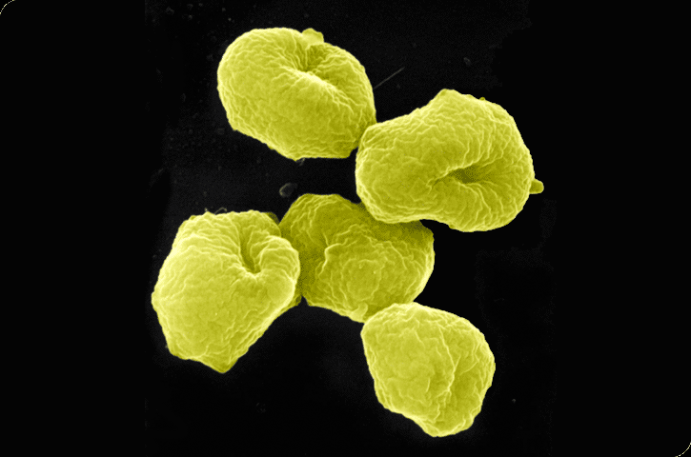
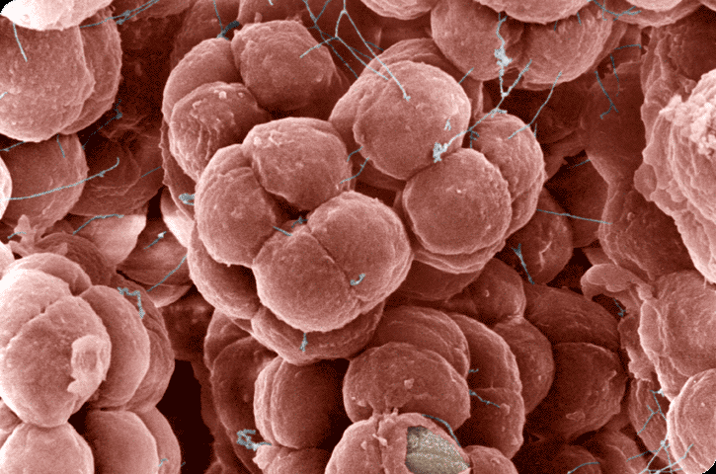
Archaea Domain
Archaea are single-celled prokaryotic that were originally classified as bacteria which they resemble in appearance. They have a unique ancient evolutionary history and are considered the oldest species of organisms on Earth. They often live in extreme environments.
Their common features are:
Their genes and protein synthesis are more similar to eukaryotes
Their membranes contain fatty acid chains attached to glycerol by ether bridges
There is no muerin in their cell walls
They have a more complex form of RNA polymerase
Some examples include:
Methanogens – metabolize hydrogen and carbon dioxide into methane
Halophiles – thrive in salt
Thermoacidophiles – thrive in acid and high temperatures (up to 110 degrees Celsius)
Sulfolobus – live in acid, sulfur-rich environments
Halococcus salifodinae – lives in water with high concentrations of salt.

Slide 25
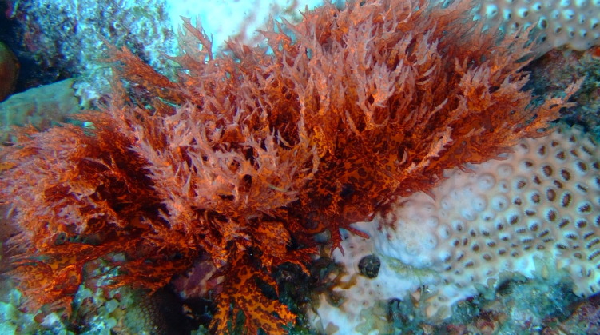
Eukarya Domain
Eukarya are a group of organisms made up of one or more eukaryotic cells.
Their common features are:
Their cells possess membrane-bounded organelles such as mitochondria and chloroplasts
They have membranes containing fatty acid chains attached to glycerol by ester linkages
Not all possess cells with a cell wall, but where they do it contains no murein
Ribosomes are larger (80s) than in Bacteria and Archaea.
The Eukarya are divided into 4 Kingdoms
Kingdom Fungi Saccharomycotina – includes true yeasts
Basidiomycota – includes shiitake mushrooms
Kingdom Plantae Bryophyta – mosses
Magnoliophyta – flowering plants
Kingdom Animalia Arthropoda – includes insects, arachnids, and crustaceans
Chordata – includes vertebrates and, as such, human beings
Kingdom Protista Rhodophyta – red algae
Chromalveolata – includes dinoflagellates

Slide 26
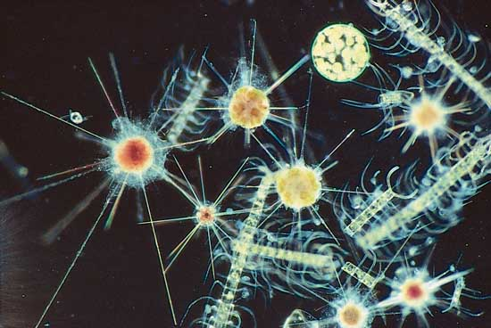
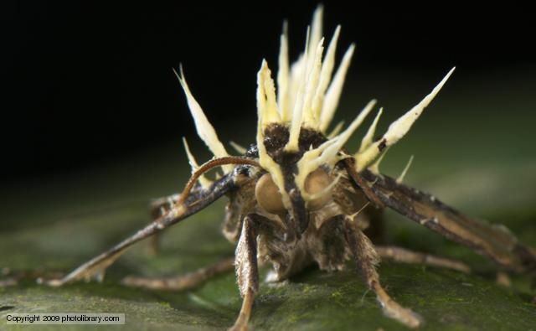
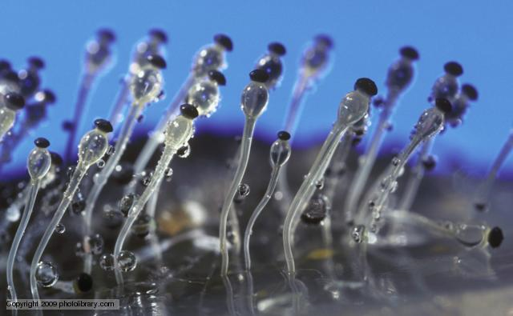
Diatoms and radiolarians
Cordyceps – parasitic fungus on an ant
Hat thrower fungus

Slide 27
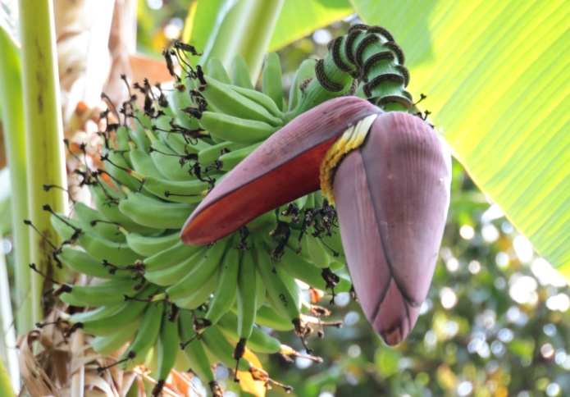
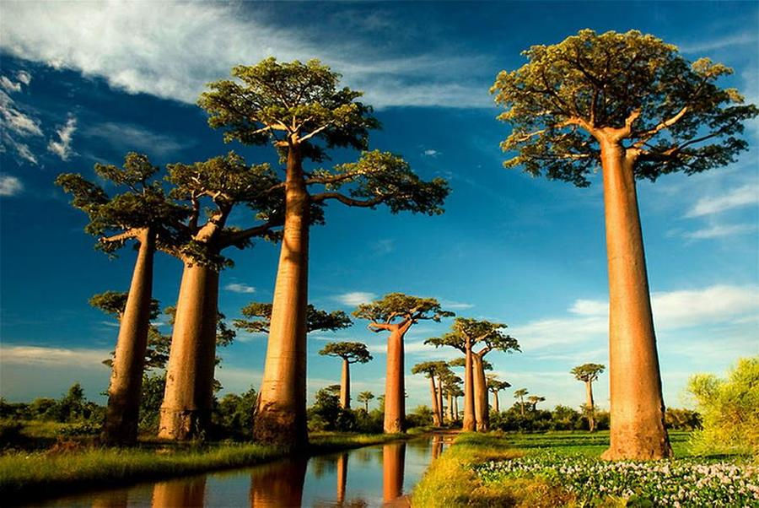
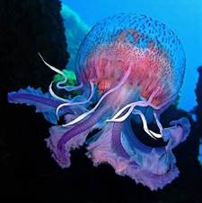
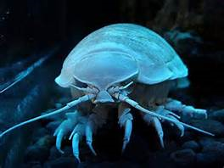
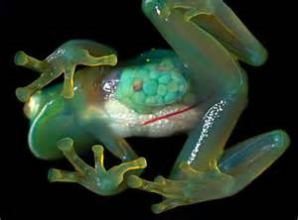
Banana tree flower
Baobab trees
Deep sea isopod
Transparent frog
Jelly fish

Slide 28
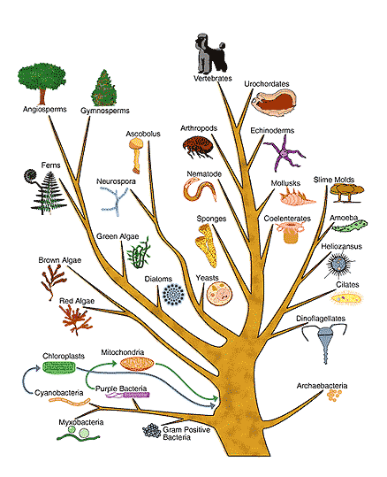
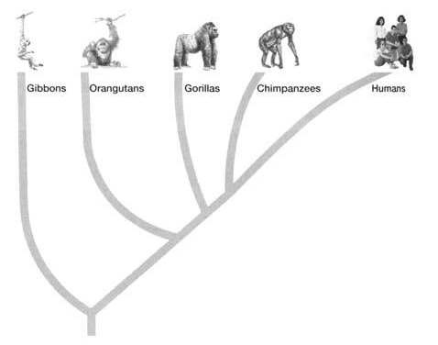
Phylogeny
The evolutionary relationship between organisms is called phylogeny.
Phylogenetic trees represent these relationships.
The oldest groups/species are at the base and the most recent at the end of the branches.
It demonstrates the point of divergence from common ancestor and different groups
e.g. members of the hominidae
family (great apes and
humans).
Closely related species
diverged most recently.
http://www.youtube.com/watch?v=fQwI90bkJl4
This tree shows the 5 kingdoms and the phyla into which they divide (before Domain theory)

Slide 29
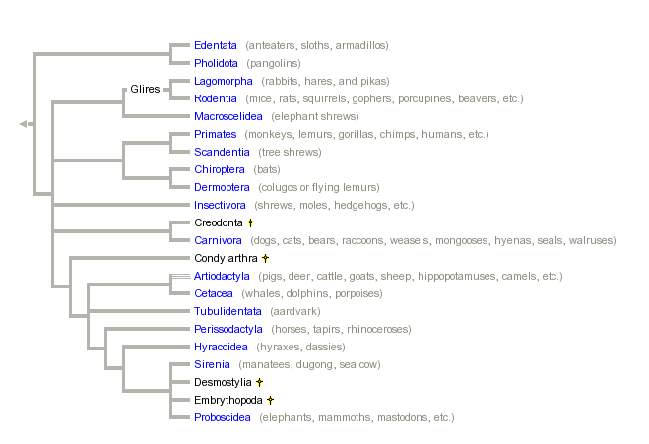
This tree shows the phylogeny within the class of Mammalia - showing the orders into which it divides
Phylogeny of Placental Mammal Orders

Slide 30
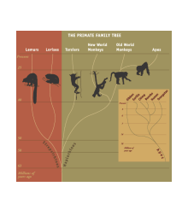
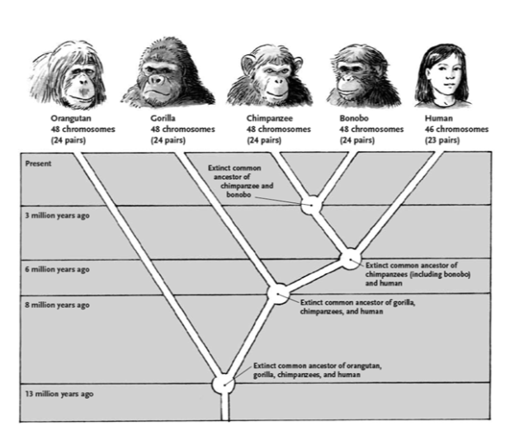
The Primate Order

Slide 31
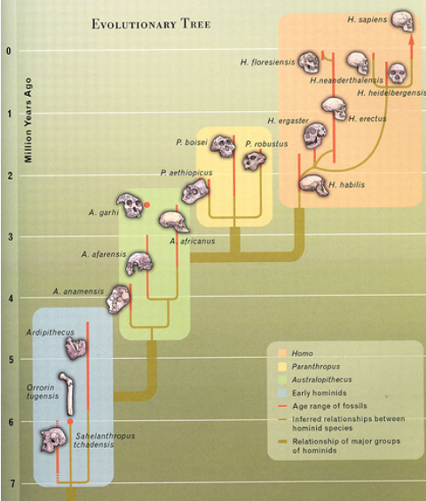
Common Ancestry
Species that appear to be very similar, and hence closely related, must have shared a common ancestor in recent evolutionary history
Species that appear to be very different, and hence distantly related, must have shared a common ancestor far back in evolutionary history

Slide 32
Evidence for relationships between organisms
Genetic Comparisons (To be covered in more detail next term)
DNA
- Base sequences
- DNA Hybridisation
Proteins
- amino acid sequences
- immunological comparisons (agglutination)
Courtship Behaviour
The origin of all courtship behaviour is genetic & therefore gives evidence for evolutionary relationships between species

Slide 33
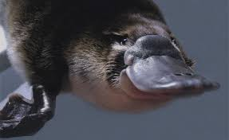
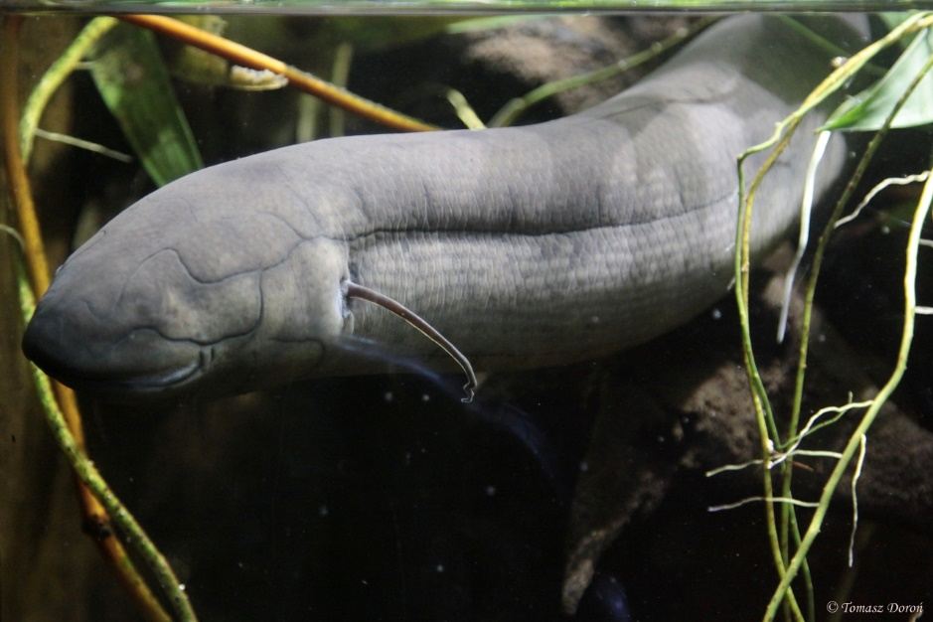
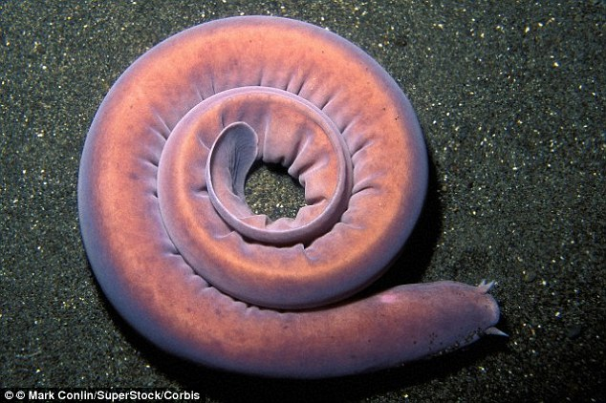
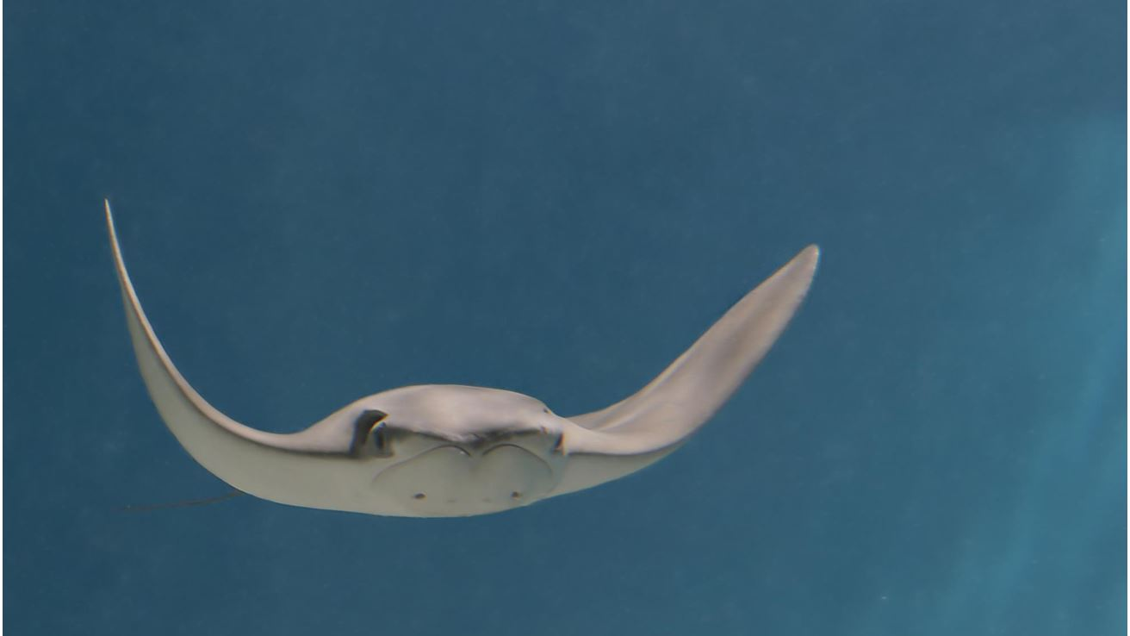
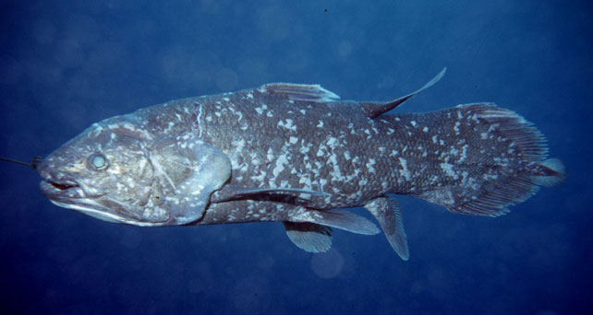
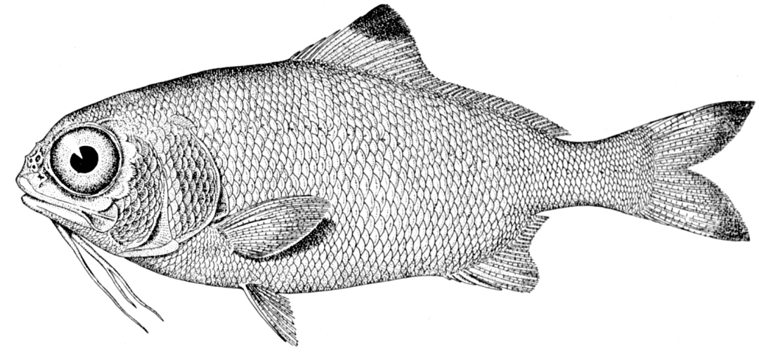
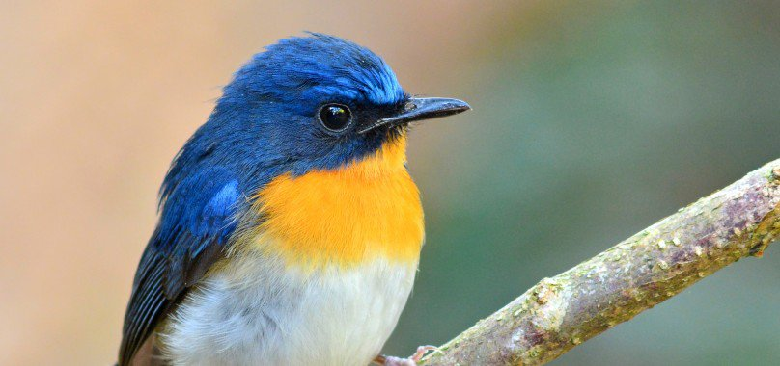
Is it a fish?

Slide 34
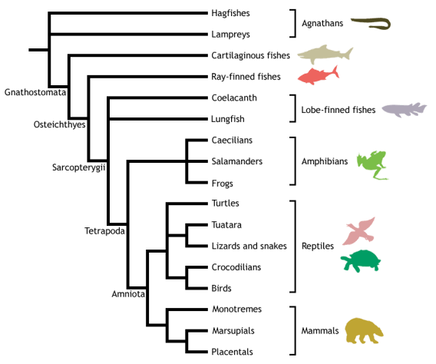
Is it a fish?

Slide 35
There’s no such thing as a fish
Given that lungfish are actually part of a group that includes you, me, reptiles and birds etc… we have to conclude that either we are all fish, or there is no such thing as a fish at all.

Slide 36
Reptiles?
Similarly, if turtles are reptiles, then so are chickens…….

