Slide 1
3.4.6 Biodiversity within a community

Slide 2
Biodiversity
Biodiversity i.e. all the variation that exists within and between all forms of life
It can be considered at 3 different levels:
Genetic diversity- the variety of genes possessed by the individuals that make up a population of a species
Species diversity- number of different species and number of different individuals of each species within any one community at a given time
Ecosystem diversity - the range of different habitats from a small local habitat to the entire Earth.
Biodiversity is very important for the resilience of ecosystems, it allows them to resist changes in the environment.
Biodiversity is an important indicator of a habitats health.

Slide 3
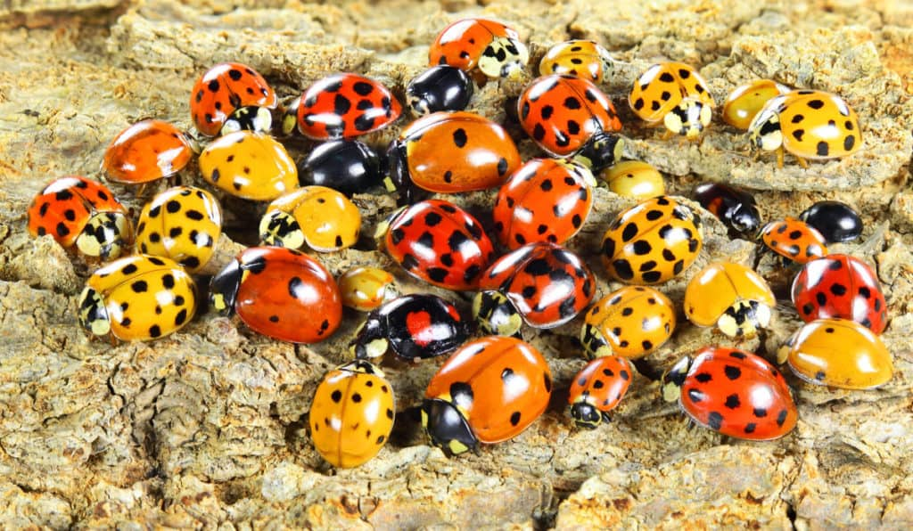
Genetic Diversity
Genetic diversity is the variation of alleles within a species or a population of a species at a given time.

Slide 4
Habitat or Ecosystem Diversity
If there is a large number of different habitats within an area, then that area has high biodiversity
Habitats include physical (abiotic) factors like soil, temperature as well as living (biotic) factors
Coral reefs have lots of microhabitats and niches to be exploited and show high habitat diversity
If there is only one or two different habitats then an area has low biodiversity
Large sandy deserts typically have very low biodiversity as the conditions are basically the same throughout the whole area

Slide 5
Species Diversity
1. Richness
The number of different species in a community.
2. Evenness/Abundance
The number of individuals for each different species. This shows the abundance of each species.
The greater the number of species in an ecosystem, and the more evenly distributed the number of organisms is among each species, then the greater the species diversity

Slide 6
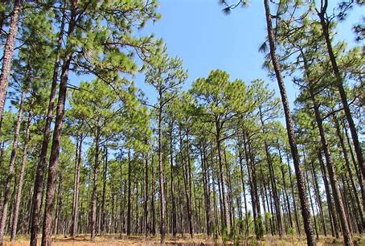
Importance of High Biodiversity
Ecosystems with high species diversity are usually more stable than those with lower species diversity as they are more resilient to environmental changes
E.g. Pine forests of Florida, the ecosystem is dominated by one or two tree species. If a pathogen comes along that targets one of the two dominant species of trees, then the whole population could be wiped out and the ecosystem it is a part of could collapse

Slide 7
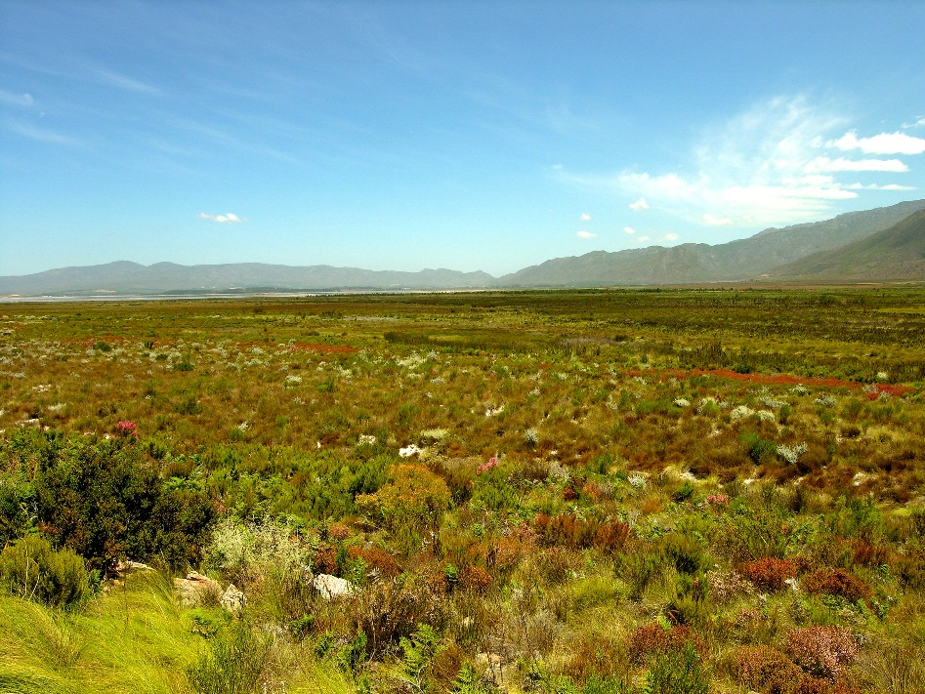
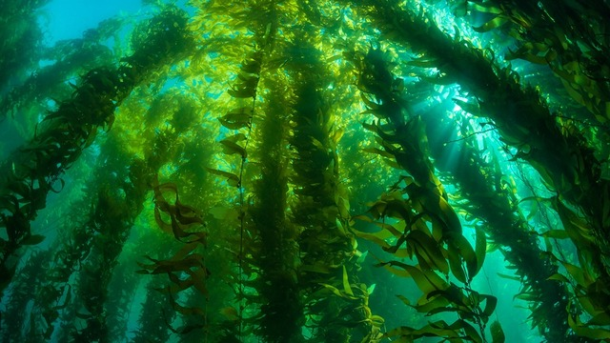
Simpsons Index of Biodiversity
Which is more diverse?
Species richness can be a misleading indicator of diversity as it does not take into account the number of individuals of each species.

Slide 8
Simpsons Diversity Index
Look at the following tables showing the results of samples down in two habitats.
Think about which habitat has the greater species richness and which habitat has the greater species evenness
Alex explaining Simpsons diversity index
Explanation
https://youtu.be/jXAKvMxiQ6A
Worked example
https://youtu.be/DuLs8Q1Io-s

Slide 9
Species Richness?
Species found | Numbers found in habitat X | Numbers found in habitat Y
A | 10 | 3
B | 10 | 5
C | 10 | 2
D | 10 | 36
E | 10 | 4
Total no. of organisms (N) | 50 | 50
Both have 5

Slide 10
Species Evenness?
Species found | Numbers found in habitat X | Numbers found in habitat Y
A | 10 | 3
B | 10 | 5
C | 10 | 2
D | 10 | 36
E | 10 | 4
Total no. of organisms (N) | 50 | 50
Habitat X has numbers which are much closer

Slide 11
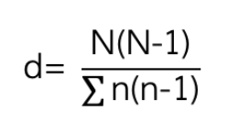
Simpson's Diversity Index
An index of diversity is the relationship between the number of species present and how each species contributes to the total number of organisms that are present in that community.
There are different indices that can be used to calculate diversity your exam board uses this one:
Where:
n = total no. of organisms for a single species in the community
N = total no. of organisms in the community
Σ = sum of

Slide 12
Interpreting Simpsons Diversity Index
It takes into account both richness and evenness
The larger the number obtained, the higher the level of diversity
The lowest possible value of D is 1 (only 1 species found)

Slide 13
Worked example
Species found | Numbers found in habitat X | Numbers found in habitat Y
A | 10 | 3
B | 10 | 5
C | 10 | 2
D | 10 | 36
E | 10 | 4
Total no. of organisms (N) | 50 | 50

Slide 14
Let’s work out habitat X to start with
Species found | Numbers found in habitat X
A | 10
B | 10
C | 10
D | 10
E | 10
Total no. of organisms (N) | 50
n(n-1)
10 x 9 = 90
10 x 9 = 90
10 x 9 = 90
10 x 9 = 90
10 x 9 = 90
Add them all up = 90 +90 +90 +90 +90
= 450
Now let’s do N(N-1)
D = 2450/ 450
50 x 49 = 2450
D = 5.44

Slide 15
Let’s work out habitat X to start with
Species found | Numbers found in habitat Y
A | 3
B | 5
C | 2
D | 36
E | 4
Total no. of organisms (N) | 50
n(n-1)
3 x 2 = 6
5 x 4 = 20
2 x 1 = 2
36 x 35 = 1260
4 x 3 = 12
Add them all up = 6 + 20 + 2 + 1260 + 12
= 1300
Now let’s do N(N-1)
D = 2450/ 1300
50 x 49 = 2450
D = 1.88

Slide 16
Now for habitat 2
n(n-1)
Flower species | Habitat 2
DAISY | 20
DANDELION | 49
BUTTERCUP | 931
TOTAL | 1000
= 380
20 x 19
49 x 48
= 882
931 X 930
= 865830
Add them all up = 867092
Now let’s do N(N-1)
D = 999000 / 867092
1000 x 999 = 999000
D = 1.15

Slide 17
Biodiversity, Farming and Conservation
Research Task
Do a quick research on the following topics and summarise your findings in your student booklet
What is a monoculture?
How does farming as a monoculture affect the biodiversity of the land?
How do farmers increase the yield of the crops or livestock?
What environmental problems arise from these practises?
How can farmers increase biodiversity on their agroecosystems?
What alternative farming practises could be used to do this?

Slide 18
3.4.7 Investigating diversity

Slide 19
Measuring Genetic Diversity
Genetic diversity within, or between species, can be made by comparing:
the frequency of measurable or observable characteristics
the base sequence of DNA
the base sequence of mRNA
the amino acid sequence of the proteins encoded by DNA and mRNA.

Slide 20
Measurable or observable characteristics
Comparing characteristics of different individuals is usually the quickest but least reliable form of determining genetic diversity
This method was used successfully to classify organisms into the taxonomic hierarchy for hundreds of years before DNA sequencing (See taxonomy presentation)
Characteristics that could be measured include:
Number of legs or number of petals
Characteristics that could be observed:
Colour or patterns on fur/scales/feathers
The problem with this method is that it is not precise enough if only one characteristic is looked at, for example, many animals have four legs
It can be useful if a species has unique characteristics such as tigers
Often if two species cannot be distinguished from their observable characteristics, measurable characteristics will give a better understanding of the similarities and differences

Slide 21
DNA Analysis and Comparison
DNA sequence analysis has replaced using characteristics as a means of determining genetic diversity
DNA is extracted from the nuclei of cells taken from an organism
DNA can be extracted from blood or skin samples from living organisms or from fossils
The extracted DNA is processed, analysed and the base sequence is obtained
The base sequence is compared to that of other organisms to determine evolutionary relationships
The more similarities there are in the DNA base sequence, the more closely related (in that the less distant the species separation) members of different species are
Computers can be used to highlight matches between the DNA samples
The differences between the nucleotide sequences (DNA) of different individuals can provide a lot of information:
The more similar the sequence the more closely related the species are
Two groups of organisms with very similar DNA will have separated into separate species more recently than two groups with less similarity in their DNA sequences
DNA sequence analysis and comparison can also be used to create family trees that show the evolutionary relationships between species

Slide 22
mRNA Analysis and Comparison
mRNA is often easier to isolate from cells than DNA as it is found in the cytoplasm and there are usually multiple copies of the same mRNA
Collected mRNA from an individual can be used as a template to produce cDNA (complementary DNA)
The first strand of cDNA produced is complementary to the mRNA (the same as the template strand of the DNA)
The first strand is then used to produce a second cDNA strand which is the same as the coding strand of DNA
Unlike the original DNA in the nucleus, the cDNA contains only the coding regions of the gene (exons) and no introns
It is important to compare the same mRNA between samples.
mRNA for a known, universal protein is often used and compared, for example, cytochrome-c (from the electron transport chain)
Primers can be used that bind to specific sequences

Slide 23
Amino Acid Sequence Analysis and Comparison
Similarly to mRNA, proteins are often easier to isolate from the cell than DNA
The sequence of amino acids of the same protein can be compared between individuals
The protein chosen must be found in all the individuals/species being compared eg. haemoglobin is used for many animals
Amino acid sequences can also be determined from mRNA sequencing if the 'frame' is known (the correct start codon is determined)
Amino acid sequences of proteins evolve much slower than DNA, especially if the protein is of high importance
Therefore, it is likely that closely related species (eg. humans and chimpanzees) will have the same amino acid sequence even though these species split from their common ancestors millions of years ago
This is because the shape, and therefore function and specificity, of a protein is determined by the amino acid sequence as the position of amino acids determines the intermolecular forces between R groups

Slide 24
Cement your knowledge
Short video explaining how sequencing occurs – put qs about video in booklet
https://www.youtube.com/watch?v=BQWGSqJHVsA
Mr Anderson links taxonomy and DNA sequencing
https://www.youtube.com/watch?v=BQWGSqJHVsA

Slide 25
Measuring species in the field
It is impossible to count every single member of a species within a habitat. Therefore samples are made that should represent the population as a whole
Quantitative measurements of species are made by sampling a habitat to ensure that:
Methods avoid bias otherwise data will be inaccurate
Repeats are made to minimise the impact of chance so data is reliable and representative.
Sampling is done in 2 ways:
Random sampling
Systematic sampling

Slide 26
Using quadrats
The quadrat method is used primarily in studies of plant populations, or where animals are immobile.
Size of quadrat – depends on size of plants/animals and their distribution.
Larger species = larger quadrats
Species not evenly distributed = larger number of smaller quadrats
Number of sample quadrats taken
More sample quadrat = more reliable results
Greater number of species present = more quadrats samples needed
If you only took one sample, there is a very high likelihood that you could place the quadrat on an unrepresentative patch of ground. Repeating many times ensures that your results can be used to calculate a mean average that is close to the true mean.

Slide 27
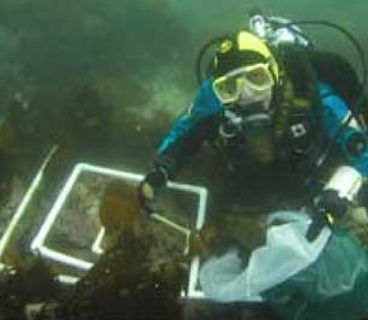
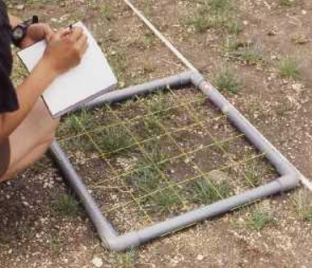
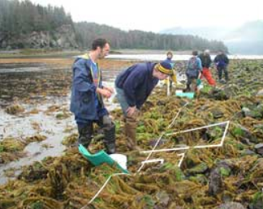
Frame and Grid Quadrats
Squares of different sizes used to look at plant communities and small slow moving invertebrates.
Can be used to look at abundance of species or simply species diversity
It is assumed that the contents of a quadrat is representative of the whole sampling area
Placed in different locations and abundance of each species recorded.
Random sampling with a frame quadrat video
http://www.bing.com/videos/search?q=using+quadrats&&view=detail&mid=45D8E03FDC5EF69EC1E545D8E03FDC5EF69EC1E5&FORM=VRDGAR

Slide 28
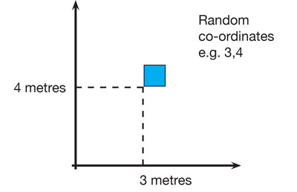
Random Sampling
This is used where you are sampling a habitat as a whole.
Method
Lay out 2 long tapes at right angles in the study area
Obtain a series of coordinates by using random numbers taken from a table or computer
Place a quadrat at the intersection of each pair of coordinates and record number of individuals of the target species is then counted in each of the chosen quadrats.
Repeat this at least 10 times to get representative data

Slide 29
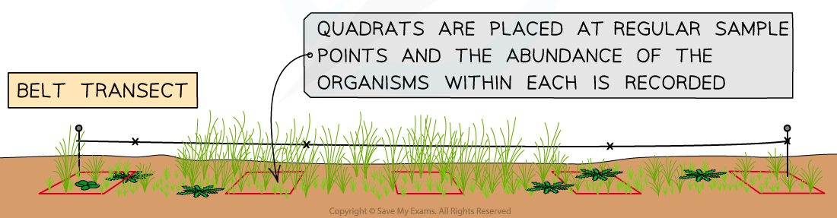
Systematic sampling
To investigate changes in habitats where there is an environmental gradient e.g. going from a shady habitat into a sunny one.
Method
Place a tape measure along the gradient which acts as a transect.
Place your quadrat at regular intervals along the transect and record the number of species and numbers of individuals in the quadrat.
Repeat the entire transect to collect representative results.

Slide 30
Mean & Standard Deviation
In quantitative investigations of variation within a species, many samples will be taken (for reliability) and then the mean and the standard deviation are calculated.
You will not have to calculate standard deviation in your exam but you will need to interpret it and explain what it shows.
Alex video explaining SD
stdev - YouTube

Slide 31
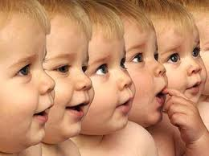
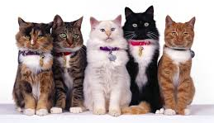
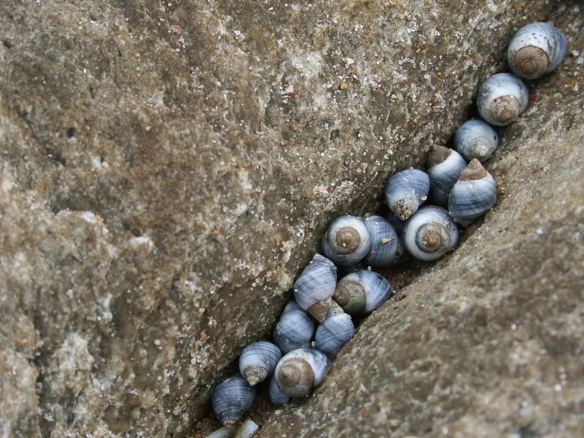
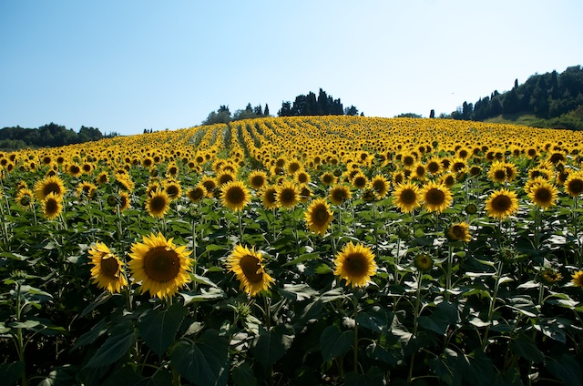
Variation
For each of these species consider:
What features could vary?
How features could be influenced by genes?
How features could be influenced by the environment?
Variation is the result of either genetic differences or environmental factors or a combination of both.

Slide 32
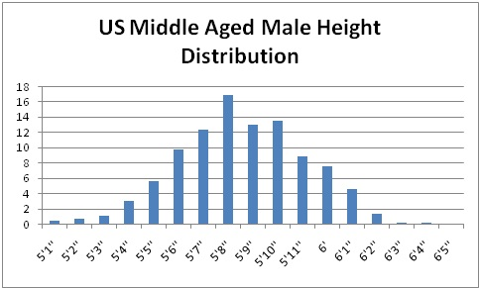
Continuous Variation & Normal Distribution Curve
In Biology, continuous variation within a species usually fits a normal distribution pattern

Slide 33
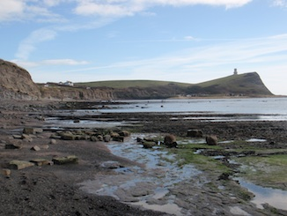
Worked example
Location A
Mean number of periwinkles /rock is 52
Location B
Mean number of periwinkles /rock is 52
I can therefore conclude that there is the same number of periwinkles/rock at location A and B

Slide 34
Problems with this conclusion
Were the samples the same size?
Was this similarity just chance? A scientific conclusion should always consider that it is possible that the similarity is just chance
What was the spread of the data? One set could have been more spread out than the other.
Was there sampling bias? (How can this be avoided?)

Slide 35
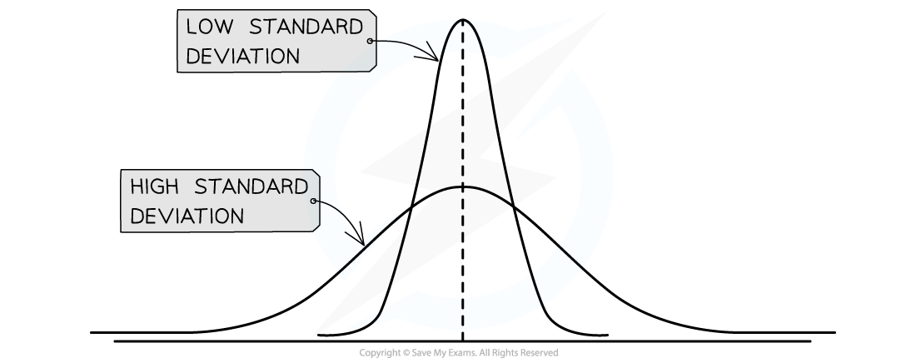
Standard Deviation
Standard deviation measures the spread of data around the mean value
A small standard deviation indicates that the results lie close to the mean (less variation)
Large standard deviation indicates that the results are more spread out

Slide 36
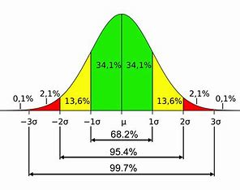
Comparing 2 sets of data using standard deviations
Whether or not the standard deviations of different data sets overlap can provide a lot of information:
If there is an overlap between the standard deviations then it can be said that the results are not significantly different
If there is no overlap between the standard deviations then it can be said that the results are significantly different
When looking at overlap, +/- 2standard deviations are used as this incorporates 95% of the data set.

