Slide 1
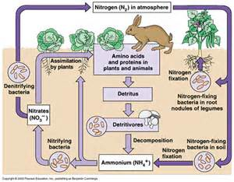
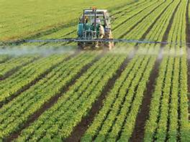
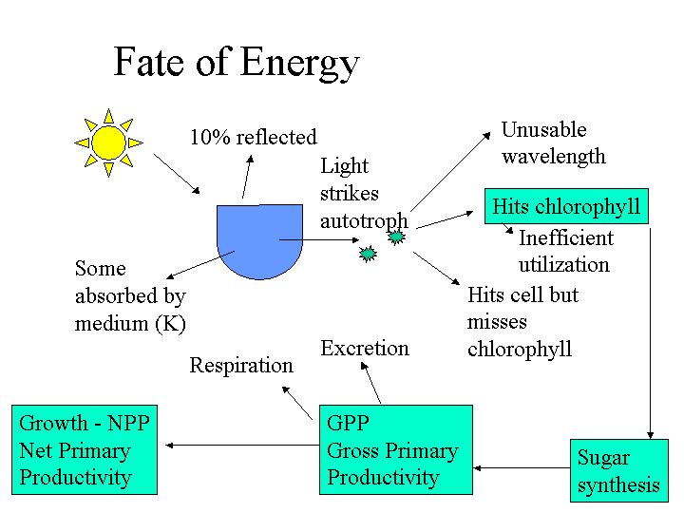
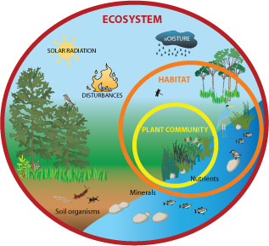
3.5.3 Energy and Ecosystems

Slide 2
10 October, 2016
Energy Transfers and Productivity
Objectives:
To explain how energy is transferred between organisms in an ecosystem.
To calculate the percentage of energy that is transferred from one trophic level to the next and explain where energy is lost.
To explain what is meant by gross primary productivity and net primary productivity.
Notes:
Practical/Demo ideas
Pluck– tie in gas exchange with this unit. Also slices of arteries and veins can be taken off the heart of the pluck to be used in the following lessons practical on elasticity of veins and arteries. (Not sure how much of the arteries and veins will be left on the hearts that the students are dissecting)
Looking at prepared slides of arteries, veins and capillaries under the microscope

Slide 3
Specification 3.5.4
Energy transfers and productivity
In any ecosystem, plants synthesise organic compounds from atmospheric, or aquatic, carbon dioxide.
Most of the sugars synthesised by plants are used by the plant as respiratory substrates. The rest are used to make other groups of biological molecules. These biological molecules form the biomass of the plants.
Biomass can be measured in terms of mass of carbon or dry mass of tissue per given area per given time.
The chemical energy store in dry biomass can be estimated using calorimetry.
Gross primary production (GPP) is the chemical energy store in plant biomass, in a given area or volume, in a given time.
Net primary production (NPP) is the chemical energy store in plant biomass after respiratory losses to the environment have been taken into account,
i.e. NPP = GPP – R
where GPP represents gross production and R represents respiratory losses to the environment.
This net primary production is available for plant growth and reproduction. It is also available to other trophic levels in the ecosystem, such as herbivores and decomposers.

Slide 4
Specification 3.5.4
Energy transfers and productivity
The net production of consumers (N), such as animals, can be calculated as:
N = I – F +R
where I represents the chemical energy store in ingested food, F represents the chemical energy lost to the environment in faeces and urine and R represents the respiratory losses to the environment.
Students should be able to appreciate the ways in which production is affected by farming practices designed to increase the efficiency of energy transfer by:
• simplifying food webs to reduce energy losses to non-human food chains
• reducing respiratory losses within a human food chain.

Slide 5
What is an ecosystem?
An ecosystem is a more or less balanced, self-sustaining natural unit of living (biotic) and non-living (abiotic) components. The biotic and abiotic components interact.
A forest is an ecosystem.
.

Slide 6
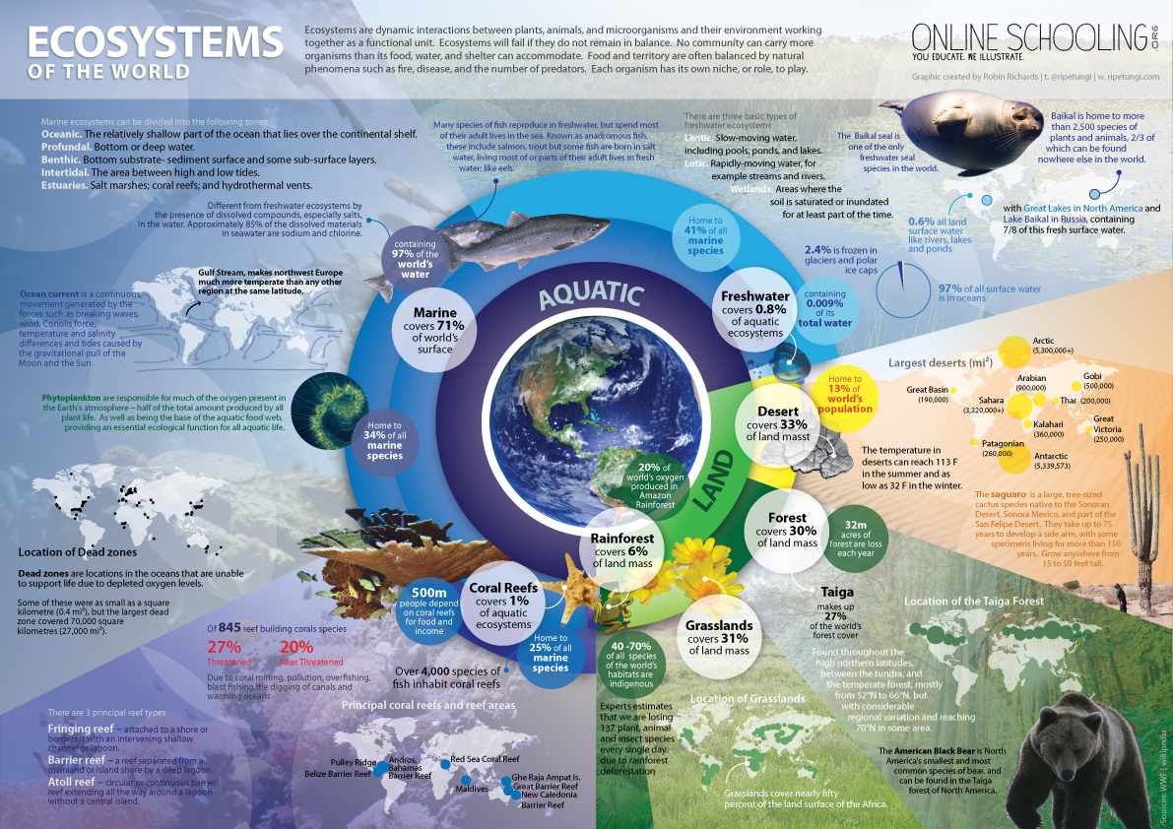

Slide 7
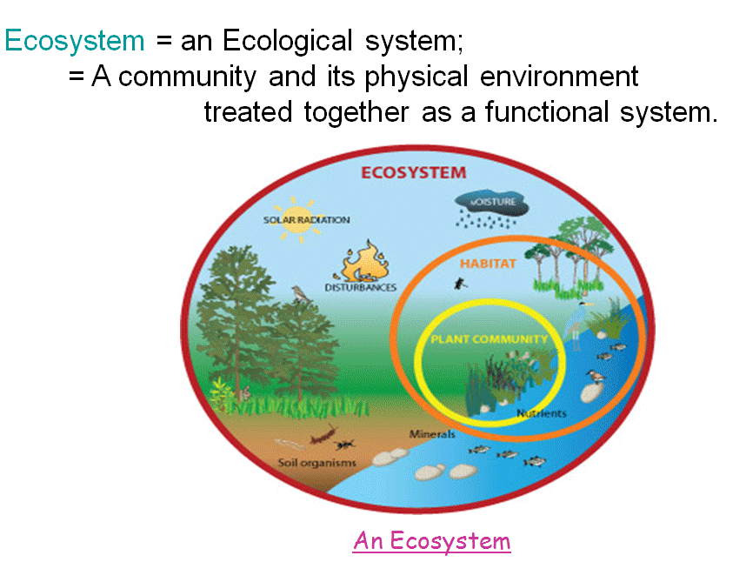
Habitat and community
A community
comprises the different
populations of species
that live in a habitat.
A habitat is the
particular area occupied
by a population.
The place where the
organism lives has abiotic and biotic features which are characteristic.

Slide 8
Biotic and abiotic features
Abiotic features | Biotic features
Edaphic features – water holding capacity of soil, topography | Parasites
Climatic features – light, moisture, temperature | Predators
 | Pathogens

Slide 9
Ecological niche
The place of each species in the ecosystem. Not only physical space but the role the species carries out and its inter-relationships with other species as well.
No two species can occupy the same niche in a specific habitat or they will compete.

Slide 10
Transfer of energy
Plants are autotrophic and use simple organic materials, carbon dioxide and water and solar energy to synthesise energy-containing complex organic compounds.
Herbivores (primary consumers) feed on plants (producers).
Carnivores (secondary, tertiary consumers feed on other consumers.
Each of these groups forms a trophic (feeding) level with energy passing from each level to a higher one as material is eaten.

Slide 11
Saprobionts
Saprobionts (some bacteria and fungi) feed by secreting enzymes on the food substrate (dead organisms) and carry out extracellular digestion. They absorb the end products. They carry out decomposition.
Detritivores feed on small fragments of organic debris from plants and animals. The material is known as detritus eg faeces, fallen leaves. EG Earthworms and woodlice.

Slide 12
Biomass
Biomass – total mass of living material in a specific area at a given time.
Fresh biomass – mass of living material but this includes water content. This can be unreliable.
Dry biomass – mass of living material that has been completely dried out. This will require killing the organism. As biologists would only use a small sample this can all be unrepresentative.
Biomass is measures as dry mass per given area in a given time.
e.g. grams per square meter (gm⁻²) on a grassland or seashore or grams per cubic meter in aquatic environments (gm⁻³)

Slide 13
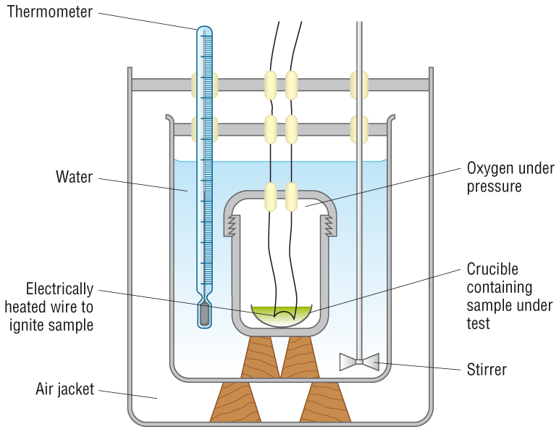
Chemical energy stored in biomass
Bomb calorimeter
A sample of dry mass is weighed and burnt in pure oxygen in a sealed container.
The bomb is surrounded by water and the temperature rise is recorded.
We know how much energy is needed to raise 1g of water by 1ºC so you can calculate the energy released from the mass of your sample in kJ kg⁻¹
Summary questions in student pack

Slide 14
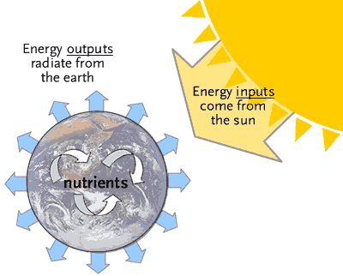
The importance of light
The majority of ecosystems depend on an input of light energy.
Remember “energy cannot be created not destroyed”. This means it can only be transferred.

Slide 15
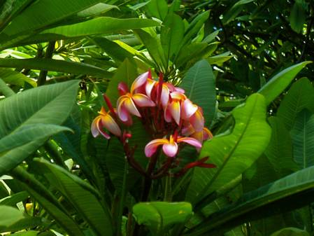
Photosynthetic efficiency
Many ecosystems depend on the light harvesting of plants.
Plants are not very efficient at capturing light energy and converting it to chemical energy of their biomass.
Plumeria shrub – a very high photosynthetic efficiency.
It has a very high leaf vein density – why would this be good?

Slide 16
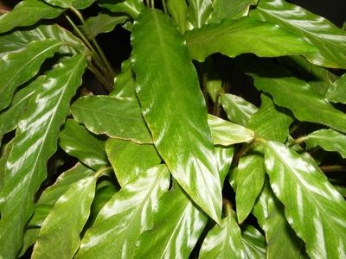
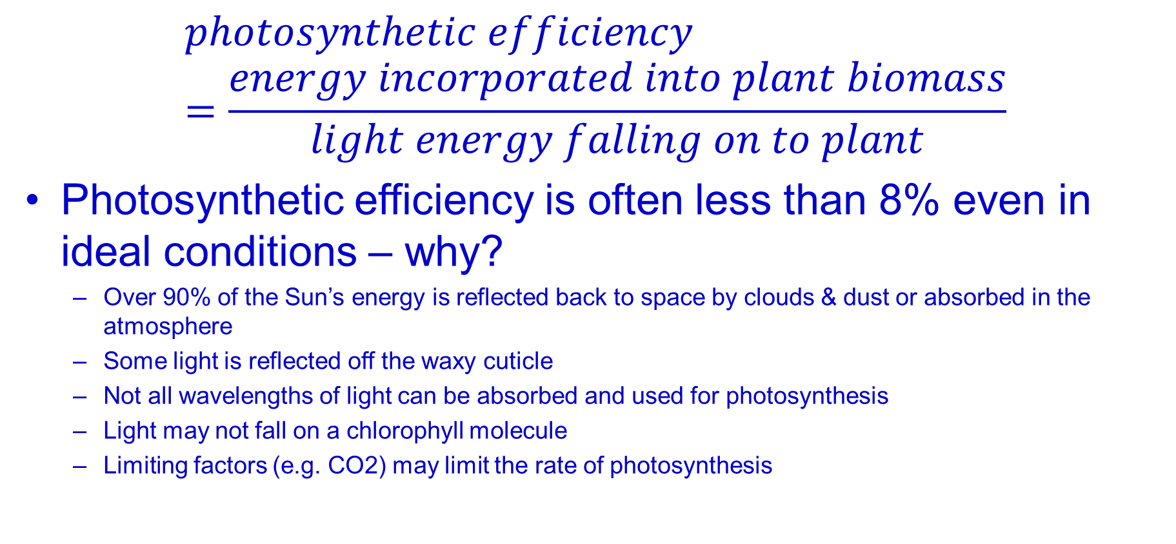
Photosynthetic efficiency
$$photosynthetic efficiency=\frac{energy incorporated into plant biomass}{light energy falling on to plant}$$
Photosynthetic efficiency is often less than 8% even in ideal conditions – why?
  Over 90% of the Sun’s energy is reflected back to space by clouds & dust or absorbed in the atmosphere
  Some light is reflected off the waxy cuticle
  Not all wavelengths of light can be absorbed and used for photosynthesis
  Light may not fall on a chlorophyll molecule
  Limiting factors (e.g. CO2) may limit the rate of photosynthesis

Slide 17
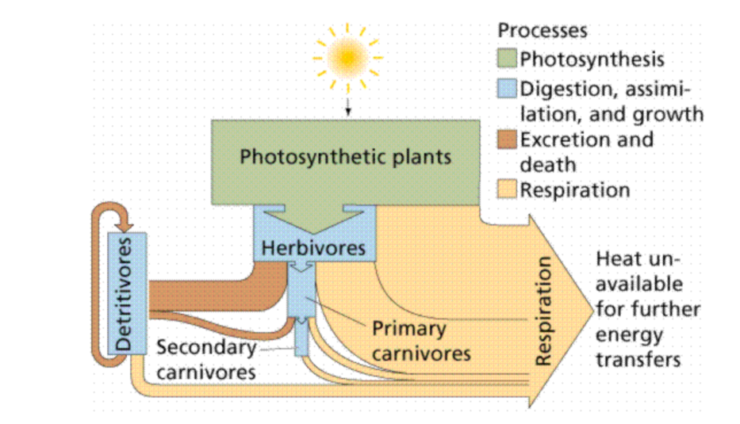
Gross Primary Production
GPP Gross Primary Production is …..
The total quantity of chemical energy stored in plant biomass in a given area, in a given time
However, the plant must ‘use’ some carbohydrate (glucose) for respiration, therefore the amount of chemical energy store which is left after respiration is called the Net Primary Productivity (NPP)

Slide 18
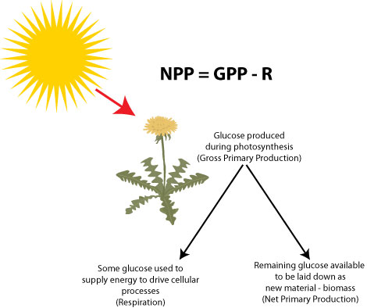
Net Primary Production
The NPP is a plant’s biomass that is available for plant growth and reproduction but also for the next trophic level i.e. primary consumers (as food)
So we use NPP as a measure of what is actually available for animals to eat.
NPP = GPP – R where R = Respiration
Remember: some of the biomass is used to form inedible material e.g. bark or is biomass in roots which is out of reach of primary consumers

Slide 19
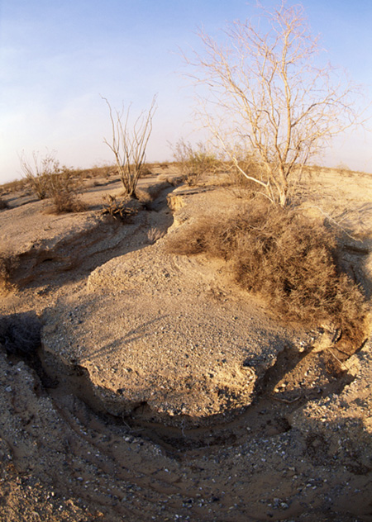
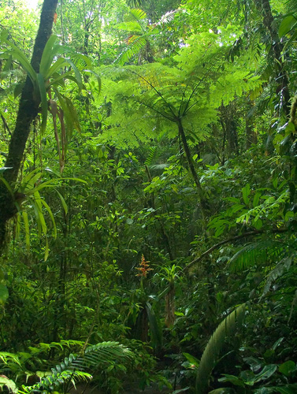

Ecosystem examples
Net primary productivity (NPP) is a good way to compare different ecosystems. The availability of light, water and nutrients are different around the world and therefore the productivity of the world’s ecosystems also varies greatly.
desert ecosystem NPP =
260 kJm⁻² year⁻¹
tropical rainforest ecosystem NPP = 400,000 kJm⁻² year⁻¹
Notes:
Photo credit (desert): Jupiterimages corporation
Photo credit (rainforest): © Shutterstock 2009, Andre Nantel
Teacher notes
Students could be ask to think about why the ecosystems differ in their net primary productivity.

Slide 20
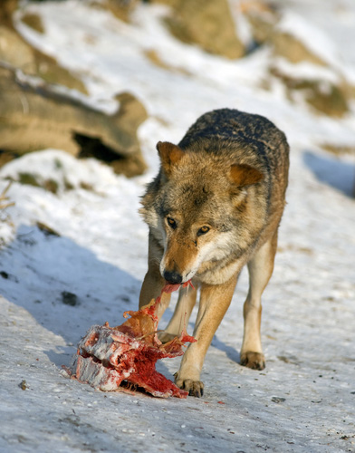
Loss of energy between trophic levels?
A large percentage of the energy is lost between trophic levels.
This is as a result of the following:
Some of the organism cannot be eaten, e.g. bones, fur, etc.
Once eaten, some of the organism cannot be digested.
Energy is lost in excretory materials, such as urine.
Energy is lost in the form of heat from respiration and body heat. This can be very high in endotherms that have to maintain a constant body temperature.
Net production of consumers can be calculated:
N = I – (F + R)
Notes:
Photo credit: © Shutterstock 2009, dean bertoncelj
Teacher notes
Students could be reminded that it is due to this loss of energy between trophic levels that food chains are naturally restricted to a maximum of five trophic levels.

Slide 21
What is trophic efficiency?
The rate at which energy is used to make new organic molecules within heterotrophs is known as secondary production.
As with the transfer of energy from the sun to autotrophs, the transfer of energy from one organism to another is inefficient. The efficiency of chemical potential energy transferred between trophic levels can be measured.
energy available after the transfer
efficiency
=
× 100
energy available before the transfer
The energy available is usually measured in kilojoules per square metre per year (kJm⁻² year⁻¹).

Slide 22
Energy flow through food chains
Inefficiency of energy transfer between trophic levels explains why
Most food chains are 4/5 trophic levels – not enough energy to support higher trophic levels.
The total mass of organisms is less at higher levels
The total amount of energy available is less at each level.

Slide 23
Calculating Net Production of Consumers
Net production of consumers can be calculated:
N = I – (F + R)
N = net production of consumers
I = chemical energy store of ingested food
F = chemical energy lost as faeces and urine
R = respiratory losses
Question 1 from question booklet

Slide 24
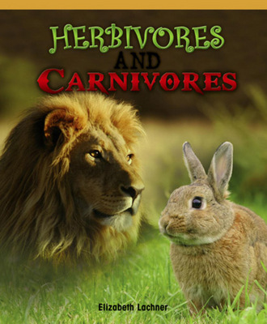
Why do Carnivores have a much higher secondary productivity than herbivores or why are carnivores more efficient than herbivores?
Carnivores are more efficient at energy conversion than herbivores, because they are able to digest and absorb more of their high protein diets
Carnivores are 20% efficient
Herbivores eat cellulose and lignin which are very difficult to digest.
Herbivores are about 10% efficient at converting energy from producer into energy of biomass of their body.

Slide 25
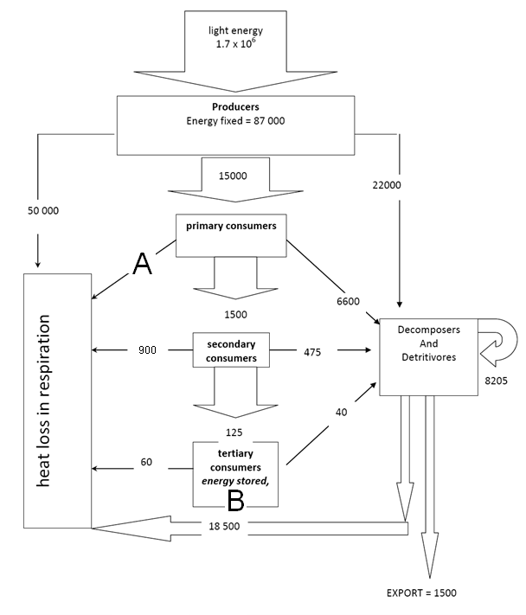
How much energy is lost in respiration by the primary consumers (labelled A)?
2) How much energy is stored by the tertiary consumers (labelled B)?
3) Calculate the percentage efficiency for the secondary consumers.

Slide 26
Intensive Farming
Intensive farming tries to produce as much food as efficiently as possible at the lowest possible production cost. Consumers benefit from ‘low cost food’ but the use of artificial fertilisers, pesticides, herbicides, fungicides, etc. all leave traces of these chemicals on the food.
There are many extreme types of intensive farming, e.g.
growing crops by hydroponics;
growing crops in glasshouses;
fish farming;
battery farming of animals, (e.g. chickens).
Intensive farming of animals requires methods which often raise ethical dilemmas.
The use of synthetic chemicals has caused concerns for public health, e.g. high levels of nitrate in drinking water (used as fertiliser) has been linked to several forms of cancer.

Slide 27
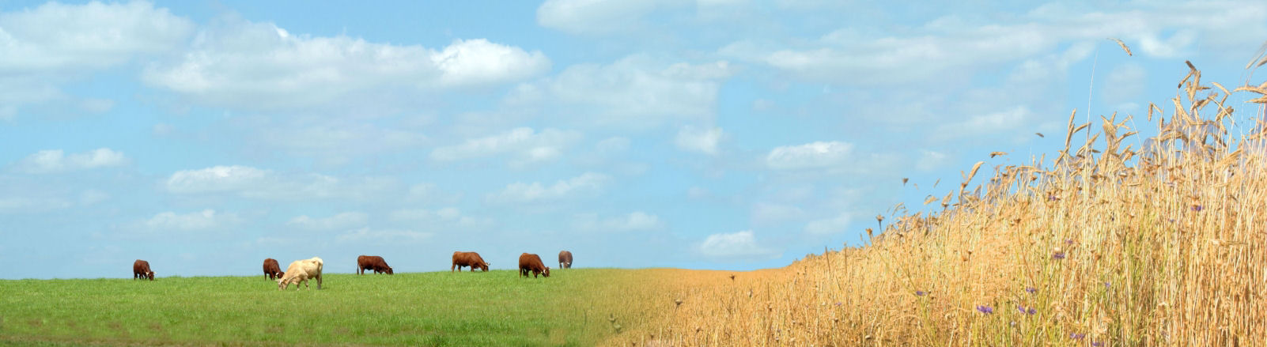
Reducing Energy Loss To Increase Food Production
Approximately 10 times the number of people can be fed by growing crops on the land (which are harvested and eaten directly), rather than using the land for grazing animals and then culling and eating the animals.
This is because there is one less stage in the food chain when crops are grown for direct human consumption.
Relatively inefficient food production
Highly efficient food production

Slide 28
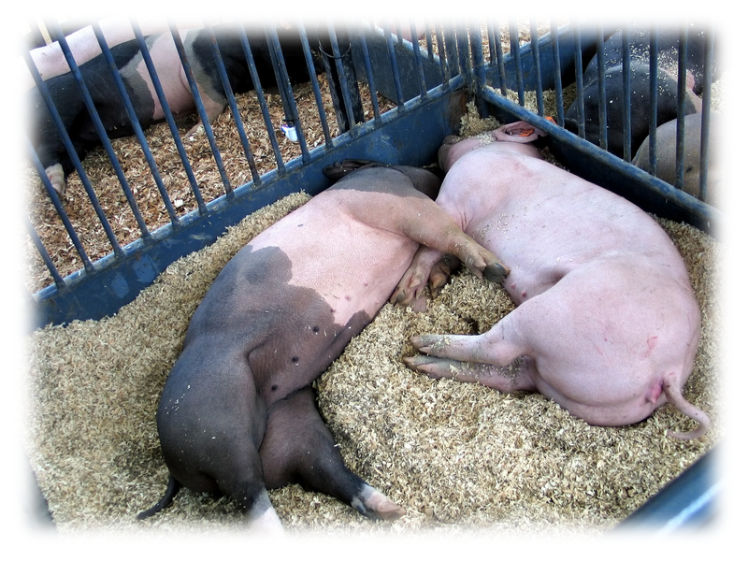
Battery Farming - Reducing Energy Loss
To Increase Food Production (1)
Animal husbandry can be modified so that animals are kept in smaller restricted areas that have controlled temperatures.
In smaller spaces, the animals are not able to move around very much so less energy is wasted. Also if the temperature is higher, the animals can lower their metabolic rate and still keep their body temperature constant.
However, many people have ethical objections to keeping animals in confined conditions for their whole lives.

Slide 29
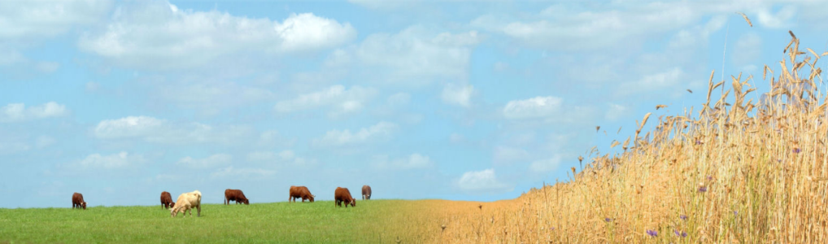

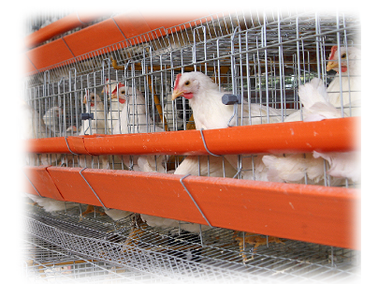
Battery Farming - Reducing Energy Loss
To Increase Food Production (2)
This means that the efficiency of food production can be improved by reducing energy loss by:
reducing the number of stages in a food chain
limiting the movement of livestock
controlling the temperature of their surroundings.
controlling feed given to livestock to ensure the optimum amount is given for growth with no wastage.

Slide 30
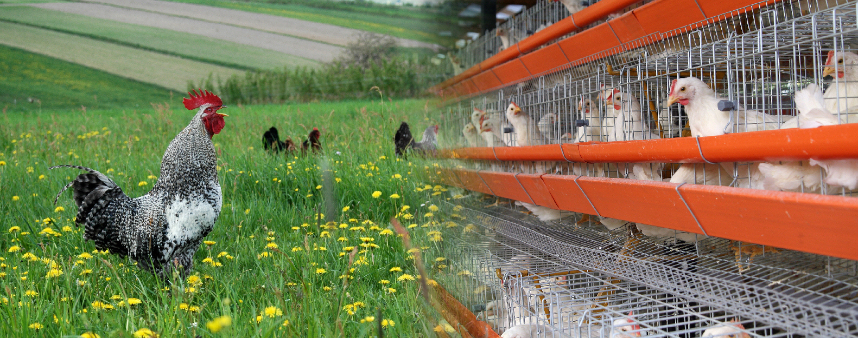
Intensive Farming and Ethics
Intensive farming tries to produce as much food as efficiently as possible at the lowest possible cost. However, intensive farming of animals requires methods which often raise ethical dilemmas.
Free range eggs are more expensive than those produced within battery farms.
Free range chickens
Battery farm chickens

