Slide 1
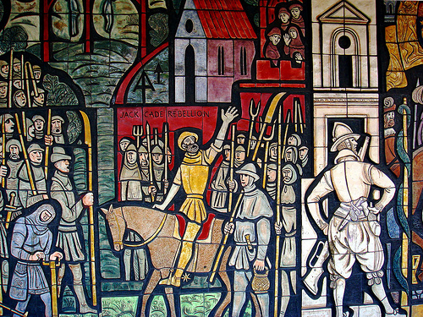
Cade’s Rebellion

Slide 2
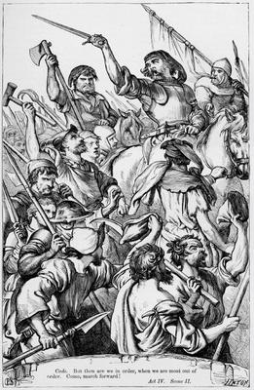
What happened
Cade’s Rebellion was an uprising which began in Kent in 1450. It was led by Jack Cade
The rebels moved through Kent and marched on London. By the time they reached black heath there were 46,000.

Slide 3
Causes
The murder of Suffolk might have triggered a fear that the Kentish folk would be blamed for it.
Taxes were unfairly levied
Taxes had been increased to counter the amount of land Henry had given away

Slide 4
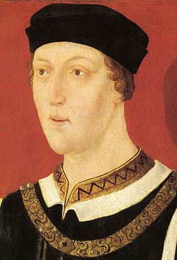
Causes
Justice was not impartial
The kings favourites were blamed for France
There was fear of invasion.

Slide 5
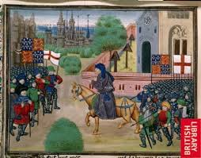
Events
Henry returned with an army of 10000. Cade withdrew but some Henry’s army followed him and were slaughtered. When the king heard of this he fled to the midlands.
Unrest spread and there were murders looting and pillaging.
However once in London the rebels lost control and looted and the Londoners then forced them out

Slide 6
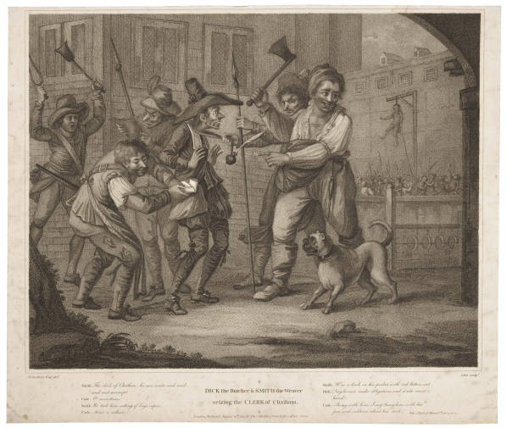
Cade was chased into Sussex where he was killed and his head set on a spike in London.

Slide 7
Why was Cade’s rebellion such a significant moment? What did it demonstrate?

Slide 8
Which reason is most significant?

Slide 9
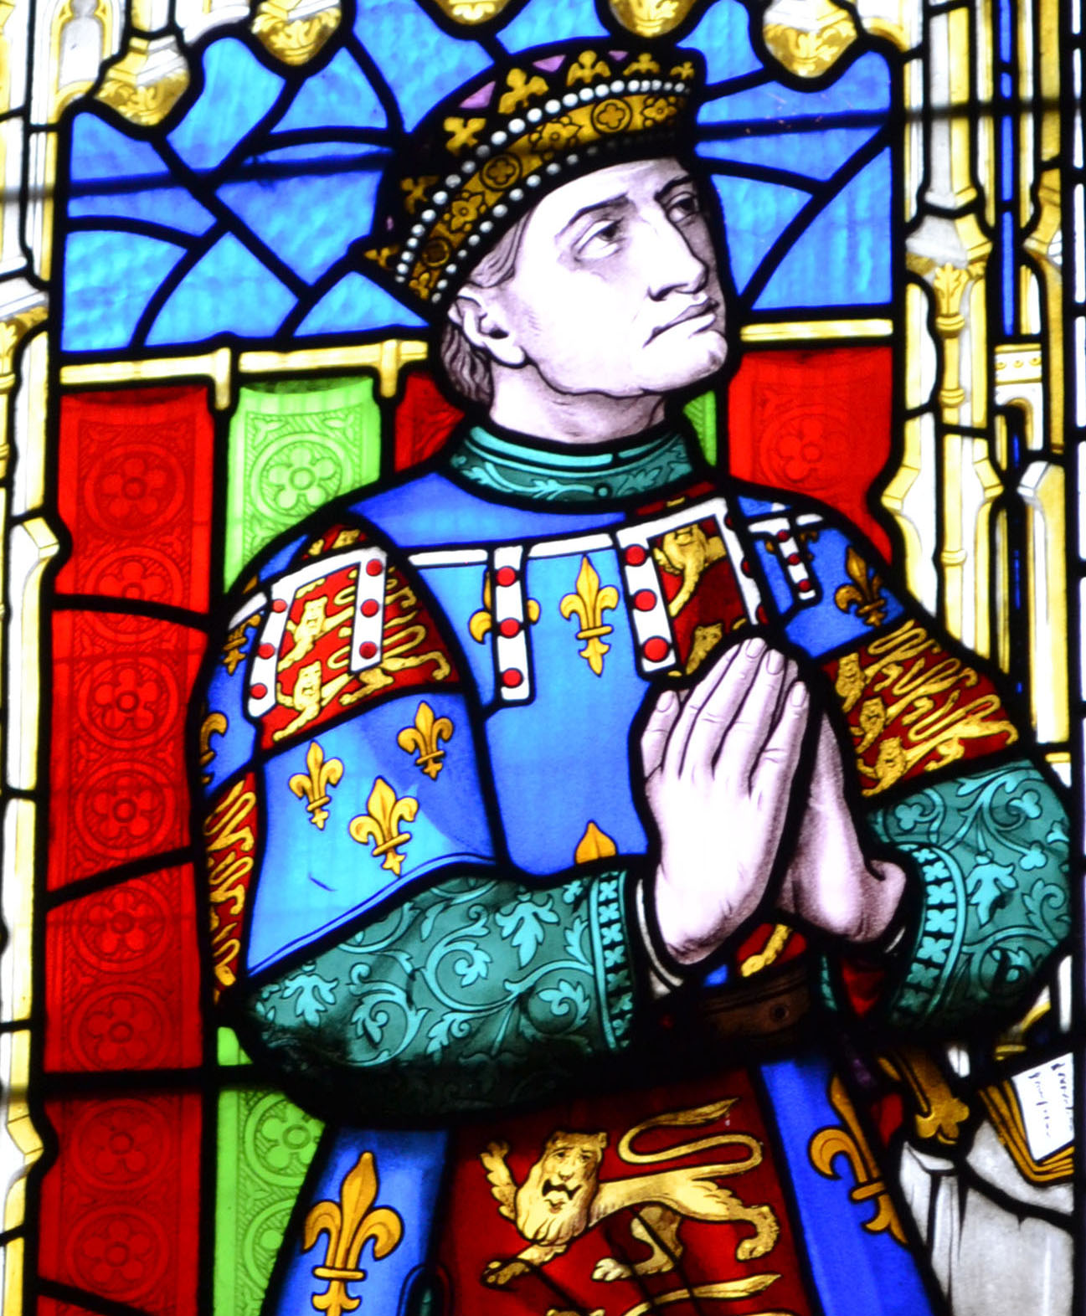
Richard Duke of York
In pairs spend 15 minutes researching Richard Duke of York online (He is the one born in 1411)
List the reasons why York was so important. (para 2 on Wiki)
What were the origins of his feud with Somerset (para 5 on Wiki)
Draw out a family tree of his of his Wife and Children.

Slide 10
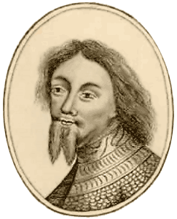
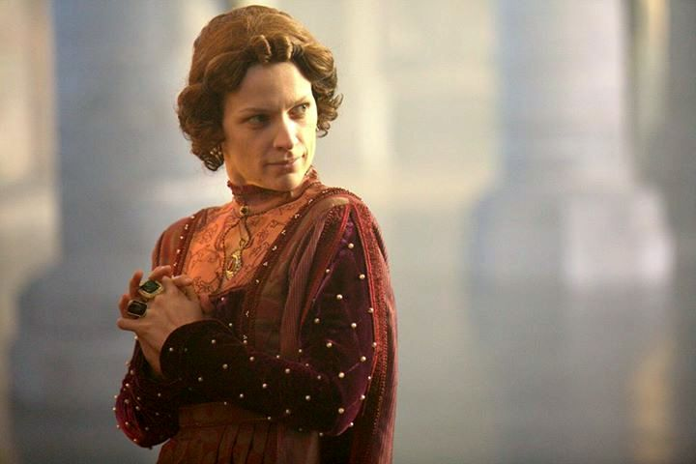
The Duke of York
Ambitious
Tried to rule through the King
Lacked political judgement
Not trusted by Margaret of Anjou

Slide 11
Exclusion of York
York was the King’s closest male relative
Despite this was excluded from government. There were three main reasons for this:
The King already had close advisers, namely the Dukes of Suffolk and Somerset. They did not wish to share power
The Queen did not trust York, because of his forcefulness and his claim to the throne
York was too arrogant, stubborn and demanding

Slide 12
Resentment of York
As well as being excluded from court York also had resentment towards Henry for other reasons.
He had not had his costs paid for his time in France, whilst the Duke of Somerset had.
He felt that he had been sent in to isolation in France
He resented that Somerset had replaced him as commander of France

Slide 13
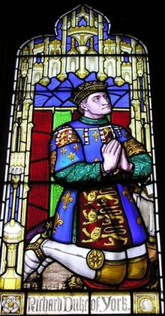
York’s action
Prepared two petitions for the King
In both York was appealing for public sympathy and support
However he found himself isolated and distrusted
Because Henry was ignoring York’s claims, York had no choice but to impose himself by force.
His lack of support meant this was bound to fail and York eventually had to submit to the King. York took an oath of allegiance to him in St Paul’s Cathedral

Slide 14
Use the sources on page 21 in the booklet
Find evidence in either of the sources for the following issues York had:
York resented being replaced by Somerset as Lieutenant General in France
York also resented being ‘exiled’ to Ireland
York blamed Somerset for the key losses in France
York was annoyed with Somerset having his loans repaid promptly by the Crown, while he did not
York felt he had been excluded from his rightful place as principal adviser to the King
Find evidence that this was destabilising the kingdom.
Create a table with these bullet points and include evidence from source M or N.

Slide 15
Imagine you are Richard, Duke of York. Write a letter from Ireland setting out why you think you’ve been treated unfairly

