Slide 1
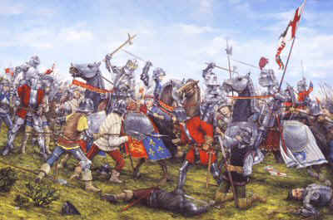

Welcome to The Wars of the Roses and Henry VII

Slide 2
Course Overview Key Topics
Outbreak of the Wars of the Roses
Early actions of Richard Duke of York
War and downfall of the Lancastrians

Slide 3
Course overview British period of study
Edward IV first reign
Edward’s second reign and Richard III
Henry VII Rule in England
Henry VII Foreign policy

Slide 4
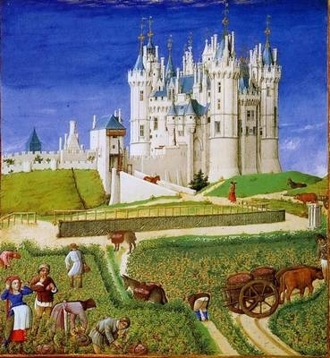
What do you understand by the phrase ‘Medieval’?

Slide 5
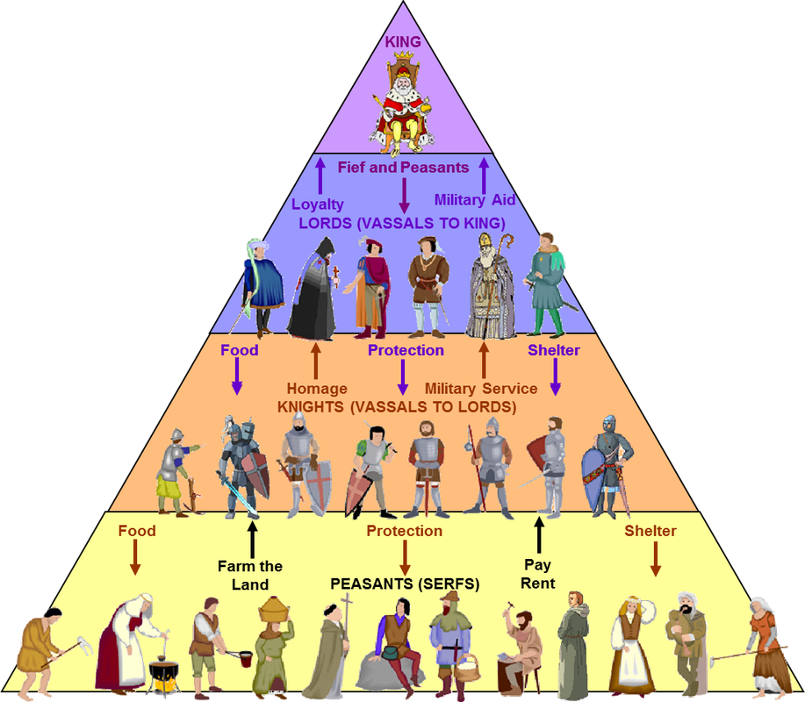
The country was run under the feudal system with the king at the top.
What might be some of the pros and cons of this system?
When would it work and when would it fail?

Slide 6
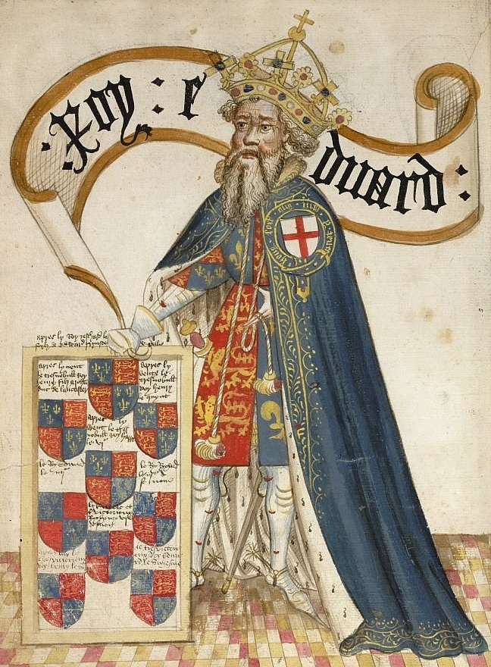
In order to understand our course you have to understand what happened before the Wars of the Roses started.
Look at your family tree and find Edward III.
Who was the king after Edward?

Slide 7
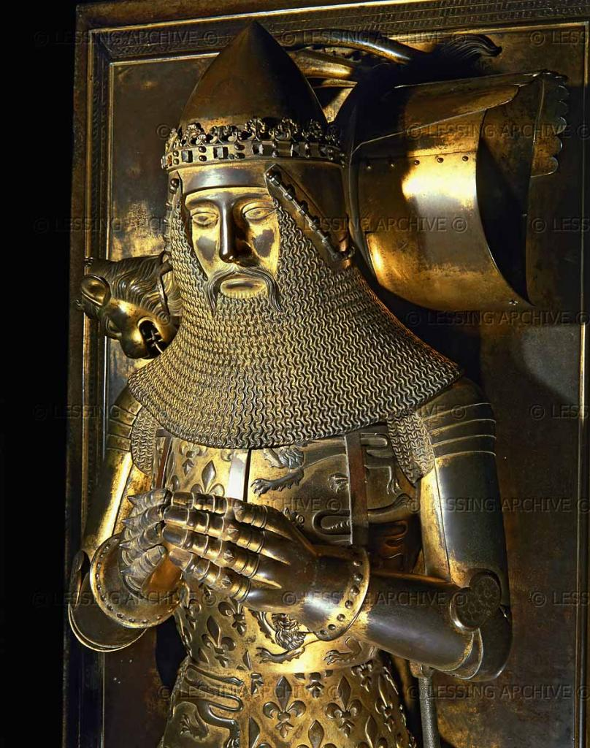
It was not Edward the Black Prince as he died fighting the French in the 100 years war.
Instead it was his son Richard who was only a child.
Look at the painting on the next slide and write down: 1 what this shows about Richard and; 2 what it shows about medieval kings in general.

Slide 8
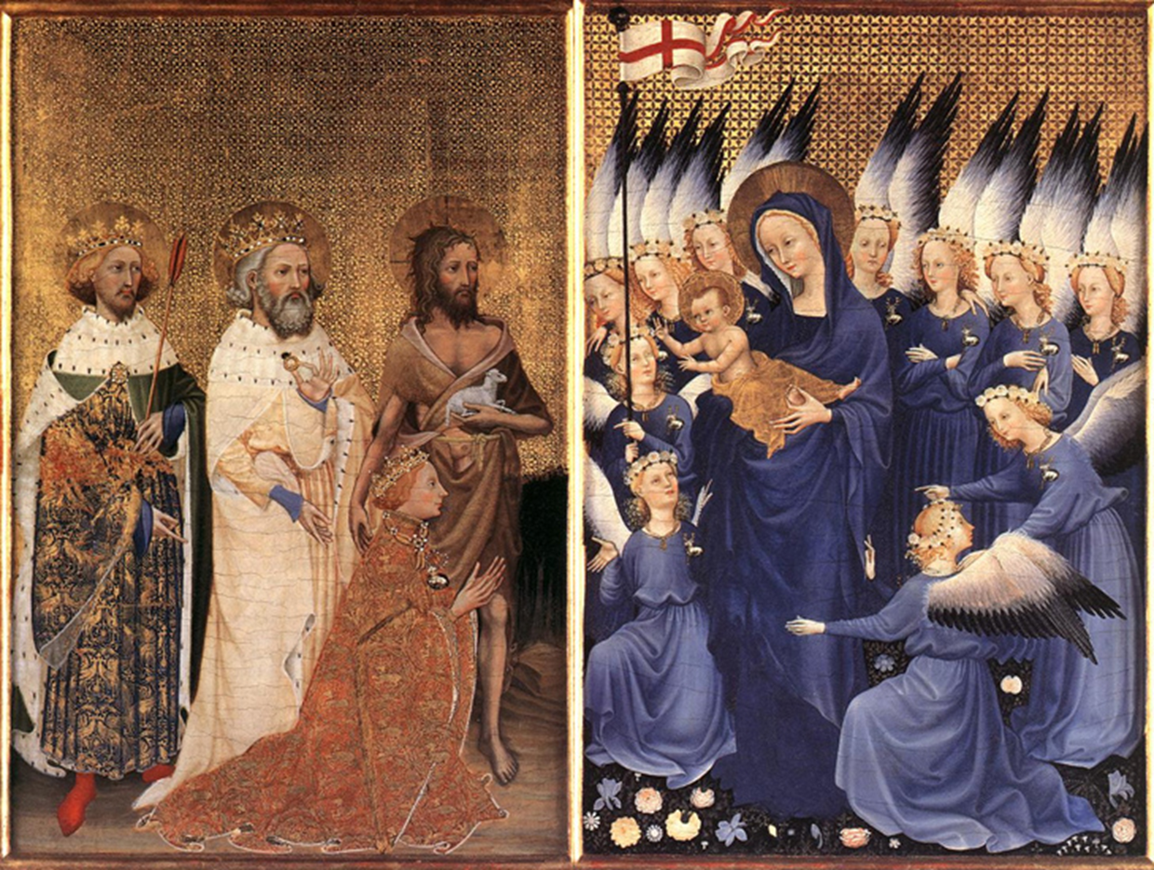
Notes:
Explain the painting and then get students to evaluate in pairs what this shows. Richard on left receiving the kingdom of England from Jesus or handing it to Jesus depending on which art historian you read. Saints are John the Baptist, Edward the confessor and Edmund the Martyr, 2 English kings. Livery of a White stag on Richard (His Livery) Stags also on angels.
Key things for students to notice: 1 Richard is only a child at his coronation 2: He was very religious being painted with Saints 3: Key point Medieval Kings were appointed by God, Discuss the implications of this.

Slide 9
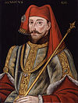
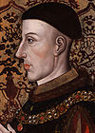
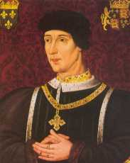
Lancastrians
Notes:
Using Family Tree get the students to list the Lancastrian and Yorkist Kings. Evaluate the lengths of the reigns and what this might imply.

Slide 10
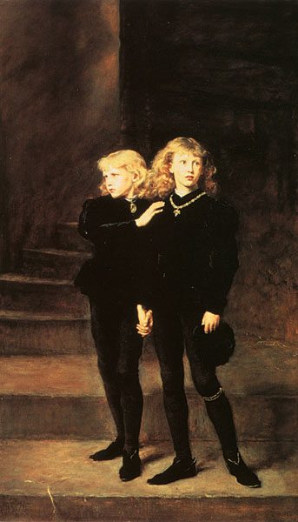
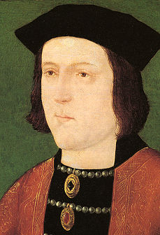
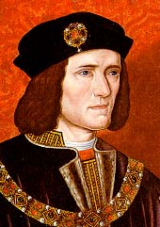
Yorkists
Notes:
Yorkist Kings: Do the students know anything already about Richard III?

Slide 11
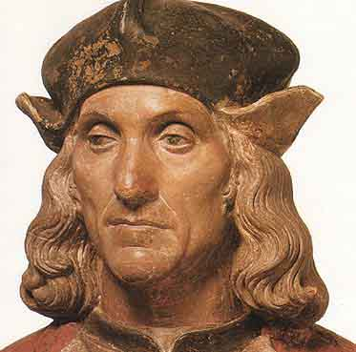
Henry VII (Tudor)
Notes:
Introduce Henry Tudor can the students find him on the Family Tree?

Slide 12
Henry V (41:00 – 46:00
http://estream.godalming.ac.uk/View.aspx?ID=8446~4w~y3CqoJiz
Watch this clip and make notes in your booklet on the characteristics needed for a strong medieval king

Slide 13
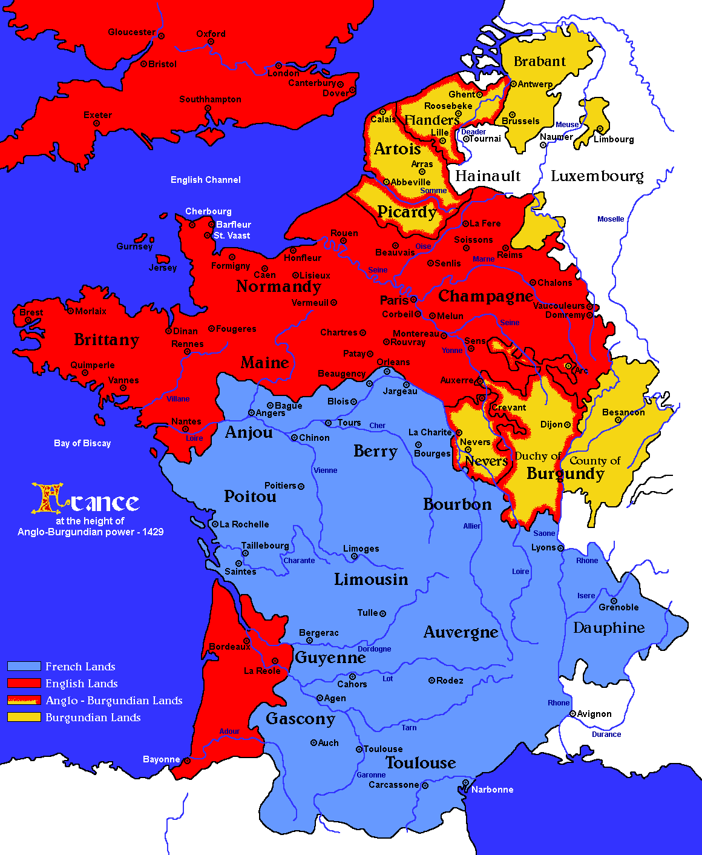
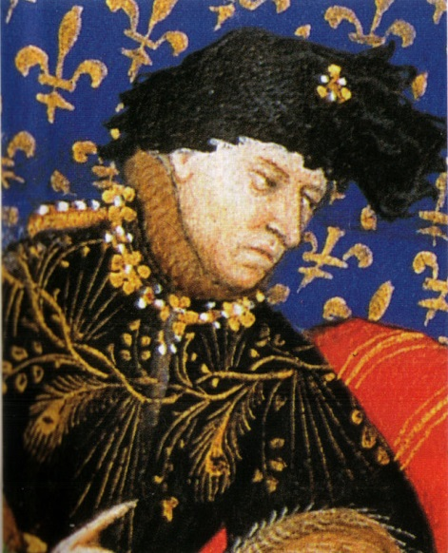
English conquests in France
Why did the English have a claim to some French lands?
By the end of Henry V’s reign in 1422 the English and their Burgundian allies had conquered huge areas of France.
They had partly done this due to the Strength of Henry V but also because of French weakness. The French king Charles VI had bouts of insanity where he believed he was made of Glass!

Slide 14
The impact of the war in France start on 29:00 – End. Questions in Booklet.
http://estream.godalming.ac.uk/View.aspx?ID=10344~59~q4KlSAorWc

