Slide 1
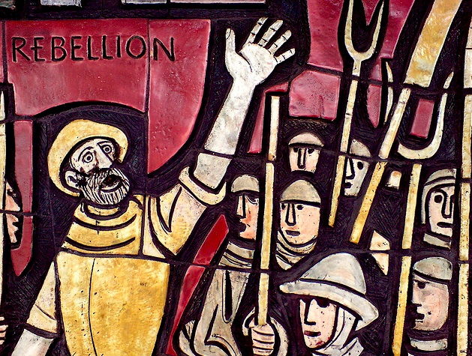
The Tax Rebellions and Edmund De La Pole

Slide 2
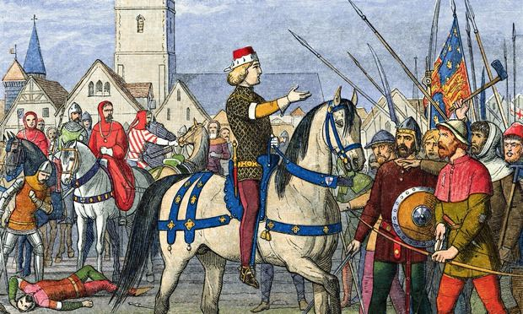
The Northern Rebellion (Yorkshire) 1489
This was a result of Henry trying to raise money to help Brittany in it’s struggle against the French King
Henry sent the Earl of Northumberland (Henry Percy) north to raise taxes but the rebels hung him.
The Earl of Surrey was then sent north with a royal army to crush the rebellion.

Slide 3
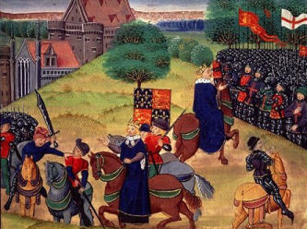
The Cornish Rebellion 1497
This was caused by the need to raise taxes to fight the Scots after their invasion of 1497 inspired by Warbeck.
The rebellion attracted 15000 supporters and they marched on London.
Henry assembled a royal army of 25000 men and crushed the rebellion at Blackheath in June 1497

Slide 4
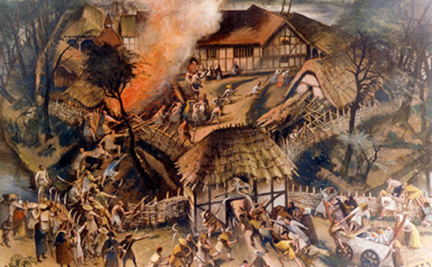
Answer the questions on p20 using p 11 of the textbook

Slide 5

Edmund De La Pole Earl of Suffolk
This was the last Yorkist threat to Henry’s reign.
Edmund De La Pole was Lincoln’s younger brother
Suffolk fled to Burgundy in 1501 for no apparent reason. He took refuge here for the next 5 years. Henry reacted by seizing the land from his relatives

Slide 6
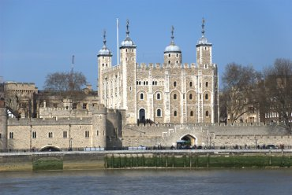
Suffolk’s capture
In 1506 the Duke of Burgundy was forced to shelter in England after a storm in the channel
Henry entertained the Duke and his wife Joanna of Castile (Also know as Joanna the Mad she was Catherine of Aragon’s sister)
They signed the Treaty of Winsor and Suffolk was handed over to Henry. In return Henry promised not to harm him.

Slide 7
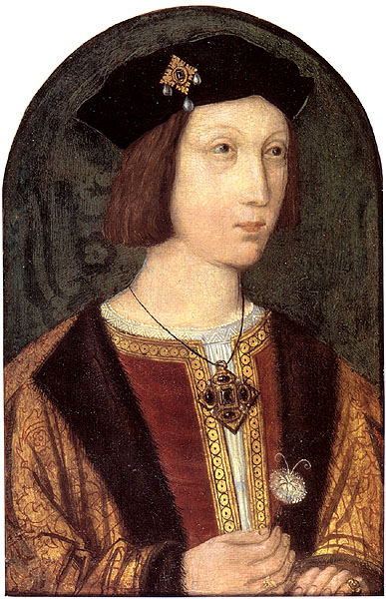
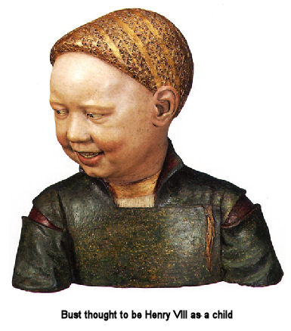
1502
1502 Prince Arthur died
This left Henry with only one 13 year old son Henry

Slide 8
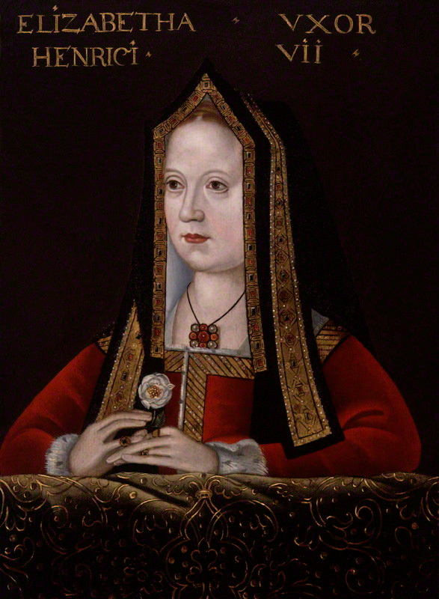
1503 Elizabeth of York died in childbirth
Why is this a particularly important event?

