Slide 1
HISTORY DEMOCRACY & DICTATORSHIP UNIT 2
DEMOCRACY & DICTATORSHIP IN GERMANY 1919-63

Slide 2
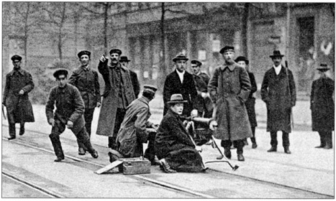
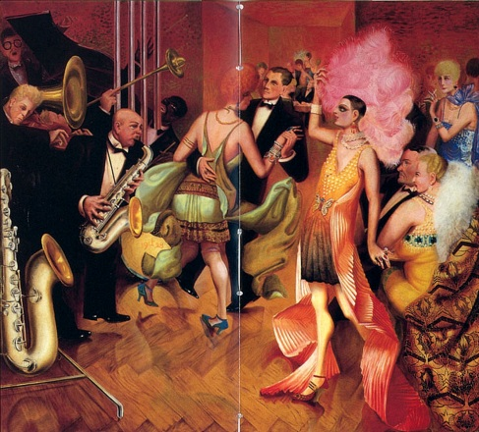
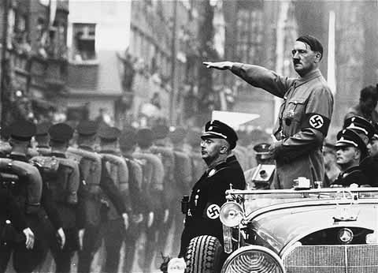
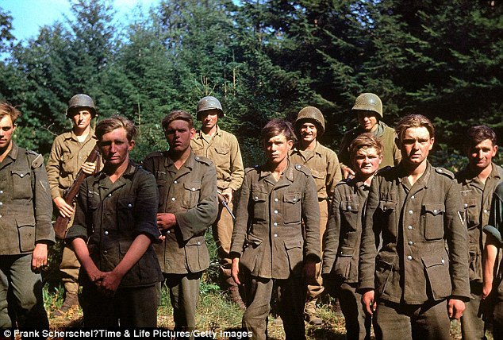
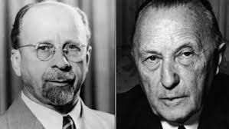
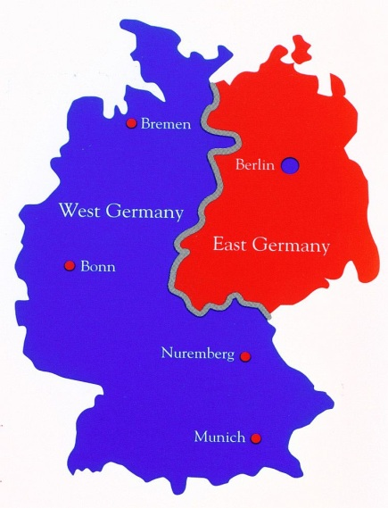
THE SYLLABUS IS IN 4 MAIN PARTS: 1. The establishment and development of the Weimar Republic 1919–33 2. The establishment of the Nazi Dictatorship and its domestic policies 1933–9 3. The impact of war and defeat on Germany 1939–49 4. Divided Germany: The Federal Republic and the DDR 1949–63

Slide 3
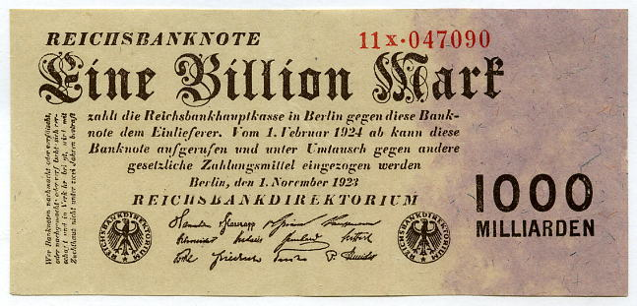
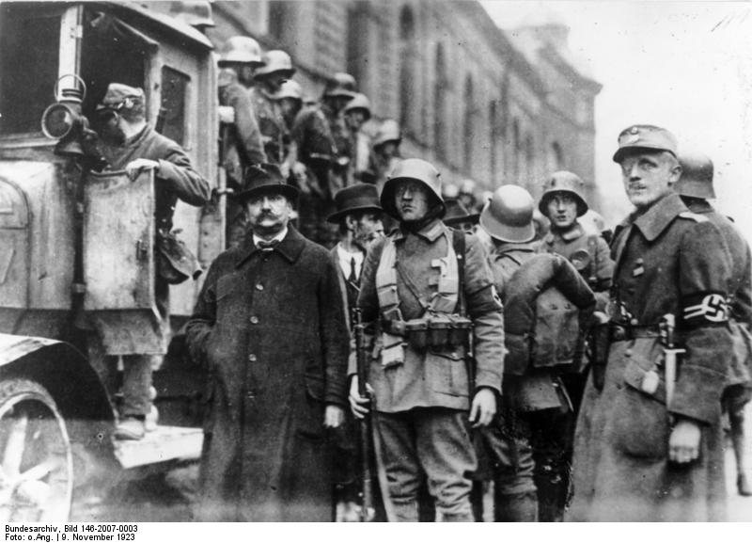
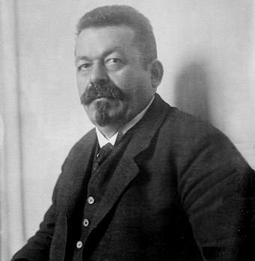
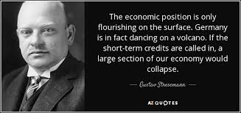
HOW DID THE WEIMAR REPUBLIC SURVIVE THE MANY CHALLENGES TO IT UP TO 1929?

Slide 4
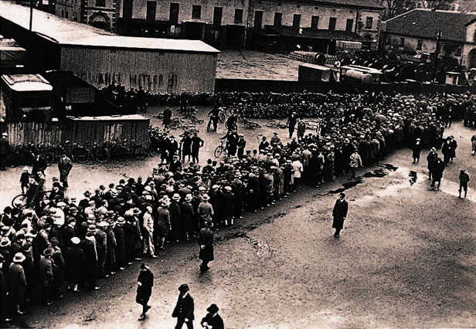
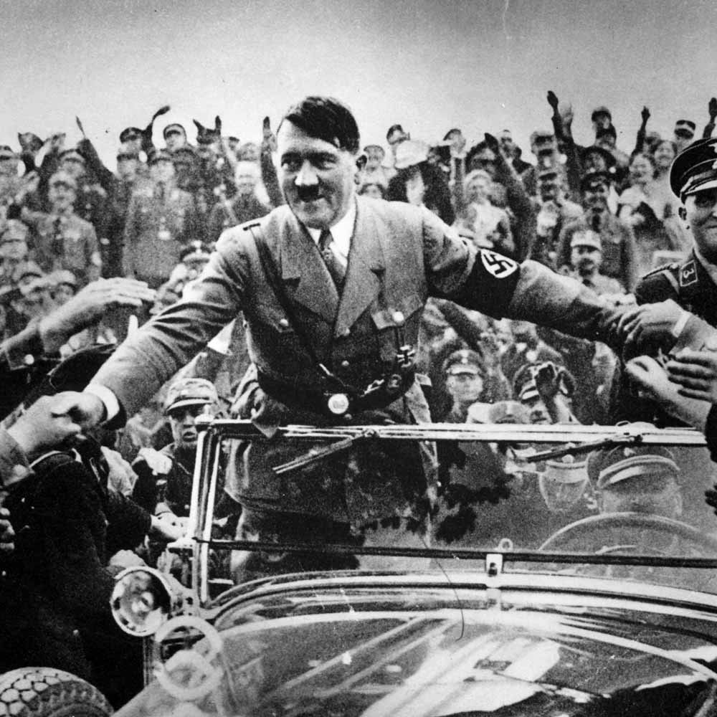
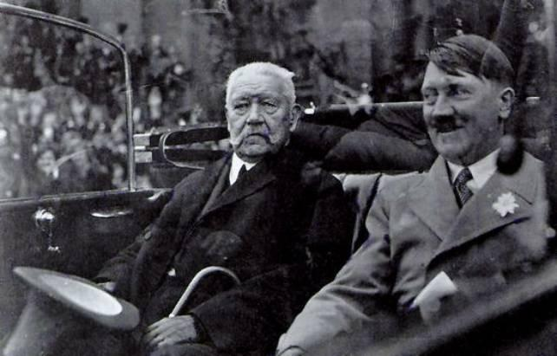
WHY NEVERTHELESS WAS HITLER ABLE TO COME TO POWER IN 1933?

Slide 5
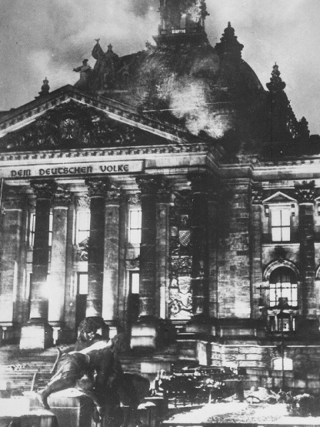
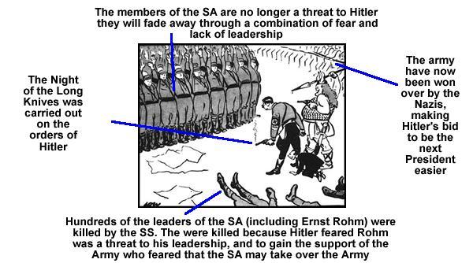
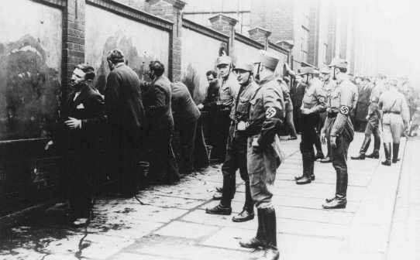
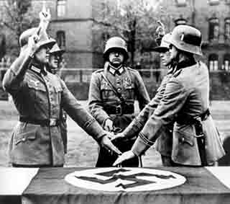
HOW DID HITLER MANAGE TO CREATE A NAZI DICTATORSHIP SO QUICKLY?

Slide 6
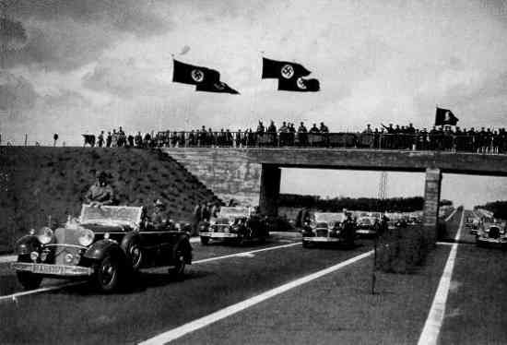
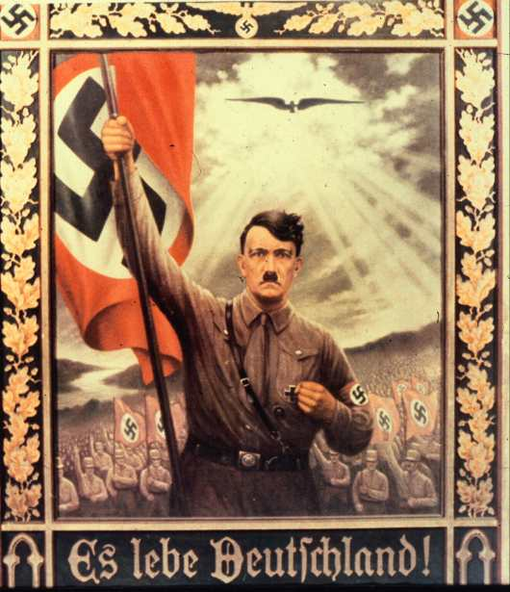
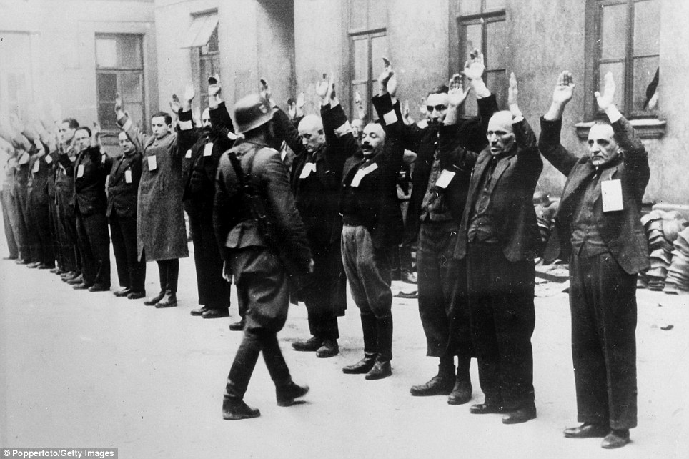
HOW DID THE NAZIS CONTROL GERMANY 1933-9?

Slide 7
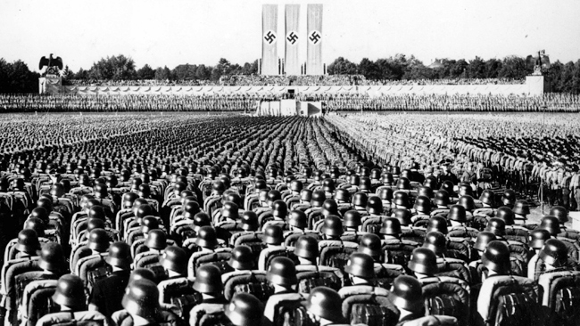
HOW SUCCESSFUL WAS NAZI ECONOMIC POLICY 1933-9?

Slide 8
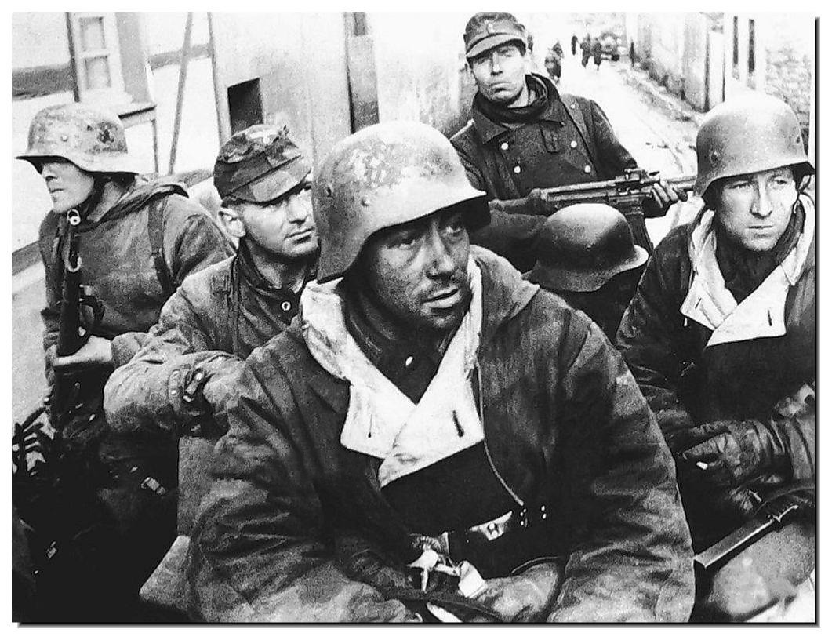
HOW DID THE NAZIS KEEP GERMANY FIGHTING TO THE END IN WW2?

Slide 9
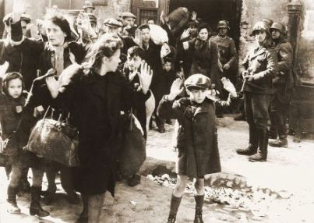
WHY DID THE HOLOCAUST HAPPEN?

Slide 10
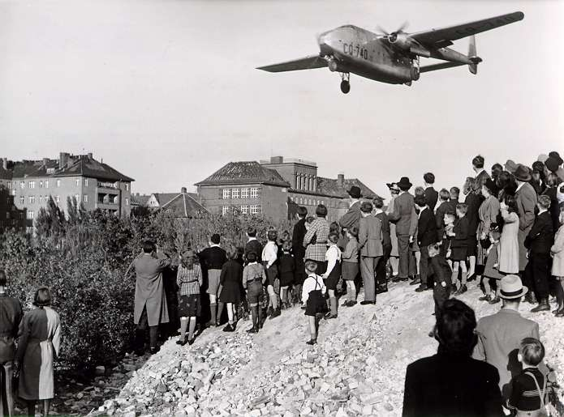
WHY WAS GERMANY DIVIDED IN 1949?

Slide 11
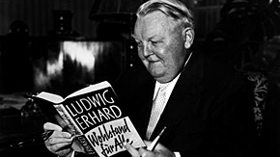
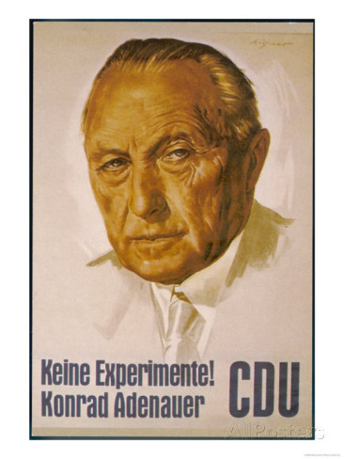
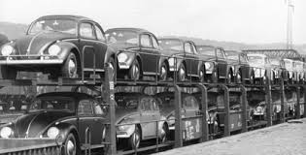
WHY WAS WEST GERMANY SO PROSPEROUS & SUCCESSFUL 1949-63?

Slide 12
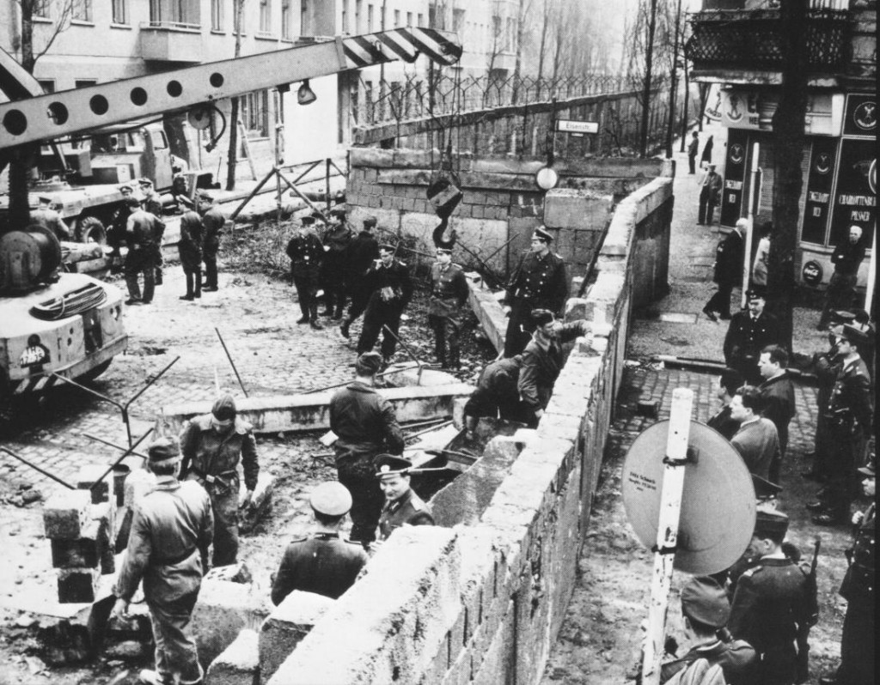
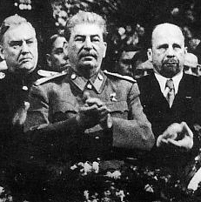
WHY WAS EAST GERMANY SUCH AN ECONOMIC FAILURE THAT THEY HAD TO BUILD THE BERLIN WALL?

Slide 13
ASSESSMENT
AS LEVEL EXAM 1 HOUR 30 MINUTES
SECTION A: 1 OF 2 ESSAY QUESTIONS (30 MARKS)
SECTION B: 1 COMPULSORY INTERPRETATION QUESTION (20 MARKS)
A-LEVEL EXAM 1 HOUR
1 OF 2 QUESTIONS, EACH CONSISTING OF (a) A STRUCTURED QUESTION ON WHICH OF 2 EVENTS WAS MORE IMPORTANT (10 MARKS) & (b) AN ESSAY WITH A SUGGESTED FACTOR (20 MARKS)

