Slide 1
The Tudors - Revision

Slide 2
Enquiry topics (sources)
The stability of the monarchy,
1547-58
Religious change, 1547-58
Rebellion and unrest, 1547-58

Slide 3
Religious Change, 1547-1558
To what extent did England become Protestant under Somerset?
How radical were the religious changes under Northumberland?
To what extent was England a Protestant country by the death of Edward Vl in 1553?
What were Mary's religious aims?
How popular were Mary’s religious policies?
To what extent was England a Catholic nation by Mary's death in 1558?

Slide 4
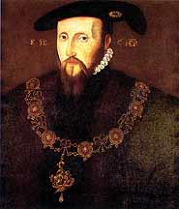
To what extent did England become Protestant under Somerset?
The situation in 1547
Somerset was a moderate Protestant.
Dissolution of the chantries, 1547
Repeal of the Treason Act, 1547
The Prayer Book and Act of Uniformity, 1549

Slide 5
The 1549 Act of Uniformity stated that:
Services were to be in English
There were only to be 5 sacraments in the Church instead of the 7 of the Catholic Church – Communion, baptism, confirmation, marriage and burial
Clergy could marry
The laity could receive bread and wine at communion.

Slide 6
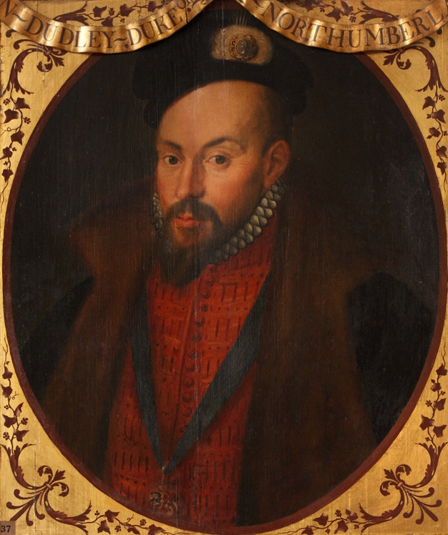
Western Rebellion, 1549
Sometimes called the ‘Prayer Book Rebellion’.
General unrest led to the removal from power of Somerset by the Duke of Northumberland.

Slide 7
How radical were the religious changes under Northumberland?
1552 –A new Treason Act which made it an offence to question the Royal Supremacy or any beliefs of the Church
1552 – Second Act of Uniformity which enforced the Second Book of Common Prayer.
1552 – The Forty Two Articles

Slide 8
To what extent was England a Protestant country by the death of Edward Vl in 1553?
Edward only ruled for 6 years.
Officially England was Protestant and the appearance of churches had changed.
Protestantism was imposed on the nation and was not necessarily welcomed.
The rapid restoration of Catholicism under Mary suggests that traditional religion remained popular.

Slide 9
What were Mary's religious aims?
She was welcomed to the throne in 1553.
Daughter of Catherine of Aragon
1553 Act of Repeal restored England to the religious position of 1547.
1554 heresy laws were re-established
1554 Cardinal Pole returns to England
1554 The second Act of Repeal restores England to the religious position of 1529.

Slide 10
How popular were Mary’s religious policies?
Parliament meeting in October 1553 initially refused to repeal the Act of Supremacy.
Wyatt’s Rebellion, 1554
800 committed Protestants went into exile in Germany and Switzerland.
Large numbers of married priests were deprived of their positions.
Opposition to restoration of heresy laws.

Slide 11
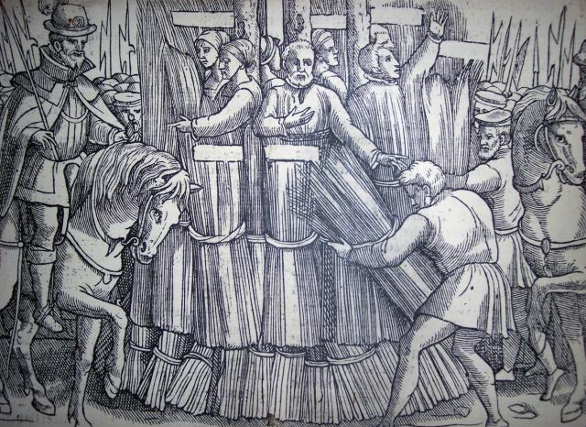
The impact of the burnings
Burnings started in February 1555
1556 Cranmer was burnt
285 people were burnt mainly in London and the south east.

Slide 12
To what extent was England a Catholic nation by Mary's death in 1558?
Edward’s Protestant reformation had not had sufficient time to take hold. This made Mary’s task easier.
However it was expensive and times were hard.
Pole took positive steps to improve the education and behaviour of the clergy.
The government was unable to compete with Protestant propaganda.

